Slide 1

EECS-343 Operating Systems
Lecture 19:
Final Review
Steve Tarzia
Spring 2019

Slide 2
Announcements
HW4 is due on Friday and cannot be turned in late.
  Answers will be posted on Saturday.
Final exam is on Monday, 3-5pm.
  Bring a calculator.
  Norris bookstore sells calculators for $4.

Slide 3
Roles of an OS
A user interface for humans to run programs
A resource manager allowing multiple programs to share one set of hardware.
A programming interface (API) for programs to access the hardware and other services.

Slide 4
Processes & System Calls
Process is a program in execution
Limited direct execution is a strategy whereby a process usually operates as if it has full use of the CPU & memory.
CPUs have user and kernel modes to prevent user processes from running privileged instructions, thus limiting execution.
Interrupts are events that cause the kernel to run
System Calls (or traps) are software interrupts called by a user program to ask the OS to do something on its behalf.
Timer Interrupt ensures that the kernel eventually gets a chance to run

Slide 5
Processes & System Calls
Process is a program in execution
Limited direct execution is a strategy whereby a process usually operates as if it has full use of the CPU & memory.
CPUs have user and kernel modes to prevent user processes from running privileged instructions, thus limiting execution.
Interrupts are events that cause the kernel to run
System Calls (or traps) are software interrupts called by a user program to ask the OS to do something on its behalf.
Timer Interrupt ensures that the kernel eventually runs.

Slide 6
Process Creation & Memory Layout
Variations in CPU architecture influence OS design
Linux supports 31 different CPU architectures
  Low-level mechanisms are different on each arch.
  High-level policies are the same for all.
Fork syscall: run one, exits twice!
Nondeterminism is when a program’s output is unpredictable
OS process scheduler can create race conditions in programs that rely on an interaction of multiple processes.
  These are tricky to debug, because they are sensitive to timing (Heisenbugs).
Kernel panic occurs when OS causes an exception and can’t recover

Slide 7
Process Memory & Virtual Memory
Showed program’s view of computer in more detail
Explained how execution stack makes subroutines easy
Heap is used by malloc to dynamically allocate memory
Virtual Memory allows each process to have its own view of memory
  Memory is divided into pages
OS creates a Page table for each process
  Tells CPU how to translate virtual to physical addresses
  Page tables are the mechanism controlled by the OS to distribute physical memory among competing processes
  OS can just change the CPU’s %CR3 register to change page tables.

Slide 8
Scheduling
Defined two conflicting metrics: turnaround time and response time
  Cannot optimize both – must tradeoff, or balance, the two
Optimized by shortest job first and round robin, respectively
Context switching overhead is due to the CPU caches
  CPU keeps most recently used data in nearby caches, so it’s more efficient to let an ongoing process continue.
I/O-blocked processes make progress without using the CPU
  We should prioritize I/O-bound processes
Multi-Level Feedback Queues are often used in real OS schedulers
  Prioritizes “polite” processes that use little CPU time when scheduled
  CPU-bound processes squander their time quotas and lose priority

Slide 9
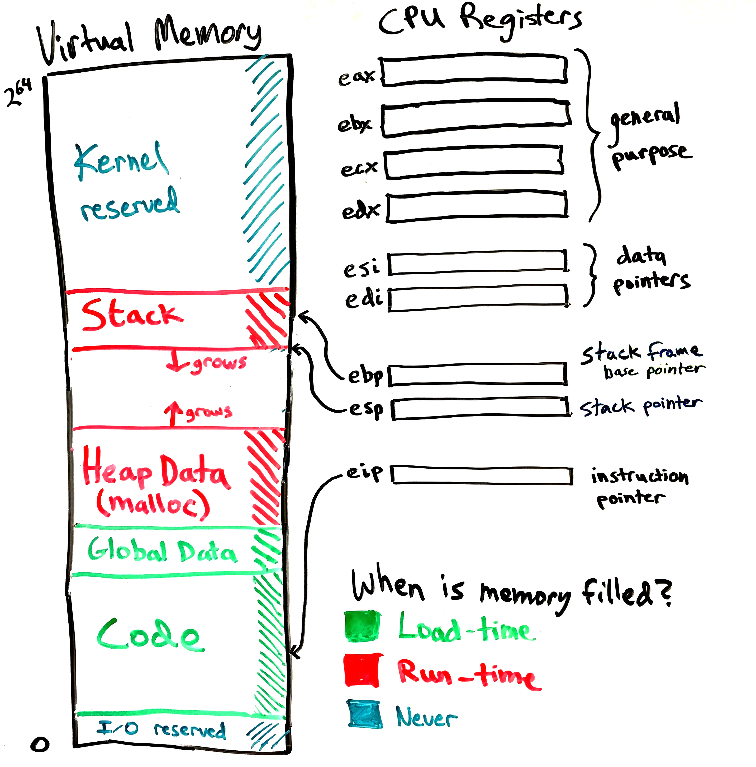
Process’ view of memory
Code and global data are filled by exec syscall to load a program.
A new frame is pushed on the stack whenever a function is called. (And popped on return.)
Heap data is managed by malloc

Slide 10
Virtual Memory
Memory is divided into equal-sized pages.
Page tables translate virtual page numbers to physical page numbers.
Showed the details of page table entries (PTEs):
  High bits translate from virtual page number to physical page number.
  Low bits in the PTE are used to indicate present/rw/kernel page.
During a context switch, kernel changes the %CR3 register to switch from the page table (VM mapping) of one process to another.
VM is handled by both the OS and CPU:
  OS sets up the page tables and handles exceptions (page faults).
  CPU automatically translates every memory access in the program from virtual addresses to physical addresses by checking (walking) the page table.

Slide 11
VM & Paging optimizations
Latency cost, because each memory access must be translated.
  Translation lookaside buffer (TLB) caches recent virtual to physical page number translations.
  Software-controlled paging removes page tables from the CPU spec and lets OS handle translations in software, in response to TLB miss exceptions.
Space cost, due to storing a page table for each process.
  Linear (one-level) page tables are large.
  Smaller pages lead to less wasted space during allocation,
  but more space is consumed by page tables.
  Multi-level page tables are the only way to truly conserve space.
  Mixed-size pages reduce TLB misses.
Copy-on-write fork, demand zeroing, lazy loading, and library sharing all reduce physical memory demands.

Slide 12
Swapping
Disk is slow, but large, and can be used to store RAM’s overflow
  Disks have high throughput (transfer bitrate) but high latency (delay)
  Magnetic disks have even higher latency than SSDs, due to moving parts.
Paging and swapping work together, using the same CPU mechanisms
  If a page is marked “not present” it may be either invalid or swapped to disk.
    Or it might indicate lazy allocation, lazy loading, or copy-on-write, as we saw last time.
  High bits of page table entry can store disk location of swapped page.
Page replacement policy decides which page(s) to evict to free memory
  Swapping can be done on demand or in the background
  Having some free physical frames will prevent delays for allocations.
  Accessed bit and Dirty bit in PTEs inform the page replacement policy
Thrashing is when swapping prevents the system from doing any work.
Unified page cache handles both traditional paging and file caching.
  Makes filesystem access seem just as fast as memory access.

Slide 13
Types of page faults
Minor/soft: Page is loaded in memory, but PTE is not configured:
  OS just wants to be informed when the page is accessed, so it pretends to evict the page (just mark it not present). Useful if CPU has no accessed/dirty bit.
  Memory can be shared from another process (eg., copy on write)
  Response: update the PTE.
Major/hard: A disk access will be needed:
  Anonymous page (process data) may have been swapped out.
  Lazy-loading program executable.
  Response: load the page from disk
Invalid: User program misbehaved:
  Dereference null or invalid pointer.
  Write to page that is read-only.
  Execute code on a page that is not executable (for security).
  Response: terminate the process.

Slide 14
Free Lists
Handled by libc’s malloc and free
  Malloc uses sbrk or mmap syscalls
Freed memory is put on a free list to be reused for later allocations.
A single header can be cleverly used and re-used for two purposes:
  As a linked list node when the block is free/available
  To store the size of the allocated block to help service free calls.
Free space management policy determines:
  which free blocks to choose for an allocation, and
  When to coalesce (join) adjacent free blocks
Free block choice policies include:
  First, next, best, and worst fit.

Slide 15
Threads
Processes can have multiple threads sharing the virtual address space
Critical sections are block of code that must be run atomically
If unprotected, critical sections lead to race conditions that make code indeterminant – we get different results depending on timing.
Locks are the simplest mutual exclusion primitive, with two main functions:
  Acquire/lock – get exclusive access to a shared resource.
  Release/unlock – release the shared resource.
Concurrency occurs naturally in multi-CPU systems
Concurrency is created by the process scheduler in single-CPU systems

Slide 16
Implementing Locks
Hardware support for atomicity:
  Disable interrupts
  Test and set
  Compare and swap
  Fetch and add
  Load-linked & Store-conditional
Various lock implementations
  Spinlock
  Ticket lock
  Yielding lock
  Queuing locks
    Park/unpark on Solaris
    Futex on Linux
Sophisticated locks can be more fair and avoid starvation, but they can add unnecessary context-switch overhead on multiprocessors.
Two-phase locks try to combine the best of both approaches.
OS scheduler and concurrent user code must coordinate for best performance.

Slide 17
Concurrent Data Structures
Simplest strategy is to use one big lock, but this limits concurrency
  It’s thread-safe, but not really concurrent
Concurrent queue used two locks (head & tail)
Concurrent hash table used one lock per bucket
Condition Variables are used to order threads, using signal() & wait().
  Wait puts a thread to sleep, signal wakes a waiting thread.
  Pthreads allows spurious wakeups, so we still need to check a status variable.
  broadcast() wakes all waiting threads
Producer/consumer queue was implemented using two condition variables.

Slide 18
Synchronization Bugs
Semaphore (up/down) is an all-purpose synchronization primitive
Reader-writer lock allows multiple readers, but one writer.
Adding too many locks can lead to deadlock, which requires:
  Mutual exclusion (avoid locks to avoid deadlock)
  Hold and wait (use trylock to release first lock to before deadlocking)
  No preemption
  Circular wait (always acquire locks in the same order to avoid deadlock)
Dining philosophers was an example of deadlock
  Circular wait can be avoided by making one philosopher grab right-hand side instead of left first.

Slide 19
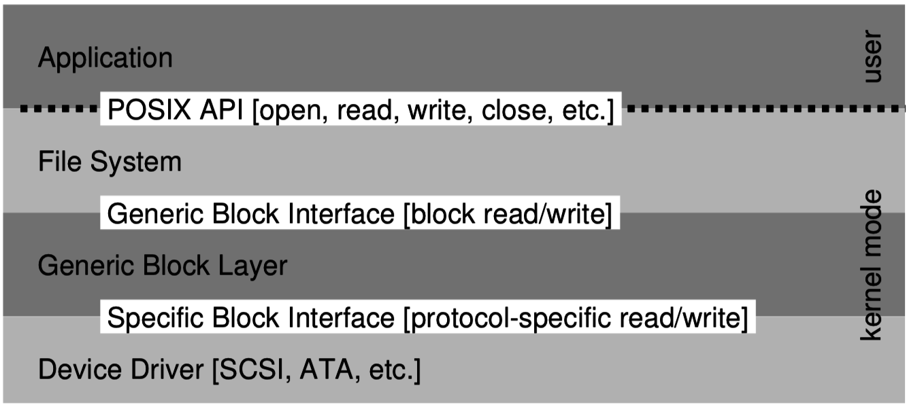
I/O and Disks
OS interacts with devices by reading/writing device registers
  Each register has an I/O port address for in/out instructions, or
  memory-mapped I/O uses special physical memory addresses (with mov)
Storage is complex, so
kernel functionality is divided
into at least three layers:
Random access to a magnetic disk is 1000x slower than sequential
  Read head must seek and disk must rotate to reach a new sector

Slide 20
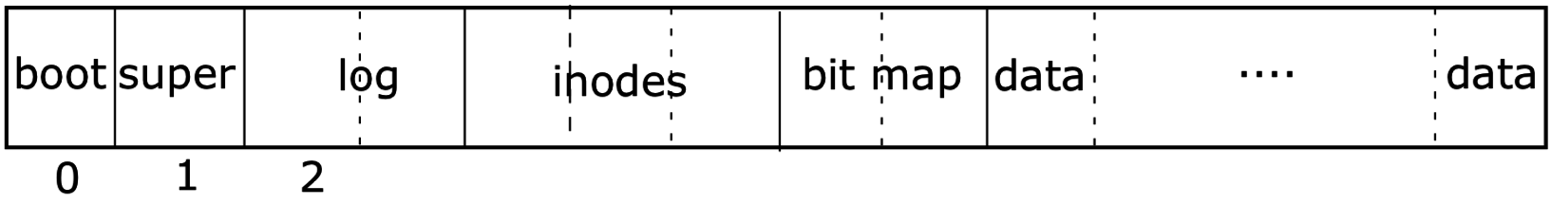
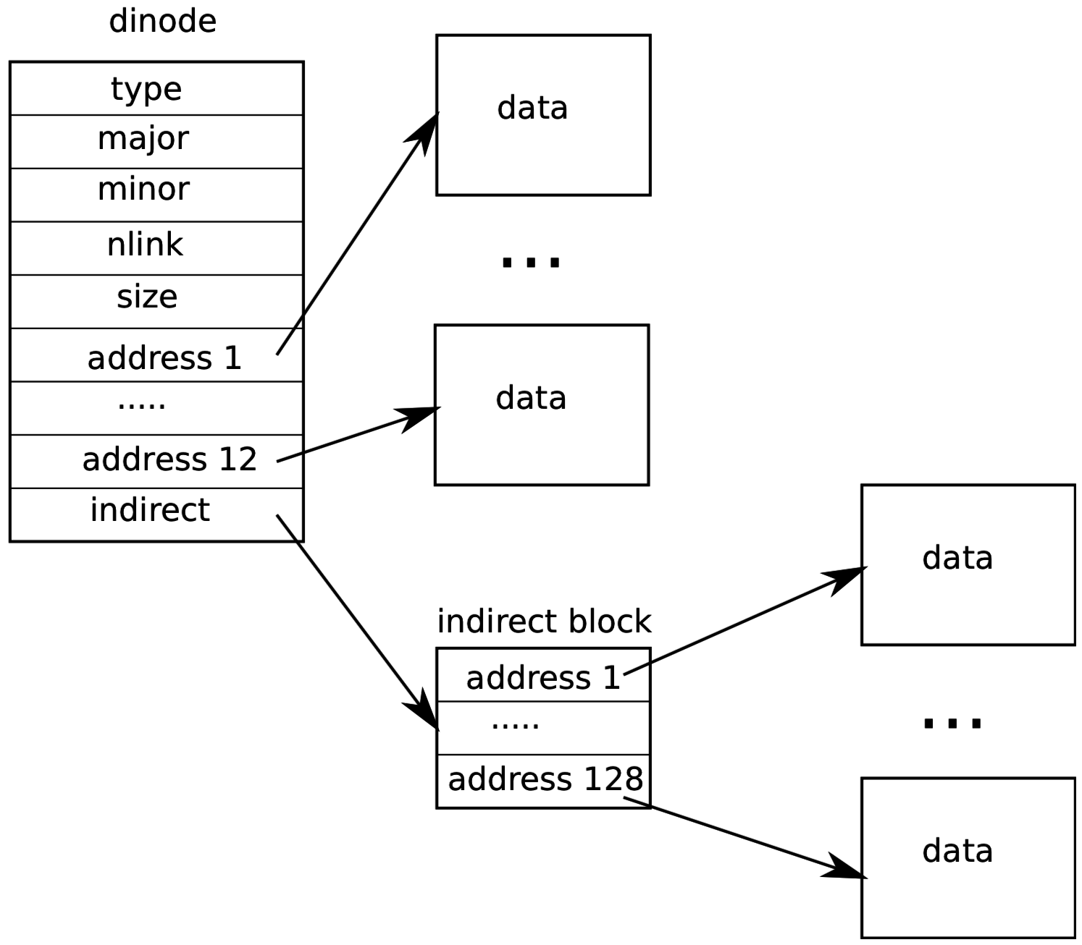
RAID & File Systems
RAID allows multiple disks to act together for better
throughput, capacity, and/or fault tolerance.
  Parity is used in RAID5 to achieve all of the above.
OSes have a application-level API (syscalls) for file I/O:
  open, read, write, seek, stat, fsync, rename, unlink, mkdir
Filesystem is a data structure the OS uses to organize disk space.
Each file/directory has an inode storing
metadata & pointers to data blocks.

Slide 21
Buffer Caching & Logging
Trace of file operations shows that many accesses to disk are needed for even a single open/read/write.
To improve performance, cache a small number of active disk blocks
  Allows later reads to happen in memory
  Multiple writes can be absorbed and all are immediately visible in memory
Each buffer is locked by a thread before use
Write-ahead logging makes multiple disk writes appear atomic, even if the machine is powered-down in the middle of the transaction.
  Very important for related changes to inodes & bitmap (metadata in general)
  Data is written twice: to log first, then to main disk.
  On reboot, interrupted transaction is either rolled back or replayed.

Slide 22
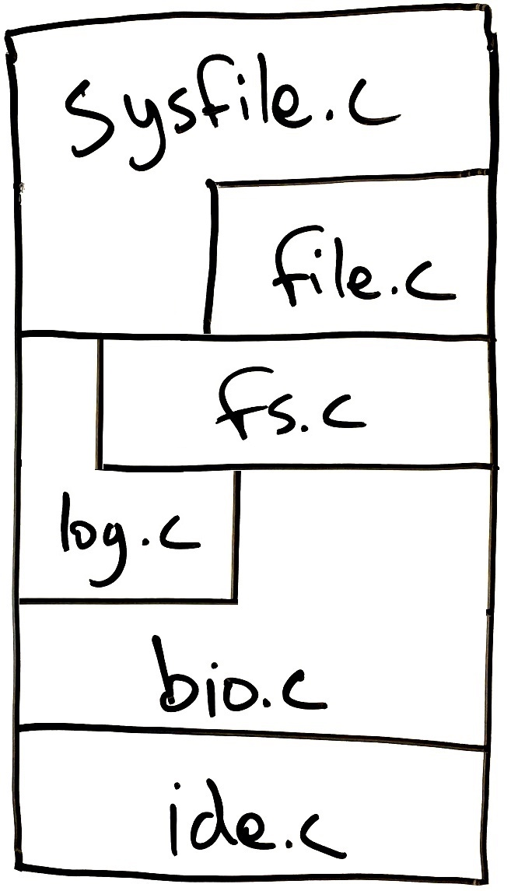
Storage Layer Interactions
Showed layered design of xv6 storage system
Implementation of each layer uses only the layer(s) directly below
  Must provide an API suitable for implementing the layer(s) directly above
  Deeper layer are hidden.
defs.h makes a subset of kernel functions in each file “public.”
Linux has a virtual file system (VFS) layer that allows multiple filesystems to coexist in one machine.

Slide 23
Log-structured File System
Tries to make all writes sequential, at the end of the disk (at first).
Never edit data blocks or inodes, just write new copies and stop referring to the old versions. Inodes are scattered throughout the disk.
Checkpoint region points to distributed inode map, to find inodes.
  CR is the only thing that is always written in a well-known location.
  Using an old version of the checkpoint region lets us see the filesystem as it looked in the past. LFS can be extended easily to become a versioned file system.
Garbage collector occasionally scans FS to compact segments with old, unused versions of blocks.
Restart from start of disk after reaching the end, filling in holes.

Slide 25
Themes:
Hardware provides features beyond basic C functionality to support OS
Virtualization:
  Providing processes with a simplified view of the underlying system
Caching & buffering improves performance, assuming:
  Temporal and/or spatial locality
Safely sharing resources:
  Data structures to quickly find unused resources and prevent accidental reuse
  Policies to allocate resources among competing clients.
Concurrency is hard: race conditions lead to bugs that are difficult to test.
Laziness: when possible, delay handling requests if it may be possible to take a shortcut later or to amortize the cost of multiple requests.

Slide 26
Hardware features for OS use
Privileged/kernel and user mode.
  Privileged instructions.
Interrupts:
  Kernel specifies that CPU should jump to certain code to handle interrupts
  Software interrupts (traps) can be initiated by user code for syscalls
  Programmable timer and timer interrupts.
Page table can be configured by OS for CPU to use virtual memory
  PTEs can be marked “not present” or “read only” to implement:
    Swapping, lazy loading, lazy allocation, copy on write
  TLB makes VM efficient, and is sometimes managed directly by the OS.
Atomic primitives to implement locks and lock-free synchronization
In/out instructions and memory mapping to perform I/O

Slide 27
Virtualization/abstraction
Limited direct execution temporarily gives processes full use of CPU (limited to non-privileged instructions)
  This makes is very easy to write programs and compilers.
Syscall interface hides hardware details and variations from processes
  Eg., open(“/home/steve/file.txt”, READ|WRITE)
Same program binary can be run on machines with different hardware, as long as the OS interface is the same.
  Application Binary Interface (ABI) defines low-level OS-process-lib interactions.
    ABI defines the Syscall numbers and the parameters for each syscall.
  If OS provides same API (syscall/library function prototypes in header files), program source code need not change, but may be require recompilation.

Slide 28
Caching makes data access faster
Computers storage hierarchy has vastly different capacities (10¹⁰×) and latencies (10⁷×). Must choose small-and-fast or big-and-slow.
Software and hardware should both be designed to take advantage of:
  Temporal locality: access the same data frequently
    Hardware caching (invisible to the OS) makes repeated access fast.
    Software should be written and compiled to reuse memory locations.
  Spatial locality: access nearby data frequently
    Hardware caching pulls chunks of data into caches, so nearby values are on hand
    Software should be written and compiled to move sequentially through data.
    Rotating disks are especially sensitive to random vs sequential access.

Slide 29
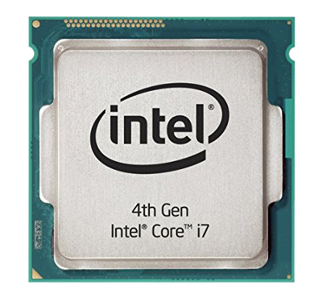
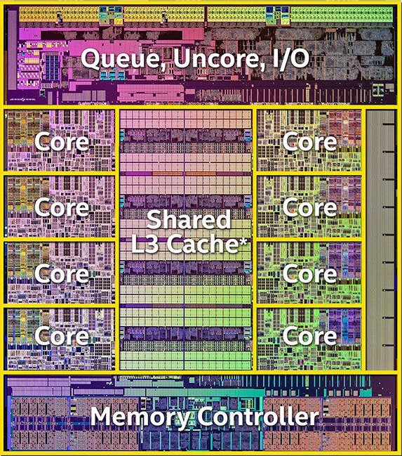
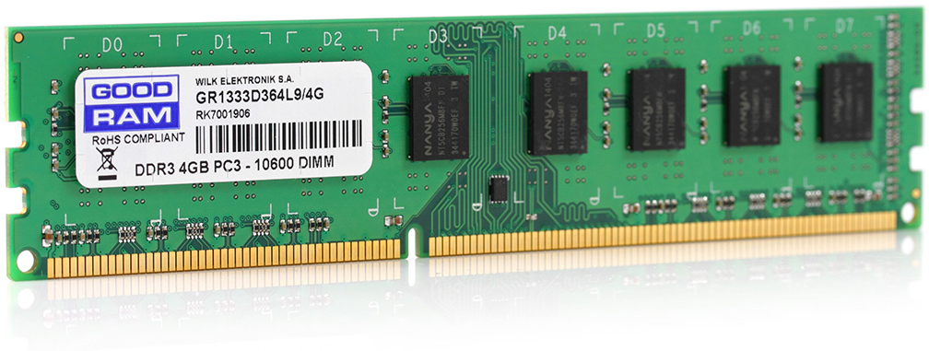
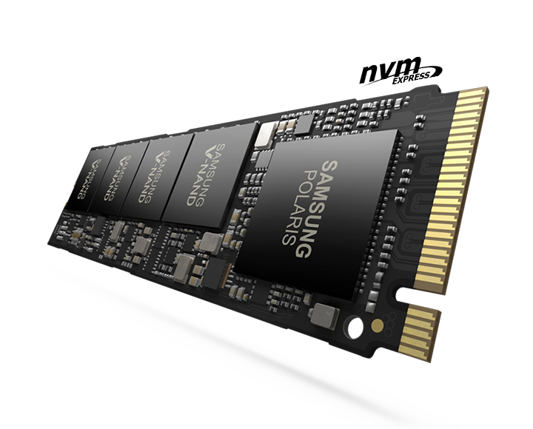
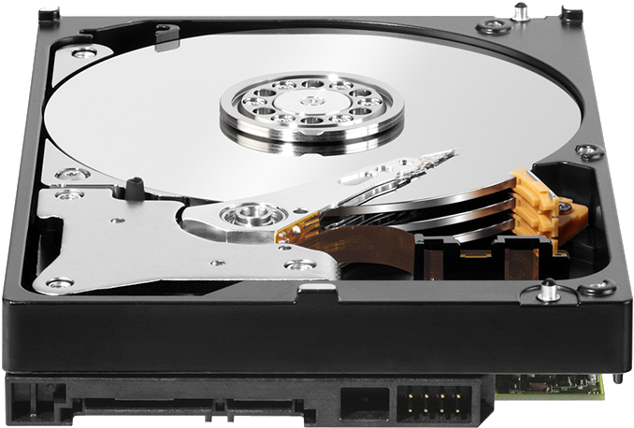
Computers have a hierarchy of storage
delay |  | capacity
0.3ns | CPU Registers | 1 kB (kilobyte)
5ns | CPU Caches (L2) | 16 MB
50ns | Random Access Memory (RAM) | 16 GB
100μs | Flash Storage (SSD) | 1 TB
5ms | Magnetic Disk | 8 TB
Larger, but slower
Disk is about ten billion times larger than registers,
but has about ten million times larger delay (latency).
Goal is to work as much as possible in the top levels.
Large, rarely-needed data is stored at the bottom level
“Memory” is not just RAM, but everything below the registers
Notes:
Speed of light means that an electron can only travel 10cm in a 3ghz clock cycle. More important, however, is the resistance and capacitance of long wires and the energy/heat budget.

Slide 30
Cache and buffer examples
Virtual memory → physical memory
Physical memory → L1/L2/L3 cache
Physical memory → CPU registers (managed by compiler)
Magnetic disk sectors → “disk buffer” (on disk, hidden from OS)
Magnetic disk sectors → solid state memory (in a hybrid or fusion disk)
Disk sectors → buffer cache in RAM
On-disk inodes → inode cache in RAM

Slide 31
Resource sharing
CPU
  Various scheduling policies (MLFQ, etc.)
  Mechanism is the interrupt.
Physical memory
  Eviction policy for swapping (LRU, etc.)
  Mechanism is paging.
Persistent storage
  Generally don’t place quotas, but limit access to files according to owner.

Slide 32
Laziness is a virtue
Main idea is that programs often ask the OS to do unnecessary work.
Fork: copy page table to child and mark everything read-only.
  Make true copies of memory pages only in response to page faults.
Mmap & sbrk:
  don’t have to write zeros to new memory or reserve space in physical memory until process actually uses it.
Buffer cache: on bwrite we have two options:
  Write through: write to disk immediately (in xv6)
  Write back: wait to write until buffer is evicted from cache (the lazy approach).
LFS: write a full segment of updates at ones (buffering helps)

Slide 33
Performance lessons
My program is slow… why?
Maybe I need a theoretically faster algorithm or data structure, …
or maybe there is a system-level issue:
  Programs may be using more memory than is physically available and thus are doing a lot of swapping (thrashing).
  Another process may be using lots of memory or CPU time (these are shared resources). Important program may have insufficient priority in scheduler.
  Process may be reading or writing a lot from disk.
  There may be lots of CPU activity on one thread. Somehow dividing the work among many threads would speed things up (but then we need to worry about concurrency bugs).
Much can be learned from simple tools like “top” and Task Manager.

Slide 34
Debugging lessons
Often, SW engineers spend more time reading than writing code.
  So, made your code readable for the next developer!
If your code doesn’t work, it’s often helpful to:
  Know exactly what changes you have made (git diff)
  Maybe throw out your changes and start again (roll back)
Unpredictable bugs are often due to race conditions.
  Must protect critical sections and enforce ordering where necessary.

Slide 35
Reliability and Security lessons
Disks are very prone to failure, but RAID significantly reduces the likelihood of losing data (or experiencing downtime).
Users are prone to do dumb things like “sudo rm –Rf /”
A versioned, log-structured filesystem lets you travel back in time to see what the filesystem used to look like.
Untrustworthy apps may try to violate your privacy and sabotage your system. Proper isolation of processes and filesystem permissions can reduce the possible damage.

Slide 36
Meltdown and Spectre hacks
OS relies of cooperation of software and hardware engineers.
Bad things can happen when SW and HW engineers don’t work together and understand each others’ work.
Huge vulnerabilities were discovered in 2017:
  Meltdown – leaks protected memory through out-of-order execution.
  Spectre – leaks protected memory through speculative execution.
https://youtu.be/RbHbFkh6eeE

Slide 37
Meltdown
Problem: Attacker can influence speculative control flow
Bug: Speculative execution not subject to page permission checks.
  Permissions are checked before exposing results, but cache can be affected and thus memory access timing leaks information.
Result: User code can read kernel data (secret), or another process’ data.
Three steps:
Setup: flush the cache
Transmit: force speculation that depends on secret
Receive: measure cache timings

Slide 38
Meltdown overview
Initial setup:
char* kernel_addr = 0xFFFF0000; // The target is a high VM address in kernel space.
char probe[256 * 4096]; // The speed of access to this userspace array will leak data!
Guess the value of that kernel byte:
char guess = 0x00; // maybe 0x0 is stored in location 0xFFFF0000?
clflush(probe[guess * 4096]); // flush CPU cache for the page corresponding to our guess.
Use kernel data cleverly in an instruction that will be rolled-back:
*0; // Generate an exception, for example dereference a null pointer.
// Another option (that does not crash the app) is to bias the branch predictor
probe[*kernel_addr * 4096]; // secret kernel data will control which of our array pages is accessed.
// This should not even be executed, and if executed it should generate a page fault,
// but it will be speculatively executed and discarded (but cache warming is leaked!).
Measure the side effects on the cache:
s = rdtsc(); // start timing
probe[guess * 4096];
e = rdtscp(); // end timing
if (e - s < CACHE_MISS_THRESHOLD)
printf("guess was right!\n"); …else: Repeat with another guess!

Slide 39
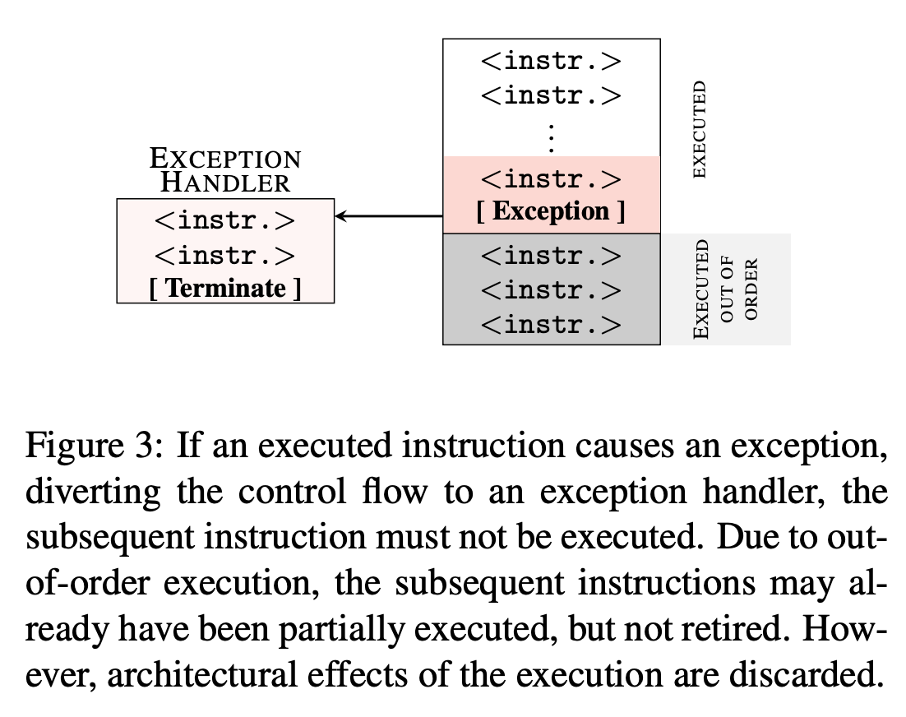
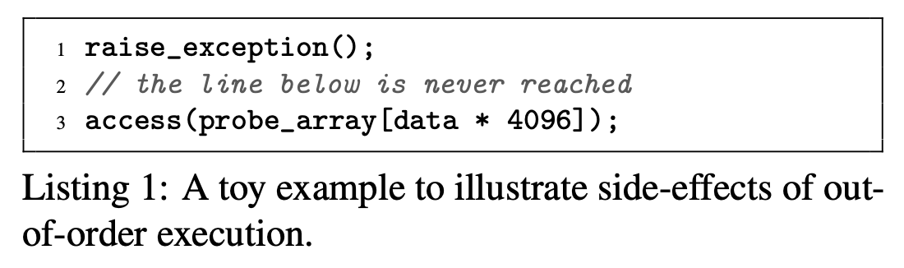
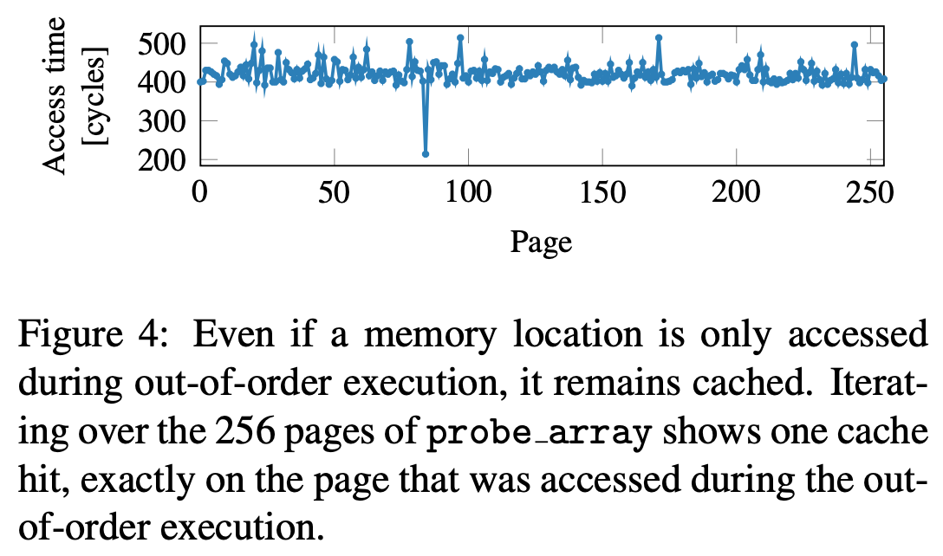
From https://meltdownattack.com/meltdown.pdf

Slide 40
Spectre
Problem: Attacker can influence speculative control flow
(same as Meltdown)
Attack: Extract secrets within a process address space (e.g. a web browser). Can also be used to attack the kernel.
Could use attacker provided code (JIT) or could co-opt existing program code
Same basic three steps! Different setup and tester.
Uses branch prediction cache instead of memory cache to leak effects of the rolled-back instructions.

Slide 41
Followup classes
If you enjoyed this class, then you should consider:
446 Kernel and other low-level software development
354 Network Penetration and Security
397 Digital Forensics
340 Intro to Computer Networking
339 Databases
203 Intro to Computer Engineering (fulfills basic engineering req.)
396 Scalable Software Architectures
COMP_ENG 361 Computer Architecture I
COMP_ENG 358 Intro to Parallel Computing

Slide 42
Questions?

Slide 43
Career advice!
Software systems are affecting society drastically. Take responsibility!
You’ll be well paid, but don’t spend it all. Avoid golden handcuffs!
  This will give you the freedom to quit if you need to, and maybe start your own company.
Software engineering is difficult and a lifelong learning experience.
  Your degree is just the start of a very long path.
  It doesn’t matter too much where you start, as long as you’re learning.

