Slide 1

EECS-343 Operating Systems
Lecture 17:
Storage Layer Interactions
Steve Tarzia
Spring 2019

Slide 2
Announcements
Project due Wednesday.
HW due next Friday.
Exam Monday June 10th at 3pm.

Slide 3
Last Lecture: Buffer Caching & Logging
Trace of file operations shows that many accesses to disk are needed for even a single open/read/write.
To improve performance, cache a small number of active disk blocks
  Allows later reads to happen in memory
  Multiple writes can be absorbed and all are immediately visible in memory
Each buffer is locked by a thread before use
Write-ahead logging makes multiple disk writes appear atomic, even if the machine is powered-down in the middle of the transaction.
  Very important for related changes to inodes & bitmap (metadata in general)
  Data is written twice: to log first, then to main disk.
  On reboot, interrupted transaction is either rolled back or replayed.

Slide 4
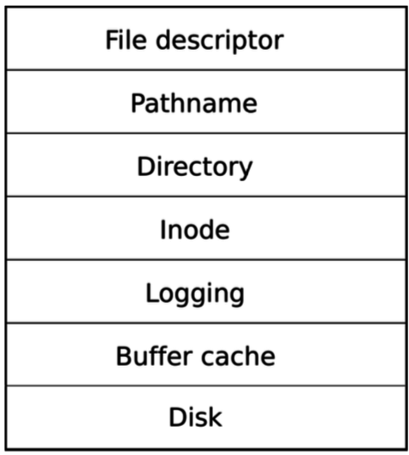
xv6 storage: a layered implementation
Book’s view:
Unfortunately, the implementations of these layers are interdependent.
They are not true layers
sys_file.c
file.c
file.c
fs.c
log.c
bio.c
ide.c

Slide 5
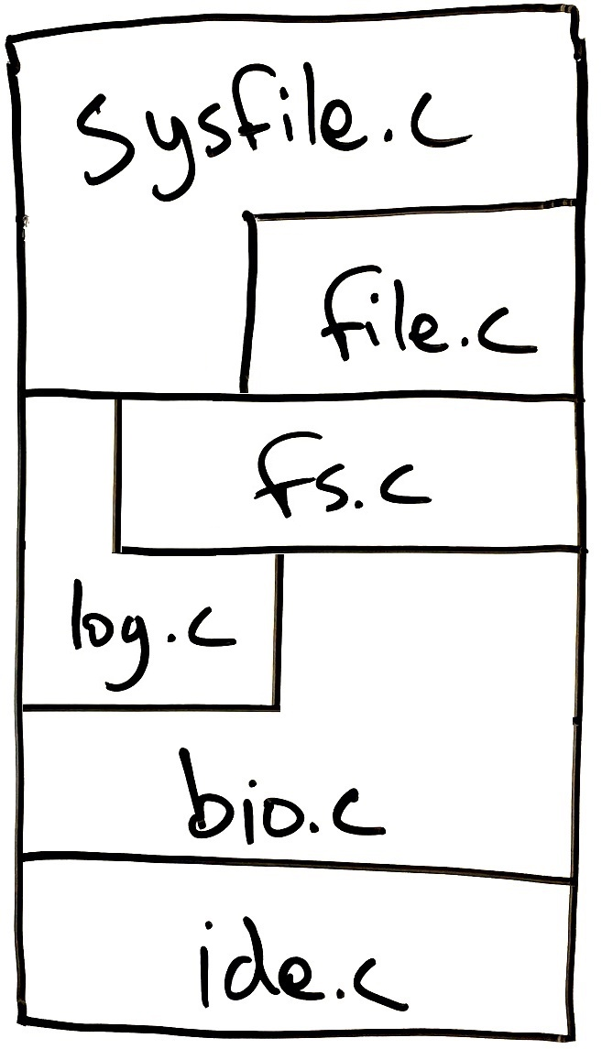
More accurate view of storage stack in xv6
⬍ int file_descriptor, char* filename
1)
⬍ struct file
2)
⬍ struct inode
3)
Objects passed between the layers.
Imperfectly layered kernel code
4)
⬍ struct buf
⬍ struct buf
5)
⬍ struct buf
6)
⬍ in/out device registers
Each layer is implemented using only the layer(s) below’s API.
  Each layer’s public API is defined in defs.h (other functions are private).
Layer’s API must be designed to meet needs of the client layer(s) directly above.

Slide 6
1) File descriptor level (syscalls, sys_file.c)
int read(int, void*, int);
int write(int, void*, int);
int open(char*, int);
int close(int);
int dup(int);
int link(char*, char*);
int unlink(char*);
int fstat(int fd, struct stat*);
int mkdir(char*);
int chdir(char*);
This is the system call API presented to user code in user.h.
Works with
  integer file descriptors
  byte arrays
  file path strings

Slide 7
File descriptors
A file descriptor is a file open by a process – an inode, r/w permissions, and a cursor:
struct file {
enum { FD_NONE, FD_PIPE, FD_INODE } type;
int ref; // reference count
char readable;
char writable;
struct pipe *pipe;
Inode *ip; // in-RAM copy of inode
uint off; // file offset/cursor
};
Each process’ proc struct has:
struct file *ofile[NOFILE]; // Up to 16 open file descriptors
struct inode *cwd; // Current directory

Slide 8
2) Virtual file system layer (file.c)
Just a bunch of helper functions for working with struct file*:
  File* filealloc(void);
  void fileclose(File*);
  File* filedup(File*);
  int fileread(File*, char* data, int size);
  int filestat(File*, Stat*);
  int filewrite(File*, char* data, int size);
Syscall implementations needs more than just these functions.
We still don’t have a way to open/create a file using a path string.
So this is an incomplete layer.

Slide 9
struct inode (in-memory version)
struct inode {
uint dev; // Device number
uint inum; // Inode number
int ref; // Reference count
int flags; // I_BUSY, I_VALID
short type;
short major;
short minor; copy of disk inode
short nlink;
uint size;
uint addrs[NDIRECT+1];
};
Global icache stores 50 active inodes in kernel memory (cleanup when ref==0)

Slide 10
3) Inode layer (fs.c) is where it gets interesting
// get inode corresponding to filename
Inode* namei(char* path);
Inode* nameiparent(char* path, char*); // get parent inode
// read/write to a specific location in a file
int readi(Inode*, char* data, uint offset, uint size);
int writei(Inode*, char* data, uint offset, uint size);
// copy file stats (size, timestamp, etc.) from inode
void stati(Inode*, struct stat*);
// write a new directory entry (name, inum) to inode
int dirlink(Inode*, char*, uint);
// Look for a directory entry in a directory
Inode* dirlookup(Inode*, char* name, uint*);

Slide 11
3) Inode layer (fs.c) continued
Inode* ialloc(uint, short); // get new inode
Inode* idup(Inode*); // “copy” inode, but actually just increment ref count
void ilock(Inode*); // also read data lazily
void iunlock(Inode*);
void iput(Inode*); // decrement ref count, cleanup
void iupdate(Inode*); // tell buffer layer that inode was modified
Functions that return an inode call iget(int dev, int inum) internally, which increments the cached inode’s reference count.
Cached inodes are shared. Call ilock and iunlock when accessing.
iupdate if modified. iput when done.

Slide 12
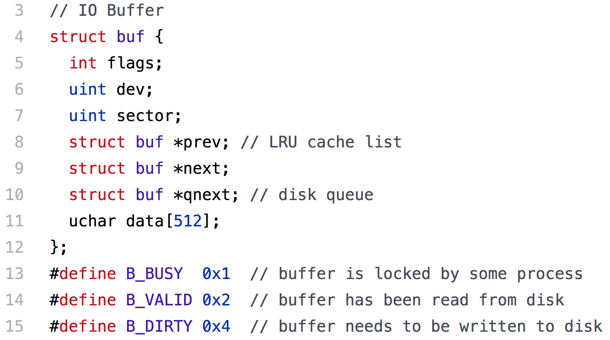
struct buf
Busy/Locked? Valid? Dirty?
Doubly-linked circular list of buffers
List of buffers waiting to be written to disk. (Implementing it here is kind of sloppy.)

Slide 13
4) Logging (log.c)
Logging is optional, and only used in filesystem critical sections.
void begin_op();
  Waits until the logging system is not committing and there is enough free space in the log.
void log_write(struct buf*);
  Reserves a place for the block in the log, but does not write to disk yet.
  Allows multiple writes to be absorbed (combined into one).
void end_op();
  Writes the transaction to disk in the log, then in the destination sectors.

Slide 14

5) Buffer cache layer (bio.c)
Buf* bread(int device, int sector)
  Returns a cache buffer with the data at a given location on a given disk.
  Buffer is locked for thread’s exclusive use.
void bwrite(Buf* b)
  Write buffer’s new contents to disk.
    xv6 uses a “write through” cache – we always write immediately.
  Must always call bread before bwrite.
void brelse(Buf* b)
  Release the lock on the buffer

Slide 15
6) Device driver layer (ide.c)
void iderw(struct buf*);
  Read from disk to buffer if valid bit=0
  Write buffer to disk if dirty bit=1
  Sleep (on buffer pointer) before returning, so it’s a blocking call from the calling thread’s perspective, even though it uses interrupts.
void ideintr(void);
  Handles disk interrupts to complete a r/w request.
  Read to buffer (if necessary) and wake sleeping thread.

Slide 16

Intermission

Slide 17
Example: open(char*,…) in sysfile.c
Assuming that the file exists,
sys_open will call:
begin_op: start a transaction
namei: file path → inode
ilock: lock inode
filealloc: make an empty file struct
fdalloc: list the file among process’ open files & get fd #
iunlock
Store inode # in file struct.
end_op: end a transaction
sys_open
fdalloc
filealloc
namei, ilock, iunlock
begin_op, end_op
Hidden layers
sys_open implementation interacts with three layers below, but none further down.

Slide 18
Example: create(char*,…) in sysfile.c
If we tell sys_open to create a new file, create will call:
nameiparent: file path → parent inode
ilock: lock parent inode
dirlookup: check whether file exists
ialloc: get inode for new file
  ilock it
  Set device number and nlink=1
dirlink: add new file to parent directory inode
iupdate new & parent inodes
iunlock: new & parent inodes
sys_open
create
nameiparent,
dirlookup, dirlink
ialloc, ilock, iunlock
Hidden layers

Slide 19
Example: filewrite(File*,char *,int n) in file.c
sys_write calls begin_op, finds the appropriate struct file and calls filewrite, which calls:
ilock
writei: the inode number and offset both come from struct file.
iunlock
sys_write
(client function)
filewrite
ilock, writei, iunlock
Hidden layers

Slide 20
Example: writei(Inode*,char *, int offset, int n) in fs.c
Now we’re working in a lower layer:
bmap : examine the inode to determine which block number corresponds to the write offset.
bread: to get the appropriate buffer
bwrite: marks the buffer as written
log_write: adds it to the transaction
brelse: release the buffer lock
Notice that bread and brelse simultaneously handle locking & buffer memory management.
Client layers
writei
bmap
log_write
bread, bwrite,
brelse
Hidden layer

Slide 21
Example: bread(int device, int sector) in bio.c
Now we’re down at the buffer layer.
bget(…,int sector): gets a cached copy or a fresh, empty buffer.
  In either case, lock the buffer.
If we missed in the cache, call:
iderw: to read the sector from disk.
Client layers
bread bget
iderw

Slide 22
Example: iderw(struct buf*) in ide.c
This is the lowest level (device driver).
Uses in/out assembly instructions and port numbers corresponding to device registers.
Implements an interrupt handler function, ideintr, which wakes the caller.
Client layer
iderw ideintr
(disk)
in/out IRQ

Slide 23
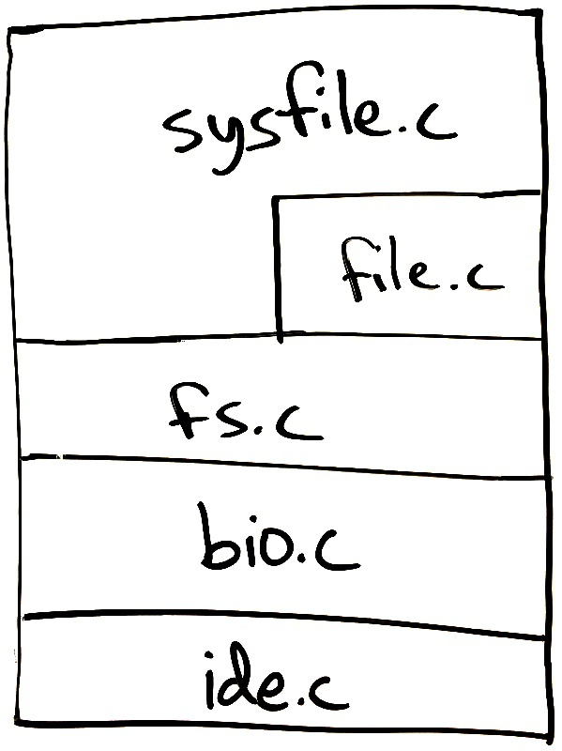
Adding logging to xv6
Old xv6 storage stack
At some point, Prof. Kaashoek at MIT decided to add write-ahead-logging to xv6.
This was actually easy to do (~300 LoC) https://github.com/mit-pdos/xv6-public/commit/13a96bae
Just added a layer between fs.c & bio.c
Implementation of fs.c would have to change, but we can minimize this by keeping the interface mostly the same:
  Try to provide an API similar to:
  bread, bwrite, brelse.

Slide 24
xv6 logging implementation is a partial layer
First version of logging API was:
begin_trans to start a transaction
log_write for writes within a transaction
commit_trans to end a transaction
A read function was not included, so client layers must call bread in lower layer.
Change bwrite → log_write in fs.c
Call begin_trans whenever entering a file-related syscall.
Call commit_trans when entering any other syscall
Later, the log was allowed to store multiple transactions & functions were renamed to begin_op, end_op
https://github.com/mit-pdos/xv6-public/commit/71453f72f2
bread

Slide 25
Supporting multiple filesystems
xv6 supports just one filesystem
Syscall implementations work directly with inodes (a filesystem detail).
  But some filesystems don’t even use inodes!
  Logging implementation is also specific to FS
Linux has a virtual file system (VFS) layer to support multiple FSs.
xv6’s lack of strict layering leads to less code, but it’s less extensible.
Specific Filesystem

Slide 26
Where would you insert a software RAID layer?
⬍ int file_descriptor, char* filename
1)
⬍ struct file
2)
⬍ struct inode
3)
4)
⬍ struct buf
⬍ struct buf
5)
⬍ struct buf
6)
⬍ in/out device registers
Somewhere below layers 3, 4, or 5. Below bio.c would be cleanest.
Hardware RAID would be below this kernel software stack, perhaps with a new device driver (replacing ide.c)

Slide 27
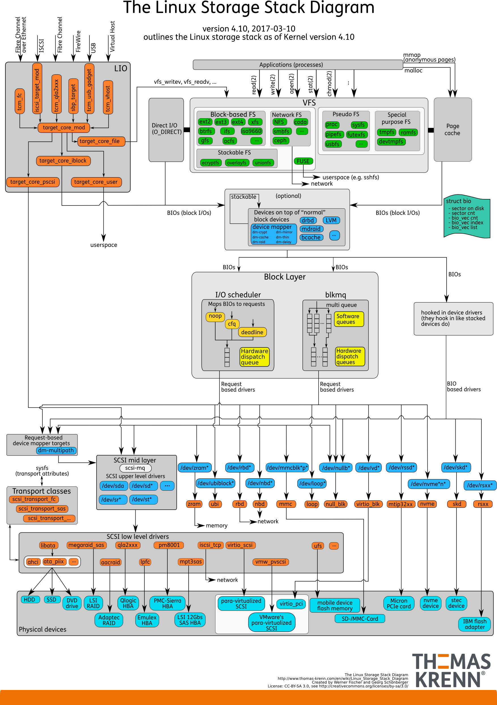

Slide 30
Recap – Storage Layer Interactions
Showed layered design of xv6 storage system
Implementation of each layer uses only the layer(s) directly below
  Must provide an API suitable for implementing the layer(s) directly above
  Deeper layer are hidden.
defs.h makes a subset of kernel functions in each file “public.”
Linux has a virtual file system (VFS) layer that allows multiple filesystems to coexist in one machine.

