Slide 1

EECS-343 Operating Systems
Lecture 16:
Buffer Caching & Logging
Steve Tarzia
Spring 2019

Slide 2
Announcements
Project 4 is due next Wednesday
Homework 4 will be out soon.

Slide 3
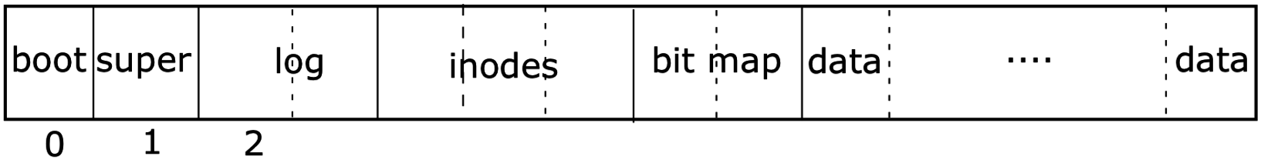
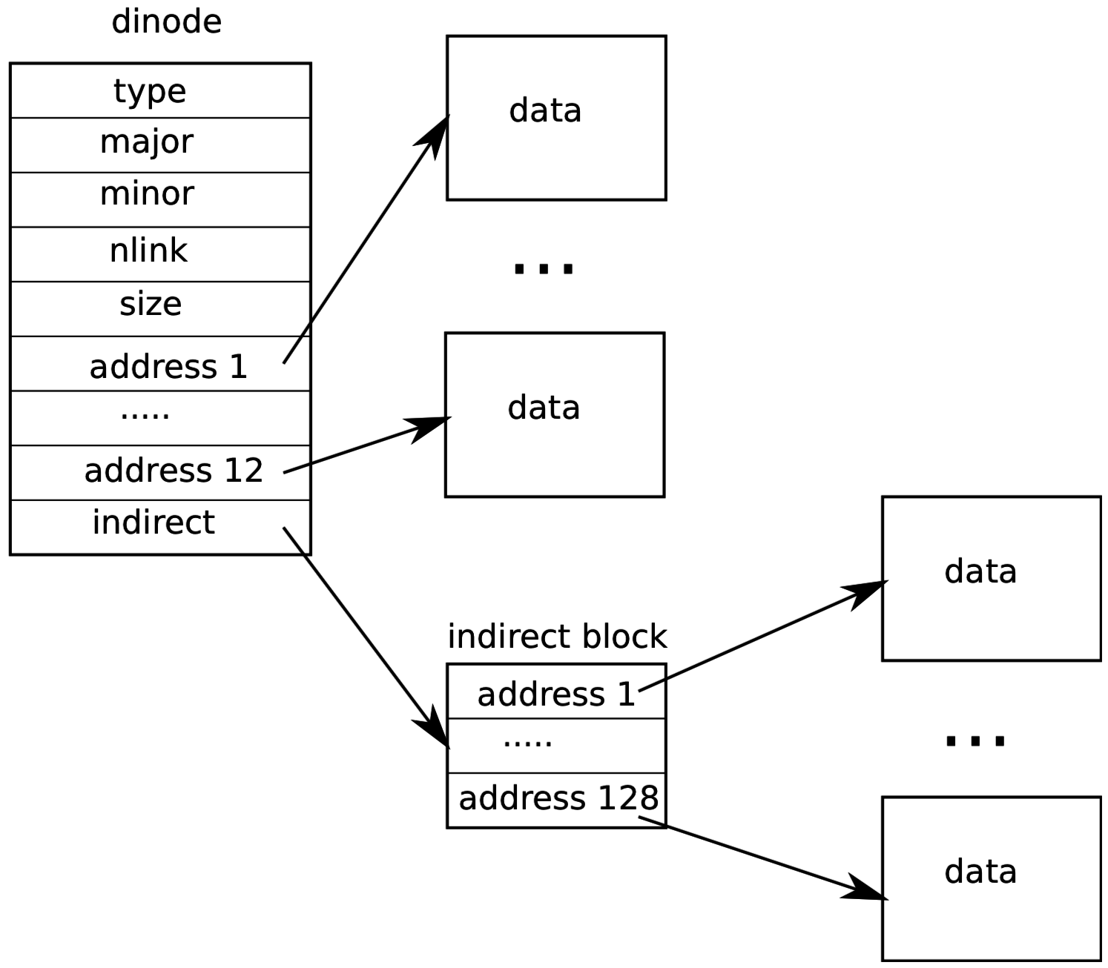
Last Lecture – RAID & File Systems
RAID allows multiple disks to act together for better
throughput, capacity, and/or fault tolerance.
  Parity is used in RAID5 to achieve all of the above.
OSes have a application-level API (syscalls) for file I/O:
  open, read, write, seek, stat, fsync, rename, unlink, mkdir
Filesystem is a data structure the OS uses to organize disk space.
Each file/directory has an inode storing
metadata & pointers to data blocks.

Slide 4
Inodes (xv6)
Each file/directory is represented by an inode (struct dinode)
A file inode stores:
  Reference count (# of hard links)
  Total file size
  Array of data blocks storing the file’s data (direct blocks)
  Optional indirect block address, for files larger than 6kB.
xv6 files can be 70kB at most!
Inodes are 64 bytes each
direct blocks

Slide 5
Directory inodes (xv6)
A Directory is like a file containing an array of <name, inode> pairs:
    struct dirent {
    ushort inum;
    char name[DIRSIZ]; // 14
    };
Inode type is set to T_DIR instead of T_FILE
Every directory contains two special entries:
  “..” pointing to parent directory
  “.” pointing to self

Slide 6
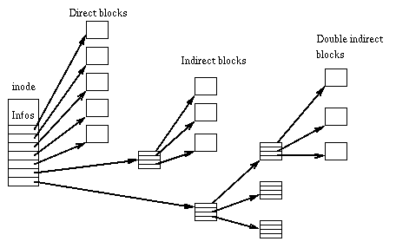
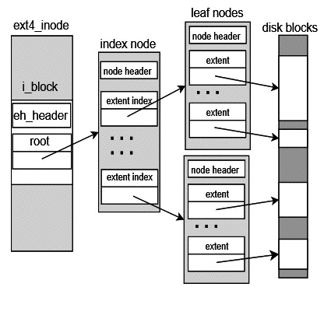
Storing larger files
ext3: double & triple indirect blocks
ext4: extents

Slide 7
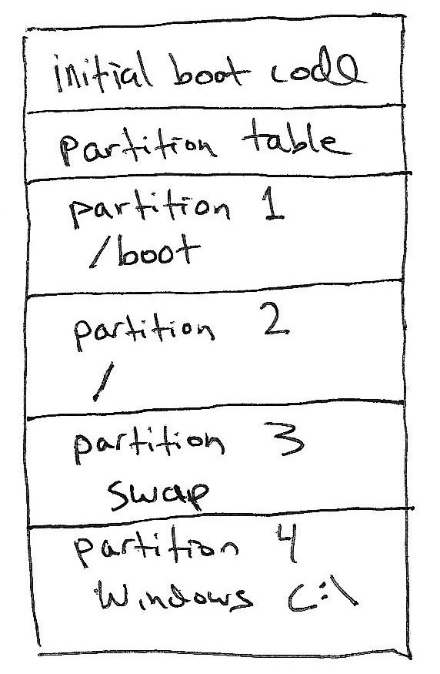
Disk partitions
Disk A
Most computers have one physical disk,
But they may require multiple filesystems.
A disk partition is a contiguous chunk of the disk that can be formatted to store a filesystem.
At left, we have:
Three different Linux partitions: /boot, swap, /
A Windows partition.
  Each of the partitions may be formatted differently.
At bootup, initial boot code will present user with a menu to choose Windows or Linux boot.
(not drawn to scale)

Slide 8
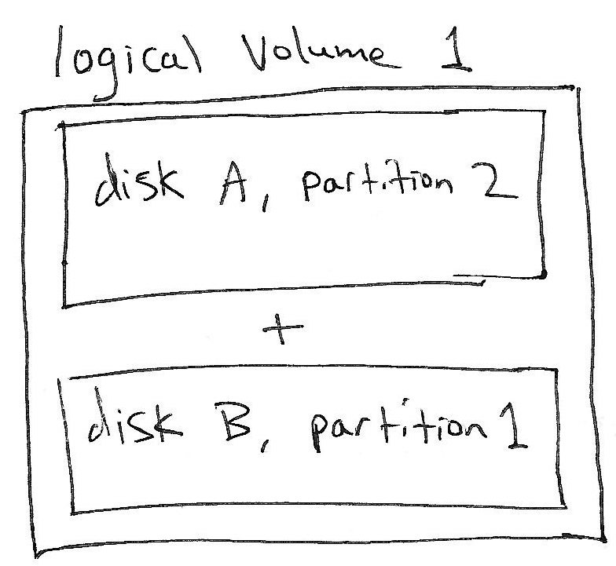
Logical Volume Management (LVM)
It’s sometimes convenient to combine multiple disk partitions into a bigger logical volume.
The concept is similar to software RAID, but it does not provide performance or redundancy benefits.
Allows user to increase the size of a filesystem by later adding another disk.
I think this feature is overused as a default setting on modern Linux distributions.

Slide 9
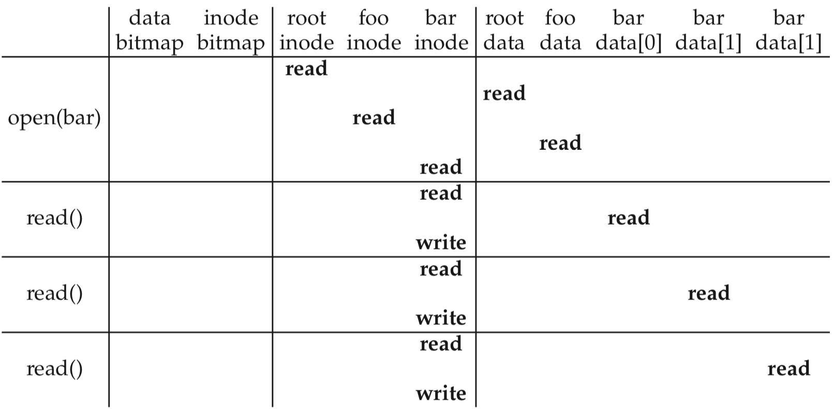
A trace through the filesystem – open & read
open("/foo/bar")
time
Note that the book’s vsfs uses an inode bitmap to find free inodes.
  xv6 filesystem simply scans through inodes to find an unused one.

Slide 10
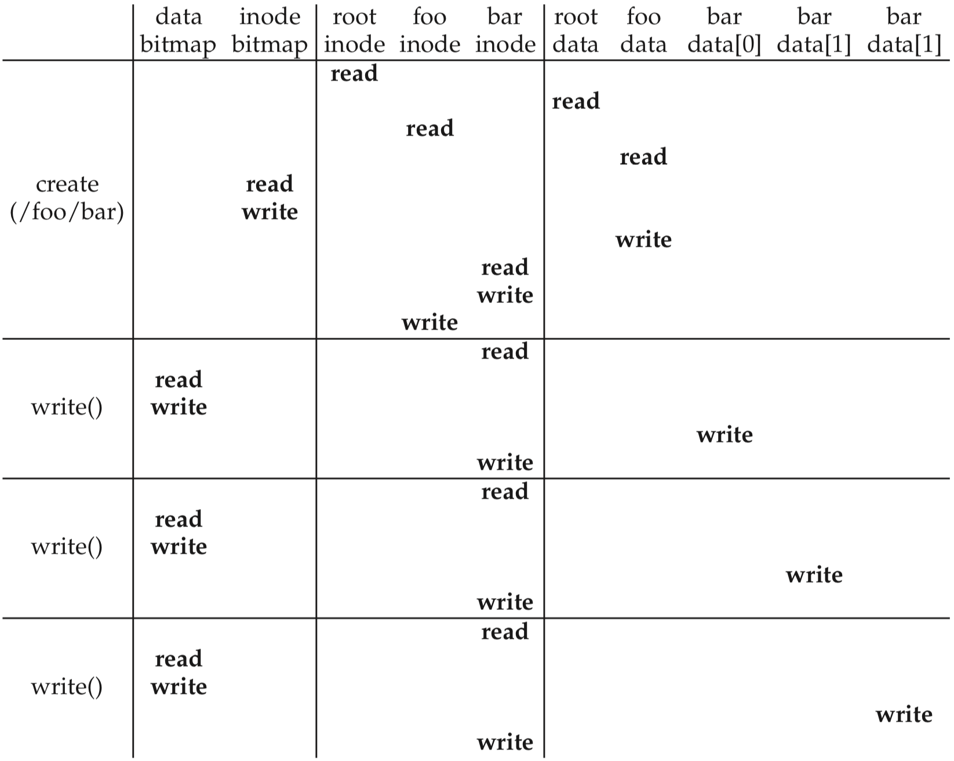
Create & write a file
Create:
First, read the parent directory to ensure that name is not already used.
Find & claim a free inode.
Add <“bar”, inode#> to parent directory.
Fill-in file metadata.
Write:
Look for remaining space in existing blocks first.
Find & claim a new data block.
Write data to new block
Point to it in inode
1
2
?
3
4
1
2
3
4

Slide 11
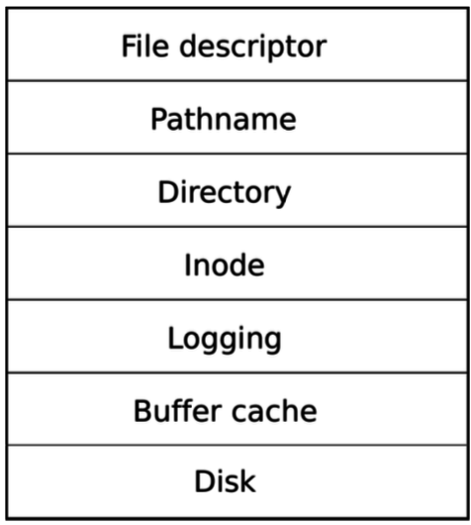
I/O overload
Filesystem is a complex data structure, requiring reads/writes to many locations of the disk to perform even basic operations:
  Open: accessed five different blocks
  Read: required three I/Os, including a write (to update last accessed time).
  Create: required nine I/Os.
How to make this fast??
  Add a buffer cache layer to the OS storage system.
    Try to cache disk blocks in RAM whenever possible.
  Layered design breaks the overall storage system’s
  complexity into a few simple layers.
Buffer cache

Slide 12
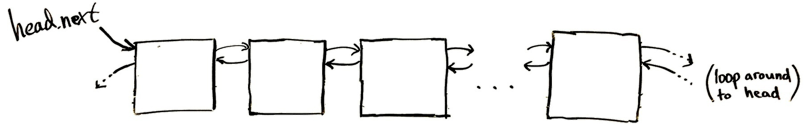
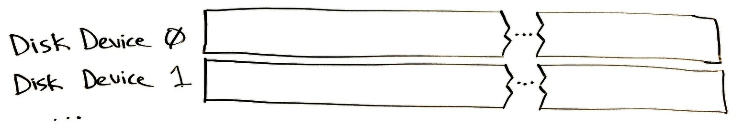
xv6 buffer cache
Upper layers (filesystem) work with buffers, not directly with disk
One of NBUF = 30 buffers
Kernel
RAM
(Fast!)
Disk 0
Sector 12
Disk 1
Sector 7
Disk 1
Sector 102
Disk 0
Sector 3
Goal is to minimize transfers between layers
Disk 0
Sector 3
Disk 0
Sector 12
Slow!
Disk 1
Sector 7
Disk 1
Sector 102

Slide 13
Buffer Cache goals
Cache popular blocks so the disk can be accessed less frequently.
  Recall that disk has 10,000× greater delay than RAM.
  Reads are faster if the disk block is already in memory from a recent access.
  Writes can be aggregated.
    If a thread writes three times briefly to the same file, these can likely be reduced to one write to disk if the writes are delayed.
    If a thread creates a new file and quickly deletes it, these writes can be skipped altogether.
  Eventually, changes must be flushed to disk, but there is no rush.
Must be careful to prevent two threads from accessing different unsynchronized copies of the disk block.
  Ie., make the cache coherent and avoid race conditions

Slide 14

Buffer cache interface (kernel/bio.c)
Higher storage layers do not access disk directly, instead they call:
struct buf* bread(int device, int sector)
  Returns a cache buffer with the data at a given location on a given disk.
  If the sector is already in a buffer, great! We avoided a disk read.
  If another thread using that buffer already, then sleep until it’s available.
  Buffer is locked for thread’s exclusive use.
void bwrite(struct buf* b)
  Write buffer’s new contents to disk.
  Must always call bread before bwrite.
void brelse(struct buf* b)
  Release the lock on the buffer (and wake any waiting thread)
  Move buffer to the head of the queue (MRU)

Slide 15
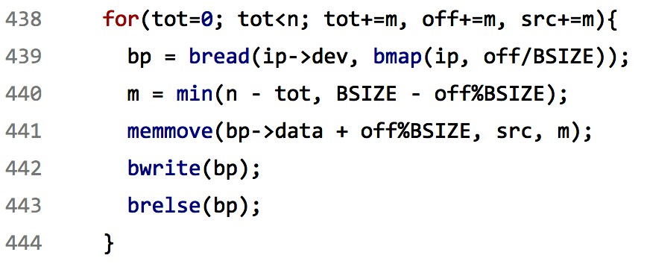
Example of buffer cache layer in action (kernel/fs.c)
write syscall → sys_write → filewrite → writei
Bread to get buffer & lock
Copy data to the buffer
Flush data
Release lock

Slide 16
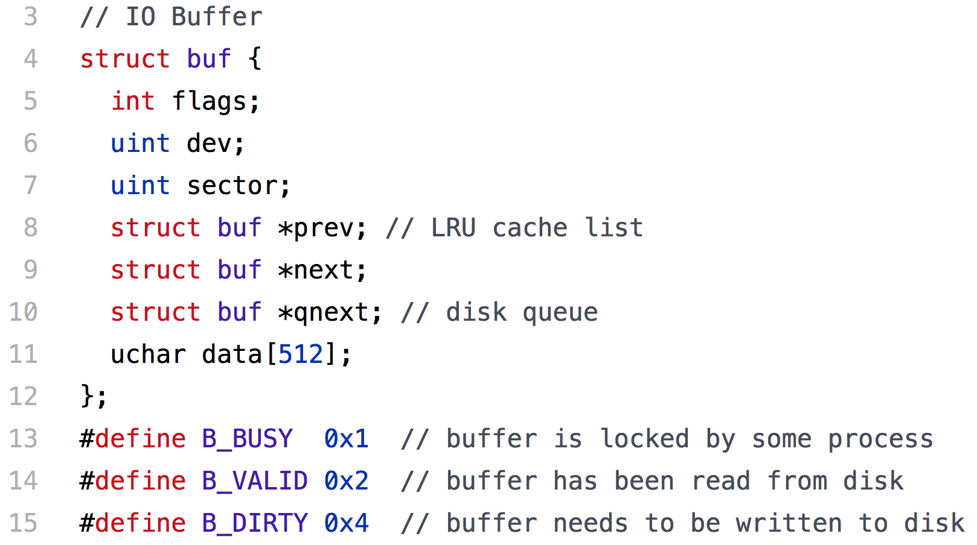
Buffer cache details
Busy/Locked? Valid? Dirty?
Doubly-linked circular list of buffers
List of buffers waiting to be written to disk. (Implementing it here is kind of sloppy.)

Slide 17
Most recently used buffer is moved to head by brelse
bread → bget looks for a matching buffer starting at head
(disk and sector #s must match)
Disk 0
Sector 12
Disk 1
Sector 7
Disk 1
Sector 102
Disk 0
Sector 3
… and allocates new buffers starting at tail
(buffer must be marked “not busy”)
xv6 panics if a suitable buffer cannot be found.
No more than 30 (NBUF) concurrent disk accesses are possible!

Slide 18
Unified page cache (Linux)
Recall that a unified page cache allocates physical memory to store both:
  process’ virtual pages, and
  device block buffers.
Use a 4 kB page frame to store 1, 2, 4, or 8 buffered disk blocks
  (depending on the filesystem’s chosen block size)
A page fault or a disk I/O can both:
  evict a resident page or cached disk block.
  request a physical frame

Slide 19
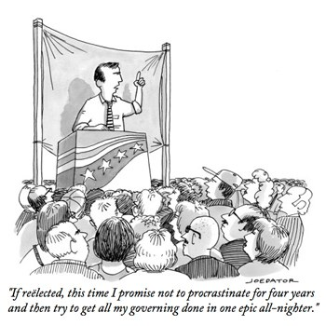
Intermission

Slide 20
Crash tolerance
Filesystems are persistent and store important data
We cannot rely on the user to shut down the system gracefully
  Power outages happen
  Kernel may panic
  USB plug may be yanked out
But, filesystem is a complex data structure with critical sections.
  The concern is not race conditions, but partial commit.
  Some filesystem transactions must be performed atomically – “all or none,” otherwise the filesystem will not be self-consistent.
It’s OK to interrupt a write, as long as it leaves the file looking like it was partially written, rather than corrupting the file or filesystem.

Slide 21
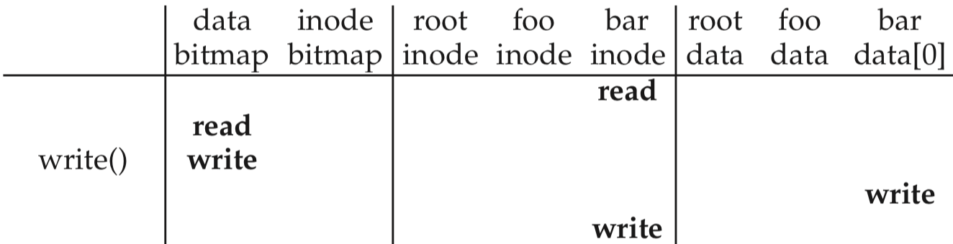
Crash example (while writing to /foo/bar)
time
Crash here!
A crash before the write to the file’s inode would leak a data block
  The data bitmap was updated to reserve a direct block, but we were not able to finish by making the file’s inode refer to that block.
  This block is lost forever. 😢
Depending on the FS implementation, more serious problems are possible:
  Inode might refer to a block that has not been written yet, adding garbage data.
  … or to a block that was freed in the bitmap, making two files share the block.

Slide 22
xv6 logging layer makes filesystem transactional
Group related writes into a transaction.
Call end_op to atomically commit the transaction.
Example usage in a syscall:
  begin_op();
  ...
  bp = bread(...);
  bp->data[...] = ...;
  log_write(bp);
  ...
  end_op();
Logging

Slide 23
Write-ahead logging: write the transaction to disk twice:
First, stage changes in log
Later, make changes permanent
Write the blocks to the log, a reserved part of the disk.
  This makes a durable record of the transaction you plan to commit.
  Continue putting all writes to the log, until commit is called.
On commit, write a commit message to the log, then start writing all of the logged writes where they belong on disk.
  Clear the log after everything is written again.

Slide 24
What happens after a crash?
The next time the machine is booted, we deal with it as follows:
Crash occurred before commit:
  There is data in the log, but no commit message.
  Just clear the log to roll back the transaction.
Crash occurred after commit, while writing data to main part of disk.
  We don’t know how much of the transaction was finished.
  However, the log tells us exactly what must be done!
  Replay the transaction (from the beginning), then clear the log.
If the log is empty, do nothing because there were no outstanding transactions.

Slide 25
Code in more depth
  begin_op();
  ...
  bp = bread(...);
  bp->data[...] = ...;
  log_write(bp);
  ...
  end_op();
begin_op waits until the logging system
is not committing and there is enough
free space in the log.
log_write reserves a place for the block
in the log, but does not write to disk yet.
  So far, everything is being done in memory, using the buffer cache.
  This allows multiple log_writes to the same block to be absorbed.
end_op writes the transaction to disk in the log, then in the destination sectors.
Note that transactions must be small enough to fit in the log.

Slide 26
Alternative crash recovery techniques
Older filesystems (ext2, FAT32) have no log.
Instead, a scavenger program (FSCK) runs on reboot to check for filesystem inconsistencies.
  This can take hours on a large filesystem.
  FSCK is only run if the system detects an unclean reboot
ext3 filesystem added a log (journal) to ext2.
Note that logging can double disk write load.
However, if you are careful you can limit logging to just the metadata (inode writes) and write data once to disk.

Slide 27
Recap: Buffer Caching & Logging
Trace of file operations shows that many accesses to disk are needed for even a single open/read/write.
To improve performance, cache a small number of active disk blocks
  Allows later reads to happen in memory
  Multiple writes can be absorbed and all are immediately visible in memory
Each buffer is locked by a thread before use
Write-ahead logging makes multiple disk writes appear atomic, even if the machine is powered-down in the middle of the transaction.
  Very important for related changes to inodes & bitmap (metadata in general)
  Data is written twice: to log first, then to main disk.
  On reboot, interrupted transaction is either rolled back or replayed.

