Slide 1

EECS-343 Operating Systems
Lecture 15:
RAID & File Systems
Steve Tarzia
Spring 2019
RAID diagrams by https://en.wikipedia.org/wiki/User:Cburnett

Slide 2
Announcements
Project 4 is out due two weeks from yesterday.
Office hours on Monday (Memorial Day) are cancelled.

Slide 3
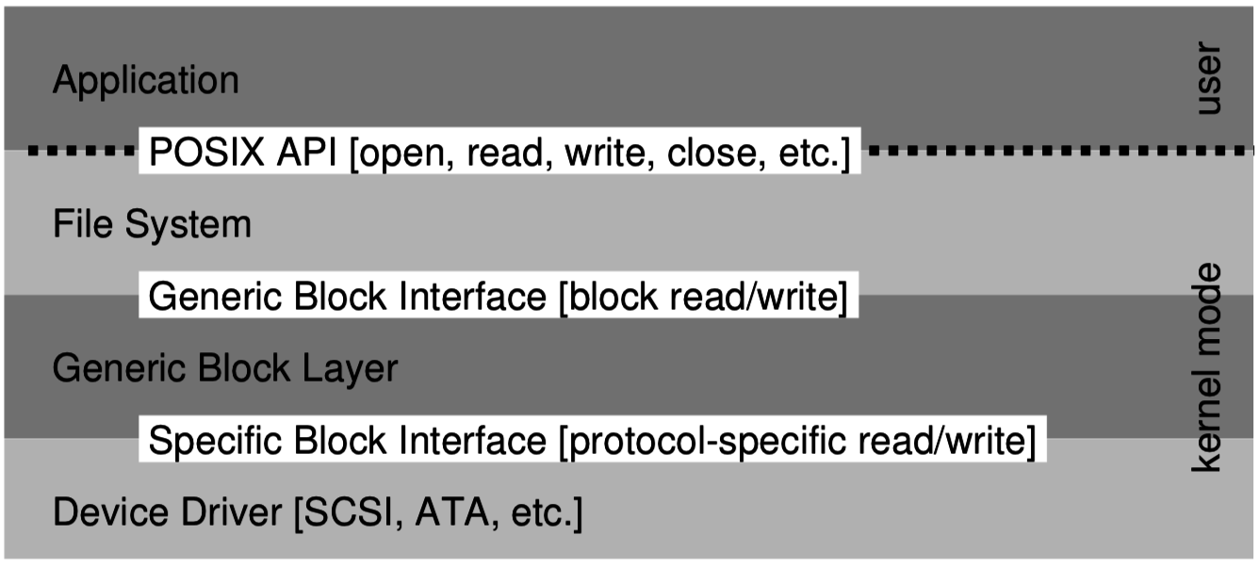
Last Lecture – I/O and Disks
OS interacts with devices by reading/writing device registers
  Each register has an I/O port address for in/out instructions, or
  memory-mapped I/O uses special physical memory addresses (with mov)
Storage is complex, so
kernel functionality is divided
into at least three layers:
Random access to a magnetic disk is 1000x slower than sequential
  Read head must seek and disk must rotate to reach a new sector

Slide 4
Redundant Array of Independent Disks (RAID)
Disks have a few shortcomings:
  Limited capacity (~8TB)
  Limited throughput (~150MB/s)
  Likelihood of failure (especially because they are mechanical)
RAID uses multiple disks to solve these problems
  Many different variations of RAID, depending on your budget and which of the above three problems are most important.
Basic ideas are:
  Increase capacity by making multiple disks available to store data.
  Increase throughput by accessing data in parallel on multiple disks.
  Reduce impact of a disk failure by storing data redundantly on multiple disks.
Disk interface is very simple (just an array of sectors), so it’s easy to create a logical/virtual disk made of sectors from multiple physical disks.

Slide 5
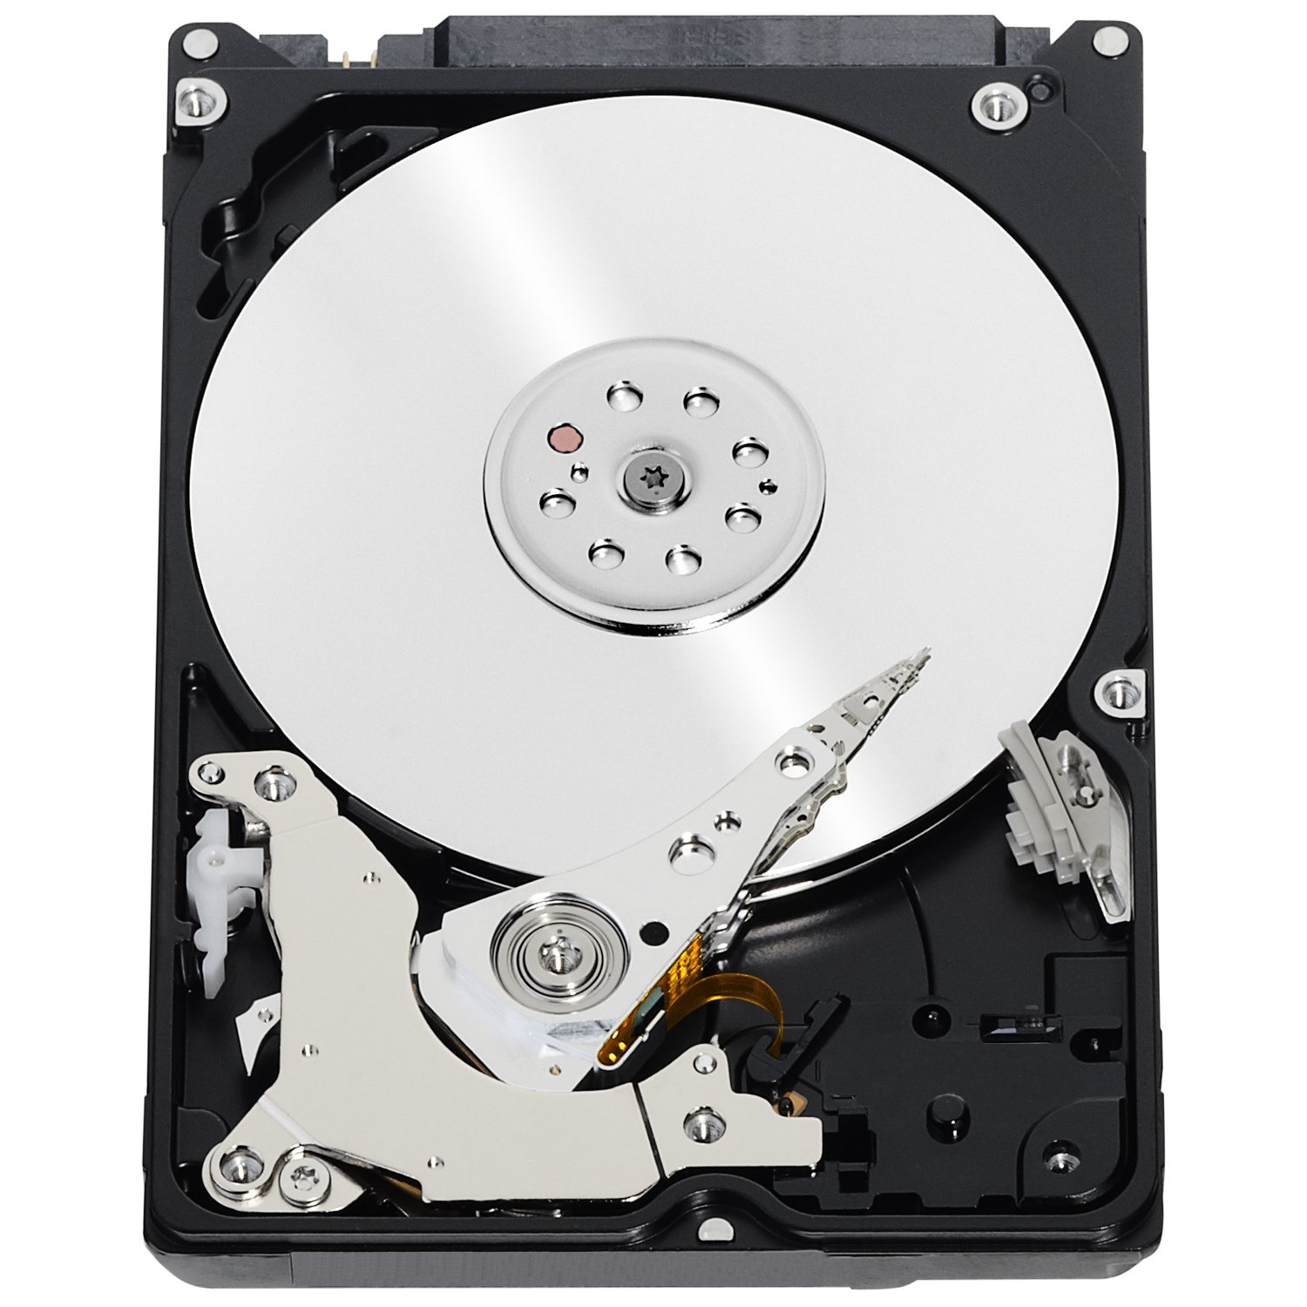

Basic idea of RAID
Combine many disks to create one superior virtual disk.
The RAID array provides the same interface as a single disk.
OS thinks it’s dealing with this:
But it’s just an illusion. The reality is:
Sector r/w requests
Sector r/w requests
RAID virtual disk
RAID controller

Slide 6
How does RAID fit into the OS?
Software RAID means that the OS is responsible for assembling multiple disks into a RAID.
  Implements a generic
  block device.
  SW and HW RAID
  work on different layers.
Hardware RAID requires a specialized controller card that coordinates the multiple disks and presents the OS with the illusion of a single disk. (The previous slide showed hardware RAID.)
  OS just needs a driver for the RAID controller, like any other disk controller.

Slide 7
RAID levels
RAID 0 – Striping:
distribute data across 2 disks for twice the peak throughput
RAID 1 – Mirroring: copy data onto 2 disks to tolerate failure of one.
RAID 4/5 – Parity:
  start with N-1 striped disks, add disk N with parity information to tolerate failure of any of the disks.
  Typically involves 3-7 disks.
  Can include 2 parity disks for double-fault tolerance (called RAID 6)

Slide 8
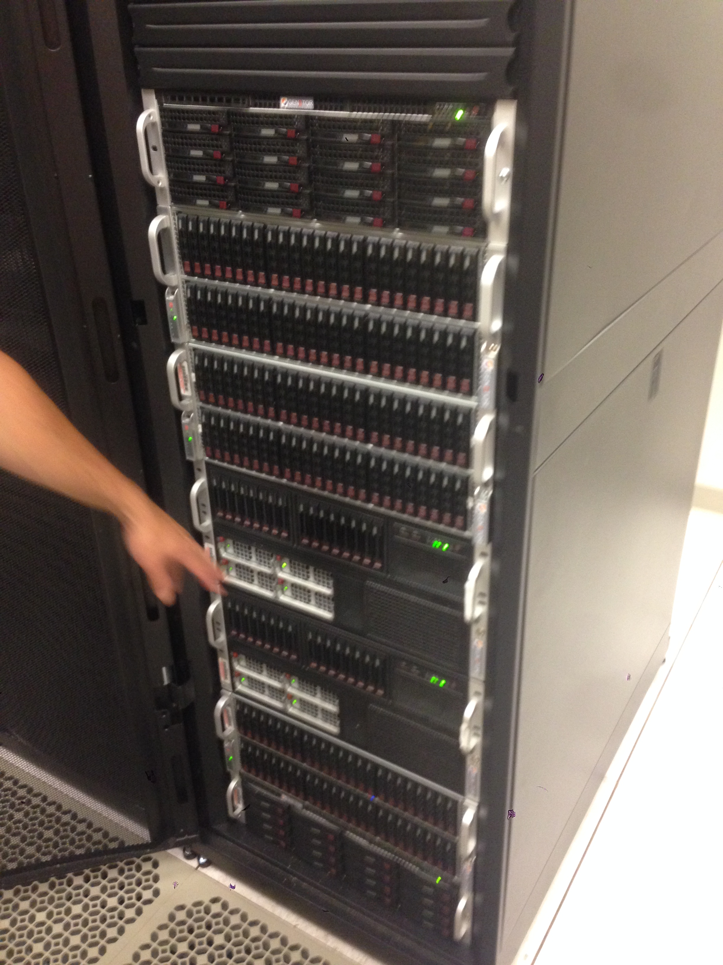
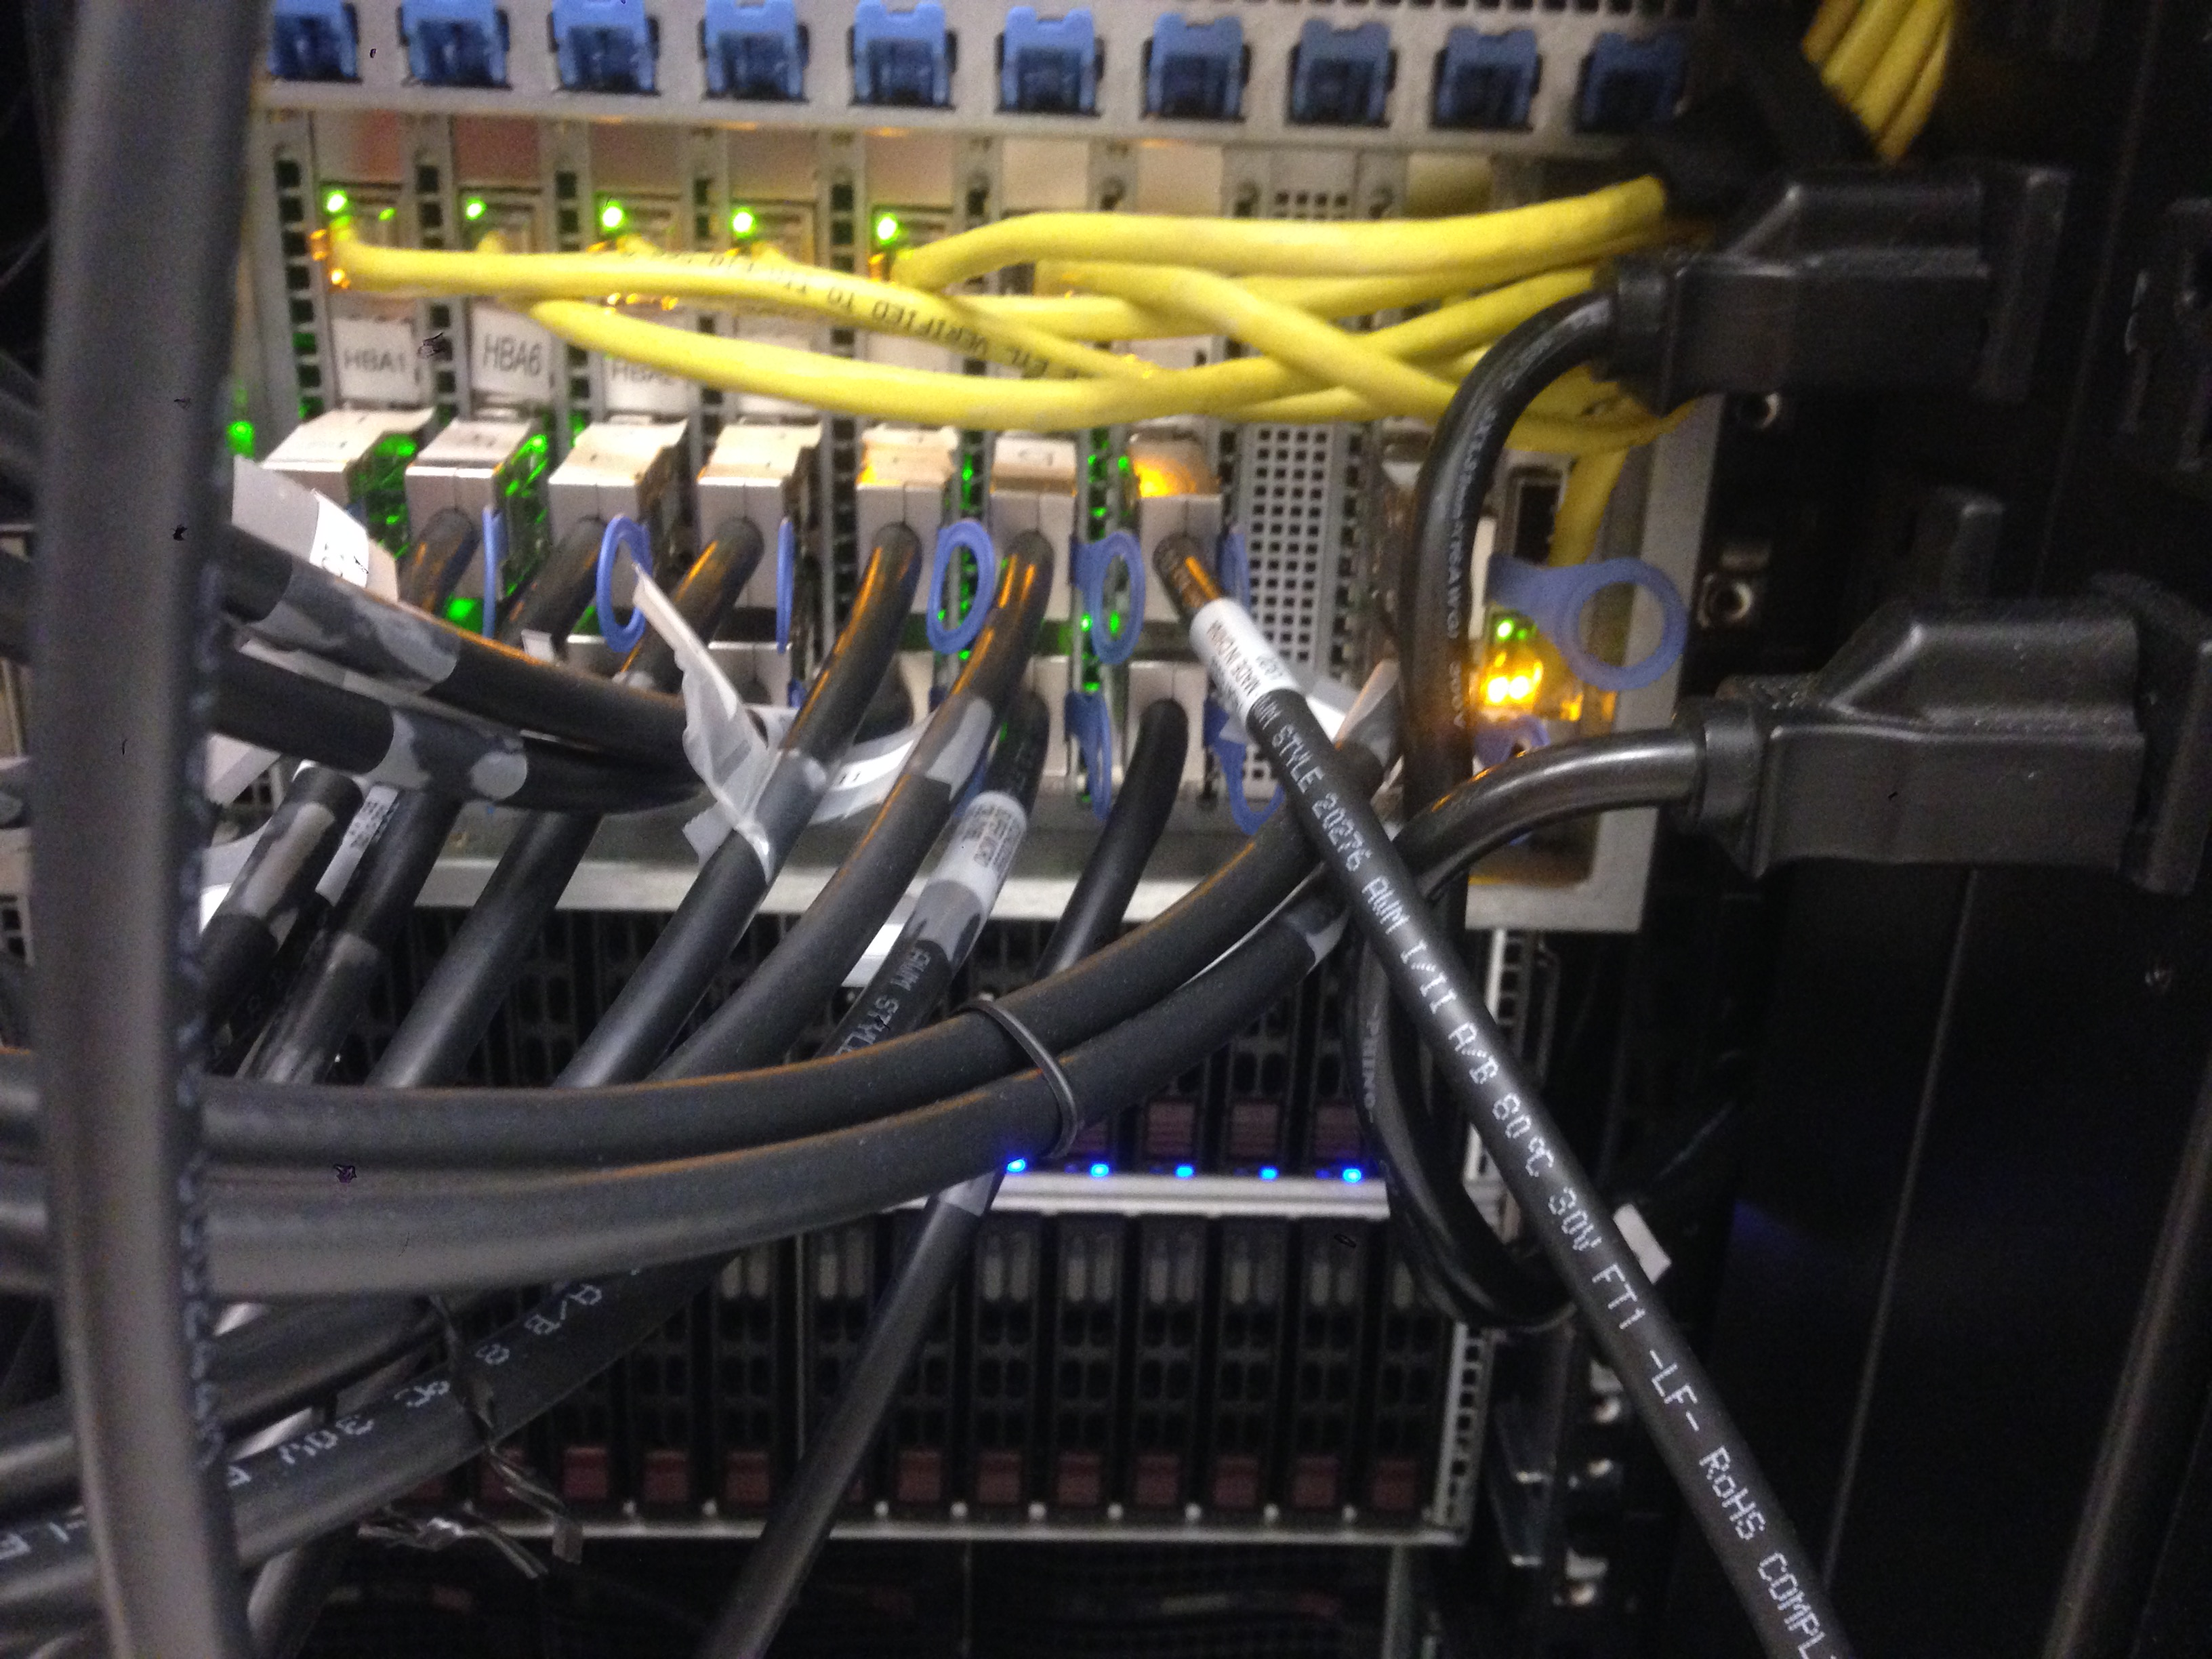
A Database Server @ NU
Front view
264 fast (10k RPM) magnetic disks (for production)
56 slow (7200 RPM) magnetic disks (for backup)
~150 TB storage capacity
Comprised of 6 physical chassis (boxes) in one big cabinet, about the size of a coat closet.
SAS cabling in back

Slide 9
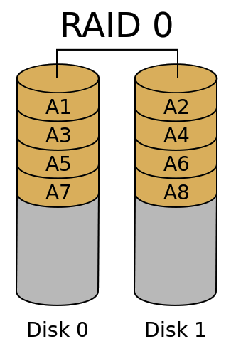
RAID 0 – Striping (for throughput and capacity)
Divide the logical disk into chunks
  (A1, A2, A3 …) ~128 kB
Distribute the chunks regularly over two or more (N) physical disks.
(+) Throughput for both random and sequential access scales with N.
  T_{RAID0} = N * T_{disk}
(+) Capacity also scales by N.
(+) Cost per byte is identical
(–) But mean time to failure is worse because failure of a single disk is catastrophic:
  MTTF_{RAID0} = MTTF_{disk}/N

Slide 10
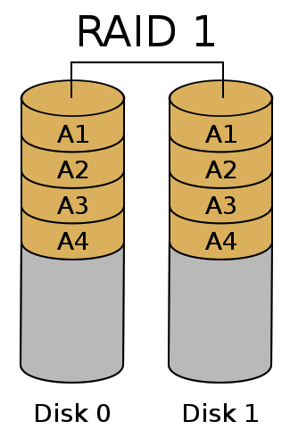
RAID 1 – Mirroring (for fault tolerance)
Duplicate each chunk on each of N physical disks.
(+) It is impossible to lose data unless all disks fail simultaneously.
  Ie., failure window is reduced to the time it takes to replace a broken disk.
(–) Throughput is not improved
(–) Cost per byte is greater
  $_{RAID1} = N * $_{disk}

Slide 11
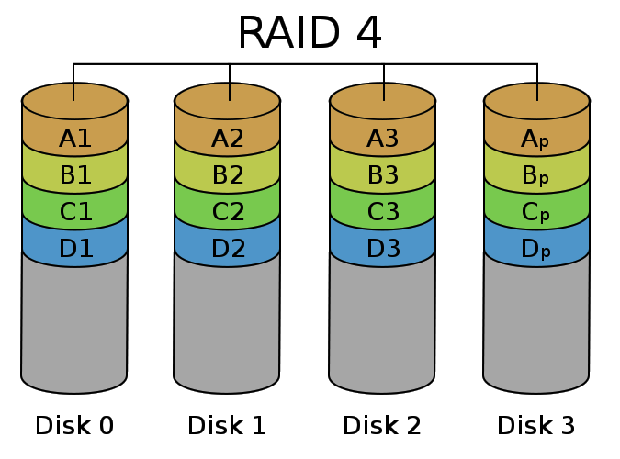
RAID 4 – Parity (for fault tolerance, capacity & throughput)
Distribute the chunks across the first (N-1) disks.
On the N^{th} disk, store a corresponding parity chunk.
  Parity chunk is redundant data about a set of chunks (a stripe)
Can tolerate loss of any one disk
Redundant data

Slide 12
Parity bit is added to allow filling-in a missing bit
Even parity – add a 0 or 1 such that the total number of 1’s is even.
eg., given [0, 0, 1, 0, 1, 1] parity bit would be 1. The sequence has three ones, so we add a one to yield an even number of ones (4):
[0, 0, 1, 0, 1, 1, 1]
original data parity bit
If a bit is lost, the parity bit allows us to infer the lost bit’s value:
  [?, 0, 1, 0, 1, 1, 1]
  The missing first bit must have been 0 because we already have an even number of ones in the remaining positions.

Slide 13
Parity chunk
Disk 0 | Disk 1 | Disk 2 | Disk 3 (parity)
0001 0010 1100 1100 | 0000 1111 0000 1111 | 1101 1111 0011 0001 | 1100 0010 1111 0010
1111 1111 1111 1111 | 0001 0001 0001 0001 | 1101 1001 0110 0110 | 0011 0111 1000 1000
0000 0000 0000 0000 | 1101 1011 0011 0011 | 1111 0011 0011 1000 | 0010 1000 0000 1011
Useful storage capacity
Redundancy overhead
Parity is computed bit-wise across corresponding chunks.
Chunks are ~128 kB
Writing a small file will involve one disk plus the parity disk.
  (parity disk can become a bottleneck)
Writing a large file will involve all the disks.

Slide 14
Rebuilding an array after failure
Disk 0 | Disk 1 | Disk 2 | Disk 3 (parity)
0001 0010 1100 1100 |  | 1101 1111 0011 0001 | 1100 0010 1111 0010
1111 1111 1111 1111 |  | 1101 1001 0110 0110 | 0011 0111 1000 1000
0000 0000 0000 0000 |  | 1111 0011 0011 1000 | 0010 1000 0000 1011
Disk failed!
If a disk fails, then we remove it and replace it with a working disk.
Then scan through the entire array to compute and write missing data.
  This is called “rebuilding” the array
  We cannot tolerate another disk failure until rebuild completes.
  Reads/write can continue while array is rebuilding!

Slide 15
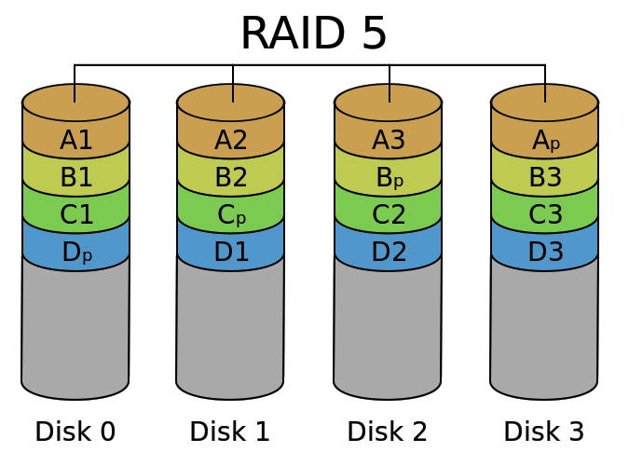
RAID 5 – Distributed Parity (the winner in practice)
Distribute parity chunks across the disks, to avoid a small-write bottleneck
(+) Failure of one disk is OK
(+) Throughput is good
  T_{RAID5} = (N-1) * T_{disk}
  (+) Cost per byte is good
  $_{RAID1} = N/(N-1) * $_{disk}
(–) High overhead for small N
(–) Failure risk is high for large N
N is typically 3 to 8

Slide 16
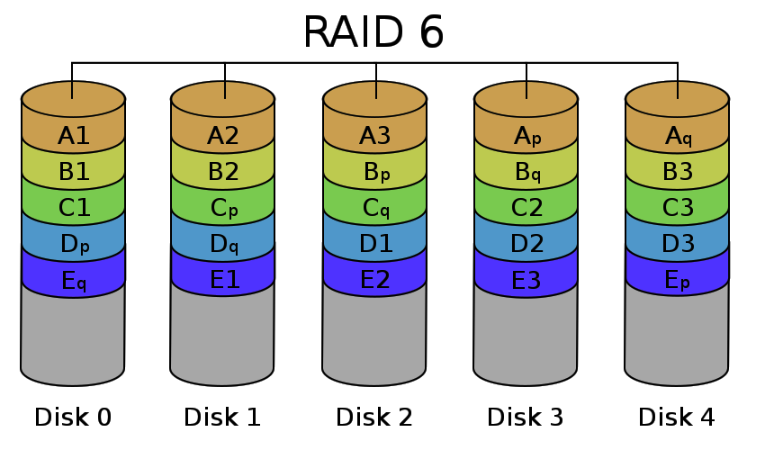
RAID 6 – Double Parity (for large arrays)
Add another disk and keep two parity chunks per stripe
  2nd parity is computed differently
(+) Failure of two disks is OK
(~) Throughput is less:
  T_{RAID5} = (N-2) * T_{disk}
  (~) Cost per byte is higher:
  $_{RAID1} = N/(N-2) * $_{disk}
Makes sense for larger N (>8)

Slide 17
Intermission

Slide 18
Filesystem basics
A filesystem is an abstraction & interface for persistent storage.
  Storage devices (eg., disks) are just big arrays of bytes.
  The filesystem organizes the storage space for ease-of-use and sharing among many processes/users on a system.
  Unlike memory, it’s often directly accessible to the computer user.
Usually structured as:
  A tree of directories/folders
  Files to store an array of bytes, each located within a directory
  With unique names for each file or directory with a directory, and
  Metadata for each file/directory (permissions, owner, modified time, etc.)
Many different filesystems have been developed over the years:
  FAT32, NTFS (Windows), ext4 (Linux), HFS, APFS (Mac), ZFS, etc.
  Some include extra features like encryption, compression, backups.

Slide 19
In other words…
A filesystem is a data structure for storing files on a disk.
Key Challenges:
Files are added and deleted over time. Free space must be managed.
Files can grow and shrink.
Should tolerate sudden electrical power loss without corruption.
Performance should be optimized for magnetic disks:
  Random access is slow, but sequential access is fast.

Slide 20
Application-level interface (syscalls)
open (or create) a file with a given path (directories & name) and set the file pointer to the beginning of the file
read up to a certain number of bytes from an open file, and move the file pointer for the next read.
write an array of bytes to an open file (and move the pointer)
close an open file
lseek to move the file pointer to a certain index in the file
fsync to push changes to disk immediately (flush dirty data)

Slide 21
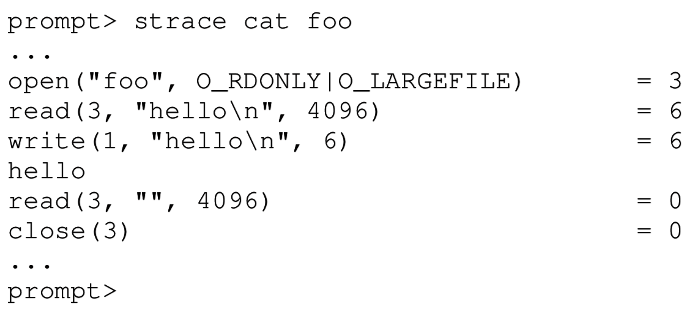
Syscall trace
strace command (on Linux) shows syscalls used by a process
Here, open() return
file descriptor number 3.
Unix standard file
descriptors are:
  0: stdin
  1: stdout
  2: stderr
  These are always open and available in a Unix process.
Unix also uses file interface for many “non-file” things that can be read/written to, like stdout/stdin to/from the terminal.

Slide 22
More file-related syscalls
stat/fstat gets file metadata (data about the data)
rename to move a file
unlink to remove a file
mkdir to make a directory
Linux:
  getdents to list the contents of a directory
xv6:
  open and read a directory to get a raw directory listing

Slide 23
File/directory metadata (Linux)
struct stat {
dev_t st_dev; /* ID of device containing file */
ino_t st_ino; /* Inode number (low-level name) */
mode_t st_mode; /* File type and mode (permissions) */
nlink_t st_nlink; /* Number of hard links */
uid_t st_uid; /* User ID of owner */
gid_t st_gid; /* Group ID of owner */
dev_t st_rdev; /* Device ID (if special file) */
off_t st_size; /* Total size, in bytes */
blksize_t st_blksize; /* Block size for filesystem I/O */
blkcnt_t st_blocks; /* Number of 512B blocks allocated */
struct timespec st_atim; /* Time of last access */
struct timespec st_mtim; /* Time of last modification */
struct timespec st_ctim; /* Time of last status change */
};

Slide 24
Filesystem Links
ln unix command creates a link to a file – like a pointer.
  Allows a file to exist in multiple paths without wasting space
Hard link creates another entry in a directory referring to the same inode number (disk address).
Symbolic/Soft link is a special file whose contents is just the string path of another file.
  Symlinks are much more common in modern practice (ln -s)
  Allow referring to file in other filesystems
  But may lead to a dangling reference – the referred-to file may be deleted

Slide 25
Making and mounting a filesystem
On Linux, mkfs command creates a new filesystem on a block device.
xv6 Makefile creates a filesystem in a file! – fs.img
The mount command tells the OS to add a filesystem under a directory in the virtual file system. Without any parameters is describes current mount points:
  [steve@vortex ~]$ mount
  /dev/md3 on / type ext4 (rw)
  proc on /proc type proc (rw)
  sysfs on /sys type sysfs (rw)
  devpts on /dev/pts type devpts (rw,gid=5,mode=620)
  tmpfs on /dev/shm type tmpfs (rw,rootcontext="system_u:object_r:tmpfs_t:s0")
  /dev/md1 on /boot type ext4 (rw)
  /dev/md4 on /home type ext4 (rw)
  none on /proc/sys/fs/binfmt_misc type binfmt_misc (rw)
  sunrpc on /var/lib/nfs/rpc_pipefs type rpc_pipefs (rw)
  192.168.0.5:/pool2 on /mnt/pool2 type nfs (rw,rsize=8192,wsize=8192,vers=4,addr=192.168.0.5,clientaddr=192.168.0.6)

Slide 26
xv6 file system goals
Create on-disk data structures to:
  Represent a tree of directories and files
  Record which disk blocks store each file’s data
  Track free blocks on the disk
Support crash recovery
  Behave reasonably if the machine if powered off at any time
Support concurrent access by many processes.
Operate quickly by using an in-memory cache.
Note: in xv6, disk block means one disk sector – 512 byte unit of disk storage

Slide 27
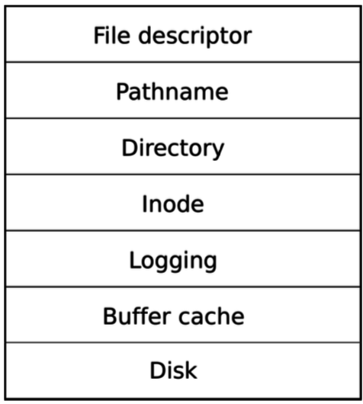
Layered storage system design (in xv6)
Layered design makes code easier to understand & write.
Lower-level details are hidden at each layer
Apps use these to open, close, read, write, etc.
Absolute location, eg. “/home/steve/hello.txt”
Containers associating names with inodes
Organizes used blocks (& mutex, caching)
Makes block writes appear as atomic transactions
For performance & mutual exclusion
Low-level driver handles device registers

Slide 28
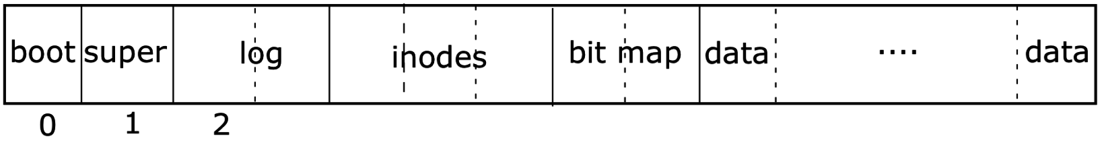
Layout of xv6 filesystem on disk
First sector on disk
Last sector on disk
Boot block contains OS initialization code
Superblock has some high-level info about the filesystem structure
Log stores block writes which are not completed yet
Inodes (each is 64 bytes) store metadata for one file or directory.
Bitmap indicates which disk blocks are free (data blocks in particular)
Data blocks store file data (inodes refer to data blocks)

Slide 29
An inflexible design
The size of each of these regions is hard-coded in the superblock
Number of inodes is determined when the filesystem is created (mkfs)
  Inode count is the maximum number of files/directories allowed
    (by default, mkfs creates 200 inodes, consuming 25 blocks)
  Tradeoff between inode region size and data region size
  Allocate fewer inodes if you plan to store just a few big files
  But, in xv6, you cannot change the number of inodes after formatting
But, the presence of a transaction log is a nice, modern feature.

Slide 30
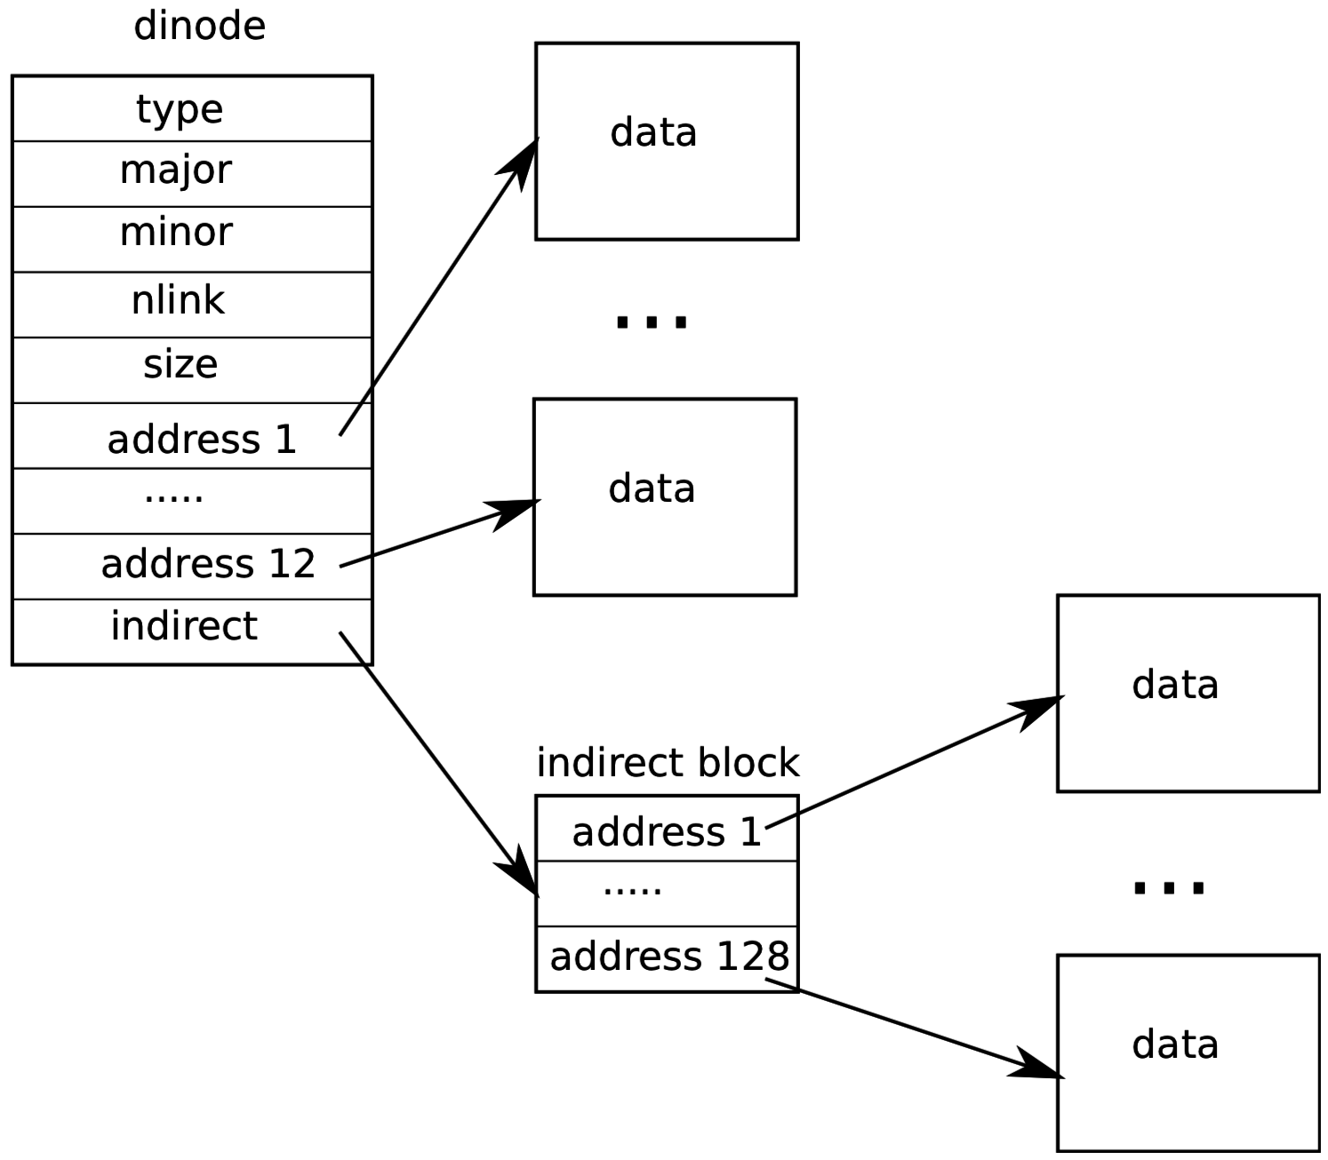
Inodes (xv6)
Each file/directory is represented by an inode (struct dinode)
A file inode stores:
  Reference count (# of hard links)
  Total file size
  Array of data blocks storing the file’s data (direct blocks)
  Optional indirect block address, for files larger than 6kB.
xv6 files can be 70kB at most!
Inodes are 64 bytes each
direct blocks

Slide 31
Directory inodes (xv6)
A Directory is like a file containing an array of <name, inode> pairs:
    struct dirent {
    ushort inum;
    char name[DIRSIZ]; // 14
    };
Inode type is set to T_DIR instead of T_FILE
Every directory contains two special entries:
  “..” pointing to parent directory
  “.” pointing to self

Slide 32
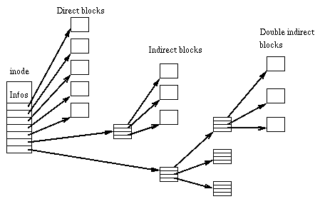
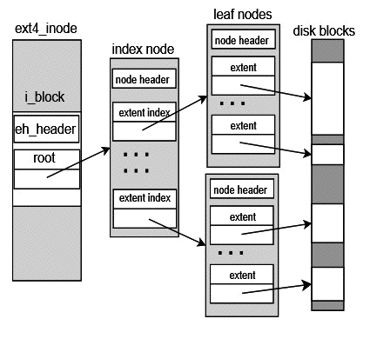
Storing larger files
ext3: double & triple indirect blocks
ext4: extents

Slide 33
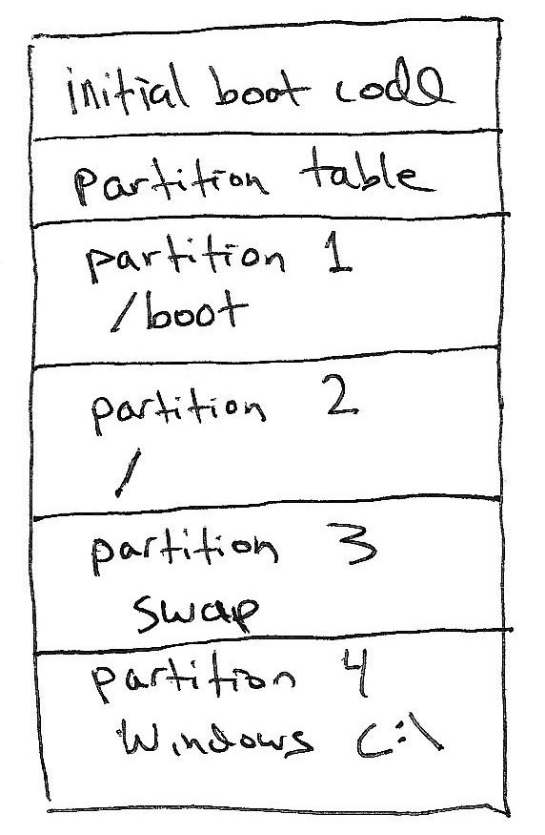
Disk partitions
Disk A
Most computers have one physical disk,
But they may require multiple filesystems.
A disk partition is a contiguous chunk of the disk that can be formatted to store a filesystem.
At left, we have:
Three different Linux partitions: /boot, swap, /
A Windows partition.
  Each of the partitions may be formatted differently.
At bootup, initial boot code will present user with a menu to choose Windows or Linux boot.
(not drawn to scale)

Slide 34
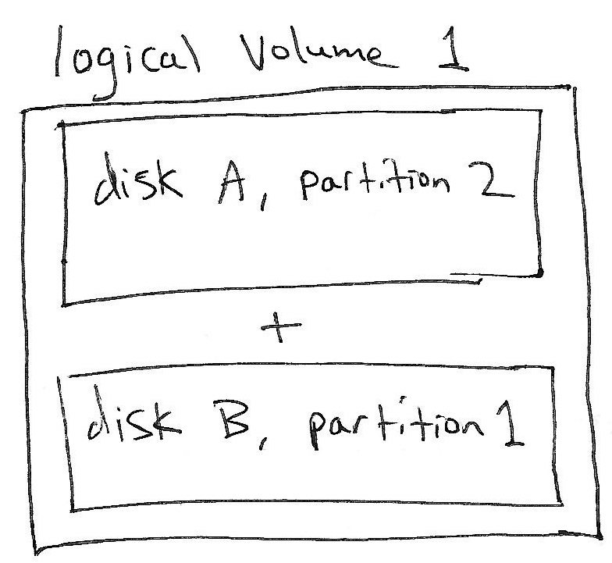
Logical Volume Management (LVM)
It’s sometimes convenient to combine multiple disk partitions into a bigger logical volume.
The concept is similar to software RAID, but it does not provide performance or redundancy benefits.
Allows user to increase the size of a filesystem by later adding another disk.
I think this feature is overused as a default setting on modern Linux distributions.

Slide 35
Recap – RAID & File Systems
RAID allows multiple disks to act together for better
throughput, capacity, and/or fault tolerance.
  Parity is used in RAID5 to achieve all of the above.
OSes have a application-level API (syscalls) for file I/O:
  open, read, write, seek, stat, fsync, rename, unlink, mkdir
Filesystem is a data structure the OS uses to organize disk space.
Each file/directory has an inode storing
metadata & pointers to data blocks.

