Slide 1

EECS-343 Operating Systems
Lecture 14:
I/O and Disks
Steve Tarzia
Spring 2019

Slide 2
Announcements
Project 4 will be posted soon.

Slide 3
Last Lecture – Synchronization Bugs
Semaphore (up/down) is an all-purpose synchronization primitive
Reader-writer lock allows multiple readers, but one writer.
Adding too many locks can lead to deadlock, which requires:
  Mutual exclusion (avoid locks to avoid deadlock)
  Hold and wait (use trylock to release first lock to before deadlocking)
  No preemption
  Circular wait (always acquire locks in the same order to avoid deadlock)
Dining philosophers was an example of deadlock
  Circular wait can be avoided by making one philosopher grab right-hand side instead of left first.

Slide 4
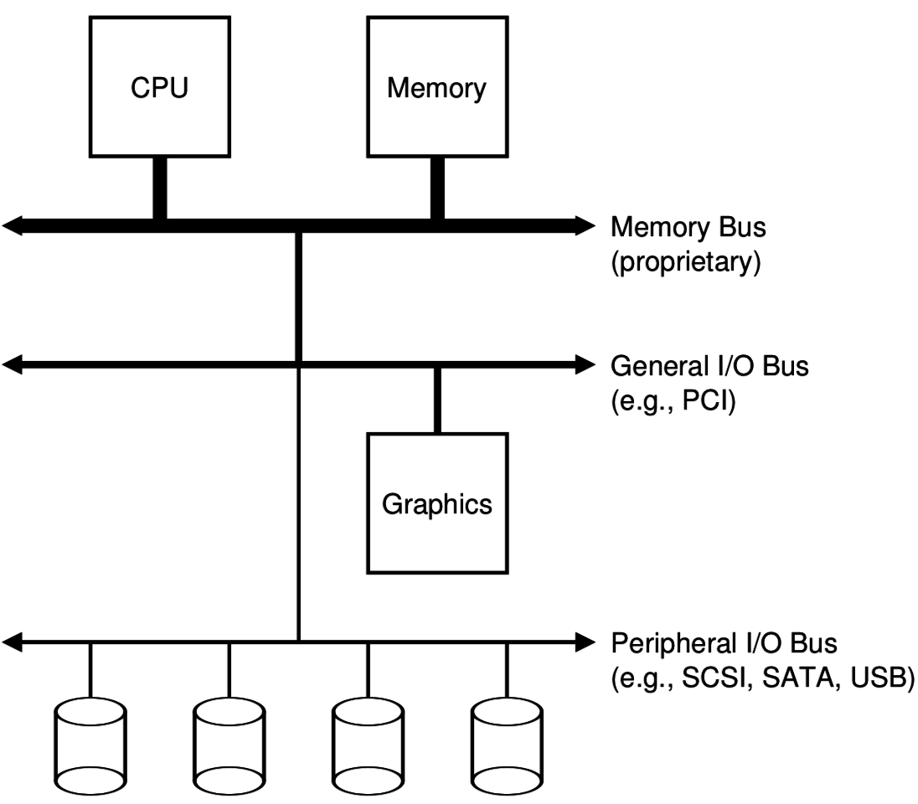
I/O is a major responsibility of the kernel
I/O = Input/Output
Peripheral hardware is a shared resource, and not directly accessible by user programs.
Includes:
  Disks
  Graphics
  Network
  Keyboard/mouse
  Audio
  Webcam
  Printer

Slide 5
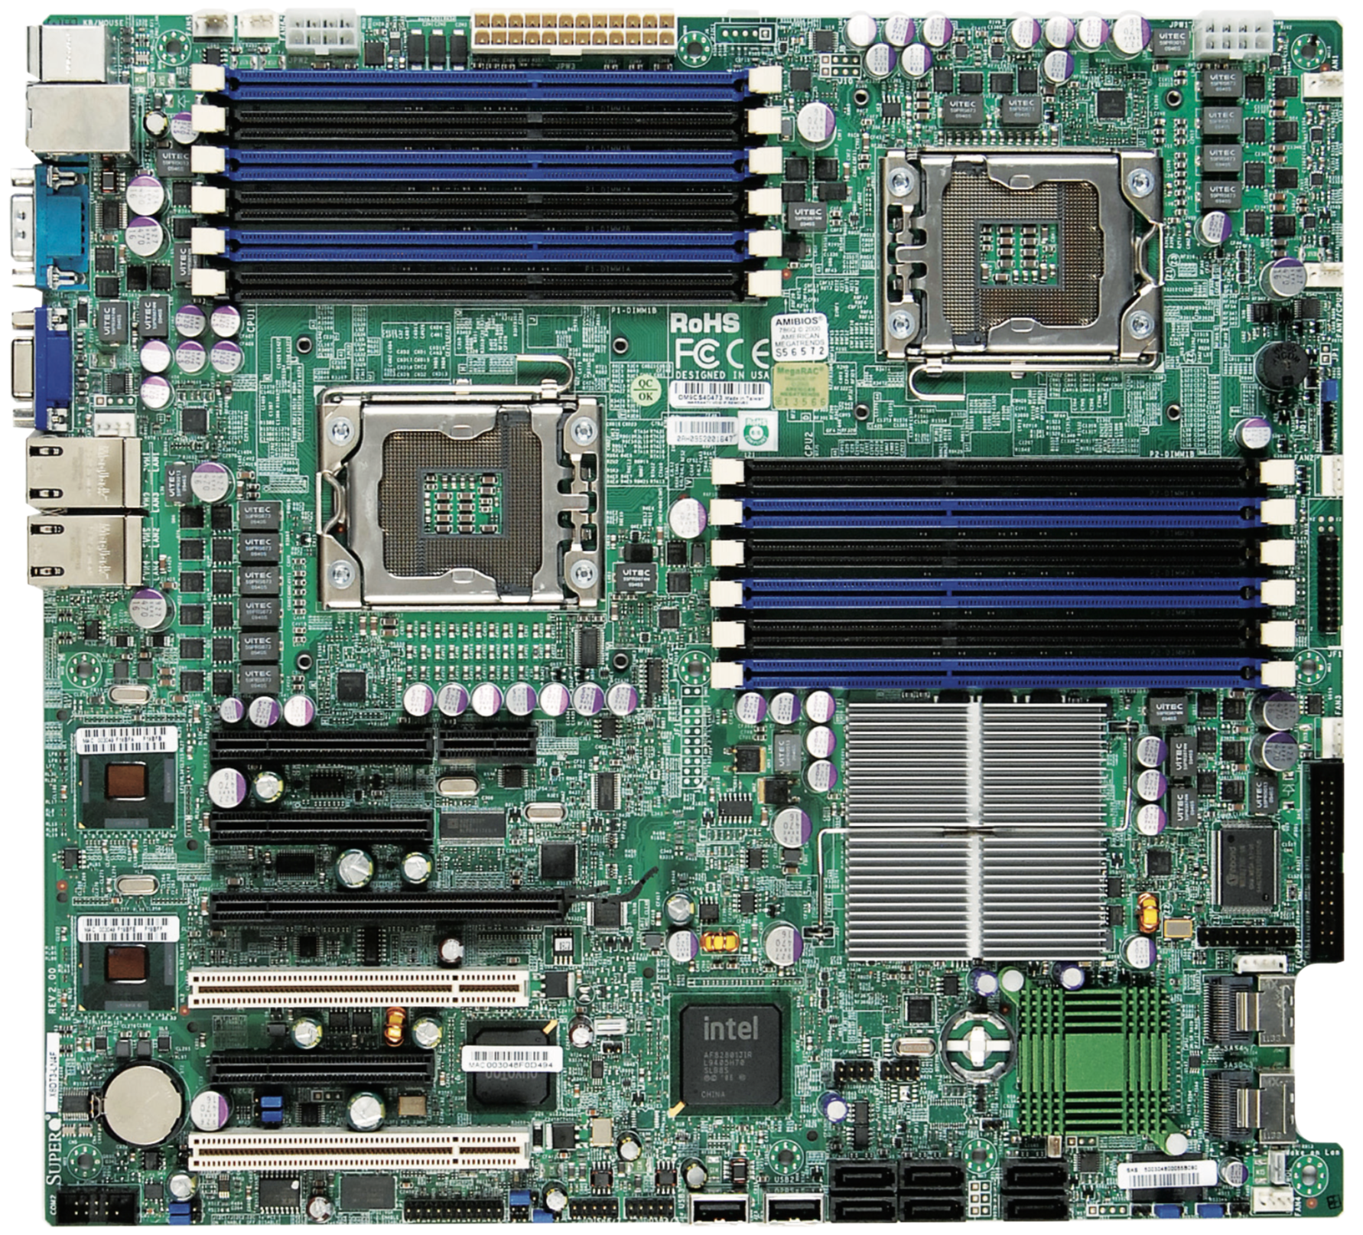
A look at a motherboard (Supermicro X8DT3, ~2011)
2 CPU sockets and 12 RAM slots in upper right.
This is what we’ve dealt with so far.
The rest of the board is dedicated to I/O controllers and devices.
  This part varies dramatically from machine to machine, and the OS must somehow handle different HW.

Slide 6
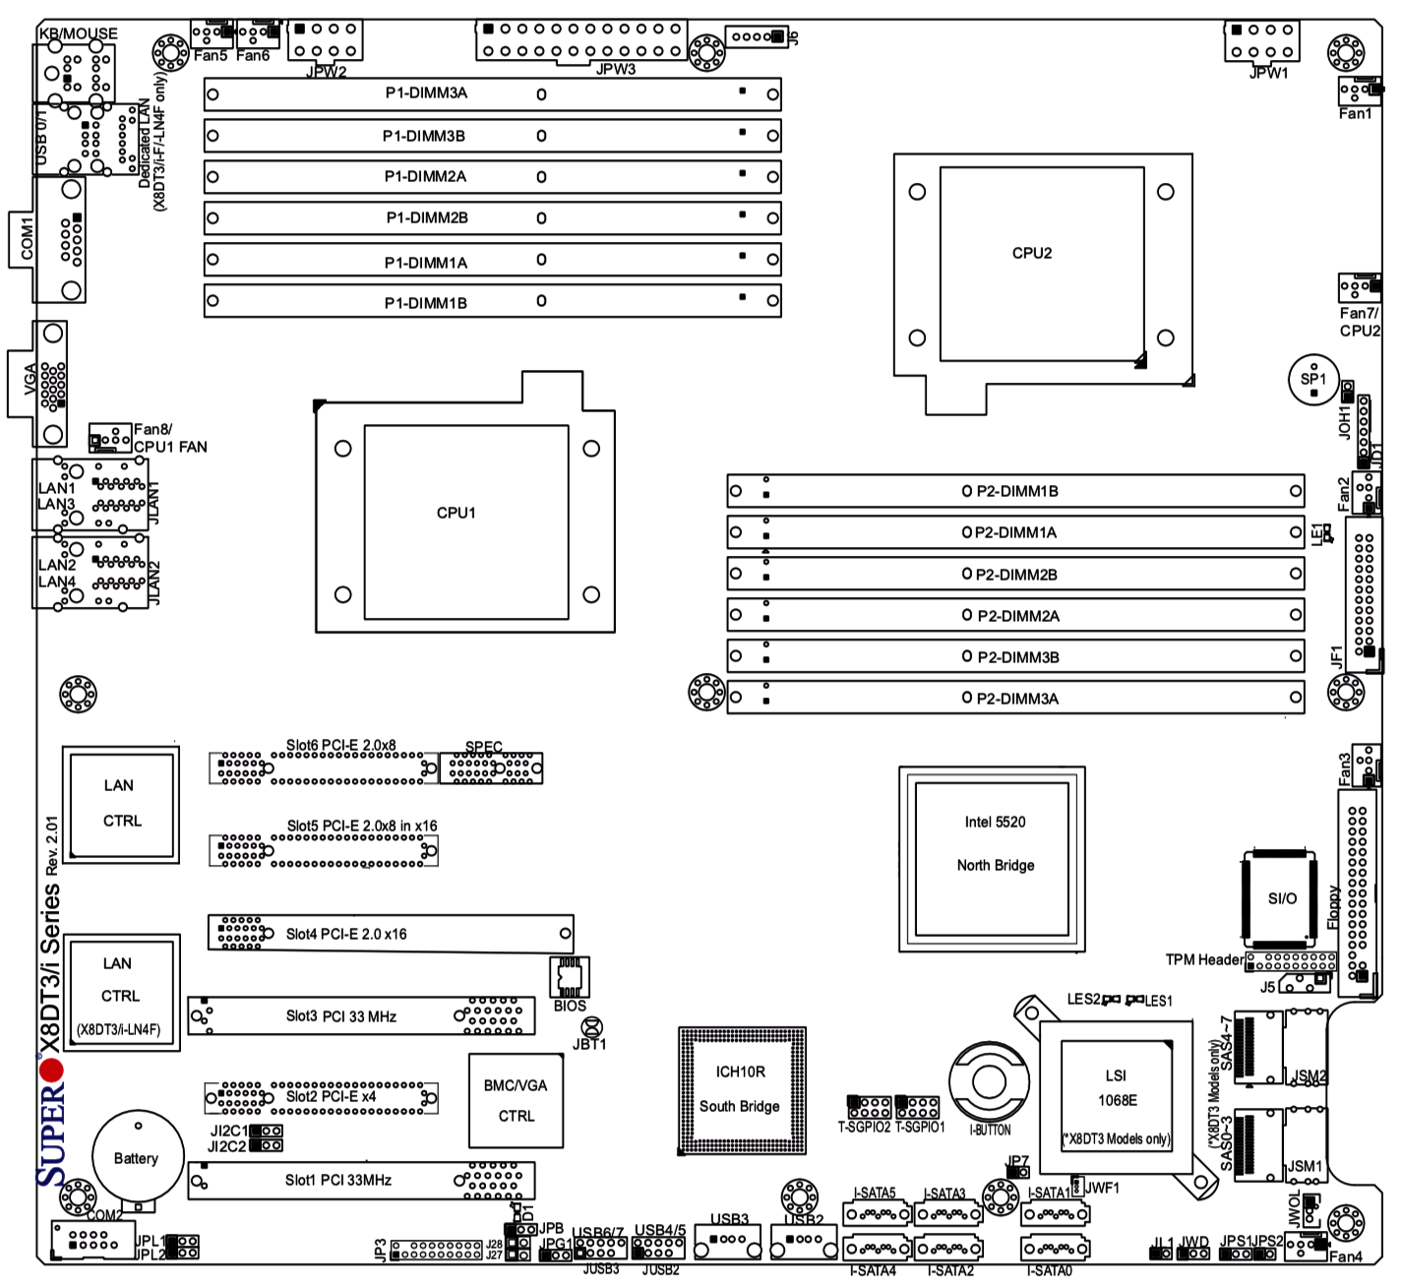
Northbridge & Southbridge
  (serving many functions)
Graphics (VGA)
2 Network controllers
  (with 4 ports)
PCI-Express slots for expansion cards
  Eg., a high-powered graphics card.
Ports for:
  SATA disks
  USB
  RS232 serial port
This physical view shows where to plug in peripheral HW

Slide 7
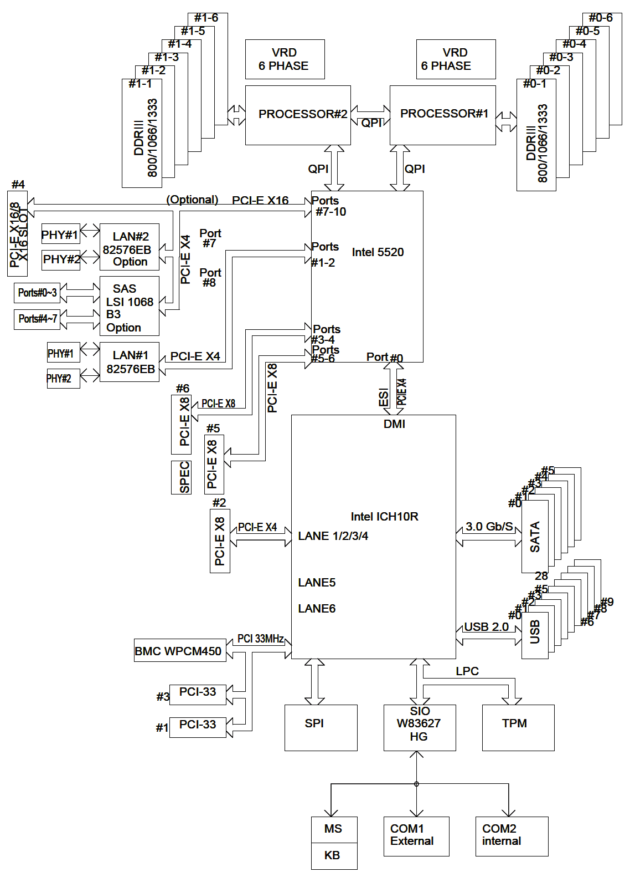
OS’s view of this machine
Northbridge handles high-speed I/O devices on PCI-Express bus
  Two network controllers and (optional) LSI-brand RAID (disk) controller is soldered onto board
  Additional high-speed devices can be installed in PCI-E slots.
Southbridge handles slower/legacy devices. In this case:
  A crappy VGA card (BMC WPCM450)
  USB controller
  SATA disk controllers
  Keyboard, mouse, rs232 serial ports
North-bridge
South-bridge

Slide 8
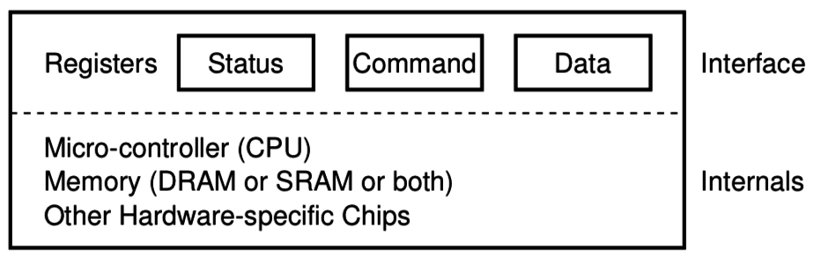
How does OS interact with I/O devices?
A hardware device can be a complex mini-computer within the computer, but we just consider the interface it exposes:
Generally, the OS sees just a few registers to read/write, and
An instruction manual (spec) explaining how to use those registers.

Slide 9
A simple polling I/O device interaction
While (STATUS == BUSY)
; // wait until device is not busy
Write data to DATA register
Write command to COMMAND register
// This starts the device and executes the command
While (STATUS == BUSY)
; // wait until device is done with the request

Slide 10
I/O modes
Programmed I/O (PIO) is when the CPU transfers the data.
  Works well for quick I/O
  No need for a context switch/interrupt
Direct Memory Access (DMA) is an alternative that frees the CPU from this “busy work”
  DMA controller is programmed by the OS to handle the data transfer loop,
  Or the device is given direct access to read/write RAM (a.k.a. bus mastering)
  DMA is very common, even in old PC hardware (1980s)
In both cases I/O can be asynchronous:
  When device is ready, generate an interrupt to let CPU/OS handle it.

Slide 11
How does OS interact with device registers?
x86 provides two options:
in/out instructions read/write data to I/O ports
  Ports are like addresses for I/O registers
  These are privileged instructions
Memory-mapped I/O
  Hardware (northbridge) maps some physical memory addresses to I/O
  Kernel uses simple mov instructions to read/write to devices.
  Must be careful to disable CPU caching of these memory addresses
Functionally, there is not much difference between the two.

Slide 12
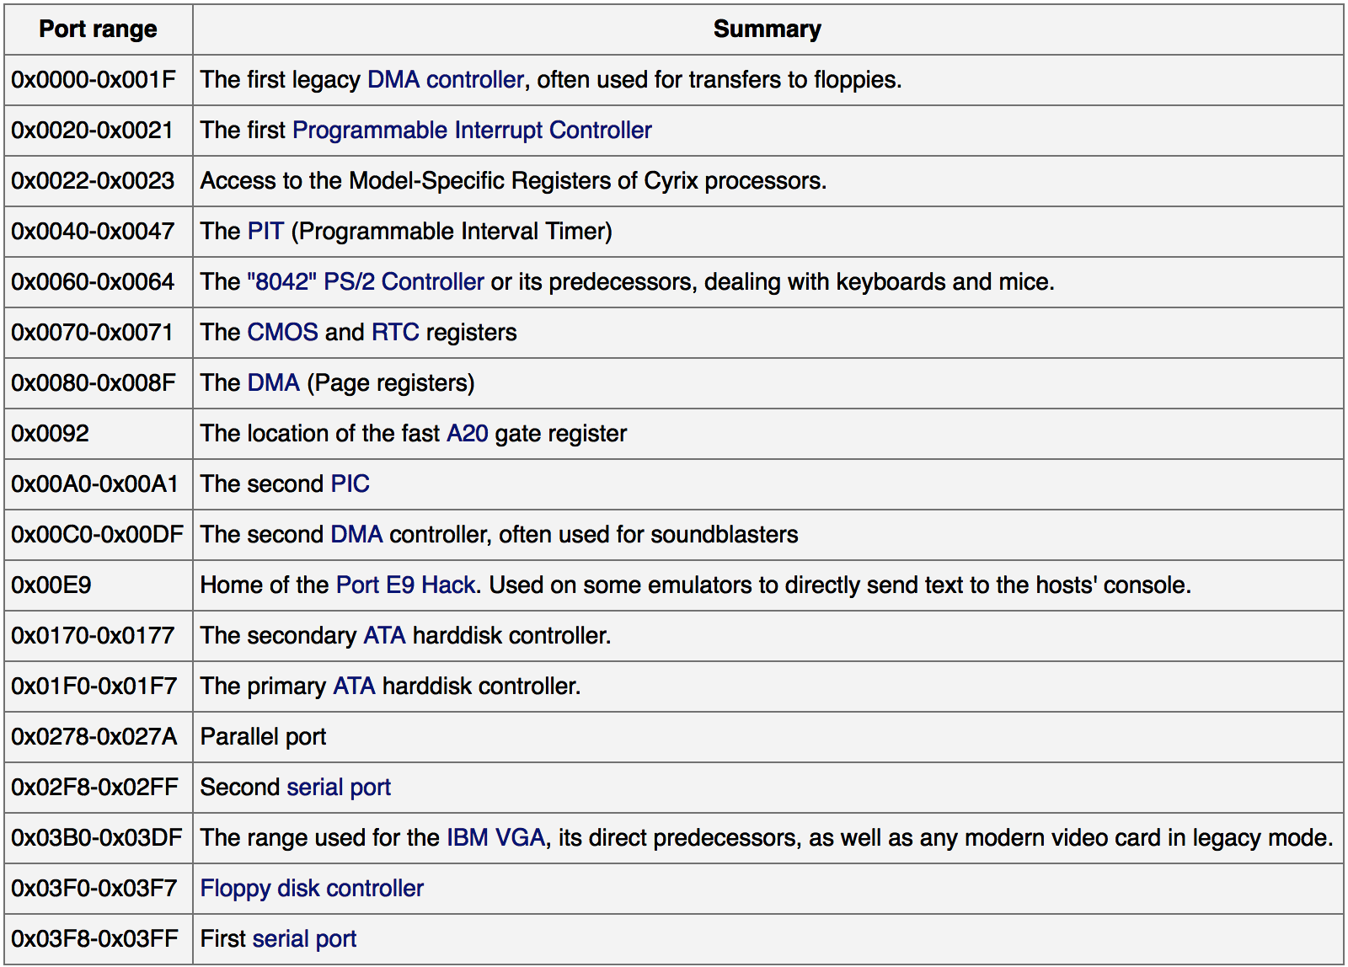
I/O ports
These are just typical values, not standardized.
https://wiki.osdev.org/Can_I_have_a_list_of_IO_Ports

Slide 13
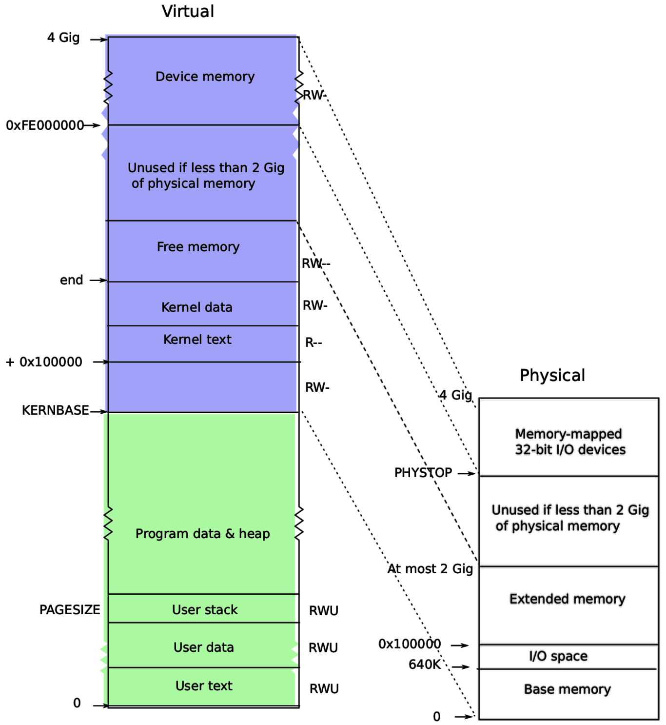
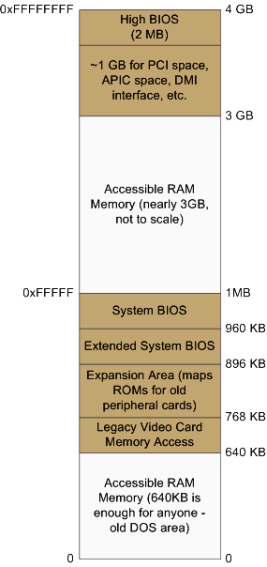
xv6 memory layout
Detailed view of Physical

Slide 14
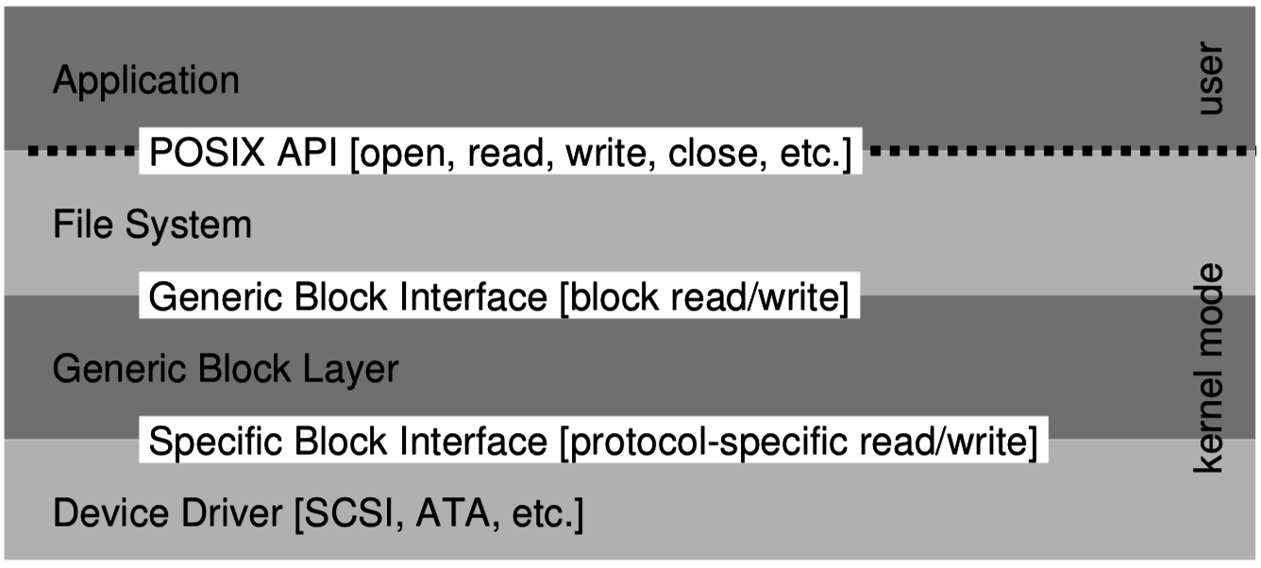
Hardware abstraction
OS creates a layered
view of storage:
Abstractions are used
even within the kernel.
Layered approach allows lower parts to be easily changed.
  Eg., filesystem implementation is independent of the type of disk
Code for managing I/O devices is in kernel device drivers
  70% of Linux code is device drivers, because there are so many different devices, each is different! (15.3M lines of source code!)
  Device drivers are the most common source of kernel bugs
  A given driver may be used by just a small fraction of systems, so it’s not highly exercised or scrutinized.

Slide 15
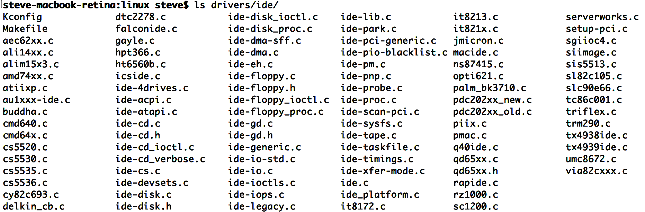
IDE disk drivers in Linux
92 different drivers, just for IDE disk controllers
  Each driver supports a family of related controllers
39k lines of code in total. ~426 lines each, on average
  There is another 222k lines for SCSI disk controllers! (119 drivers)

Slide 16
Abstraction of a disk
Each of the 92 different disk controller drivers on Linux provides the same simple abstraction to upper layers: a block device.
The kernel adds a block buffering/caching layer (covered later)
User code (if running with root permissions) and kernel filesystem code can access each disk as a virtual device file:
  /dev/sda the first disk
  /dev/sdb the second disk
  /dev/sdc and so on …
Files and disks are both just arrays of bytes (although files are byte addressable and disks are block addressable -- 512 byte chunks).

Slide 17
Abstraction of a sound card
Unix systems abstract many devices as virtual files.
OSS – the Open Sound System was an early Linux sound interface that uses the virtual file /dev/dsp.
To play some white noise through the speaker:
cat /dev/random > /dev/dsp
To read samples from the microphone to file a.a:
cat /dev/dsp > a.a
Thus, programs can be written to use audio without any concern for the particular sound card’s details, if the kernel has an OSS driver.

Slide 18
Kernel’s interfaces for IO
Kernels provide several different interfaces for user processes to do IO:
System calls
  eg., network connections (sockets) have dedicated system calls on POSIX.
Libraries (that use system calls)
  SDL (Standard DirectMedia Library)
  glibc (printf, file open/write/read, etc.)
Virtual file system
  eg., disks, sound cards, serial ports
  Would use syscalls or glibc to access the virtual files.

Slide 19
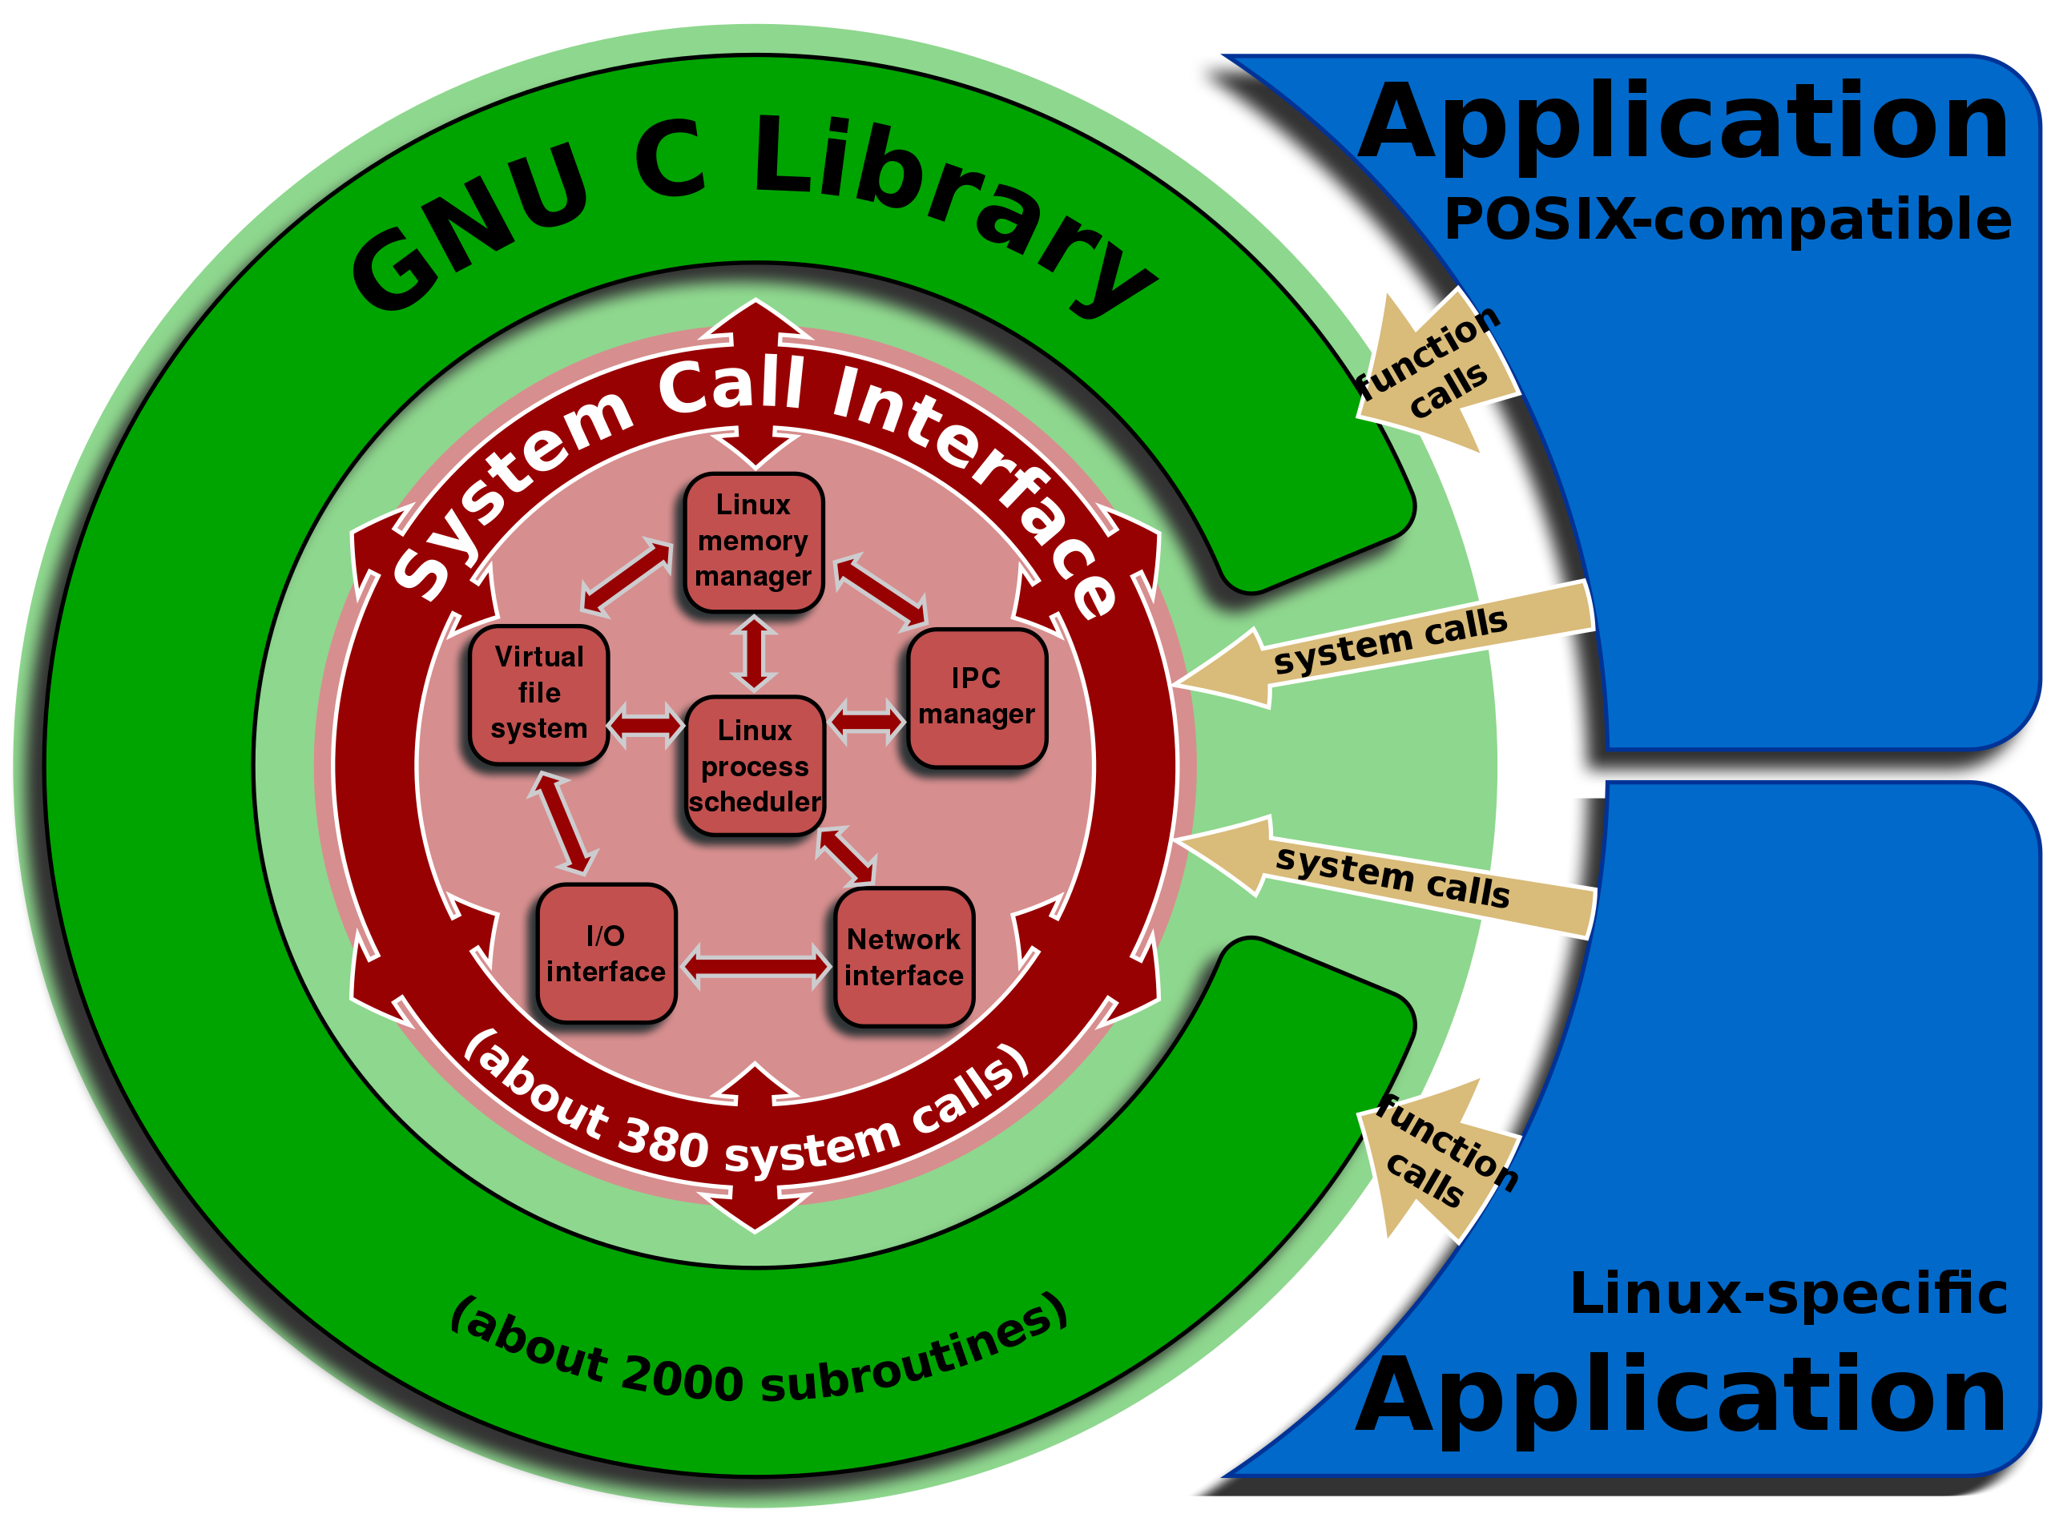

Slide 20
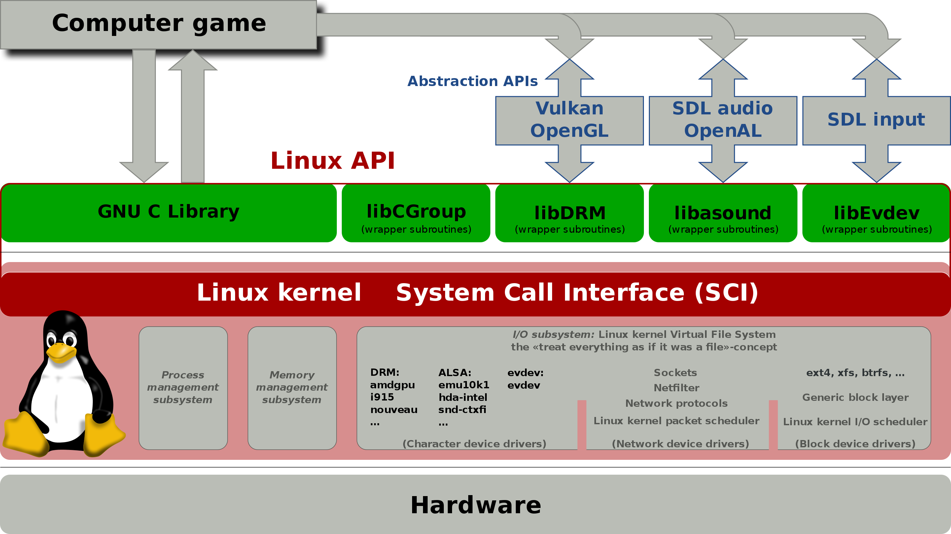
https://en.wikipedia.org/wiki/Linux_kernel_interfaces

Slide 21
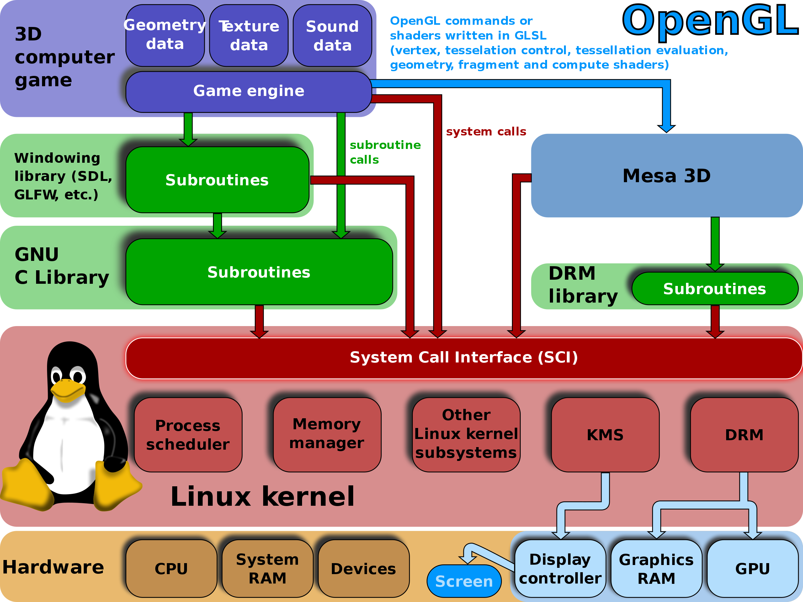

Slide 22
Device driver example
IDE disk controller (for hard disk or CD-rom drive)

Slide 23
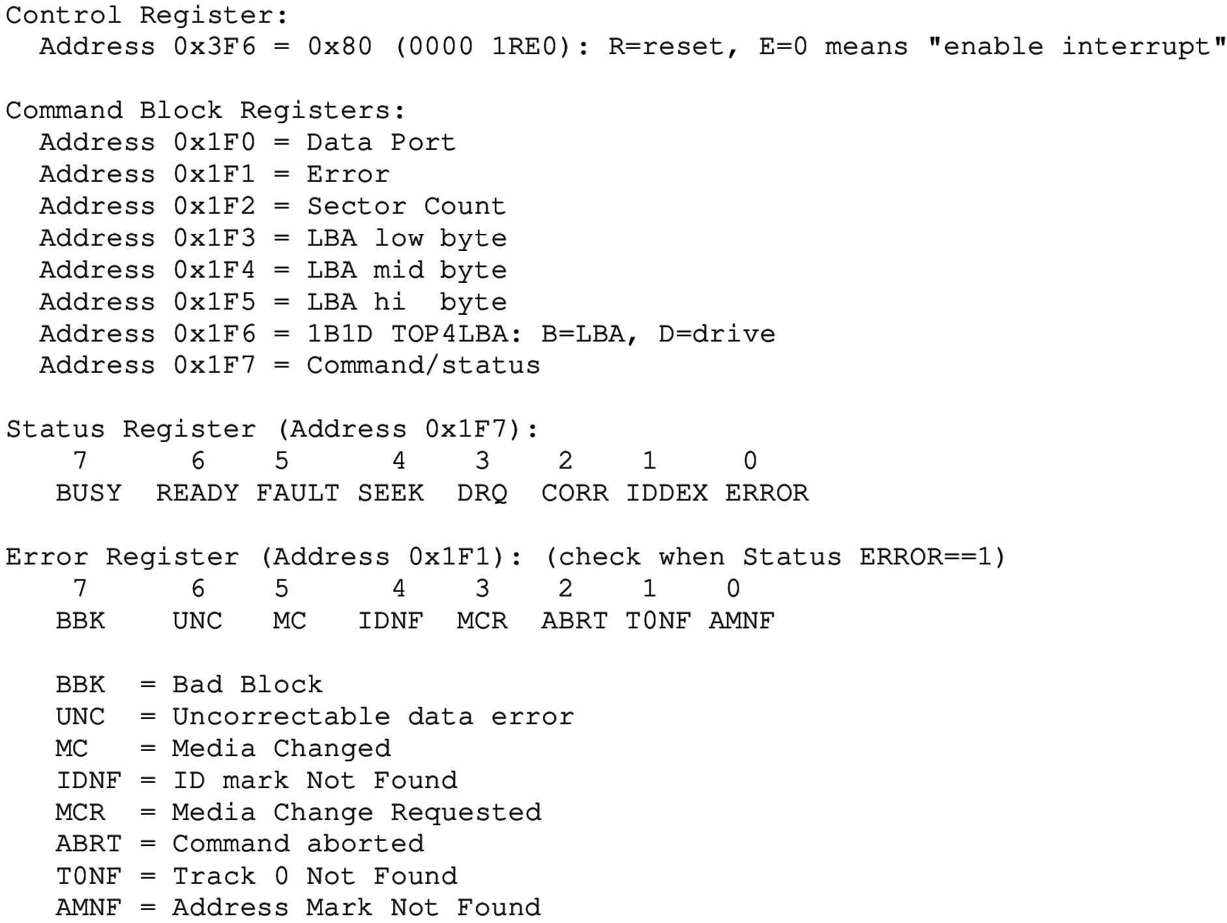
Example IDE registers for Programmed I/O
9 one-byte registers for interacting with device
Use x86 in/out instructions
Sometimes individual bits in registers are used.
0x3F6 can enable interrupts
0x1F0 is a data buffer
0x1F7 is where you write command.
Grab a lock before accessing device!

Slide 24
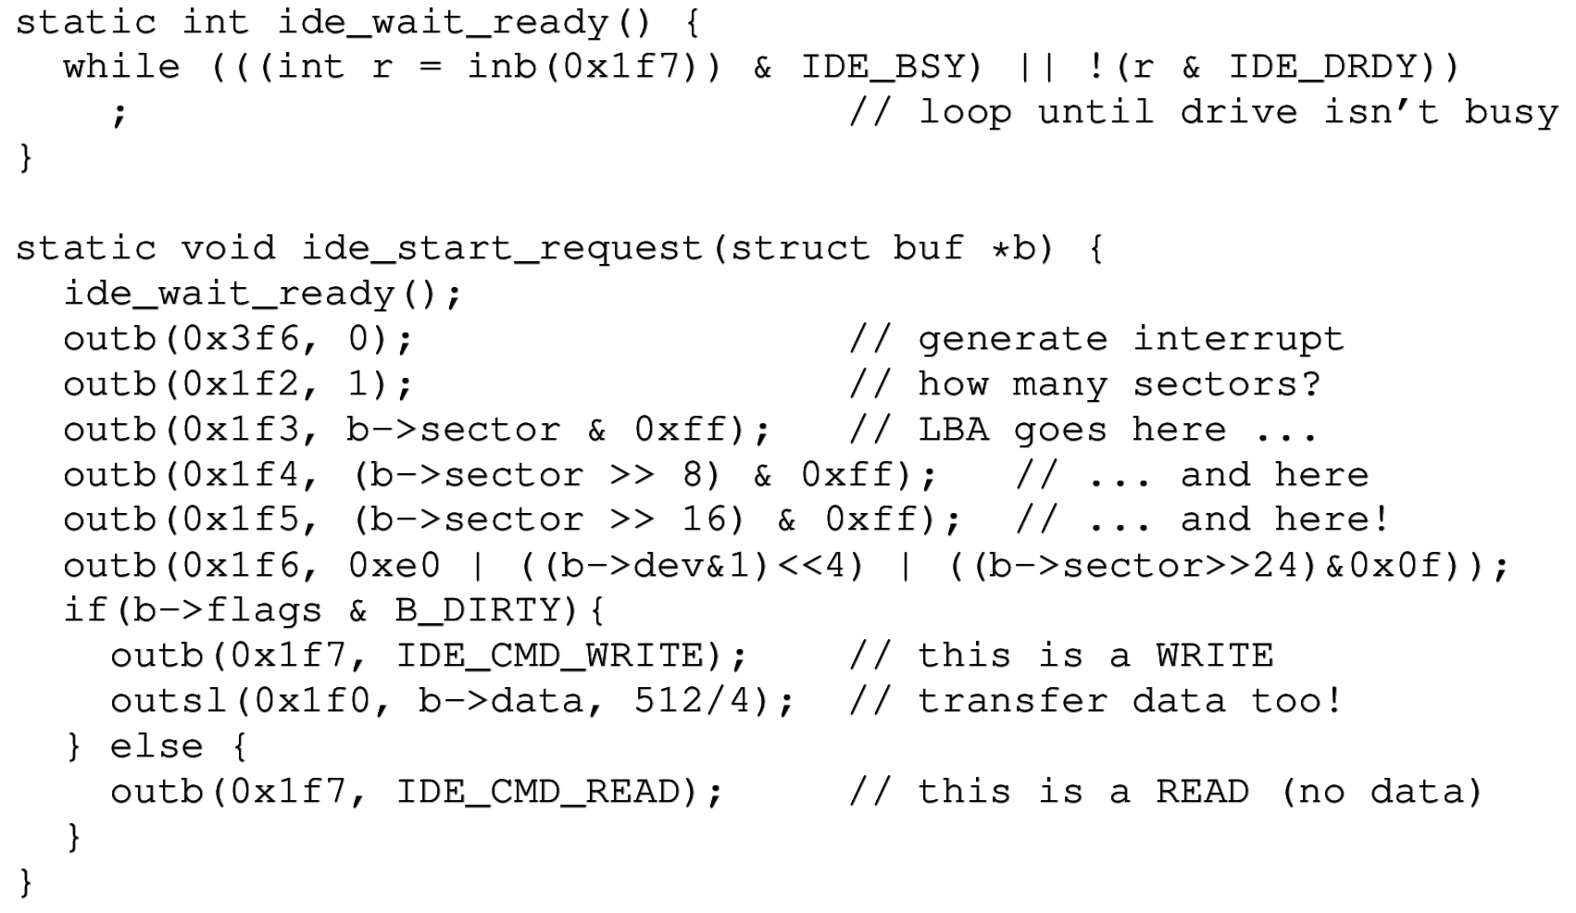
Using an IDE disk’s I/O ports
0x1f7 = command/status
0x3f6 = control register
0x1f3-0x1f6 = disk address
0x1f0 = data
enable

Slide 25
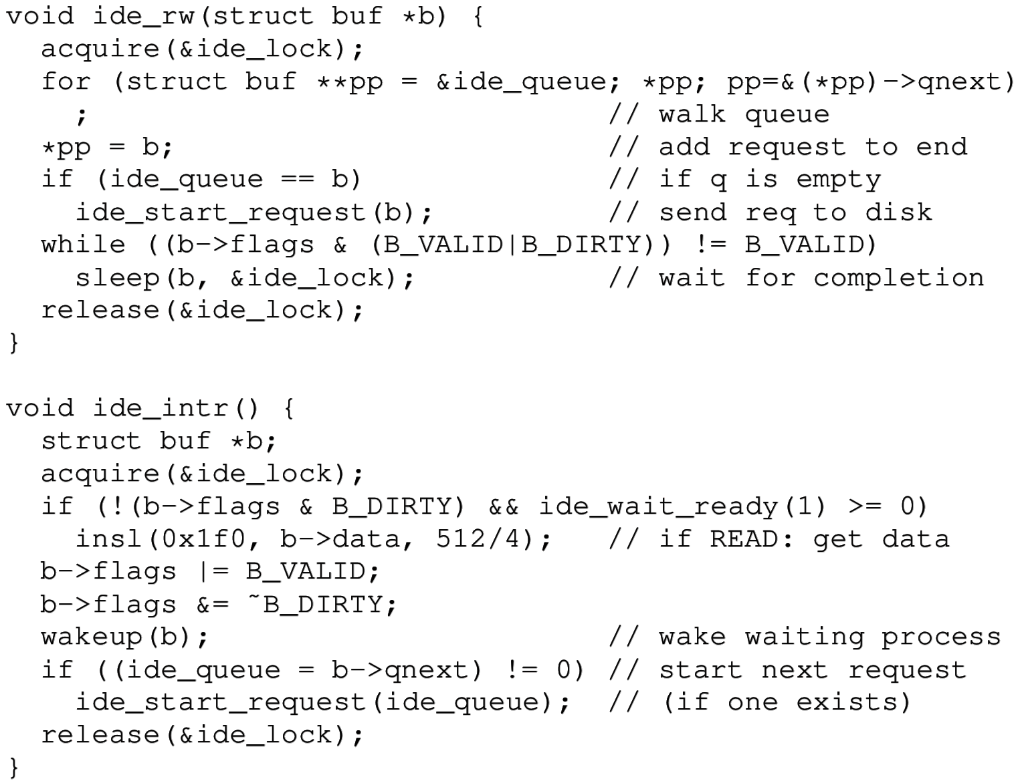
Simplified xv6 IDE driver (continued)
Queue new requests
Interrupt handler

Slide 26

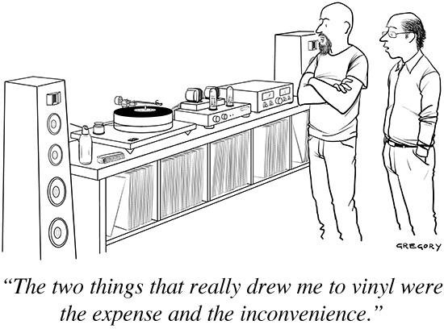
Break time

Slide 27
How magnetic disks work
All hard disk drives (magnetic or SSD) present a simple abstraction to the OS: an array of 512-byte sectors.
  Read or write a 512-byte sector
  Number of sectors determines the disk capacity.
Solid state disks (SSDs) are common on laptops/smartphones
  Allow quick random access, like RAM.
  But these have smaller capacity
Magnetic disks, however, have more complex physical properties…

Slide 28
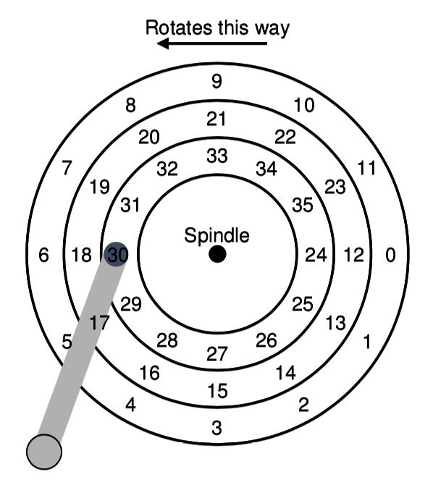
Magnetic disk geometry
Sectors are arranged on circular tracks
A read/write head is attached to an arm
  Head senses/magnetizes the disk’s surface
  Data can only be read/written under the head
  Arm angle can change to reach different tracks (called seeking).
A motor rotates the disk at constant speed
  (4200-15k RPM)
  Rotational delay is incurred as we wait for a given sector to rotate under the head.

Slide 29
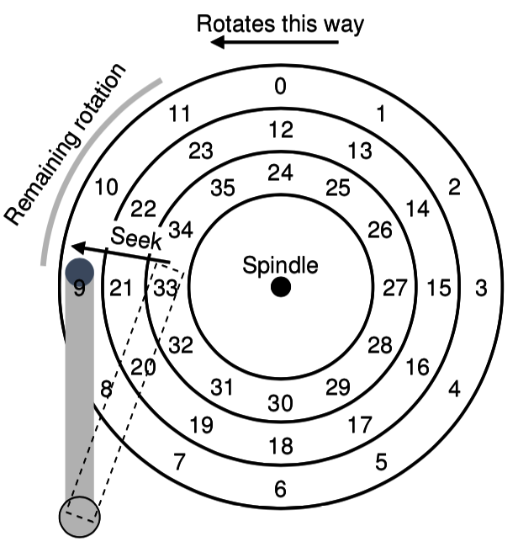
Reading sector 11 requires rotation and seek

Slide 30
Average delays for random access
On average half a rotation will be required
  10k RPM → full rotation requires 6ms
  Average rotational latency ~3ms
On average one third of a full seek is required to reach a random track
    It would be one half if we always started at the edge, but we are often near the middle, which is close to many tracks.
  Avg seek time ~= 6ms
These are big delays for a computer!
  Seek time and rotational latencies have not improved much in the past 20 years.

Slide 31
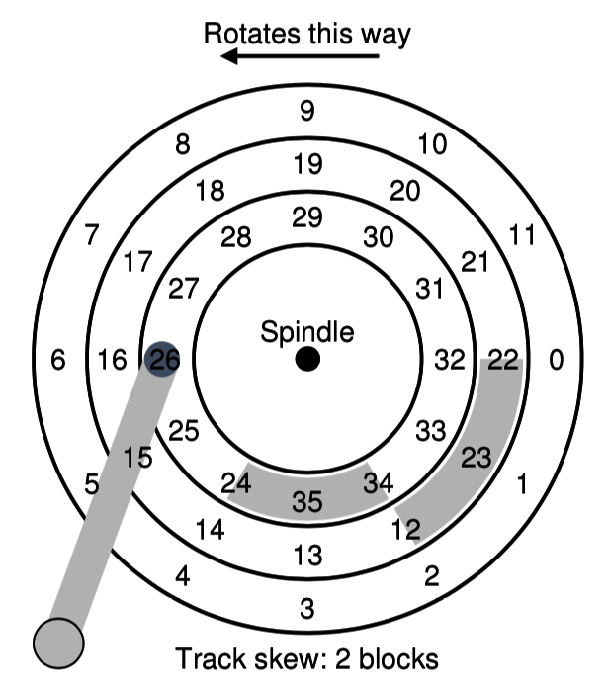
Sequential disk performance
Reads of sequential sectors are fast because little rotation and seek are required.
Seek time can be minimized by choosing a track skew equal to the single-track seek time.
Disk’s maximum sustained throughput is often very high:
  ~150 MB/sec = 3.4 microseconds/sector
  This is ~1000 times faster than random access delays due to seek/rotation.

Slide 32
Scheduling disk requests is important
The ordering of disk requests drastically affects performance.
There is actually some benefit to delaying requests slightly in order to batch multiple requests and amortize the seek/rotation delays.
  Ideal performance ~= 150 MB/sec
  Worst case performance ~= 0.15 MB/sec
OS does not really know the underlying geometry of the disk: doesn’t know current head location nor the precise position of sectors.
  Past OSes were very careful about disk request scheduling
  Current practice is to just send many requests to the disk and let the disk schedule them. Disks nowadays are smarter and have large buffers.
However, OS can at least assume that nearby sector numbers are nearby on the disk, and thus faster to access sequentially.

Slide 33
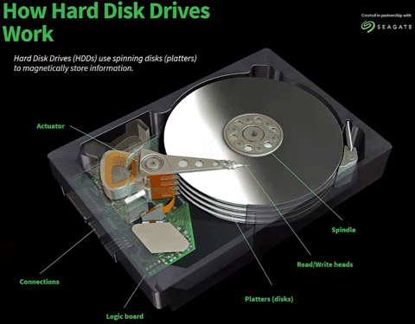
Real disks
Disks actually have several double-sided platters, but there is a single arm that holds all the read/write heads.
  Multiple disk surfaces provide parallelism
The logic board has a RAM buffer to cache ~128MB of data temporarily.
https://animagraffs.com/hard-disk-drive/

Slide 34
Recap– I/O and Disks
OS interacts with devices by reading/writing device registers
  Each register has an I/O port address for in/out instructions, or
  memory-mapped I/O uses special physical memory addresses (with mov)
Storage is complex, so
kernel functionality is divided
into at least three layers:
Random access to a magnetic disk is 1000x slower than sequential
  Read head must seek and disk must rotate to reach a new sector

