Slide 1

EECS-343 Operating Systems
Lecture 13:
Synchronization Bugs
Steve Tarzia
Spring 2019

Slide 2
Last Lecture – Concurrent Data Structures
Simplest strategy is to use one big lock, but this limits concurrency
  It’s thread-safe, but not really concurrent
Concurrent queue used two locks (head & tail)
Concurrent hash table used one lock per bucket
Condition Variables are used to order threads, using signal() & wait().
  Wait puts a thread to sleep, signal wakes a waiting thread.
  Pthreads allows spurious wakeups, so we still need to check a status variable.
  broadcast() wakes all waiting threads
Producer/consumer queue was implemented using two condition variables.

Slide 3

Semaphores
A generalization of condition variables and locks
  But they’re more difficult to understand and use
  More general is not always better
Semaphore has an integer value
  often indicates the number of resources available
Two functions (with many alternative names!):
up/V/signal/post:
  Increase the value. If there is a waiting thread, wake one.
down/P/wait:
  Decrease the value. Wait if the value is negative.
Counting semaphore is very useful in cases when a finite number of threads are allowed to use a resource (eg., bounded buffer)

Slide 4
Semaphores vs Condition Variables
Semaphores
Condition Variables
Up/Post: increase value and wake one waiting thread
Down/Wait: decrease value and wait if it’s negative
Signal: wake one waiting thread
Wait: wait
Compared to CVs, Semaphores add an integer value that controls when waiting is necessary
It counts the quantity of a shared resource currently available
Up makes a resource available, down reserves a resource
Negative value -x means that x threads are waiting for the resource

Slide 5
Implementing a lock with a semaphore
Choose an appropriate initial value for the semaphore
To implement a Lock:
  Initialize to 1 (access to the critical section is the one shared resource)
  Lock → Down: (decreases the value and waits if negative)
    Will decrease the value to 0 if it lock is not already taken
    Will decrease the value to -1 and wait if the lock is taken (value was 0)
  Unlock → Up: (increases the value and wakes one waiting thread)
    If value was 0, then no thread was waiting, and no thread is woken
    If value was -1, then one thread was waiting, and it is woken
    If value was -x, then x threads are waiting, one is woken, value becomes x-1.
  If value is already 1, Up should not be called. (Unlock before lock?!)

Slide 6
Reader-writer Lock
Some resources don’t need strict mutual exclusion, especially if they have many read-only accesses. (eg., a linked list)
Any number of readers can be active simultaneously, but
Writes must be mutually exclusive, and cannot happen during read
API:
  acquire_read_lock(), release_read_lock()
  acquire_write_lock(), release_write_lock()

Slide 7
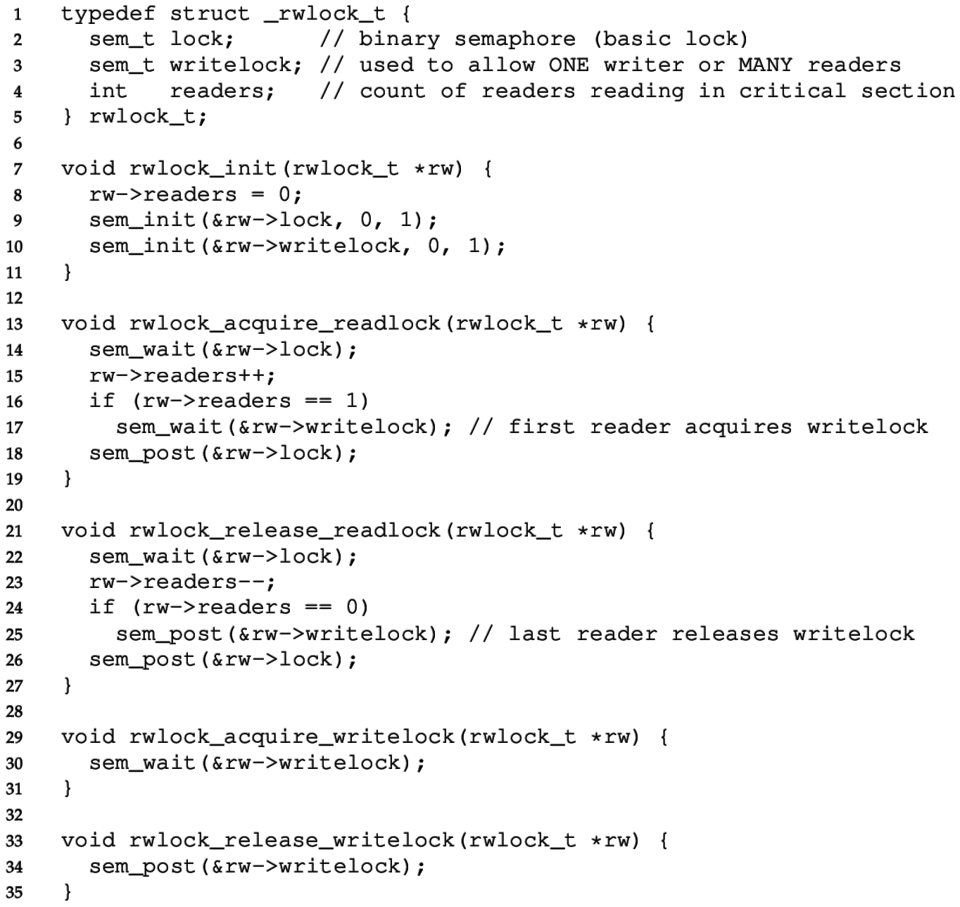
Reader-writer Lock
Writelock must be held during read to block writes.
Number of active readers is counted.
First/last reader handles acquiring/releasing writelock.

Slide 8
Common synchronization bugs
Atomicity violation
  Critical section is violated (due to missing lock).
Order violation
  Something happens sooner (or later) than we expect.
Deadlock
  Two threads wait indefinitely for each other.
Livelock (not common in practice)
  Two threads repeatedly block each other from proceeding and retry.

Slide 9
Atomicity violation
It’s relatively easy to find and protect critical sections,
But often we forget to add locks around other uses of the shared data.
Obvious critical section is here:
  Two threads should not enter this at once
But, we also have to make sure that file
is not modified elsewhere.
Even if this one-line close is atomic we
have to make sure it doesn’t run during
the above critical section.
lock(lck);
if (file == NULL) {
file = open("~/myfile.txt");
}
write(file, "hello file");
unlock(lck);
…
close(file); // whoops!!

Slide 10
Order violation
Code often requires a certain ordering of operations, especially:
  Objects must be initialized before they’re used
  Objects cannot be freed while they are still in use
Parent
file = open("file.dat");
thread_create(child_fcn);
// do some work
…
close(file);
Child Thread
child_fcn() {
write(file, "hello");
}
Close must happen after write, but code does not enforce this ordering.

Slide 11
Why is this difficult?
It seems like we can just add lots of locks and CVs to be safe, right?
  Wrong! Too many locks can cause deadlock – indefinite waiting.
How about just one big lock?
  (+) Cannot deadlock with one lock.
  (–) However, this would limit concurrency
    If every task requires the same lock, then unrelated tasks cannot proceed in parallel.
Concurrent code is always difficult to write ☹
  although somewhat easier with some higher-level languages

Slide 12
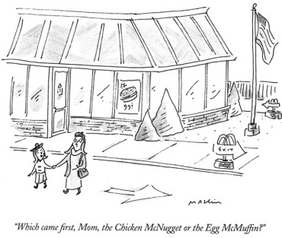
Intermission

Slide 13
Locking granularity
Coarse grained lock:
  Use one (or a few) locks to protect all (or large chunks of) shared state
  Linux kernel < version 2.6.39 used one “Big Kernel Lock”
  Essentially only one thread (CPU core) could run kernel code
  It’s simple but there is much contention for this lock, & concurrency is limited
Fine grained locks:
  Use many locks, each protecting small chunks of related shared state
  Leads to more concurrency and better performance
  However, there is greater risk of deadlock

Slide 14
Deadlock
A concurrency bug arising when:
  Two threads are each waiting for the other to release a resource.
  While waiting, the threads cannot possibly release the resource already held.
  So the two threads wait forever.
Can arise when multiple shared resources are used.
  For example, acquiring two or more locks.

Slide 15
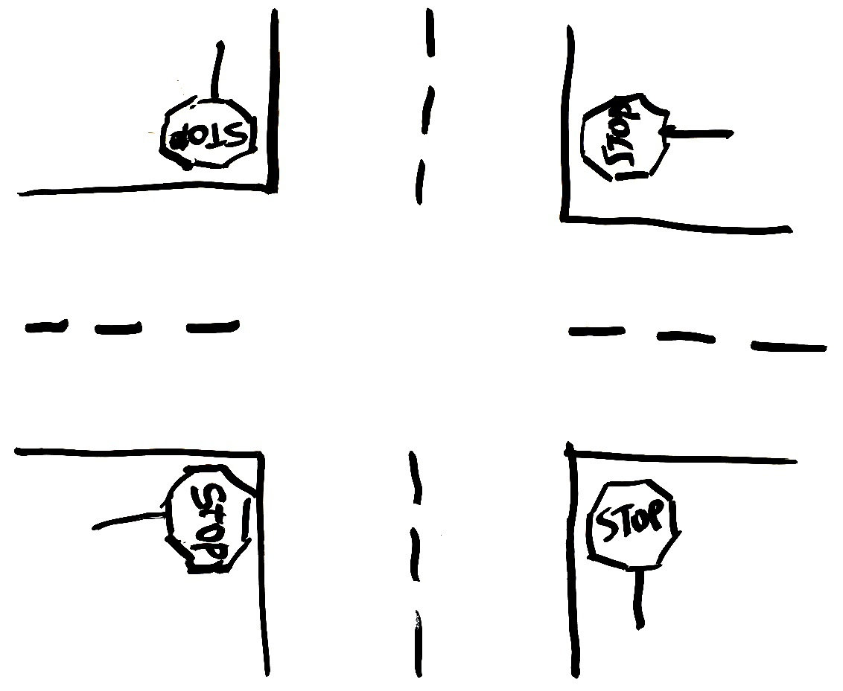

Simple example: four-way stop
Traffic rules state that you must yield to the car on your right if you reach the intersection simultaneously.
This rule usually works well.
But there’s a problem if
four cars arrive simultaneously.
Circular waiting!

Slide 16
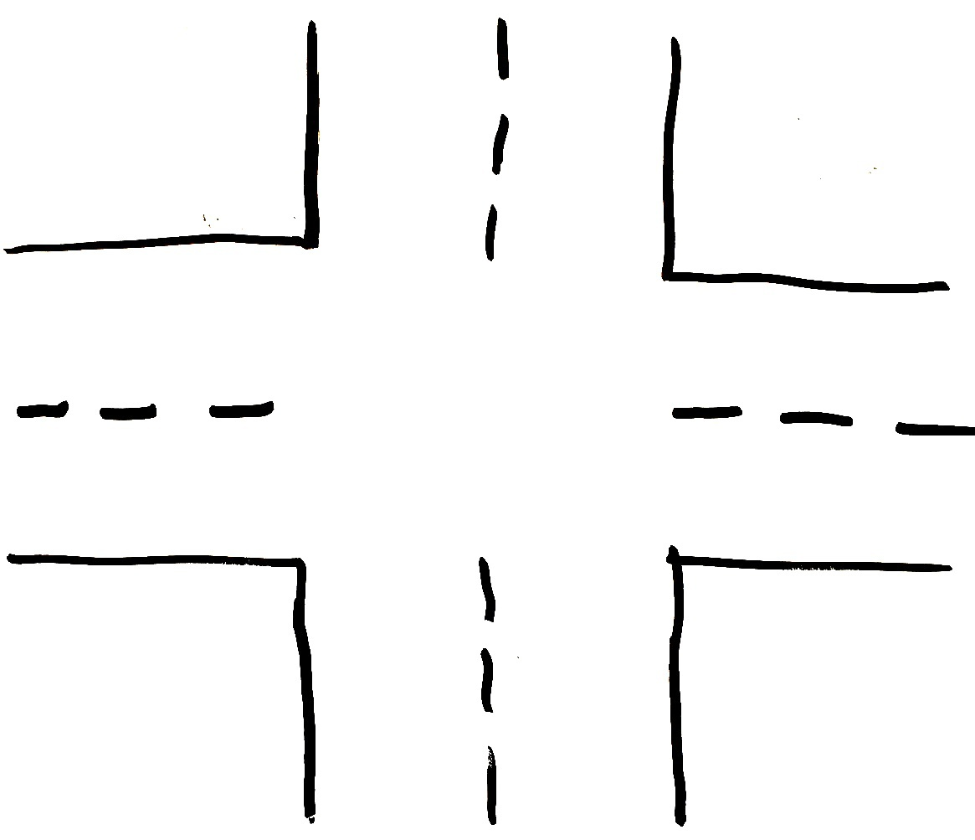
Another 4 way intersection, without stop signs
There is a problem here if drivers are unwilling to reverse

Slide 17
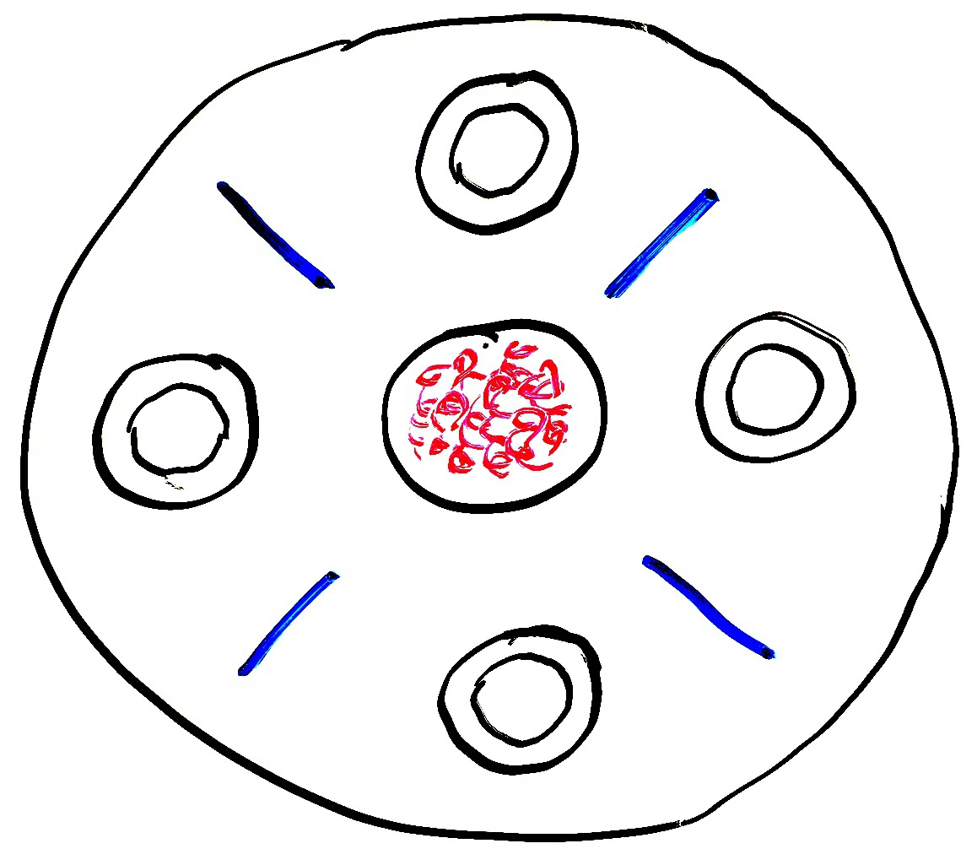
Dining philosophers
A theoretical example of deadlock
There are N philosophers sitting in a circle and N chopsticks
  left and right of each philosopher
Philosophers repeatedly run this loop:
  Think for some time
  Grab chopstick to left
  Grab chopstick to right
  Eat
  Replace chopsticks
If they all grab the left chopstick simultaneously (step 2),
they will deadlock and starve!
A solution: one philosopher must grab right before left

Slide 18
A more practical deadlock example
Thread 1
  lock(L1);
  lock(L2);
  // do work
  …
  unlock(L2);
  unlock(L1);
Thread 2
  lock(L2);
  lock(L1);
  // do work
  …
  unlock(L1);
  unlock(L2);
If we are unlucky and both of the first lines execute before the second lines, we will deadlock.
T1 holds L2 while waiting for L1… T2 holds L1 while waiting for L2

Slide 19
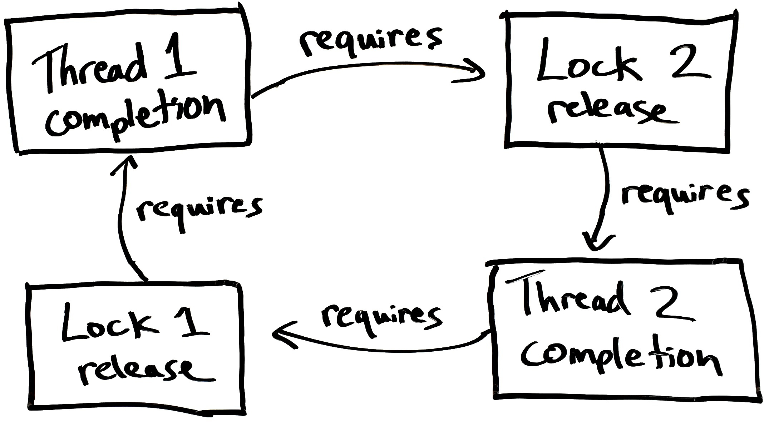
Deadlocks involve circular dependencies

Slide 20
Deadlock requires four conditions
Mutual exclusion
  Threads cannot access a critical section simultaneously
  In other words, we’re using locks so there is the potential for waiting.
Hold-and-wait
  Threads do not release locks while waiting for additional locks
No preemption
  Locks are always held until released by the thread. We cannot cancel a lock.
Circular wait
  Thread is waiting on a thread that is waiting on the original thread
  This can involve just two threads or a chain of many threads.
Avoid any one of these to avoid deadlock.

Slide 21
4. Avoiding Circular Wait
This is the most practical way to avoid deadlock.
The simplest solution is to always acquire locks in the same order.
  If you hold lock L1 and are waiting for lock L2
  The holder of L2 cannot be waiting on you,
  because they would have already acquired L1 before acquiring L2.
However, in practice it can be difficult to know when locks will be acquired because they can be buried in subroutines.

Slide 22
Ordered locking for dining philosophers
The chopsticks are shared resources, like locks
If we require the lower-numbered chopstick to be grabbed first, this eliminates circular waiting.
Philosophers A, B, C grab left then right.
However philosopher D will grab
right then left.
If everyone tries to start at once, A & D race to grab chopstick 0 first, and the winner eats first.
While one is waiting to grab its first chopstick a neighbor will be able to grab two chopsticks.
3
2
C
B
D
A
0
1

Slide 23
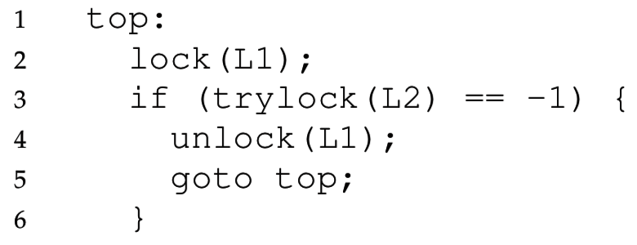
2. Trylock to avoid hold and wait
We can avoid deadlock if we release the first lock after noticing that the second lock is unavailable.
Trylock tries to acquire a lock, but returns a failure code instead of waiting if the lock is taken:
This code cannot deadlock,
even if another thread does
the same with L2 first, then L1.
However it can livelock – two threads can get stuck in this loop forever

Slide 24
Livelock vs Deadlock
Livelock is a condition where
two threads repeatedly take action,
but still don’t make progress.
Differs from deadlock because deadlock is always permanent.
Livelock involves retries that may lead to progress,
but there is no guarantee of progress.
  A malicious scheduler can always keep the livelock stuck
Any randomness in the timing of retries will fix livelock.
In practice, livelock is a much less serious concern than deadlock.

Slide 25
Other deadlock avoidance strategies
Wait-free synchronization
  Instead of using locks, build data structures that directly use atomic primitives like compare-and-swap or load-linked & store-conditional.
  This is difficult!
Don’t simultaneuously schedule threads that use the same sets of locks.
  Like the “one big lock” strategy, this reduces concurrency and performance.
Detect and kill:
  Periodically check which threads are holding locks and waiting for locks.
  If there is a circular wait, then kill the process.
  It’s not making progress anyway!
  Yes, the crash can be harmful, but it’s inevitable because we’re stuck.
  At least it frees up resources for other processes and makes the user aware of the deadlock bug.

Slide 26
Helgrind tool
Helgrind (part of the Valgrind tool) detects many common errors when using the POSIX pthreads library in C & C++, such as:
  Race conditions (missing locks)
  Lock ordering problems (leading to deadlock)
  Double-unlocking
  Freeing a locked lock
  … and much, much more
  http://valgrind.org/docs/manual/hg-manual.html

Slide 27
Recap – Synchronization Bugs
Semaphore (up/down) is an all-purpose synchronization primitive
Reader-writer lock allows multiple readers, but one writer.
Adding too many locks can lead to deadlock, which requires:
  Mutual exclusion (avoid locks to avoid deadlock)
  Hold and wait (use trylock to release first lock to before deadlocking)
  No preemption
  Circular wait (always acquire locks in the same order to avoid deadlock)
Dining philosophers was an example of deadlock
  Circular wait can be avoided by making one philosopher grab right-hand side instead of left first.

