Slide 1

EECS-343 Operating Systems
Lecture 12:
Concurrent Data Structures
Steve Tarzia
Spring 2019
  Some slides based on those by Nima Honarmand

Slide 2
Announcements
HW3 was posted and is due next Wednesday
Project 3 is due on Monday

Slide 3
Last Lecture – Implementing Locks
Hardware support for atomicity:
  Disable interrupts
  Test and set
  Compare and swap
  Fetch and add
  Load-linked & Store-conditional
Various lock implementations
  Spinlock
  Ticket lock
  Yielding lock
  Queuing locks
    Park/unpark on Solaris
    Futex on Linux
Sophisticated locks can be more fair and avoid starvation, but they can add unnecessary context-switch overhead on multiprocessors.
Two-phase locks try to combine the best of both approaches.
OS scheduler and concurrent user code must coordinate for best performance.

Slide 4
Thread-safe data structures
Multi-threaded programs can concurrently access shared memory.
We say that a data structure is thread safe if it can be concurrently accessed by multiple threads.
These are also called concurrent data structures.
Simple implementations are usually not thread safe.
Usually we use one or more lock to protect critical sections in the data structure read/update functions.
The simplest way to achieve thread safety is to use one big lock.
  The big lock prevents any concurrent access to the data structure.
  However, this is not very scalable – it eliminates concurrency!

Slide 5
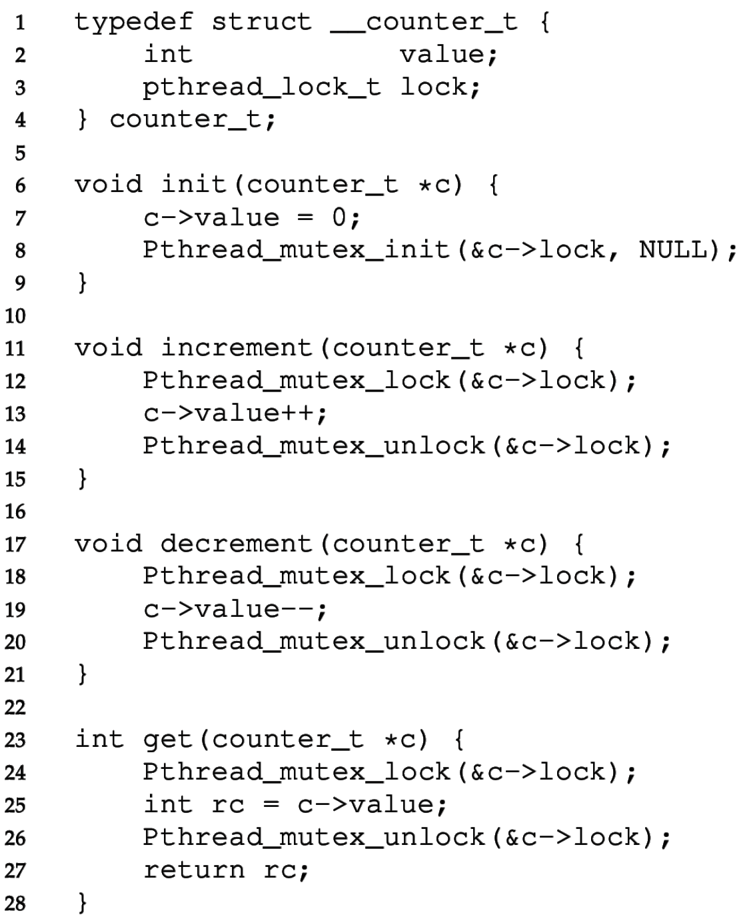


Concurrent counter
Simplest approach: use one lock to protect increment and decrement.
Lock in get() is not strictly necessary.
  Reading an out-of-date value is still consistent.
Problem:
  There is a lot of locking overhead for just a tiny bit of work (++ or --)
  2.4 seconds to run 40,000,000 increments divided across 4 threads
  Runtime is just 0.4 seconds without locks (~6x slowdown)
  Atomic CPU ops (eg., xchg) are slow.

Slide 6
How to reduce the locking overhead?
Reduce the lock frequency.
Give each thread a chunk of work to do between each synchronization
Give each thread a local counter.
  Periodically flush local counters to the global counter.
  We’ll make large increments to the global counter, not just single increments.
  There is no contention on the local counter, does not require a lock.
Sloppy counter is a slightly-out-of-date global counter

Slide 7
Performance experiment: count to 40 million
(source code is posted to Canvas: “sample code/counters.tar.gz”)
Single-threaded: 0.09 seconds
  fast because there is no thread creation and no locking.
Multi-threaded (4 threads):
Buggy multi-threaded (no locks): 0.4 seconds
  (only counted to ~11M)
One big lock: 2.4 seconds
Sloppy counter with local locks: 0.49 seconds
  Increment global counter every time local counter reaches 1000.
Sloppy counter with just one global lock: 0.05 seconds
  Here we didn’t bother to lock the local counter since it’s not shared.

Slide 8
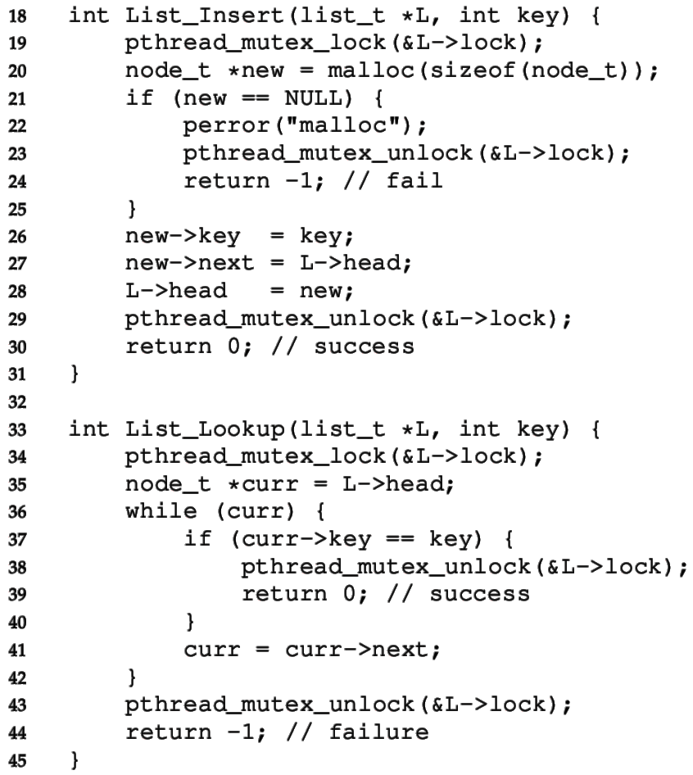
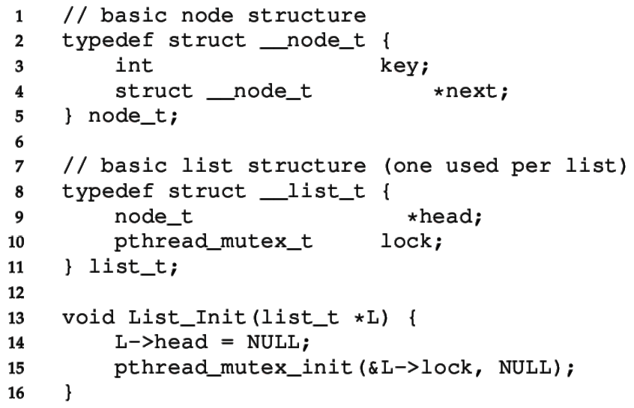
Basic Concurrent Linked List
Just use one “big” lock
Don’t forget to unlock when returning early.
Simplicity means it’s easy to verify

Slide 9
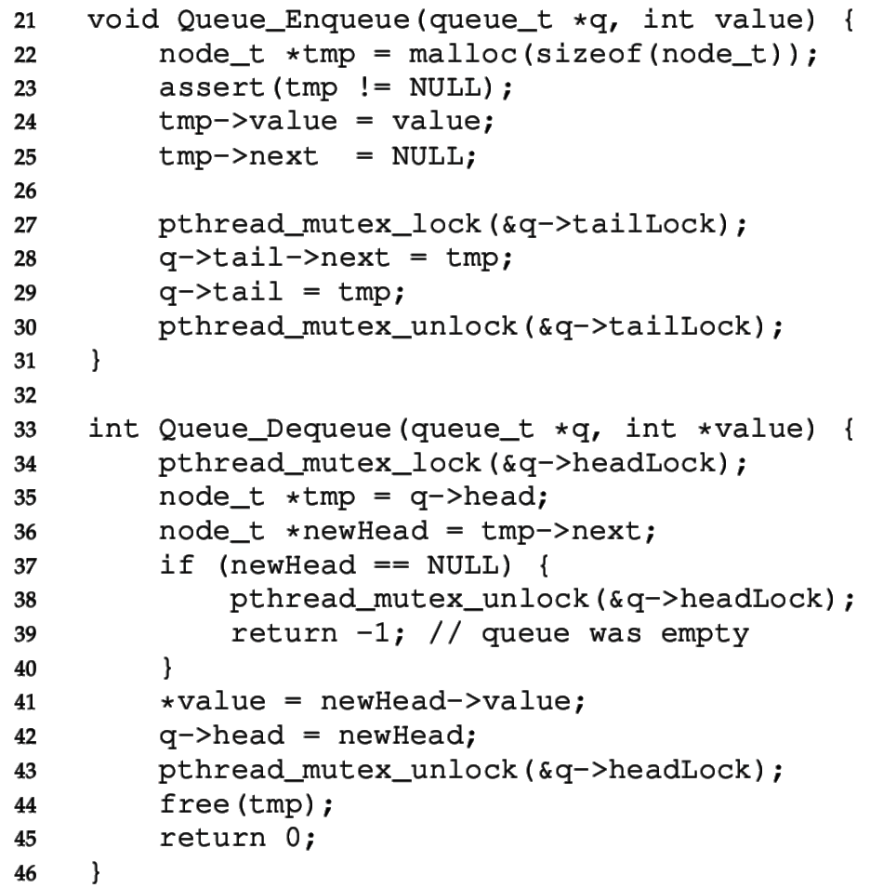
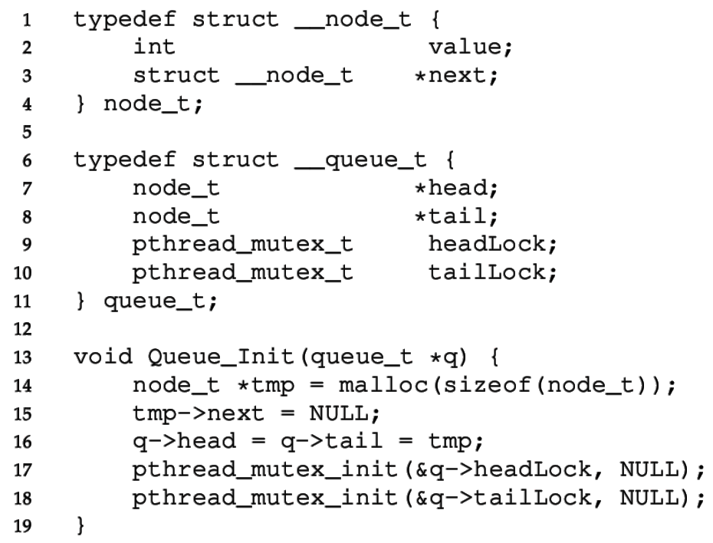
Concurrent Queue
Separate head & tail locks
Allows concurrent add & remove
  Up to 2 threads can access without waiting

Slide 10
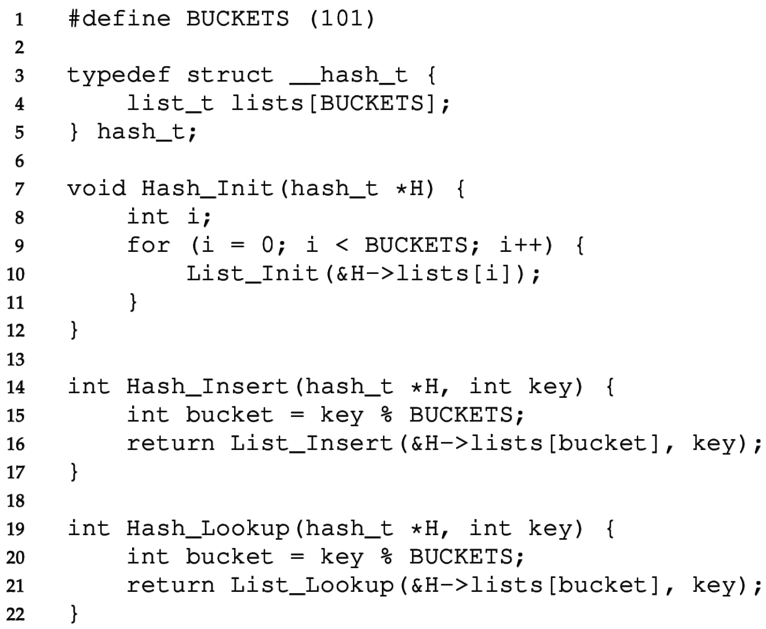
Concurrent Hash Table
Each bucket is implemented with a Concurrent List
  We don’t have to define any locks!
  (Locks are in the lists)
A thread can access a bucket without blocking other threads’ access to other buckets.
Hash tables are ideal for concurrency.
  Hash (bucket id) can be calculated without accessing a shared resource.
  Distributed hash tables are used for huge NoSQL databases.

Slide 11
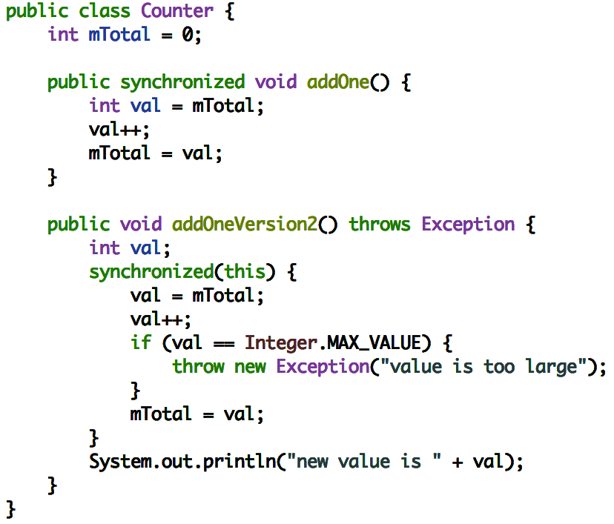
Language-level support for critical sections
Java has synchronized keyword for surrounding critical sections
Automatically releases the lock when exiting early:
Python: “with self.lock:”
Objective-C: “@synchronized”
C++/C: 😔

Slide 12
Multithreaded app development advice
Avoid using locks directly. Instead use provided thread-safe objects.
  Concurrency code is tricky, so don’t try to write your own.
Read documentation to learn whether libraries’ data structures and functions are thread-safe.
For example, Java has many thread-safe data structures:
  HashMap → ConcurrentHashMap
  Queue → BlockingQueue
    Blocks when trying to add to a full queue or retrieve from an empty queue
  Collections.synchronized[ Set | SortedSet | List | Map | SortedMap ]
If possible, pass immutable (read-only) objects to threads.

Slide 13
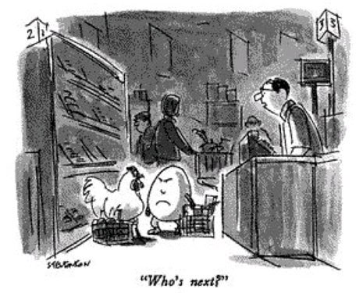
Intermission

Slide 14
Requirements for sensible concurrency
Mutual exclusion (the topic of the last two lectures)
  Prevents corruption of data manipulated in critical sections
  Atomic instructions → Locks → Concurrent data structures
Ordering (B runs after A)
  We can use mutex variables to control ordering, but it’s inefficient:
    while(!myTurn) sleep(1);
  We would like cooperating threads to be able to signal each other.
  Park/unpark and futex can be used solve this problem, but
  Condition Variables are a simpler, higher-level solution.

Slide 15
Waiting for a thread to finish
pthread_t p1, p2;
// create child threads
pthread_create(&p1, NULL, mythread, "A");
pthread_create(&p2, NULL, mythread, "B");
...
// join waits for the child threads to finish
thr_join(p1, NULL);
thr_join(p2, NULL);
return 0;
How to implement join?

Slide 16
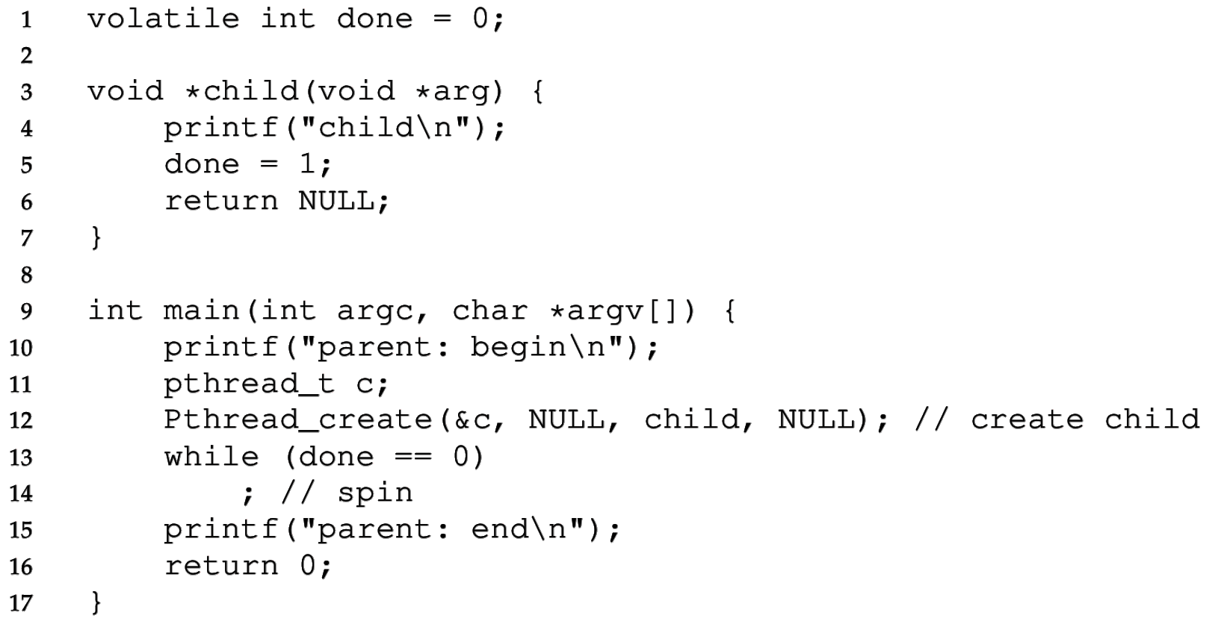
Waiting for child with a status variable
This works, but the waiting loop either:
  Spins: wasting CPU time, or
  Sleeps: delaying the response, or
  Yields: leading to unnecessary context switches.
It’s not an ideal solution.

Slide 17
Condition Variable
… is a queue of waiting threads with two operations:
Wait to queue the thread and wait for a signal.
Signal to wake one waiting thread (or none if no one is waiting).
  (real POSIX implementation actually lets you specify the number to wake.)
pthread_cond_wait(pthread_cond_t *c, pthread_mutex_t *m);
pthread_cond_signal(pthread_cond_t *c);
CV has an associated lock to protect itself and related shared state.
Must hold lock m when calling wait
  Will release the lock before sleeping and acquire the lock before returning
Wait and signal can be implemented with park/unpark or futex.

Slide 18
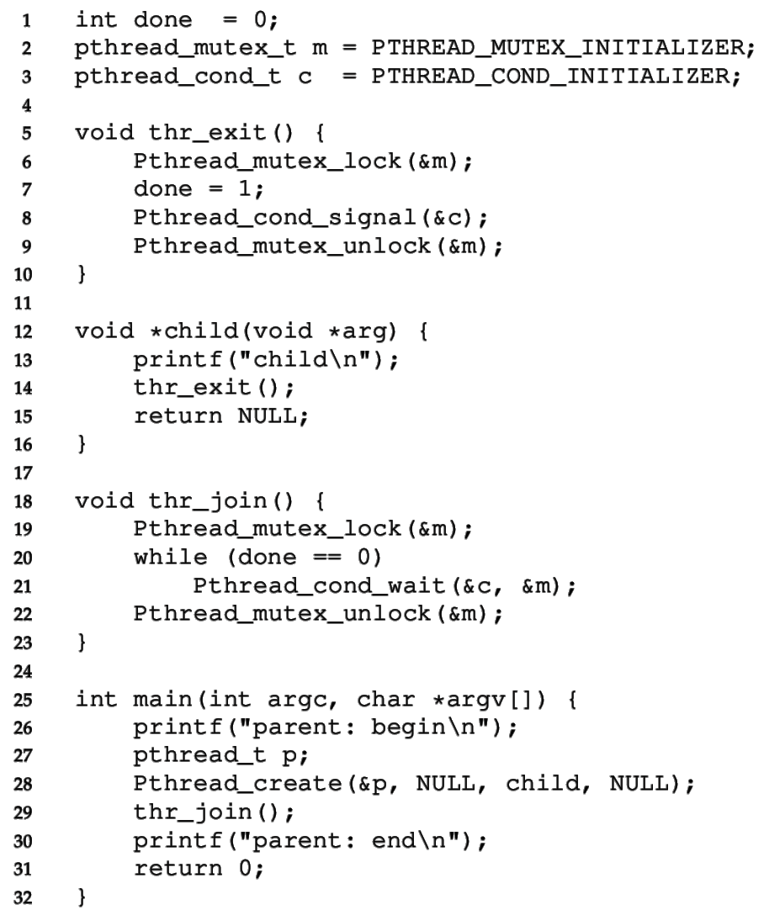
CV for child wait
Must grab lock before calling wait
Still need done variable because child may finish before parent gets to thr_join.
  Don’t want to wait indefinitely for a signal that already passed.
while loop on line 20 could be an if, but while is more careful.

Slide 19
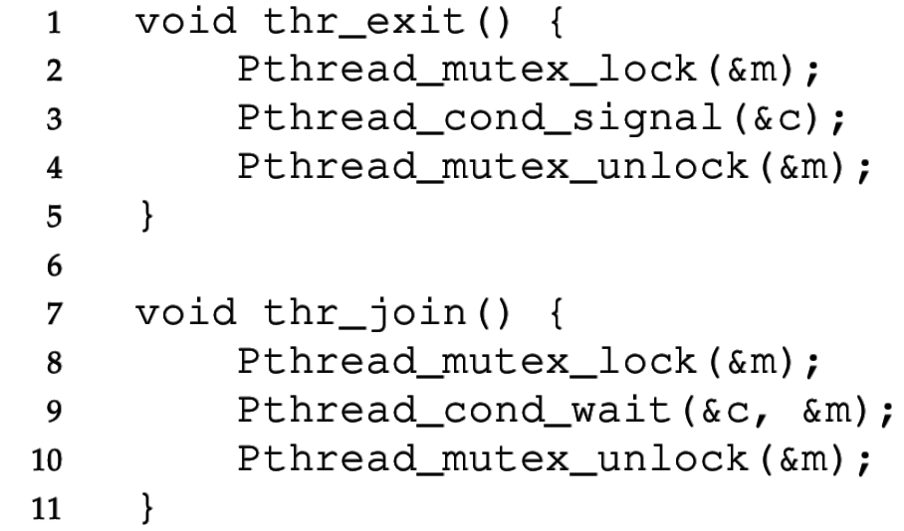
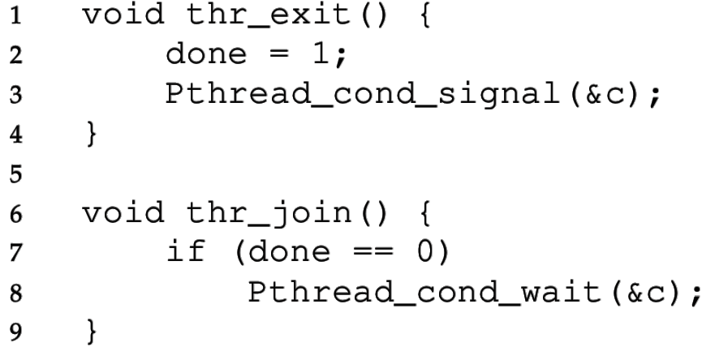
Buggy attempts to wait for a child
Parent Child
Parent Child
1) Without done variable, the child could run first and signal before the parent starts waiting for the child.
2) Without a lock, the parent could see done==0, then the child could finish and signal, then the parent would start waiting (after the signal).

Slide 20
Spurious (fake) wakeups
Pthreads allows wakeup to return not just when a signaled, but also when a timer expires or for no reason at all!
Spurious wakeups were included in the specification because they may allow some implementations be more efficient.
There is no guarantee that the condition you’ve been waiting for is true when you are awoken
So, we must also use a “predicate loop.” (while, not if)

Slide 21
Bounded buffer (producer/consumer)
We have multiple producers and multiple consumers that communicate with a shared queue (FIFO buffer).
  Concurrent queue allows work to happen asynchronously.
Buffer has finite size (does not dynamically expand).
Two operations:
  Put, which should block (wait) if the buffer is full.
  Get, which should block (wait) if the buffer is empty.
This is more complex than a (linked-list-based) concurrent queue because of the finite size and waiting.
Example: request queue in a multi-threaded web server.

Slide 22
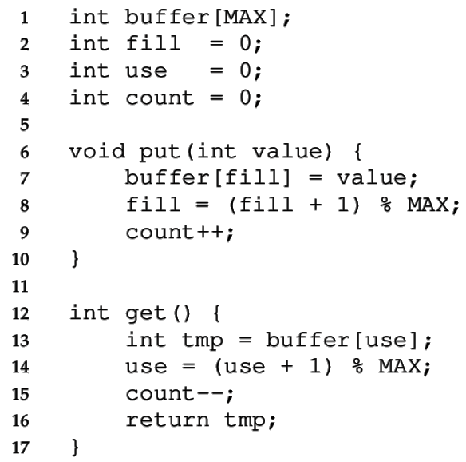
Managing the buffer
A simple implementation of a circular buffer that stores data in a fixed-size array.
fill is the index of the tail
use is the index of the head
count = (fill – use) % MAX
This simple implementation assumes:
Concurrency is managed elsewhere
It will overwrite data if we try to put more than MAX elements.

Slide 23
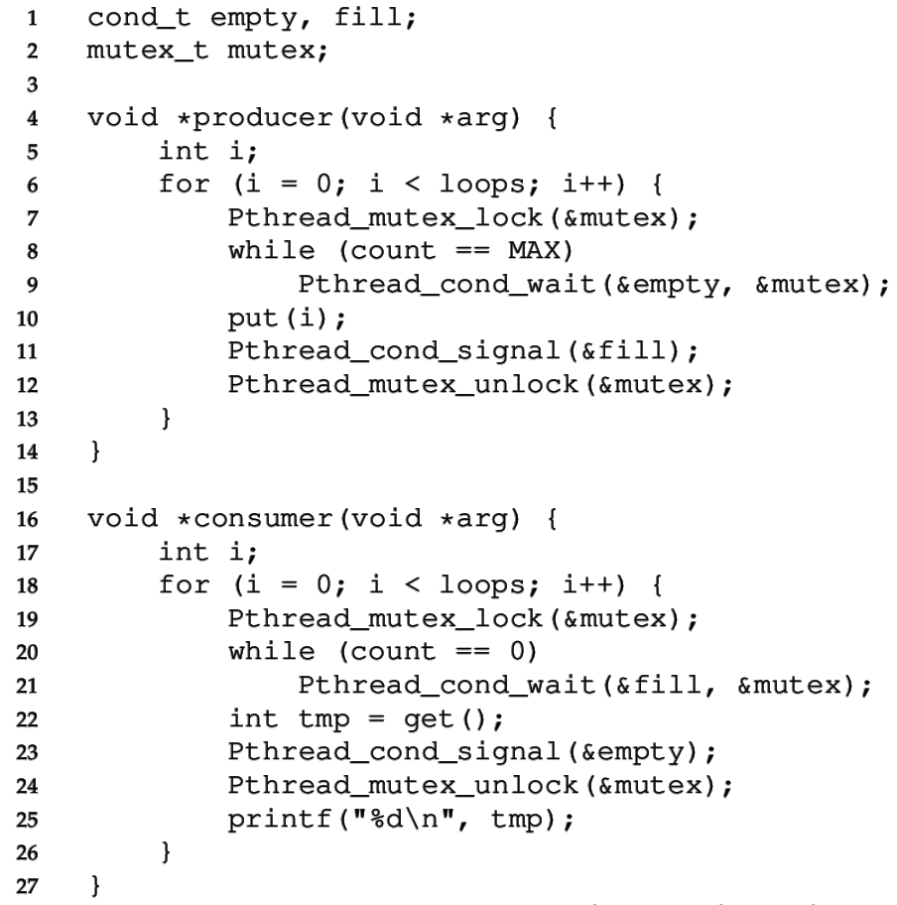
Managing the concurrency
Always acquire mutex
  Must use same mutex in both functions
Use two condition variables
Producer waits for an empty if the buffer is full
  Consumer signals empty after get
Consumer waits for fill if the buffer is empty
  Producer signals fill after put
While loops re-check count condition after breaking out of wait, to handle spurious wakeups.

Slide 24
Covering conditions
Recall that signal wakes one waiting thread (FIFO)
But there are times when threads are not all equivalent
The signal may not be serviceable by any of the threads
For example, consider memory allocation/free requests
  An allocation can only be serviced by free of >= size
pthread_cond_broadcast wakes all threads
This approach may be inefficient, but it may be necessary to ensure progress.

Slide 25
Rules of thumb
Shared state determines if condition is true or not
Check the state in a while loop before waiting on CV
Use a mutex to protect:
  the shared state on which condition is based, and
  operations on the CV
Remember to acquire the mutex before calling cond_signal() and cond_broadcast()
Use different CVs for different conditions
Sometimes, cond_broadcast() helps if you can’t find an elegant solution using cond_signal()

Slide 26
Pthreads condition variable API
Initialization/cleanup
pthread_cond_init(cv, attr)
pthread_cond_destroy(cv)
Specify attributes of CVs (eg., threads of this process only or all procs)
pthread_condattr_init(attr)
pthread_condattr_destroy(attr)
Waiting and signalling
pthread_cond_wait(cv, mutex)
pthread_cond_timedwait(cv, mutex, time) pthread_cond_signal(cv)
pthread_cond_broadcast(cv)

Slide 27
Recap – Concurrent Data Structures
Simplest strategy is to use one big lock, but this limits concurrency
  It’s thread-safe, but not really concurrent
Concurrent queue used two locks (head & tail)
Concurrent hash table used one lock per bucket
Condition Variables are used to order threads, using signal() & wait().
  Wait puts a thread to sleep, signal wakes a waiting thread.
  Pthreads allows spurious wakeups, so we still need to check a status variable.
  broadcast() wakes all waiting threads
Producer/consumer queue was implemented using two condition variables.

