Slide 1

EECS-343 Operating Systems
Lecture 11:
Implementing Locks
Steve Tarzia
Spring 2019
Diagrams in the slides are by Arpaci-Dusseau

Slide 2
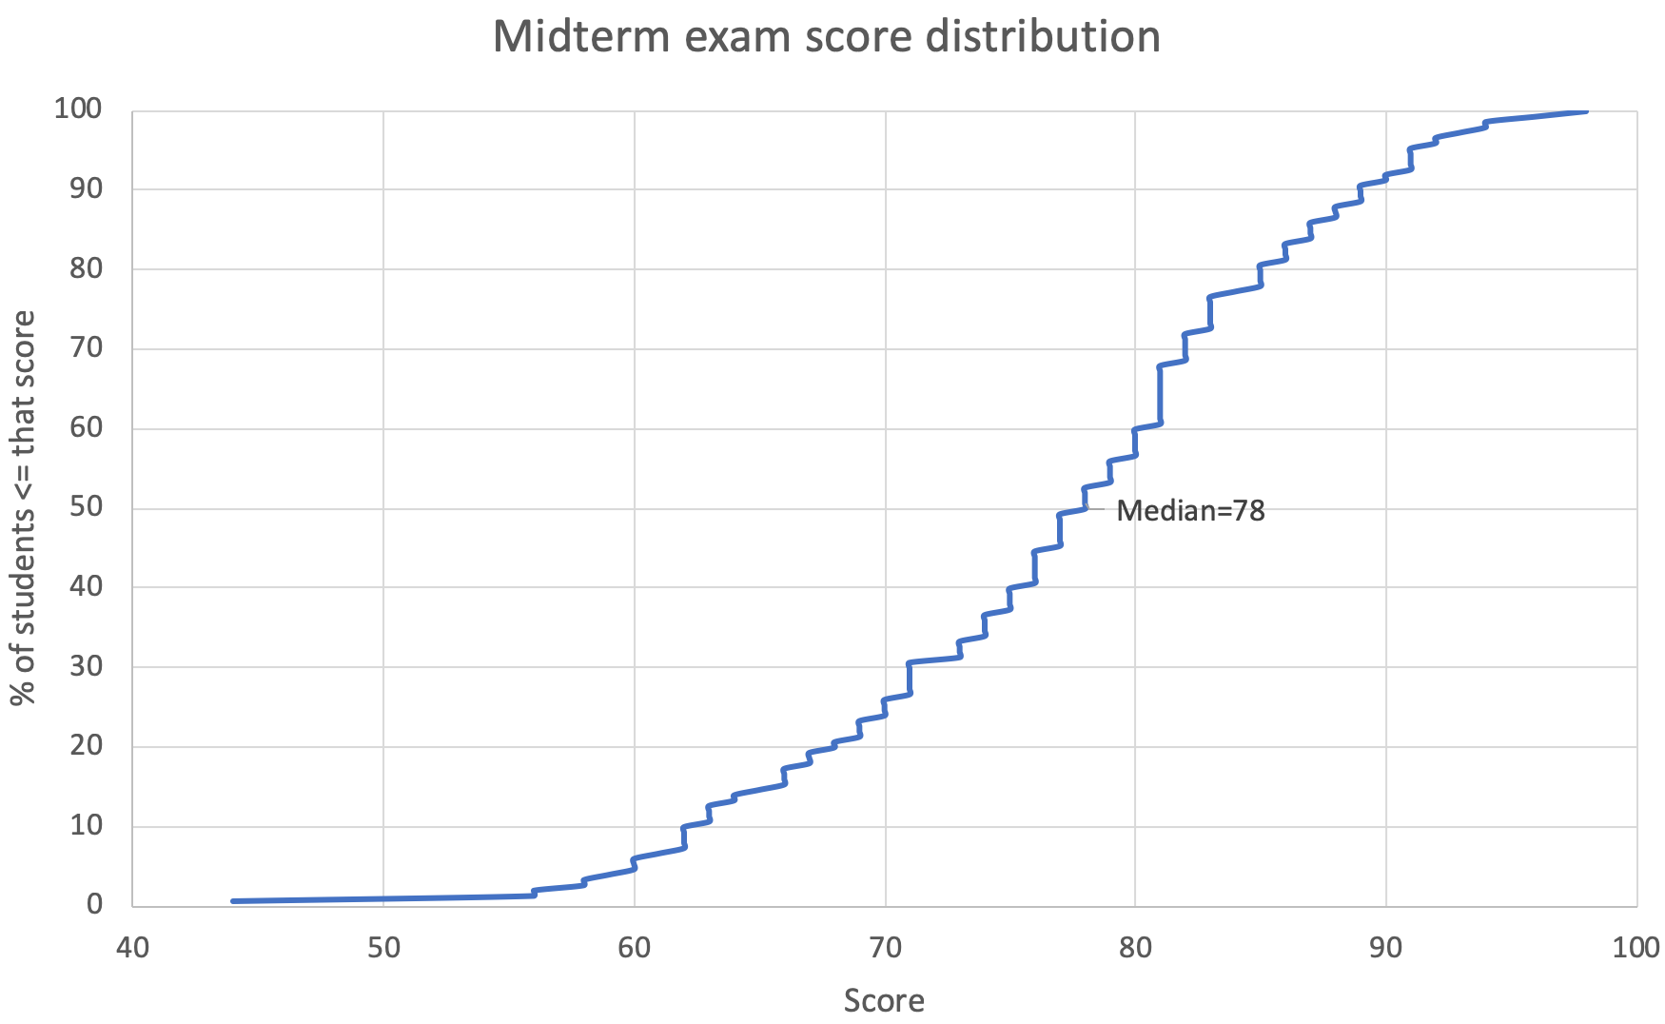
Announcements
Drop deadline is tomorrow. Stop by my office if you’re thinking about dropping.

Slide 3
Last Lecture: Threads
Processes can have multiple threads sharing the virtual address space
Critical sections are block of code that must be run atomically
If unprotected, critical sections lead to race conditions that make code indeterminant – we get different results depending on timing.
Locks are the simplest mutual exclusion primitive, with two main functions:
  Acquire/lock – get exclusive access to a shared resource.
  Release/unlock – release the shared resource.
Concurrency occurs naturally in multi-CPU systems
Concurrency is created by the process scheduler in single-CPU systems

Slide 4
Simple approach for single-CPU: disable interrupts
void lock() {
disable_interrupts();
}
void unlock() {
enable_interrupts();
}
Disabling interrupts prevents preemption during a critical section.
This simple approach is used in some kernel code, but:
  Does not help with concurrency on multiple CPUs.
  Masking/unmasking interrupts is slow.
  Important HW interrupts might be lost.
  Would give too much power to user code
    A process could acquire a lock and run forever
    With interrupts disabled, kernel has no ability to preempt user processes.
So, this is not a very useful lock strategy.

Slide 5
Using a lock flag
int locked = 0;
void lock() {
while (locked);
locked = 1;
}
void unlock() {
locked = 0;
}
Lock will keep checking the flag until it’s unset, then set it to exclude any other threads.
But this implementation does not work because two threads may simultaneously see locked==0, exit the while loop, and both grab the lock.
In other words, the test and the set are not atomic.

Slide 6
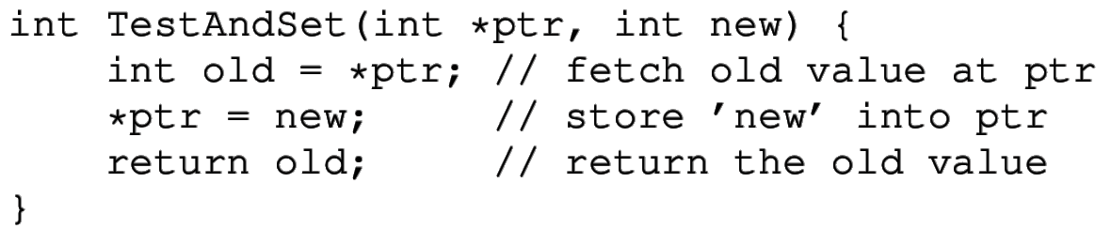
CPU hardware support for concurrency
Atomic test-and-set instruction
  Called “atomic exchange” – “lock; xchg” on x86
Operates on a particular memory location
Simultaneously sets a new value and returns the old value
It’s atomic, so the three steps cannot be interrupted halfway through.

Slide 7
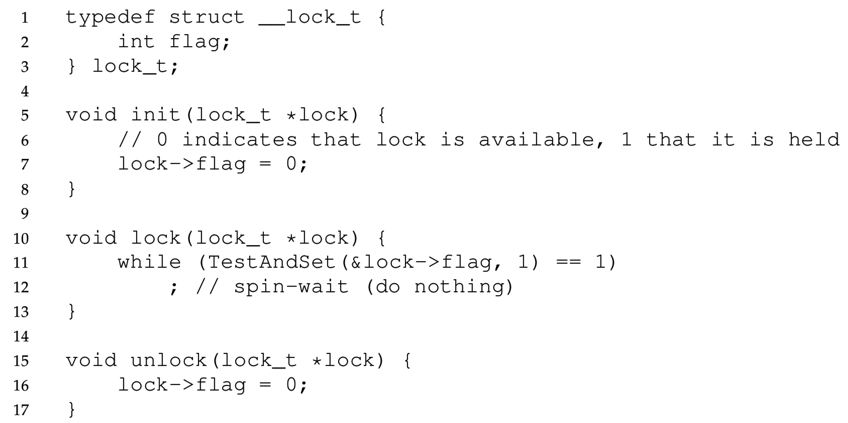
Our first useful spinlock, with test-and-set

Slide 8
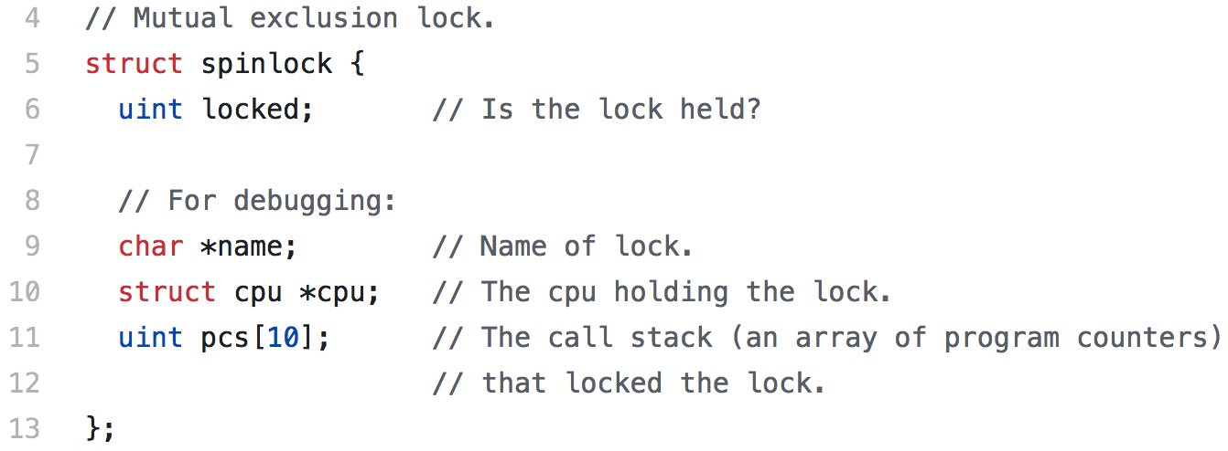
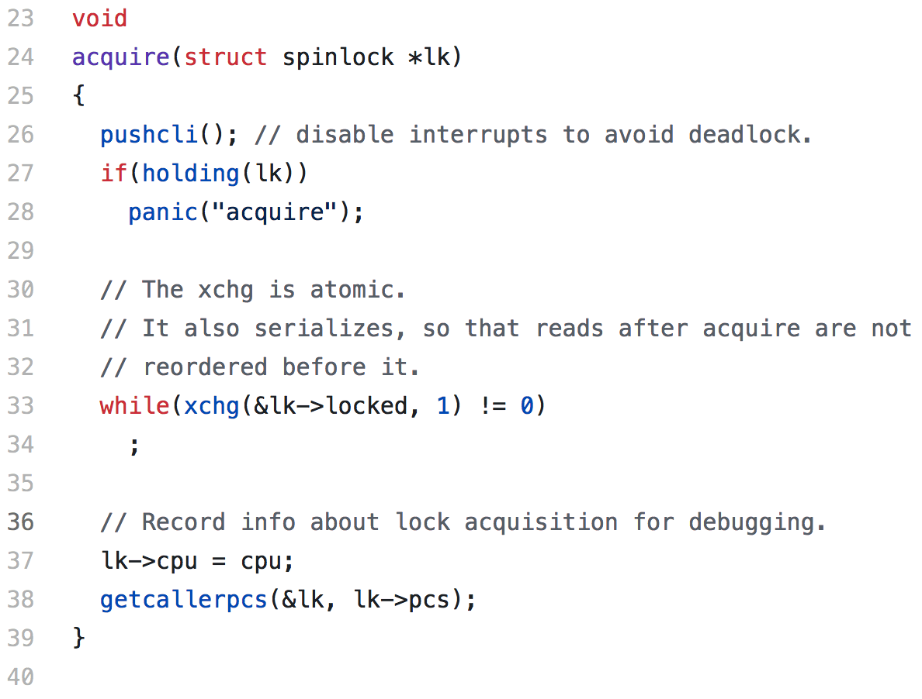
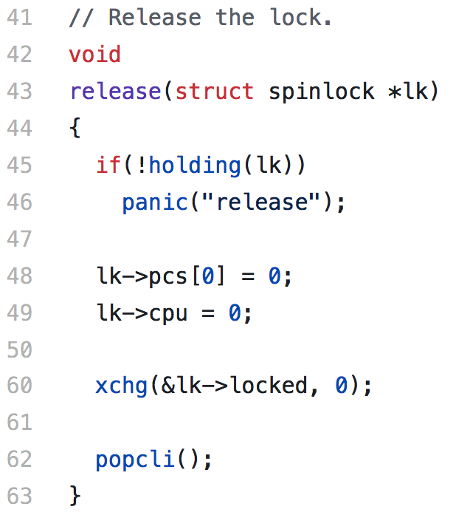
xv6’s spinlock.[ch]

Slide 9
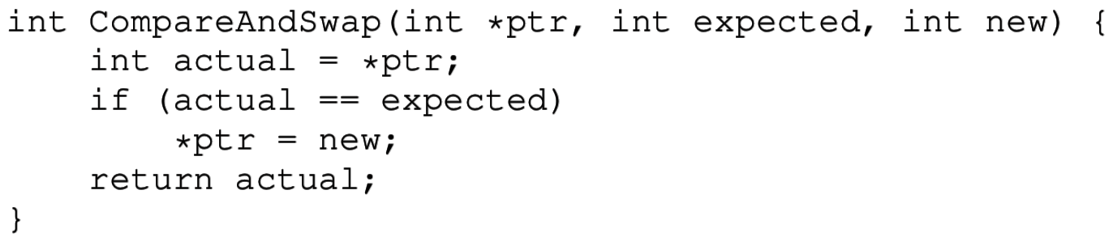
Compare and Swap
Another, more powerful, atomic instruction
Atomically compares a memory location to a register, returns the original result, and sets a new value if the comparison was true.
It’s a generalization of test-and-set
  TestAndSet(ptr, new) → CompareAndSwap(ptr, *ptr, new)
“lock; cmpxchg” in x86 assembly

Slide 10
How to evaluate a lock implementation?
Correctness – must provide mutual exclusion
Fairness – threads acquire lock in the order they request it
Progress – if several threads request the lock, one must acquire it
  (avoid deadlock)
Bounded wait – no thread should wait forever (or starve).
Performance – minimize latency/overhead introduced by the lock

Slide 11
Simple spinlock problems
Lacks Fairness and bounded wait – starvation can occur.
  Next thread to acquire the lock is whichever the scheduler chooses
  Even if scheduler is “fair” and schedules the waiting process periodically, there is no guarantee that the lock will be available when scheduled.
Performance – (on uniprocessor)
  CPU “spins,” repeatedly checking a variable that will not change.
  Timeslice must expire before another thread is given a chance to unlock
  If N threads want the lock, then N timeslices can be wasted spinning.
  Notice that spinlocks may be efficient on a multiprocessor, because a thread on another core may release the lock being waited for.
Nevertheless, the spinlock is correct, simple, and safe for user code.

Slide 12
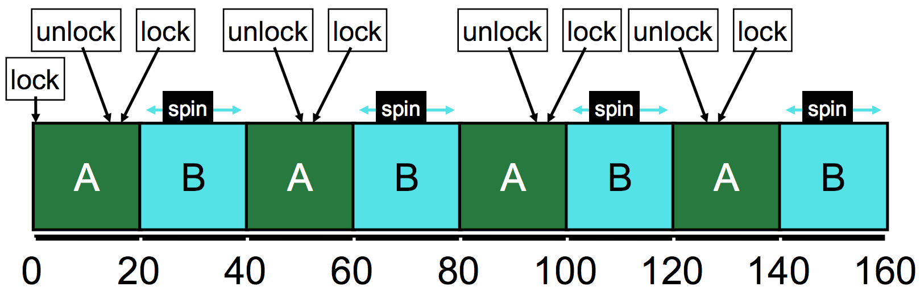
Spinlock starvation illustrated
Problem is that scheduler has no knowledge of locks,
and locking threads have no control over scheduler
B makes no progress and wastes a timeslice every time it is scheduled!

Slide 13

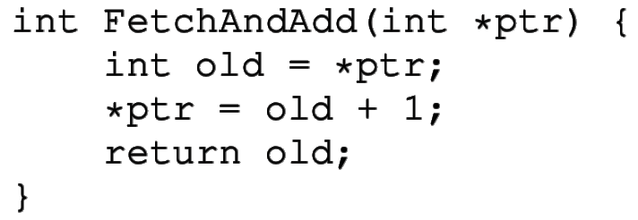
Fetch and add
Return old value and increment it
This is yet another atomic instruction for concurrency
Can be used to atomically reserve a “ticket number”
“lock; xadd” in x86 assembly

Slide 14
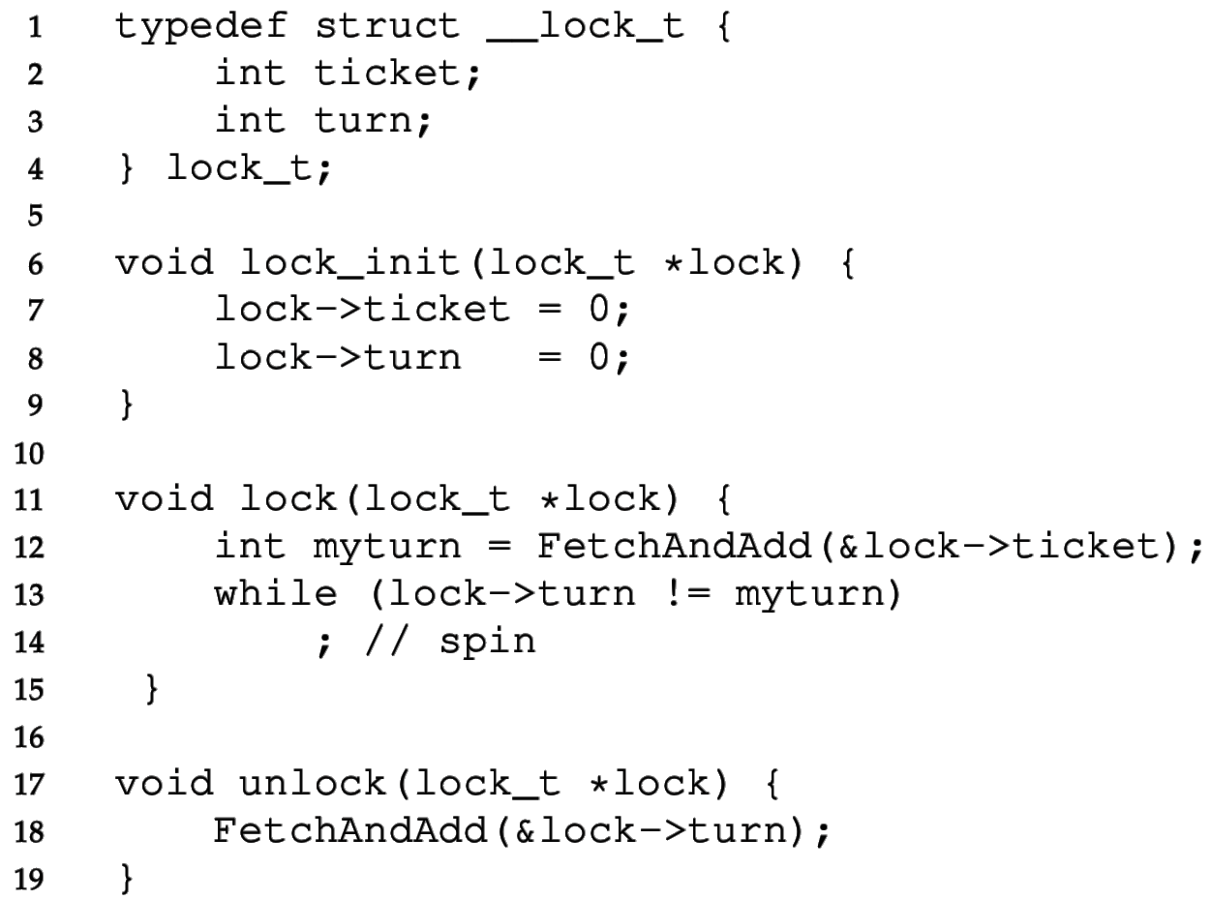
Ticket lock
Each thread uses fetch-and-add to atomically reserve its turn number.
In lock(), spin while checking whether it’s your turn.
  Unique turn numbers prevent race
To unlock, just increment “turn”
Prevents starvation because threads acquire the lock in FIFO order.
Atomic instruction is not really needed in unlock.
  Can avoid overflow with:
  lock->turn = (lock->turn + 1) % MAX_INT

Slide 15
GCC has built-in functions for atomic operations
type __sync_fetch_and_add (type *ptr, type value)
bool __sync_bool_compare_and_swap (type *ptr, type oldval type newval)
type __sync_lock_test_and_set (type *ptr, type value)
void __sync_lock_release (type *ptr)
… and more
  See https://gcc.gnu.org/onlinedocs/gcc-4.1.0/gcc/Atomic-Builtins.html
These will be compiled to the appropriate atomic instructions on the particular target CPU architecture.

Slide 16
Load-linked & Store-conditional
A special pair of load/store instructions for concurrency
Load-linked reads the value at an address
Store-conditional writes a new value to an address
  However, it aborts if there has already been a write to that address since the last load-linked.
Can be used to implement a lock
  But more importantly, can be used directly for lock-free concurrent code.
  Instead of locking before working on shared memory, just use load-linked.
    The store-conditional later on will tell you whether you need to retry.
Supported on some RISC/ARM CPUs, but not on x86.

Slide 17

Intermission

Slide 18
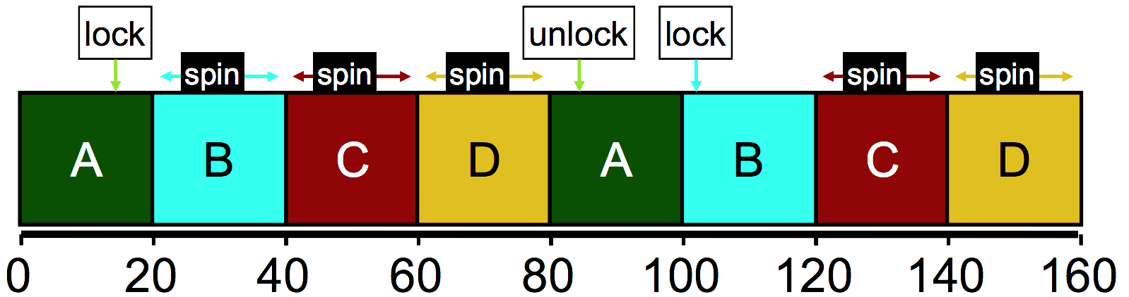
Ticket lock avoids starvation, but it’s still not ideal
Imagine 4 processes competing on one CPU for a lock:
B,C,D are wasting time by busy waiting.
Scheduler is trying to be fair to B,C,D by letting them run, but scheduler is ignorant of locks, and does not know they are just waiting.
It would be better to skip B,C,D and let A finish the critical section.

Slide 19
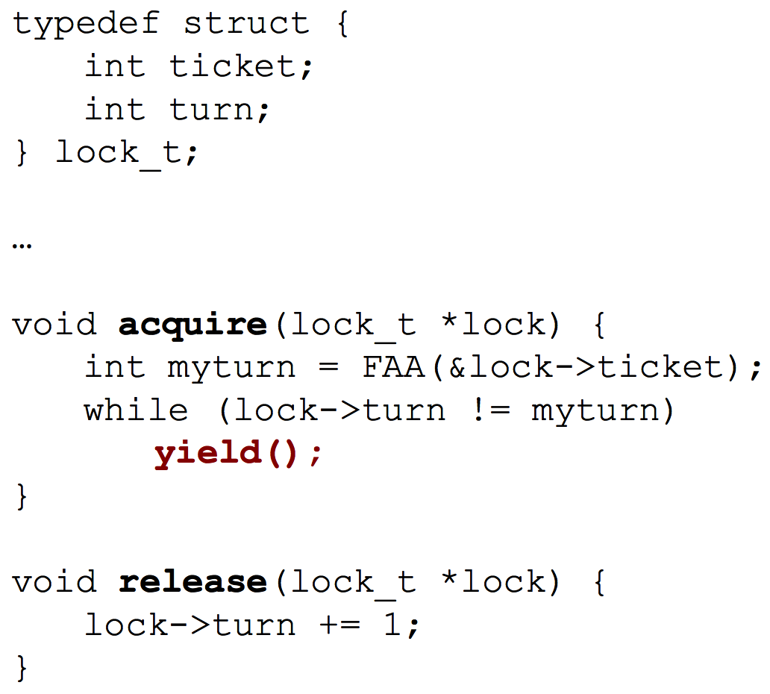
Yielding is a simple solution
Give the user process just a little control over the scheduler.
Create a yield syscall that un-schedules the current thread (before the timeslice expires).
In acquire, the thread will check the lock variable once.
If the lock is not available, the thread is better off letting another thread run because it’s waiting for someone else to unlock.

Slide 20
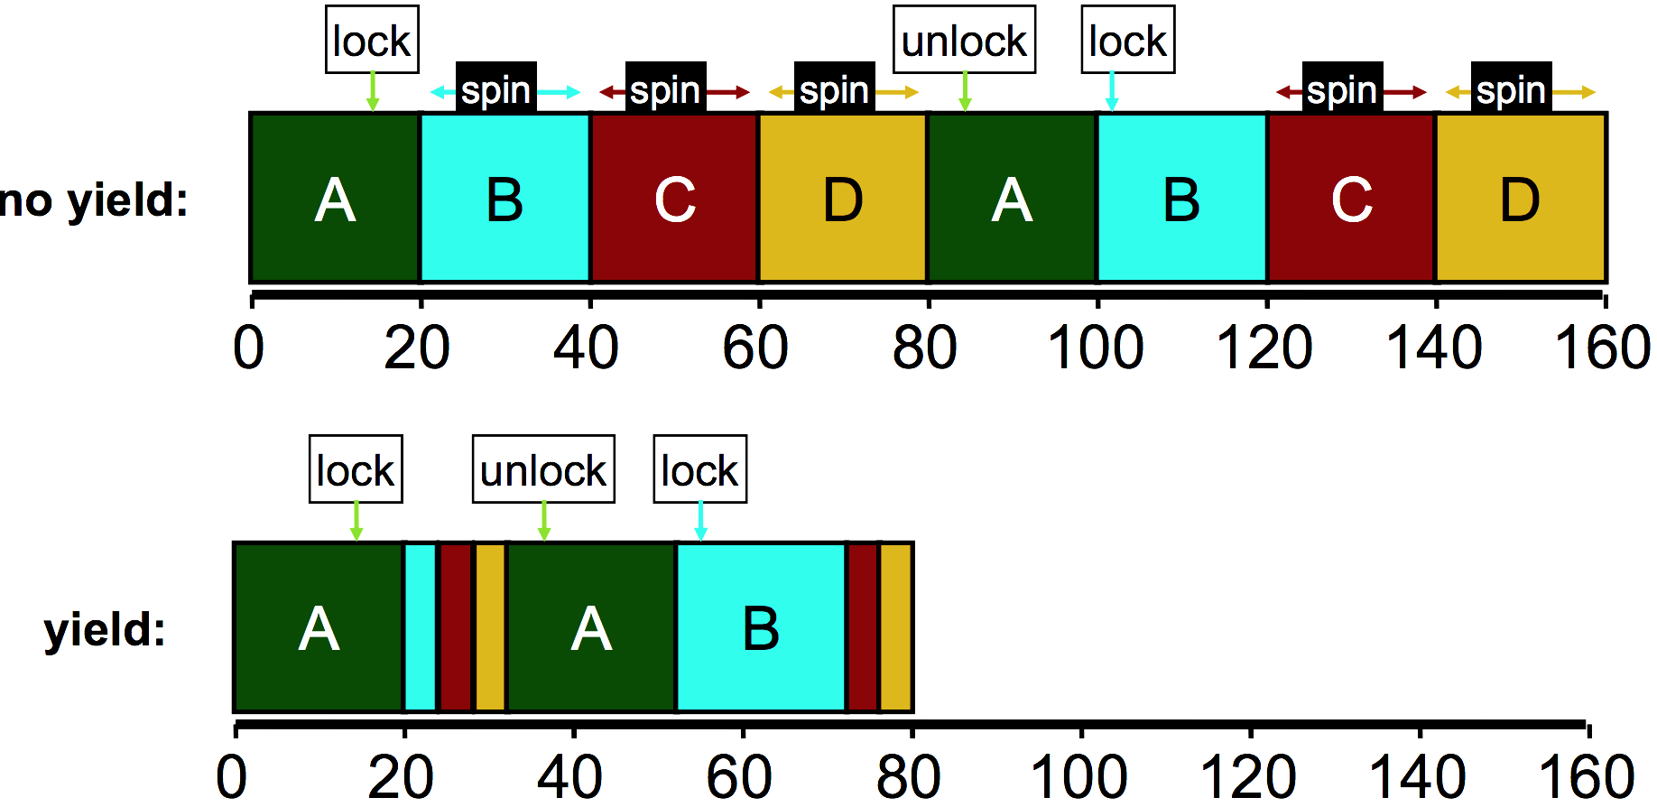
Yielding eliminates busy-waiting

Slide 21
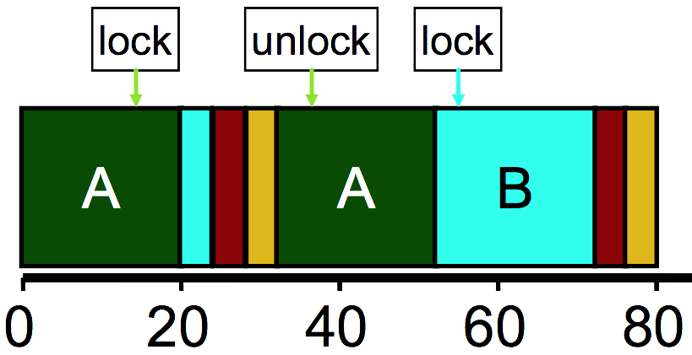
One remaining problem
Performance is better with yield,
but we are still doing a lot of
unnecessary context switches
Remember that context switches are
costly because they flush caches & TLB.
Solution is to make the scheduler aware of who is holding which locks
Then scheduler can avoid scheduling a thread until the lock it’s waiting for is free.
Thread “A” should be scheduled again at time 20, because the other three processes are all waiting for a lock that has not yet been released.

Slide 22
Blocking locks and wait queues
A better solution requires some
cooperation between the user thread’s locks and the OS scheduler.
Solaris provides park/unpark syscalls to influence the scheduler:
  Park blocks the current thread.
    Yields, but also puts the thread in a special blocked state so it cannot run.
  Unpark unblocks another thread, identified by thread_id.
A lock based on park/unpark can be implemented as follows:
  If lock acquire fails, add the thread to the queue of parked threads and park.
  release dequeues the next waiting thread (if any) and unparks it, so it can run.
  Queue resides in user memory and unlocking thread effectively decides which thread is scheduled next.
See the book for details.

Slide 23
Linux Futex (“fast userspace mutex”) syscalls
Similar to park/unpark, but the queue is in the kernel.
futex_wait(address, expected) – put the thread to sleep if the value at address equals “expected.” Used in lock/acquire function.
futex_wake(address) – wake one thread (in FIFO order) that previously called futex_wait. Used in unlock/release function.
Behind the scenes, the kernel will create a queue for each address associated with a futex. (Queue will be protected by locks.)

Slide 24
Two classes of locks
Spinlocks
Blocking locks
Just use an atomic CPU instruction like test-and-set or fetch-and-add.
“Spinning” is trying to acquire the lock repeatedly in a loop.
Simple
Wastes CPU time
Still require atomic instructions.
But somehow tell the scheduler to run a different thread if lock acquire failed.
Frees up the CPU
But context switches are costly

Slide 25
Both blocking locks and spinlocks are useful!
Spinlocks on multiprocessors do not require a context switch.
If locks are held a short time, and threads are running on multiple CPUs, then spinlocks are the most efficient choice.
  In this scenario, a thread will only spin a few times before a thread scheduled on another CPU releases the lock.
  The short “hold time” suggests that the lock holder is probably running. Why?
  Is this still true on a uniprocessor?
On the other hand, a spinning thread on an uniprocessor will have to be preempted before another thread is given an opportunity to release.
On a uniprocessor, blocking locks are always better
On a multiprocessor, spinlocks are better for short critical sections.
  For long-held locks, spinning would waste a lot of CPU time.

Slide 26
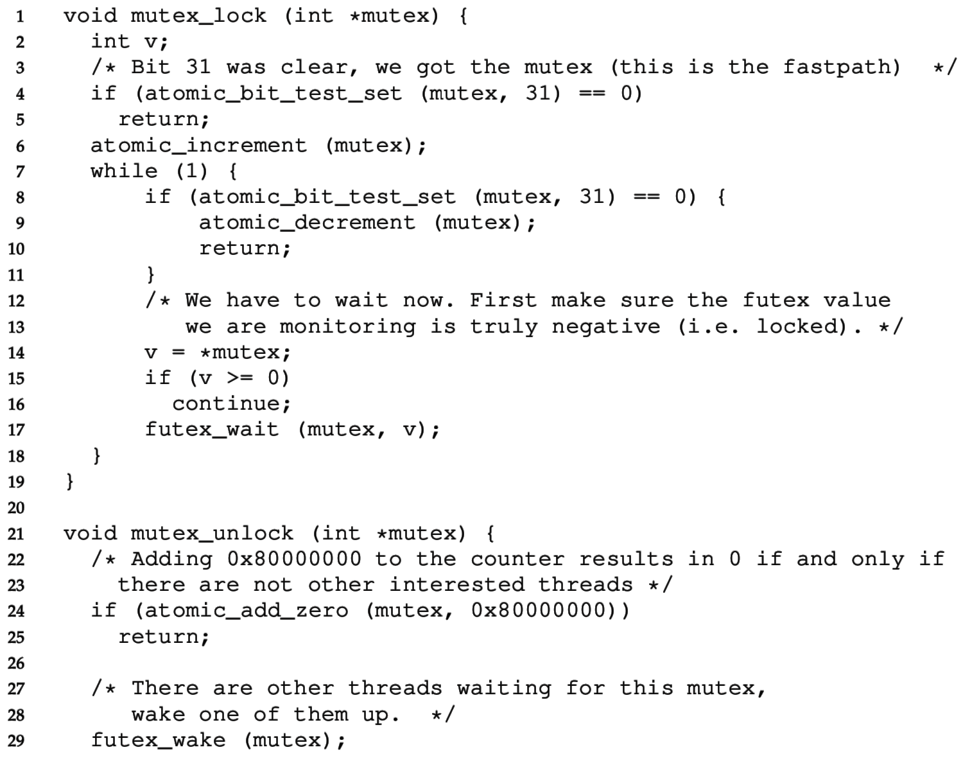
A two-phase lock (in Linux/glibc’s NPTL lib)
The top bit (31st) is set if the lock is acquired.
Lower 0-30 bits count the number of waiting threads.
If there is no contention, lock and unlock are very fast (just one atomic op).
Otherwise use the futex.
Check the lock at least three times before blocking with futex.

Slide 27
Recap
Hardware support for atomicity:
  Disable interrupts
  Test and set
  Compare and swap
  Fetch and add
  Load-linked & Store-conditional
Various lock implementations
  Spinlock
  Ticket lock
  Yielding lock
  Queuing locks
    Park/unpark on Solaris
    Futex on Linux
Sophisticated locks can be more fair and avoid starvation, but they can add unnecessary context-switch overhead on multiprocessors.
Two-phase locks try to combine the best of both approaches.
OS scheduler and concurrent user code must coordinate for best performance.

