Slide 1

EECS-343 Operating Systems
Lecture 8:
Free-Space Management
Steve Tarzia
Spring 2019

Slide 2
Announcements
Project 2 due Monday
HW2 is out and due on Wednesday.
Midterm in one week (Thursday)
Tuesday will be a midterm review
  A Piazza post will ask for topics to cover.

Slide 3
Last Lecture: Swapping
Disk is slow, but large, and can be used to store RAM’s overflow
  Disks have high throughput (transfer bitrate) but high latency (delay)
  Magnetic disks have even higher latency than SSDs, due to moving parts.
Paging and swapping work together, using the same CPU mechanisms
  If a page is marked “not present” it may be either invalid or swapped to disk.
    Or it might indicate lazy allocation, lazy loading, or copy-on-write, as we saw last time.
  High bits of page table entry can store disk location of swapped page.
Page replacement policy decides which page(s) to evict to free memory
  Swapping can be done on demand or in the background
  Having some free physical frames will prevent delays for allocations.
  Accessed bit and Dirty bit in PTEs inform the page replacement policy
Thrashing is when swapping prevents the system from doing any work.
Unified page cache handles both traditional paging and file caching.
  Makes filesystem access seem just as fast as memory access.

Slide 4
Paging overview
Virtual memory addresses are translated to physical memory addresses by the CPU, and the translation is dynamically configured by the OS in each process’ page table.
Swapping is the movement of pages between disk and physical mem.
Page tables also allow several memory management optimizations:
  Copy-on-write fork – delays memory copies
  Shared libraries – read/execute-only code can be shared by several processes
  Lazy allocation/demand zeroing – wait before allocating user memory.
Filesystem caching allows page-sized portions of files to be stored in physical memory.

Slide 5
Memory management illustrations

Slide 6
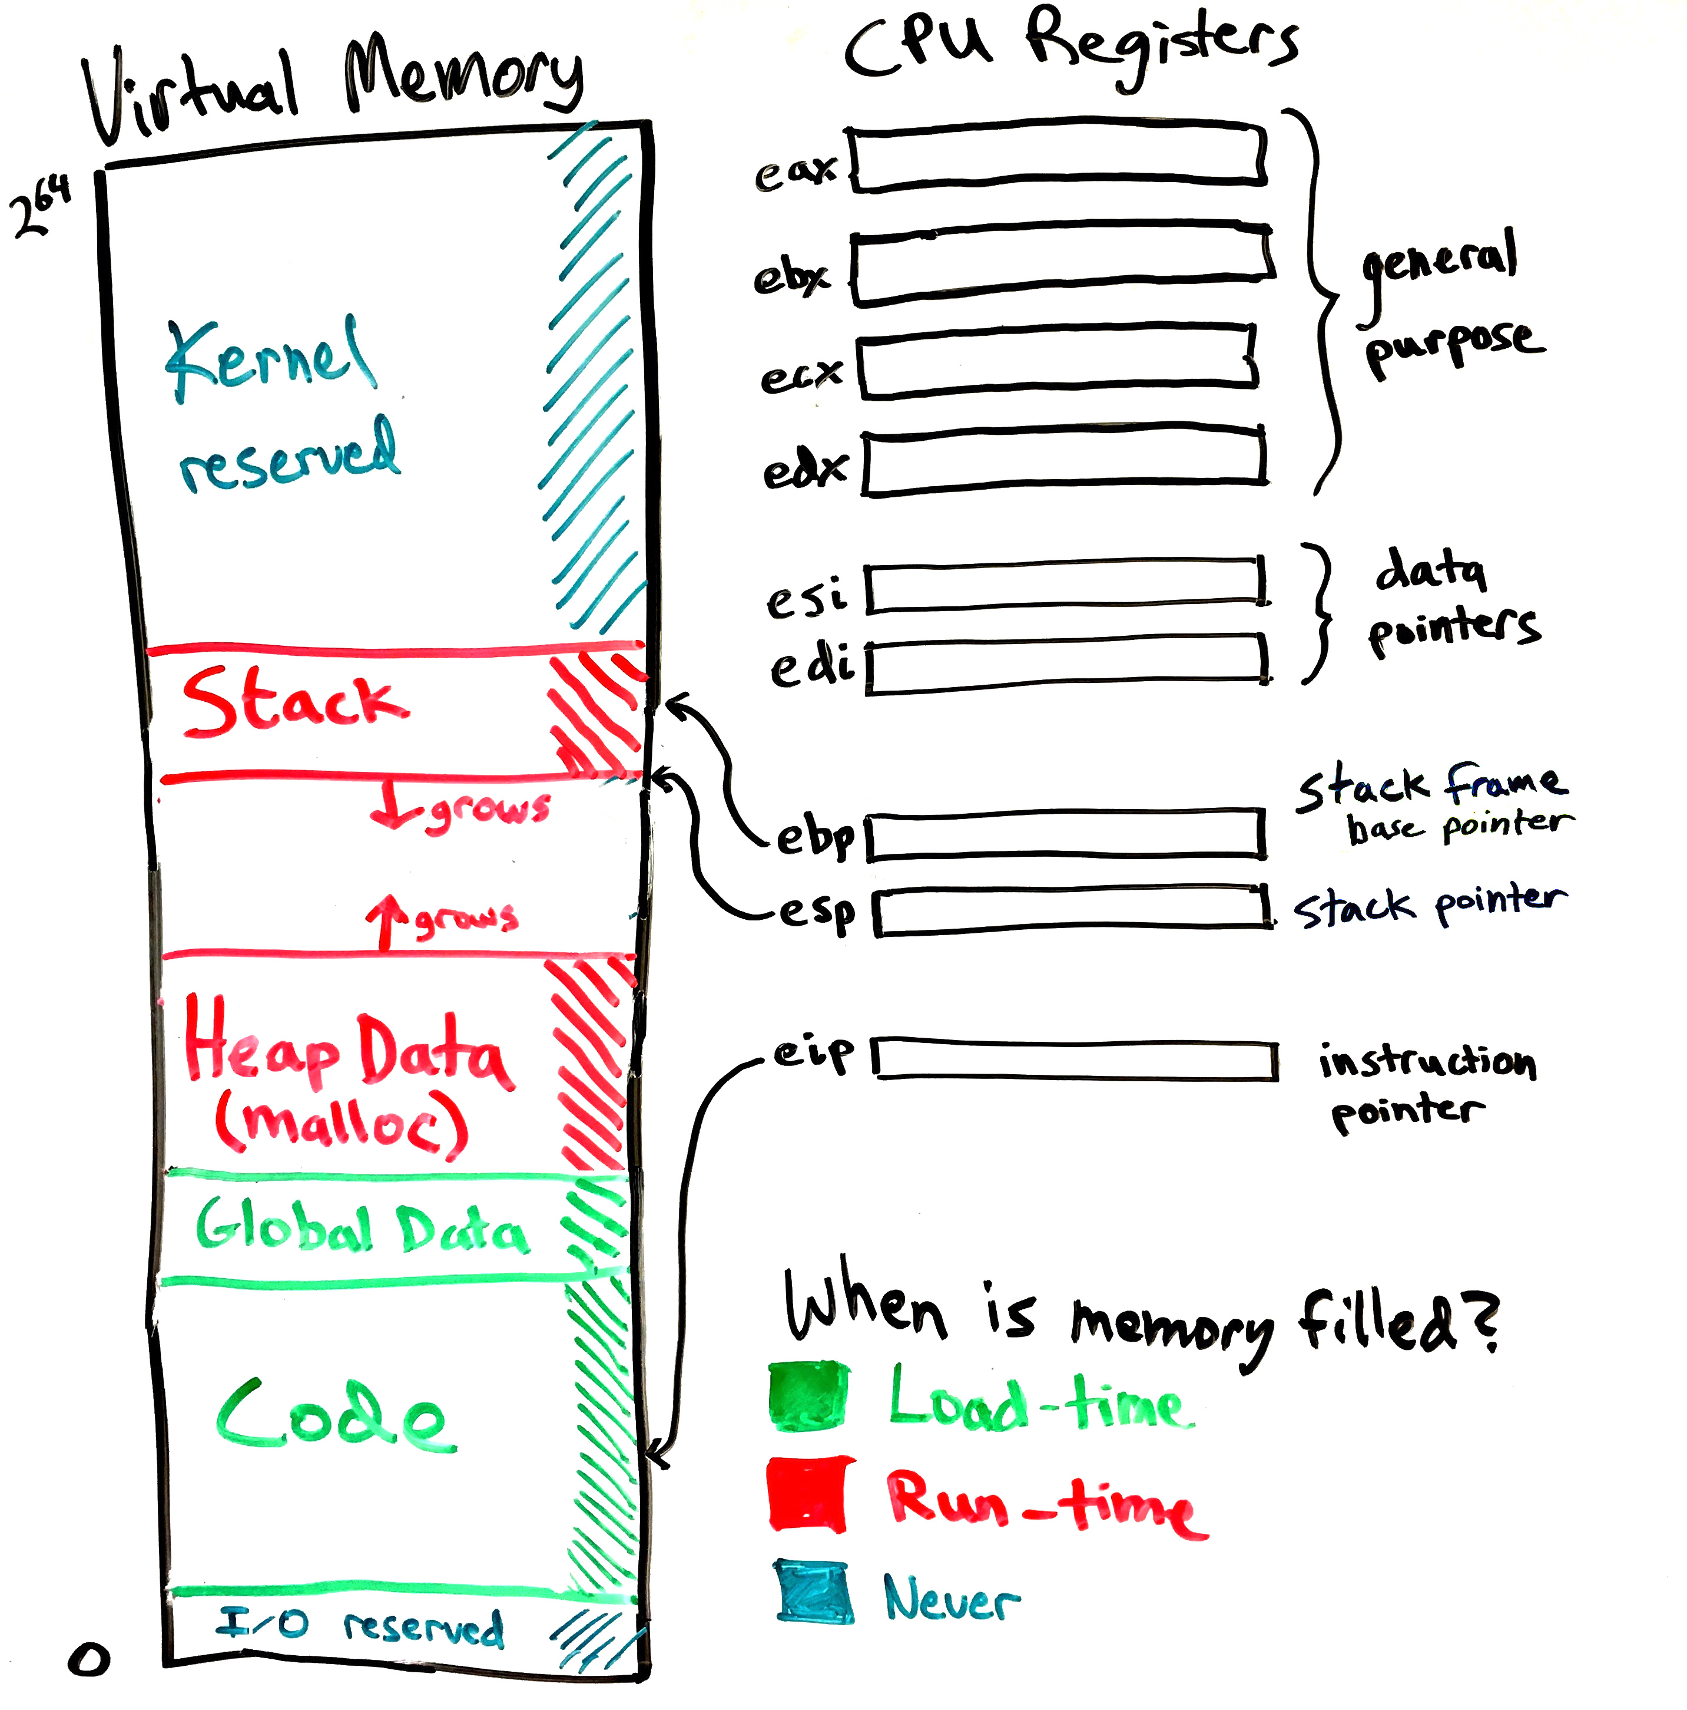
The process’ view of memory
Code and global data are filled by exec syscall to load a program.
A new frame is pushed on the stack whenever a function is called. (And popped on return.)
Heap data is managed by malloc
How does malloc work?

Slide 7
Free-space management
Given: A single block of contiguous memory
Goals:
Handle malloc and free requests
  void* malloc(int n): find a unused block of size n
  free(void* ptr): reclaim a block that was previously malloc-ed
Minimize the total extent of memory required (be compact)
Minimize the time required to malloc and free
Free-space management will also be a topic in filesystems.

Slide 8
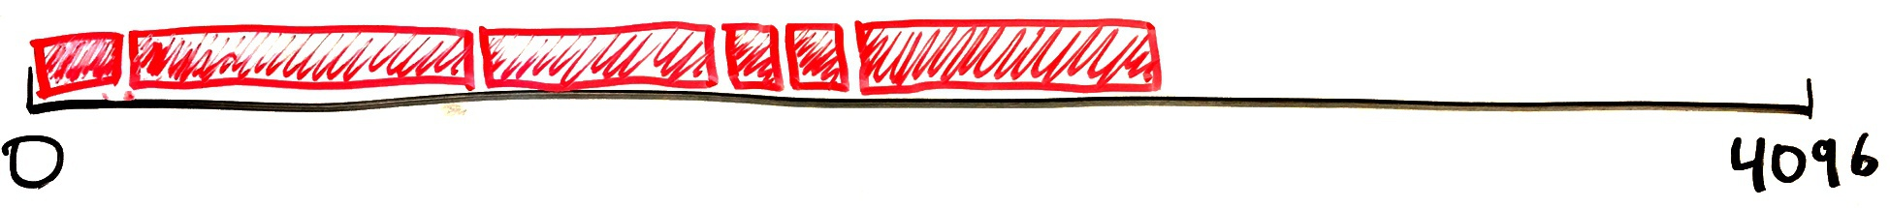
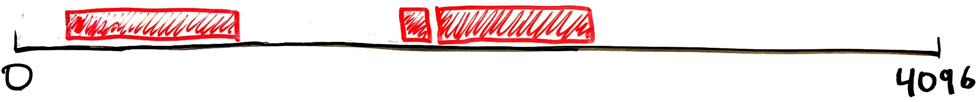
Heap dynamics
Ideally, malloc would waste no space:
Actually, Stack memory looks nice and compact like above.
But malloc is used for dynamic memory
  it will be freed later, at some unknown time
Frees create vacancies in the Heap that waste space,
but can be re-allocated:
Remember that user programs expect malloc to return a contiguous block of (virtual) memory.

Slide 9
Grow the Heap only as a last resort
Goal is to make maximum use of the Heap range already in use.
Look for a free block >= the current malloc request
If none is found, then we have to expand the heap.
  On xv6, malloc uses sbrk syscall to tell the OS that the process’s address range has increased and page table must be expanded.
  Modern OSes do not use sbrk, but mmap or perhaps nothing.
Memory leaks cause heap to grow indefinitely (if you forget to free)

Slide 10
Malloc in user and kernel code
Both the kernel and user code must dynamically allocate memory
Free space management algorithms can be the same in both cases
But different implementations are used. In xv6:
  User level: umalloc.c: 90 lines of code
    Basic C memory management: malloc & free
    Missing: calloc & realloc (it’s not ANSI C)
  Kernel level: kalloc.c: 72 lines of code
    xv6 lacks dynamic memory allocation in the kernel
    No malloc & free, just allocate and free a full page of memory (4kb block)
Linux has kmalloc, kfree (like user-level malloc and free)

Slide 11
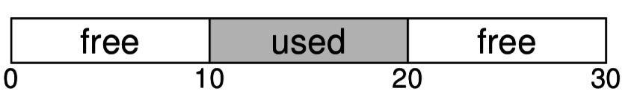
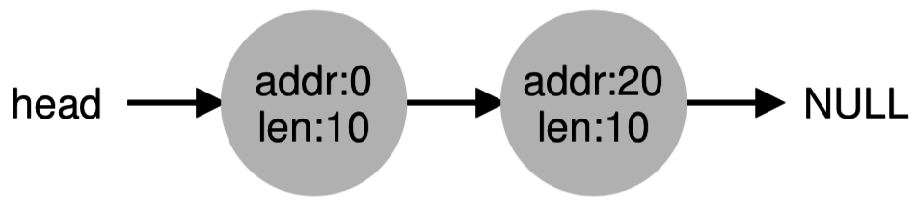
Free list is a linked list tracking free blocks
Ordering is arbitrary
This example shows two free blocks of size 10.
  Space between two free blocks can be used by multiple mallocs
  We’ll track used blocks another way
Like any linked list:
  It’s easy to insert and delete nodes
  Finding the n^{th} node is slow
    Start at the head node
    Traverse n pointers
  Lacks any indexing
    Must examine every node when searching
Above is represented as:

Slide 12
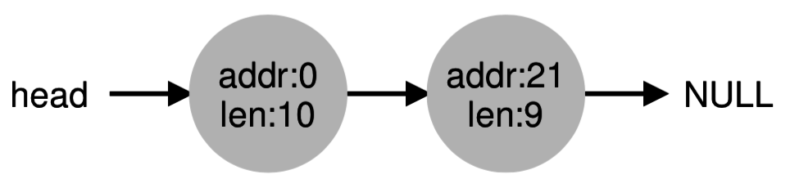
Allocate memory by splitting free blocks
Before:
After allocating one byte from the second free block:
We just found a free block large enough for the allocation and claimed a chunk of it. (The policy decides which block to choose.)

Slide 13
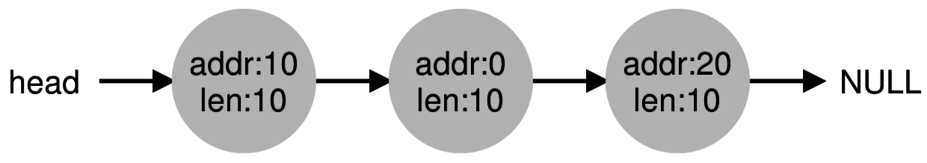
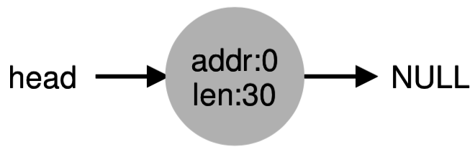
Coalescing eliminates artificial fragmentation
Before:
After freeing 10 bytes of data at address 10
  (We usually add new nodes to a linked list’s head):
After coalescing:
Splitting this big block of free space among three small nodes makes it difficult to recognize it as a large contiguous free block

Slide 14
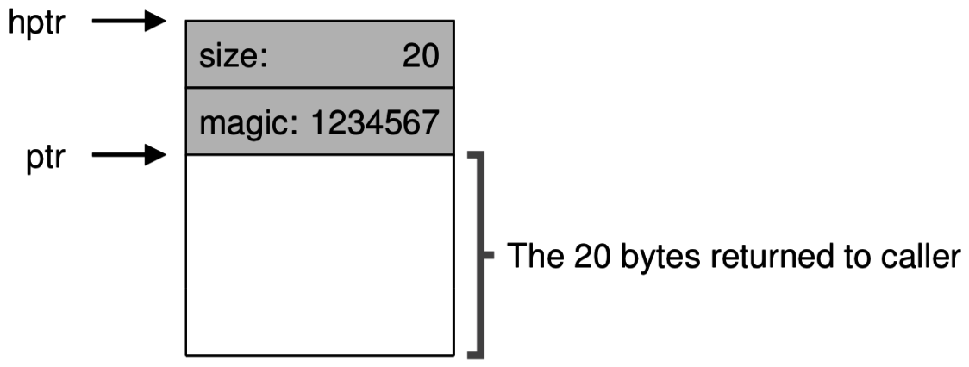

A trick to help with frees
free(ptr) doesn’t tell us how long the block is, just where it starts
  But we need that information to free the block.
Solution: cleverly prefix the block with a header:
  Eg., malloc(20):
  To handle free(ptr) just look at (ptr – (sizeof hptr)) to find the block size.

Slide 15
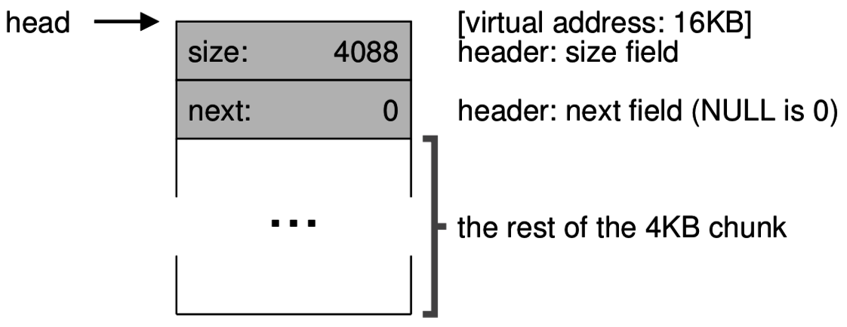
Heap example: step 1: initialization
Start with an empty 4kb block of memory (4096 bytes)
Part of the Heap is always used to store the free list.
We just have a free list with one node, representing one big free block:
Assuming pointers are 32 bits = 4 bytes, the free list node occupies 8 bytes, leaving 4088 bytes free below it.

Slide 16
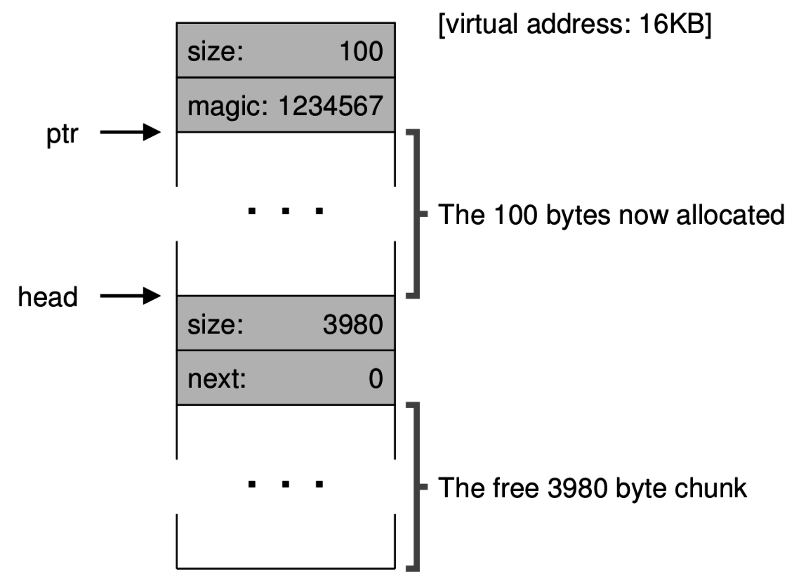
Heap example: step 2: malloc(100);
The malloc implementation will traverse the free list (starting at “head”)
and find the one node that has >= 100 bytes.
Free block had 4088 bytes
  It is split, leaving 4088 – 100 – 8 = 3980 bytes.
  8 bytes are reserved for the new node’s header.
After:
Before:

Slide 17
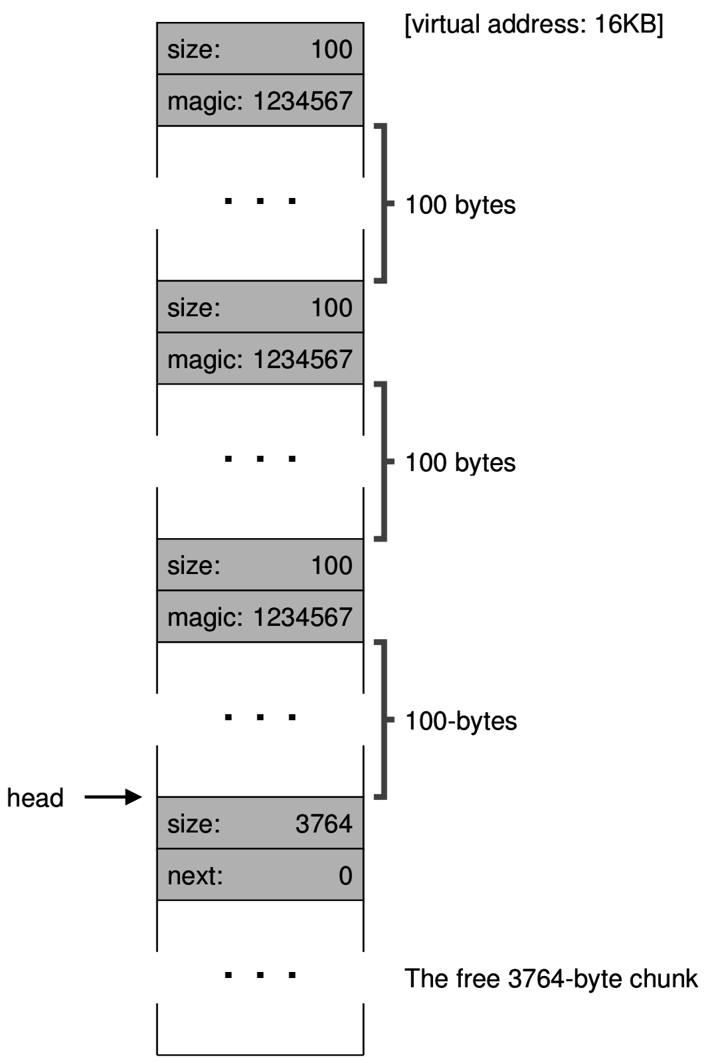
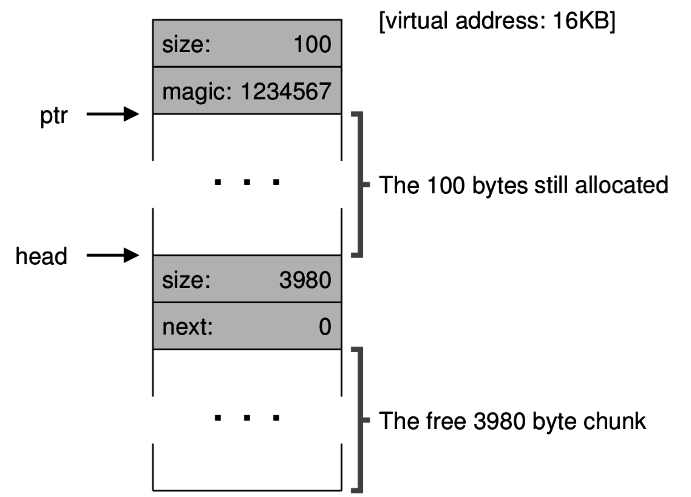
Heap example: step 3: two more calls to malloc(100);
After:
In each case there is one free block and we split.
Before:

Slide 18
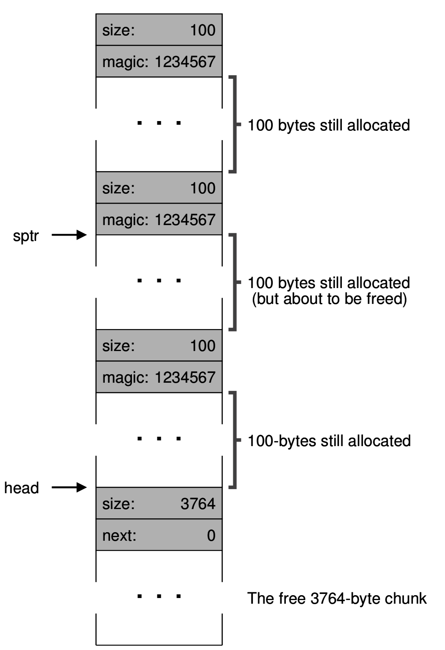
Heap example: step 4: free(sptr)
When handling the “free,” all we have is sptr (the free parameter) and head (a global variable).
The caller didn’t tell us how large a block to free, but we look back from sptr to find that size=100.
To free the block, we just convert the malloc header into a free list node by changing the magic number into a pointer to the former head of the free list.
Before:

Slide 19
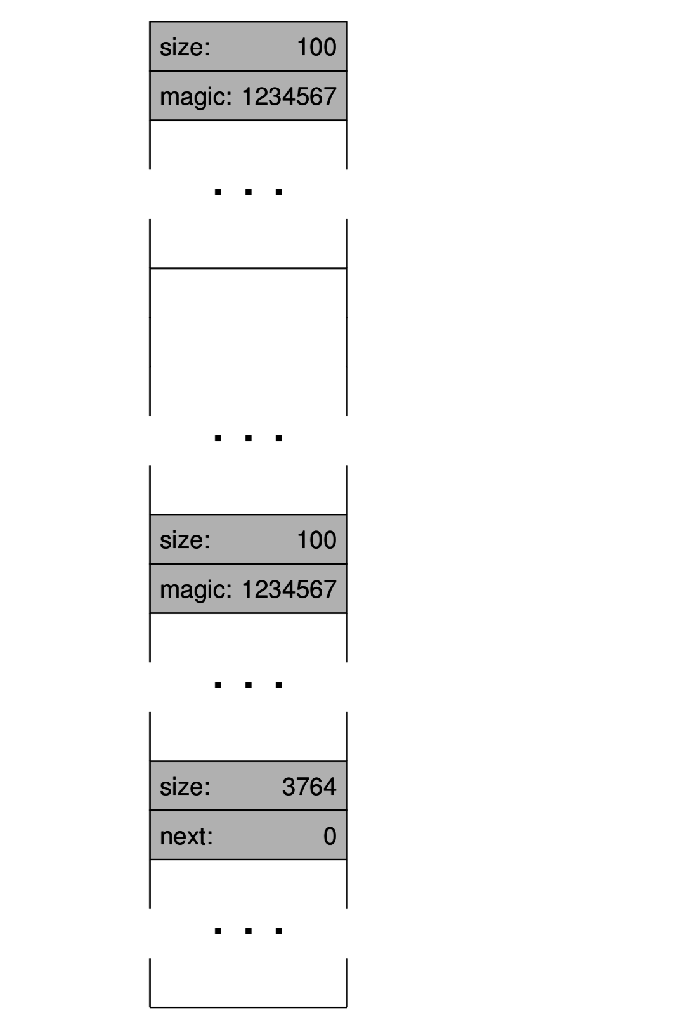
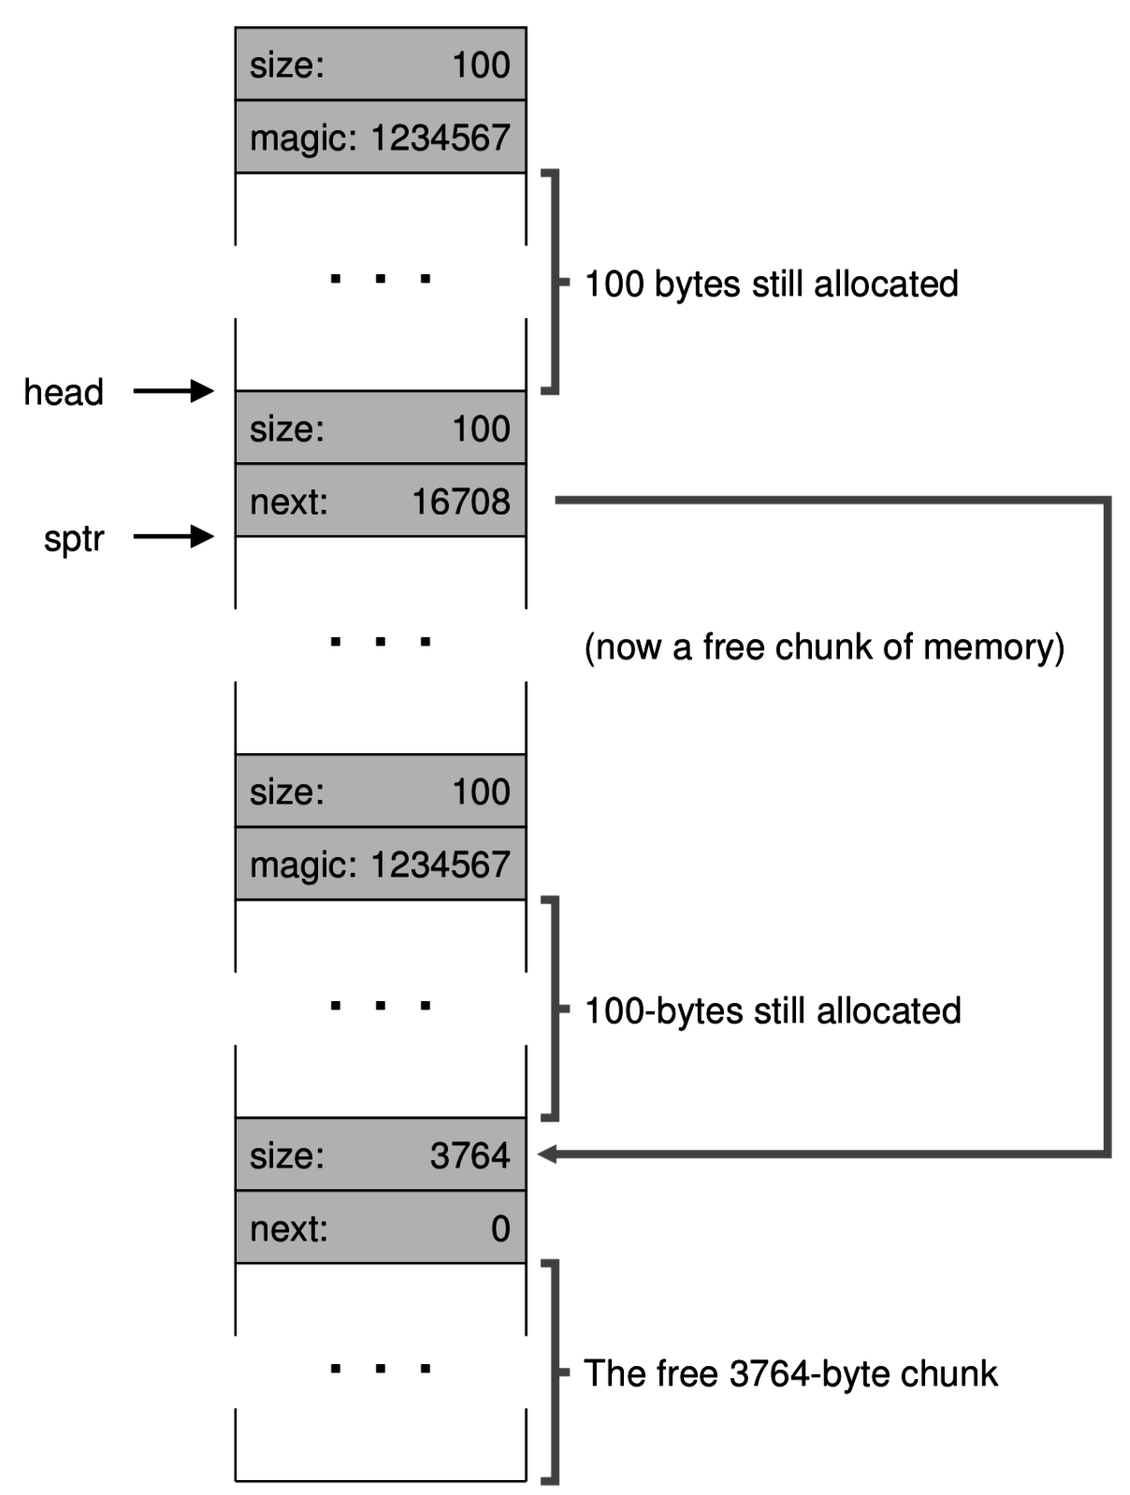
Heap example: step 4: free(sptr) …in slow motion
Look back to find block size
Clear the block
Create a new free list node

Slide 20
Heap example: step 4: free(sptr) …the net change
Before:
After:
Actually, just two small things changed!
sptr – 4 = head
head = sptr – 8
Our work is easy because malloc block headers are very similar to free list nodes

Slide 21
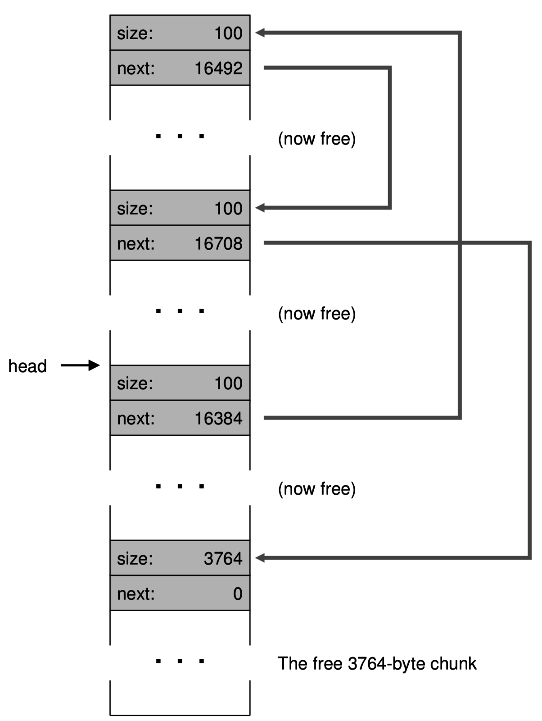
Heap example: step 5: free everything else
This leaves a free list with four chunks.
Notice that the free list is out of order.
And it badly needs to be coalesced.
1st free
2nd free

Slide 22
What’s up with the magic number?
It’s just an unusual, large numeric constant. Always the same number.
It allows free to detect whether the pointer it received is valid.
If there is no magic number behind the pointer, then
  Free should abort and warn the user.
  Maybe the code already called free? In other words, a “double free” error.

Slide 23

Intermission
Question: What could happen if you ignored the magic number and allowed a double free to proceed?

Slide 24
Linked lists are just one way to track free space
There are many alternatives, especially if you want:
  Quickly find a block of a given size
  Quickly find neighboring blocks for coalescing
One alternative is a bitmap:
  Divide the memory into fixed-size chunks and use a bit to indicate whether the chunk has been allocated.
  Memory allocations would be rounded up to a multiple of the chunk size.
  Eg., “111000000001000000”
    a used block a large free block
But lists are a very common choice

Slide 25
Free space management policies & optimizations
We have seen a basic malloc/free mechanism
  Glossed over some details of maintaining the linked list, but that’s trivial.
There are still some policy decisions to make:
  Which of the free blocks do we choose for a given allocation?
  When do we coalesce?
In other words, how do we avoid memory fragmentation?

Slide 26
Choosing a free block to serve an allocation:
First fit – simple and fast:
Next fit – start looking where you left off:
Best fit – try to leave the smallest remainder
  But have to search the whole list and leaves small holes (hard to reuse)
Worst fit – try to leave large remainders that are easy to reuse
last

Slide 27
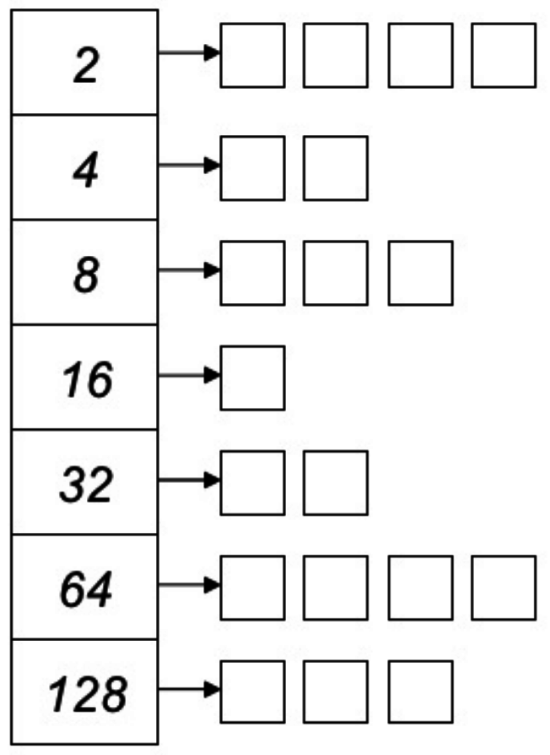
Segregated lists (Slab memory allocator)
Instead of keeping one list of free blocks, we can keep different lists for small, medium, and large blocks.
This will allow us to find the right sized block more efficiently.
Just keep an array of free lists (many heads)
On free (or if splitting), add free block to the appropriate list
Many variations are possible, but this design often uses fixed-length chunks (powers of 2).
Free block size

Slide 28

Warning: bad style
xv6 codebase suffers from some code style problems.
  Lacks comments
  Variable names are too short: np, bp, hp, s, b, etc. Why so short!?
  if/else should always use {}
  goto
Most of these are due to obsolete habits. Computer screens used to be small, so shorter code was favored.
Don’t learn these bad habits!

Slide 29
Malloc in xv6
Taken from Section 8.7 of Kernighan and Ritchie “C book”
Free list is circular (tail points back to head instead of to null)
Uses the “next fit” policy – head pointer changes each time
Free list is ordered according to memory address
  This enables easy coalescing
  When freeing a block, don’t just place it at the list head:
    Scan for the correct location in the list for that address
    Check whether neighbors are directly adjacent in memory (and coalesce)
When free list cannot serve the request, use sbrk syscall to get a pointer to a block of new memory from the OS.

Slide 30
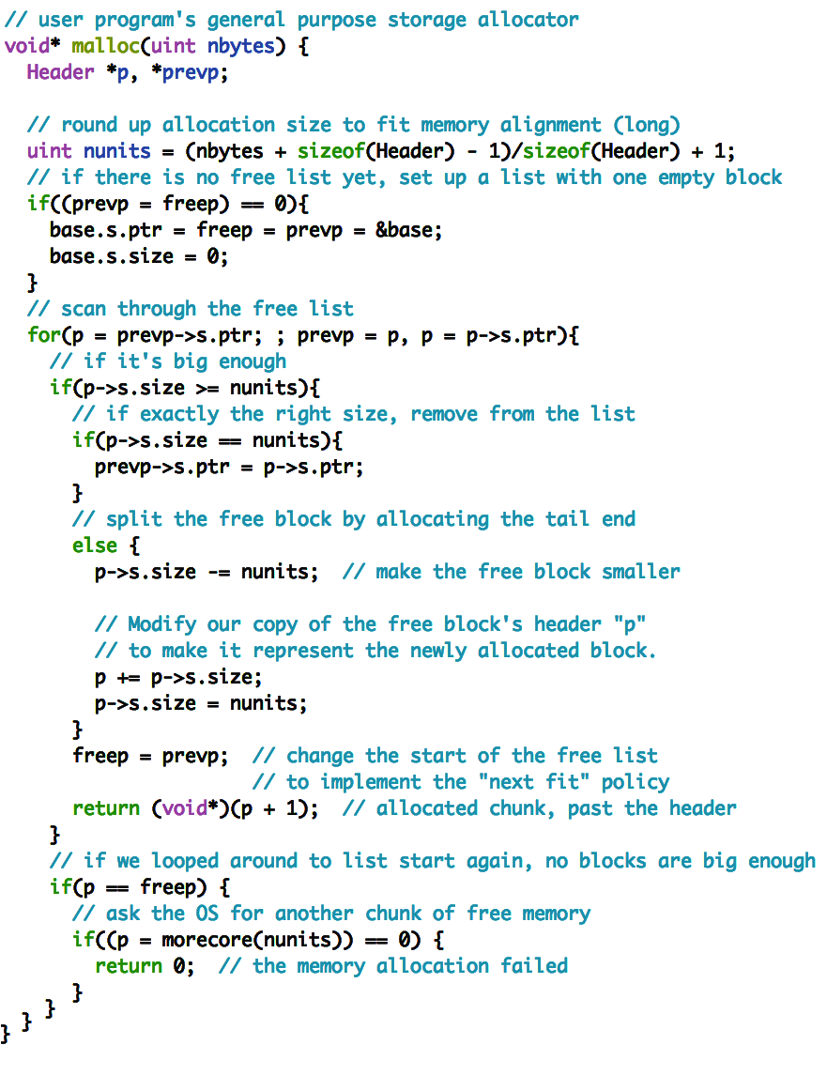
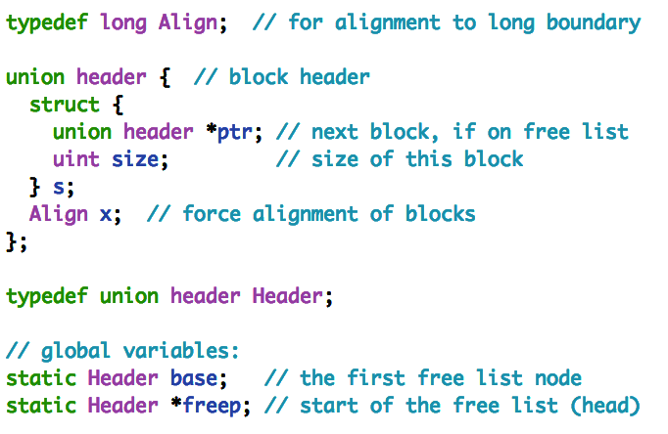
xv6/umalloc.c
(in 64-bit units)

Slide 31
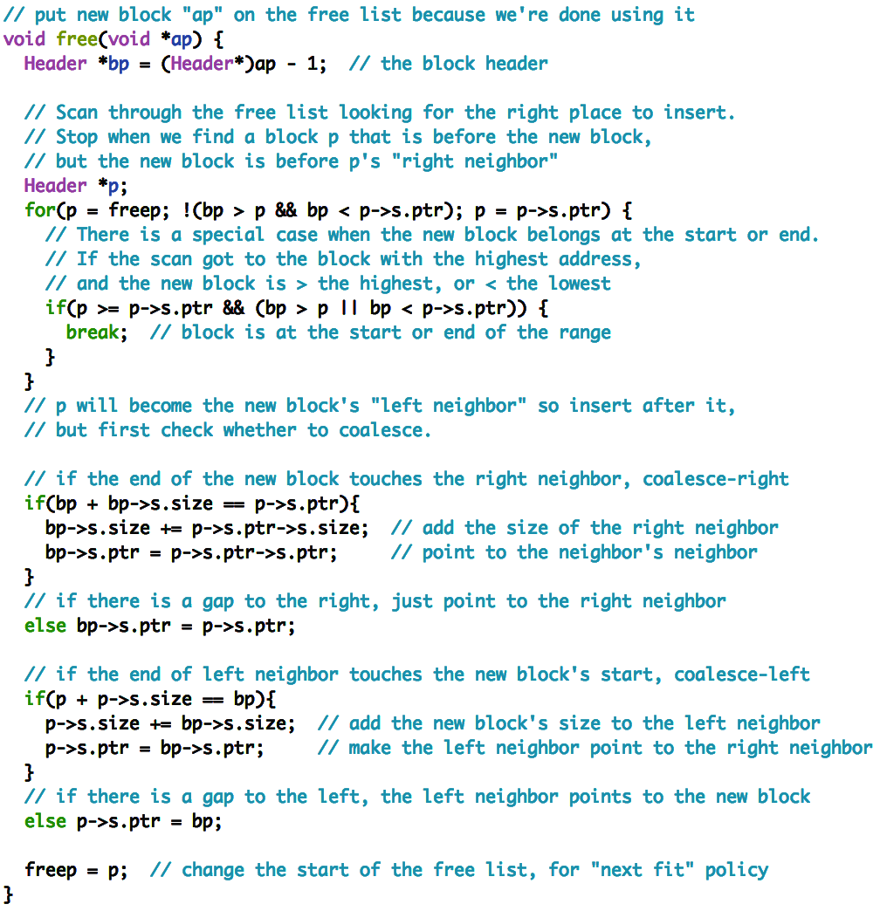
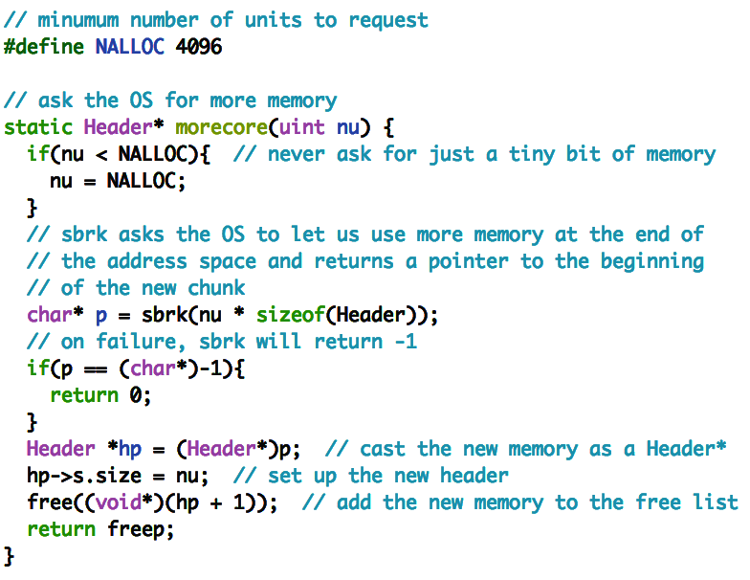

Slide 32
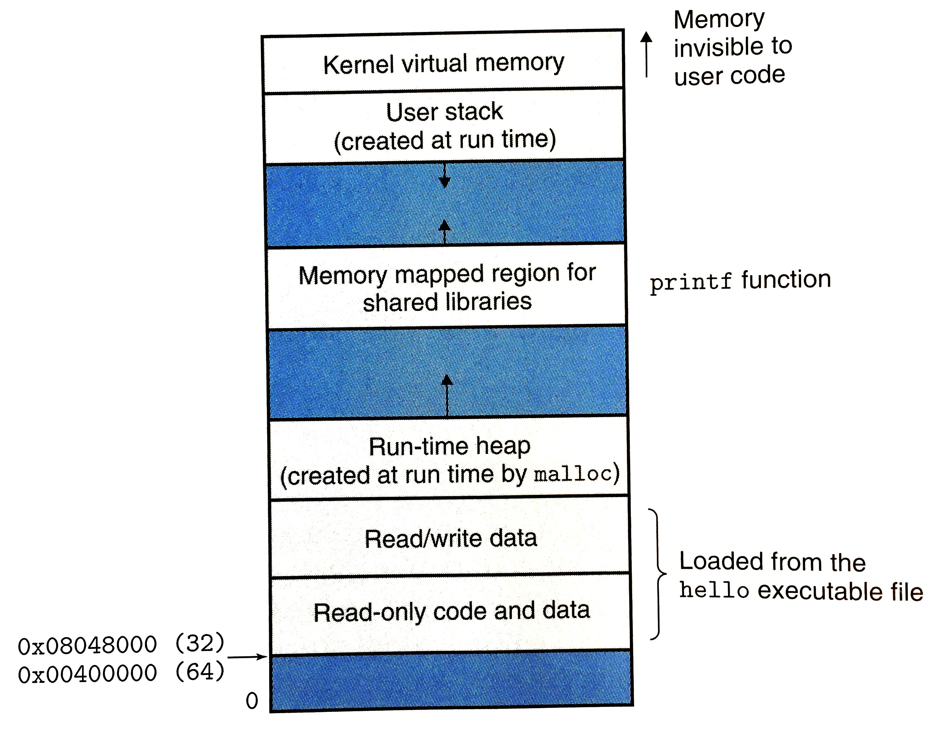
Malloc with mmap
Linux’s mmap syscall activates a new range of virtual addresses.
  The kernel chooses the virtual addresses.
  Why let kernel choose?
    The simpler sbrk requires heap to be in contiguous memory.
    Mmap with kernel-chosen location allows allocation to happen around shared libraries, stack, etc.
Notice that the malloc implementation does not care if morecore() gives adjacent memory.

Slide 33
Recap
Freed memory is put on a free list to be reused for later allocations.
A single header can be cleverly used and re-used for two purposes:
  As a linked list node when the block is free/available
  To store the size of the allocated block to help service free calls.
Free space management policy determines:
  which free blocks to choose for an allocation, and
  When to coalesce (join) adjacent free blocks
Free block choice policies include:
  First, next, best, and worst fit.

