Slide 1

EECS-343 Operating Systems
Lecture 7:
Swapping
Steve Tarzia
Spring 2019

Slide 2
Announcements
Project 2 due Monday
  It’s much more difficult than Project 1!
Midterm exam next Thursday, May 2nd

Slide 3
Last Lecture: VM & Paging optimizations
Latency cost, because each memory access must be translated.
  Translation lookaside buffer (TLB) caches recent virtual to physical page number translations.
  Software-controlled paging removes page tables from the CPU spec and lets OS handle translations in software, in response to TLB miss exceptions.
Space cost, due to storing a page table for each process.
  Linear (one-level) page tables are large.
  Smaller pages lead to less wasted space during allocation,
  but more space is consumed by page tables.
  Multi-level page tables are the only way to truly conserve space.
  Mixed-size pages reduce TLB misses.
Copy-on-write fork, demand zeroing, lazy loading, and library sharing all reduce physical memory demands.

Slide 4
Motivation for swapping
Paging allows many processes to share the same physical memory
Each process has a large virtual address space
  Programs aren’t really aware of how much RAM is in the system
  This is very convenient to the programmer, but actually RAM space is limited!
When physical RAM is fully consumed, OS must somehow react:
  Option 1: Give up and kill the memory-hog process(es)
  Option 2: Free some physical memory by temporarily moving pages to disk
    Disk is large (~100x RAM size), but very slow.
    Hopefully, some of the memory used by processes is infrequently used.
Swapping is temporarily moving memory pages to disk

Slide 5
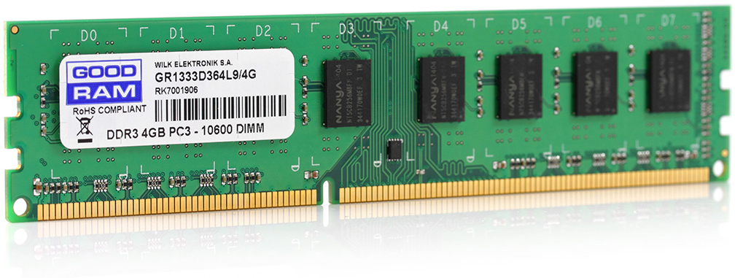
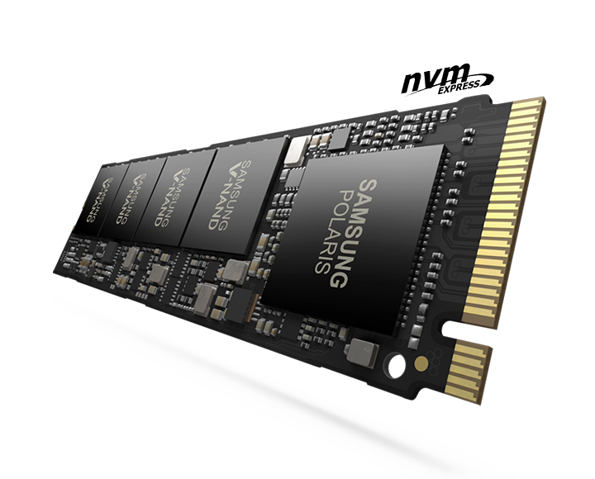
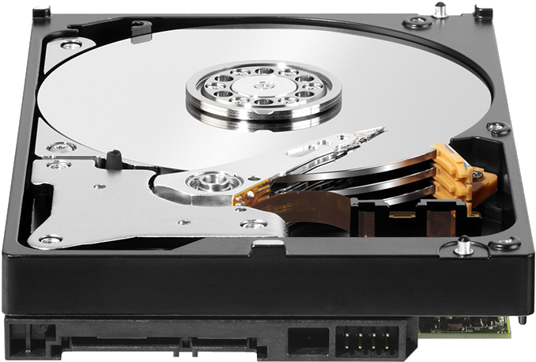
Computer storage hierarchy
delay |  | capacity
0.3ns | CPU Registers | 1 kB (kilobyte)
5ns | CPU Caches (L2) | 16 MB
50ns | Random Access Memory (RAM) | 16 GB
100μs | Flash Storage (SSD) | 1 TB
5ms | Magnetic Disk | 8 TB
Larger, but slower
Disk is about 100 times larger than RAM,
but has about 10,000 times higher latency (delay)
if magnetic, or 1000 times higher latency if SSD.
As always,
  Goal is to work as much as possible in the top levels.
  Large, rarely-needed data is stored at the bottom level
Notes:
Speed of light means that an electron can only travel 10cm in a 3ghz clock cycle. More important, however, is the resistance and capacitance of long wires and the energy/heat budget.

Slide 6
Swapped pages are stored on disk
On Linux, swap space is a special (optional) disk partition
  Allocated when you install the OS
  This part of the disk is only used for swapping, never for regular files
  Its formatting is optimized for storing page-sized chunks of data
On Windows, swap space is in a hidden file called pagefile.sys
  Allows swap space to grow and shrink on demand, sharing space with the main filesystem.
  Compared to Linux’s strategy it’s more flexible, but slower.
SSDs are better than magnetic disks for swap space, because of much lower latency (relatively little space is needed for swapping).

Slide 7
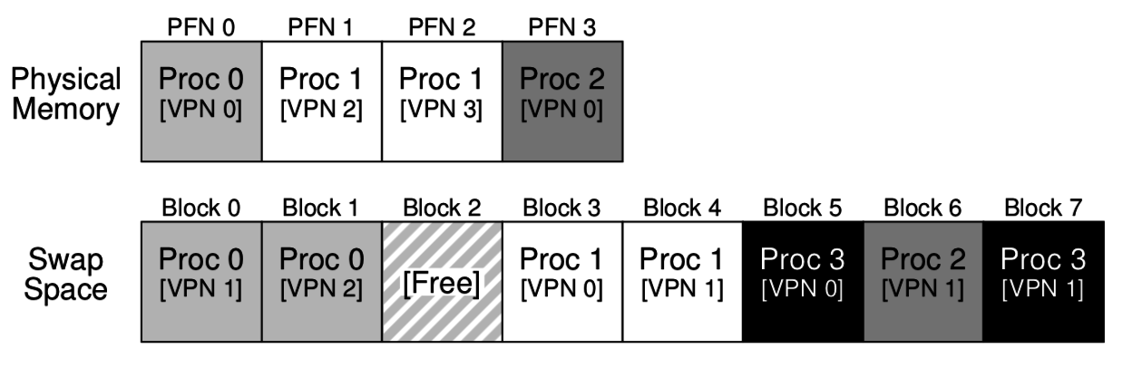
A simple swapping example
Process’s memory pages are distributed between RAM and disk:
Processes 0, 1, & 2 are partially in RAM
Process 3 is entirely in Swap Space
System’s total memory is effectively tripled (12 pages instead of 4)
But, swapped memory cannot be used by the CPU. It’s in deep storage.
  A page fault exception and some kernel action will be needed to retrieve it.

Slide 8
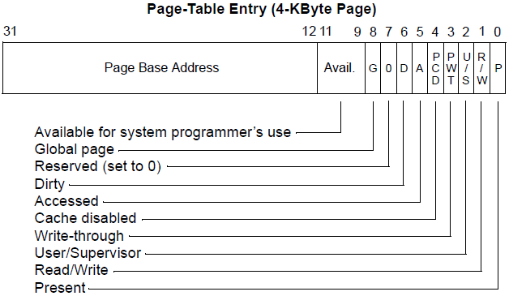
Swapping Mechanics
To swap a page to disk:
Set the PTE present bit to zero
To distinguish from an invalid page,
also store the disk address of the page in a kernel data structure.
  We can actually store the disk address in the high bits of the PTE!
  The top 31 bits can be used
Copy the page to the disk location

Slide 9
Page faults occur when PTE is marked “not present”
If CPU sees a present bit set to zero when doing a virtual address translation, it:
  sets the %CR2 register to the offending virtual address
  generates a page fault exception #14
OS handles the page fault interrupts in two possible ways:
Option 1: if process made an invalid memory access
  Read an invalid (or privileged) address or wrote a read-only page.
  Kill the process and report “segmentation fault” to the user
Option 2: if page was swapped out by the OS
  Program didn’t do anything wrong, it was just unlucky (or a memory hog)
  Have to swap in the page and retry the last instruction
How to distinguish these two cases? Interrupt handler checks the high bits of PTE:
  OS can choose to store all zeros for invalid pages vs disk location for swapped pages.

Slide 10
Types of page faults
Minor/soft: Page is loaded in memory, but PTE is not configured:
  OS just wants to be informed when the page is accessed, so it pretends to evict the page (just mark it not present). Useful if CPU has no accessed/dirty bit.
  Memory can be shared from another process (eg., shared library)
  Response: update the PTE.
Major/hard: A disk access will be needed:
  Anonymous page (process data) may have been swapped out.
  Lazy-loading program executable.
  Response: load the page from disk
Invalid: User program misbehaved:
  Dereference null or invalid pointer.
  Write to page that is read-only.
  Execute code on a page that is not executable (for security).
  Response: terminate the process.

Slide 11
Swapping in
If swap space is being used, that means that RAM is in short supply
Probably have to evict a page to make room for the demanded page.
Page replacement policy determines which page to evict
  Recall that disk read/write is very slow, so we should chose wisely.
  Goal is to minimize future page faults by evicting an unpopular page
  Evicted page can live happily on disk while it is unused

Slide 12
Magnetic disk demo
Don’t try this at home:
https://www.youtube.com/watch?v=3owqvmMf6No

Slide 13
Throughput versus Latency
There are two very different metrics for measuring I/O “speed”
  Throughput is bytes per second
  Latency is the delay before the action starts
Latency is always higher for large, distant storage devices
  Magnetic disk > SSD > RAM > L3 cache > L2 > L1 > Registers
  At best, speed of light limits information transfer to 30cm/ns
  Disk latency includes mechanical rotation and seek
However, throughput can be increased using parallelization
A small I/O to disk is just as slow as a larger one
  So, we try to batch I/O requests together.

Slide 14
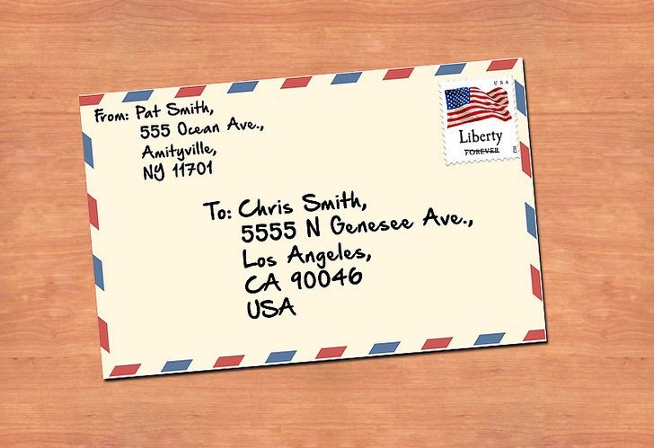
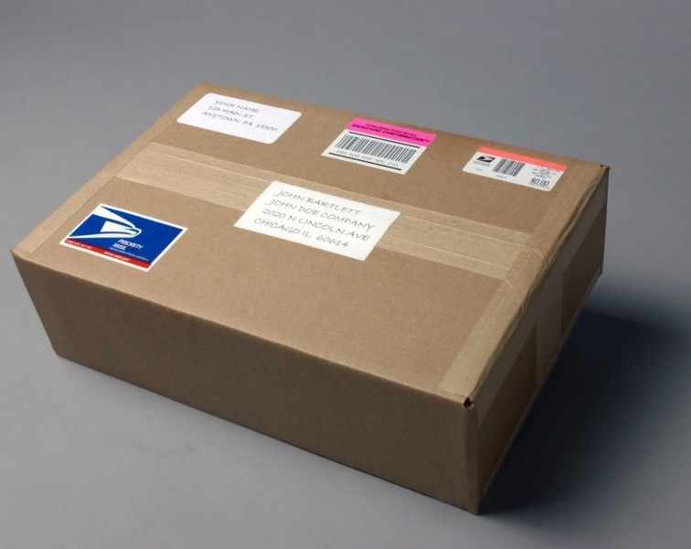
A Postal analogy
Letter represents as small disk I/O
Package represents a big disk I/O
A small letter and a big package both take the same time to reach Los Angeles.
  Latency is identical
However, the big package transfers more info at once.
Package is a batched transfer
  Package throughput is higher

Slide 15
When to swap?
Demand swapping – swap pages in response to page faults
  The simplest approach
  For efficiency, the swap would happen asynchronously:
    Interrupt handler should be fast – just start the disk I/O and block the process to let another process run.
Background swapping – swap pages preemptively
  A swap daemon (background process) periodically runs (like the scheduler)
  If # free physical frames < “low water mark,” evict some pages until the quantity reaches the “high water mark”
    The system will swap many pages at once to get from the low to high level.
    We do this because writing a large block to disk is more efficient (batched transfer)

Slide 16
Background swapping
Avoids long, unexpected delays in allocating memory
Also reduces page fault latency because there is no need to evict a page prior to swapping in.
Can be scheduled with low priority
Takes advantage of idle time to prepare future work
Linux swap daemon is a process called kswapd
Note: swapping is sometimes called “paging,” so the background process can be called a “page daemon.”

Slide 17
Page faults enable lazy allocation and lazy loading
In practice, paging is not just used to handle memory overflow
  Paging provides an opportunity to be lazy about loading requested data
  This is an important performance optimization, reducing program start time
If a process uses sbrk or mmap to request a huge chunk of memory, maybe it will not use all that memory immediately (or ever!).
  Programmers and compilers are sometimes greedy in their requests
  We can virtually allocate memory, but mark most of the pages “not present”
  Let the CPU raise an exception when the memory is really used
  Then really allocate the demanded page
Lazy loading also works for large code binaries
  Delay loading a page of instructions until it’s needed

Slide 18

Speaking of laziness – break time!

Slide 19
Page Replacement Policies
Same idea as the Translation Lookaside Buffer (TLB) in last lecture
  Again memory access either hit or miss. (Miss triggers a slow swap-in)
When time comes to evict a page, we want to choose one that will not be used again soon, and we use recent history to predict the future
Page faults are more costly than TLB misses, so we can afford to spend some time and energy implementing a sophisticated good policy.
Definition: memory pressure is high demand for memory

Slide 20
Page replacement policy – problem definition
Given:
A small number of page frames
A larger number of virtual pages
A sequence of memory accesses (a sequence of virtual page demands)
Choose:
An mapping of VPs to PFs at each time step (page table config.)
Such that:
No two VPs are mapped to the same PF at the same time
Demanded virtual page at each time step is mapped to a physical page
We minimize changes in the mapping over time. (Minimize swaps.)

Slide 21
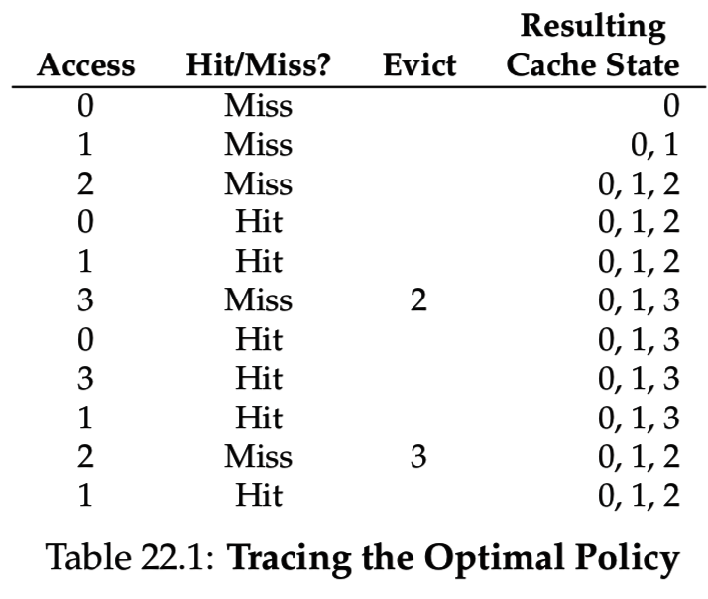
Optimal page replacement policy
Replace page that will be accessed furthest in the future
This makes sense because it will evict rarely-used pages
However, it’s not practical because we can’t observe the future
  But it’s useful to construct simulations comparing real policies to the optimal policy – a performance upper-bound.
Notice that even an optimal policy has misses due to cold-start and capacity.

Slide 22
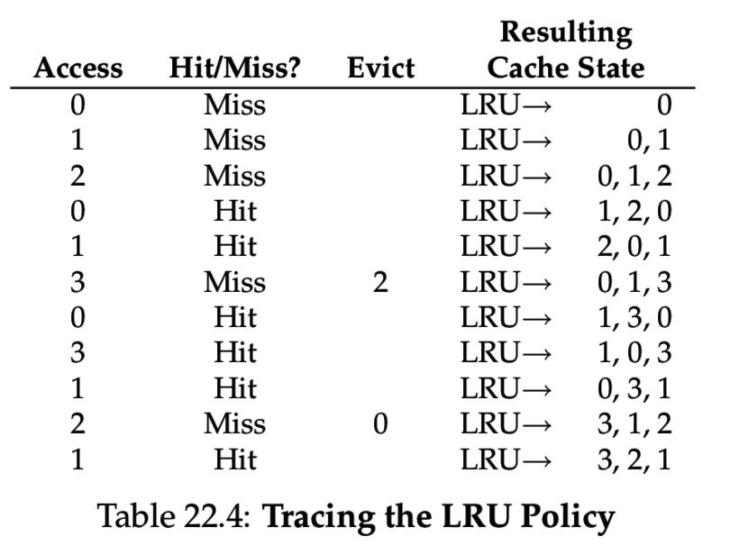
Least Recently Used (LRU) approximates optimal
Evict the LRU virtual page
Assuming temporal and spatial locality, future memory accesses should be similar to past accesses.

Slide 23
LRU suffers from “corner case” behaviors
Certain access patterns can cause LRU to make the wrong prediction every time.
Imagine a system with 3 page frames and the following access pattern:
  Virtual pages: 1, 2, 3, 4, 1, 2, 3, 4, 1, 2, 3, 4, …
  In this case the LRU page is exactly the one we’re going to use next!
  Every access would be a miss.
  The problem is that LRU’s “remembers” only the past 3 accesses,
  but the repetition happens on a longer time scale (4).
Random eviction policy avoids this “worst case” behavior
  Simple to implement
  But performs worse that LRU on many workloads

Slide 24
OS performance analysis
As we have seen, no one OS policy works best for every program.
When testing an OS (or any complex software system),
must choose a sample workload:
  A workload (sometimes called a benchmark) is a repeatable execution scenario that is meant to mimic a variety of realistic use patterns.
  Every program is written differently
  Every user places different demands on those programs
Any performance evaluation is just an experiment in conditions that should be designed to answer a particular question.

Slide 25
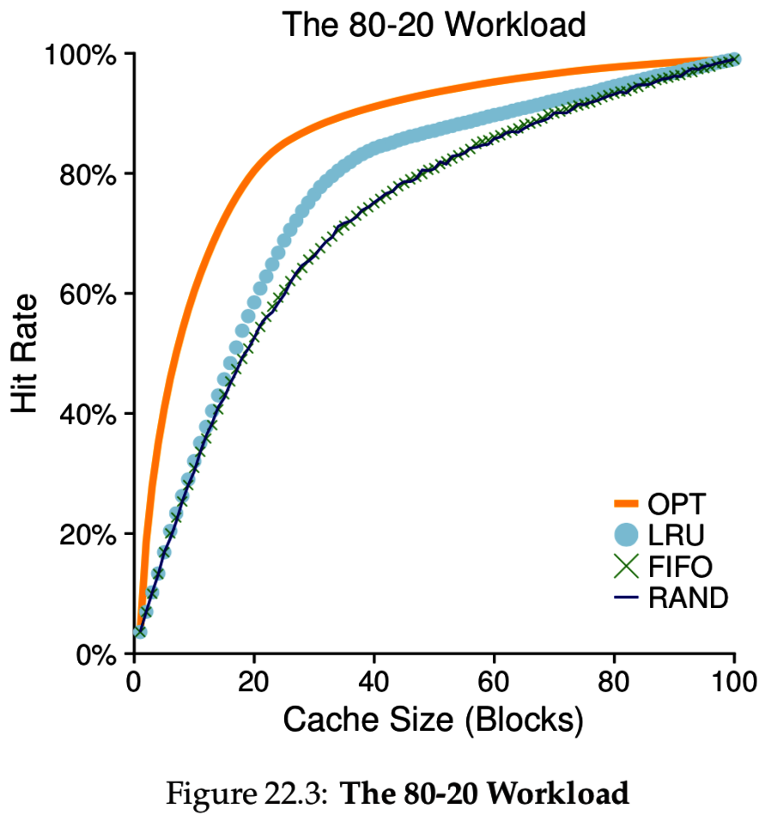
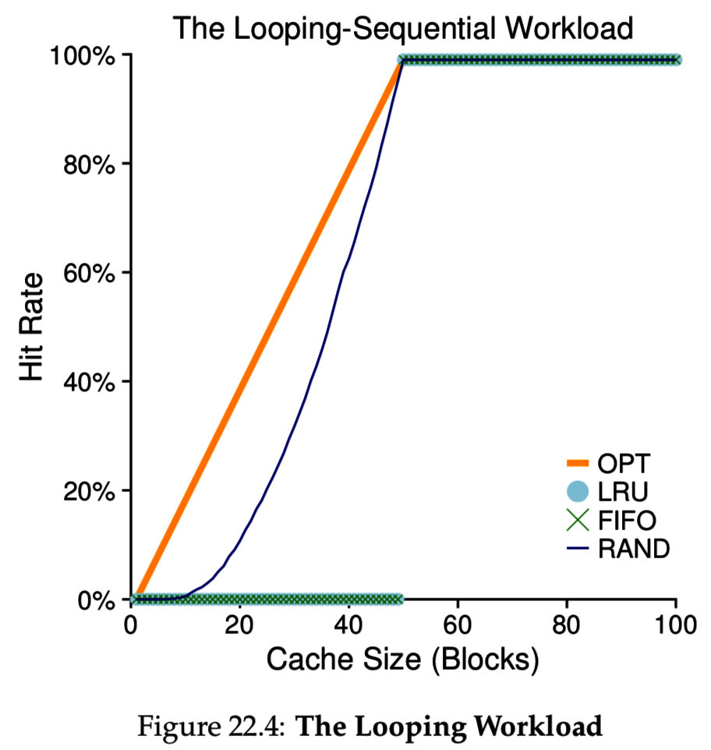
Some page replacement experiments (varying RAM size)
RAM

Slide 26
How to implement LRU
So far, OS has no way of knowing which pages were used recently
The CPU hardware provides some additional features to help the OS
  x86 sets an accessed bit in PTE if a page is read/written
  additionally sets dirty bit if page has been written
Clock algorithm:
  OS evicts the first page it sees having
  accessed = 0.
  If it sees accessed = 1,
  reset the bit and move on to next page.
  Start looking where you left off last time,
  using a circular linked list of pages.

Slide 27
Keeping your hands clean
Read-only pages are good candidates for eviction because we can simply throw out the page (without writing to disk).
  This assumes that the OS is being clever about tracking the source of pages.
For example:
  Instructions from a code binary can be be re-read from the filesystem.
  A data page can be duplicated in both swap space and in memory
    If the in-memory copy was never written, it can be evicted without re-writing it to disk.
Dirty bit allows OS to recognize data pages that have been changed and thus are inconsistent with the copy on disk.
In other words, the eviction policy should not touch the dirty pages.

Slide 28
Thrashing
Thrashing is a condition where swapping happens constantly
  This is due to processes simply using way too much memory.
  Swapping is very slow, so all programs are essentially frozen
Linux top command lets you see the page fault count per process to detect thrashing.
When thrashing, it’s usually a good idea to kill some processes.
  Better to do one thing well than to do many things very poorly

Slide 29
Approximating LRU for page replacement
Clock algorithm is one option:
  Basically, just scan through pages until we find one with accessed bit = 0.
  Not truly LRU, but will find a page that was not recently used.
What if our CPU architecture doesn’t set an accessed bit (like VAX)?
  Emulate an accessed bit using the present bit and page faults.
  Set present bit = 0 but leave page in physical memory and leave address in PTE.
    Set one of the OS-reserved bits in the PTE to recognize that the page is given a second chance.
  If we see a page fault then the page was read, set present = 1 (no need for I/O)
The above is called the Second chance algorithm:
  Pretend page was evicted, but just test to see if it will be accessed again

Slide 30
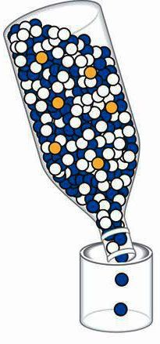
Disk buffering and filesystem caching
Swapping gives the illusion that RAM is as big as the disk.
Similarly, filesystem caching gives the illusion that disk is as fast as RAM.
Programs explicitly access three kinds of storage:
(1) registers (2) memory (3) files
File I/O can be a significant performance bottleneck:
  A bottleneck is the one slow component that limits performance
Filesystem caching:
  To improve performance, OS stores most recently used “pages”
  of disk in RAM (physical page frames).

Slide 31
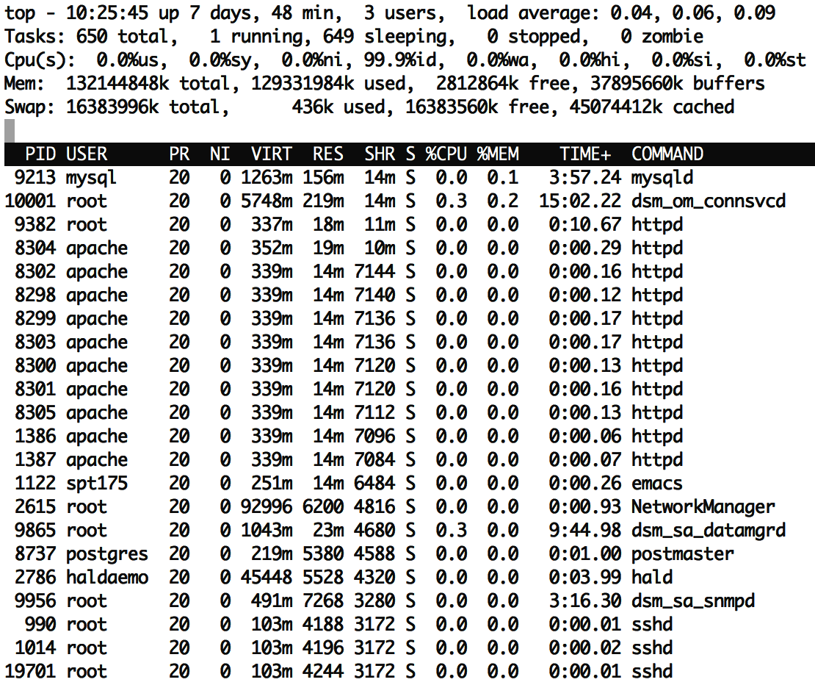
top also reports filesystem cache size
buffers and cached both represent file data that is being stored in memory for improved performance
  There is a slight difference between the two, but it’s not important.
This machine has lots of RAM (128GB)
  The majority of RAM is now being used to cache files (~83GB)

Slide 32
Unified Page Cache
In modern OSes, the page replacement policy simultaneously considers
placement of both VM pages and disk blocks in physical RAM.
  May choose to evict either a VM page or a cached disk block.
  Eventually, disk blocks are really written to the disk (flushed).
    Certainly when the page is evicted, but may also be flushed earlier to make sure the file data is not lost if the machine crashes or loses power.
A VM page is either:
  file-backed if it can be reloaded from a file (code)
    We can discard this page if evicting
  anonymous if it is memory that was created by a process
    Must save page to swap space if evicting

Slide 33
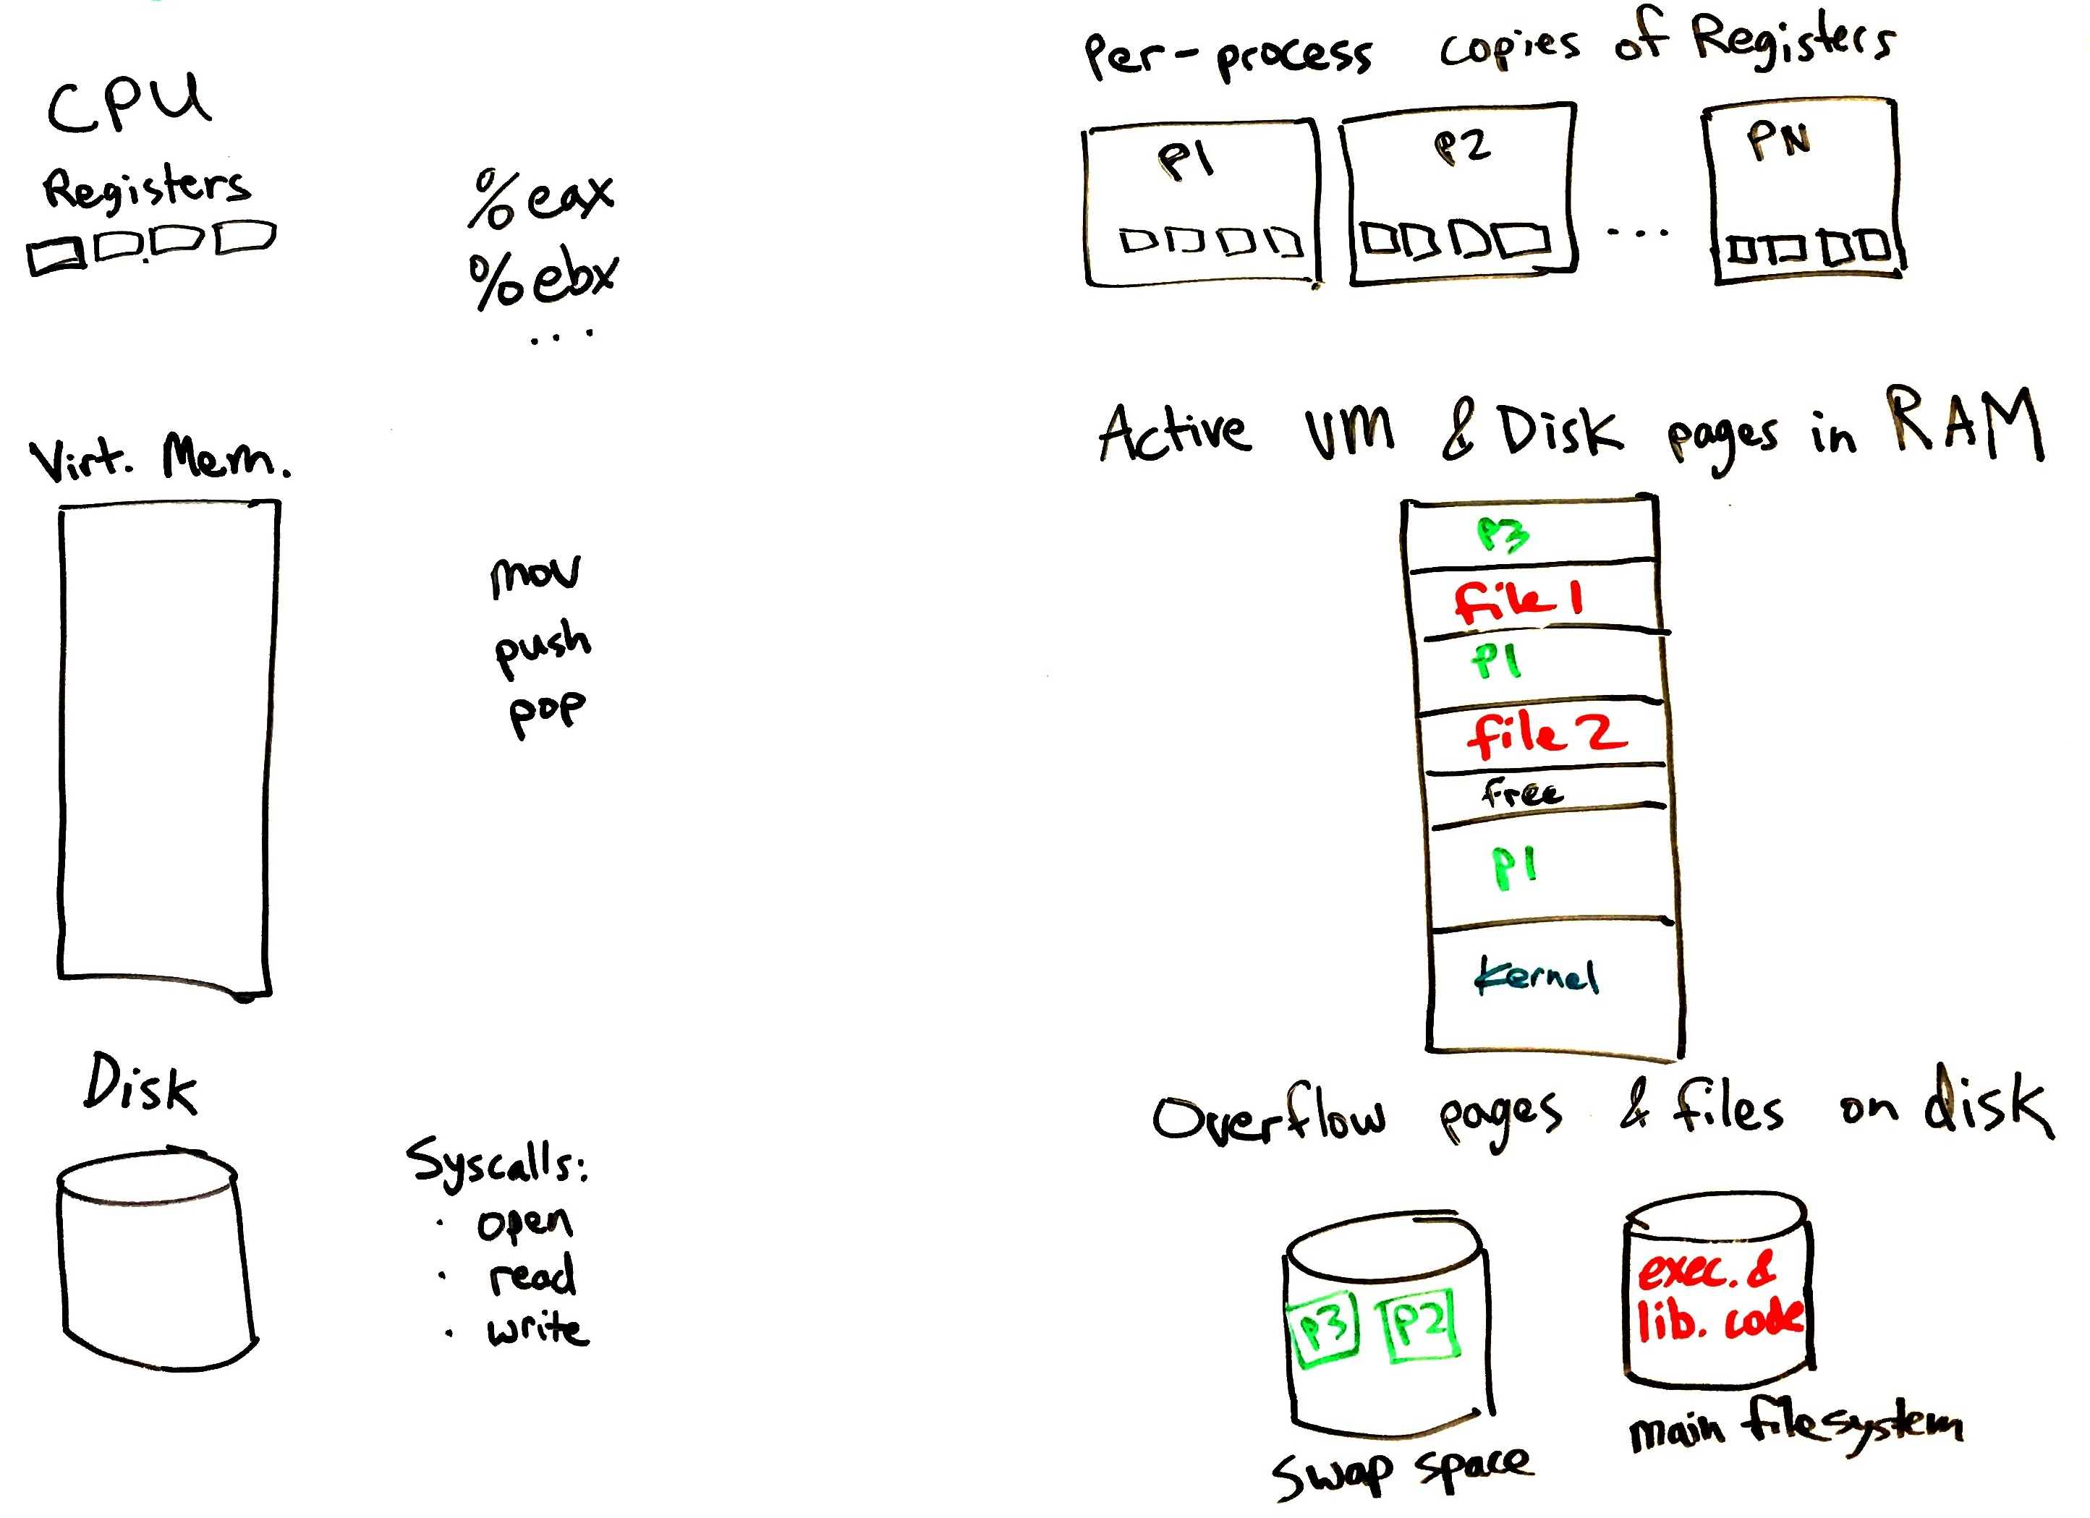
Programmer’s view OS’s view Reality …
Hardware has further optimizations which the OS cannot see:
CPU places most recently accessed RAM in L3, L2, and L1 caches.
Disks have caches of ~128 Mb.
Hybrid disks migrate data between flash and magnetic platters.

Slide 34
The benefits filesystem caching
Filesystem caching allows programmers to focus on functionality rather than performance.
Write data to disk if it needs to be persistent.
Don’t worry about disk speed, OS will somehow make it seem fast.
Actually, accessing a file can be almost as fast as a register if the disk block is stored in an L1 cache.
  Although there will be some overhead for the file read/write syscall
A great example of why intelligent OSes are important!

Slide 35
Recap
Disk is slow, but large, and can be used to store RAM’s overflow
  Disks have high throughput (transfer bitrate) but high latency (delay)
  Magnetic disks have even higher latency than SSDs, due to moving parts.
Paging and swapping work together, using the same CPU mechanisms
  If a page is marked “not present” it may be either invalid or swapped to disk.
    Or it might indicate lazy allocation, lazy loading, or copy-on-write, as we saw last time.
  High bits of page table entry can store disk location of swapped page.
Page replacement policy decides which page(s) to evict to free memory
  Swapping can be done on demand or in the background
  Having some free physical frames will prevent delays for allocations.
  Accessed bit and Dirty bit in PTEs inform the page replacement policy
Thrashing is when swapping prevents the system from doing any work.
Unified page cache handles both traditional paging and file caching.
  Makes filesystem access seem just as fast as memory access.

