Slide 1

EECS-343 Operating Systems
Lecture 6:
Memory management optimizations
Steve Tarzia
Spring 2019

Slide 2
Announcements
HW 1 due Monday
Project 2 due the following Monday
  It’s much more difficult than Project 1!
Midterm exam in two weeks (Thurs. May 2nd).
Physical memory management for Project 2.2:
  Free physical memory pages in xv6 is managed with a circular linked list.
  Each free physical page stores a pointer to another free physical page.
  kalloc() removes one physical page from the free list.
  kfree() returns a physical page to the free list.
  We’ll talk more about free lists next week.

Slide 3
Last Lecture: Virtual Memory
Memory is divided into equal-sized pages.
Page tables translate virtual page numbers to physical page numbers.
Showed the details of page table entries (PTEs):
  High bits translate from virtual page number to physical page number.
  Low bits in the PTE are used to indicate present/rw/kernel page.
During a context switch, kernel changes the %CR3 register to switch from the page table (VM mapping) of one process to another.
VM is handled by both the OS and CPU:
  OS sets up the page tables and handles exceptions (page faults).
  CPU automatically translates every memory access in the program from virtual addresses to physical addresses by checking (walking) the page table.

Slide 4
Paging costs
Latency
  Every memory access now requires an additional read to get the physical page number from the page table
  RAM access is slow (~50ns), so this is very bad!
Space
  Each process must have a page table mapping the entire address range
  On a 32-bit system linear page tables would consume 4MB of mem per process
    Assuming 4kb pages, and 32-bit addresses (4GB of virtual memory)
    we require one million PTEs. Each PTE is 4 bytes.
    On a 64-bit system this would be much, much worse

Slide 5
Translation lookaside buffer (TLB)
TLB is the solution to our paging latency problems
TLB caches recently used PTEs
  In other words, it’s a small fraction of the current page table that is stored on-chip, in fast memory.
  Usually “fully associative”
Caches are common in computer systems
  A cache is a record of recent transactions that allows you to skip repeated requests
  Eg., a web browser caches all your HTTP GET requests so that you don’t have to reload repeated images, like logos, menus, etc.

Slide 6
Why does a TLB help?
Because programs don’t access random addresses
We’re likely to need the same translations in the future
Temporal locality – programs reuse the exact same memory addresses
Spatial locality – programs typically will access memory near recently-used memory. For example:
  Looping through an array (each access is adjacent to the last one)
  A function’s local variables and parameters are on the same stack frame.
  Code has to be read from memory, and these are contiguous until a branch/jump happens

Slide 7
Cache dynamics
A cache hit is when data is found in the cache
  This is the fast case, and hopefully the most common
A cache miss is when data is not found in the cache
  Our attempt to take a shortcut failed
  Must carry out the request normally (access page table in RAM)
  When done, store the data in the cache for next time
  To make space in the cache, we must chose an existing entry to evict (remove)
CPU caches (like the TLB) make performance unpredictable because
  It’s usually invisible to the OS (*except for software-managed TLBs)
  Cache status depends on prior activity, perhaps by other processes.

Slide 8
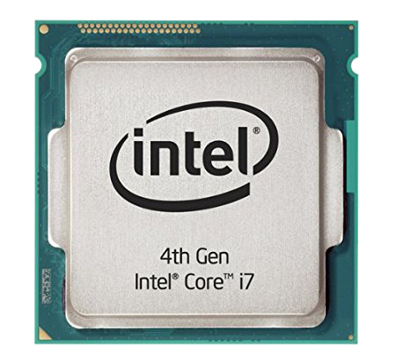
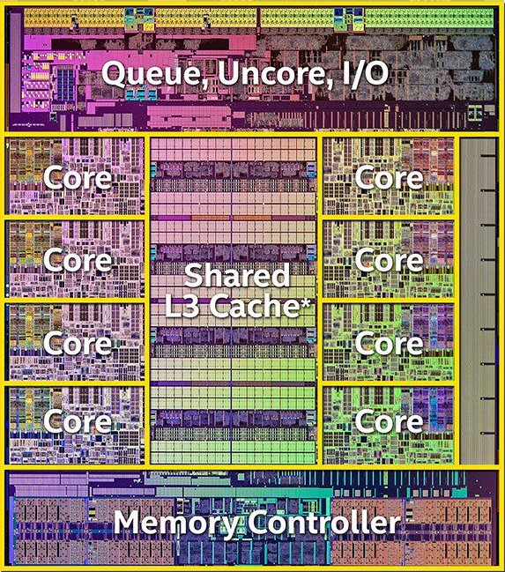
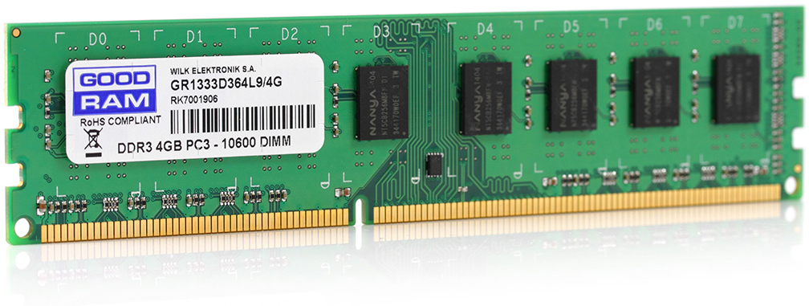
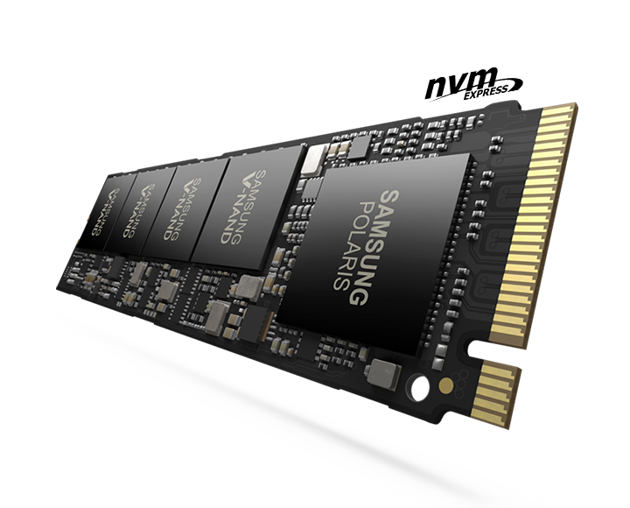
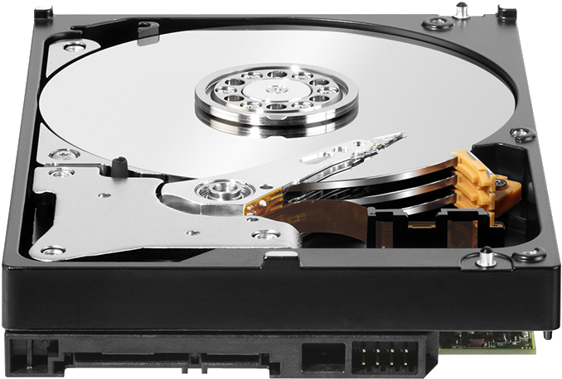
Computers have a hierarchy of storage
delay |  | capacity
0.3ns | CPU Registers | 1 kB (kilobyte)
5ns | CPU Caches (L2) | 16 MB
50ns | Random Access Memory (RAM) | 16 GB
100μs | Flash Storage (SSD) | 1 TB
5ms | Magnetic Disk | 8 TB
Larger, but slower
Disk is about ten billion times larger than registers,
but has about ten million times larger delay (latency).
Goal is to work as much as possible in the top levels.
Large, rarely-needed data is stored at the bottom level
“Memory” is not just RAM, but everything below the registers
Notes:
Speed of light means that an electron can only travel 10cm in a 3ghz clock cycle. More important, however, is the resistance and capacitance of long wires and the energy/heat budget.

Slide 9



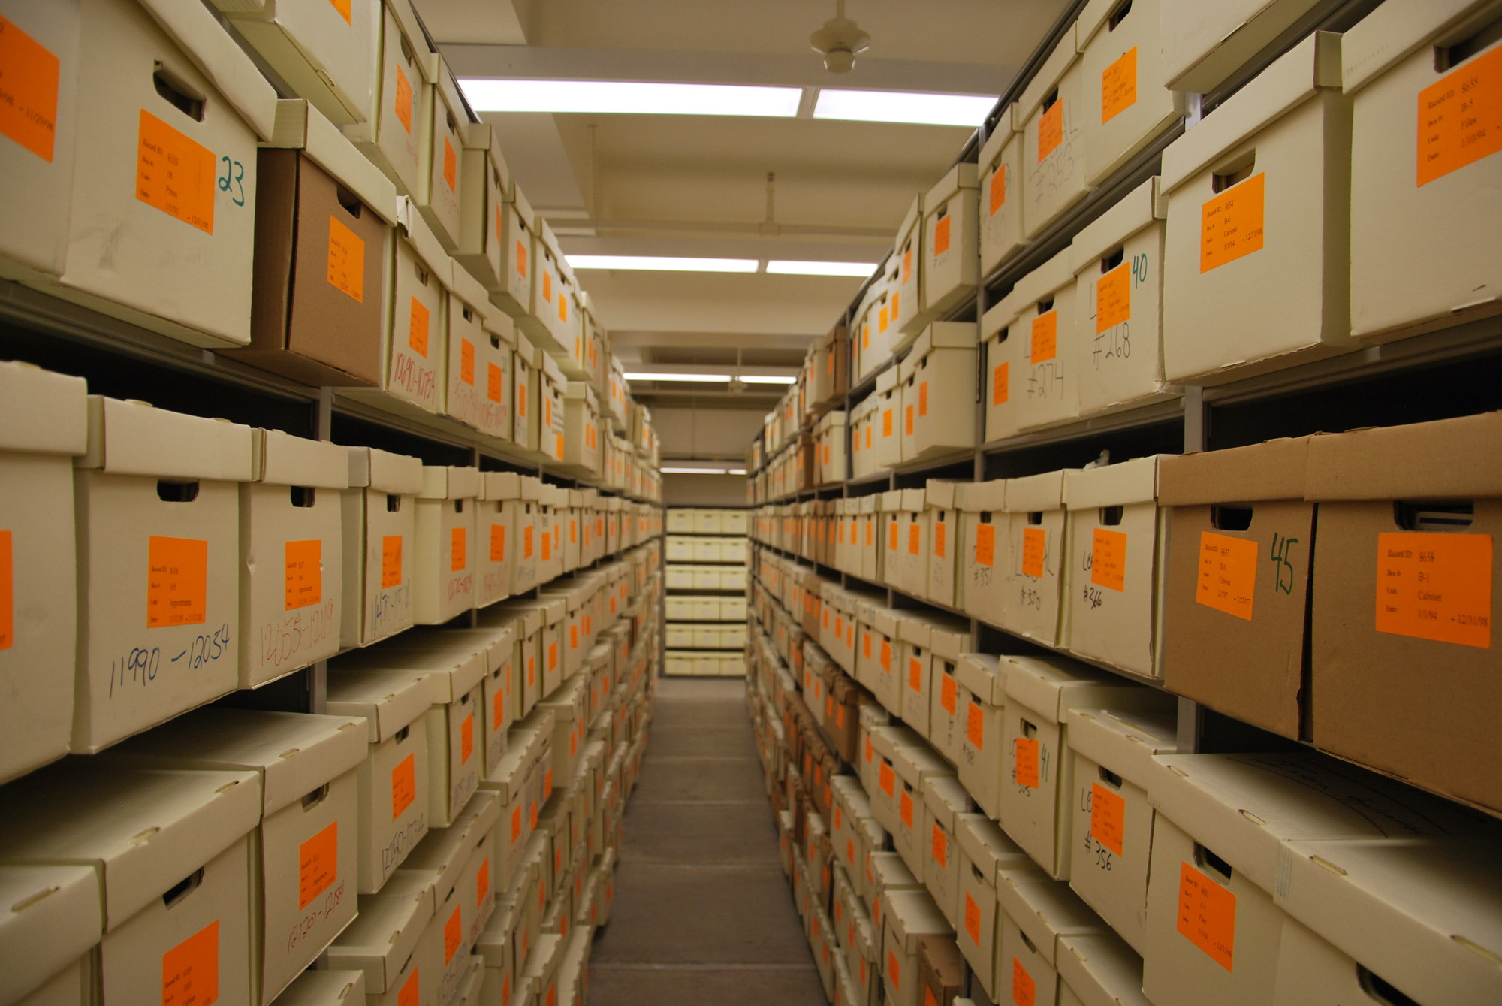
Paper-in-office analogy
Imagine doing a really complex pen-and-paper data analysis.
You would move papers between these storage levels, as needed:
You would move papers in chunks (folders or boxes).
Organize papers to keep related sheets together, to reduce the number of data-fetching trips.
delay |  | capacity
< 1s | Papers on desk | 4 sheets
5s | Stack of paper on desk | 20 sheets
10s | File folders in one desk drawer | 1,000 sheets
5 min. | Filing cabinets in storage room | 100k sheets
1 day | Off-site archival warehouse | 10M sheets
Larger, but further
Notes:
Difference between registers and magnetic disk (10M times) equates to 3 month delay. Think of an off-site warehouse in Antarctica, where there are two shiping trips, one at the beginning of summer, and one at the end of summer. Instead of working on papers, maybe you are doing a biological analysis and the samples have to be kept frozen. It’s cheapest to archive the samples in the poles.

Slide 10
Software-controlled paging
Intel x86 CPUs (and xv6) use hardware-managed TLB
  CPU automatically walks the page table & controls the TLB
Some RISC CPUs use a software-managed TLB:
  These CPUs know nothing about the page tables. Just uses the TLB.
  If a translation is not present in the TLB, CPU causes an exception
  OS interrupt handler consults its page tables to find the address translation.
  OS evicts an entry from the TLB and adds the new translation to the TLB, using special instructions.
  Interrupt return instruction resumes by repeating the instruction that failed.
  Flush the TLB before a context switch.
This can simplify the CPU hardware and gives more control to the OS.

Slide 11
Reducing space overhead of paging
Recall that we need 10⁶ PTEs for 32-bit address space & 4kb pages
We can reduce the page table size by making pages larger:
  4MB “superpages” on x86 lead to just 1000 PTEs (4kb overhead) per process
  Also leads to more TLB hits, because each page translation serves more data
  However, superpages are not a full solution
  Allocating huge pages for everything will lead to wasted space
We would like to keep fine-grained page allocation, but lose some of the overhead.

Slide 12
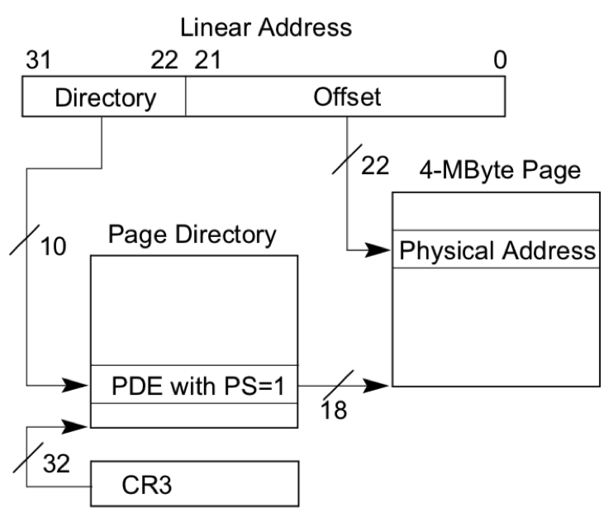
Linear (one-level) page table with 4mb (big) pages
This is a real option on Intel x86.
Page table size = 4gb/4mb = 1,000 * 32bit
We actually want small (4kb) pages,
to waste less space when allocating.
Theoretically, a linear page table could
also be used for regular-sized (4kb) pages…
But it would be huge even for a 32-bit system
with just 4gb of RAM:
  4gb/4kb = 1 million entries
  Each process would need a 4mb page table!
  That’s OK for a large process, but unacceptably wasteful for small processes.
A two-level page table can start small and it adapts its size as needed.

Slide 13
Linear page table addressing clarification
How are 18 bits from PDE + 22 bit offset (40 bits) used to find a 32-bit address?
Add 14 zeros to end of 18-bit PDE value to find the 32-bit starting address of the 4mb page (page must be aligned to a 16kb frame).
22 bit offset finds the location within that 4mb page.

Slide 14

Linear page table has fixed space overhead
The page table space overhead is actually OK for large processes.
  4MB page table is just 0.1% of a process using the full 4GB of memory
However, the 4MB overhead is terrible for small processes
  Most of the page table will be empty:
  (PTEs will have “present” bit = 0)

Slide 15
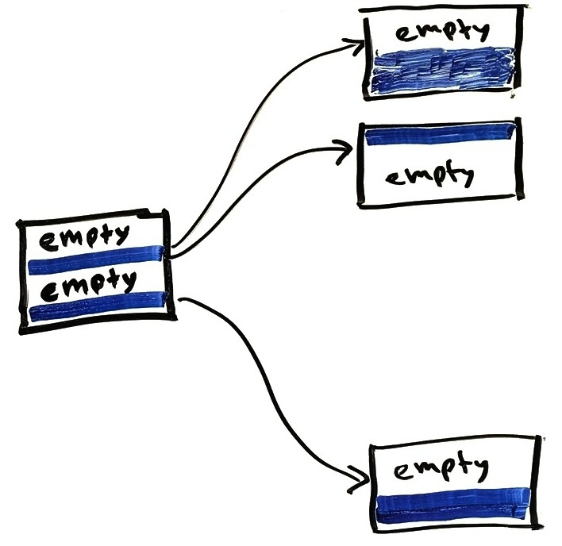
Multi-level page tables eliminate wasted space
Only the occupied parts of the page table are represented in full detail.
Small page directory indicates which parts of the page table are used. If used, there is a pointer to the page table details

Slide 16
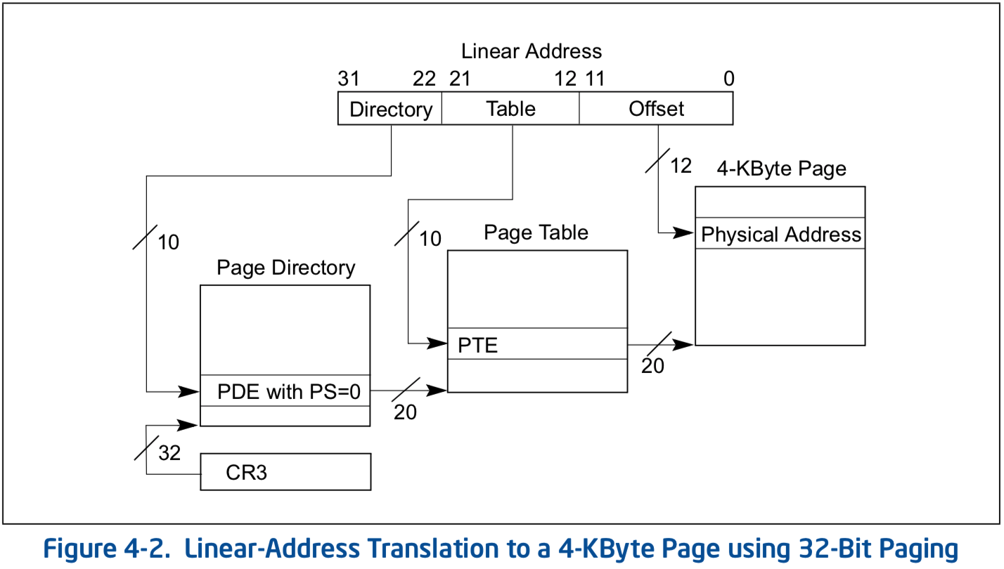
Multi-level page table mechanics
Virtual address is broken into 3 or more parts
Highest bits index into the highest-level page table
A page fault can occur if an
entry is missing at any level
OS can initialize a process
with just a highest-level table
and just a few lower-level
tables.
More tables are added as a
process demands more
memory

Slide 17
2-level page table addressing clarification
Page table pages must be aligned to a 4096 byte page
  In other words, the bottom 12 bits of the address must be zero
In two level paging:
  PTE address is constructed with:
    20 bits from PDE
    10 bits from middle of linear address
    2 remaining bits are zero because PTEs are 4 bytes long
    = total of 32 bits

Slide 18
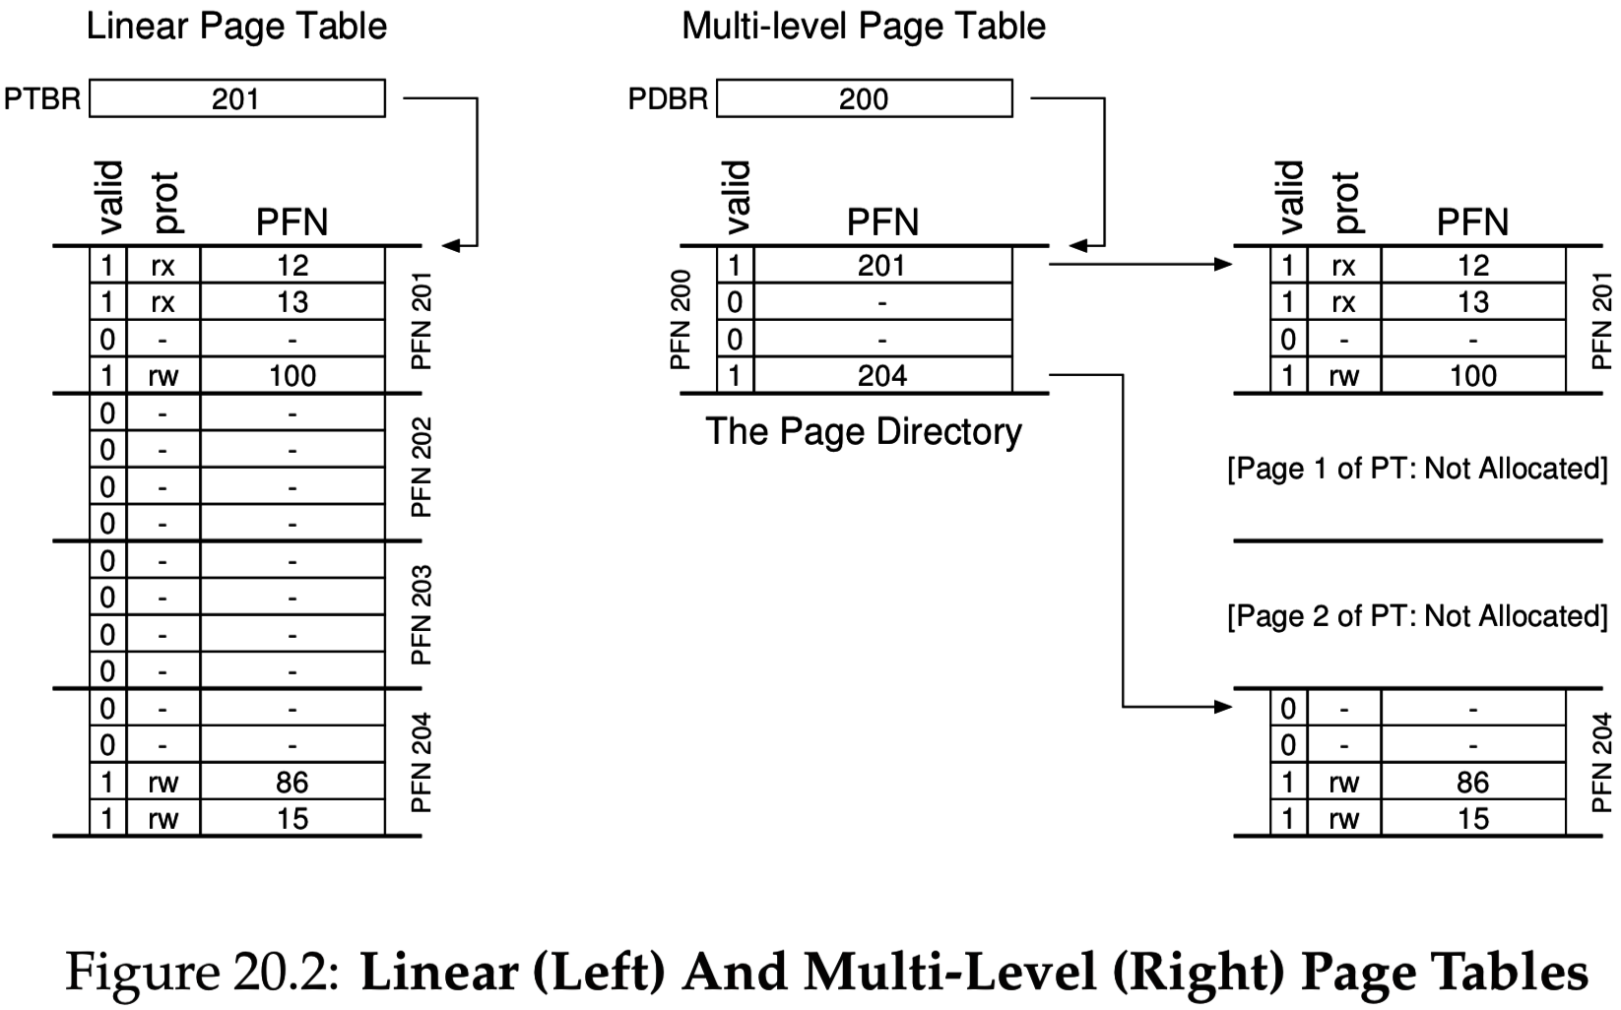
Multi-level paging example (from 3EP book)
Notice the valid bits.
CPU will cause a page fault exception if it encounters a valid=0 PTE when walking the table.
  Will also cause an exception if writing to an address whose PTE is marked not writable, etc.

Slide 19
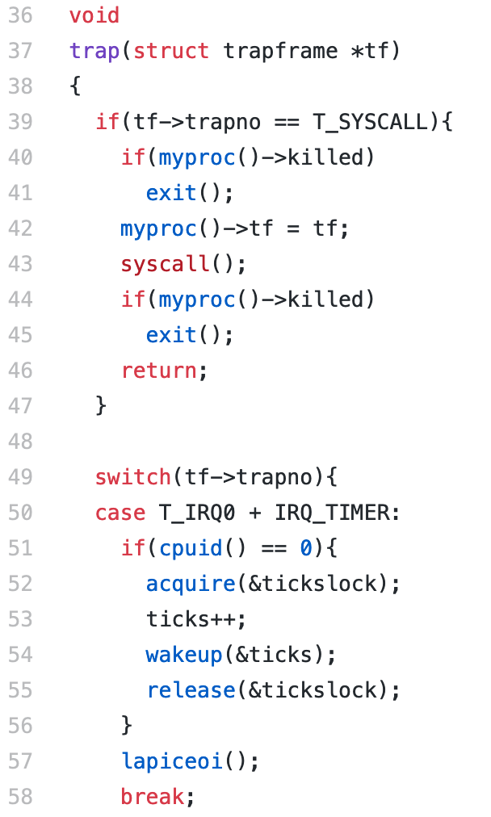
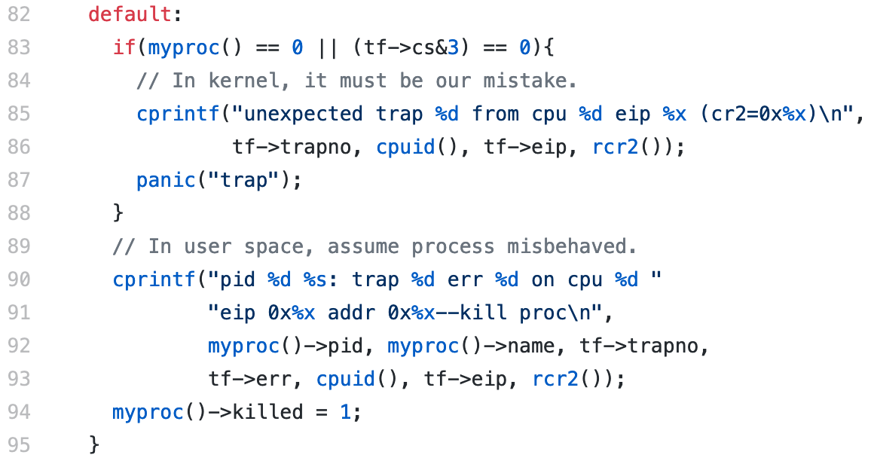
Improper virtual memory access causes an exception
Project 2.2 requires a new interrupt handler in trap.c:
…

Slide 20
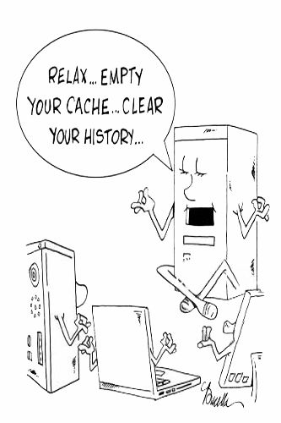
Intermission

Slide 21
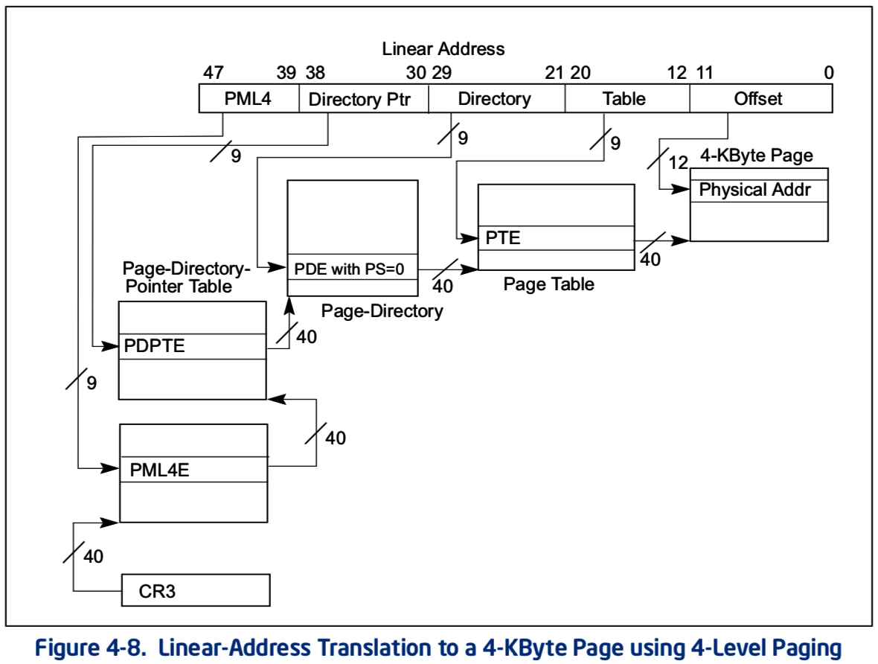
64-bit address space requires > 3 levels
64-bit address space allows 1.8 × 10¹⁹ = 18 billion gigabytes of memory
So, 64-bit address spaces are
very, very sparse
Requires 3 or 4 paging levels
to keep page tables small:
x86-64 CPUs actually use
48-bit memory addresses, not 64.
  But it still requires 3 or 4 levels

Slide 22
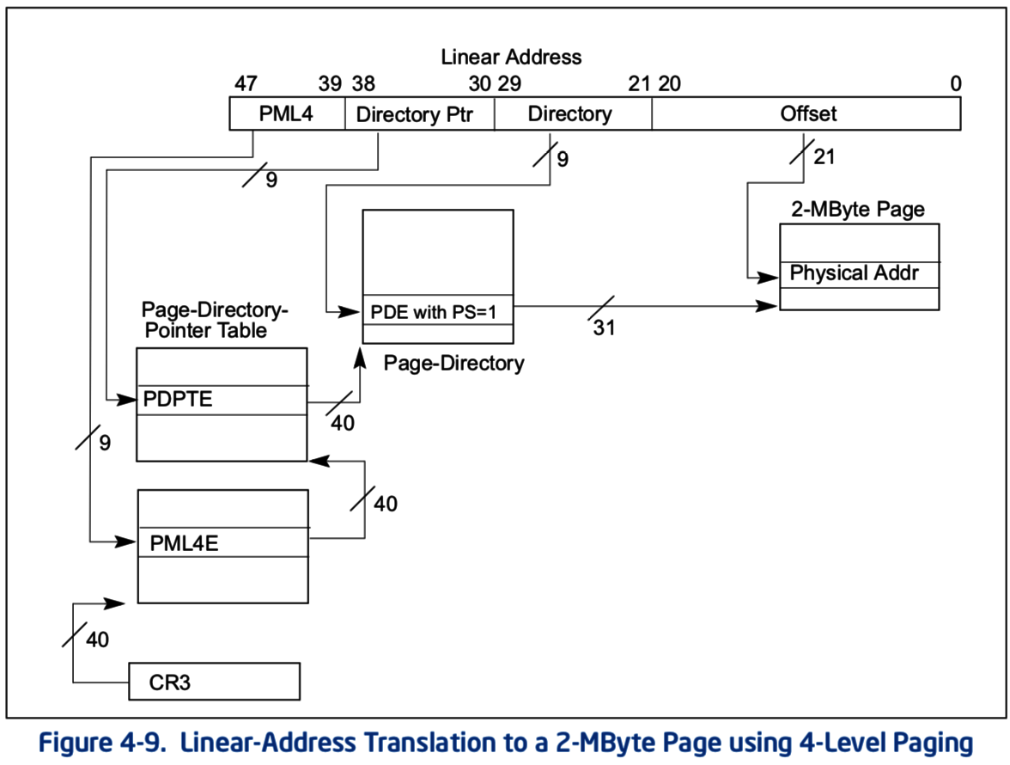
x86 lets you mix page sizes – throw in a 4mb page!
Set a bit here to skip straight to a big page.

Slide 23
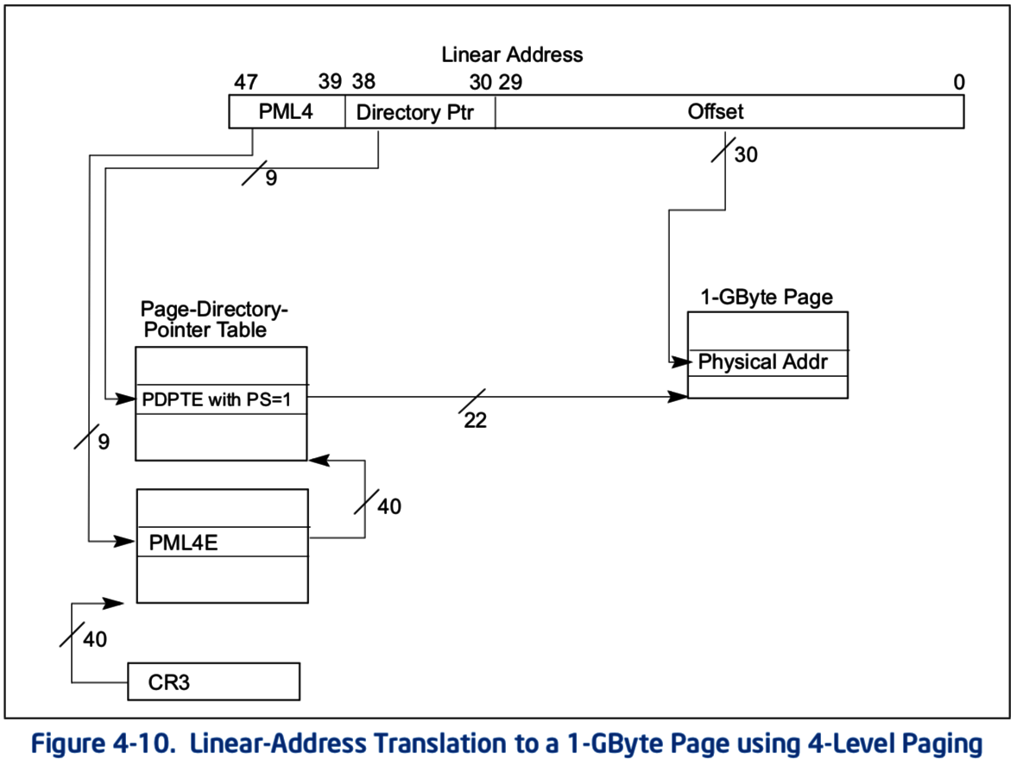
… or even a 1GB huge page
Why use a huge page?
If you’re using a huge chunk of data…
  (it makes the page table smaller, but that’s not too important)
Just one TLB entry can be used for 1GB of data.
  Conserves precious TLB space.
Thus, reduces TLB miss rate!

Slide 24
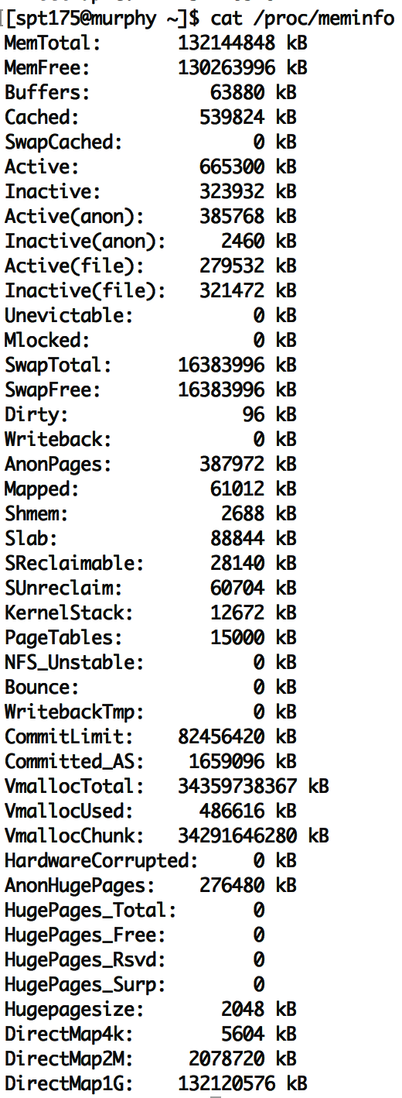
To see VM info on Linux
cat /proc/meminfo
vmstat
top
  (resident)

Slide 25
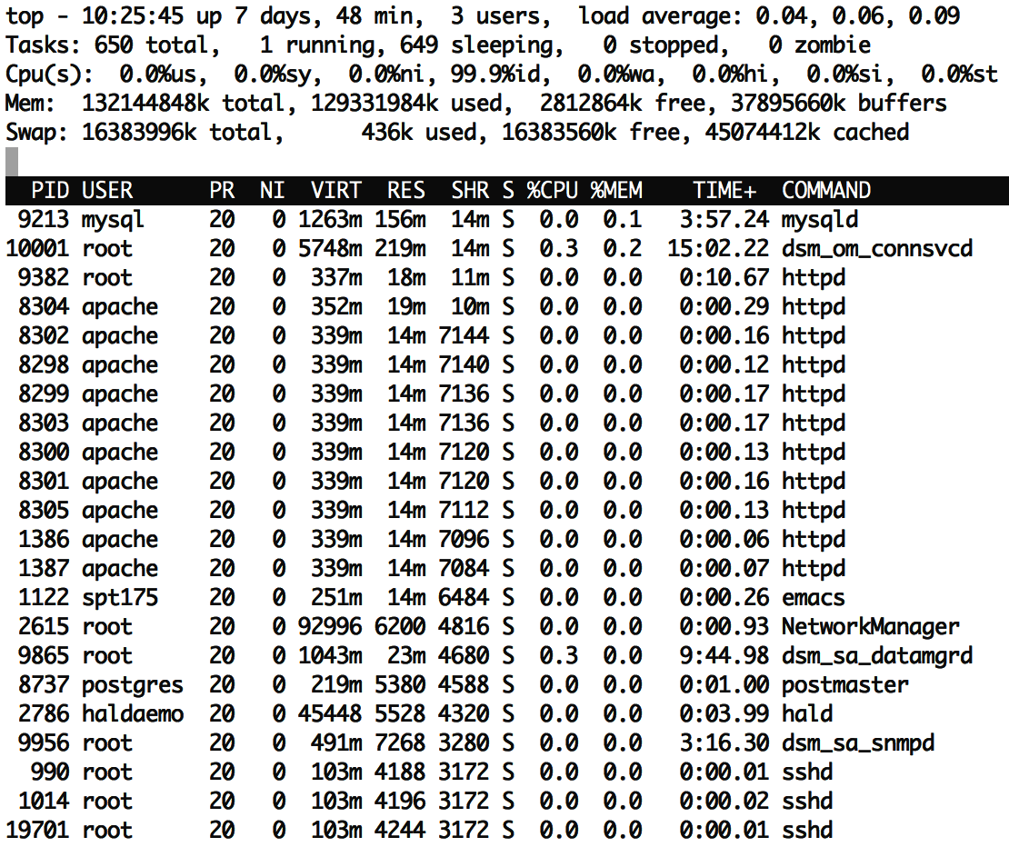
top
RES column is “resident memory”
“q” to quit

Slide 26
Copy-on-write with Fork
Recall that fork + exec is the only way to create a child process in unix
Fork clones the entire process, including all virtual memory
  This can be very slow and inefficient, especially if the memory will just be overwritten by a call to exec.
Copy on write is a performance optimization:
  Don’t copy the parent’s pages, share them
    Make the child process’ page table point to the parent’s physical pages
    Mark all the pages as “read only” in the PTEs (temporarily)
  If parent or child writes to a shared page, a page fault exception will occur
  OS handles the page fault by:
    Copying parent’s page to the child & marking both copies as writeable
    When the faulting process is resumed, it retries the memory write.

Slide 27
Demand zeroing
If a process asks for more memory with sbrk or mmap the OS can allocate it lazily.
  In other words, don’t allocation the full block immediately.
  Lazy allocation minimizes latency of fulfilling the request
  and it prevents OS from allocating memory that will not be used.
OS must also write zeros to newly assigned physical frames
  Program does not necessarily expect the new memory to contain zeros,
  But we clear the memory for security, so that other process’ data is not leaked.
OS can keep one read-only physical page filled with zeros and just give a reference to this at first.
  After the first page fault (due to writing a read-only page), allocate a real page.

Slide 28
Virtual memory in practice
On Linux, the pmap command shows a process’ VM mapping.
We see:
  OS tracks which file code is loaded from, so it can be lazily loaded
  The main process binary and libraries are lazy loaded, not fully in memory
  Libraries have read-only sections that can be shared with other processes
cat /proc/<pid>/smaps shows even more detail
References:
https://unix.stackexchange.com/a/116332
https://www.akkadia.org/drepper/dsohowto.pdf

Slide 29
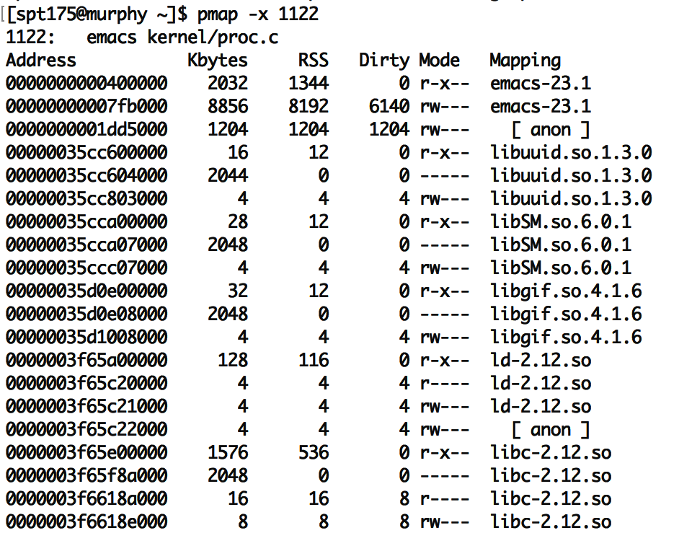
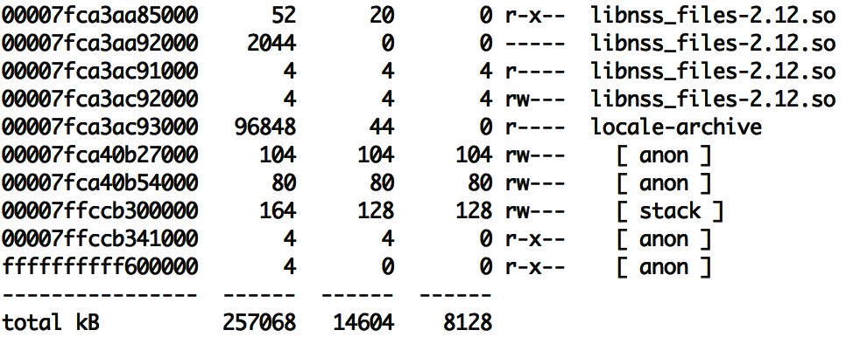
emacs
“Mapping” shows source of the section, more code can be loaded from here later.
  “anon” are regular program data,
  requested by sbrk or mmap.
  (In other words, heap data.)
Each library has several sections:
  “r-x--” for code can be shared
  “r----” for constants
  “rw---” for global data
  “-----” for guard pages:
    (not mapped to anything, just reserved to generate page faults)
RSS means resident in physical mem.
Dirty pages have been written and therefore cannot be shared with others
… … …

Slide 30
top has a column showing shared memory
The duplicate processes are using a lot of shared memory:
  ~50% of resident memory for httpd is shared
  (RES/2 == SHR)
  ~75% of resident memory for sshd is shared
Even if there is just one instance of emacs running, it may share many libraries with other running programs.
Total virtual memory is ~10x larger than resident memory
  Processes only use a small fraction of their VM!
  Due to sharing and lazy loading.

Slide 31
Recap: the costs of virtual memory and paging
Latency cost, because each memory access must be translated.
  Translation lookaside buffer (TLB) caches recent virtual to physical page number translations.
  Software-controlled paging removes page tables from the CPU spec and lets OS handle translations in software, in response to TLB miss exceptions.
Space cost, due to storing a page table for each process.
  Linear (one-level) page tables are large.
  Smaller pages lead to less wasted space during allocation,
  but more space is consumed by page tables.
  Multi-level page tables are the only way to truly conserve space.
  Mixed-size pages reduce TLB misses.
Copy-on-write fork, demand zeroing, lazy loading, and library sharing all reduce physical memory demands.

