Slide 1

EECS-343 Operating Systems
Lecture 5:
Virtual Memory & Paging
Steve Tarzia
Spring 2019

Slide 2
Announcements
Project 1 due yesterday
Late policy: up to two days at 10% off per day
HW 1 due Monday
Project 2 due the following Monday
  It’s much more difficult than Project 1!
Additional weekly office hours: Tuesdays 2-4pm in Wilkinson

Slide 3
Last Lecture
Defined two conflicting metrics: turnaround time and response time
  Cannot optimize both – must tradeoff, or balance, the two
Optimized by shortest job first and round robin, respectively
Context switching overhead is due to the CPU caches
  CPU keeps most recently used data in nearby caches, so it’s more efficient to let an ongoing process continue.
I/O-blocked processes make progress without using the CPU
  We should prioritize I/O-bound processes
Multi-Level Feedback Queues are often used in real OS schedulers
  Prioritizes “polite” processes that use little CPU time when scheduled
  CPU-bound processes squander their time quotas and lose priority

Slide 4
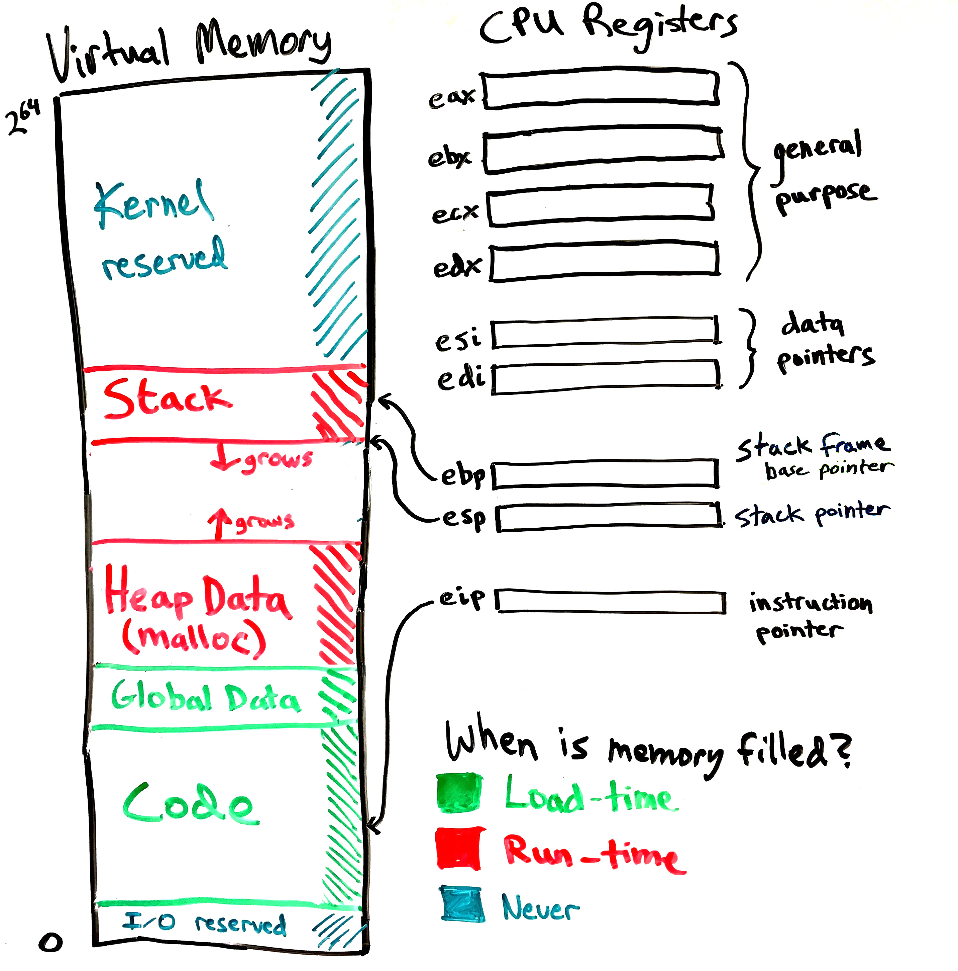
Program’s view of the Machine
Programs are compiled to run alone on a machine with lots of memory.
  “64-bit” machine = 2⁶⁴ bytes of memory
  “32-bit” machine = 2³² bytes = 4GB of memory (xv6 is a 32-bit OS).
In reality:
  Programs share memory with others
  Machine has less than the maximum amount of memory.

Slide 5
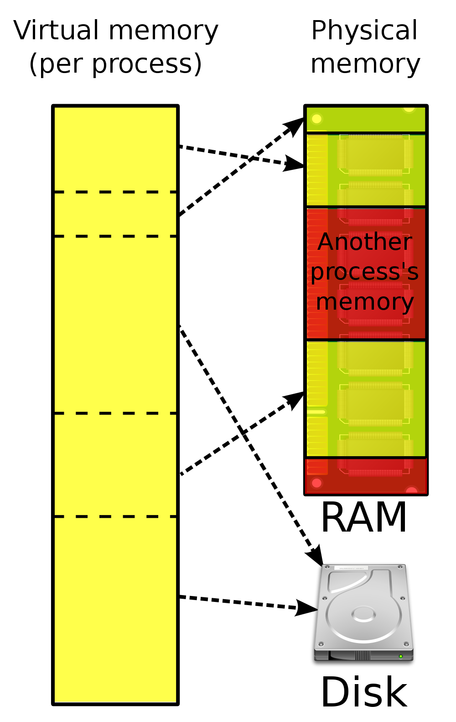
Virtual Memory
Splits memory between various processes,
But gives each process the illusion that it has the full address space.
  Code uses virtual memory addresses
    Called “logical address” by Intel
  CPU somehow translates to physical addresses assigned to that process
Virtual memory also gives the illusion that memory is huge.
  OS swaps memory to disk if there is no space in physical memory. (More on this in later lectures.)
So, no memory is moved during context switch.
We just need to configure the CPU to use a different virtual-to-physical address translation

Slide 6
Virtual Memory
Virtual Memory allows the OS and hardware to control how CPU instructions’ memory addresses are translated to physical memory addresses.
  adds a layer of indirection between programs and the physical memory.
Virtual Memory gives each programs the illusion that it is not competing with other processes for use of the machine’s memory
  This does not exactly mean that a program can access the full address range
  OS may still place restrictions on what memory can be accessed
  sbrk or mmap syscalls may be required for a process to request access to areas of its address space.
VM is disabled at boot time, but soon used by both kernel & user code

Slide 7
Segmentation
Modern systems use paging to translate virtual memory addresses
Earlier systems used segmentation, which is simpler:
  Each process has a memory segment for its code, stack, and heap.
  Segments can be any size, defined by a base and bound (size)
  Memory accesses are offset by the appropriate base and checked that they don’t fall outside the bounds (otherwise you get a segmentation fault).
Segment registers (or table) would be altered by the OS on context switch
Flaw is that a program’s memory must reside in a large chunk of physical memory. Paging can distribute a program’s memory.
Virtual
Physical

Slide 8
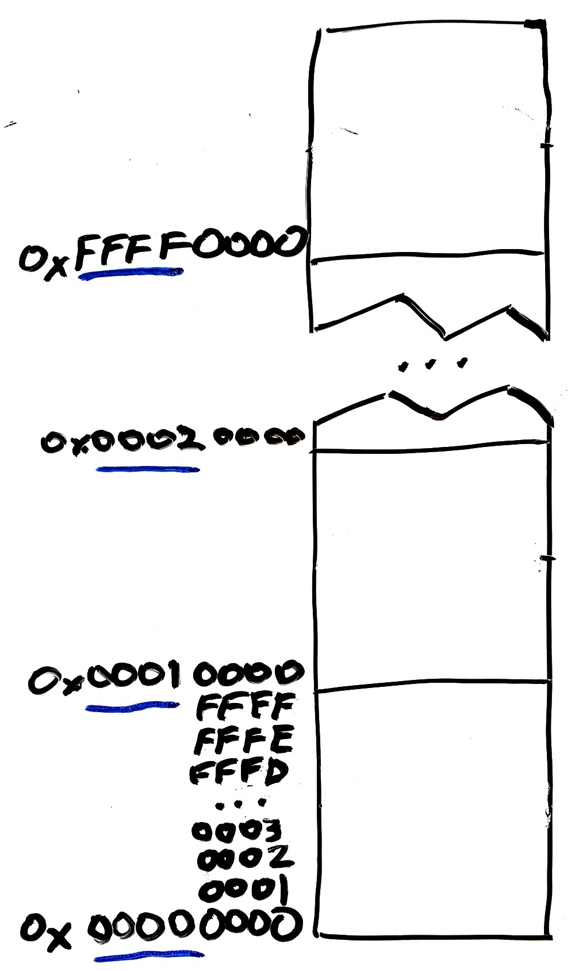
Pages are contiguous blocks of memory
Pages are usually all the same size
  Configurable by the OS
  (at boot time)
  from 4 kb to 4 Mb
High bits of virtual address identify the page
Low bits identify the offset within the page
Larger pages lead to:
  More low bits identifying offset
  Fewer high bits identifying page#
Page 65,535
(0xFFFF)
Page 1
Page 0

Slide 9
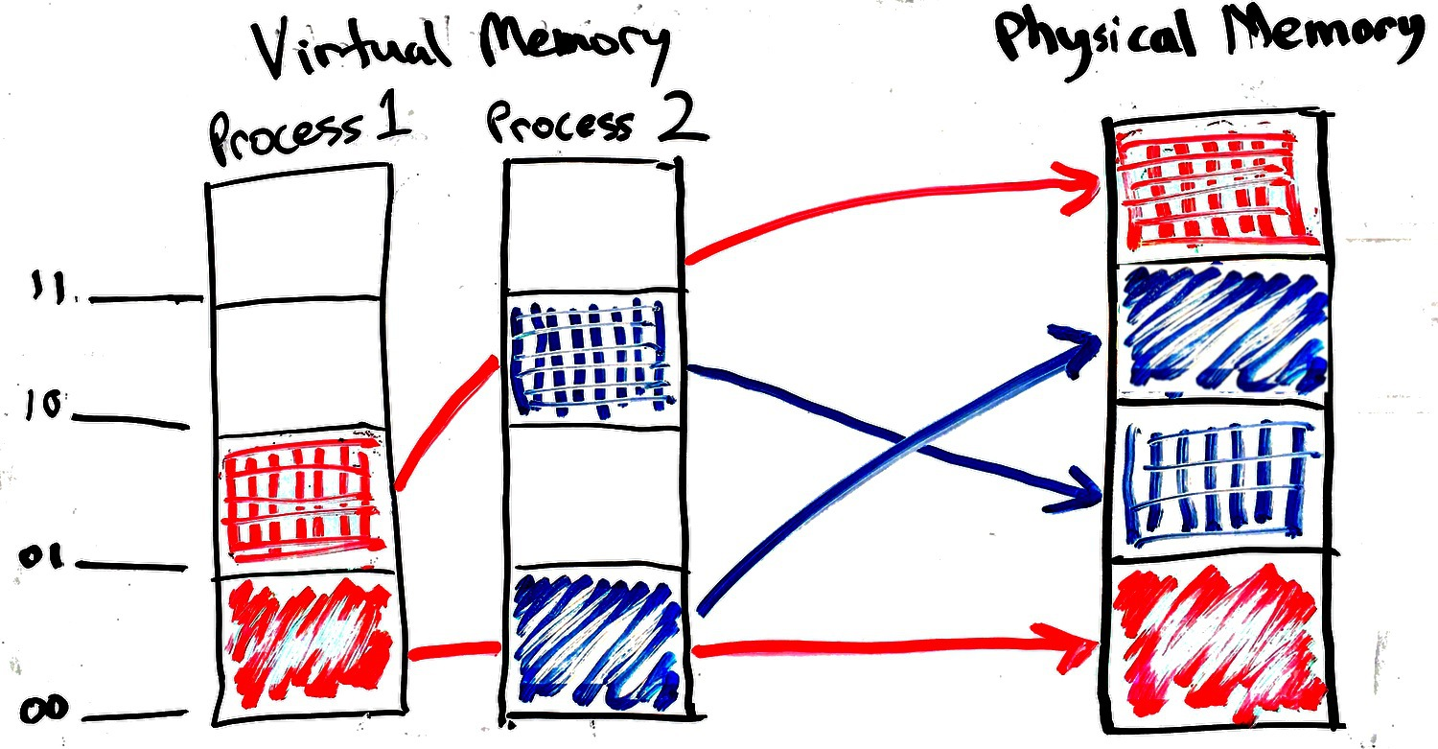
Physical memory is split among multiple processes
OS needs a policy for splitting physical memory among competing processes
  (We’ll discuss memory management policies in a later lecture.)
CPU needs a mechanism to implement that policy
  At runtime the CPU translates every virtual address mentioned by user code into the appropriate physical address.

Slide 10
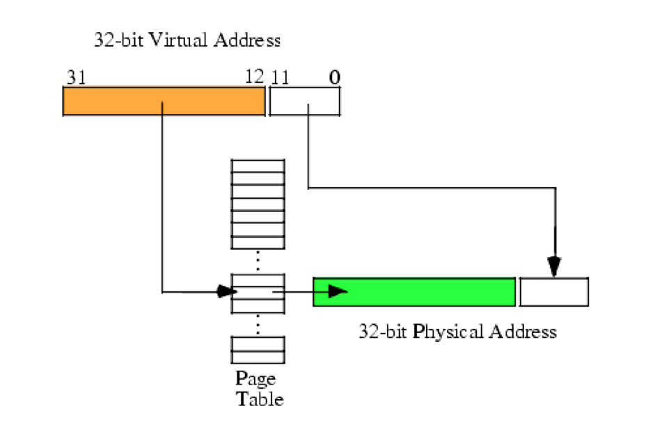
Page table translates virtual to physical addresses
Just need to translate the page numbers
  The high bits of the virtual address
The simplest type of page table is an array of physical addresses, one for each virtual page. (Linear page table)
  Special values can be used to indicate that page has never been used or is on disk.
To switch process contexts, just switch to a different page table
  Different page table will cause the program to access a totally different set of physical memory locations.

Slide 11
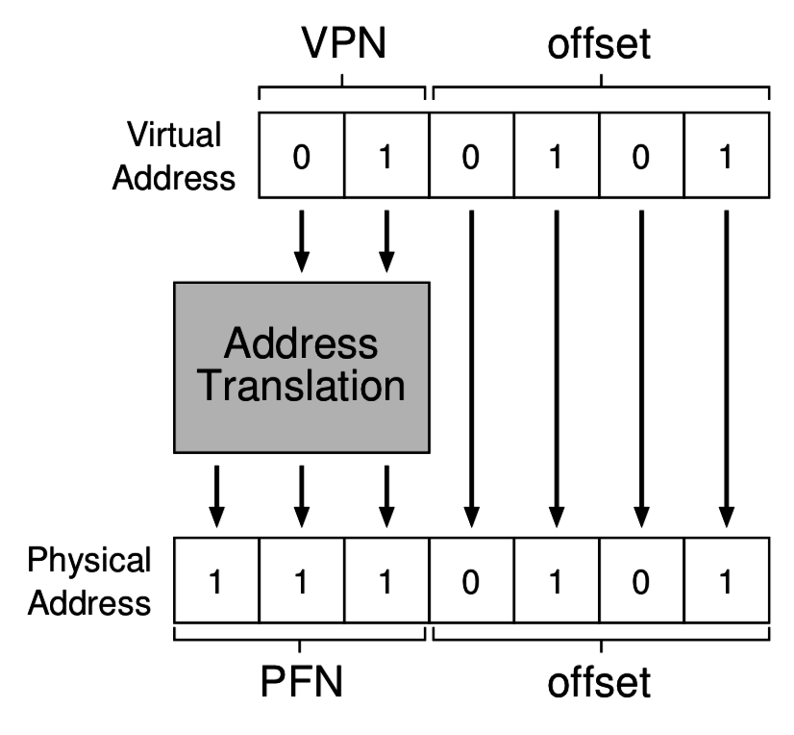
Address translation
Recall that the high bits of a virtual address refer to the page number, and low bits refer to the offset within that page
System must translate virtual page numbers to physical frame numbers

Slide 12
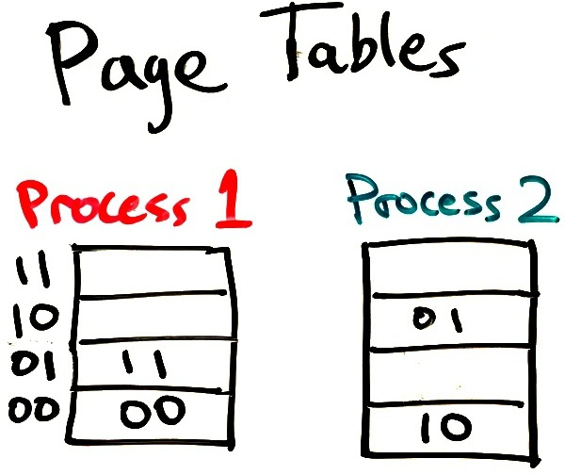
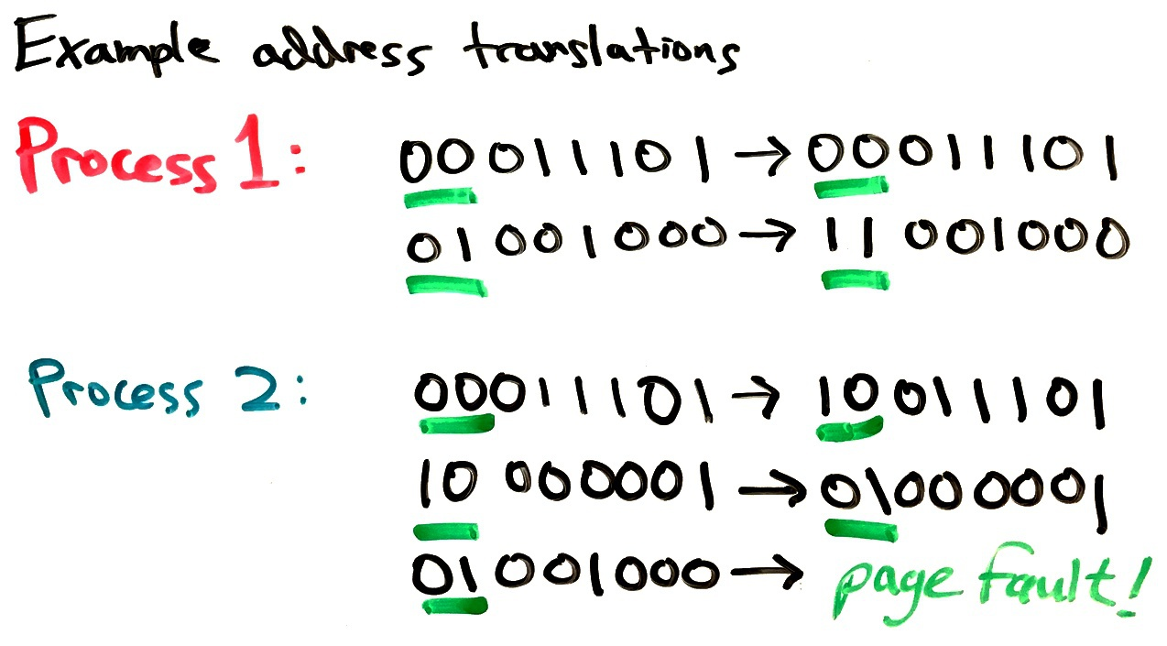
Page table example
Stored in kernel memory

Slide 13
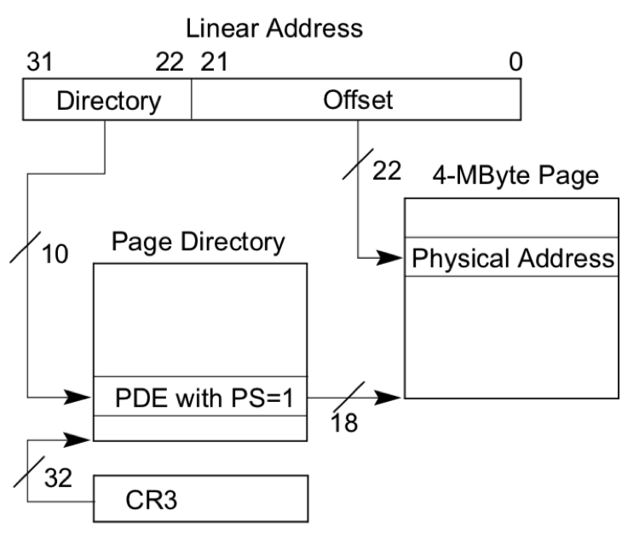
Changing page tables
Intel CPUs’ %CR3 register stores the page table’s address.
  Cannot be changed in user mode.
OS kernel changes the %CR3 value when switching processes.
CPU will use the page tables to translate address of every single memory access
  Except the OS’s boot code uses physical addresses directly to set things up.

Slide 14
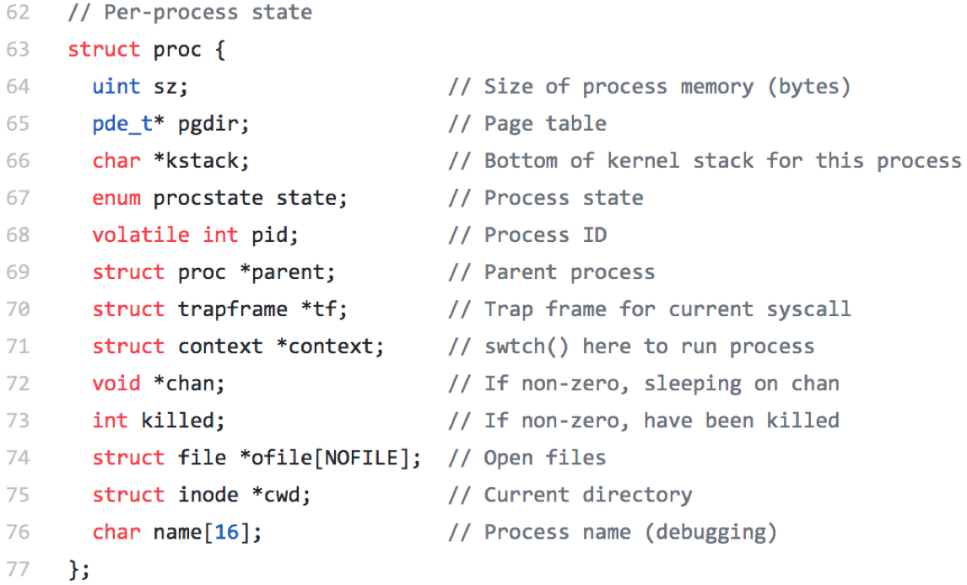
Inactive process state in xv6’s proc.h
pde_t* pgdir points to this process’ page table

Slide 15
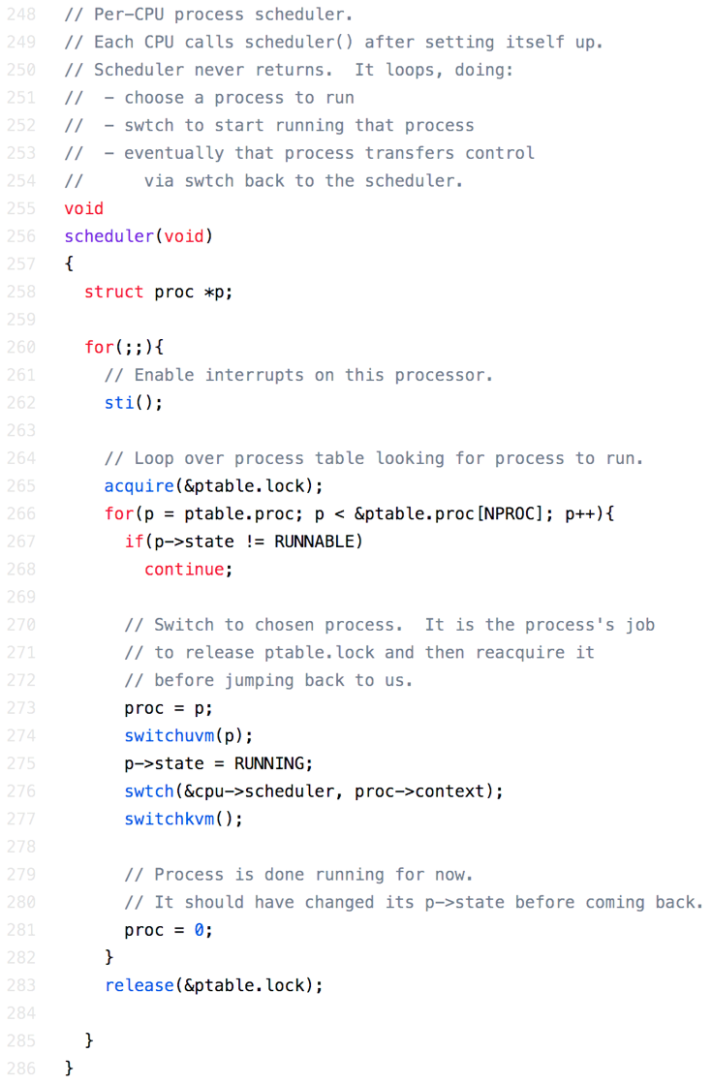
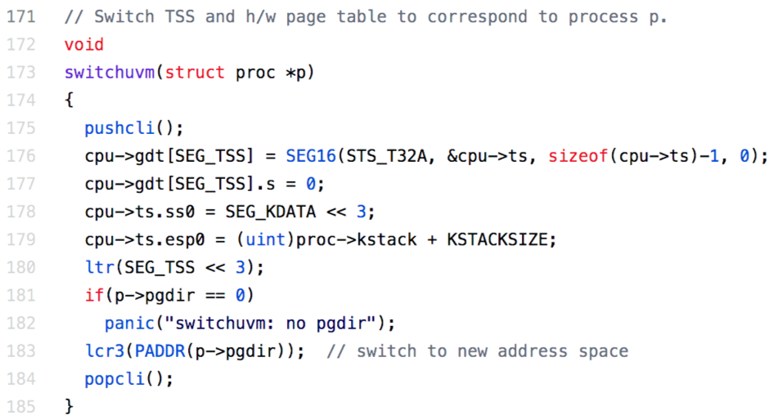
Context switch in xv6
In vm.c and proc.c

Slide 16
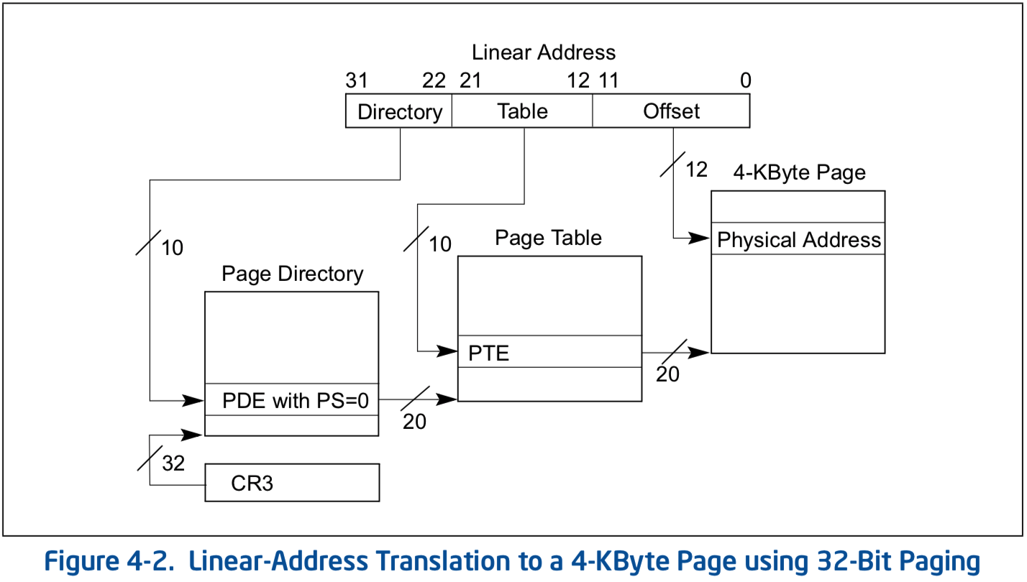
Actually, Intel x86 supports more complex VM schemes

Slide 17
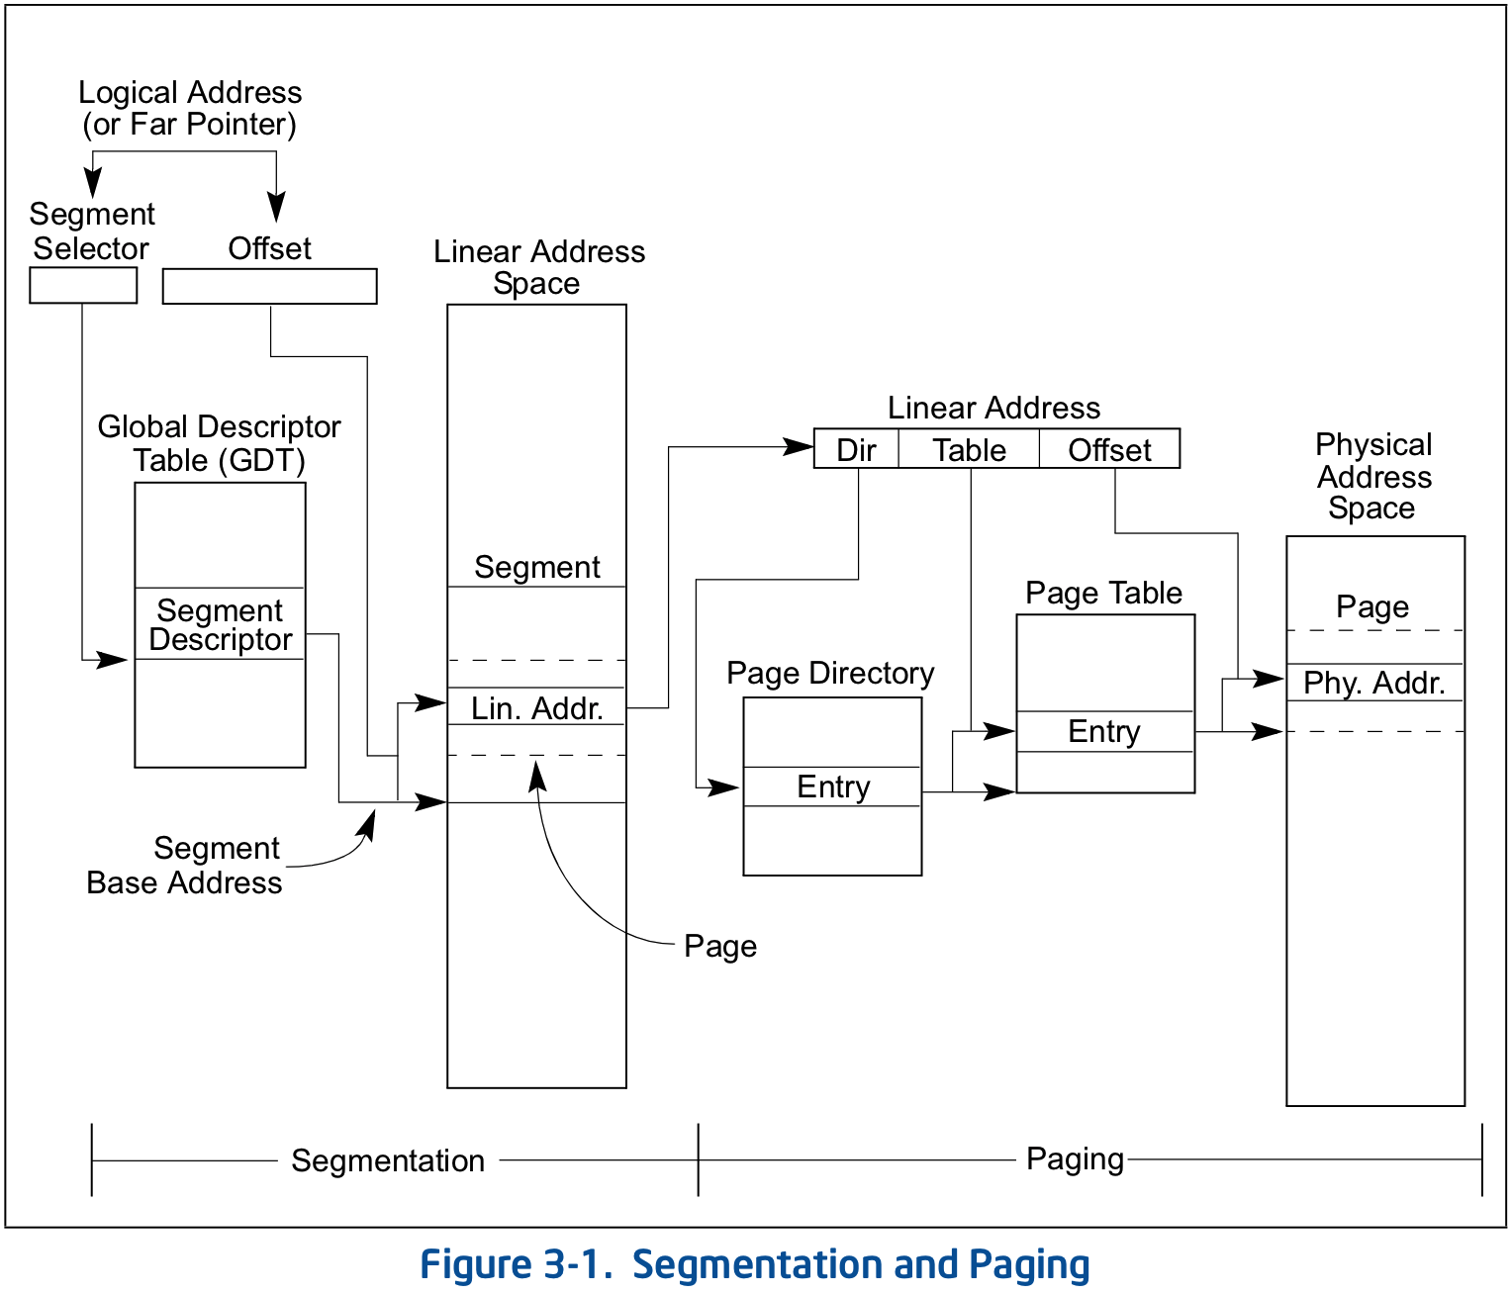
…and even more complex schemes

Slide 18
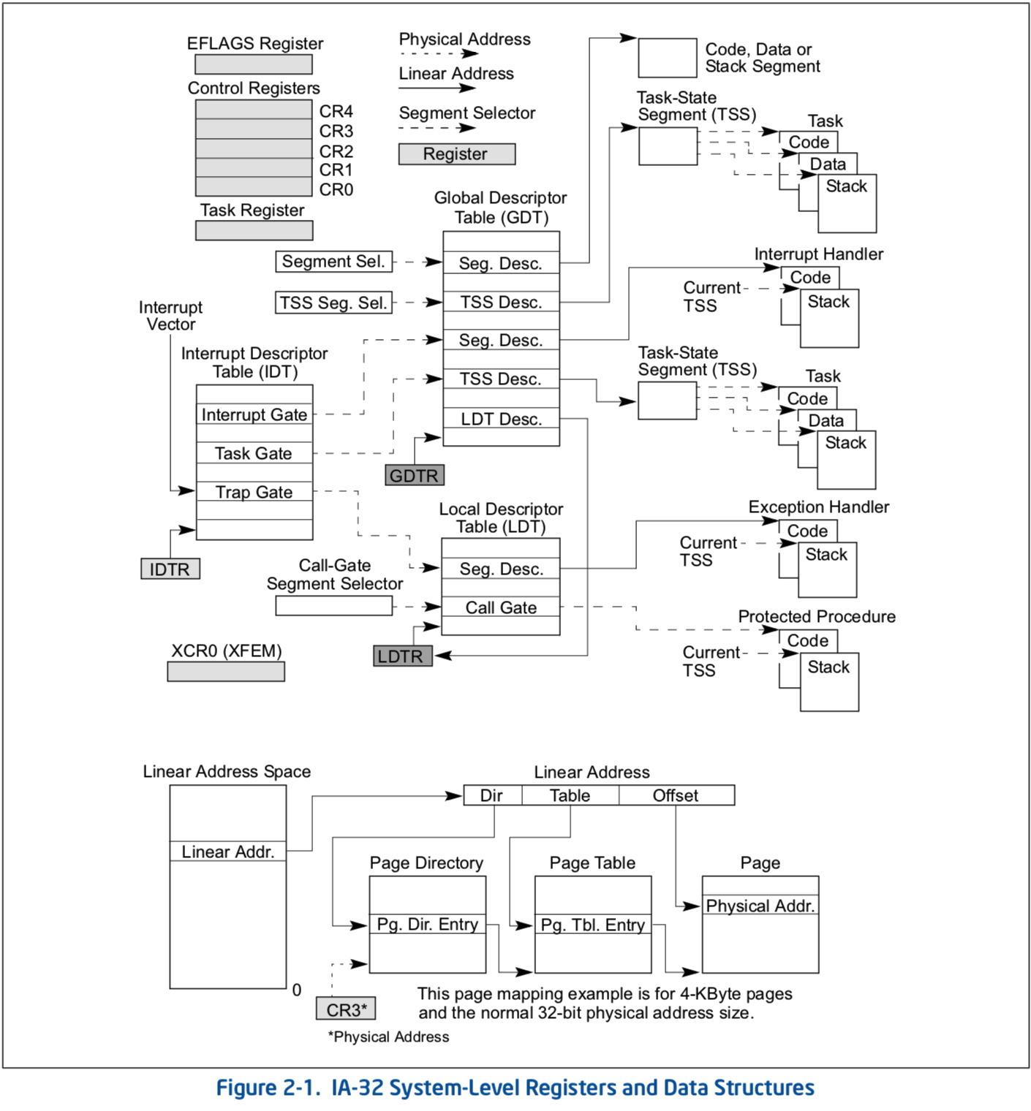
CPU behaviors configured by the OS
Most importantly:
Interrupt tables - %IDTR
Page tables - %CR3
Store tables in kernel memory
Store pointers to tables in control registers

Slide 19
The many benefits of Virtual Memory & Paging
Program code need not worry about:
  where in memory it will run
  the size of physical memory
  Compiler and Loader’s job is now much easier
Process memory is isolated & secure
  (assuming pages table entries point to unique locations)
  Changing page tables is a privileged instruction
Can efficiently share memory between processes when desired
  (just make page table entries for two processes point to same physical page)
Can run programs needing more memory than we physically have
  (by swapping to disk)
Can build a machine with more memory than is addressable by programs
  (eg., “physical address extension” on 32-bit Intel processors)

Slide 20
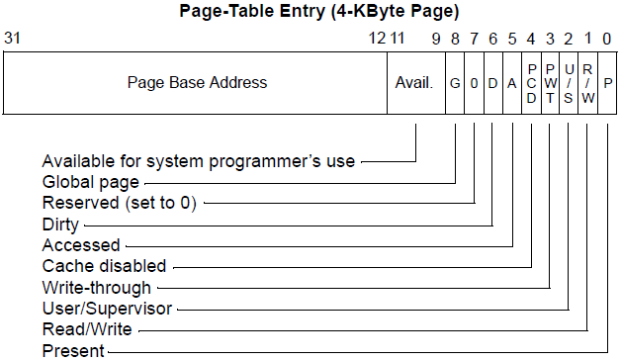
Page table entries (PTEs) in detail (32-bit Intel x86)
PTEs just need the high bits for the physical frame number
Low bits can be set by kernel to control access, etc.
Hardware will automatically
check these bits when
“walking” the page table
for a memory access.
Last 3 bits control user program’s permission to use this page

Slide 21
How OS controls virtual memory (x86)
Allocate a page table for each process.
Set high bits of PTEs to control which physical pages are used
Set low bits of PTEs to control read/write and user/kernel access
Change the page table register (%CR3) on context switch

Slide 22
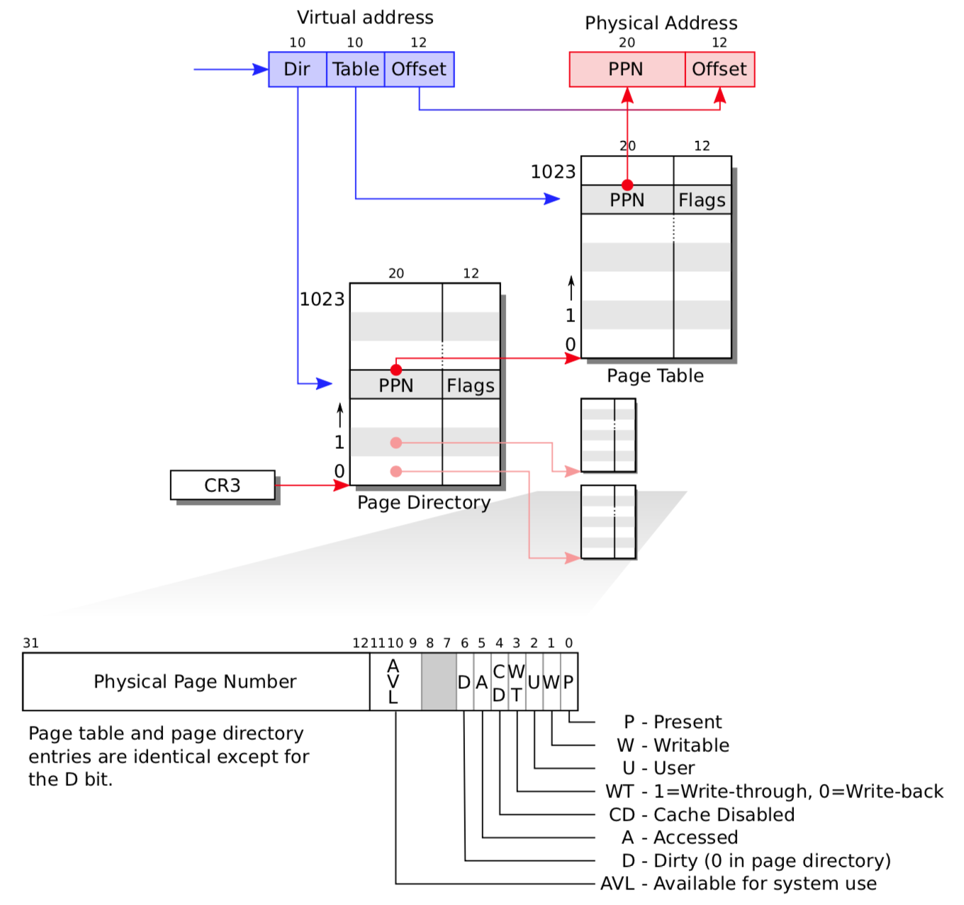
Complete view of paging (from xv6 book)

Slide 23
Recap
Introduced about Virtual Memory
Showed the details of page tables and page table entries (PTEs)
  High bits translate from virtual page number to physical page number.
  Low bits in the PTE are used to indicate present/rw/kernel page.
During a context switch, kernel changes the %CR3 register to switch from the page table (VM mapping) of one process to another.
Next time:
  Page faults
  Page table performance optimizations

