Slide 1

EECS-343 Operating Systems
Lecture 4:
Scheduling
Steve Tarzia
Spring 2019

Slide 2
Announcements
Project 1 due on Monday
HW1 due the next Monday (22nd).

Slide 3
Recap
xv6 OS code is written for the Intel x86 CPU architecture, but…
Linux supports 31 different CPU architectures
  Low-level mechanisms are different on each arch.
  High-level policies are the same for all.
Fork syscall: run once, exits twice!
Nondeterminism is when a program’s output is unpredictable
OS process scheduler can create race conditions in programs that rely on an interaction of multiple processes.
  These are tricky to debug, because they are sensitive to timing (Heisenbugs).
Kernel panic occurs when OS causes an exception and can’t recover

Slide 4
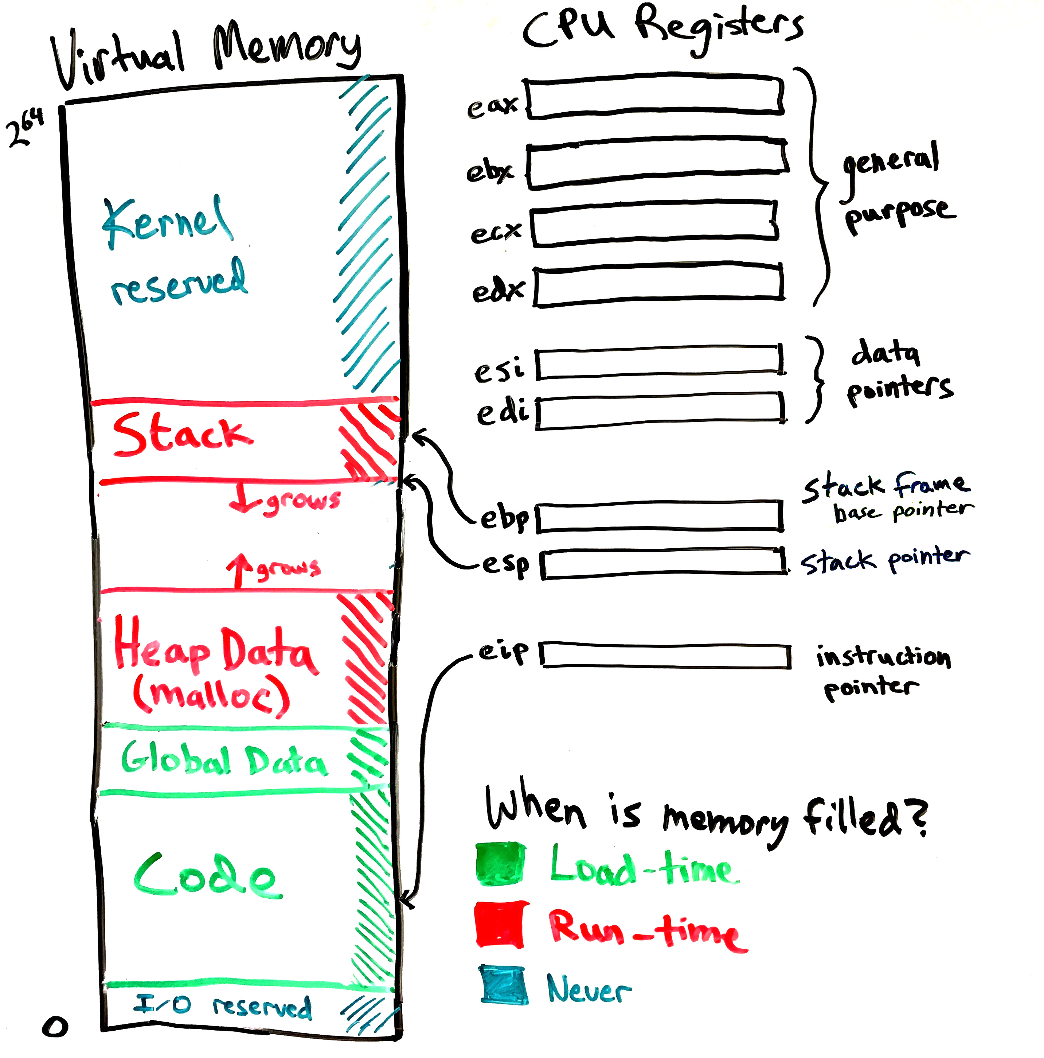
Recap (continued)
fork + exec runs a program.
  fork duplicates the current process
  exec copies code and global data from an executable file, and creates a new empty stack.
Stack grows from high addresses down to lower.
  Grows larger when a function is called.
  Shrinks when a function returns.
Heap is a block of memory managed by C’s malloc & free.

Slide 5
Scheduling
We have talked about the mechanisms for sharing the CPU:
  Limited direct execution
  User/kernel mode
  Timer interrupts
  System calls
Scheduling is creating a policy for sharing the CPU:
  Which process is chosen to run, and when?
  When (if ever) are running processes preempted (interrupted)?

Slide 6
We’ll begin with a simplified scheduling problem
Let’s take ideas from Operations Research (process == “job”)
Simplifying assumptions:
Jobs are the same length
No new jobs are added (they all are available at the beginning)
Jobs cannot be preempted (interrupted)
No I/O is done; it’s just CPU work
Job length is known ahead of time
There is only one CPU
All processes have equal priority

Slide 7

Metrics
A metric is a standard for measuring something
  Like an “objective function” in mathematical optimization,
  or a “utility function” in economics.
We must choose a metric before designing a scheduling policy
  Computing systems have many different goals and uses, so there are many competing performance metrics.
Operating systems (and life) are full of tradeoffs
“fast acting” or “long lasting”?
Do I want to feel better now or later?

Slide 8
Average turnaround time is our first scheduling metric
T_{turnaround} = T_{completion} – T_{arrival}
It’s just the total time waited to finish the job, including both it’s execution time and the time it was waiting before execution.
Average turnaround time is computed across all processes.

Slide 9
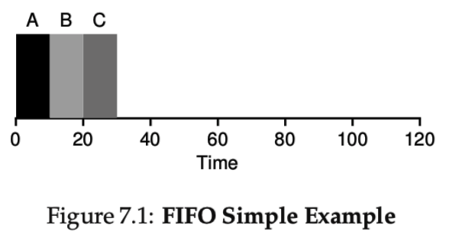
First in, first out (FIFO)
FIFO is the simplest scheduling policy.
Just let a job run until it is done, then schedule the next job
Average turnaround time here is (10 + 20 + 30)/3 = 20

Slide 10

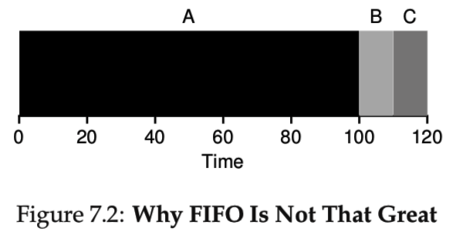
FIFO shortcomings
FIFO is like a grocery store with one checkout line
One big job can cause lots of jobs behind it to wait
Above, avg turnaround time = 110
Convoy effect – lots of small jobs getting stuck behind a big one
Photo from https://www.flickr.com/photos/countryluvinchix/4013902615

Slide 11
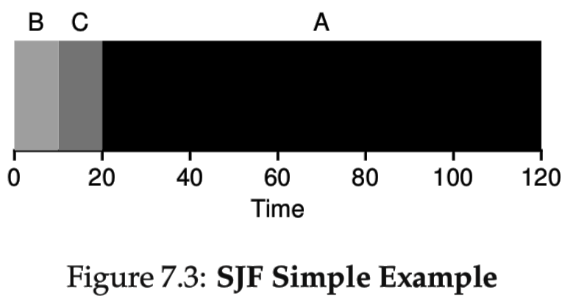
Shortest Job First (SJF)
Start with the smallest jobs to minimize the number of waiting jobs
Minimizing waiting will minimize average turnaround time
Above, average turnaround time = (10 + 20 + 120) / 3 = 50 😆
  Compare to 110 for FIFO

Slide 12
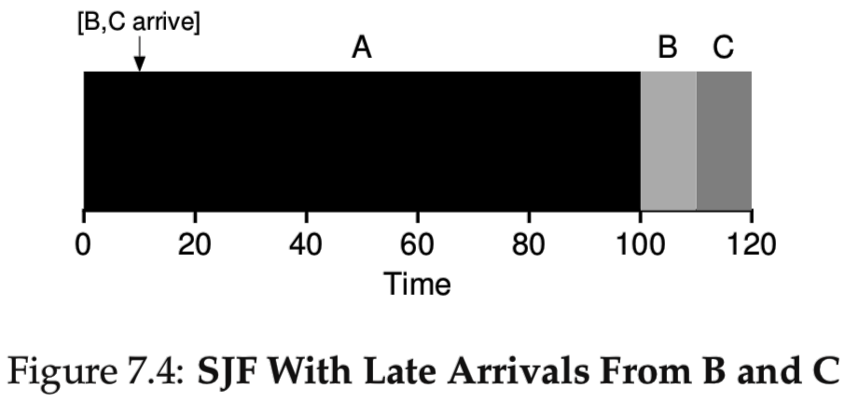
Let’s get real
Allow new jobs to be added after the start (drop assumption #2)
Now, we can suffer from long waits even with Shortest Job First!
SJF fail:
If B & C arrive late, they will have to wait because we already scheduled job A, and jobs must finish once they start (assumption #3)
Average turnaround time = (100 + (110-10) + (120-10))/3 = 103.3 😞

Slide 13
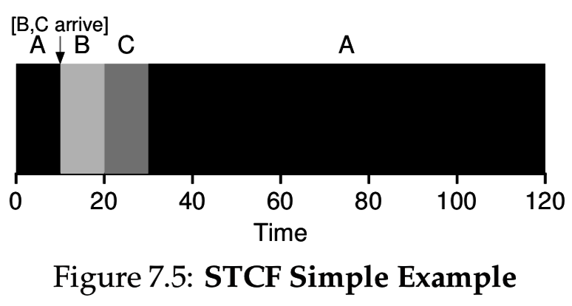
Shortest Time-to-Completion First (STCF)
Let’s give our schedule the power to preempt jobs
  Preemption is pausing a job to run another one (word “interrupt” was taken)
Shortest Time-to-Completion First causes scheduler to:
  reevaluate all the jobs when a new one arrives
  schedule the job with the shortest remaining time
After B & C arrive, A is no longer the shortest time-to-completion job.
Avg turnaround time =
(120 + 10 + 20) / 3 = 50

Slide 14
A different metric – response time
STCF gives optimal avg turnaround time
But long jobs may wait a long, long time and this may be undesirable
Response time metric minimizes the time we wait for a job to start:
T_{response} = T_{start} – T_{arrival}
But we do not care how long it takes to finish a job
This is good for interactive processes (GUI) which must quickly show that they are reacting to user inputs, but can service requests slowly

Slide 15
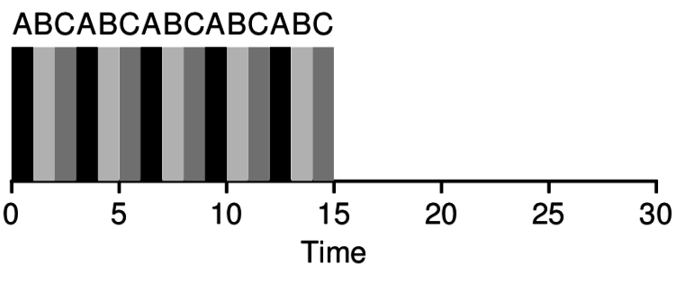
Round Robin optimizes response time
Round Robin (RR) scheduling runs a job for a small time slice, then schedules the next job:
Above, avg response time = (0 + 1 + 2) / 3 = 1
  In general, avg response time = (num_jobs – 1) * time_slice / num_jobs
Smaller time slice means smaller response time

Slide 16
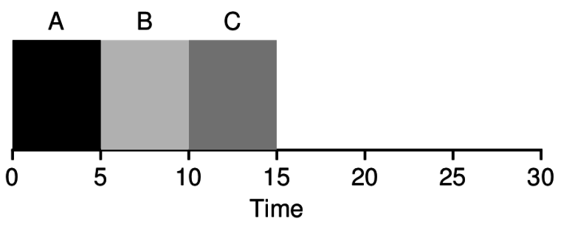
Different policies favor different metrics
Round Robin scheduling:
Avg turnaround time = 14
Avg response time = 1
Context switches = 14
Shortest Job first or STCF:
Avg turnaround time = 10
Avg response time = 5
Context switches = 2

Slide 17
Time slice (a.k.a. time quantum) tradeoffs
Round Robin scheduling
with time slice = 1:
Avg response time = 1
Context switches = 14
Round Robin scheduling
with time slice = 5:
Avg response time = 5
Context switches = 2
Better response time vs. Less context switch overhead

Slide 18
Context switching overhead
We might expect context switches to be very quick because it just involves switching a few registers.
However, there is a large cost in “warming” the CPU’s caches.
Caches store copies of recently-used memory on the CPU itself
  L1, L2, L3 memory cache
  Translation Lookaside Buffer (TLB) is a cache of recent page mappings
  (it’s a cache of the current page table)
  Execution speed is often dominated by memory access, so this is important
New process will use totally different physical memory locations, so all the cache data is useless to the new process.

Slide 19
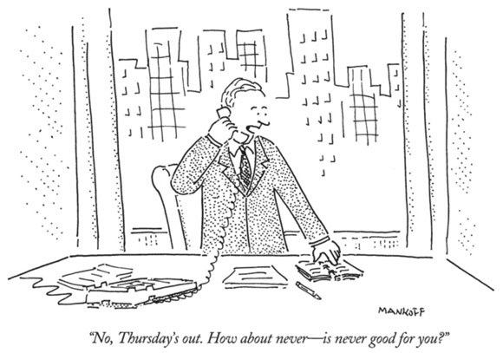
Intermission

Slide 20
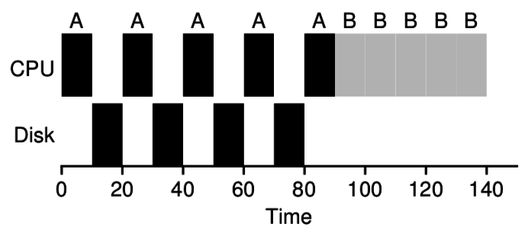
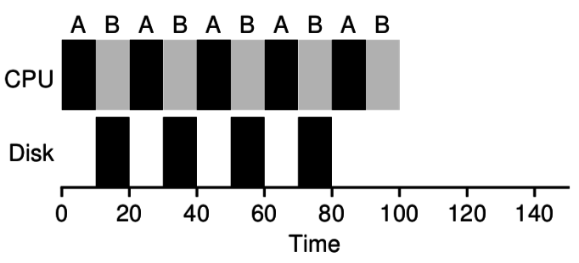
I/O creates scheduling overlap opportunities
If process A does I/O every ten
milliseconds and each I/O takes 10 ms,
then the CPU is free during those I/Os:
A is blocked during it’s I/O.
  It’s just waiting for data from the disk
  But it does not need the CPU
We can schedule another job during
process A’s I/O:
Scheduler should favor processes that will
do I/O soon because I/O frees the CPU
and makes use of other hardware.
Blocked processes are actually making progress, but not using the CPU.

Slide 21
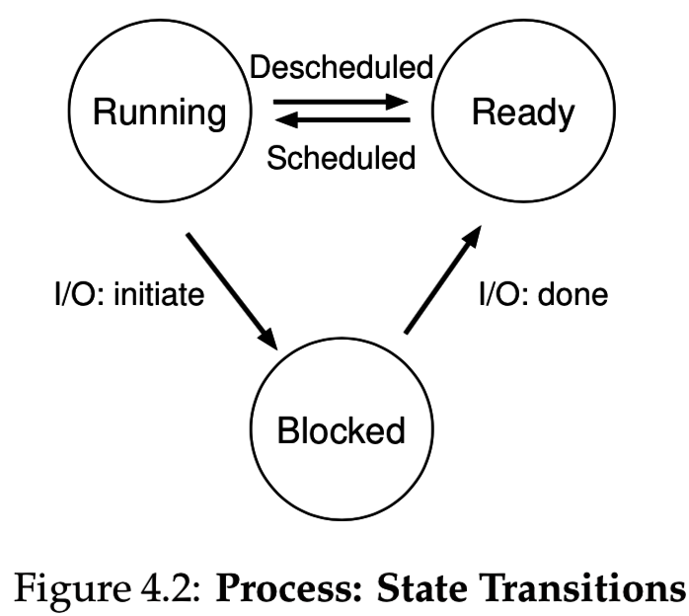
I/O bound and CPU bound processes
We say a process is CPU bound if it needs lots of CPU time to progress
  These processes have a lot of logic and math.
  Usually in running or ready state
A process is I/O bound if it needs to do lots of I/O to progress
  These processes access disk, network, etc.
  or they are interactive, spending most of their time waiting for the next user input
    (from the keyboard, mouse, or touchscreen)
  Usually in the blocked state

Slide 22
Real OS Schedulers
In reality, we don’t know the future behavior of processes
  How long will a process run?
  When will it perform I/O next?
However, we can track past behavior and assume future will be similar
Usually we want a policy that balances response time and turnaround time, and without too much context switching overhead
Interactive processes should usually be prioritized, because they will use little CPU, but make the system feel responsive.
Xv6 uses a simple round-robin scheduler, but that’s not realistic

Slide 23
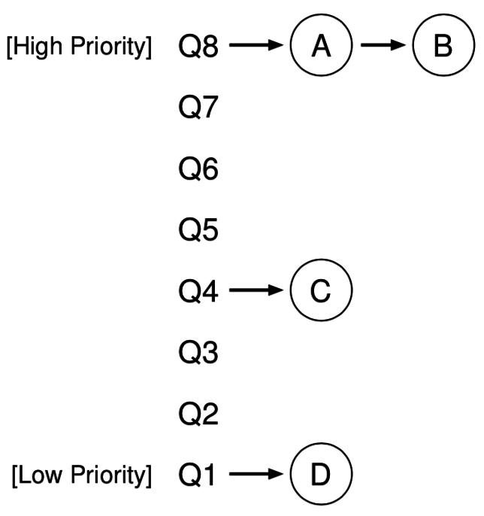
Multi-Level Feedback Queue (MLFQ)
Several run queues, with varying priority
Keep interactive jobs in high priority queues
Processes at a given level are Round Robin scheduled
Always run the highest priority processes
Run lower-priority processes when all higher processes are blocked.
Over time, processes lose and gain priority
  Each process has a CPU usage quota at a given level. When used up, it moves down one level.
  Periodically reset by moving all processes up to highest priority.

Slide 24
MLFQ rules
If Priority(A) > Priority(B),
A runs (B doesn’t).
If Priority(A) = Priority(B),
A & B run in RR.
When a job enters the system, it is placed at the highest priority (the topmost queue).
Once a job uses up its time allotment at a given level (regardless of how many times it has given up the CPU), its priority is reduced (i.e., it moves down one queue).
After some time period S, move all the jobs in the system to the topmost queue.

Slide 25
MLFQ parameters
Round-robin time slice
Number of levels
CPU time quota at each level
Reset interval (S)
Note that we can use a formula to calculate a process’ current priority level if we know the amount of CPU time used in the past S seconds.

Slide 26
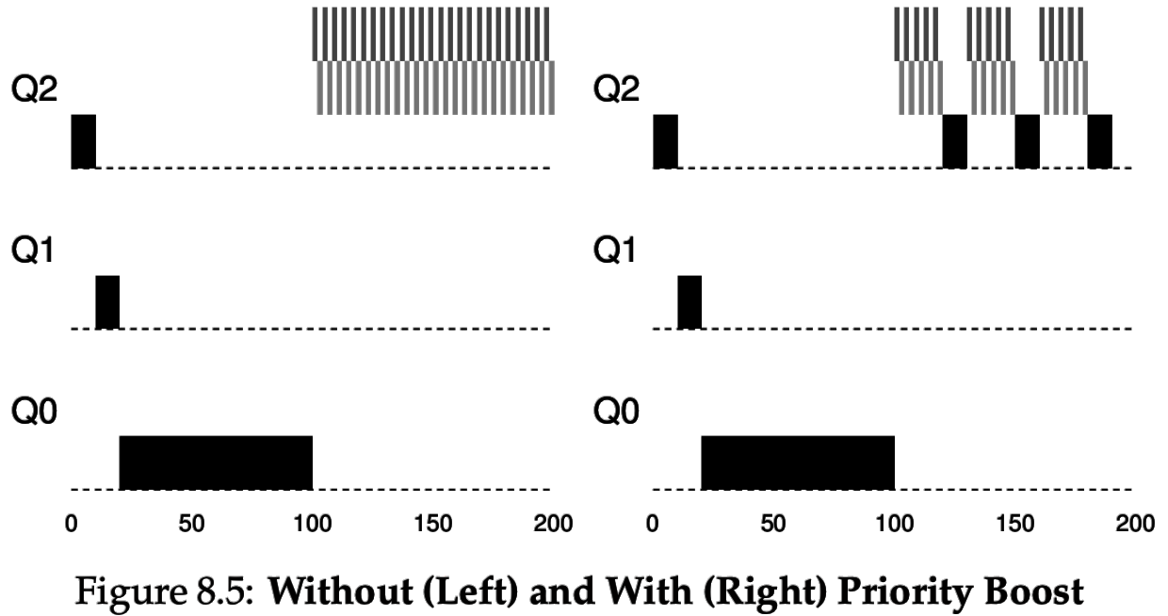
Avoiding starvation
Low-priority processes are said to starve if they never are given a chance to run.
MLFQ avoids starvation by periodically boosting all process’ priorities (rule 5).
Many new interactive processes are created that hog the CPU
Process A’s priority drops as it runs on the CPU
*This diagram shows a simplified version of MLFQ

Slide 27
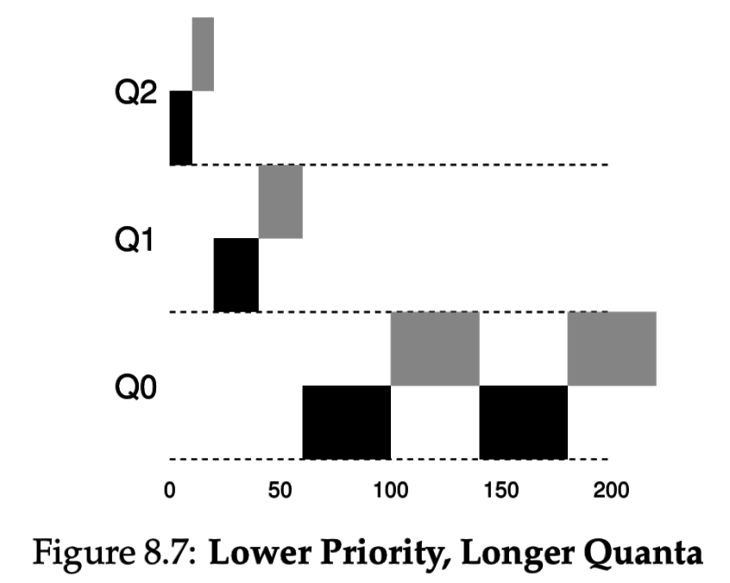
An MLFQ optimization
Lower priority processes are CPU-bound, not interactive, so we can use longer time slices (quanta) to minimize context switches:

Slide 28
User-defined process priority
MLFQs are designed to automatically favor the right processes
  But sometimes it makes sense to give the OS some scheduling hints
Most OSes also have a way for users to specify a process’ “priority”
Eg., nice command on Unix
User-specified priority can change the MLFQ behavior
For example, if the user marks a process as “low priority” then
  MLFQ may reset it to one of the middle levels instead of the top level.
  May give it a smaller CPU quota at each level
The OS may also treat system (root) processes with higher priority

Slide 29
Context switch mechanisms revisited
Recall that OS takes over when an interrupt occurs
At this time, it can use its scheduling algorithm to determine which process should run next.
  Can return to the same process, or
  Can context switch to a different process
Programmable timer should be set to the scheduling time slice (or a multiple of it) to give the OS scheduler an opportunity to run.

Slide 30
Recap
Defined two conflicting metrics: turnaround time and response time
  Cannot optimize both – must tradeoff, or balance, the two
Optimized by shortest job first and round robin, respectively
Context switching overhead is due to the CPU caches
  CPU keeps most recently used data in nearby caches, so it’s more efficient to let an ongoing process continue.
I/O-blocked processes make progress without using the CPU
  We should prioritize I/O-bound processes
Multi-Level Feedback Queues are often used in real OS schedulers
  Prioritizes “polite” processes that use little CPU time when scheduled
  CPU-bound processes squander their time quotas and lose priority

