Slide 1


EECS-343 Operating Systems
Lecture 2:
Processes & System Calls
Steve Tarzia
Spring 2019
Covers Chapter 4 and 5 in Three Easy Pieces

Slide 2
Announcements
Midterm is on Thursday, May 2nd.
First two parts of project 1 are due on Monday.
Project part 2 (the big part) was posted, due the following Monday.
TA and Peer Mentor office hours will be in the Wilkinson Lab
(Tech M338)
Another open OS book that will help you greatly:
  “xv6: a simple, Unix-like teaching operating system” by Cox et al.
  Google “xv6 book rev11”
Don’t forget to read the book! This lecture covers chapters 4-5.

Slide 3
Operating systems roles
A user interface for humans to run programs
A resource manager allowing multiple programs to share one set of hardware.
A programming interface (API) for programs to access the hardware and other services.
In this lecture we’ll start talking about how OS provides programs with the illusion that they have the entire CPU and Memory to themselves.

Slide 4
Operating systems run processes
A process is a program in execution
  On Linux/Mac run “ps” or “top” to see the active processes
  On Windows use the Task Manager
OS assigns each new process a numeric process id.
Each process has it own private view of the computer:
  CPU register values, including
    General purpose registers (eax, ebx, ecx, edx), index registers (edi, esi)
    Stack pointer (esp, ebp), used to locate local variables, function return address, etc.
    Instruction Pointer, indicating the next instruction that will execute
  Virtual memory address space
    We will explore virtual memory in detail in a couple of weeks.

Slide 5
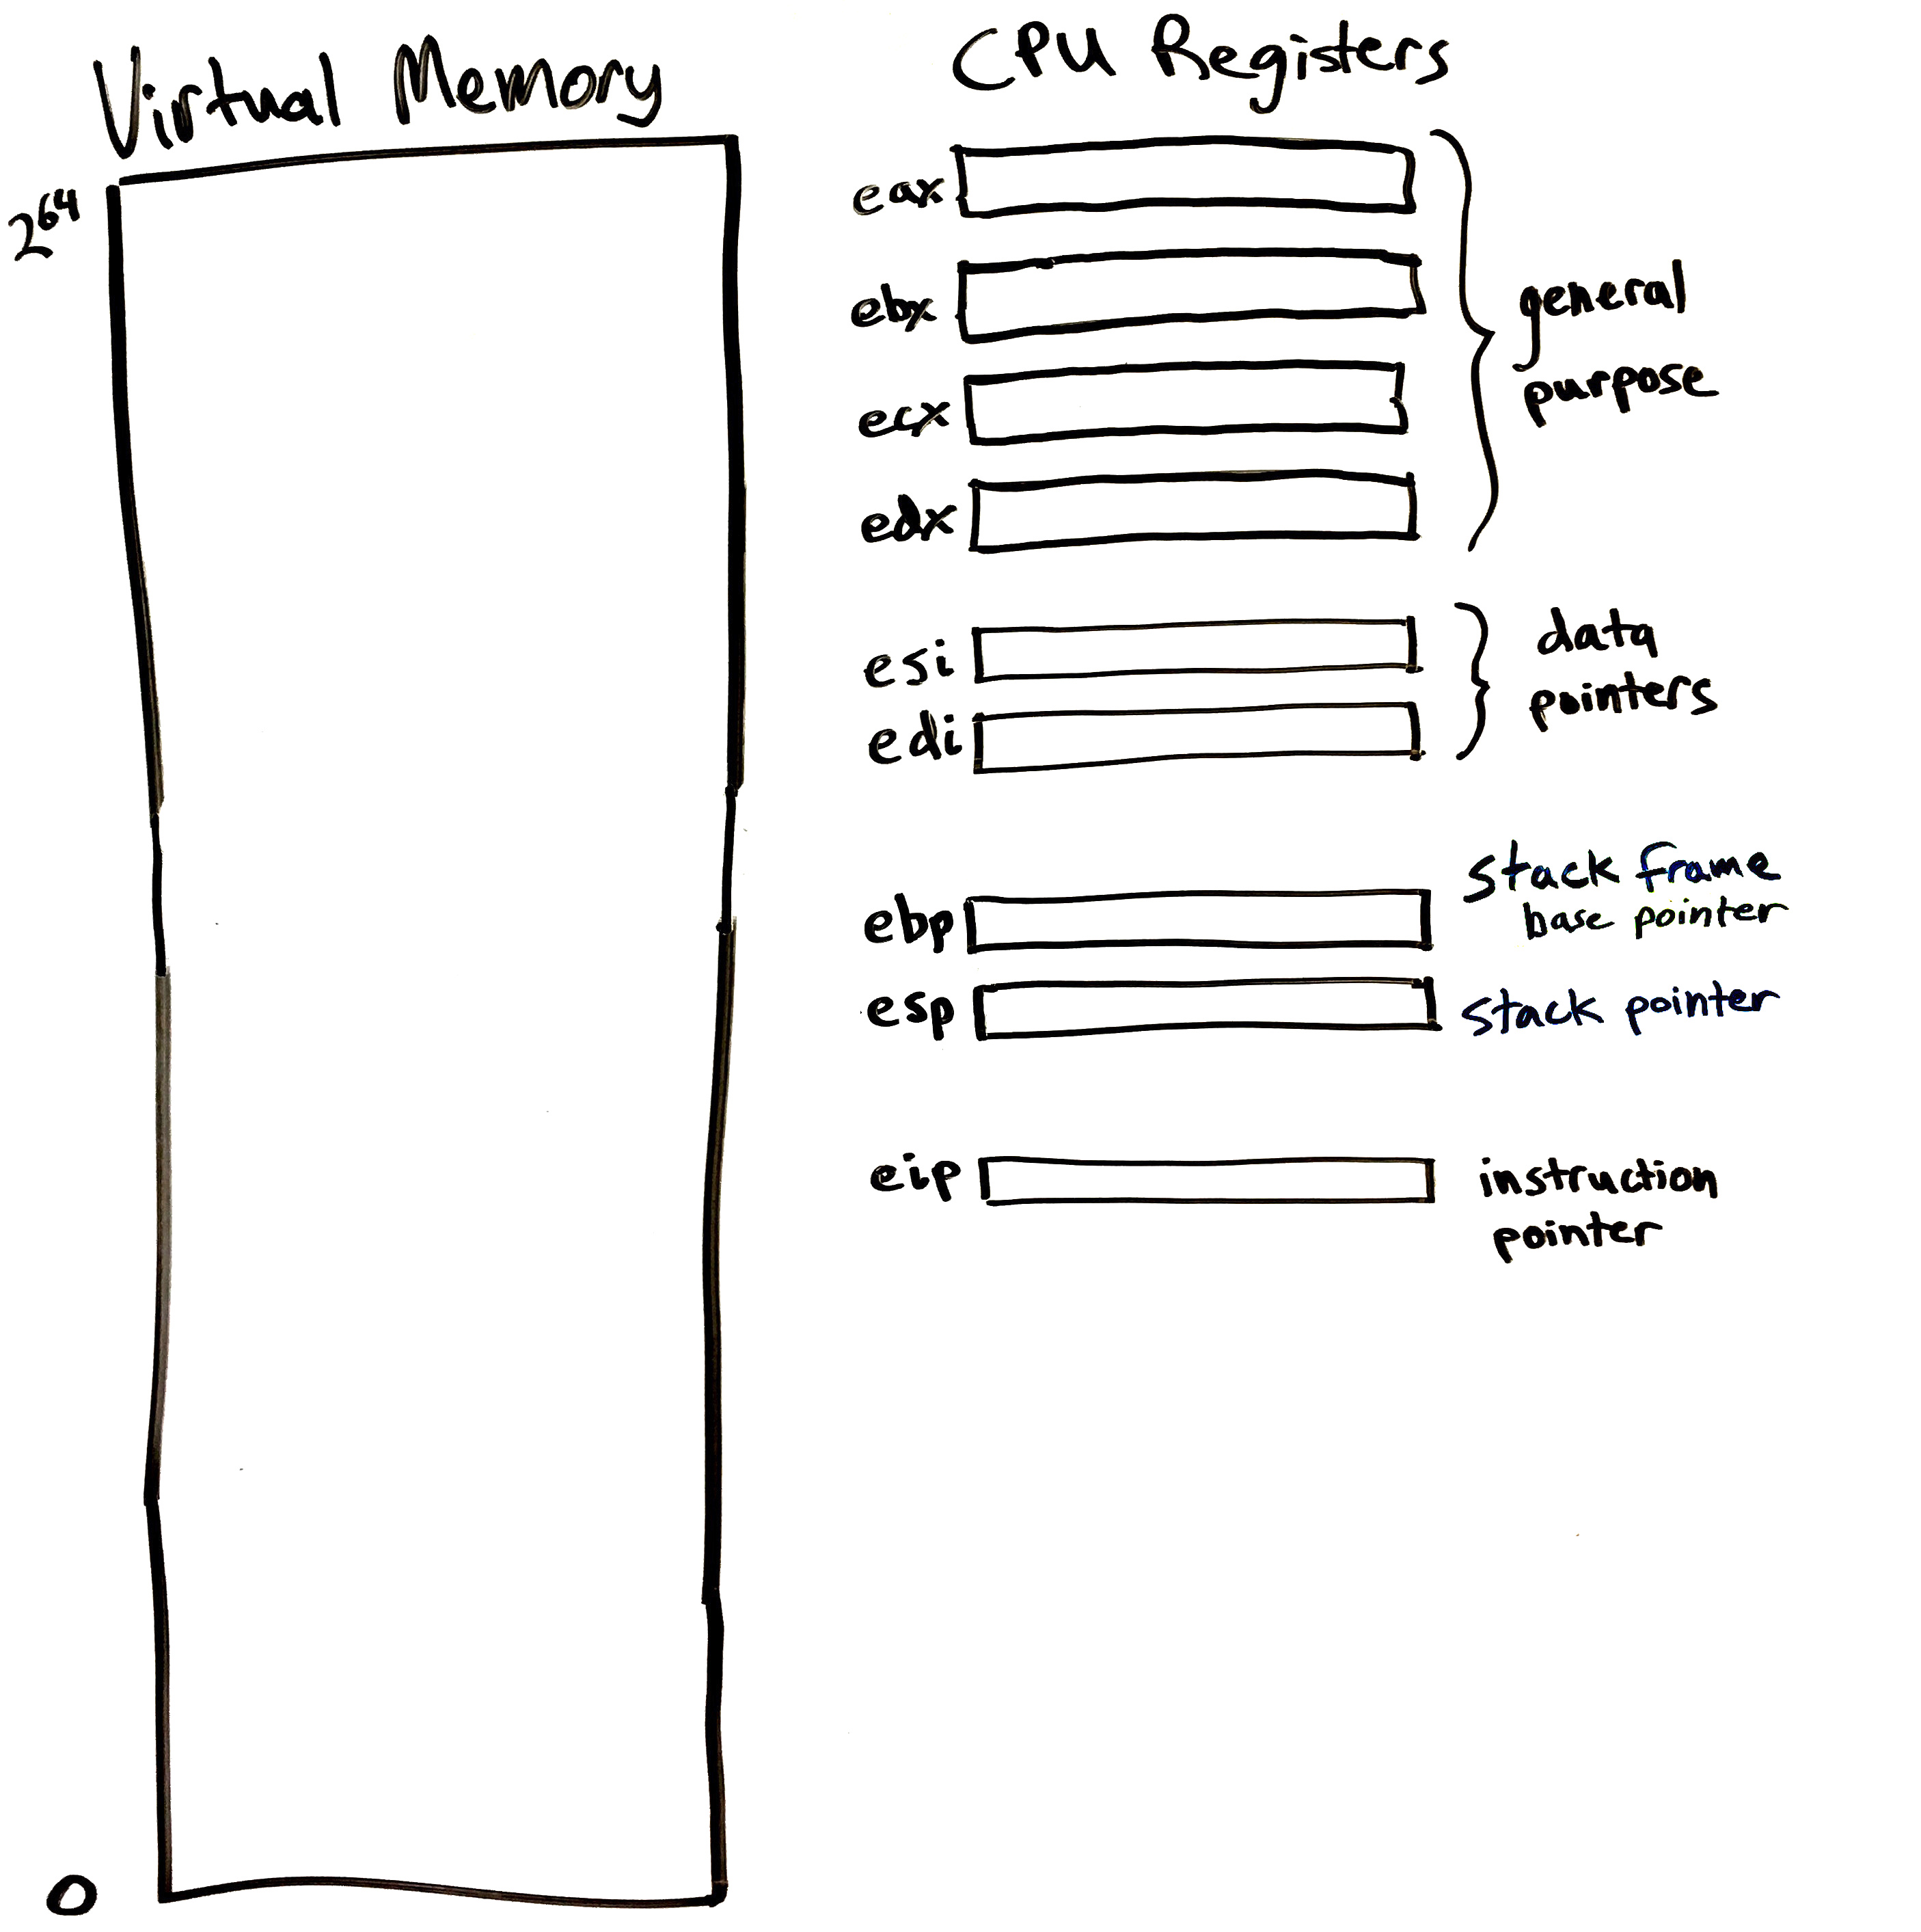
A program’s view of the computer
Machine code (after compilation) is a sequence of simple instructions understood by the CPU circuitry.
  Arithmetic, copy to/from memory, and conditional jumps
Operates on a few fast registers, and a large block of memory.
  You may have heard of CPU caches. There are optional and hidden from the program.
Values stored in registers and in memory represent a program’s state
  (We’re ignoring the OS for a moment)
Each program has its own view like this. The OS and CPU together create this illusion.
Code
&
Data

Slide 6
Let’s think at the assembly level for a moment
C Language:
x86 assembly:
void function1() {
int A = 10;
A += 66;
}
function1:
pushl %ebp #
movl %esp, %ebp #,
subl $4, %esp #,
movl $10, -4(%ebp) #, A
leal -4(%ebp), %eax #, addl $66, (%eax) #, A
movl %ebp, %esp
popl %ebp
ret
Example is from http://www.hep.wisc.edu/~pinghc/x86AssmTutorial.htm

Slide 7
“Limited direct execution”
This is how the OS supports multi-tasking (concurrent execution)
(In this class we usually assume a machine has one CPU core)
Let a process run for a while with exclusive use of the CPU
  Can use all the CPU registers
Eventually, the OS pauses that process to let another process run
  Then that process will use CPU for a while …
This is a context switch: the OS/kernel has changed the active process.

Slide 8
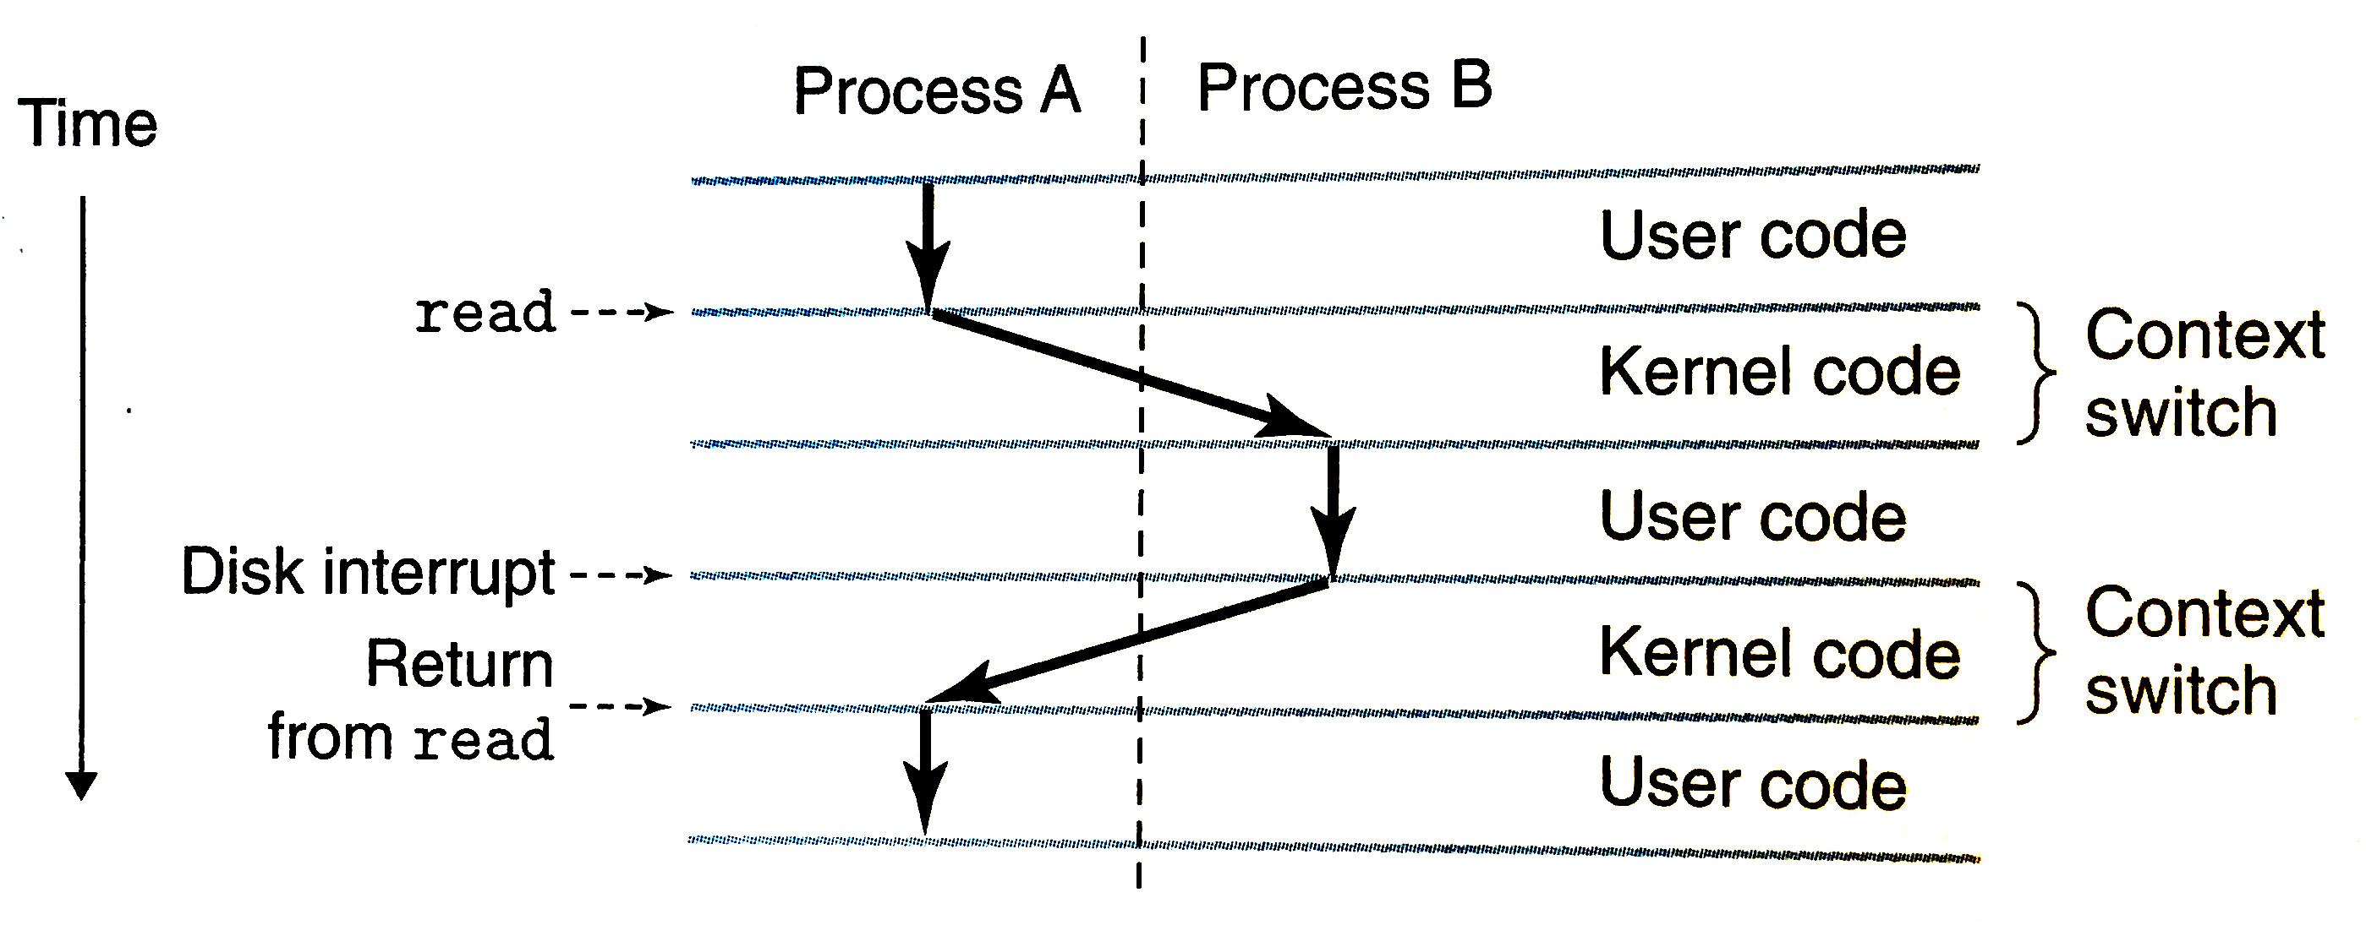
Multitasking
Diagram from Bryant & O’Hallaron book

Slide 9
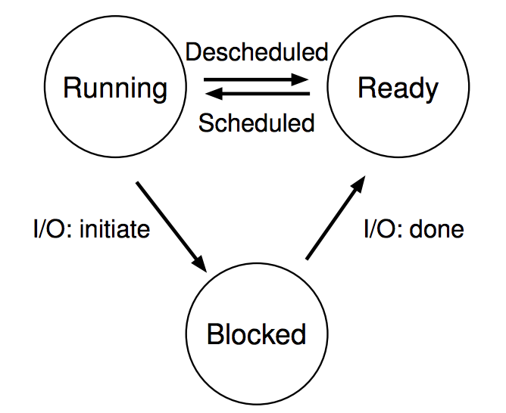
Processes don’t run all the time
OS schedules processes
  Decides which of many competing processes to run.
A blocked process is not ready to run.
I/O means input/output – anything other than computing.
  For example, reading/writing disk, sending network packet, waiting for keystroke, updating display.
  While waiting for results, the process often cannot do anything, so it blocks, telling the OS to let someone else run.
The three basic process states:

Slide 10
Process execution is limited
User processes execute with CPU in “user mode”
  Can only execute basic arithmetic, branching, and memory read/write instructions (within a specific range/segment).
  CPU will not execute certain privileged instructions when in user mode..
OS kernel runs with the CPU in “privileged/kernel mode”
  Allows all instructions, including:
    Changing registers that control which memory is accessible
    Performing I/O, switching CPU mode.
Early CPUs lacked multiple modes, so could not support a real OS.
  For example, the first IBM PC had an Intel 8088 CPU lacking this feature,
  so PC DOS was a very limited OS.
  Intel 386 processor in 1985 enabled a true OS for PCs (OS/2 and Windows).

Slide 11
Things a program cannot do itself
Print “hello world”
  because the display is a shared resource.
Download a web page
  because the network card is a shared resource.
Save or read a file
  because the filesystem is a shared resource and the OS wants to check file permissions first.
Launch another program
  because processes are managed by the OS
Send data to another program
  because each program runs in isolation, one at a time

Slide 12
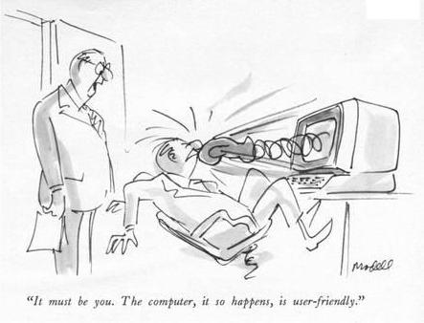
Break time

Slide 13
Interrupts
A way for the CPU to be, well, interrupted.
CPU switches to privileged mode (kernel activates)
  Now any instruction can be executed, including privileged ones.
Execution jumps to a predefined location
  (specified in the CPU’s interrupt vector table)
  This ensures that the kernel code starts running.
  Interrupts are the only way the kernel is activated (after boot-up)
Used to support asynchronous I/O
  Lets a hardware device tell the CPU that some data is ready
  Remember that a disk operation is millions of times slower than an add.
CPU has an electrical pin for hardware interrupts.
There is also an instruction for software interrupts.

Slide 14
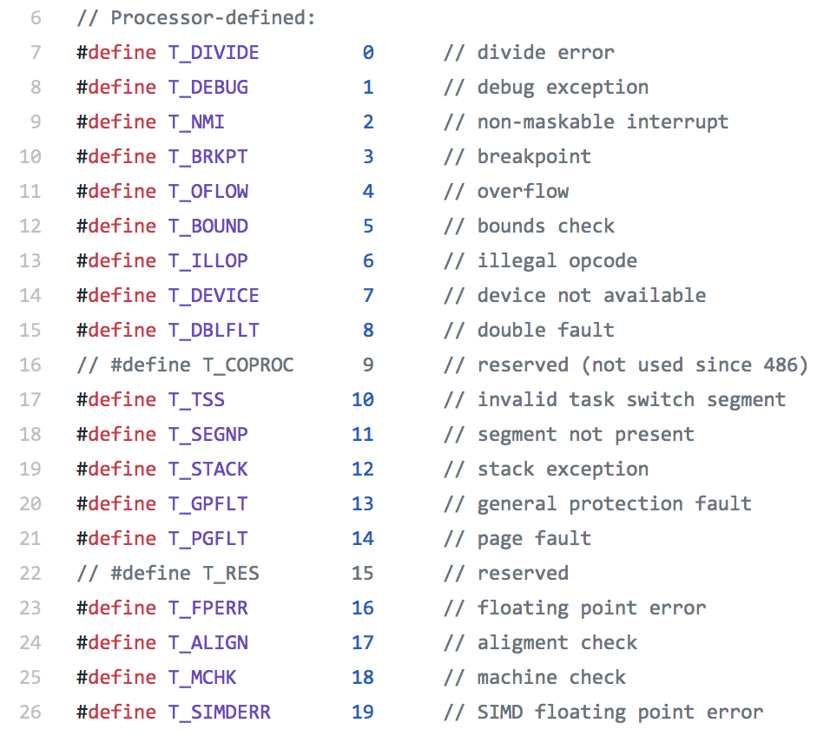
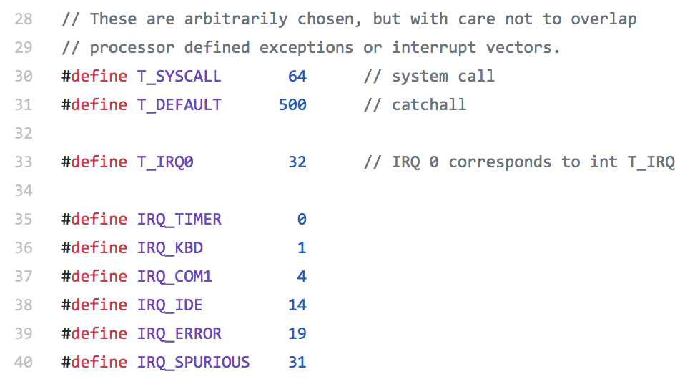
Interrupts numbers in xv6 (traps.h)
External hardware:
Keyboard
IDE disk
CPU exceptions trigger interrupts, eg.:
arithmetic overflow
invalid memory access
(general protection fault)

Slide 15
System Calls (syscalls)
…are the way that processes ask the OS to do things for them.
Run a Software Interrupt (a.k.a. trap) instruction (int on x86)
Syscall number and parameters are loaded into pre-defined registers
Kernel takes over during the interrupt handler routine
A regular function call into a library would be insufficient because it would run in the same process, in user mode.

Slide 16
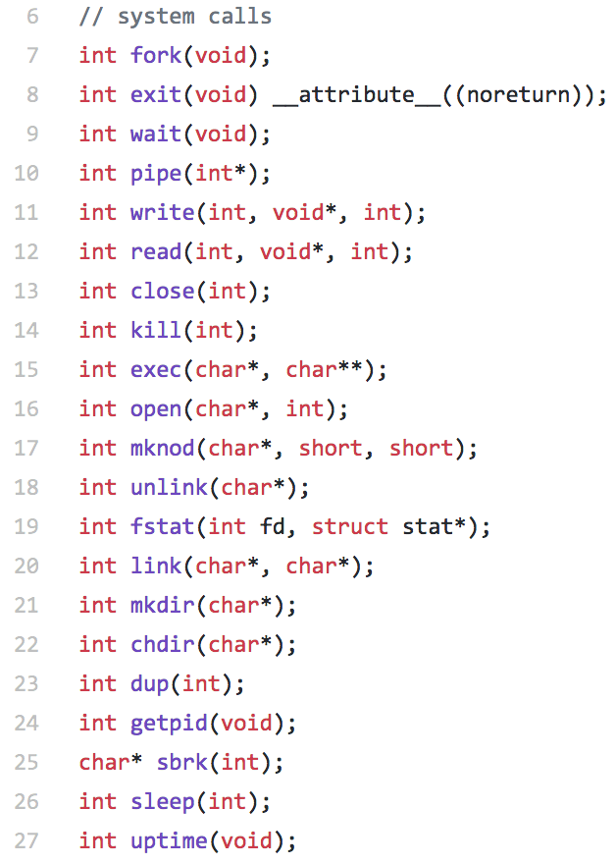
Syscalls in xv6
user.h defines function prototypes for syscalls:
User processes can call these functions in C code
But these are not regular functions!
  They’re just wrappers that trigger software interrupts.

Slide 17
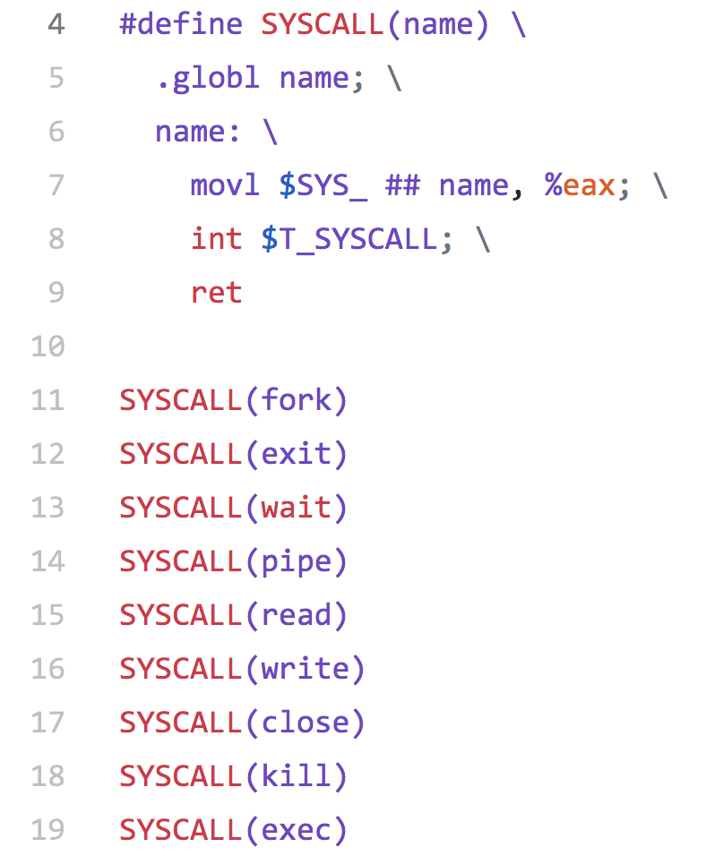
Implementation of syscall user functions is in assembly
usys.S
There’s some funky C-preprocessor syntax here.
Will generate this code for kill(int):
  .globl kill
  kill: movl $SYS_kill, %eax
  int $T_SYSCALL
  ret
“.globl” makes the symbol visible to the linker, so it’s like writing a C function.

Slide 18
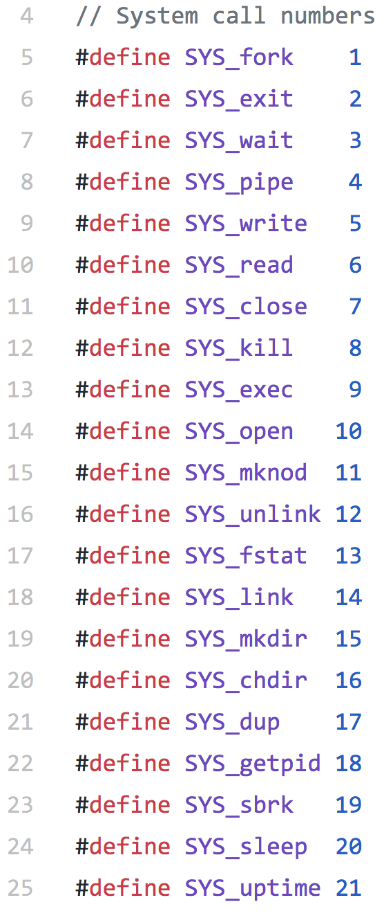
Syscall numbers are defined in syscall.h

Slide 19
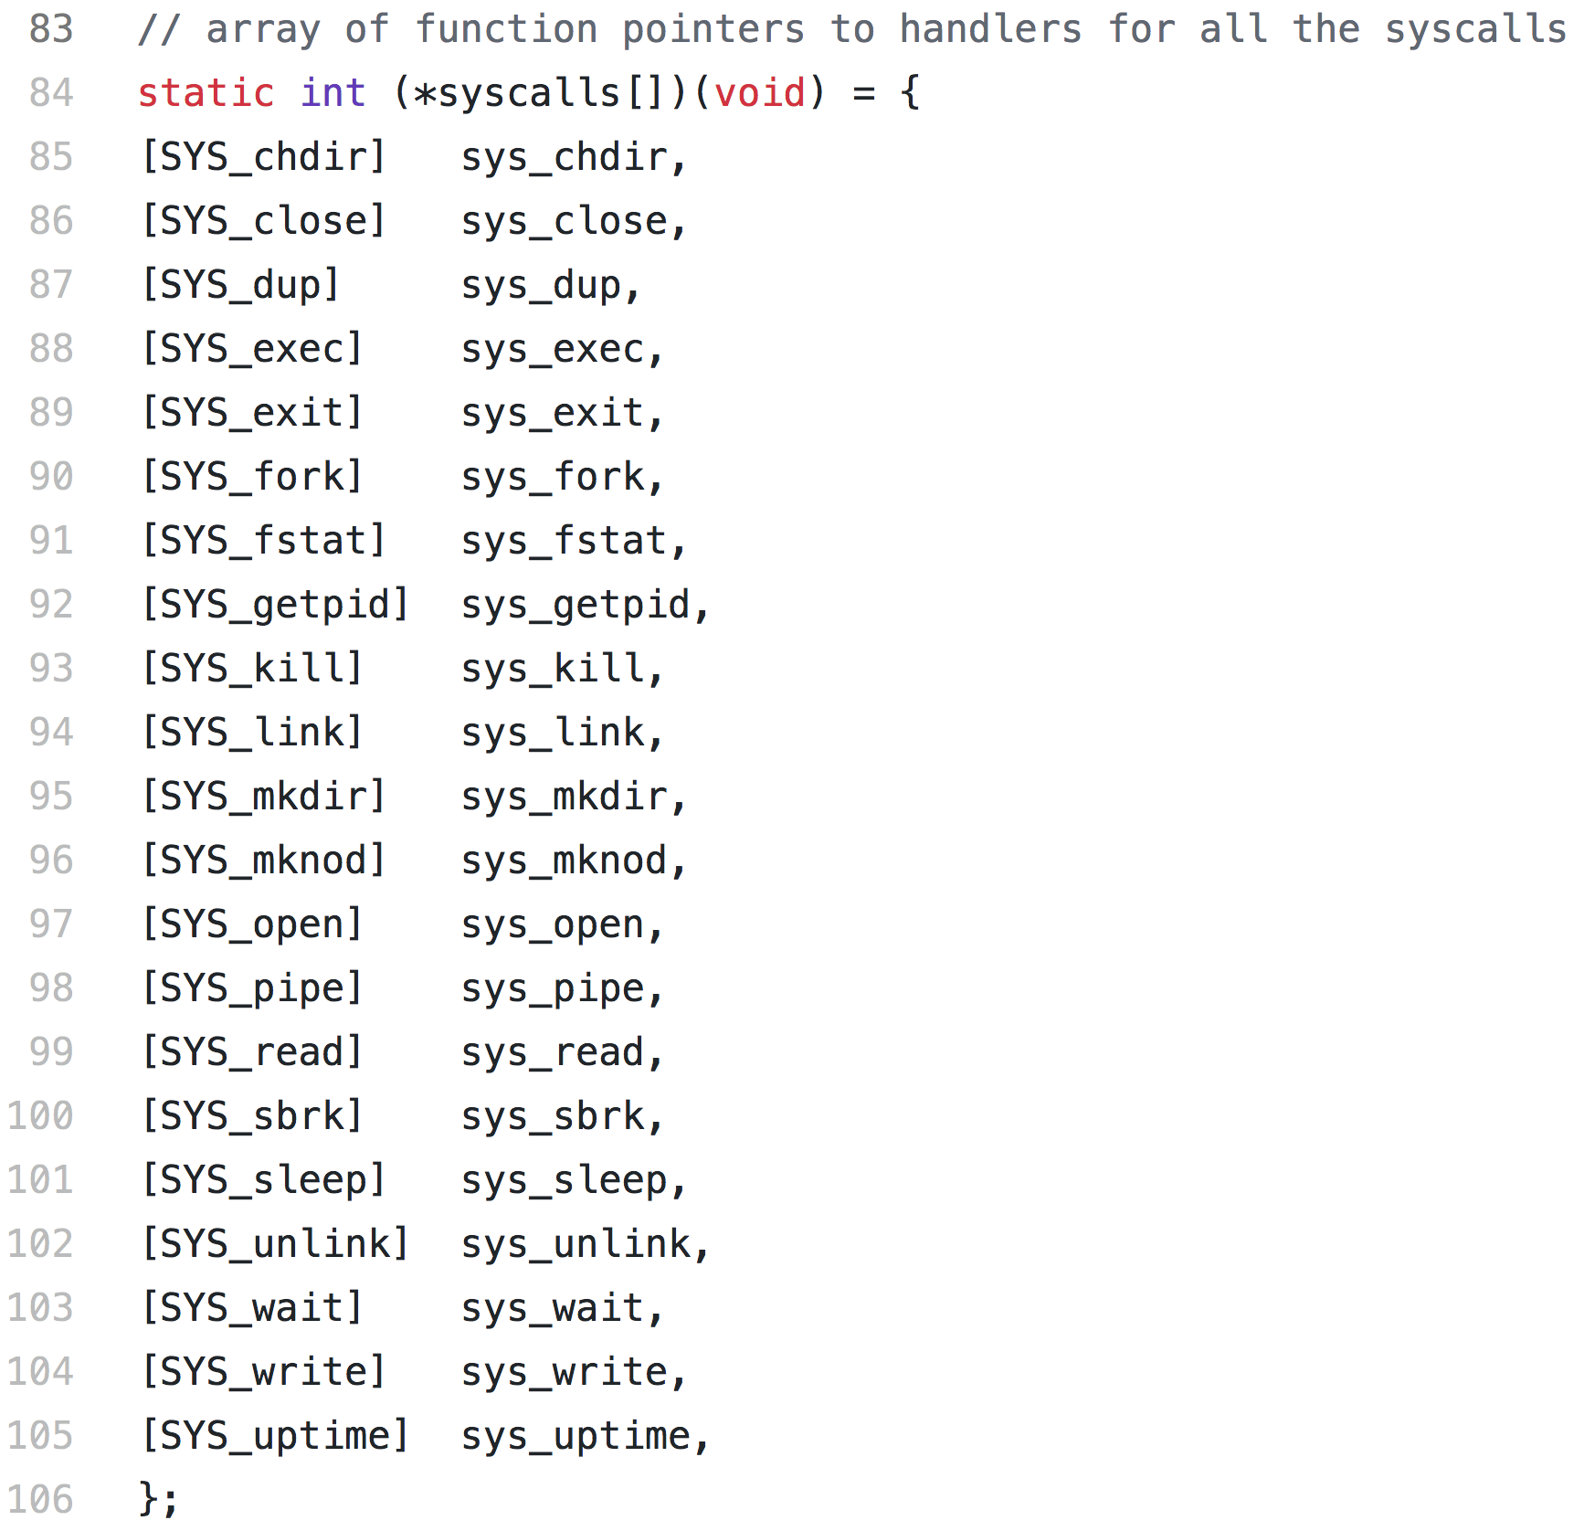
Syscall table is defined in syscall.c
There is one software interrupt handler function in the kernel, but it looks at the @eax register value to determine which of many syscalls was intended.
This table tells the kernel which kernel function to call (sys_*) for each numbered syscall (SYS_*)

Slide 20
How syscall is handled in xv6
  This C code in a user program:
  kill(43);
  Will compile to something like:
  push 43
  call kill
  …
  kill: movl 8, %eax
  int 64
  ret
$SYS_kill = 8 is the syscall number for “kill”
$T_SYSCALL = 64 is the interrupt number chosen by xv6 for syscalls

Slide 21
The int(errupt) command switches control to the OS
Having just received an interrupt, the CPU will:
Switch to privileged (kernel) mode
Get the interrupt handler address by checking the interrupt vector table (in this case using the 64th entry)
Check the %eax register for the syscall number (8 in this case)
Call the appropriate syscall handler function
  In this case, the 8th handler gives sys_kill()
The kernel function sys_kill() gets the parameter left by the user process on the stack (“43” ) and handles it accordingly.
When the syscall handler is done, we switch back to user mode and resume execution of the user process (using iret instruction).

Slide 22
Interrupts trigger context switches
How are context switches implemented?
Somehow we have to move processes on and off and on the CPU.
Diagram from Bryant & O’Hallaron book

Slide 23
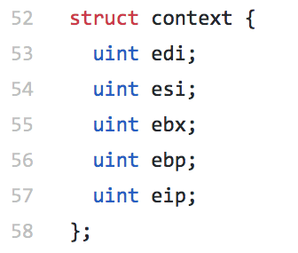
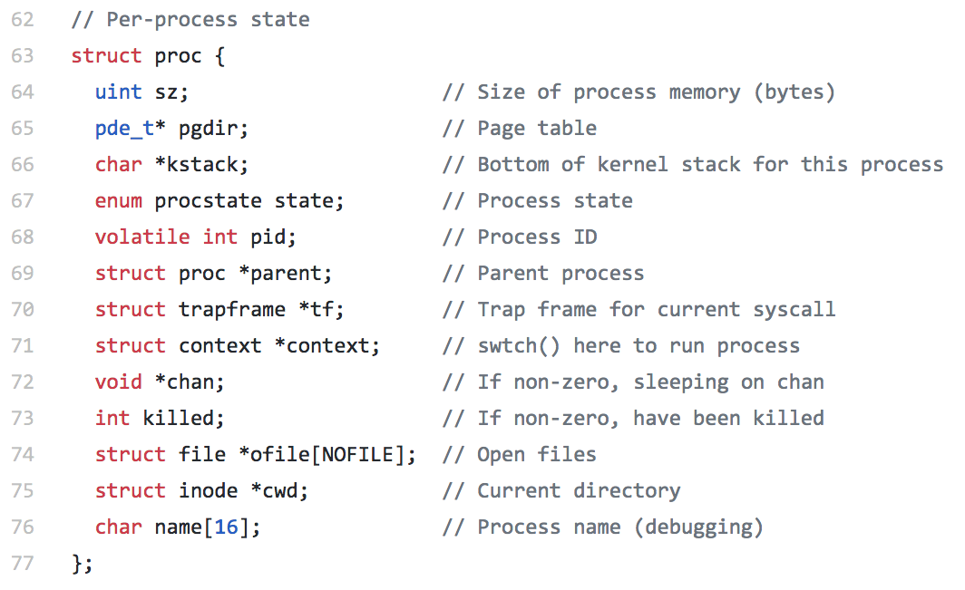
Inactive process state
OS has a process list in kernel memory to store the CPU state of processes that are not currently running.
Context switches read and write this process state.
In xv6’s proc.h:

Slide 24
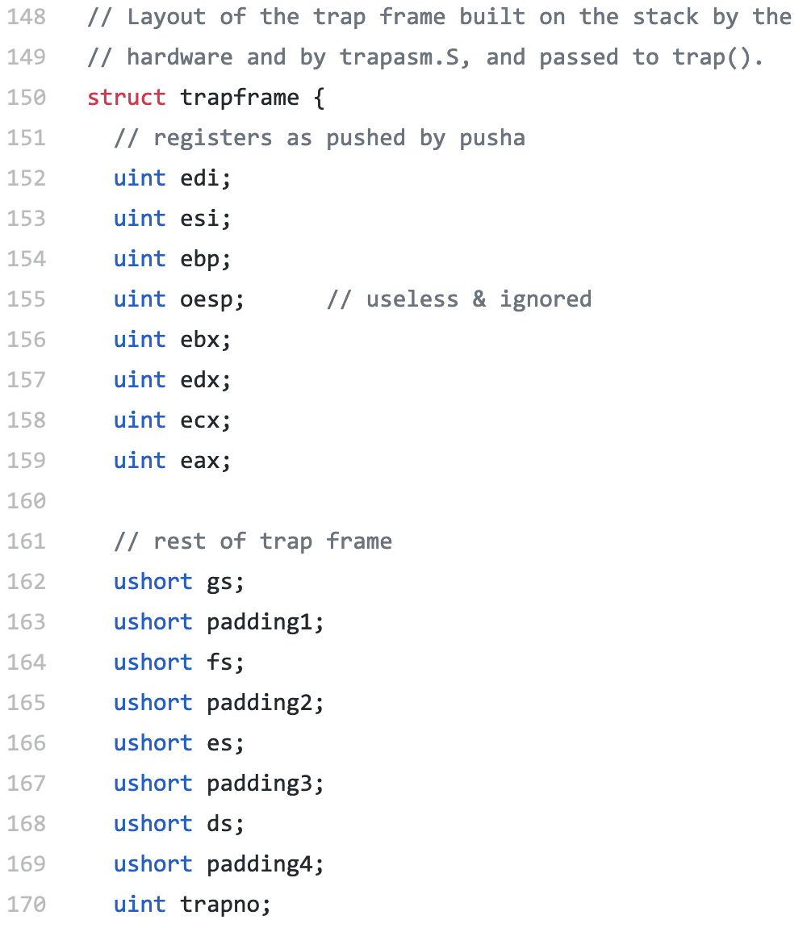
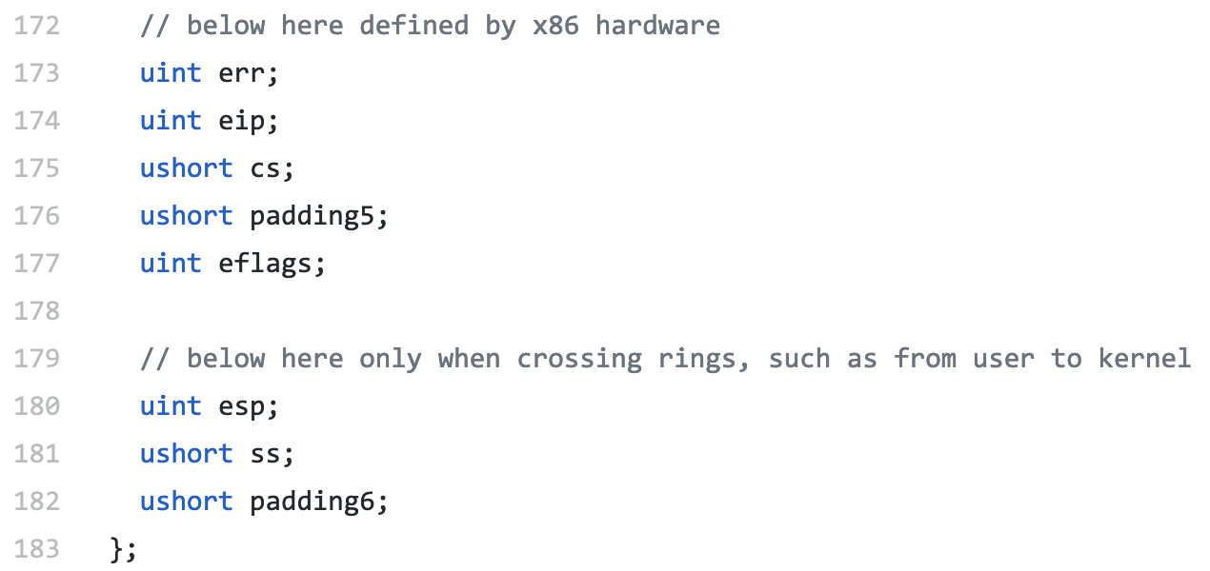
…and in x86.h:

Slide 25
CPU’s state is switched during context switch
Stored on the top of the process’ stack
Memory is “virtual.” We’ll see later that it’s very easy to switch.

Slide 26
Stop and think
So far, we’ve seen the kernel’s mechanism for switching processes and these are called context switches.
We’ve seen than the kernel gets control after the CPU gets an interrupt
  Hardware interrupts can be triggered by I/O devices
  Software interrupts are created by programs making system calls to ask the OS to do something that the user program is not privileged to do.
After an interrupt, the kernel can choose to do a context switch, and thus schedule another process.
But what’s to prevent a program from hogging the CPU forever?
What is the program never does any I/O or systems calls?
No interrupts will happen and the kernel will never run! … right???

Slide 27
Solution: programmable timer interrupt
The programmable timer is another hardware feature for the OS.
Timer is a hardware device that can be programmed to generate an interrupt after a certain amount of time.
  Perhaps after 1 to 10 milliseconds
Before context switching to a user process, the kernel sets the timer.
Timer interrupt ensures that the kernel gets an opportunity to act.
  Recall that kernel only runs in response to interrupts
  Timer is necessary to implement process scheduling policies
    (Give another process a chance to run)
Prevents a user process from getting stuck in an infinite loop

Slide 28

Aside: Watchdog Timer
PC’s timer generates a periodic interrupt to let the OS check on things.
Similarly, embedded systems often have a watchdog timer:
  A running countdown to reboot
  Software is supposed to reset it periodically.
  If software/hardware is hung, watchdog timer will expire and reboot the CPU.
Left: Mars Exploration Rover

Slide 29
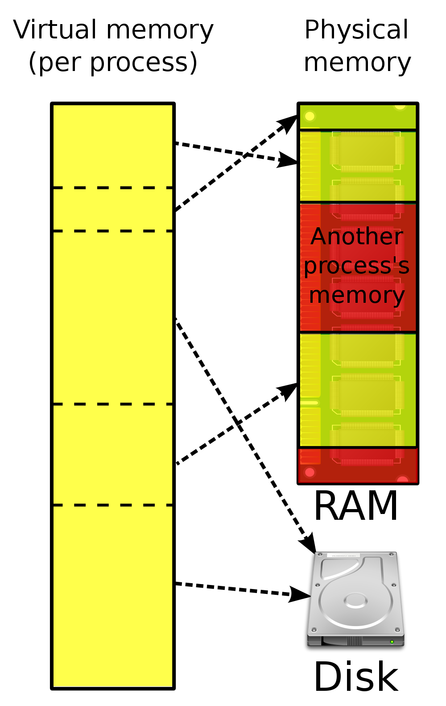
What about memory?
We have shown how each process gets it’s own copy of CPU registers.
  However registers only store a little data
Each process also has its own virtual memory
Virtual memory gives the illusions that:
  Each process has exclusive use of the memory
  Processes have “infinite” memory available
OS and CPU handle virtual memory mapping using page tables.
This is a complex topic that we will discuss starting in Lecture 6 or 7.

Slide 30
Recap
Process is a program in execution
Limited direct execution is a strategy whereby a process usually operates as if it has full use of the CPU & memory.
CPUs have user and kernel modes to prevent user processes from running privileged instructions, thus limiting execution.
Interrupts are events that cause the kernel to run
System Calls (or traps) are software interrupts called by a user program to ask the OS to do something on its behalf.
Timer Interrupt ensures that the kernel eventually runs.
Next time: process creation and process memory layout.

