Slide 1

CS-340 Introduction to Computer Networking
Lecture 17: Mobility
Motorola DynaTAC ~1984
Steve Tarzia
Many diagrams adapted from those by J.F Kurose and K.W. Ross

Slide 2
Last Lecture: Authentication
Digital signatures are special bit sequences attached to documents that can only be computed by the holder of a private key.
  Signatures are used to establish transitive trust and verify new public keys, thus preventing Man In The Middle and other attacks.
  Certificate authorities verify public keys with digitally signed certificates.
  MITM with root authority’s private key can forge arbitrary certificates.
Cryptographic hash functions are irreversible and unpredictable.
  Used to create a small summary of a document than can be signed with RSA.
  Also used in Message Authenticate Codes (HMAC) to verify that sender has a shared secret: MAC = hash(message +🗝)
Transport Layer Security (TLS) encrypts a TCP stream.
  Details are complex, to allow many different systems to interoperate and to mitigate a variety of attacks: Eg., packet replay, connection replay.

Slide 3
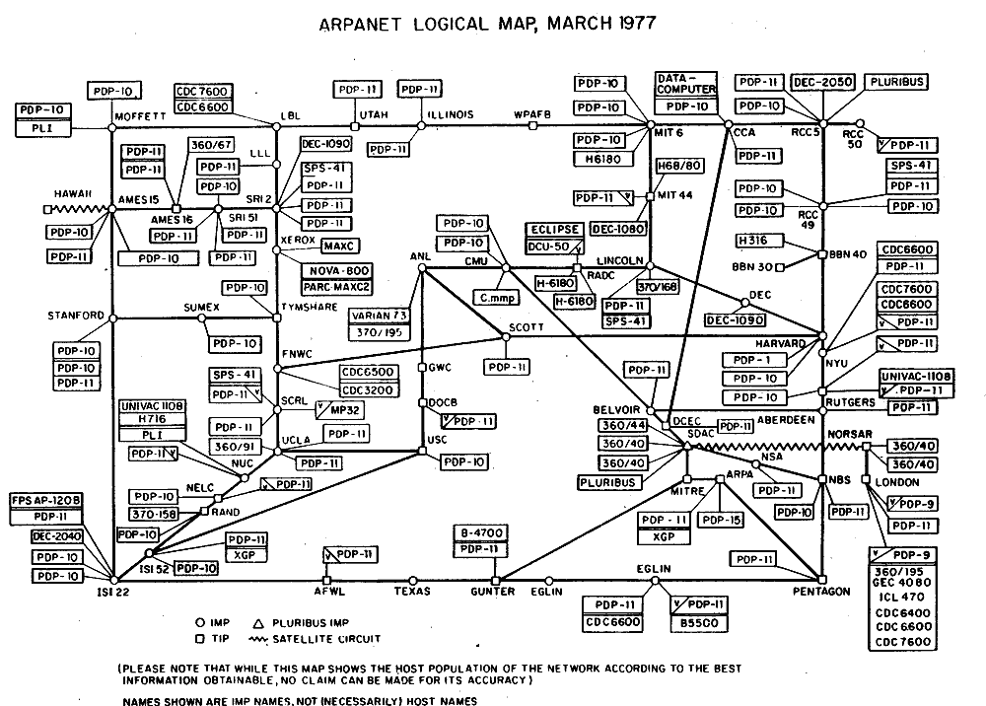
Notes:
Original Internet design did not account for mobility.

Slide 4
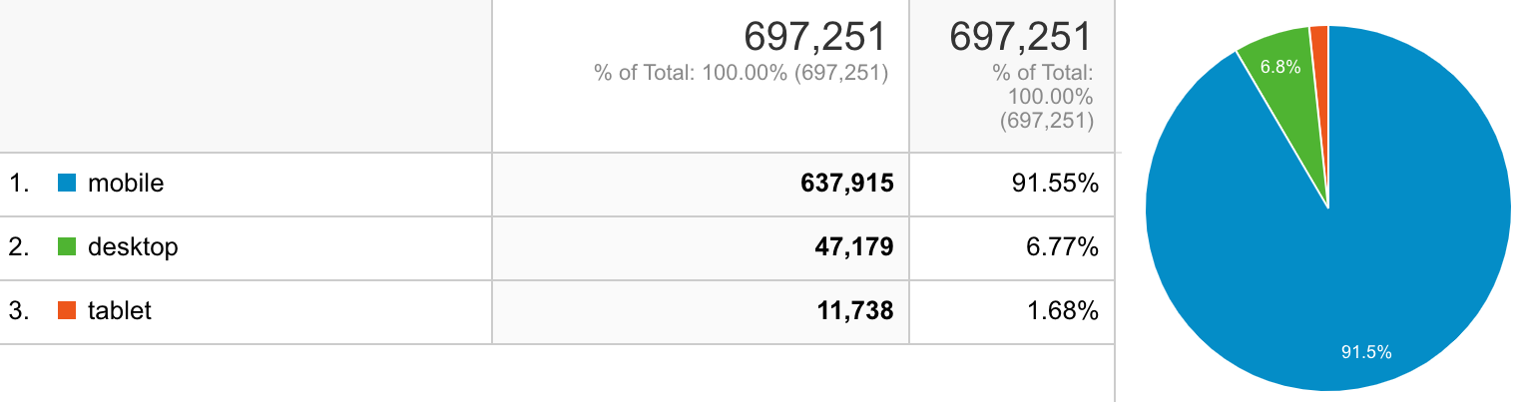
Mobility
Internet protocols were designed assuming that hosts are fixed.
Wireless radios + battery-powered computers = mobile computing
Smartphones are now more common than wired hosts.
February 2020 unique users on gunmemorial.org website:
Notes:
EECS-340 Introduction to Computer Networking
Lecture 18 - Final Review

Slide 5
Types of mobility
Wireless enables mobility, but it’s not the same thing
no mobility
high mobility
Wireless user always using same access
point.
(eg., ALOHA)
Your laptop, connecting to different networks using DHCP.
Smartphone passing through various base stations while maintaining a connection.

Slide 6
IP addresses and mobility
Applications use sockets to connect to ⟨IP address, port⟩.
IP address cannot change during connection.
Eg., consider a mobile user watching a YouTube video.
Service is designed to use a single TCP connection to send all data.
Changing IP address would require requesting the video again.
Laptop users experience application interruptions when moving between networks. Somehow, cellular data continues smoothly.

Slide 7
Why not use BGP for mobility?
STOP
and
THINK
BGP allows routes to change.
Theoretically, it could be used to let your one IP address roam between different parts of the Internet, even through different AS’s.
But this would add a lot of load to BGP and would be too slow.
Core routers would need hundreds of millions of extra /32 routes as smartphones moved between networks.
  We would lose the benefits of route aggregation (due to blocks of addresses being in one place).
  Core routers are already a bottleneck for the Internet’s speed.
Solution: do some kind of routing/redirection at the network edge.

Slide 8
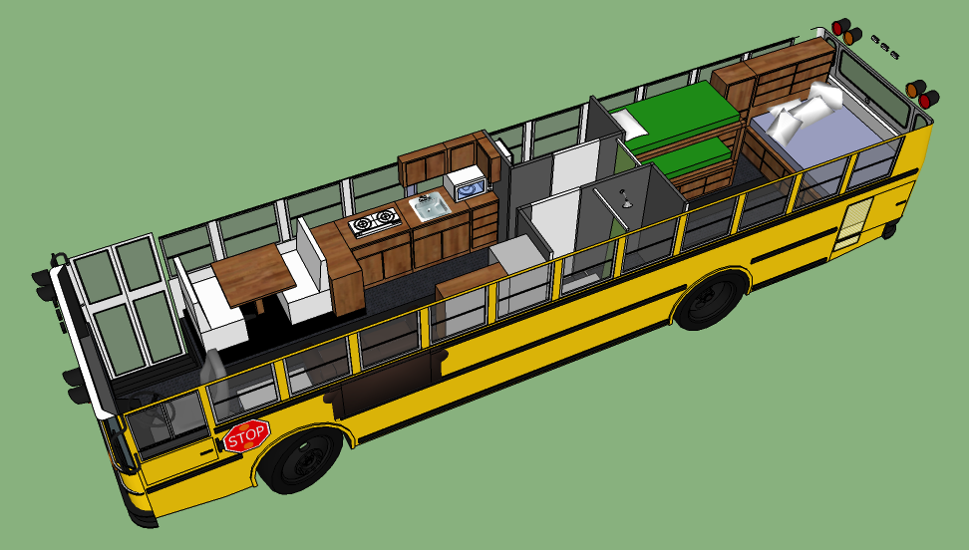

Transient youth analogy
Young adults’ mailing addresses are very “mobile”
  Various dorm rooms, sublets, internships, first few jobs, …
Also true for active-duty military.
How can we send a package or letter to a friend whose last-known address may be out of date?
  Use some other permanent connection to request address (SMS/Facebook).
  Send package to parent’s house.
  Ask parent for child’s address.
  Send package to Army Post Office (APO)
  or Fleet Post Office (FPO).
We need to contact some permanent address.
STOP
and
THINK

Slide 9
IP Tunnel
Remember how we sent IPv6 packets through old routers by wrapping them in IPv4 packets? That’s an example of IP tunneling.
Also use IP tunnel for mobile IP.
Mobile client registers its temporary address to home agent.
Home agent is the router responsible
for home address’ subnet.
Packets are addressed to home address,
received by home agent,
and encapsulated in packet addressed
to temporary address and forwarded.
Home agent wraps and forwards packet to actual/current address
Addressed to home
Dest: 20.1.30.2 …
Type: IP …
Dest: 43.1.20.2 …
Type: TCP …
Dest: 43.1.20.2 …
Type: TCP …
TCP segment
TCP segment

Slide 10
Indirect Routing
foreign-agent-to-mobile packet
packet sent by home agent to foreign agent: a packet within a packet
dest: 128.119.40.186
dest: 79.129.13.2
dest: 128.119.40.186
Permanent address: 128.119.40.186
(virtual location)
Foreign agent
Home agent
Care-of address: 79.129.13.2
dest: 128.119.40.186
packet sent by correspondent
Message source

Slide 11
Mobile IP details (RFCs 3344, 5944)
Home agent is router that receives packets addressed to home address.
Foreign agent is router that delivers packets at final hop.
  Its address is the care-of address.
Setup:
Mobile host uses a protocol similar to DHCP to find Foreign Agt.
Mobile host registers Home Agt and home address with Foreign Agt.
Foreign Agt relays registration to Home Agt.
Operation:
Home Agt receives packets addressed to home address
Home Agt encapsulates packet, addressing it to care-of address
Foreign Agt receives encapsulated packet, and unpacks it.
Foreign Agt sends packet to mobile host (using MAC address)

Slide 12
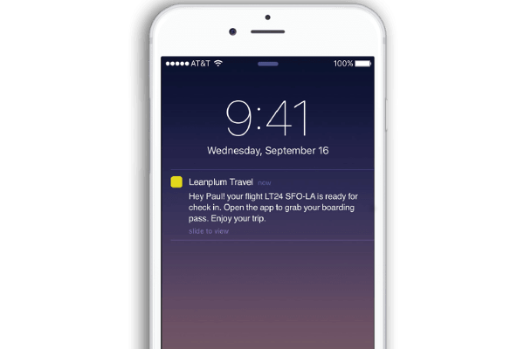
Smartphone Push Notifications
Location registration is also used for iOS and Android push notifications.
Whenever phone gets a new IP address, the OS registers that address with a central push notification server. It gets: ⟨user id, IP address⟩
Smartphone apps like WhatsApp or Snapchat send user notifications to the iOS/Android push notification server: ⟨user id, message⟩
  The push notification server relays the message to the user’s current IP addr.
On iOS, to protect users’ privacy, different apps
have different user ids (called device tokens).
How to deal with NAT?
  OS sends keepalive msgs.
  Just one active TCP socket is needed for all apps.
STOP
and
THINK

Slide 13
Link-Layer Handoff
Generally speaking, handoff is the act of transferring an ongoing connection from one channel to another.
Basic handoff steps:
  Notice that first channel is weak or crowded
  Find a superior second channel
  Join the second channel
  (now we are using both channels)
  Tell “router” that second channel should be used
  Notice that data is arriving on second channel
  Close the first channel
In WiFi, alternative “channels” correspond to different base stations advertising the same network id (ssid). Probably on a different frequency.

Slide 14
TCP behavior on mobile wireless
Recall that TCP assumes that packet loss is due to congestion.
However wireless noise and handoff can cause temporary packet loss.
Congestion window may be reduced unnecessarily.
In other words, TCP was design with the assumption that hosts are stationary.
Mobile-aware TCP is an active area of research.

Slide 15
GSM cellular connections
Basic idea is same as mobile IP, but it operates at the Link Layer.
Correspondent
wired public telephone
network
MSC
MSC
MSC: Mobile Switching Center routes traffic to/from multiple “cells.”
MSC is the equivalent of an edge router.
MSC
MSC
MSC
Verizon
AT&T
Different cellular networks,
operated by different providers

Slide 16
Handoff within a Mobile Switching Center
Old Cell informs MSC of impending handoff, provides list of new Cells
MSC sets up path (allocates resources) to new Cell
New Cell allocates radio channel for use by mobile.
New Cell signals MSC, old Cell: ready
Old Cell tells mobile: handoff to new Cell
Mobile & new Cell activate new channel
Mobile signals via new Cell to MSC: handoff complete. MSC reroutes call
MSC-old-Cell resources released
Mobile
Switching
Center
2
4
1
7
8
3
old Cell
5
6
new Cell

Slide 17
Handoff between MSCs
Anchor MSC: first MSC visited during call.
Call remains routed through anchor MSC
New MSCs add on to end of MSC chain as mobile moves to new MSC.
Optionally bypass intermediate MSCs to shorten the multi-MSC chain.
home network
correspondent
Home MSC
anchor MSC
PSTN
MSC
MSC
MSC
a) Before handoff

Slide 18
Handoff between MSCs
Anchor MSC: first MSC visited during call.
Call remains routed through anchor MSC
New MSCs add on to end of MSC chain as mobile moves to new MSC.
Optionally bypass intermediate MSCs to shorten the multi-MSC chain.
home network
correspondent
Home MSC
anchor MSC
PSTN
MSC
MSC
MSC
b) After handoff & chain shortening

Slide 19
Recap
IP addressing was designed for a static world.
Mobile IP gives host a permanent home address.
  Registers with Foreign Agent which registers with Home Agent.
  Home agent encapsulates received traffic in IP tunnel, forwards traffic to foreign agent at care-of address.
Smartphone push notifications also use location registration.
Handoff: set up the 2nd channel, transfer connection, then close 1st.

