Slide 1
CS-340 Introduction to Computer Networking
Lecture 16: Authentication
Steve Tarzia

Slide 2
Last Lecture: Encryption and Anonymity
Network security goals are:
  Confidentiality, Reliability, Integrity, Authentication & Anonymity
Routers and other participants on the network cannot be trusted.
AES is a the standard symmetric-key encryption algorithm. Must somehow establish a shared session key, used by both parties.
Public Key cryptography (RSA, ECC) uses a pair of related keys.
  Public key is openly advertised and is used for encryption
  Private key is secret and is used for decryption.
Onion-routing/mix networks create routing overlays on the Internet.
  Sender encrypts data many times. Relays decrypt one layer each.
  This enables anonymous web browsing and even anonymous services.

Slide 3
Authentication definition
Verifying the identity of the person/host I’m communicating with.
Why does confidentiality (keeping messages secret) require authentication?
There are many ways in which Internet messages can be read by untrusted 3rd parties.
In order to start encryption, we have to verify that we are exchanging public keys with the intended party, not a “man in the middle.”
STOP
and
THINK

Slide 4
Man-in-the-middle (MITM) attack
A major flaw remains in this communication scheme.
We cannot be sure that the machine we contacted is actually who we intended to contact – messages may not be authentic.
A malicious intermediate router may establish two different encrypted sessions between the communicating parties and relay messages.
  MITM advertises a false public key (its own) to the sender
  MITM is then able to decrypt sender’s message and re-encrypt message with the receiver’s true key before delivery.
Messages can be viewed and altered before delivery.
MITM can violate confidentiality, integrity, and authentication.

Slide 5



MITM Attack
An evil router
A
(🔑_{G},🔓_{G})
G
(🔑_{A},🔓_{A})
(🔑_{M},🔓_{M})
Let’s talk securely!
Here’s my public key
🔓_{A}
Let’s talk securely!
Here’s my public key
🔓_{M}
OK. Here’s my public key 🔓_{G}
OK. Here’s my public key 🔓_{M}
4903c2…
“I feel pretty”
5933c0…
11290a…
“Do you?
Rewrite to
“So do I!”
0943e2…
MITM can read and alter messages!

Slide 6
How to avoid MITM attacks?
Simple, but impractical, solution is to avoid public-key cryptography.
Instead just use symmetric encryption with pre-shared key.
To use public key cryptography, we must be sure that the public key we receive really belongs to the endpoint, and not some MITM.
  If so, we can be assured that only the endpoint has the private key.
Real-world solutions involve using digital signatures to verify public keys (certificates).

Slide 7
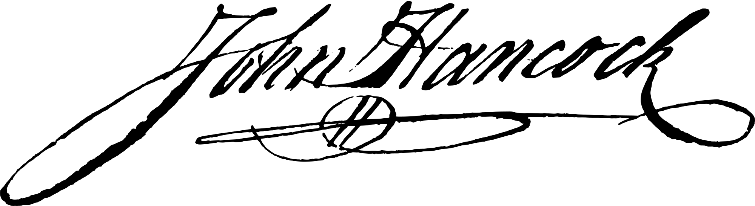
Why digital signatures?
Want to produce a public document (not encrypted) that:
  Makes some claim (or has a message, in general).
  Anyone can verify the author of the document/message.
    In other words, it’s not possible that someone else forged the document.
The existence of the signature on the document proves something.
  We don’t care who gave us a copy.
  Unlike real-world ink signatures, an attacker cannot copy a signature from one document to another. Signature is somehow unique to the document.
Notice this is a case when we need authentication and integrity, but not confidentiality.

Slide 8
Digital Signatures
A digital signature is a short bit-sequence generated from a digital document and a private key, with the following properties:
  Like a hash function, it always produces the same result (for given data).
  It produces different results for different documents and keys.
  The document cannot be signed without a private key.
  The signature can be verified using only the corresponding public key.
Closely related to public key encryption: can use the same RSA keys.
Changing a signed document will make the former signature invalid.

Slide 9
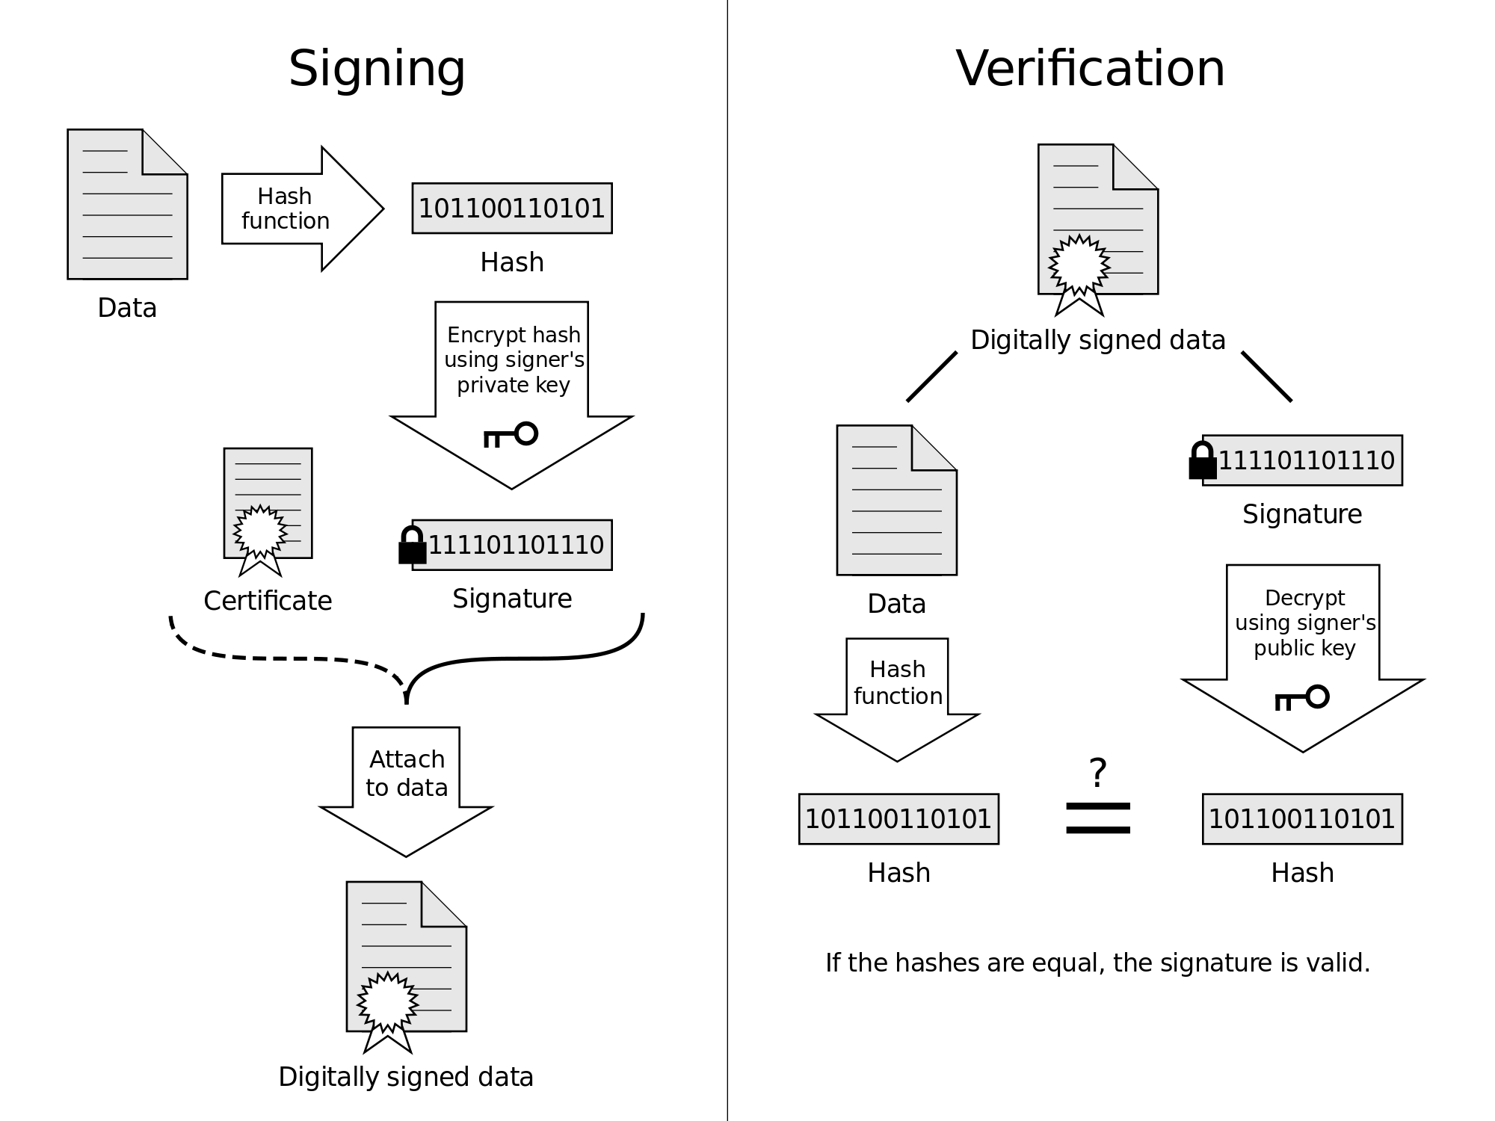

Signing: The signer uses the RSA private to encrypt the message hash, creating a signature.
Verification: Anyone looking at the certificate can use the public key to try to decrypt the signature. If this leads to the true message hash, then the signature must have been generated using the true private key.
Meg likes beets
Meg likes beets
🔑
Meg likes beets
Name of signer, Public key 🔓
Certificate
🔓
Meg likes beets
If hashes are equal, the signature is valid

Slide 10
For confidentiality, we encrypt with public keys, but here we use private key. Why?
Signing: The signer uses the RSA private to encrypt the message hash, creating a signature.
Verification: Anyone looking at the certificate can use the public key to try to decrypt the signature. If this leads to the true message hash, then the signature must have been generated using the true private key.
Meg likes beets
Meg likes beets
STOP
and
THINK
🔑
Meg likes beets
Name of signer, Public key 🔓
Certificate
🔓
Meg likes beets
If hashes are equal, the signature is valid

Slide 11
The meaning of signatures
If I download a document with a statement (“Meg likes beets”) and that document contains a valid digital signature for public key 🔓_{M},
I know that:
  Someone with access to the private key 🔑_{M} saw the document and chose to run the signing algorithm to compute the corresponding signature.
  We know that only someone holding the private key would have any reasonable chance of computing the correct signature for that ⟨document, public-key⟩ pair.
Therefore, if I already know that Meg’s public key is 🔓_{M} then I can trust that she is the author of the statement “Meg likes beets”.
Meg cannot claim that she does not like beets (non-repudiation).
But, how do I know 🔓_{M} is really her public key? transitive trust…

Slide 12
But what is the “signature” itself?
Signing is generating and publishing a number (signature).
The number is associated with a message (document), and a public key.
The number is computationally infeasible to calculate without knowing the private key.
Hence, the fact that the number is known by anyone implies that the holder of the private key chose to generate it.
Anyone can verify that the number is correct using the document and the public key.

Slide 13
Digital signatures can provide transitive trust
Let’s say I want to browse the web and securely visit thousands of websites over the lifetime of the computer.
It’s impractical to get a pre-shared key ahead of time from these thousands of websites, yet I still wish to communicate securely.
However, I can easily get just a few trusted public keys:
  These are called root authorities.
Root authority can sign a certificate identifying another trustworthy certificate authority.
Website operator must get their HTTPS public keys (certificates) signed by a certificate authority
  Certificate authority does some kind of check that the person asking for the certificate really represents the domain & organization listed on the cert.
  Website then advertises that certificate, proving that their public key is legit.

Slide 14
Demo of SSL chain of trust
https://northwestern.edu

Slide 15
Public Key Infrastructure (PKI)
PKI creates, distributes, and verifies stranger’s claims (certificates).
A distributed and scalable way to verify public keys.
At first, client does not trust server, however server provides two certificates which are sufficient to earn the customer’s trust:
Chain of trust links the advertised public key to an already-trusted key.
Server certificate
www.shopping.com
Public key: e231…
Signed by: Webbycorp
Public key: 904e…
Signature: 3902…
Intermediate certificate
Webbycorp
Certificate authority
Public key: 904e…
Signed by: AAA corp.
Public key: 0c92…
Signature: 0032…
Customer
Root certificate
Crosby corporation
Public key: 0c92…
www.shopping.com
Root certificate
Baker corporation
Public key: 0c92…
Root certificate
Actalis Inc.
Public key: 493a…
Root certificate
AAA corporation
Public key: 0c92…

Slide 16
Getting a certificate
Pay a fee to a certificate authority and send them a
certificate signing request (CSR):
“Common name: northwestern.edu; Public key: 3a203c…”
Certificate authority (CA) somehow verifies the claim in the certificate:
  Email the registrant listed in the WHOIS database.
  Look up the phone number of the requester and call them.
  Send a letter to the requester and wait for a reply.
  Visit the requester’s office and verify the public key in-person.
  Challenge the requester to post a random number/document on their webpage or in a DNS record.
If the CA is satisfied, it will compute a digital signature certifying the claims in the CSR, and send you the certificate (CSR + signature).
How to verify requester's identity?
STOP
and
THINK

Slide 17
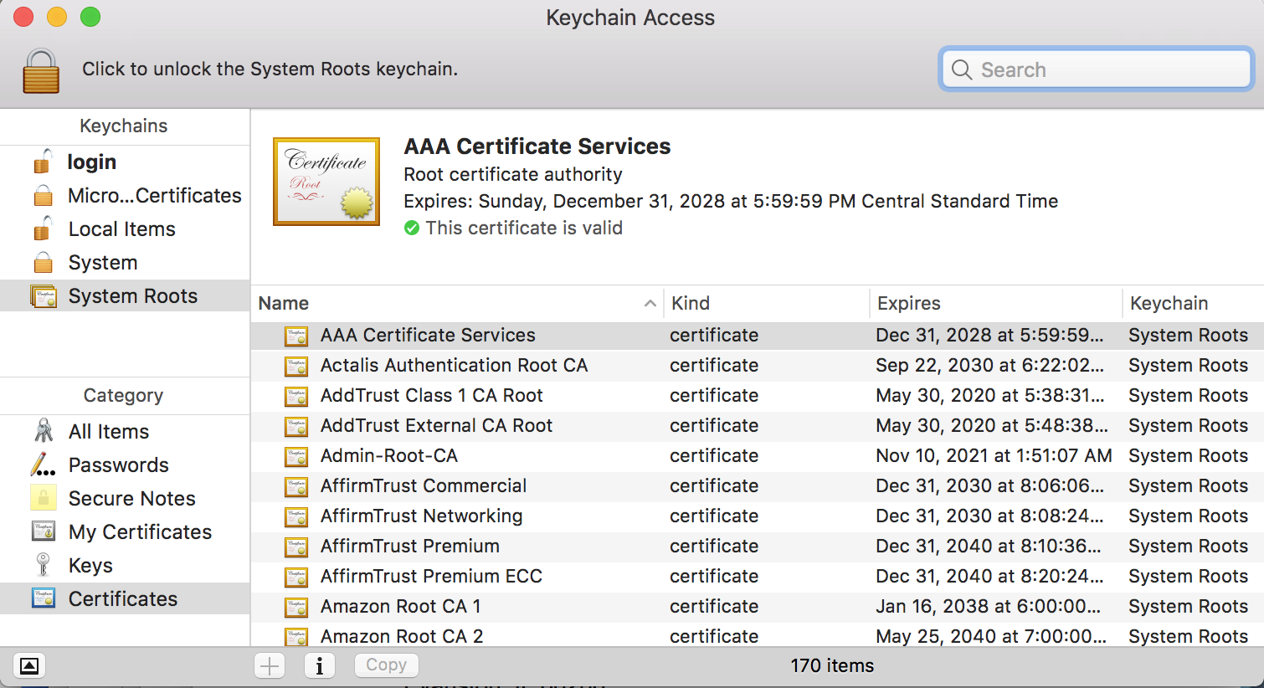
Mac OS comes with 170 root certificates

Slide 18
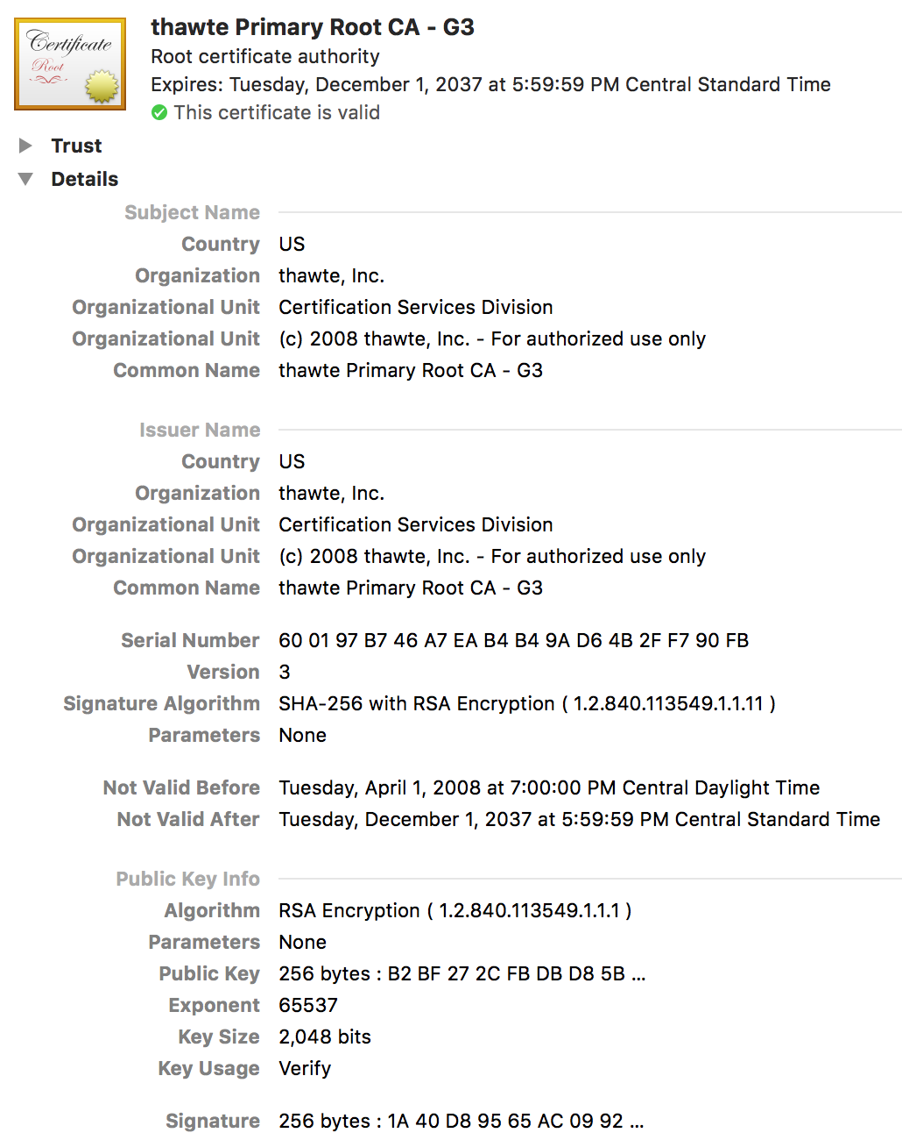
Root certificate components
Expiration date
Subject’s name
Issuer name
Issuer’s signature algorithm
Public key of subject
Issuer’s signature
Root certificates are self-issued and self-signed. The user must have some outside reason to trust it.

Slide 19
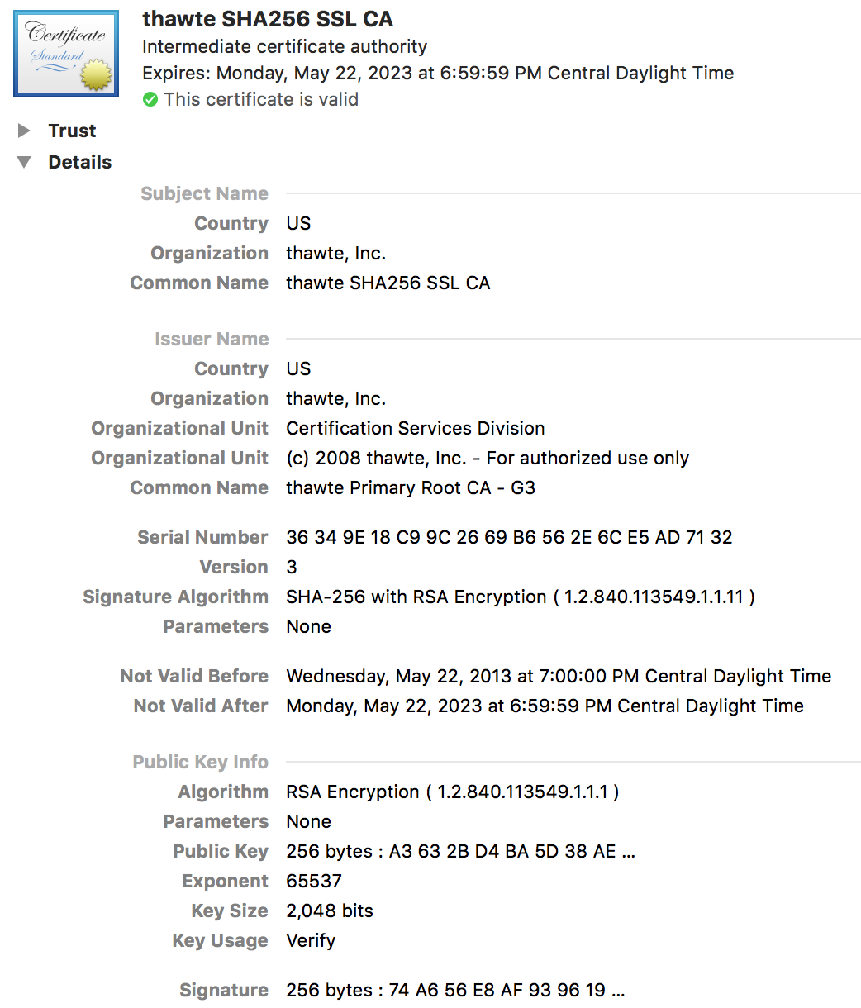
Intermediate certificate
Has same basic components as root certificate.
Must be signed by a trusted issuer.
This certificate was issued by a root authority at the same company:
“thawte SHA256 SSL CA”
is signed by
“thawte Primary Root CA - G3”

Slide 20
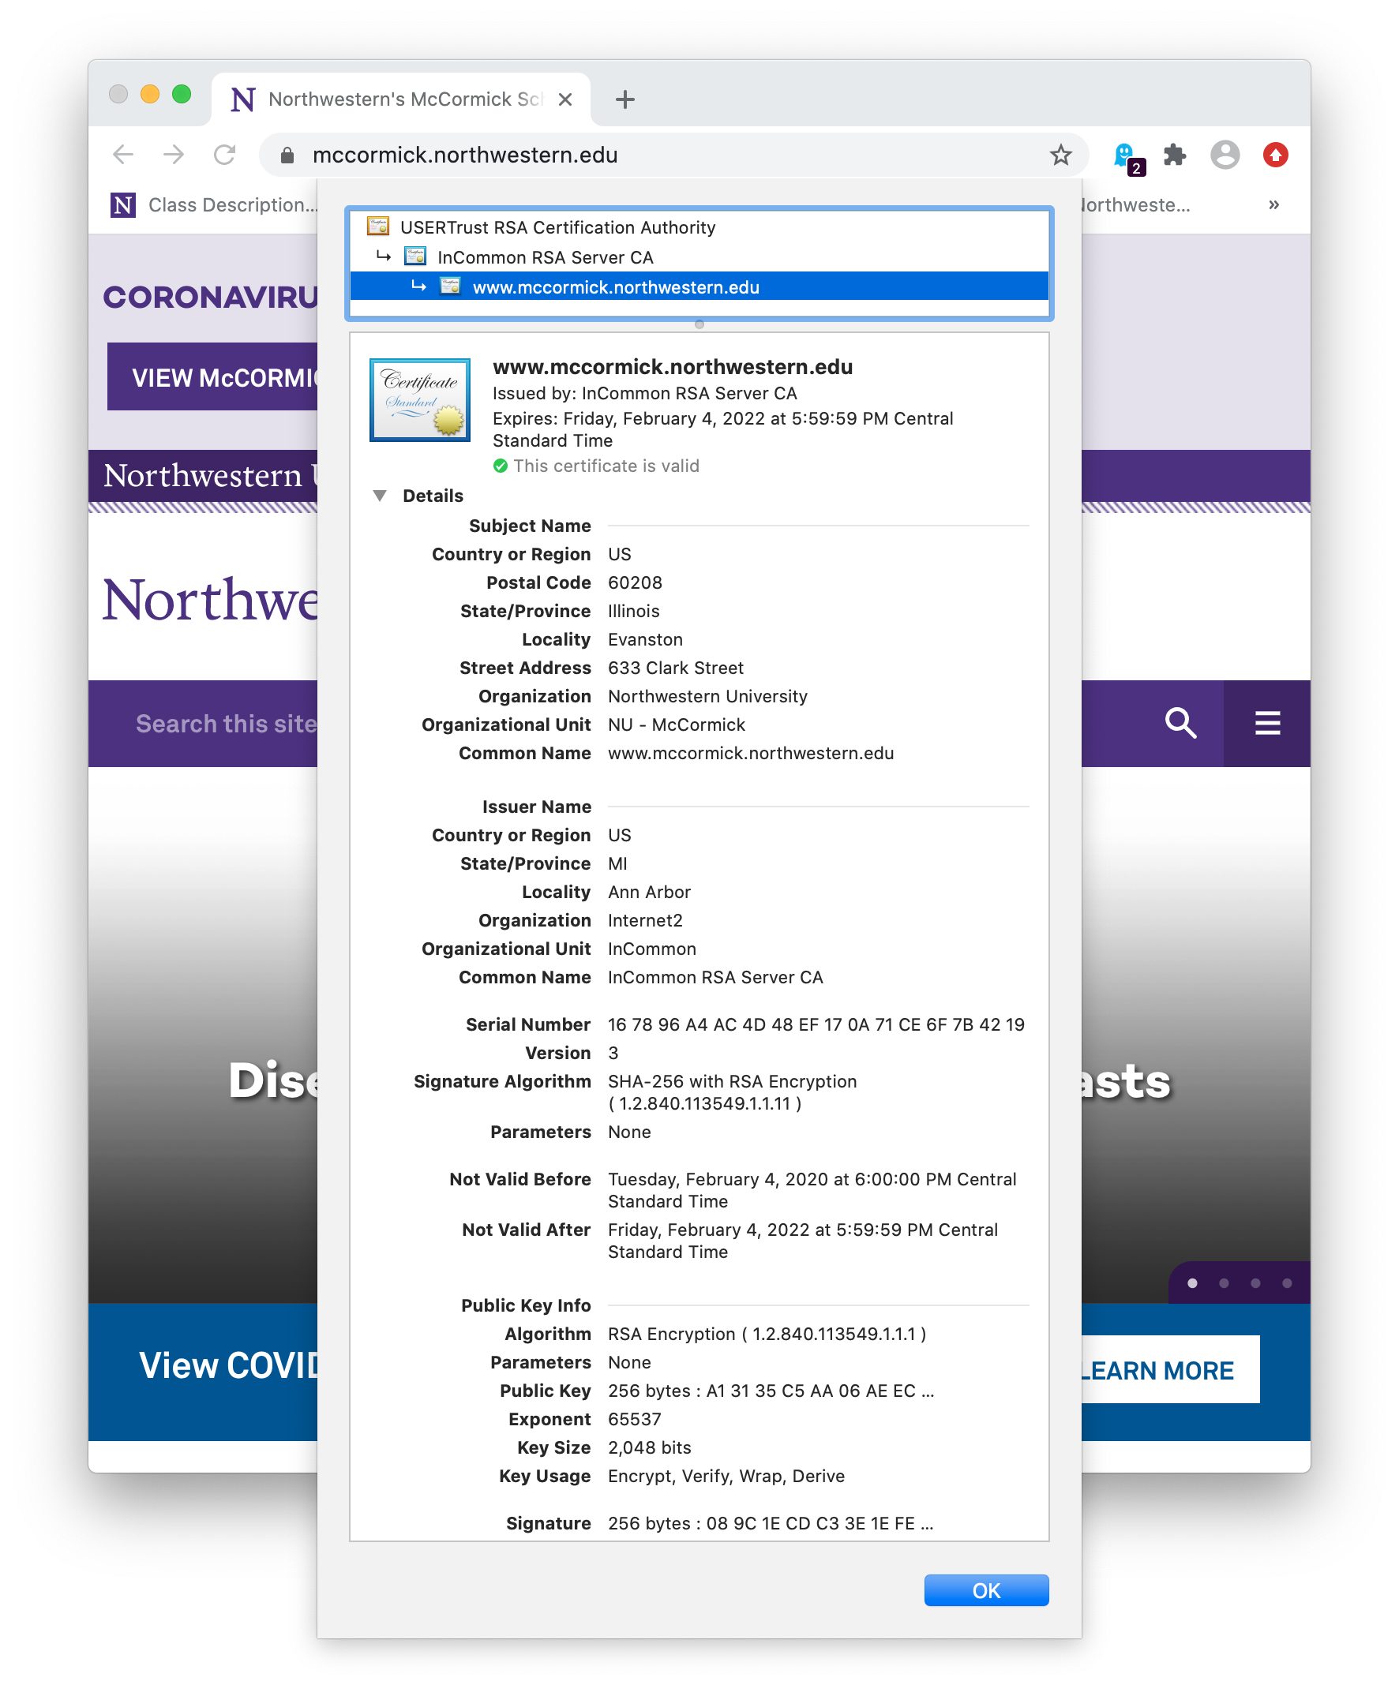

Slide 21
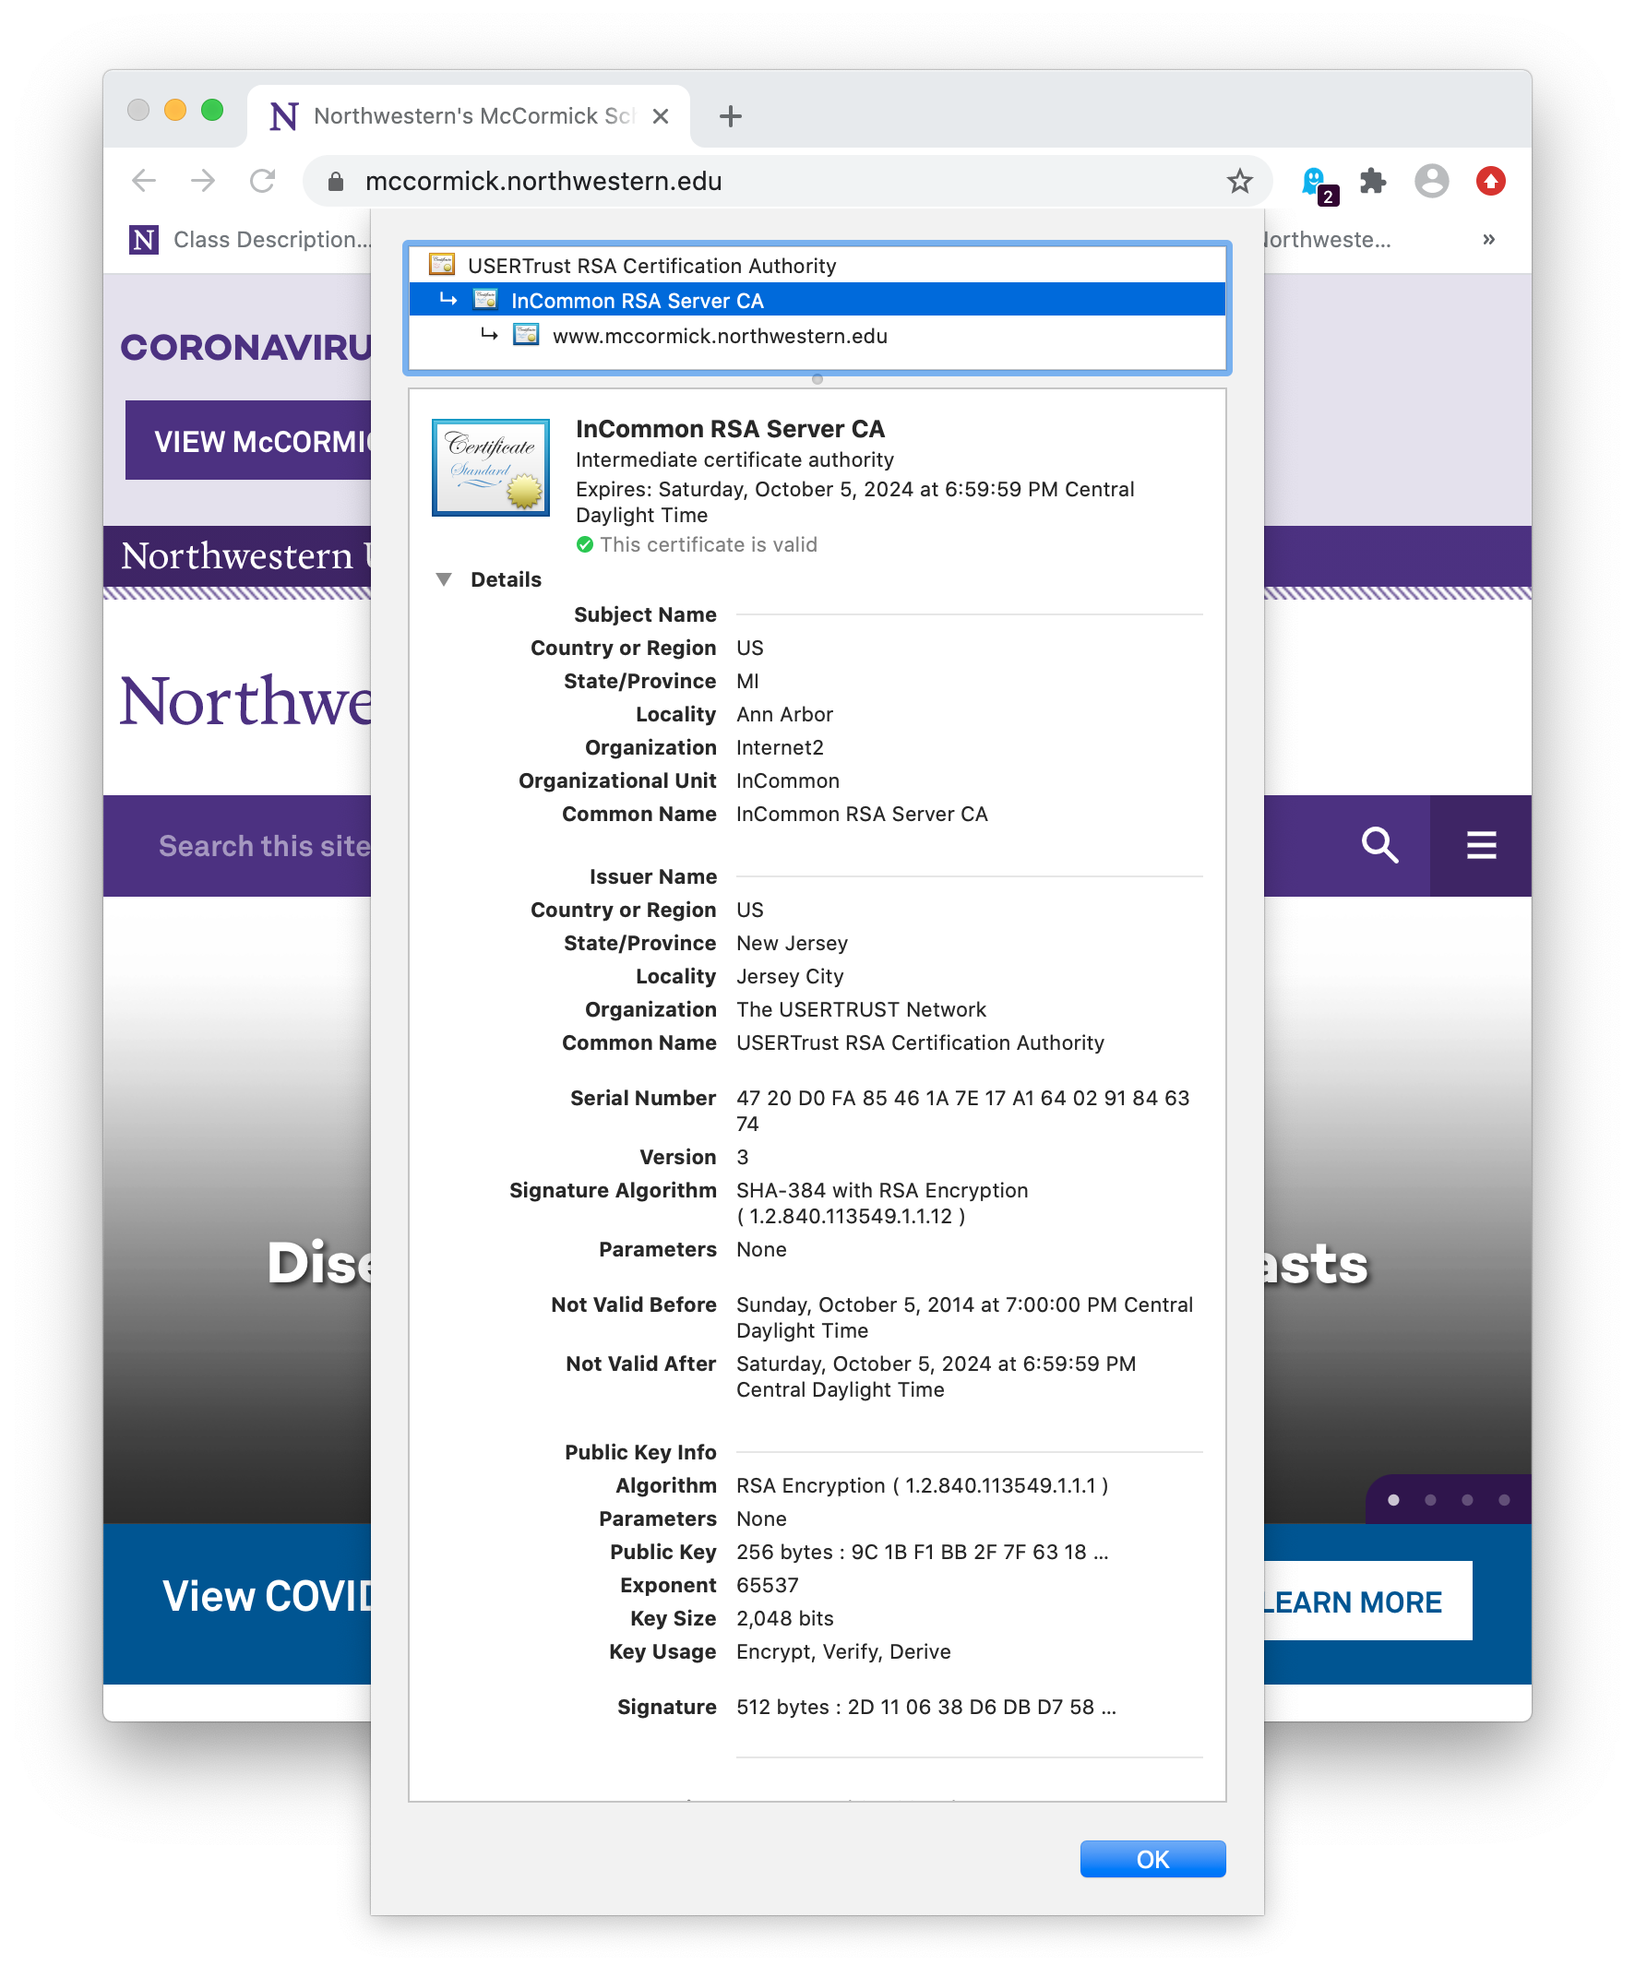

Slide 22
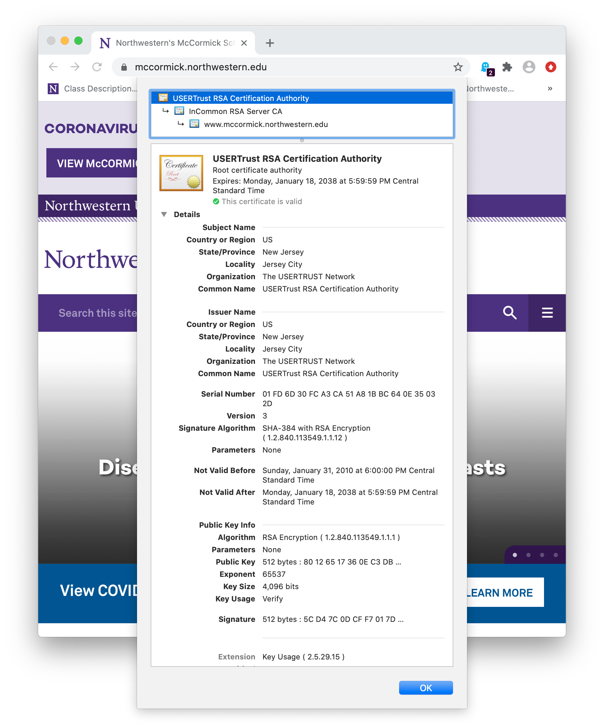

Slide 23
User can add and remove root certificates
This controls which organizations (and public keys) are trusted to vouch for others.
What would happen if you removed lots of these root certificates?
  Many HTTPS websites (and other SSL connections) would stop working.
What would happened if you added a “bad” root certificate?
  Your web browser would trust public keys that may be invalid, making you vulnerable to a man-in-the-middle or other impersonation attack.
STOP
and
THINK
STOP
and
THINK

Slide 24
MITM Attack Revisited
A
(🔑_{G},🔓_{G})
G
(🔑_{A},🔓_{A})
(🔑_{M},🔓_{M})
Let’s talk securely!
Here’s my public key
gadgets.com
🔓_{A}
Let’s talk securely!
Here’s my public key
🔓_{M}
OK. Here’s my public key 🔓_{G} and my signed certificate 📄_{G}
OK. Here’s my public key 🔓_{M} and (an invalid) certificate 📄_{M}
STOP
and
THINK
Server does not notice the attack because it doesn’t expect a signed certificate from client.
Instead, passwords are usually used to authenticate clients.
Client notices that certificate is fake or missing. A real certificate authority would not have signed a certificate listing 🔓_{M} as the public key for gadgets.com.
Client drops the connection.
Why?
📄_{M} must have one of these problems:
Domain name is not “gadgets.com”
Signature is invalid.
Issuer is not trusted.

Slide 25
Sketchy root certificates allow MITM attacks
Some corporate and campus networks require machines to install a new root certificate to connect to networked services.
By installing a single malicious root certificate, all of client’s encrypted network traffic can be read and modified.
This technique is also used by some legitimate debugging tools (eg. Charles Proxy) to sniff HTTPS traffic.
  Normally, Wireshark cannot view HTTPS traffic because it’s encrypted at the application layer.
  Charles Proxy is a MITM running on your machine that shows decrypted HTTPS streams.

Slide 26
Successful MITM Attack
A
(🔑_{G},🔓_{G})
G
(🔑_{A},🔓_{A})
(🔑_{M},🔓_{M})
(🔑_{B},🔓_{B})
Let’s talk securely!
Here’s my public key
gadgets.com
Root certificate
Big Brother
Pub key: 🔓_{B}
🔓_{A}
Let’s talk securely!
Here’s my public key
🔓_{M}
OK. Here’s my public key 🔓_{G} and my certificate 📄_{G}
(signed by a legitimate authority)
MITM creates a new certificate 📄_{M} for gadgets.com and signs it using Big Brother’s private key 🔑_{B}
OK. Here’s my public key 🔓_{M} and my certificate 📄_{M}
(signed by “Big Brother”).
Client accepts the connection because Big Brother has been installed as a trusted root authority.
PKI failed because the client installed a root certificate from a malicious party who is willing to sign fake certificates.

Slide 27
Certificate Revocation Lists (CRLs)
Private keys are supposed to be kept private, but mistakes happen.
What happens if someone steals the private key on the www.mccormick.northwestern.edu webserver?
  A trusted certificate authority has already issued a certificate saying the corresponding public key is valid for that domain until February 4, 2022.
  Using the private key and a copy of the certificate, the attacker can run a webserver impersonating www.mccormick.northwestern.edu.
Certificate authorities maintain Certificate Revocation Lists (CRLs) listing revoked (but unexpired) certificates. CRL web address is listed in CA cert.
Client may consult CRL before trusting a certificate, but this is slow.
PKI’s scalability (through transitive trust) is lost if you always double-check with a central authority, so CRLs are usually not checked.
  In practice, losing a private key can have serious security implications.

Slide 28
2011 Comodo Hack
Comodo is a root certificate authority, but in 2011 its certificate-signing server was hacked.
Attacker got a username/password for a system that Comodo had built to allow their trusted affiliates to request digital signatures.
Allowed attacker to generate new certificates for popular services like Gmail, Yahoo Mail, and Hotmail.
https://www.csoonline.com/article/2623707/hacking/the-real-security-issue-behind-the-comodo-hack.html
Bogus certificates were revoked and some browsers considered dropping the Comodo root certificate.
  This would have required all their past customers to buy new certificates from another vendor!

Slide 29

Hashing before signing
Notice that the digital signature algorithm encrypts a hash of the document’s data.
RSA can only encrypt integers m < n.
  Plaintext must be less than 1024 or 2048 bits.
Hashing maps a large document to a fixed integer range, small enough to RSA-encrypt.
But hashing must be done carefully!
By signing a hash, we are actually signing an infinite set of documents that map to that hash.
We must be confident that the other documents are random, not useful to attackers.
🔑
Name of signer, Public key 🔓
Certificate
🔓

Slide 30
Hashing example
If the hash is 256 bits, it can take 2²⁵⁶ different values.
HTTPS certificates are about 2000 bits long: 2²⁰⁰⁰ possible certs.
We expect 2²⁰⁰⁰/2²⁵⁶ ≅ 2¹⁷⁴⁴ such documents to share each hash value.
128-bit hash function
Name: gadgets.com
Public key: 930a…
940294a9bc9233eb5829848ecb9e2482
Name: 3kjD|Sj3;…
Public key: a329…
Hash collisions
940294a9bc9233eb5829848ecb9e2482
Name: \(we(CC1…
Public key: 44a0…
940294a9bc9233eb5829848ecb9e2482
…
Name: shop.com
Public key: 201e…
45b798e10349ae8750cd45209809ec94

Slide 31
Cryptographic Hash functions
If H(x) is a cryptographic hash function, it should be computationally infeasible to:
Map backwards from hash output to input: find x given H(x)
Find two inputs x and y that map to the same hashed value: H(x) = H(y)
  We know that there is an infinite set of such (x,y) pairs, but the hash function is designed to make them nearly impossible to find.
  In particular, if we know x, we should not be able to find y in polynomial time such that H(x) = H(y)
  Like a good symmetric encryption algorithm, a cryptographic hash must have good confusion and diffusion. It must behave very randomly.
  If input is called the message, the output is sometimes called the message digest.
SHA-1 and MD5 are examples of cryptographic hash functions.

Slide 32
Back to digital signatures
If I sign a SHA-1 hash of a document and publish that signature, it will be difficult for an attacker to construct a second document with the same SHA-1 hash as the original document that I signed.
Thus, it’s difficult for that signature to be used to falsely verify other documents that I have not seen and signed.
If I used a dumb hash function, like “the sum of all bytes,” forgery would be easy:
  SUM(“fun and cats”) == SUM(“gun and bats”)
  The change f+1→g is cancelled by the change c-1→b
  Using this really bad hash function, the signature of “fun and cats” would also be valid for “gun and bats”

Slide 33
Hash-based Message Authentication Code (HMAC)
Public-key cryptography & digital signatures are computationally expensive.
HMAC provides a more efficient way to authenticate public messages:
HMAC steps:
  Assume sender and receiver have a shared secret: 🗝 ⟵ a new requirement :(
  MAC = hash(message +🗝)
  Send ⟨message, MAC⟩
  Anyone can read the message.
  Receiver with 🗝 can also compute the MAC to verify the received MAC.
Again, we must use a strong cryptographic hash, like SHA-1
We could have used 🗝 to encrypt with AES, but this is slower than a SHA-1 hash (and maybe we want 3rd parties to see the message).
HMAC is often used to authenticate API calls (eg., AWS REST API).

Slide 34
SSL/TLS
Ethernet Packet
MAC addresses, CRC, etc.
Ethernet payload
Transport Layer Security (TLS) is the Internet standard for encrypted communication, formerly called Secure Sockets Layer (SSL).
  A real-world implementation of public-key encryption and auth.
It’s built on top of TCP, sitting below the application layer.
TLS payload is encrypted. Eg., this
could be an encrypted segment of an HTML document.
Defined in RFC 5246.
IP Packet
IP addresses, TTL, etc.
IP payload
TCP Packet
Port #, sequence #, ack #, etc.
TCP payload
TLS Record
Sequence #, length, MAC
TLS payload
HTTP Response
status code, content-type, etc.
<html><body><h1>My great page</h1><p>…
🔒

Slide 35
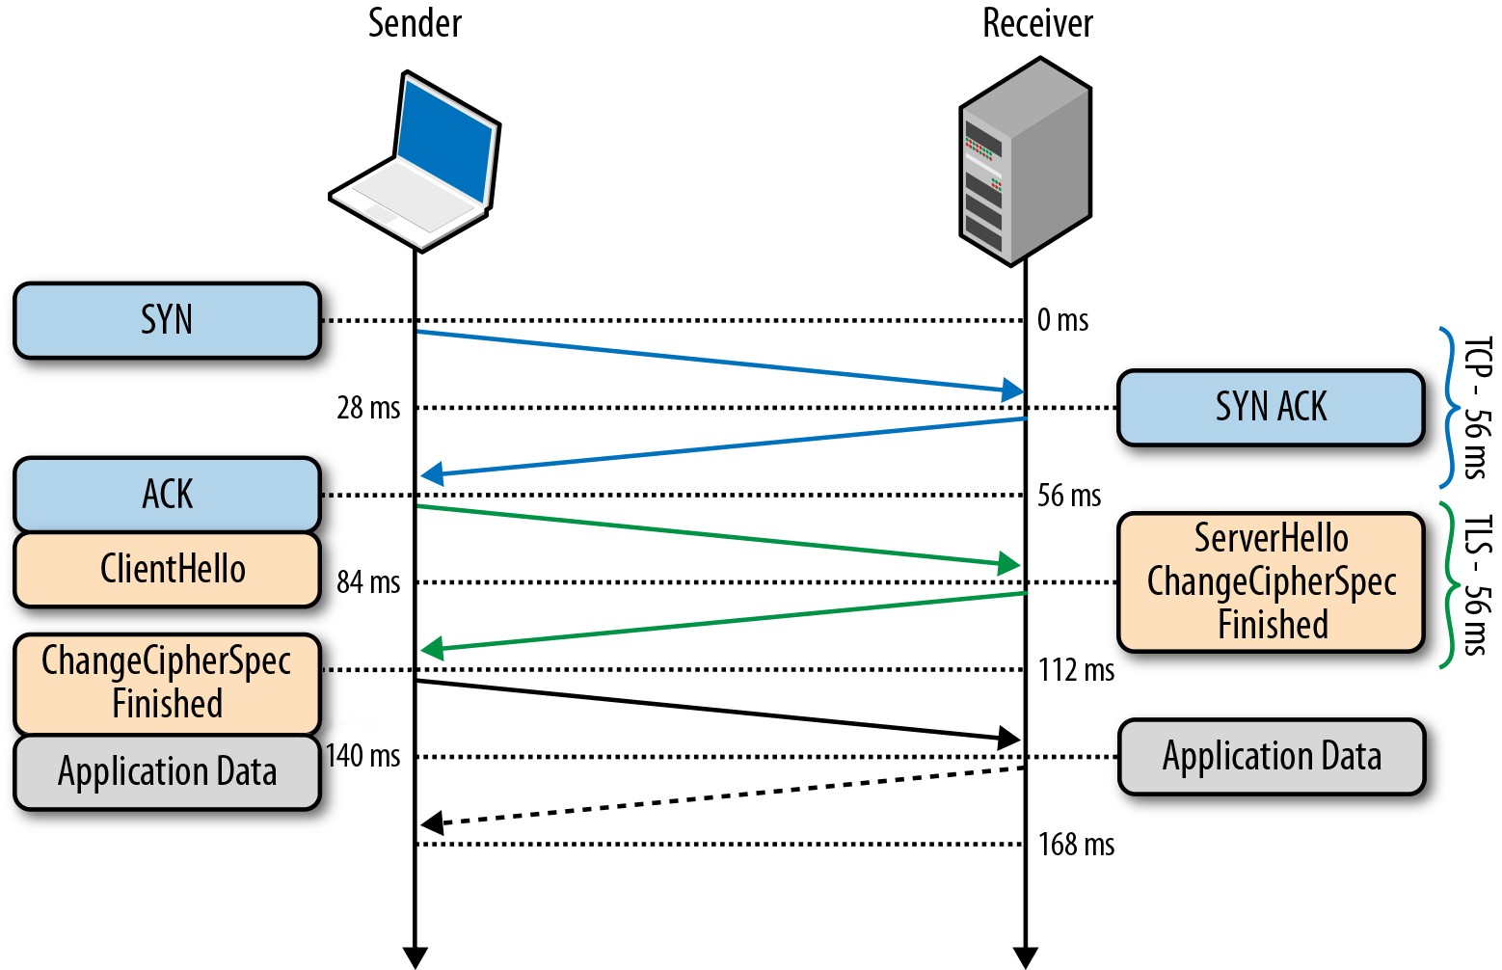
TLS handshake (after TCP handshake)
Sender and receiver must agree on:
encryption algorithms
eg., RSA+AES
Shared keys. TLS actually uses four different keys
(sender, receiver)×(encryption, MAC)
Other random values:
  Initialization Vector used by AES
  Nonce

Slide 36
Packet replay attack
Attacker cannot decrypt packets, but it can intercept and replay any packet.
Receiver might think that it’s valid, since it decrypts just fine.
Solution: TLS records include sequence numbers.
Replayed packet would be dropped
How to protect against packet replay?
STOP
and
THINK

Slide 37
Connection replay attack
I’m listening!
🔑=private key
🔓=public key
A
G
Generate key pair
Generate key pair
(🔑_{A},🔓_{A})
(🔑_{G},🔓_{G})
Let’s talk securely!
Here’s my public key 🔓_{A}
OK. Here’s my public key 🔓_{G}
🔓_{G}
“I would like to buy 10 widgets.”
RSA_{e}
92b102…
🔑 _{G}
92b102…
“I would like to buy 10 widgets.”
92b102…
RSA_{d}
🔓 _{A}
“OK, it’s shipped.”
RSA_{e}
5773ae…
🔑 _{A}
5773ae…
5773ae…
RSA_{d}
“OK, it’s shipped.”
Network observer only sees public keys and encrypted messages. 🔑_{A} & 🔑_{G} are never seen.

Slide 38
The replay
I don’t know what the previous messages said, but I’ll just blindly repeat them (within a new TCP connection).
🔑=private key
🔓=public key
G
I don’t have the private key 🔑_{A}, but I can still cause trouble!
Generate key pair
(🔑_{G},🔓_{G})
Let’s talk securely!
Here’s my public key 🔓_{A}
OK. Here’s my public key 🔓_{G}
I’ll just replay the encrypted messages I observed before.
🔑 _{G}
92b102…
“I would like to buy 10 widgets.”
92b102…
RSA_{d}
🔓 _{A}
“OK, it’s shipped.”
RSA_{e}
5773ae…
Hmm, I don’t know what happened, but hopefully it was something bad!
Let’s do it again!
5773ae…
The attacker made the customer pay for another order!
Let’s talk securely!
Here’s my public key 🔓_{A}

Slide 39
Connection replay attack
How to prevent this?
STOP
and
THINK
Attacker can observe entire client-server interaction and replay it.
Solution: receiver sends a random nonce in handshake message.
Sender must include encrypted nonce in the next message.
This requires each connection’s data to be at least slightly different.
Replay will not work because original connection had a different nonce.

Slide 40
Add a Nonce to prevent replay
🔑=private key
🔓=public key
G
Generate key pair
I don’t have the private key 🔑_{A}, but I’ll still try to cause trouble!
(🔑_{G},🔓_{G})
Let’s talk securely!
Here’s my public key 🔓_{A}
Generate a new random Nonce: 8903
OK. Here’s my public key 🔓_{G}
Please repeat the Nonce 8903
I’ll just replay the encrypted messages I observed before.
🔑 _{G}
“The Nonce is 7344. I would like to buy 10 widgets.”
92b102…
92b102…
RSA_{d}
The server rejects this connection because the returned Nonce is wrong (because it came from replaying a prior connection).

Slide 41
Fundamental network security lessons
Secure communication involves many considerations.
Encryption primitives are not enough, they must be used carefully.
TLS must be carefully designed to avoid all kinds of clever attacks, like replay attacks (and many others!)
Authentication is still not a fully-solved problem,
(Public Key Infrastructure has many drawbacks).
  Learn more in CS-396 Cryptography
Lessons for the software/network engineer:
Don’t try to build your own encryption scheme from scratch.
Just use the latest version of TLS.
Know the meaning of PKI/certificates, and keep private keys safe!

Slide 42
Recap
Digital signatures are special bit sequences attached to documents that can only be computed by the holder of a private key.
  Signatures are used to establish transitive trust and verify new public keys, thus preventing Man In The Middle and other attacks.
  Certificate authorities verify public keys with digitally signed certificates.
  MITM with root authority’s private key can forge arbitrary certificates.
Cryptographic hash functions are irreversible and unpredictable.
  Used to create a small summary of a document than can be signed with RSA.
  Also used in Message Authenticate Codes (HMAC) to verify that sender has a shared secret: MAC = hash(message +🗝)
Transport Layer Security (TLS) encrypts a TCP stream.
  Details are complex, to allow many different systems to interoperate and to mitigate a variety of attacks: Eg., packet replay, connection replay.

