Slide 1
CS-340 Introduction to Computer Networking
Lecture 15: Encryption and Anonymity
Steve Tarzia

Slide 2
Last Lecture: Ethernet Link Layer
Link layer handles error detection and correction: Parity, Checksum, and Cyclic Redandancy Check (CRC).
Ethernet adds MAC addresses to identify src/dst on a shared link.
  ARP uses Ethernet broadcast to find IP address → MAC address mapping
DHCP requests are sent by Ethernet broadcast (to FF:FF:FF:FF:FF:FF)
Old Ethernet hubs broadcasted data to all ports.
Ethernet switches learn/remember which MAC addresses are reachable on each port and relay traffic only to the appropriate ports.
  Reduce broadcast traffic and eliminate collisions.
VLANs create multiple isolated LANs/subnets on one switch.
Data Centers & Supercomputers demand fast local networks.

Slide 3
Network Security Overview
STOP
and
THINK
Why is the Internet difficult to secure?
STOP
and
THINK
How would you define "network security?"
Goals
Challenges
Confidentiality:
  Keep message private/secret.
Reliability:
  Deliver message to the intended recipient. Don't drop it!
Integrity:
  Deliver message without alteration.
Authentication:
  Verify the identity of the endpoint I’m communicating with.
Anonymity:
  Conceal relationship between two Internet hosts. Conceal who I am talking to.
Internet messages travel through untrusted, 3rd-party links and routers.
  Routers must see all bits of the packet to copy it to the next hop.
Local networks use shared media.
  Nearby Ethernet or WiFi hosts can often see your packets.
DNS may be poisoned, sending you to the wrong IP address.
Individual attackers, corporations, and governments all wish to violate your network security.
IP packets must be addressed to reach destination.

Slide 4
Encryption provides confidentiality
Plaintext or cleartext is the message you wish to send.
  For example, ”GOODBYE AND THX FOR ALL THE FISH”
Ciphertext is the encrypted version of the message, which should have no meaning to an intruder who observes the message before delivery.
  For example, ”HPPECZF BOE UIY GPS BMM UIF GJTI”
Sender uses an encryption algorithm to produce ciphertext from plaintext.
Receiver uses a decryption algorithm to recover plaintext from ciphertext.
A cipher is a pair of compatible encryption & decryption algorithms.
Ciphertext
HPPECZF…
Untrusted Internet
Sender
Plaintext →
GOODBYE…
Receiver
→ Plaintext
GOODBYE…
Encryption algorithm
Decryption algorithm

Slide 5
Strong encryption
Our example used a very simple, weak cipher.
  Plaintext: ”GOODBYE AND THX FOR ALL THE FISH”
  Ciphertext: ”HPPECZF BOE UIY GPS BMM UIF GJTI”
  Just replace each letter with the next letter in the alphabet (A→B, B→C, ...)
Decryption algorithm must be known only to the receiver
Decryption algorithm must be different for each connection, otherwise the receiver would be able to decode senders messages to other destinations.
Details of Cryptography are beyond the scope of this course, but we‘ll see how cryptographic primitives can be used to secure networks.
  CS-396 Intro to Cryptography covers this in depth.

Slide 6
Parameterized encryption algorithms
  In practice, cryptographic algorithms are standardized, but use a unique erncryption key for each connection. (Also called the session key.)
The key alters the algorithm’s behavior and changes the output.
Allows a single, standard algorithm to be used for many connections.
  Just choose a different parameter value (key value) for each connection.
Eliminates the need to invent a new new, secure encryption scheme for each new connection, just choose a random number to serve as the key.
  Receiver must know the exact key used by the sender in order to decrypt.
Ciphertext
KDJOSKC…
Untrusted Internet
Key 🔑
Key 🔑
Receiver
→ Plaintext
GOODBYE…
Sender
Plaintext →
GOODBYE…
Encryption algorithm
Decryption algorithm

Slide 7
Caesar Cipher is a simple parameterized cipher
It’s a generalization of the first cipher we saw.
  Replace each letter A-Z with the letter that is k places later in the alphabet
  (wrapping around when you reach the end).
  It’s a family of 26 related ciphers. The parameter k is the encryption key.
With key k=1: “GOODBYE” → “HPPECZF”
With key k=13: “GOODBYE” → “TBBQOLR”
Receiver must know the key to decode correctly.
  Using the wrong key, k=1, “TBBQOLR” → “SAAPNKQ”
Try it out: https://cryptii.com/pipes/caesar-cipher

Slide 8
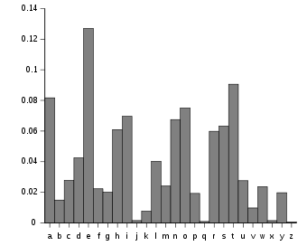
Breaking weak encryption
Caesar Cipher has just 26 possible keys, so we can do a brute force attack:
  Try decrypting with all possible keys and stop when you get something that looks like valid information (eg., contains English).
Can also do a statistical attack:
  Letter frequencies in English are well known.
  Letter pair frequencies, etc., can also be used.
  Any cipher that just substitutes one letter for
  another is susceptible.

Slide 9
What makes a cipher resistant to statistical attacks?
Confusion – each bit of the ciphertext should depend on several bits of the key. Make the relationship between ciphertext and key unclear.
Diffusion – if we change one bit of the plaintext, on average half the bits of the ciphertext should change, and vice versa.
Key 🔑
confusion
Cipher
Plaintext
Ciphertext
diffusion
We should not be able to determine the key, even if:
Attacker has many samples of (plaintext, ciphertext) pairs using the key.
Even worse, the attacker can choose a plaintext to run through the cipher and examine the results.

Slide 10
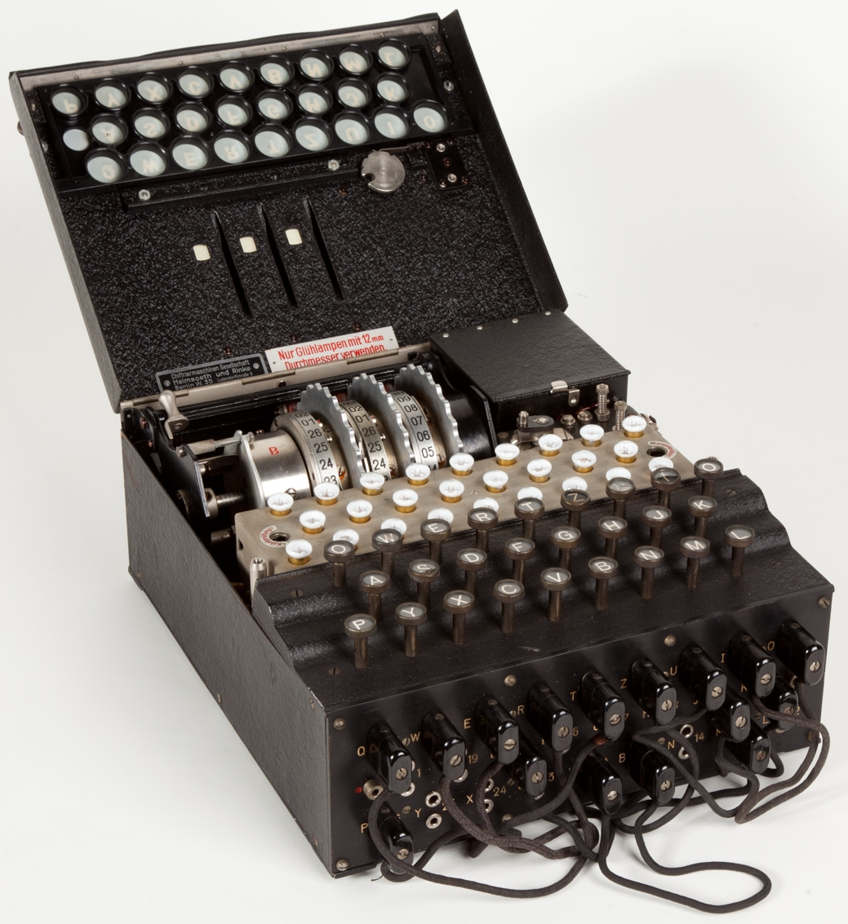
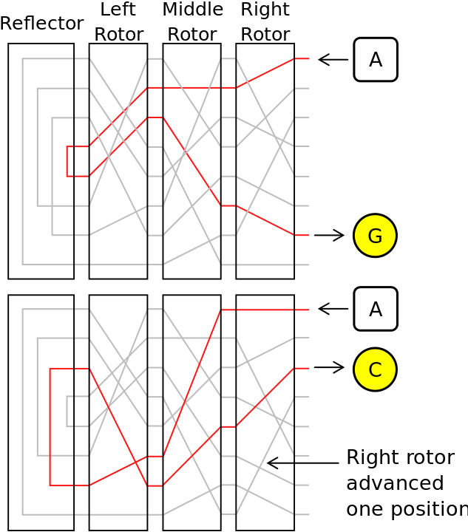
Modern cryptography began before computers
Enigma machine: a German electro-mechanical rotor cipher
  Invented in ~1920
  Heavily used in WWII.
Three Rotors scrambled each character, and changed configuration after each character.
Configuration of wires connected to the plugboard changed the output. This configuration was a key.
Right rotor rotated, so second “A” leads to a different output.

Slide 11
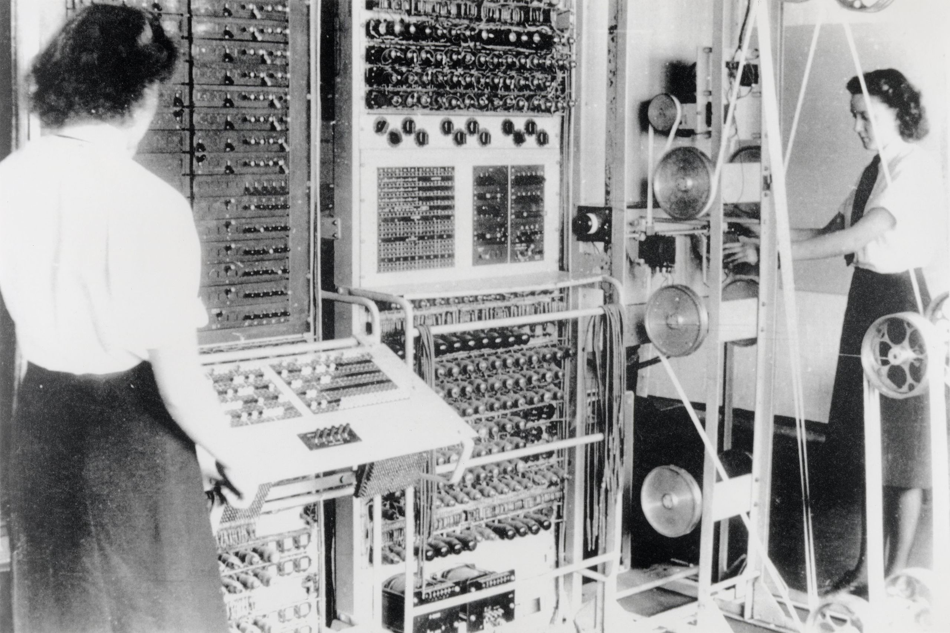
British Ultra project decoded many messages in WWII
Alan Turing and the team at Bletchley Park used statistics and cryptanalysis to decode German messages.
German messages often repeated certain phrases at the start, making decoding easier.
Built two computers for decoding:
  Bombe (electromechanical), and Collosus (vacuum tubes)
Somewhat innaccurately portrayed in “The Imitation Game” 2014 film.
“Collosus” computer

Slide 12
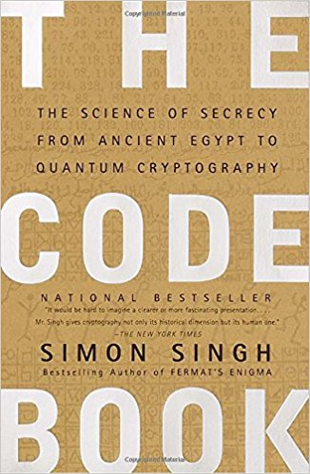
Further reading on the history of ciphers
The Code Book, by Simon Singh

Slide 13
Strong encryption with AES
Advanced Encryption Standard (AES) uses the Rijndael cipher.
AES is used to encrypt most HTTPS encrypted web traffic.
Key length can be 128, 192, or 256 bits
Using a larger key is more secure, but slower.
Brute force attack of AES-128 would likely require decrypting the message 2¹²⁷ = 2×10³⁸ times. This would take ~one billion billion years
In reality, AES has some flaws that allow an attacker to narrow down the search space, but it’s still impractical to break (as far as we know).
AES is a symmetric-key encryption algorithm:
  The same key is used to encrypt and decrypt.

Slide 14
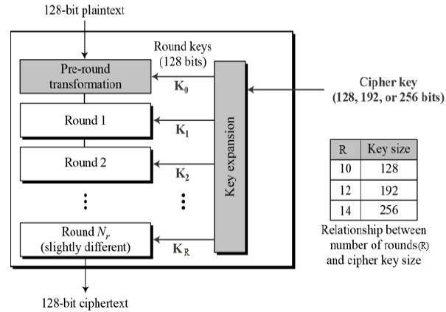
AES characteristics
Operates on a fixed-size block of plaintext.
Organizes data into a matrix.
Performs many rounds of these transformations:
  Replace bytes using a lookup table
  (a non-linear operation)
  Last 3 rows are shifted k steps.
  Combine 4 bytes in each column
  XOR the “round key” to each byte

Slide 15
Key distribution
Symmetric-key encryption (including AES) requires that the two participants have a shared secret key.
Sender can generate the key with a good random number generator.
But how can we send the key to the receiver?
  Simple solution is to use a pre-shared key:
    Must somehow meet ahead of time to agree on a key.
    Both participants type-in the same passphrase/key before communicating.
  But, most secure communication over the Internet is between “strangers.”
  Cannot send the key as plaintext over the network – attacker would see it!
In practice, public key cryptography is used to share keys.
  Does not require pre-sharing the key. Can interact entirely over the network.
STOP
and
THINK

Slide 16
Public Key Cryptography
Public Key cipher is asymmetric because it uses two related keys:
  Public key is used for encryption.
  Private key is used for decryption.
Each party generates a (public, private) key pair
  Keep your private key hidden, and share the public key openly.
To send you an encrypted message, I just need your public key.
RSA (invented in the 1970s) uses factoring of large prime integers.
Elliptic Curve Cryptography (ECC) came into use around 2005.
Mathematically related. Must be generated simultaneously.
Both these are used on today's Internet.
Receiver’s Public Key🔓
Ciphertext
BKCOSOE…
Untrusted Internet
My Private Key🔑
Sender
Plaintext →
GOODBYE…
Receiver
→ Plaintext
GOODBYE…
Encryption algorithm
Decryption algorithm

Slide 17


Public Keys in action
🔑=private key
🔓=public key
A
G
Generate key pair
Generate key pair
(🔑_{A},🔓_{A})
(🔑_{G},🔓_{G})
Let’s talk securely!
Here’s my public key 🔓_{A}
OK. Here’s my public key 🔓_{G}
🔓_{G}
“I feel pretty”
RSA_{e}
92b102…
🔑 _{G}
92b102…
92b102…
RSA_{d}
“I feel pretty”
🔓 _{A}
“Do you?”
RSA_{e}
5773ae…
🔑 _{A}
5773ae…
5773ae…
RSA_{d}
“Do you?”
Network observer only sees public keys and encrypted messages. 🔑_{A} & 🔑_{G} are never seen.

Slide 18
Combining asymmetric and symmetric ciphers
Public key algorithms like RSA are much more computationally expensive than symmetric ciphers like AES.
In practice, we use public key cryptography just to exchange a shared key (a session key), then use AES for the remaining messages.
This allows us to use an efficient symmetric cipher (AES) without having pre-shared a key.

Slide 19
Using public key to establish a session
Generate key pair
🔑=private key
🔓=public key
🗝=AES key
Generate key pair
(🔑_{A},🔓_{A})
(🔑_{G},🔓_{G})
Let’s talk securely!
Here’s my public key 🔓_{A}
Generate random 128-bit number: 🗝_{S}
🔓 _{A}
OK. Here’s our encrypted session key: 9382e2…
🗝_{S}
RSA_{e}
9382e2…
🔑 _{A}
Public-key (RSA) operations are slow.
9382e2…
RSA_{d}
🗝_{S}
🗝_{S}
“I feel pretty”
AES_{e}
4950e2…
4950e2 …
🗝_{S}
495e2…
AES_{d}
“I feel pretty”
🗝_{S}
“Do you?”
AES_{e}
789aab…
🗝_{S}
789aab…
789aab…
AES_{d}
“Do you?”
Symmetric-key (AES) operations operations are fast.

Slide 20
RSA Public Key Cryptography: basic principles
RSA uses modular exponentiation for encryption and decryption.
Number theory tells us that we can find three large integers: n, e, d
such that for any integer m < n:
(m^{e})^{d} mod n = m
m is the message to encrypt, viewed as an integer.
e is the encryption exponent. The pair (e, n) is the public key.
  To encrypt a message to ciphertext c, raise the plaintext to the e^{th} power (mod n):
m^{e} mod n = c
d is the decryption exponent. The pair (d, n) is the private key.
  To decrypt a message, raise the ciphertext to the d^{th} power (mod n):
c^{d} mod n = (m^{e} mod n)^{d} mod n = (m^{e})^{d} mod n = m

Slide 21
More about RSA
It turns out that there are many sets of (e, d, n) that satisfy
(m^{e})^{d} mod n = m, for all m > n
These form different public-private key pairs for RSA encryption
We can’t go into the details here (generating (e, d, n), proofs…).
  Each key pair can be derived from a pair of large large prime numbers.
Key idea is that modular exponentiation of huge numbers is efficient, but factoring large prime numbers (to reverse it) takes exponential time.
  Even knowing e, n, and m, it’s extremely difficult to find d.
Notice that RSA public and private keys can be reversed:
(m^{e})^{d} mod n = m^{ed} mod n = (m^{d})^{e} mod n = m
  If private key is used for encryption, then the public key will decrypt it!
  Later, we’ll use RSA keys in this reverse way for digital signatures.
Good RSA demo: https://www.cryptool.org/en/cto-highlights/rsa-step-by-step

Slide 22
Intermission

Slide 23
Anonymity on the Internet
Even with encryption, routers know who you are communicating with.
Every IP packet reveals its source and destination IP address.
This allows governments and corporations to monitor and block access to certain websites or services.
Anonymity can be a goal of network security.

Slide 24
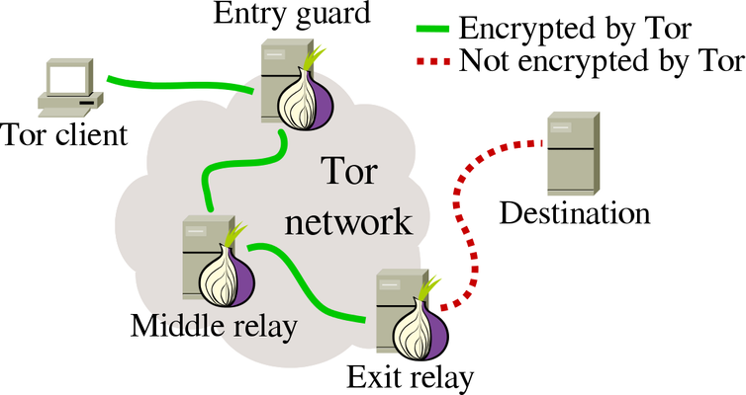
Onion routing obscures the communication path
Onion Routing creates an overlay network at the application layer.
  Mix routing idea described in 1981 by David Chaum
  Further developed in the 1990s at the US Naval Research Lab.
  Implemented in the Tor Browser in ~2002--2006.
  Used by the Dark Web, starting in ~2011.
Sending a message from A to B involves a chain of many TCP connections to hide the original source and final destination of the traffic.
Public-key encryption lets a relay
forward traffic one hop without
knowing the final destination.
Assumption:
Attacker may control one or a
few Internet hosts but not all.

Slide 25


Onion routing involves a random choice of several relays
Relays are listed in a public directory for anyone to see.
  Each relay publishes its IP address and public key.
Listens for encrypted messages sent over TCP connections.
  Will accept traffic from anyone and will deliver it wherever instructed.
Client chooses the full path to be taken by the message.
  No other node knows the full path!
Onion-routing relays
Tom
(🔑_{A},🔓_{A})
(🔑_{B},🔓_{B})
(🔑_{C},🔓_{C})
Jan
(🔑_{D},🔓_{D})
(🔑_{E},🔓_{E})
(🔑_{F},🔓_{F})

Slide 26
Building an anonymized, onion-routed message
Message is encapsulated in several layers of encryption, one for each hop in the onion network.
Sender 1.2.3.4 does the following:
  Constructs a message to be delivered to 5.6.7.8:80. Message includes some encrypted return address info.
  Randomly choose several relays: A,B,C.
  Get their public keys: 🔓_{A}, 🔓_{B}, 🔓_{C}
  Add onion layers to the message, by:
    Adding a header with the relay X address
    Encrypting the message with 🔓_{X}
To: Relay A
Content encrypted by 🔓_{A}:
To: Relay B
Content encrypted by 🔓_{B}:
To: Relay C
Content encrypted by 🔓_{C}:
To: 5.6.7.8:80
Return-address: [???]
GET / HTTP/1.1
Host: wikileaks.org

Slide 27
Encrypted layers of the onion
To: Relay A
Content encrypted by 🔓_{A}:
(need private key 🔑 _{A} to decrypt)
To: Relay B
Content encrypted by 🔓_{B}:
(need private key 🔑 _{B} to decrypt)
To: Relay C
Content encrypted by 🔓_{C}:
To: 5.6.7.8:80
Return-address: [???]
GET / HTTP/1.1
Host: wikileaks.org
(need private key 🔑 _{C} to decrypt)

Slide 28
Each relay has a limited view of the transaction
Consider Relay B:
B knows
Who is contacting it (other relays).
Who it is forwarding to (other relays).
Nothing else!
B gets this from Relay A:
To: Relay B
Content encrypted by 🔓_{B}:
🔓_{A}
(🔑_{B},🔓_{B})
🔓_{C}
(need private key 🔑 _{B} to decrypt)
B unwraps one layer of the onion.
Decrypts using 🔑_{B} to this:
To: Relay C
Content encrypted by 🔓_{C}:
(need private key 🔑 _{C} to decrypt)

Slide 29
Entry node
Consider Relay A:
Acting as the entry node in this transaction, Relay A knows:
The IP address of a Tor participant (Tom). This is slightly sensitive.
Who it is forwarding to (another relay).
Nothing about the final destination.
A gets this from Tom:
To: Relay A
Content encrypted by 🔓_{A}:
Tom
(🔑_{A},🔓_{A})
🔓_{B}
(need private key 🔑 _{A} to decrypt)
A unwraps one layer of the onion.
Decrypts using 🔑_{A} to this:
To: Relay B
Content encrypted by 🔓_{B}:
(need private key 🔑 _{B} to decrypt)

Slide 30
Exit node
Tor is designed to be compatible with any web server, and exit nodes make the final connection:
Exit node C knows:
The destination address. Only slightly sensitive, because don't know sender.
The request contents.
Something about the return address…
What must the exit node know to return a response to the client?
C gets this from Relay B:
To: Relay C
Content encrypted by 🔓_{C}:
Regular web server
(need private key 🔑 _{C} to decrypt)
Tom
🔓_{B}
(🔑_{C},🔓_{C})
C unwraps one layer of the onion.
Decrypts using 🔑_{C} to this:
To: 8.9.9.2:80
Return-address: [???]
GET / HTTP/1.1
Host: northwestern.edu
STOP
and
THINK

Slide 31
Hiding the return address
🗝_{X}
Exit relay
Tom
(🔑_{C},🔓_{C})
If the exit relay knew the client address, it could send the response back in the normal onion-routing way, but that would reveal too much.
  The relationship between source and destination must be kept secret all!
Solution (described by Chaum): client request includes:
  an onion-encrypted return path, chosen
  and encrypted by the client, and
  a one-time-use encryption key
  for the response message.
Request seen by exit node looks like this:
Why is a new key generated?
To: 8.9.9.2:80
Return-key: 🗝_{X}
Return-path: (D, remainder of path encrypted by 🔓_{D})
GET / HTTP/1.1
Host: northwestern.edu
STOP
and
THINK
Notes:
…because repeating a key would tell the relay which combination of requests were from the same client.

Slide 32
Onion-routed request vs. response
Response constructed by Exit Relay C:
To: Relay A
Content encrypted by 🔓_{A}:
To: Relay D
Content encrypted by 🔓_{D}:
Content encrypted by 🗝_{X}:
To: Relay B
Content encrypted by 🔓_{B}:
To: Relay E
Content encrypted by 🔓_{E}:
To: Relay C
Content encrypted by 🔓_{C}:
To: Relay F
Content encrypted by 🔓_{F}:
Final relay will know destination, but not source
To: 8.9.9.2:80
Return-key: 🗝_{X}
Return-path: (D, remainder of path encrypted by 🔓_{D} )
GET / HTTP/1.1
Host: northwestern.edu
Encrypted return path is copied from request
Deliver-To: 1.2.3.4:10001
HTTP/1.1 200 OK
Content-Type: text/html
Content-Length: 2093
<html> …

Slide 33
Anonymous services
Tor focuses on making web browsing (clients) anonymous.
I2P takes the idea further by allowing anonymous web hosting (and other services).
  Hostnames map to onion-encrypted paths (instead of to IP addresses).
  Doesn't use DNS, but another distributed database on the P2P relay network.
Cryptocurrencies (eg., Bitcoin) enable anonymous e-commerce.
This is the Dark Web.

Slide 34
Tradeoffs in a free society
Censorship and surveillance are the favorite tools of oppressors.
  2% of the East German population worked full-time in domestic surveillance.
  15% of their population acted as informants to the secret police (Stasi).
  This was done even with old technologies – a person had to listen in real time.
Democratic societies are not immune to these threats.
  U.S. National Security Agency has an estimated $10B annual budget and ~35k employees. Roughly the size of Facebook's staff. What are they all doing?
    Snowden's 2013 whistleblowing revealed that NSA has access to (eg.,) Google cloud data, phone records (including GPS), and was listening in on U.S. phone conversations.
On the other hand, anonymity removes consequences.
Anonymity online + the ability to do harm online = chaos.
  Is it a good thing to enable child pornography, hitmen-for hire, etc?

Slide 35
Recap
Network security goals are:
  Confidentiality, Reliability, Integrity, Authentication & Anonymity
Routers and other participants on the network cannot be trusted.
AES is a the standard symmetric-key encryption algorithm. Must somehow establish a shared session key, used by both parties.
Public Key cryptography (RSA, ECC) uses a pair of related keys.
  Public key is openly advertised and is used for encryption
  Private key is secret and is used for decryption.
Onion-routing/mix networks create routing overlays on the Internet.
  Sender encrypts data many times. Relays decrypt one layer each.
  This enables anonymous web browsing and even anonymous services.

