Slide 1
CS-340 Introduction to Computer Networking
Lecture 14: Ethernet
Steve Tarzia
Many diagrams adapted from that by J.F Kurose and K.W. Ross

Slide 2
Last Lecture: Medium Access Control
Link-layer handles sharing a physical link/medium with multiple nodes.
Medium Access Control / Multiple Access Protocol
  Decide how to share the link.
  Two nodes sending simultaneously is a collision. Packets are lost.
Three classes of sharing protocols:
Channel Partitioning:
  Frequency Division Multiplexing - WiFi
  Time Division Multiplexing
Random Access:
  ALOHA (simple historical example)
  CSMA/CD (Carrier Sense Multiple Access/Collision Detection) - Ethernet, Wifi
Turn-Taking:
  Polling - Bluetooth
  Token-passing

Slide 3
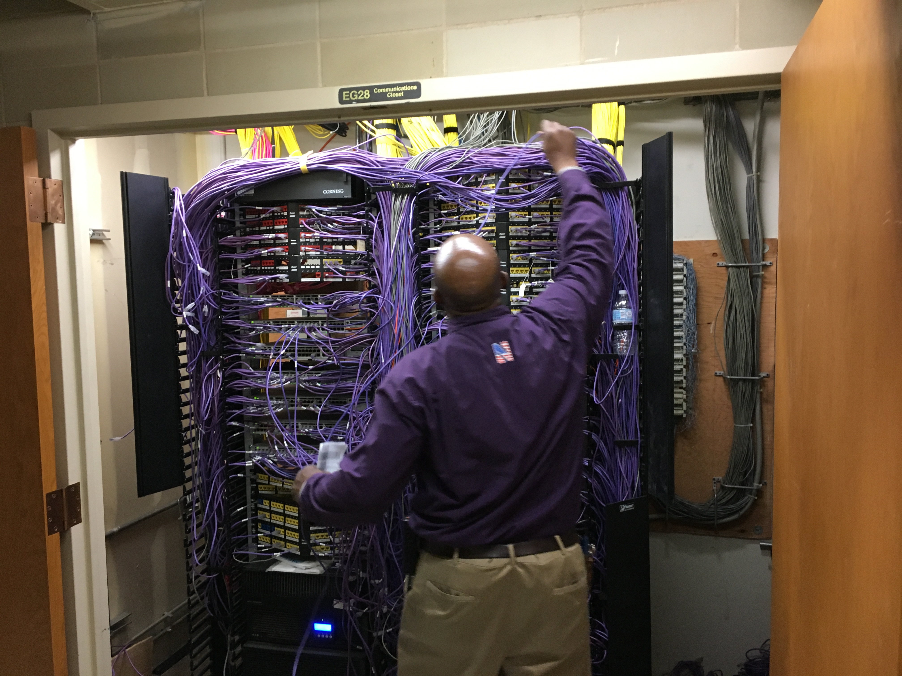

Slide 4
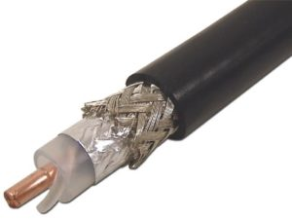
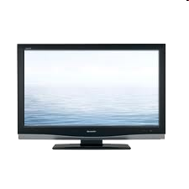



DOCSIS: Cable Internet Link-Layer Protocol
Internet frames,TV channels, control transmitted
downstream at different frequencies
cable headend
…
CMTS
…
splitter
cable
modem
cable modem
termination system
ISP
upstream Internet frames, TV control, transmitted
upstream at different frequencies in time slots
Combines ideas from all three classes of multiple access protocols!
All cable modems in a neighborhood share the same coaxial medium.
  They are all connected to “one big wire.” It's a shared, broadcast medium.
  They can all “hear” each other’s traffic, in both directions.

Slide 5
Time slot assignment
for interval [t1, t2]
Downstream channel i
Rest of Internet
Upstream channel j
cable modem termination system (CMTS)
t₁
t₂
Residences with cable modems
Minislots containing
minislots time requests
Assigned minislots containing cable modem
upstream data frames
FDM (channel partitioning) creates multiple up & down “channels”.
Upstream channels also use TDM:
  Some time slots are for modems to send time requests.
  Time requests use a random-access protocol and may collide.
  Remaining time slots are assigned to specific modems (taking turns).
CMTS periodically broadcasts the time slot assignments, taking into account the time requests that were received.
STOP
and
THINK
Why is there no collision in the downstream direction?

Slide 6
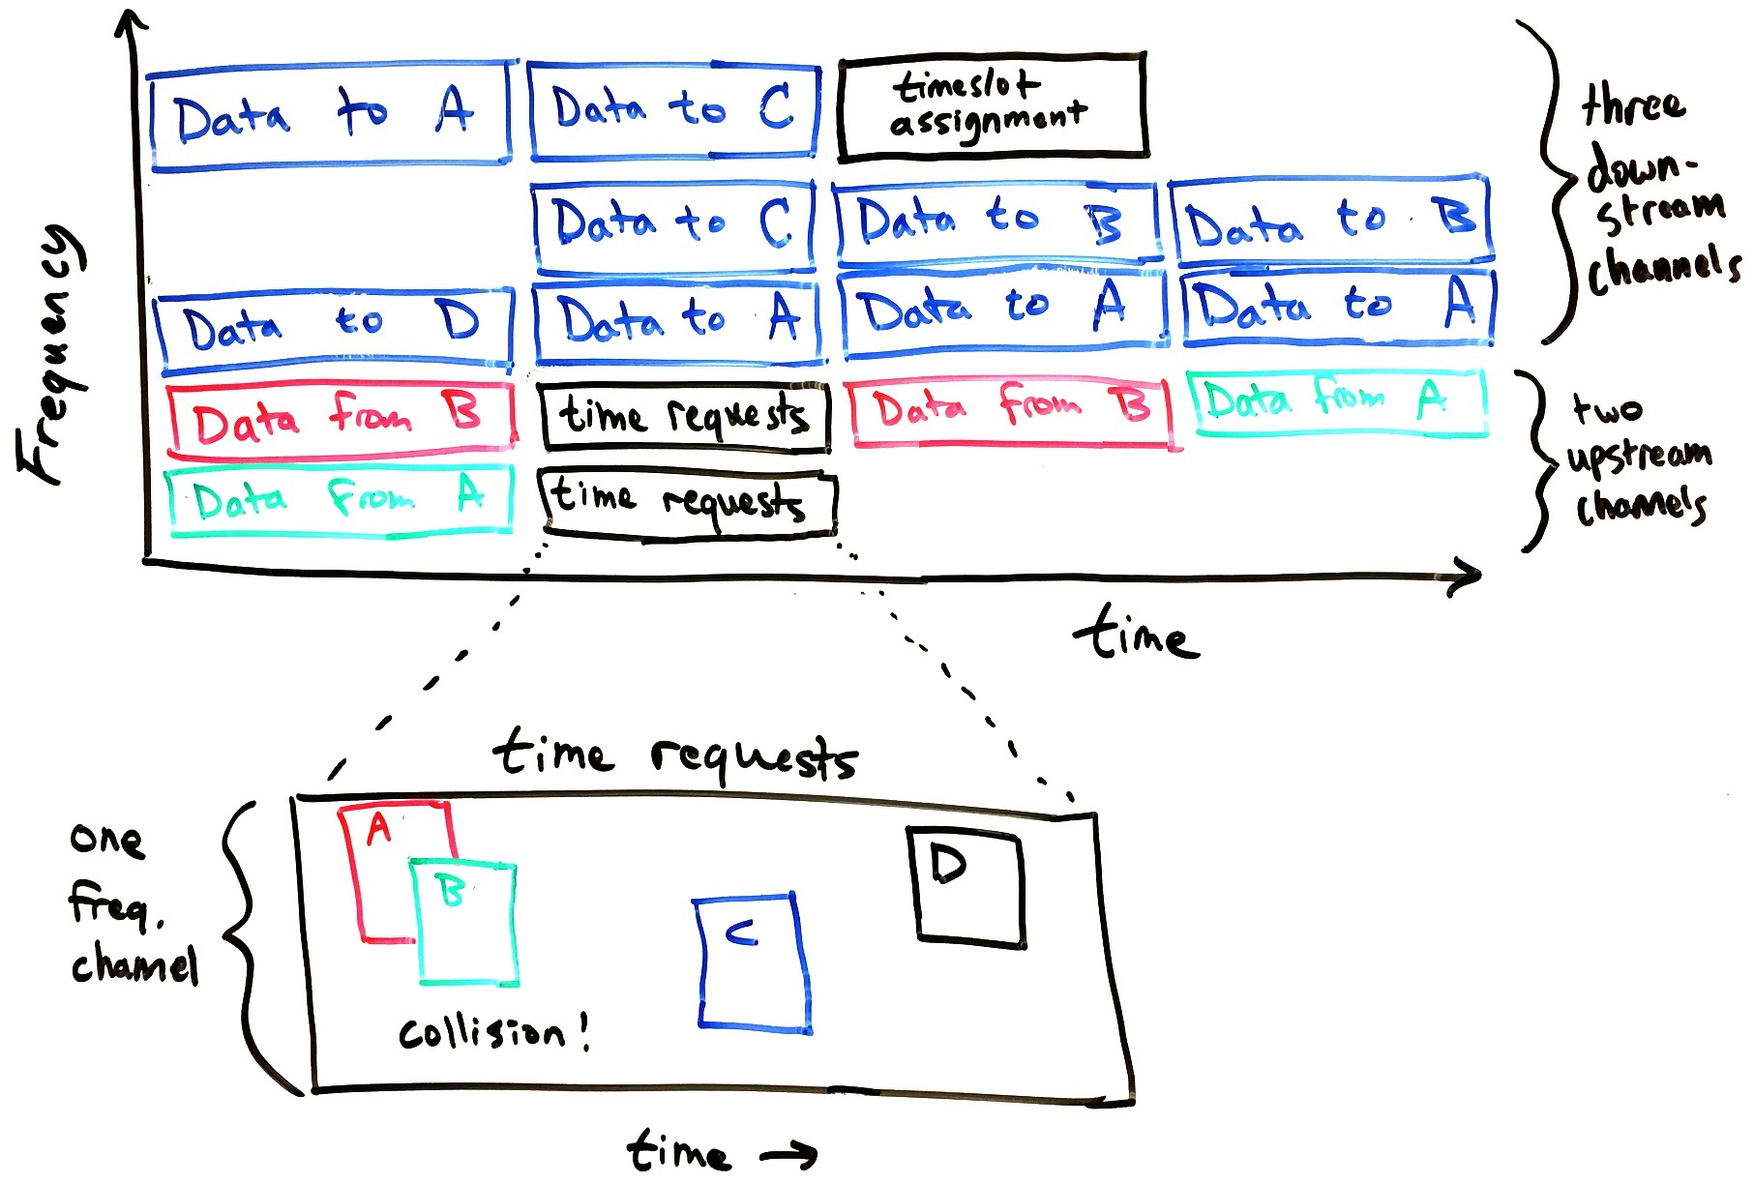
A, B, C, and D are different DOCSIS cable modems connected to a single wire.
Downstream channels are always reserved by the headend CMTS.
Upstream channels are allocated exclusively to the different modems,
Except the “time requests” slot is a free-for-all wherein anyone can request time using a random-access protocol
FDM and TDM create many virtual channels.
Taking-turns assigns channels to different modems
Random access is used in one special time-request channel.
C and D’s time requests will be heard, but A and B’s requests are lost due to collision.

Slide 7
Error Detection and Correction
The secondary purpose of the Link Layer (aside from MAC).
Wireless media are especially prone to bit-flip errors, due to noise.
Error detection – notice a bit error and discard the packet.
Error correction – fix a bit error before delivering the packet.
In both cases, additional bits of redundant data are added.

Slide 8
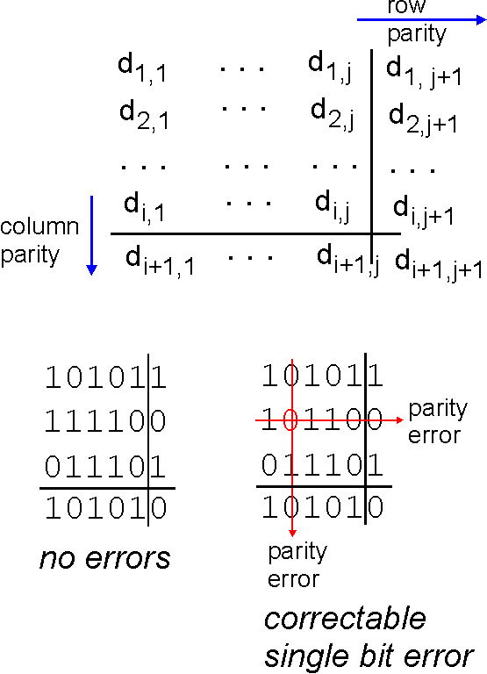
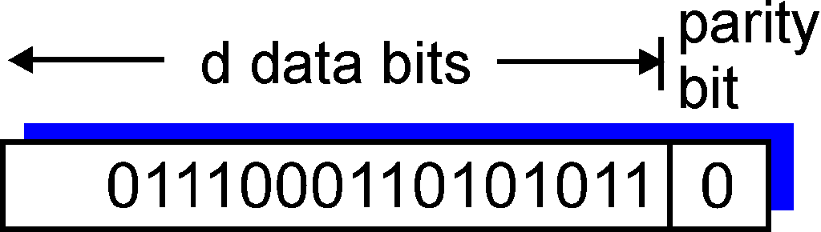
Parity
Add a one or zero to make the total number of ones even.
Single-bit parity detects a single bit error:
Two-dimensional bit parity can correct errors:

Slide 9
Checksum (used in IPv4, UDP, and TCP headers)
Break the data into a sequence of 16-bit integers
Add the integers
Wrap the carry-out bits to the least-significant position.
Finally, invert the result.
1 1 1 0 0 1 1 0 0 1 1 0 0 1 1 0
1 1 0 1 0 1 0 1 0 1 0 1 0 1 0 1
1 1 0 1 1 1 0 1 1 1 0 1 1 1 0 1 1
1 0 1 1 1 0 1 1 1 0 1 1 1 1 0 0
0 1 0 0 0 1 0 0 0 1 0 0 0 0 1 1
wraparound
sum
checksum

Slide 10
Cyclic Redundancy Check (CRC)
Error detection scheme that can be efficiently implemented using XOR circuitry.
Very common in practice.
Ethernet header uses CRC-32, using a specific 32-bit generator integer.

Slide 11
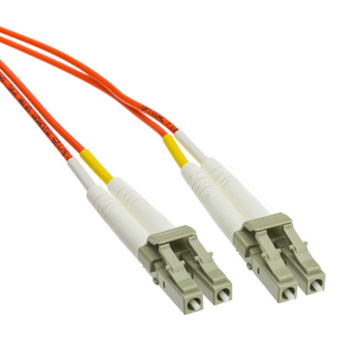
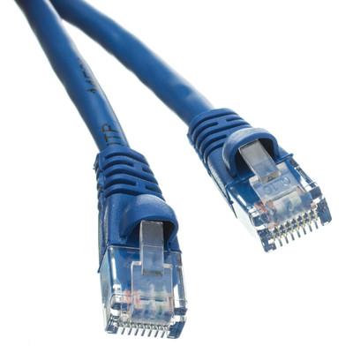
Ethernet
Cat5
A link-layer protocol for wired
local area networks (LANs).
Uses CSMA/CD: Carrier-Sense Multiple Access/Collision Detection
  Bandwidth utilization is good • Totally distributed, “plug and play”
Uses Cat5 twisted pair or fiber-optic cabling.
Same basic protocols also apply to WiFi networks (WiFi also uses FDM).
Each adapter on the LAN has a unique MAC address: (Media Access Control address)
  6-byte number expressed in hex, like 2B-39-0F-14-EE-A3.
  MAC address is permanent and assigned at the factory.
  Network device manufacturers buy blocks of MAC addresses from the IEEE.
    Manufacturer is identified by MAC address prefix.
  MAC address usually corresponds to a specific “plug” on a node.
MAC address is used for communication within a subnet.
Fiber optic

Slide 12
MAC addresses
Previously, we assumed that links were point-to-point.
  It was enough to set the packet’s destination IP address and choose the correct link.
If multiple nodes are listening on a link, we need the MAC address to identify the true destination.
When sending a packet through the router, the destination IP address will be outside the network, eg., 2.0.0.1.
  If the MAC destination is set to 58-23-D7-FA-20-B0, then the two other hosts will ignore the packet and the router will accept it and forward it.
192.168.0.11
1A-2F-BB-76-09-AD
192.168.0.10
58-23-D7-FA-20-B1
LAN
(wired or
wireless)
192.168.0.1
71-65-F7-2B-08-53
58-23-D7-FA-20-B0
STOP
and
THINK
0C-C4-11-6F-E3-98
Why not just use the IP address?
Why do we need two address types (IP & MAC)?
192.168.0.12
192.168.0.12

Slide 13
Ethernet frame
Adds bytes before and after an IP datagram.
Preamble is 8 bytes, 1010…1011
  Used to synchronize bit-clock of the receiver to the sender.
Type (2 bytes) usually indicates IP payload (ARP has a different type).
CRC (4 bytes) is added after the payload, for bit-error detection.
type
preamble
dest.
MAC address
source
MAC address
data
(IP payload)
CRC
Inter-packet gap

Slide 14
Address Resolution Protocol (ARP)
Allows nodes to discover MAC address associated with an IP address.
Request lists a target IP address, and response gives the MAC address.
  ARP requests are addressed to special broadcast MAC address, FF-FF-FF-FF-FF-FF.
  All hosts on the subnet accept messages sent to the broadcast address.
The host assigned that IP address replies with its MAC address:
“You were looking for 192.168.0.10… Here I am, and here’s my MAC address!”
  Response can be addressed directly to the MAC address of the requester.
  Responses are cached in adapter’s ARP table.
  Response has a TTL, typically 20 minutes.
Like DNS, but responses come from all hosts on the subnet.
Ethernet hosts are responsible for advertising their own existence.
  Thus, Ethernet is plug-and-play.

Slide 15

Routing between LANs/subnets
Send datagram from A to B, via R
Initially,
  A knows B’s IP address …from DNS response
  A knows IP address of gateway router, R, …from IP configuration
  A knows R’s MAC address …from ARP response
A
B
R
111.111.111.111
222.222.222.222
74-29-9C-E8-FF-55
49-BD-D2-C7-56-2A
111.111.111.110
222.222.222.220
E6-E9-00-17-BB-4B
1A-23-F9-CD-06-9B
111.111.111.112
222.222.222.221
CC-49-DE-D0-AB-7D
88-B2-2F-54-1A-0F

Slide 16
Routing: first hop, A to R
A constructs IP datagram as expected, addressed end-to-end.
Datagram is wrapped in an Ethernet Frame with MAC addresses relevant for the first hop.
  Source: MAC of A, Destination: MAC of R.
MAC src: 74-29-9C-E8-FF-55
MAC dest: E6-E9-00-17-BB-4B
IP src: 111.111.111.111
IP dest: 222.222.222.222
A
B
R
111.111.111.111
222.222.222.222
74-29-9C-E8-FF-55
49-BD-D2-C7-56-2A
111.111.111.110
222.222.222.220
E6-E9-00-17-BB-4B
1A-23-F9-CD-06-9B
111.111.111.112
222.222.222.221
CC-49-DE-D0-AB-7D
88-B2-2F-54-1A-0F

Slide 17
Routing: processing at R
R accepts the packet because it sees its own MAC destination address.
R looks at the IP payload, sees the destination IP address, checks its forwarding table, and decides to forward the packet to the right-side link.
  The IP destination is within a subnet that R is on (at right).
  The packet will next go to the MAC address of the destination, not a router.
MAC src: 74-29-9C-E8-FF-55
MAC dest: E6-E9-00-17-BB-4B
IP src: 111.111.111.111
IP dest: 222.222.222.222
A
B
R
111.111.111.111
222.222.222.222
74-29-9C-E8-FF-55
49-BD-D2-C7-56-2A
111.111.111.110
222.222.222.220
E6-E9-00-17-BB-4B
1A-23-F9-CD-06-9B
111.111.111.112
222.222.222.221
CC-49-DE-D0-AB-7D
88-B2-2F-54-1A-0F

Slide 18
Routing: second hop, R to B
R does an ARP query on the right-hand subnet looking for 222.222.222.222.
B replies with its MAC address.
R sends the packet with the MAC address of it’s right-hand adapter as the source and B’s MAC address as the destination.
MAC src: 1A-23-F9-CD-06-9B
MAC dest: 49-BD-D2-C7-56-2A
IP src: 111.111.111.111
IP dest: 222.222.222.222
A
B
R
111.111.111.111
222.222.222.222
74-29-9C-E8-FF-55
49-BD-D2-C7-56-2A
111.111.111.110
222.222.222.220
E6-E9-00-17-BB-4B
1A-23-F9-CD-06-9B
111.111.111.112
222.222.222.221
CC-49-DE-D0-AB-7D
88-B2-2F-54-1A-0F

Slide 19
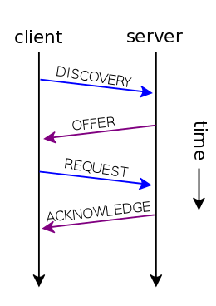
Dynamic Host Configuration Protocol (DHCP)
Recall that DHCP is how hosts automatically get IP configuration:
  IP address • Subnet mask • Gateway address • DNS server address
When a host joins a network, it brings its permanent MAC address.
Sends a DHCP request with broadcast destination, FF-FF-FF-FF-FF-FF.
DHCP server (often the edge router) allocates IP addresses.
  It listens for DHCP broadcasts & replies to the sender’s MAC address (like ARP).
DHCP involves
four UDP packets:
Advantage:
Machine can move and join nearby network.
Disadvantage:
IP address changes, so others cannot easily find you. Cannot run a server application.

Slide 20
Static IP configuration
Hard-code machine’s IP configuration, instead of using DHCP.
Common for routers and servers, to make them permanently reachable at a certain IP address.
Static DHCP combines both ideas:
  A machine joining the network requests IP configuration with DHCP.
  However, DHCP server is configured to always give certain machines specific IP addresses, based on MAC address observed in the request.
    Eg., DHCP server is hard-coded to always return 222.222.222.222 in response to requests from 49-BD-D2-C7-56-2A
  This gives the administrator one place to track IP address assignments.
  Machines with unrecognized MAC addresses will get dynamic IP addresses from a pool of unused addresses.

Slide 21
What makes wired Ethernet a shared medium?
Cat5
Fiber optic
Cat5 and Fiber Optic cables have dedicated channels in both directions!

Slide 22
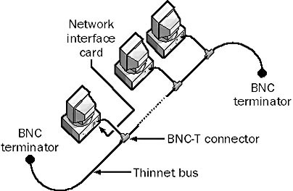
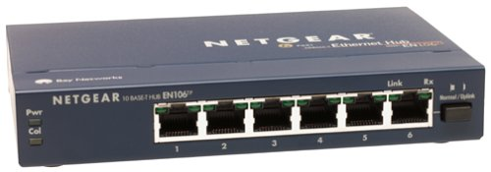
Ethernet began on shared electrical media
Early Ethernet networks (1980s) connected many computers to a single coaxial cable wire.
Used a bus topology.
  Single shared electrical channel
Later networks (1990s) used cheaper twisted-pair cabling
Used a star topology.
Ethernet hub is at the center of the LAN and connects to each host.
Ethernet Hub
Coaxial cable

Slide 23
Ethernet hubs (early to mid 1990s)
Note: “port” here means physical plug
Data received by one port is broadcast to all the other ports.
Machine should ignore packets addressed to different MAC address.
Simple and easy to build (just read/send one bit at a time).
Hub detects collisions and send special “jamming” signal to fail CRC check.
✘Not scalable – a busy subnet will have many collisions.
✘All machines must operate at same line speed (10 or 100Mbit/s)
hello
hello
hello
hello
hello
hello
hello
STOP
and
THINK
Shortcomings?

Slide 24
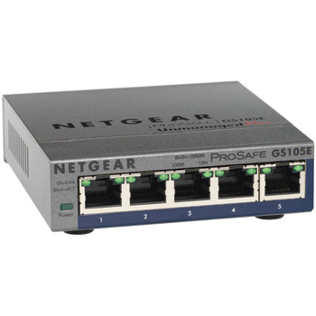
Ethernet switches (late 1990s–today)
Avoid collision by avoiding broadcasts – relay message to the one correct port.
  Allow multiple pairs of ports to communicate simultaneously.
Switches are store and forward devices, like routers.
  Requires much more complex hardware – parallel packet processing and queueing.
Switch remembers MAC addresses of recent senders on each port.
If packet is addressed to an unknown address, broadcast to all ports.
STOP
and
THINK
Hola
hello
dst:A
hello
dst:E
Hola
Hola
How to know where to send packets?
A
B
C
D
E
F

Slide 25
Switches (continued)
Switch allows a subnet to efficiently grow very large, because packet flows are isolated from each other and can happen in parallel.
No special configuration is required on nodes or in switch.
  It’s entirely “plug and play,” and compatible w/original ethernet design.
If a port is connected to another switch, then it will relay traffic for many MAC addresses.
hello
Hola
dst:A
hello
dst:E
Hola
Hola
A
B
C
D
E
F

Slide 26
Switches avoid collision entirely
Cat5 twisted pair
  Switch ports have output queues (like a router),
  so switch will wait to send a packet until the port is free.
    Worst that can happen is that a packet is dropped due to a full queue.
  A message may arrive on a port at the same time we’re sending because twisted pair and fiber cabling are full duplex media:
    Have separate signal channels for sending and receiving.
    Collision cannot be caused by incoming data.
  Coaxial cable and wireless are half-duplex media:
        Share the same channel for sending and receiving.
        Sending and receiving cannot occur simultaneously.
        Collision can happen unless we carefully schedule transfers.
        Can use FDM to support full-duplex operation.
LC fiber optic
Coaxial

Slide 27
Switching loops
STOP
and
THINK
What happens if you connect three Ethernet switches like this?
Broadcast packets will travel in an infinite loop!
Switch 2
Switch 1
Switch 3
A
B

Slide 28
Switching loops (cont.)
STOP
and
THINK
How about this?
Same problem!
Switch 1
A
B

Slide 29
Ethernet Switch
IP Router (layer 3 switch)
Chooses an outbound link using packet’s destination MAC address.
Forwarding rules are learned by inspecting traffic.
Redundant links are not allowed. (Unless using spanning tree protocol.)
No configuration is required, just “plug and play.”
ARP and DCHP (broadcast) traffic must be sent to all switch ports (on all connected switches).
  Beyond ~1000 nodes, should break up the subnet with routers.
Chooses an outbound link using packet’s destination IP address.
Forwarding rules are decided by IGP and BGP.
Routing algorithm chooses shortest among multiple paths.
Router must be configured to assign its IP addresses, IGP, etc.
Isolates Ethernet broadcasts.
Gives administrator greater control over where traffic is sent
(traffic engineering).

Slide 30


A simple campus LAN
mail server
to external
network
web server
router
Central switch should have faster switching rate than edge switches below.
switch
IP subnet
switch
switch
switch
switch

Slide 31
VLANs (Virtual LANs)
single physical switch ……
VLANs divide a switch into multiple virtual switches
  Allows large switches to be flexibly configured.
  Often configured by port, but can also assign certain MAC addresses to certain VLANs.
Often used to isolate private subnets for security.
Traffic from one VLAN cannot flow into another VLAN (unless a router is connected).
1
7
9
15
2
8
10
16
…
…
Electrical Engineering
(VLAN ports 1-8)
Computer Science
(VLAN ports 9-15)
… operates as multiple virtual switches
1
7
9
15
2
8
10
16
…
…
Electrical Engineering
(VLAN ports 1-8)
Computer Science
(VLAN ports 9-16)

Slide 32
Data Center networks
Data Centers house 10s or 100s of thousands of machines.
Fast communication is essential
  higher-level switches and routers can become bottlenecks.
Internet AS1
Internet AS2
…
Border routers
Access routers
Tier-1 switches
Tier-2 switches
Top-of-rack switches
…
Server racks

Slide 33
Reducing bottlenecks in Data Center networks
Much data-center traffic goes between servers.
Ideally, place related applications in same rack
Use multiple interconnections to place less load on highest level switches.
STOP
and
THINK
Are there switching loops here?
Tier-1 switches
Tier-2 switches
TOR switches
Server racks

Slide 34
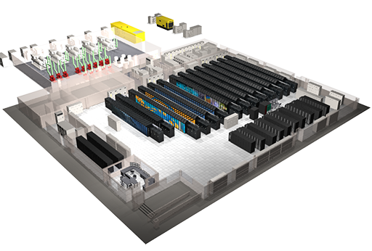
Supercomputer (HPC) networks
Supercomputers look superficially like data centers, but applications differ.
The goal is to use entire cluster to do a single distributed computation.
Interconnect speed is more important than speed of individual nodes.
Typically uses InifiniBand links instead of Ethernet due to lower latency.
  IB supports remote direct memory access (RDMA). OS need not run an interrupt handler when message arrives.
COMP_ENG-358 Parallel Computing discusses various network topologies for parallel computing.
"Titan" Supercomputer at Oak Ridge National Lab

Slide 35
Recap
Link layer handles error detection and correction: Parity, Checksum, and Cyclic Redandancy Check (CRC).
Ethernet adds MAC addresses to identify src/dst on a shared link.
  ARP uses Ethernet broadcast to find IP address → MAC address mapping
DHCP requests are sent by Ethernet broadcast (to FF:FF:FF:FF:FF:FF)
Old Ethernet hubs broadcasted data to all ports.
Ethernet switches learn/remember which MAC addresses are reachable on each port and relay traffic only to the appropriate ports.
  Reduce broadcast traffic and eliminate collisions.
VLANs create multiple isolated LANs/subnets on one switch.
Data Centers & Supercomputers demand fast local networks.

Slide 36
That concludes our trip down the networking stack!

Slide 37
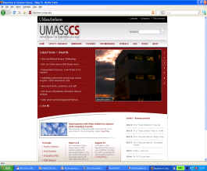


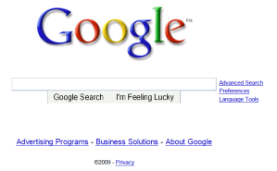
What happens when visiting www.google.com?
browser
DNS server
Comcast network
68.80.0.0/13
school network
68.80.2.0/24
web page
web server
Google’s network
64.233.160.0/19
64.233.169.105

Slide 38
Step 1: Connect to the network
connecting laptop needs to get its own IP address, addr. of first-hop router, addr. of DNS server: use DHCP
DHCP request encapsulated in UDP, encapsulated in IP, encapsulated in 802.3 Ethernet.
Ethernet frame broadcast (dest: FF:FF:FF:FF:FF:FF) on LAN, received by router running DHCP server
Ethernet unpacked to get IP, unpacked to get UDP, unpacked to get DHCP
DHCP
DHCP
UDP
IP
Eth
Phy
DHCP
DHCP
DHCP
DHCP
DHCP
DHCP
UDP
IP
Eth
Phy
DHCP
DHCP
DHCP
DHCP
router
(runs DHCP)

Slide 39
Connecting to network (continued)
DHCP server creates DHCP ACK containing client’s IP address, IP address of first-hop router for client, subnet mask, & IP address of DNS server
Encapsulation at DHCP server, frame forwarded (switch learning) through LAN, demultiplexing at client
Client receives DHCP ACK
DHCP
DHCP
UDP
IP
Eth
Phy
DHCP
DHCP
DHCP
DHCP
DHCP
UDP
IP
Eth
Phy
DHCP
DHCP
DHCP
router
(runs DHCP)
DHCP

Slide 40
ARP (before DNS, before HTTP)
Before sending HTTP request, we need to send a DNS request to get IP address of www.google.com
Create DNS request, inside UDP segment, inside IP datagram, inside Ethernet frame, but we don’t yet have the MAC address of the router to set as the first-hop Ethernet destination.
Client broadcasts ARP query listing the router’s IP address. Router replies with its MAC address (on that subnet).
DNS
DNS
UDP
IP
Eth
Phy
DNS
DNS
ARP
ARP query
ARP
ARP reply
Eth
Phy
router
(runs DHCP)

Slide 41
DNS
DNS
UDP
IP
Eth
Phy
DNS
DNS server
DNS
UDP
IP
Eth
Phy
DNS
DNS
DNS
DNS
DNS
DNS
DNS
DNS
ISP network
68.80.0.0/13
router
(runs DHCP)
IP datagram containing DNS query forwarded via LAN switch from client to 1st hop router. Router unwraps ethernet frame and rewraps with different MAC addresses (for next hop).
IP datagram forwarded from campus network into ISP network, routed (tables already created by RIP, OSPF, IS-IS and/or BGP routing protocols) to DNS server.
DNS server replies to client with IP address of www.google.com

Slide 42
TCP
To send HTTP request, client opens TCP socket to server IP address, port 80.
TCP SYN packet sent -- step 1 of 3-way handshake.
Server sends SYN-ACK – step 2 of 3-way handshake
TCP connection is established!
HTTP
HTTP
TCP
IP
Eth
Phy
SYNACK
SYN
SYNACK
SYN
SYNACK
SYN
SYN
router
(runs DHCP)
TCP
IP
Eth
Phy
SYNACK
SYN
SYNACK
SYN
SYNACK
SYNACK
SYN
web server
64.233.169.105

Slide 43
HTTP Request/Reply
HTTP
HTTP
TCP
IP
Eth
Phy
web page finally (!!!) displayed
HTTP
HTTP
HTTP
HTTP
HTTP request sent into TCP socket.
  IP datagram containing request routed to www.google.com.
Web server replies with HTTP response (containing web page HTML).
  IP datagram containing response routed back to client.
HTTP
HTTP
HTTP
HTTP
router
(runs DHCP)
HTTP
HTTP
TCP
IP
Eth
Phy
HTTP
HTTP
HTTP
HTTP
web server
64.233.169.105

