Slide 1
CS-340 Introduction to Computer Networking
Lecture 13: Medium Access Control
Steve Tarzia
Fall 2020
Many diagrams adapted from those by J.F Kurose and K.W. Ross

Slide 2
Recap
IP anycast: BGP trick to send traffic for one IP address to two hosts.
Broadcasting is sending a single message to every host.
  Multicast is sending a single message to many (but not all) hosts.
Controlled flooding: add a sequence number to messages, and retransmit only if you have not seen the received sequence number.
Spanning tree: a graph without cycles that reaches all nodes.
Broadcast can be done by transmitting along a spanning tree.
  Prim’s algorithm constructs a minimum-cost spanning tree
  Dijkstra’s algorithm constructs a shortest-path-from-root spanning tree

Slide 3
Each layer solves a particular set of problems
Ethernet Packet
MAC addresses, CRC, etc.
Ethernet payload
Link layer: shares a physical channel among several transmitters/receivers
Network layer: routes from source to destination, along many hops.
Transport layer:
  Multiplexing (>1 connection / machine)
  Ordering, • Acknowledgement, • Pacing
HTTP layer:
  Resource urls, • Response codes,
  Caching, • Content-types, • Compression
IP Packet
IP addresses, TTL, etc.
IP payload
TCP Packet
Port #, sequence #, ack #, etc.
TCP payload
HTTP Response
status code, content-type, etc.
<html><body><h1>My great page</h1><p>…

Slide 4
Who implements each layer?
Hardware & driver
Link layer: shares a physical channel among several transmitters/receivers
Network layer: routes from source to destination, along many hops.
Transport layer:
  Multiplexing (>1 connection / machine)
  Ordering, • Acknowledgement, • Pacing
HTTP layer:
  Resource urls, • Response codes,
  Caching, • Content-types, • Compression
Base station
Switch
Router
Operating System
User-
level application
Language/Libraries

Slide 5



Terminology
  cables connect two interfaces
  switches connect multiple
  Ethernet interfaces
  base stations connect multiple wireless interfaces.
  routers connect subnets
Nodes are hosts and routers.
Links are communication channels that connect adjacent nodes along communication path
  wired links
  wireless links
  LANs
Physical connectivity is called Layer 1.
Link layer is called Layer 2.
IP layer is Layer 3.
Transport (TCP) layer is Layer 4.
223.1.1.1
223.1.2.1
223.1.1.2
223.1.1.4
223.1.2.9
223.1.1.3
223.1.3.27
223.1.2.2
223.1.1.4
223.1.3.3
223.1.3.1
223.1.3.2

Slide 6
Why does a router have multiple IP addresses?
Nodes on a given subnet can all communicate via link-layer
Router routes packets between subnets.
So, it must have an IP address on each subnet it is participating in
223.1.1.1
223.1.2.1
223.1.1.2
223.1.1.4
223.1.2.9
223.1.1.3
223.1.3.27
223.1.2.2
223.1.1.4
223.1.3.3
223.1.3.1
223.1.3.2

Slide 7




Medium Access Control (MAC)
Communication happens in some
physical medium. (Plural is media.)
Wireless communication occurs in open space, in some freq. band.
Wired communication occurs on a wire.
  Many nodes are often connected to the same wire, physically or logically.
MAC is needed in broadcast links, where more than one node is sharing a single channel.
MAC is unnecessary in point-to-point links.
  Eg., a wired link with separate send and receive wires
  such connections are only common over long distances.
shared wire (e.g.,
cabled Ethernet)
shared RF
(e.g., 802.11 WiFi)
shared RF
(satellite)

Slide 8
Multiple Access Protocols
Collision is the fundamental problem in broadcast links:
  Multiple nodes try to communicate at the same time.
  Simultaneous messages interfere with each other.
  None of the colliding messages can be received.
  Precious time and bandwidth is wasted.
  Messages must be retransmitted.
If we’re too aggressive in sharing, many collisions will occur.
If we’re too polite about sharing, may waste time/bandwidth waiting.

Slide 9
Multiple Access Protocol Goals
Assuming multiple nodes are sharing a link with throughput R bps:
If only one node is communicating, then it should get the full bandwidth (R).
When N nodes have data to send, they should each get R/N bandwidth.
Protocol should be decentralized, with no single point of failure.
It should be simple and inexpensive to implement.
Three basic classes of multiple access protocols:
Channel partitioning • Random access • Taking turns

Slide 10
Channel Partitioning Protocols
Frequency division multiplexing (FDM)
4 nodes
Each channel can only use ¼ of the frequency range, so it can send only ¼ of the total max throughput.
frequency
time
Time division multiplexing (TDM)
Why less data throughput?
frequency
STOP
and
THINK
time

Slide 11
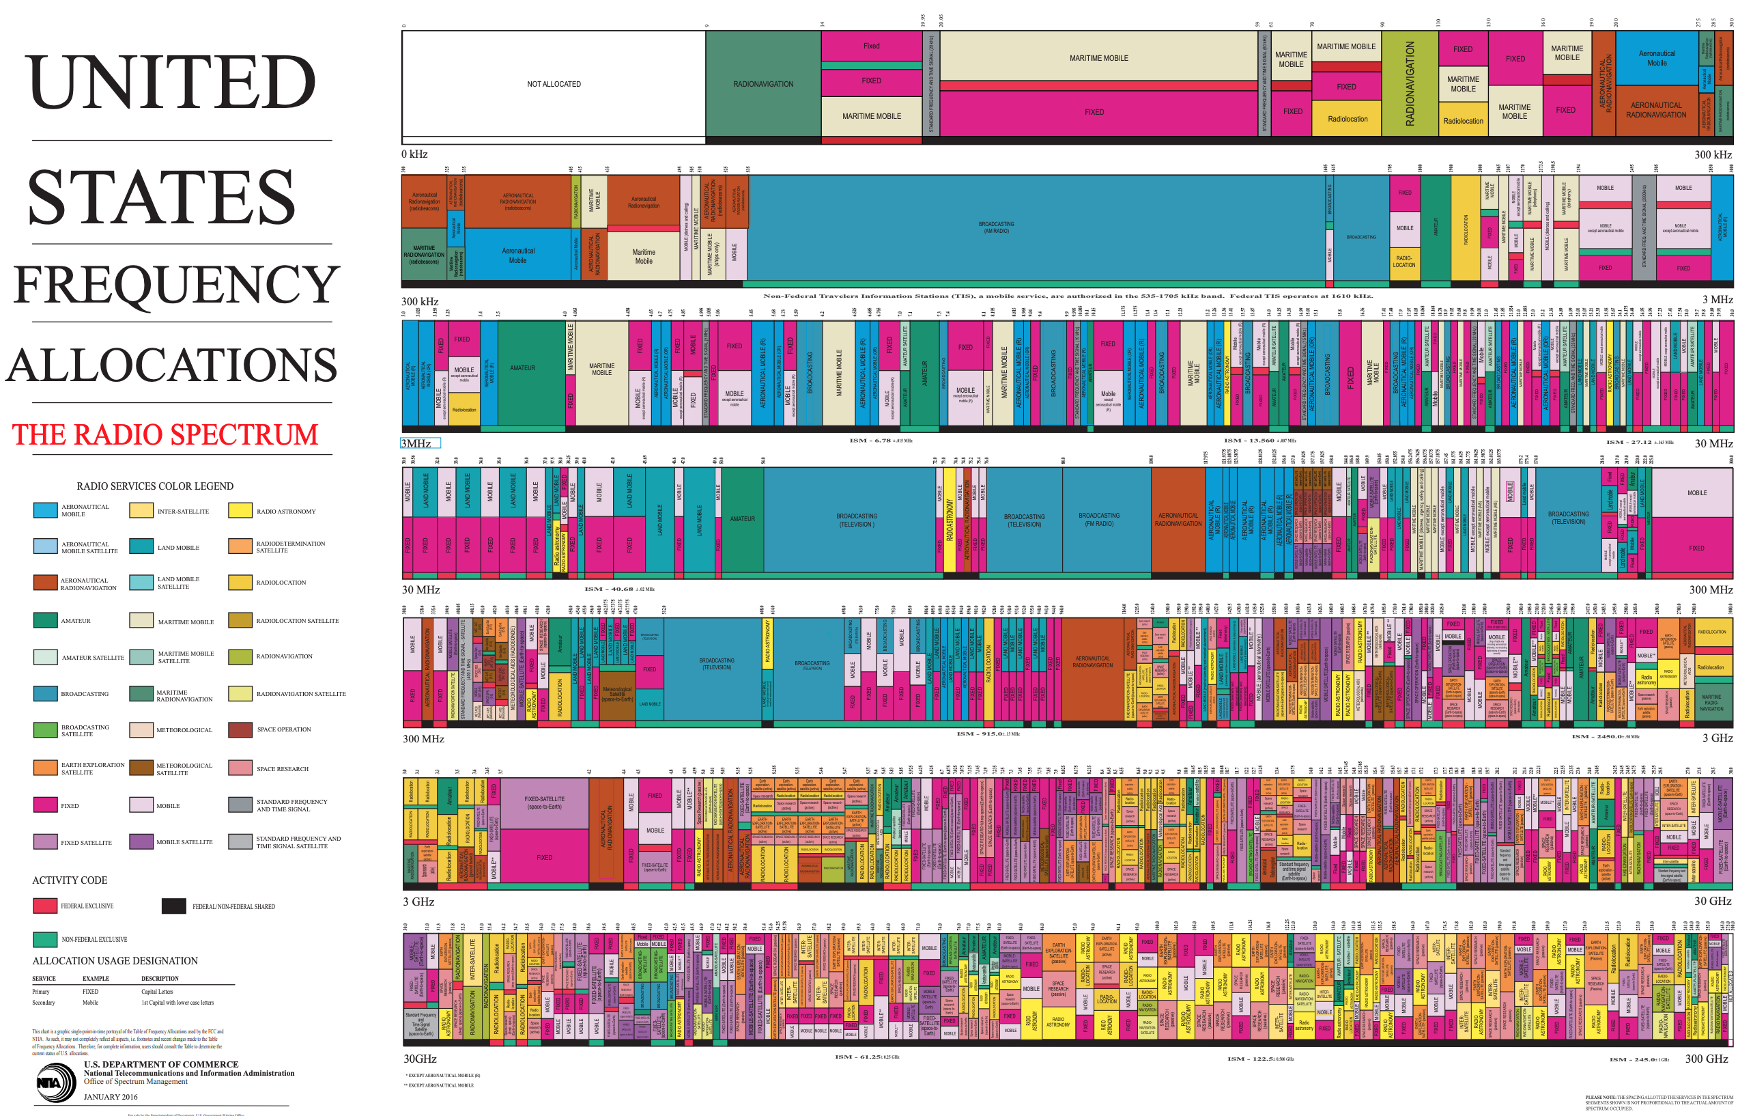
US radio spectrum (use of frequencies bands) is governed by the FCC

Slide 12
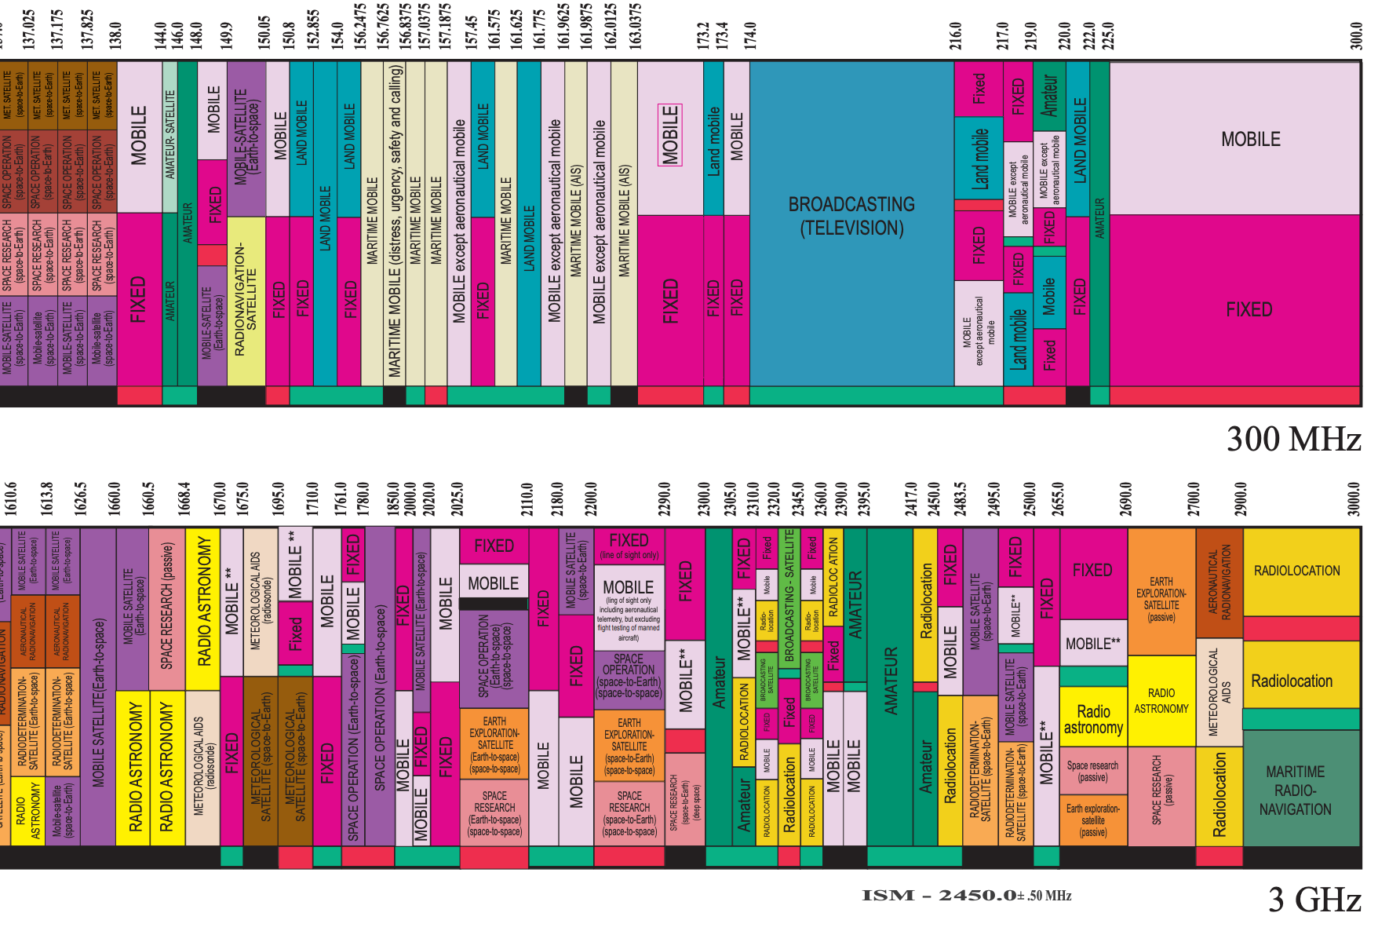
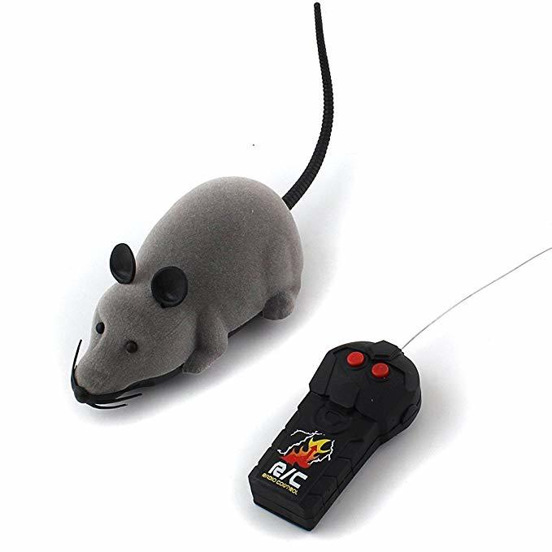
Zoomed-in view
Frequency ranges are called bands.
ISM band: Industrial, Scientific, and Medical bands are "unlicensed" & usable by random electronic devices. 2.4Ghz band is used by:
Microwave ovens
802.11b/g/n/ax WiFi
Cordless telephones
Radio-controlled toys
Whatever!

Slide 13
Channel Partitioning Protocols
"Bandwidth" literally means the size of a frequency range and is measured in hertz. The word's use as a synonym for throughput derives from FDM
Each node gets a reserved “slice” of the bandwidth.
FDM: each node uses a fraction of the spectrum, thus less bandwidth
TDM: each node communicates a fraction of the time
These are collision-free and fair, but inflexible:
  Max throughput is R/N, even if only one node wants to communicate!
Code division multiplexing (CDM)
is similar, but more difficult to
explain without EE background.
Frequency division multiplexing (FDM)
4 nodes
frequency
Time division multiplexing (TDM)
time
frequency
time

Slide 14
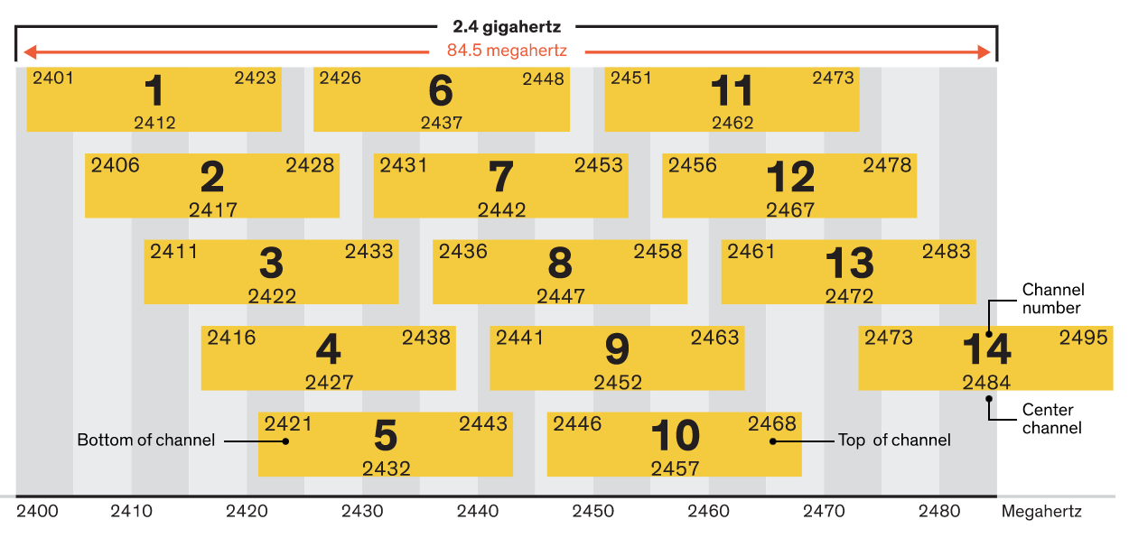
Wifi uses FDM to isolate different base stations
2.4Ghz WiFi technically support 14 channels, but the overlap means that it's best to use only three: channels 1, 6, and 11.
If your neighbor uses channel 9, their traffic will interfere with channels 5-13, leaving just one free channel (1, 2, 3 or 4)

Slide 15
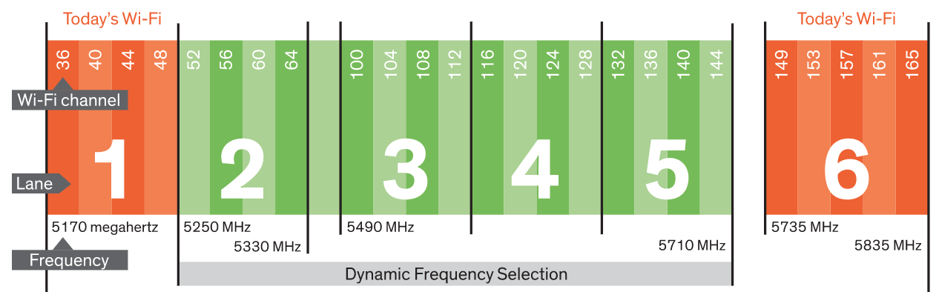
5Ghz WiFi adds another 9 to 25 channels
In the 5Ghz band, 9 channels are dedicated to WiFi (red) and 16 more can be used during times when weather and military radar is not active (DFS/green).
802.11ac merges channels (perhaps all 9 red ones above) to get up to 1.3Gbps
For more details, see:
https://spectrum.ieee.org/telecom/wireless/why-wifi-stinksand-how-to-fix-it

Slide 16
Wi-Fi Scanner Tool Demo
Option-click wifi icon in tray
Open wireless diagnostics
Window → Scan

Slide 17
Random Access Protocols
Abandons strict partitioning of so that individual sender can operate faster.
Anyone can try sending immediately at full bitrate.
In the event of collision, wait a random delay before retransmitting.
Host 1: send (collision) ………send (success)
Host 2: send (collision) …………………… send (success)
Randomization will likely cause the two hosts to retry at different moments in the future:
  What happens if we foolishly use a constant retransmission delay?
Host 1: send (collision) …… send (collision) …… send (collision) …
Host 2: send (collision) …… send (collision) …… send (collision) …
But, how to choose the random delay?
STOP
and
THINK

Slide 18

ALOHA: an early random access protocol
Invented in 1970, for radio communication between Hawaiian islands.
Send immediately. If collision, retransmit the packet with probability p or wait (with probability p-1) for the time needed to send one packet.
Keep trying until the packet is sent.
Senders have no collision detection. Receiver uses checksum to drop corrupted packets. Retry if no ACK was received.
Don’t listen before broadcasting – just assume channel is free
node 1
1
1
1
1
node 2
2
2
2
node 3
3
3
3
C
E
C
S
E
C
E
S
S

Slide 19
ALOHA: expected throughput
Delay probability p should be tuned according to the expected number of concurrent senders. (Lower if channel is busier.)
If the channel is busy, then on average we expect:
  18% of the peak throughput. (see book for formula derivation)
Slotted ALOHA requires time synchronization among senders.
  Achieves 37% of the peak throughput. (sent packet blocks one slot, not two)
node 1
1
1
1
1
node 2
2
2
2
node 3
3
3
3
C
E
C
S
E
C
E
S
S

Slide 20
ALOHA
STOP
and
THINK
Ideas for improvement?
Pros
One sender can use full bitrate
Decentralized
Simple
Cons
Collisions are possible
Link may be idle while waiting
May interrupt another sender simply because didn’t listen first.
Poor throughput when busy
node 1
1
1
1
1
node 2
2
2
2
node 3
3
3
3
C
E
C
S
E
C
E
S
S

Slide 21
CSMA/CD
Carrier Sense Multiple Access with Collision Detection
Carrier Sensing: listen to the channel before sending,
  If it’s busy, then wait. This anticipates and prevents collision.
Collision Detection: listen while transmitting,
  Stop transmission immediately if another transmission is heard.
  This minimizes the channel-time wasted due to collision.
Requires hardware that can detect signals on the transmission channel.
Used by wired Ethernet (very effectively) and 802.11 WiFi (less effectively).
Why does Collision Detection work better for wired links?
STOP
and
THINK

Slide 22
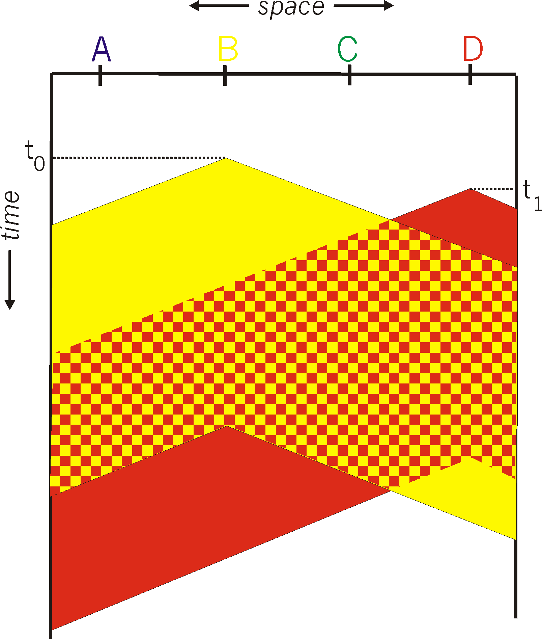
Collisions are unavoidable
spatial layout of nodes
You might think that carrier sensing is enough to prevent collisions.
However, propagation delay across the channel delays carrier sensing observations.
  Also, there is a small delay between sensing and transmission.
A node’s knowledge of channel state is always slightly out-of-date.
Longer propagation delay leads to more collision in CSMA.

Slide 23
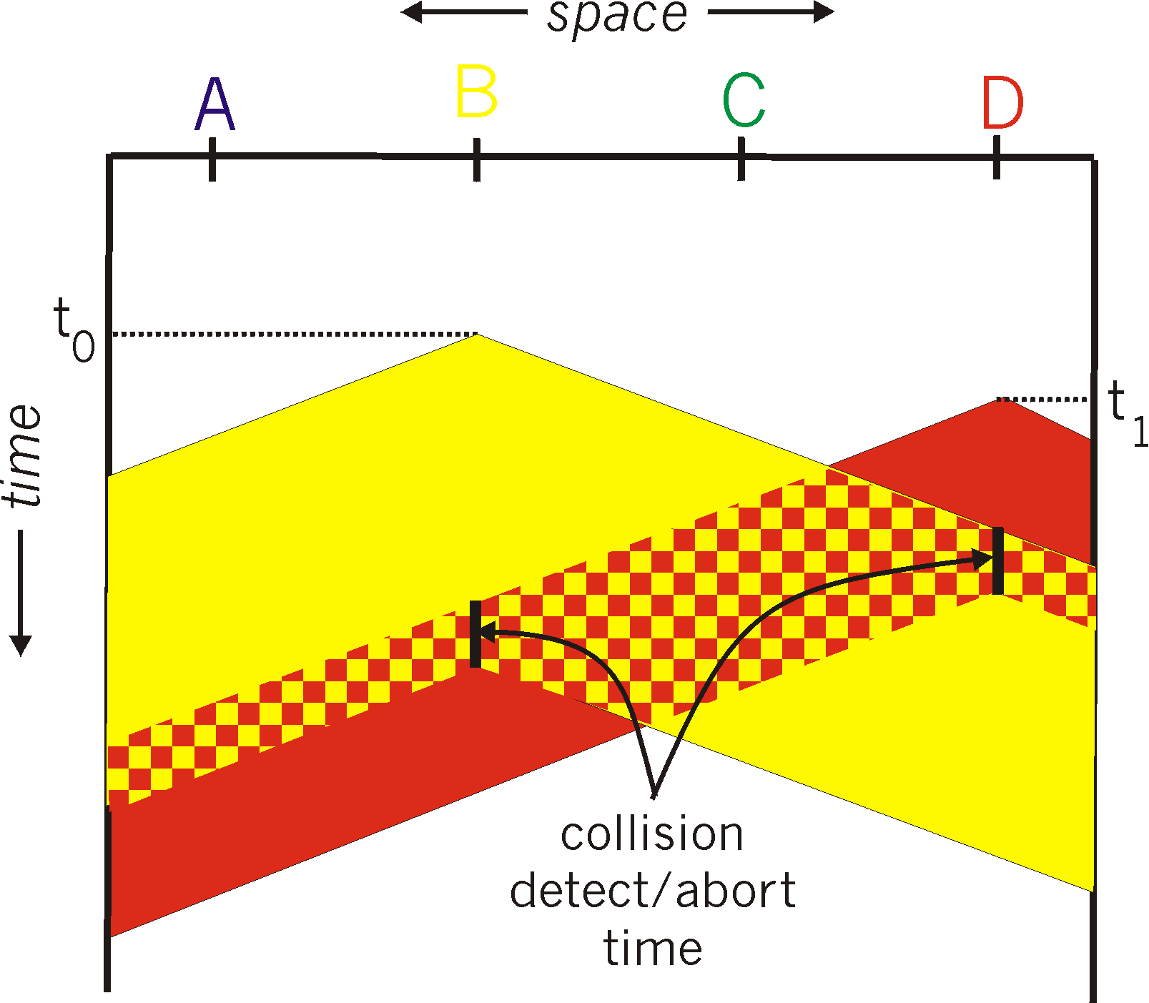
Collision Detection
Reduces the channel-time wasted by collisions.
How?
  Measure channel signal while sending.
  If energy is greater than transmission energy, then there must be some added signal.
Works well for wired channels.
Received radio signals are much weaker than transmitted signals, so collision detection is difficult for wireless links.
spatial layout of nodes

Slide 24
CSMA/CD steps
Carrier Sensing: listen to the channel before sending,
  If it’s busy, then wait. Start sending when channel is free.
Collision Detection: listen while transmitting,
  Stop transmission immediately if another transmission is heard.
Binary exponential backoff determines when transmission is retried.
  If packet has collided n times, choose a random delay between 0 and C*(2^{n}-1)
  For Ethernet, the constant C=512/bitrate, and n cannot grow past 10.
  Exponential backoff resets for each new packet.

Slide 25
Taking-Turns Protocols
  Random access protocols do not guarantee a fair share of bandwidth.
  Taking-Turns protocols are like TDM in the sense that time slots are reserved, but the reservations are dynamic, not pre-scheduled.
Bluetooth is a type of taking-turns protocol called a Polling Protocol:
  One node is designated the Leader.
  Leader polls the nodes in a round-robin manner, sending a message to each node telling it to send up to H packets.
  Polling messages add some coordination overhead (C*N) where C is a constant
If leader sees that a node stopped sending packets early, it polls the next node. Assuming H=5:
Leader observes silence
Leader polls A
A sends 5 packets
Leader polls B
B sends 1 packet
Leader polls C
Leader polls A
A sends 5 packets
Leader polls B
…

Slide 26
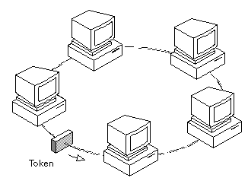
Token-passing protocols
Like a polling protocol, but without the special leader node.
Nodes have a designated order 1…N.
One nodes transmits up to some maximum number of packets, then sends a special message (a token) giving the next node a turn.
Nodes only send packets while “holding” the token, so collisions are avoided.
If token-holding node crashes, the entire
network is crashed. (like crashing
the leader node in a polling protocol).
Shared medium

Slide 27
Multiple access protocol summary
Channel Partitioning
Random Access
Taking-Turns
 | FDM | TDM | ALOHA | CSMA/CD | Polling | Token-Passing
Single Sender throughput | R/N | R/N | R | R | R – C*N | R – C*N
Busy throughput | R | R | ~37% R (slotted) or ~18% R | R 1+5d_{prop}/d_{trans} | R – C*N | R – C*N
Collisions |  |  | yes | unlikely
Centralized | yes | yes |  |  | yes
Crash-sensitive |  |  |  |  | yes | yes
Requires time synchronization |  | yes | optional
Requires carrier sensing |  |  |  | yes | yes

Slide 28
Recap
Link-layer handles sharing a physical link/medium with multiple nodes.
Medium Access Control / Multiple Access Protocol
  Decide how to share the link.
  Two nodes sending simultaneously is a collision. Packets are lost.
Three classes of sharing protocols:
Channel Partitioning:
  Frequency Division Multiplexing - WiFi
  Time Division Multiplexing
Random Access:
  ALOHA (simple historical example)
  CSMA/CD (Carrier Sense Multiple Access/Collision Detection) - Ethernet, Wifi
Turn-Taking:
  Polling - Bluetooth
  Token-passing

