Slide 1
CS-340 Introduction to Computer Networking
Lecture 12: Broadcast
Steve Tarzia

Slide 2
Last Lecture: BGP routing
DV Count to infinity leads to slower convergence when links get worse.
  Good news travels quickly, bad news travels slowly.
Internet routing is hierarchical.
Autonomous systems (ASes) are grouped routers with one routing policy.
An Interior Gateway Protocol (IGP) (eg., OSPF) determines optimal routes within an AS.
  Can use a centralized (Link State) shortest path algorithm, like Dijkstra’s.
The Border Gateway Protocol (BGP) determines routes between ASes.
  Uses a distributed shortest-AS-hop path algorithm (Distance Vector).
BGP advertisement includes a list of routes, each looking like:
  {PREFIX: 43.5.0.0/16, AS-PATH: [AS4, AS65, AS1], NEXT-HOP: 5.6.7.200)}
  This tells a neighboring AS that it can forward packets to the prefix.

Slide 3
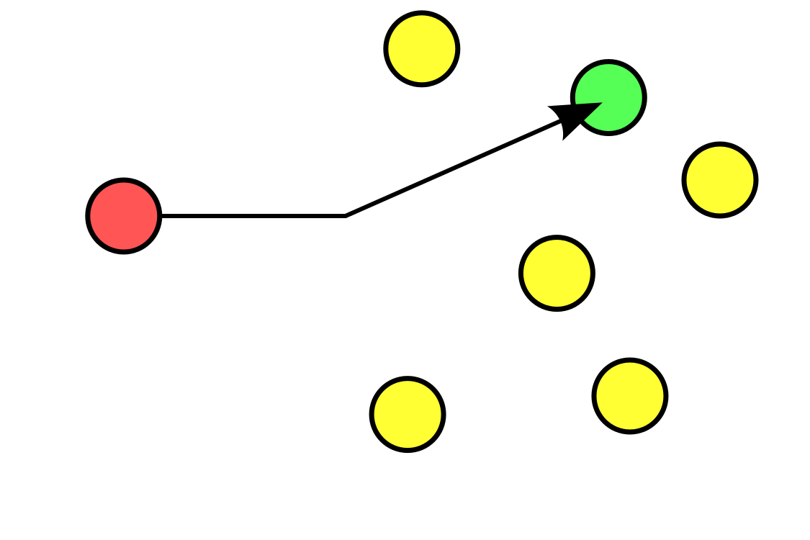
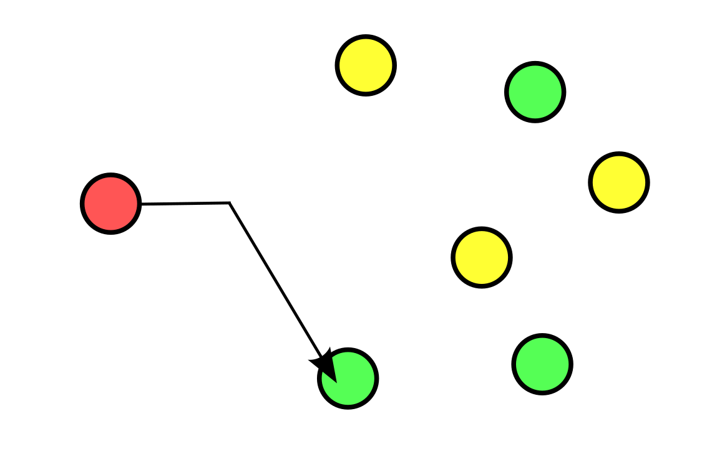
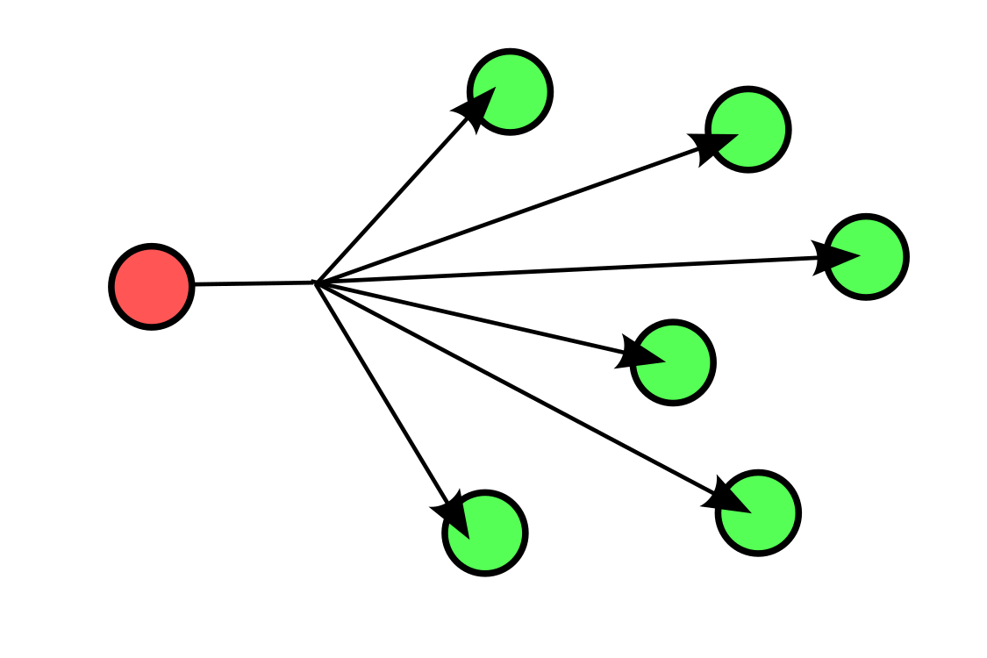
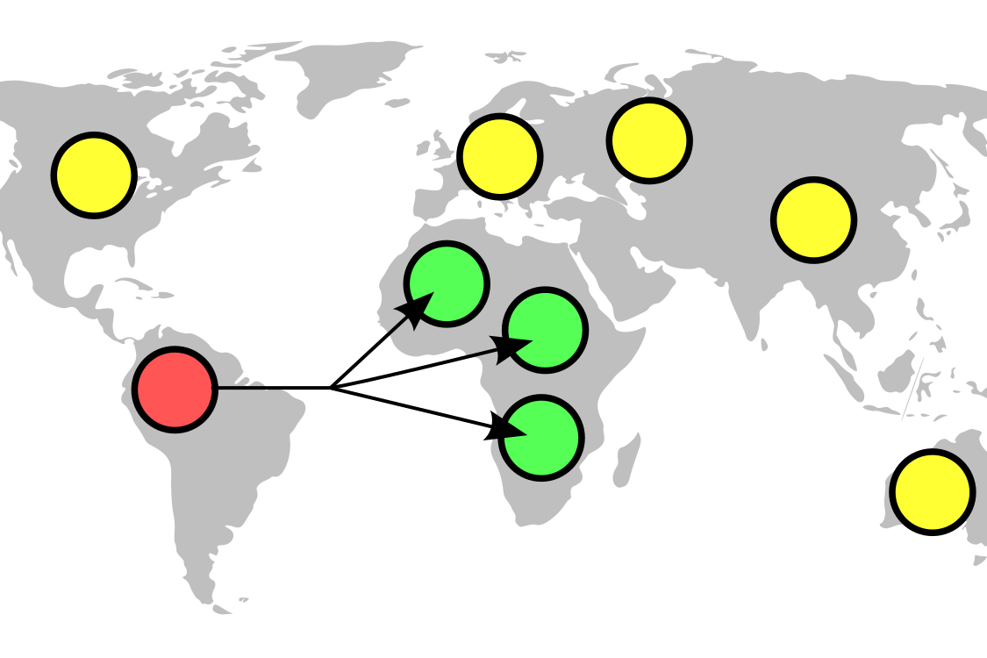
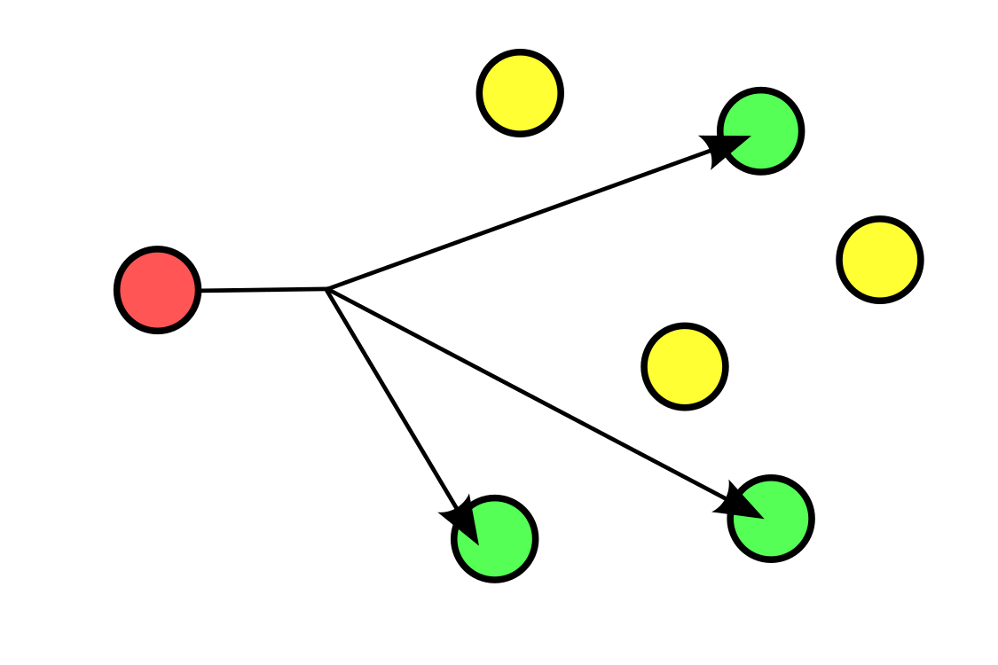
Generalized packet delivery
IP networks were built for unicast addressing (sending a packet to a single destination address) but applications have more general needs:
Unicast: to one node
Anycast: to one of many possible nodes
Geocast: to nodes in a specific location
Broadcast: to all nodes
Multicast: to a set of nodes

Slide 4
IPv4 anycast hack
Remember, this is Google's public DNS server
The single IP address 8.8.8.8 maps to may different machines across the world, using a hack called IPv4 anycast.
Multiple border gateways (routers) advertise short routes to 8.8.8.8.
Within the AS, traffic is directed to the closest 8.8.8.8 instance.
Below, there is nothing stopping two AS’es from advertising short routes to the same IP address, thus creating two copies of the same IP address.
BGP Hijacking is the malicious takeover of another AS’es IP addresses.
8.8.8.8
8.8.8.8

Slide 5
IP Multicast (optional)
Certain IP addresses are reserved to identify broadcast groups.
  Eg., 239.1.1.1. Traffic sent to that address is forwarded to every host that has subscribed to that broadcast group using Internet Group Management Protocol (IGMP).
Adds burden to routers, since they must track all broadcasts active at that time. (To which neighbors should I forward multicast traffic?)
  More routing info to track (in addition to BGP) and with finer granularity.
Public Internet routers generally do not support IP Multicast.
Used in special scenarios for streaming content to many viewers.
  Eg., IPTV in hotels or video broadcast on a campus.
Applications must use UDP, not TCP
  (because sender would have to track ACK status of thousands of receivers)

Slide 6
Broadcast as a basic network building block
STOP
and
THINK
IP (the Internet) does not support broadcast. Why?
  No one message is relevant to all hosts on the entire Internet!
Broadcasts are crucial in small-to-moderate sized ad hoc networks:
  Networks of neighboring hosts that connect without prior planning.
  Also called mesh networking and MANETS.
  Firechat (2014–18) was a P2P chat app using bluetooth and ad-hoc WiFi.
Broadcasts can be used to share information about network structure to later enable unicast routing.

Slide 7
How to implement link state (LS) flooding?
Remember, a "link state" routing algorithms uses Dijkstra's algorithms to compute the shortest paths. Information on the whole network must be gathered in one place. Another way of looking at this is that any information about every link and node must be broadcast to everyone in the network.

Slide 8
Broadcasting (flooding)
Naïve approach is to unicast the message to each node. Downsides?
  Requires prior knowledge of the full network and it is inefficient:
Broadcast allows a message to be duplicated in transit to reach different parts of the network.
Must be careful to ensure:
  Correctness: all nodes get the message.
  Efficiency: ideally, message is received just once by each node
  Termination: message is not retransmitted forever.
STOP
and
THINK
R1
R1
First hop has duplicates
R2
R2
R3
R4
R3
R4
3x unicast
broadcast

Slide 9
How would you implement broadcast?
STOP
and
THINK
Assume that each node just knows about its neighbors
What challenges arise?

Slide 10
Broadcast strategy #1: Controlled Flooding
Nodes retransmit packet only the first time it is seen by a node.
  Obviously, don’t retransmit it on the link it was received on.
How does a node tell that a packet is “new”?
  Broadcast packets must contain a unique identifier.
  Nodes must remember all recently-seen message identifiers.
In Link-State algorithm, when flooding link state, messages include: ⟨link source, link destination, sequence number, link cost⟩
uniquely identifies the message
Node checks message id. It’s new, so retransmit!
Id matches a message that we already saw. Do nothing!
New message
…Later, the same message arrives again

Slide 11
LS flooding demo
Why do we need sequence numbers?

Slide 12
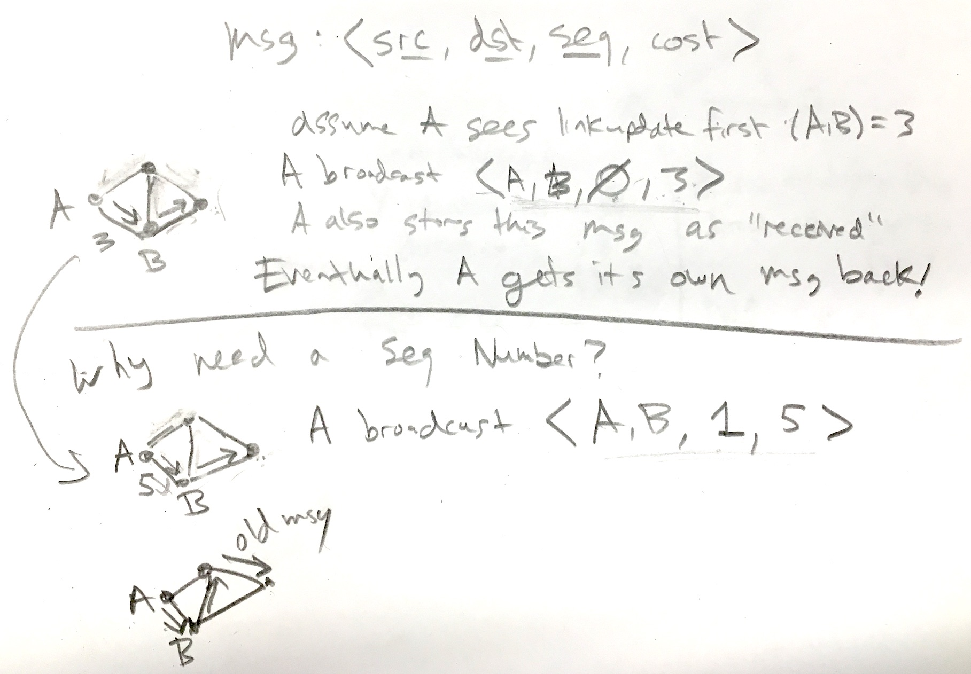

Slide 13
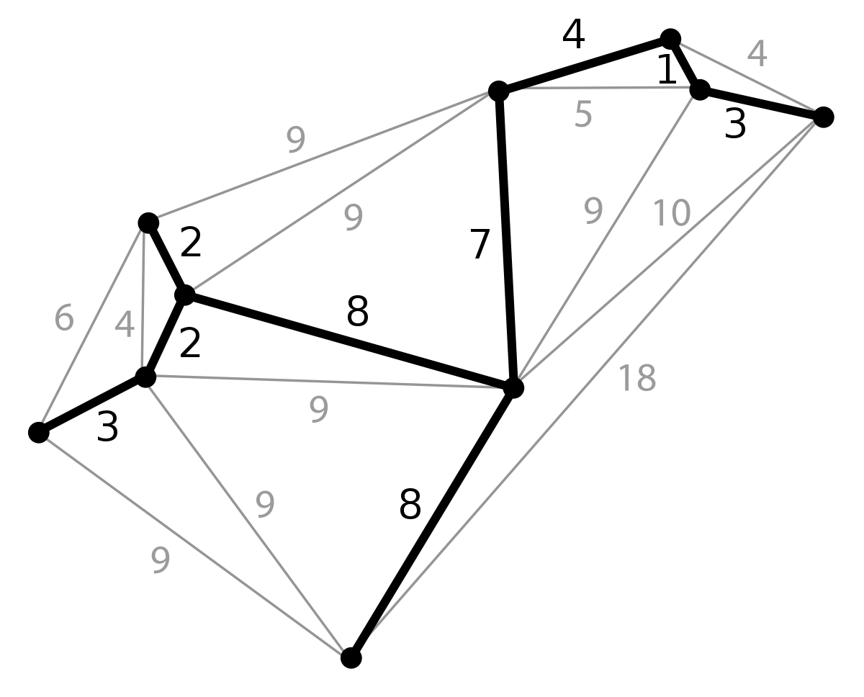
Broadcast strategy #2: Spanning Tree
In a graph, a spanning tree is a subset of edges that connects all the nodes and has no cycles (loops).
To implement broadcast efficiently,
“flood” message only along spanning tree.
All nodes will be reached.
Lack of cycles prevents
duplication and guarantees
termination.
No need to remember message identifiers.
But must somehow find a spanning tree,
and all nodes must use the same spanning tree.

Slide 14
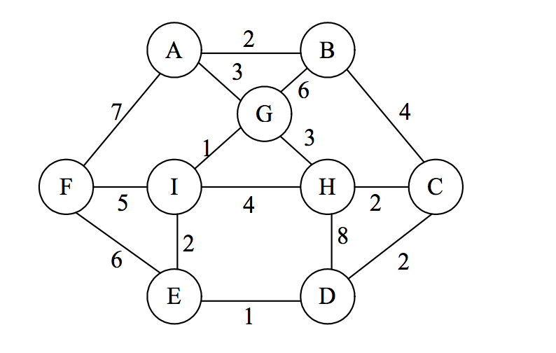
Simplest spanning tree algorithm
Root
DFS:
|V| times, find an edge that does not create a cycle and add it to the tree.
In more detail:
Do a depth-first or breadth-first search for unvisited nodes, adding the connecting edges.
Track the nodes already in the tree (visited) and ignore edges leading to those.
Does not compute a minimal-cost spanning tree.
Root
BFS:

Slide 15
Minimum Spanning Tree
Root
Find a spanning tree such that the sum of all edge costs is minimized.
This minimizes the total communication cost for broadcast.
Prim’s algorithm:
  Start with a root node.
  Repeatedly add the minimum-cost
  edge on the frontier of the tree.
    A frontier edge connects a node in
    the tree to a node outside the tree.
See also: Kruskal’s algorithm
STOP
and
THINK
How to efficiently find the min-cost frontier edge?
= frontier edge
Notes:
This is an optimal greedy algorithm. Kruskal’s algorithm finds the minimal-cost edge that connects two disjoint trees. Store frontier edges in a priority queue (min-heap). Add and remove edges when frontier is expanded.

Slide 16
Shortest Path Tree
Minimizes the longest path in the broadcast.
A special spanning tree computed by Dijkstra’s algorithm.
Minimizes the path cost to every node
Thus, minimizes the path cost to the farthest node from the root.
If link costs represent latencies, shortest path tree minimizes the
broadcast latency.
Not a minimum spanning tree.
Total edge “cost” may be greater, but this
is irrelevant for parallel message latencies.
Root

Slide 17
Tradeoff between total cost and longest path
Minimum Spanning Tree (eg., Prim's alg.)
Total cost: 18
Longest path: 13
Best choice if edge costs are cumulative (eg., dollars, energy).
Shortest Path Spanning Tree (Dijkstra)
Total cost: 23
Longest path: 9
Best choice for broadcast if edge costs represent delays.
Root
Root

Slide 18
Broadcasting summary
Controlled flooding
Nodes re-broadcast new messages.
Must track recently-seen messages.
Duplicate messages may be received.
It’s simple and it works!
A totally distributed approach.
Spanning tree
Sends messages only along necessary paths.
Nodes do not get duplicates.
No need for message id’s.
Communication cost or delay can be minimized.
Requires centralized knowledge of full network (to run opt. alg.)
All nodes must agree on a spanning tree, so they must have the same information.
In the case of Internet routers, flooding is needed to share this full network knowledge.

Slide 19
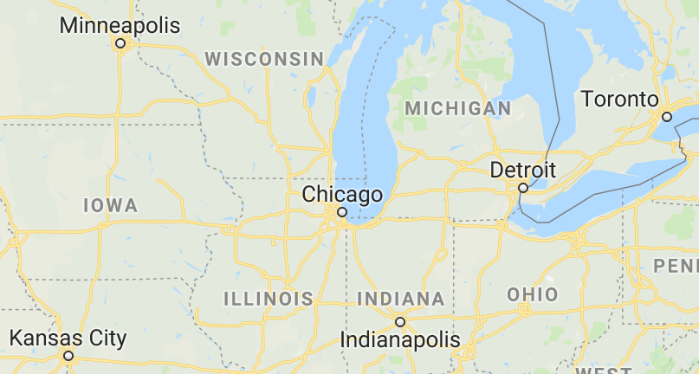
Network design problems
Would we ever want to build a shortest path tree network instead of an MST?
STOP
and
THINK
MST can be used for other problems in networking (and elsewhere!)
Eg., given a list of cities and their locations, what is the cheapest way to build a network that interconnects them?
Cities are nodes and
distance between all
pairs of cities are
weighted edges.
MST is the cheapest
connected graph
(network) that can be
built.

Slide 20
Recap
IP anycast: BGP trick to send traffic for one IP address to two hosts.
Broadcasting is sending a single message to every host.
  Multicast is sending a single message to many (but not all) hosts.
Controlled flooding: add a sequence number to messages, and retransmit only if you have not seen the received sequence number.
Spanning tree: a graph without cycles that reaches all nodes.
Broadcast can be done by transmitting along a spanning tree.
  Prim’s algorithm constructs a minimum-cost spanning tree
  Dijkstra’s algorithm constructs a shortest-path-from-root spanning tree

