Slide 1
CS-340 Introduction to Computer Networking
Lecture 11: BGP Routing
Steve Tarzia

Slide 2
Last Lecture: Router internals & Routing algorithms
Weighted Fair Queueing can prioritize classes of packets in router queue.
Routing algorithms determine each router’s forwarding table. It’s a a shortest path problem on the weighted graph graph representing the network.
  May be centralized/global or distributed.
Dijkstra’s Algorithm is a fast centralized (LS) algorithm for shortest path.
  Used by Open Shortest Path First (OSPF) protocol within an AS.
  Routers initially flood/broadcast local link information to entire network.
  Each router then solves shortest path from itself to all other routers.
Distance Vector (DV) algorithm is a distributed shortest path algorithm
  Used by the Border Gateway Protocol (BGP) to route between AS’s.
  Initially, routers only knows distance to neighbors – broadcast to neighbors.
  When receive a neighbor’s DV, update own DV, & broadcast if DV changed.

Slide 3
What's in a Distance Vector?
Each network node has its own DV.
For that node, DV lists the ⟨cost, next_hop⟩ for every destination.
  Ie., it's a dictionary mapping from destination to ⟨cost, next_hop⟩.
How is the DV used?
The next_hop tells which direction to travel to reach the destination most quickly. At each hop, check the node's DV to find the next hop.
When we share our DV with a neighbor, the cost lets the neighbor decide its best next_hop for that destination.

Slide 4
Distance Vector (DV) calculation
Each node operates independently (a distributed algorithm).
Each node must store:
Its outbound links: who do they connect to, and at what cost.
Each neighbor’s latest DV: who can I reach through neighbors?
Each node must compute:
Its own DV using 1 & 2. This will be optimal, given the info I have.
Whenever either 1 or 2 changes, I must recompute my DV.
Whenever my DV changes, send my updated DV to all neighbors.
When DV messages are no longer sent, we have converged to an optimal solution. Each node’s DV is an optimal forwarding table for routing.

Slide 5
What happens when link costs change?
Node detects local link cost change
Recalculates distance vector
If DV changed, notify neighbors
Link cost was decreased – Good news travels quickly
y detects new link-cost, updates its DV, sends new DV to neighbors.
z receives update from y, updates its table, computes new least cost to x , sends its neighbors its DV.
y receives z’s update, updates its distance table. y’s least costs do not change, so y does not send a message to z.
STOP
and
THINK
What if my DV does not change?

Slide 6
Bad news travels slowly
When link costs are increased, updates can be slow.
In this example, it will take 44 iterations for the
algorithm to re-converge to the correct solutions.
Count to infinity problem:
  Neighbors think that the other still has a good path and keep trying to route through each other, meanwhile each node’s estimated distance slows increases.

Slide 7
Count to Infinity Demo

Slide 8
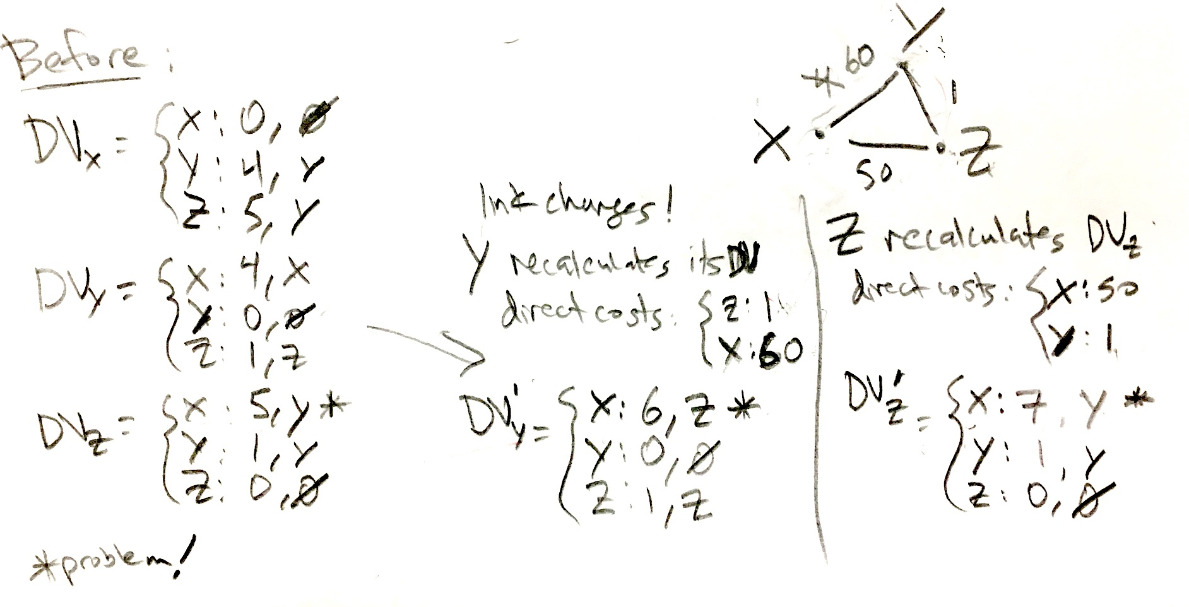

Slide 9
Count to Infinity solutions
STOP
and
THINK
Can you think of a way to avoid count to infinity?
Poisoned reverse solves this problem for pairs:
  If Z routes through Y to get to X:
  Z tells Y its (Z’s) distance to X is infinite (so Y won’t route to X via Z).
But routing loops can still temporarily arise (involving ≥3 nodes).
How can you avoid routing loops in general?
  List entire path in DV and avoid routes that travel through me.
  This is done in BGP with the AS_PATH.
STOP
and
THINK

Slide 10
Centralized (LS)
Distributed (DV)
vs
Message complexity:
  Θ(|V||E|) messages sent to propagate complete graph info.
Convergence speed:
  Θ(|E|+|V|log|V|)
  “oscillations” are possible when costs change (like to count-to-inf.)
Robustness to router malfunction:
  Incorrect link cost may be advertised.
  But this can be checked with cost advertised by other node on link.
  Depends on convergence behavior
  Depends on convergence behavior
  Count-to infinity problem
  Incorrect path cost may be advertised.
  Bad router can attract traffic if it claims to be close to everywhere.

Slide 11
Hierarchical routing
In reality, routers are not all equal. Network graph is hierarchical.
Why?
Scaling:
  Too many routers (>100M) to solve one big shortest path problem.
Administrative autonomy:
  Internet is a network of networks
  Each network operator prefers to control its own internal routing policy.

Slide 12
Autonomous System (AS)
The Internet is divided into about 100k autonomous systems.
  Each has an AS number, distributed by the ICANN’s regional authorities.
Gateway routers (border gateways) at edge of the AS connect to other AS’s.
Routers in an AS run one interior-gateway (intra-AS) routing protocol.
Border Gateway Protocol (BGP) is used by all border gateways to route traffic between AS’s.

Slide 13
List of BGP autonomous systems is here:
  http://www.bgplookingglass.com/list-of-autonomous-system-numbers
  Northwestern is AS #103
  H-MART - Grandsuper Center Inc is AS #32401

Slide 14
Interior Gateway Protocols (Intra-AS routing)
Within an AS, network operator has full control.
  A centralized or distributed routing algorithm can be used.
Centralized IGPs (Link-State algorithms), using Dijkstra’s algorithm:
  Open Shortest Path First (OSPF) – “open” as in “open source”
  Intermediate System to Intermediate System (IS-IS)
Distributed IGPs (Distance-Vector algorithms)
  Routing Information Protocol (RIP)
  Enhanced Interior Gateway
  Routing Protocol (EIGRP)
AS3 may use OSPF
AS2 may use IS-IS
AS1 may use EIGRP

Slide 15
OSPF highlights
Messages are authenticated to prevent malicious tampering.
Multiple same-cost paths are allowed.
Links can have different costs for different types of traffic
Hierarchical OSPF can be used in large AS’s:
Generally, an AS can be
divided into multiple
private AS’s internally,
but look like one AS to
outside Internet.

Slide 16
Border Gateway Protocol (Inter-AS routing)
BGP is the Internet-standard routing protocol for connecting AS’s
  The glue that holds the Internet together.
eBGP: allows neighboring AS’s to share their subnet reachability information: “I can reach 3.2.4.0/24 in 4 hops”
  Prefix reachability table is the distance-vector that is shared and updated.
  Eventually finds the fewest-AS-hop path to every subnet on Internet.
iBGP: propagates reachability information to all AS-internal routers.
All AS’s must use BGP at borders

Slide 17
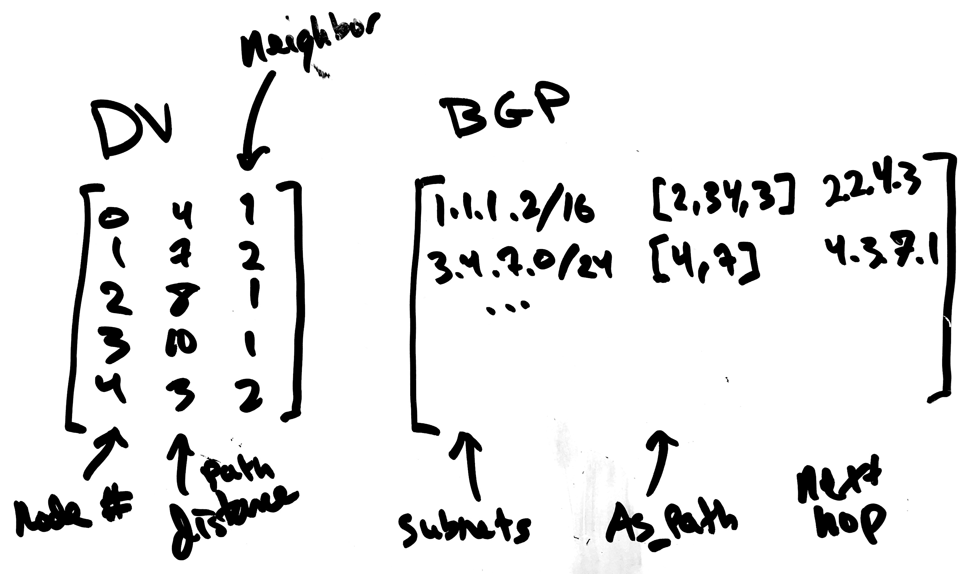
DV vs. BGP advertisement
Next Hop
Next Hop
Destination
Path cost
Destination Subnet
AS_PATH

Slide 18
BGP Basics
BGP session: two BGP routers (“peers”) exchange BGP messages:
  advertise paths to different destination network prefixes
  (network prefixes are the nodes/endpoints in this shortest-path problem)
  exchanged over semi-permanent TCP connections
When AS3 advertises a prefix to AS1:
  AS3 promises it will forward packets towards that prefix
  AS3 can aggregate prefixes in its advertisement:
  20.1.0.0/24 + 20.1.1.0/24 + 20.1.2.0/24 + 20.1.3.0/24 = 20.1.0.0/22

Slide 19
BGP Advertisements (DVs in practice)
Border gateways share lists of BGP routes, each has a prefix & attributes
Two important route attributes:
  AS-PATH: AS numbers through which the advertisement has passed.
  Indicates the AS-path that will be followed to reach the prefix.
  NEXT-HOP: IP address of the router beginning the AS-PATH
{PREFIX: 43.5.0.0/16, AS-PATH: [AS4, AS65, AS1], NEXT-HOP: 5.6.7.200)}
Above, a router in AS4 is advertising:
  You can send traffic to 43.5.0.0/16 through my router 5.6.7.200, and it will travel through three AS’s before arriving.

Slide 20
AS_PATH
Why does BGP advertise the full AS_PATH instead of just the path length?
Allows routers to prevent loops:
  RFC 4271: “AS loop detection is done by scanning the full AS path (as specified in the AS_PATH attribute), and checking that the autonomous system number of the local system does not appear in the AS path.”
  If I am AS0 and I receive a route with path [2, 4, 0, 5], I should not use it.
STOP
and
THINK

Slide 21
BGP Route Selection in practice
AS policy determines local preference for various routes.
(A hard-coded preference based on financial cost, agreements, etc.)
Among routes with the highest local preference,
choose route with shortest AS-PATH. (DV algorithm.)
If multiple options remain, use hot-potato routing, that is, choose the route whose NEXT-HOP is closest.
  This considers the within-AS distance using an IGP such as OSPF.
If multiple options still exist, use a random tie-breaker
(eg., BGP router id)

Slide 22
Combining Intra- and Inter-AS decisions
Forwarding table is controlled by both inter- and intra-AS routing algorithms.
  Local destinations configured by intra-AS algorithm
  External destinations configured by intra+inter algorithms.
Border gateways share BGP routing results with all internal routers (using iBGP).

Slide 23
Summary: Why different Intra-, Inter-AS routing?
Policy:
Inter-AS: admin wants control over how its traffic routed, who routes through its net. BGP ads can differ for different neighbors.
Intra-AS: single admin, so can simply optimize for shortest path.
Scale:
Hierarchical routing reduces table size, reduces update traffic.
BGP optimizes global Internet routing only at the AS-level.
Performance:
Intra-AS: can focus on performance
Inter-AS: policy and $ may dominate over performance

Slide 24
Intermission

Slide 25
An extended BGP example
AS0
1.0.0.0/16
2.0.0.1
2.0.1.1
AS1
1.1.0.0/16
2.0.0.2
2.0.3.2
ICANN has distributed a total of
~1 million IP addresses to these organizations (overall: 1.0.0.0/12)
  /16 = 64k
  /14 = 256k
  /13 = 512k
Each has also been given an AS number 0-5.
Each AS is reachable from neighbor AS’s, through border routers.
2.0.*.* addresses are used by border routers for convenience
2.0.1.2
2.0.2.1
AS2
1.2.0.0/16
2.0.4.1
2.0.3.1
2.0.2.2
AS3
1.3.0.0/16
2.0.5.1
2.0.4.2
AS4
1.4.0.0/14
2.0.5.2
AS6
1.8.0.0/13

Slide 26
Basic shortest-hop
AS0
1.0.0.0/16
2.0.0.1
2.0.1.1
AS1
1.1.0.0/16
2.0.0.2
2.0.3.2
First, let’s assume no local preference:
  All links can be used equally
BGP should converge to a solution that minimizes AS-hop count.
A BGP route contains:
  {Prefix, AS_PATH, NEXT_HOP}
We expect AS0’s routing table to be:
  {1.0.0.0/16, [], … varies internally by IGP}
  {1.1.0.0/16, [1], 2.0.0.2}
  {1.2.0.0/16, [2], 2.0.1.2}
  {1.3.0.0/16, [2, 3], 2.0.1.2}
  … or {1.3.0.0/16, [1, 2], 2.0.0.2}
  {1.4.0.0/14, [2, 4], 2.0.1.2}
  {1.8.0.0/13, [2, 3, 6], 2.0.1.2}
  … or {1.8.0.0.3/13, [1, 3, 6], 2.0.0.2}
2.0.1.2
2.0.2.1
AS2
1.2.0.0/16
2.0.4.1
2.0.3.1
2.0.2.2
AS3
1.3.0.0/16
2.0.5.1
2.0.4.2
AS4
1.4.0.0/14
2.0.5.2
AS6
1.8.0.0/13
see next slides

Slide 27
Intra-AS routing
AS0
1.0.0.0/16
Within AS0, an IGP like OSPF will find the shortest-path route between each interior prefix and each border gateway.
For BGP routes with equal AS-hop count, hot potato routing will choose a different route for different routers within AS0.
  To break ties in external AS-hop-count, choose the route with fewest internal hops.
  Eg., when routing to AS3 and AS6, some routers in AS0 will go through AS1 and others will go through AS2.
2ms
1ms
AS1
1.1.0.0/16
2.0.0.2
2.0.3.2
1ms
1ms
2ms
3ms
2.0.1.2
2.0.2.1
AS2
1.2.0.0/16
2.0.4.1
2.0.3.1
2.0.2.2
AS3
1.3.0.0/16
2.0.5.1
1ms
2.0.4.2
AS4
1.4.0.0/14
2.0.5.2
AS6
1.8.0.0/13

Slide 28
Forwarding tables
AS0
1.0.0.0/16
At the router 1.0.0.1:
  local subnet is 1.0.0.1/18
  (those IPs can be reached directly)
  1.0.64.0/18 → 1.0.64.1
  1.0.128.0/18 → 1.0.128.1
  1.0.192.0/18 → 1.0.128.1
  1.1.0.0/16 → 1.0.128.1
  1.2.0.0/16 → 2.0.1.1
  1.3.0.0/16 → 2.0.1.1
  1.4.0.0/14 → 2.0.1.1
  1.8.0.0/13 → 2.0.1.1
These routes can be aggregated…
1.0.192.1
1.0.64.1
1.0.128.1
AS1
1.1.0.0/16
2.0.0.2
2.0.3.2
2ms
1ms
1ms
1ms
2ms
2.0.0.1
3ms
2.0.1.1
2.0.1.2
2.0.2.1
AS2
1.2.0.0/16
2.0.4.1
2.0.3.1
2.0.2.2
AS3
1.3.0.0/16
2.0.5.1
1.0.0.1
1ms
*AS0 routers actually have multiple IP addresses (not shown) to communicate on multiple neighboring subnets. We ignore this detail for simplicity.
2.0.4.2
AS4
1.4.0.0/14
2.0.5.2
AS6
1.8.0.0/13

Slide 29
Aggregating routes
Original routes:
1.0.0.0/18 → local
1.0.64.0/18 → 1.0.64.1
1.0.128.0/18 → 1.0.128.1
1.0.192.0/18 → 1.0.128.1
1.1.0.0/16 → 1.0.128.1
1.2.0.0/16 → 2.0.1.1
1.3.0.0/16 → 2.0.1.1
1.4.0.0/14 → 2.0.1.1
1.8.0.0/13 → 2.0.1.1
After aggregation:
1.0.0.0/18 → local
1.0.64.0/18 → 1.0.64.1
1.0.128.0/17 → 1.0.128.1
1.1.0.0/16 → 1.0.128.1
1.0.0.0/12 → 2.0.1.1
Last route contains all the others, but longest-prefix matching is used.

Slide 30
Prefix aggregation detail
1.0.128.0/18 = 00000001.00000000.10XXXXXX.XXXXXXXX
1.0.192.0/18 = 00000001.00000000.11XXXXXX.XXXXXXXX
Two prefixes above are equivalent to:
1.0.128.0/17 = 00000001.00000000.1XXXXXXX.XXXXXXXX
/18
/17

Slide 31
Prefix aggregation detail (2)
1.0.0.0/18 = 00000001.00000000.00XXXXXX.XXXXXXXX
1.0.64.0/18 = 00000001.00000000.01XXXXXX.XXXXXXXX
1.0.128.0/17 = 00000001.00000000.1XXXXXXX.XXXXXXXX
1.1.0.0/16 = 00000001.00000001.XXXXXXXX.XXXXXXXX
1.2.0.0/16 = 00000001.00000010.XXXXXXXX.XXXXXXXX
1.3.0.0/16 = 00000001.00000011.XXXXXXXX.XXXXXXXX
1.4.0.0/14 = 00000001.000001XX.XXXXXXXX.XXXXXXXX
1.8.0.0/13 = 00000001.00001XXX.XXXXXXXX.XXXXXXXX
All prefixes above are equivalent to:
1.0.0.0/12 = 00000001.0000XXXX.XXXXXXXX.XXXXXXXX

Slide 32
BGP step-by-step
AS0
1.0.0.0/16
2.0.0.1
2.0.1.1
AS1
1.1.0.0/16
2.0.0.2
2.0.3.2
Initially, AS0 knows only about itself:
  {1.0.0.0/16, [], local}
AS0 advertises its routes to neighbors:
  AS1 gets: {1.0.0.0/16, [0], 2.0.0.1}
  AS2 gets: {1.0.0.0/16, [0], 2.0.1.1}
Neighbors advertise their routes, too:
  AS1 sends: {1.1.0.0/16, [1], 2.0.0.2}
  AS2 sends: {1.2.0.0/16, [2], 2.0.1.2}
iBGP coordinates routers within AS0 to share these new advertisements internally, but we ignore iBGP for now.
2.0.1.2
2.0.2.1
AS2
1.2.0.0/16
2.0.4.1
2.0.3.1
2.0.2.2
AS3
1.3.0.0/16
2.0.5.1
2.0.4.2
AS4
1.4.0.0/14
2.0.5.2
AS6
1.8.0.0/13

Slide 33
After hearing from neighbors
AS0
1.0.0.0/16
2.0.0.1
2.0.1.1
AS1
1.1.0.0/16
2.0.0.2
2.0.3.2
AS0 now has the following routes
  {1.0.0.0/16, [], local}
  {1.1.0.0/16, [1], 2.0.0.2}
  {1.2.0.0/16, [2], 2.0.1.2}
Eventually neighbor AS1’s routes are:
  {1.1.0.0/16, [], local}
  {1.0.0.0/16, [0], 2.0.0.1}
  {1.3.0.0/16, [3], 2.0.3.1}
  {1.8.0.0/13, [3, 6], 2.0.3.1}
  {1.2.0.0/16, [3, 2], 2.0.3.1}
  {1.4.0.0/14}, [3, 2, 4], 2.0.3.1}
2.0.1.2
2.0.2.1
AS2
1.2.0.0/16
2.0.4.1
2.0.3.1
2.0.2.2
AS3
1.3.0.0/16
2.0.5.1
2.0.4.2
AS4
1.4.0.0/14
2.0.5.2
AS6
1.8.0.0/13

Slide 34
BGP advertisement from AS1
AS0
1.0.0.0/16
2.0.0.1
2.0.1.1
AS1
1.1.0.0/16
2.0.0.2
2.0.3.2
AS1’s routes are:
  {1.1.0.0/16, [], local}
  {1.0.0.0/16, [0], 2.0.0.1}
  {1.3.0.0/16, [3], 2.0.3.1}
  {1.8.0.0/13, [3, 6], 2.0.3.1}
  {1.2.0.0/16, [3, 2], 2.0.3.1}
  {1.4.0.0/14}, [3, 2, 4], 2.0.3.1}
AS1 advertises to AS0:
  {1.1.0.0/16, [1], 2.0.0.2}
  {1.0.0.0/16, [1, 0], 2.0.0.2}
  {1.3.0.0/16, [1, 3], 2.0.0.2}
  {1.8.0.0/13, [1, 3, 6], 2.0.0.2}
  {1.2.0.0/16, [1, 3, 2], 2.0.0.2}
  {1.4.0.0/14}, [1, 3, 2, 4], 2.0.0.2}
2.0.1.2
2.0.2.1
AS2
1.2.0.0/16
2.0.4.1
2.0.3.1
2.0.2.2
AS3
1.3.0.0/16
2.0.5.1
2.0.4.2
AS4
1.4.0.0/14
2.0.5.2
AS6
1.8.0.0/13

Slide 35
AS0 recalculates its routes
AS0
1.0.0.0/16
2.0.0.1
2.0.1.1
AS1
1.1.0.0/16
2.0.0.2
2.0.3.2
Formerly:
  {1.0.0.0/16, [], local}
  {1.1.0.0/16, [1], 2.0.0.2}
  {1.2.0.0/16, [2], 2.0.1.2}
Advertisement from AS1 said:
  {1.1.0.0/16, [1], 2.0.0.2}
  {1.0.0.0/16, [1, 0], 2.0.0.2} ← an inferior & loopy route
  {1.3.0.0/16, [1, 3], 2.0.0.2}
  {1.8.0.0/13, [1, 3, 6], 2.0.0.2}
  {1.2.0.0/16, [1, 3, 2], 2.0.0.2} ← an inferior route
  {1.4.0.0/14}, [1, 3, 2, 4], 2.0.0.2}
Updated AS0 routes:
  {1.0.0.0/16, [], local}
  {1.1.0.0/16, [1], 2.0.0.2}
  {1.2.0.0/16, [2], 2.0.1.2}
  {1.3.0.0/16, [1, 3], 2.0.0.2}
  {1.8.0.0/13, [1, 3, 6], 2.0.0.2} added
  {1.4.0.0/14}, [1, 3, 2, 4], 2.0.0.2}
2.0.1.2
2.0.2.1
AS2
1.2.0.0/16
2.0.4.1
2.0.3.1
2.0.2.2
AS3
1.3.0.0/16
2.0.5.1
2.0.4.2
AS4
1.4.0.0/14
2.0.5.2
AS6
1.8.0.0/13
This is like a DV update

Slide 36
Next, AS0 hears from AS2 & updates
AS0
1.0.0.0/16
2.0.0.1
2.0.1.1
AS1
1.1.0.0/16
2.0.0.2
2.0.3.2
Updated:
Formerly:
  {1.0.0.0/16, [], local}
  {1.1.0.0/16, [1], 2.0.0.2}
  {1.2.0.0/16, [2], 2.0.1.2}
  {1.3.0.0/16, [1, 3], 2.0.0.2}
  {1.4.0.0/14}, [1, 3, 2, 4], 2.0.0.2}
  {1.8.0.0/13, [1, 3, 6], 2.0.0.2}
  {1.4.0.0/14, [2, 4], 2.0.1.2} ← shorter route
  {1.3.0.0/16, [2, 3], 2.0.1.2} ← equal alternative
  {1.8.0.0/13, [2, 3, 6], 2.0.1.2} ← equal alternative
Advertisement from AS2 said:
  {1.0.0.0/16, [2, 0], 2.0.1.2}
  {1.2.0.0/16, [2], 2.0.1.2}
  {1.3.0.0/16, [2, 3], 2.0.1.2}
  {1.1.0.0/16, [2, 3, 1], 2.0.1.2} ← an inferior route
  {1.4.0.0/14, [2, 4], 2.0.1.2} ← a better route!
  {1.8.0.0/13, [2, 3, 6], 2.0.1.2}
2.0.1.2
2.0.2.1
AS2
1.2.0.0/16
2.0.4.1
2.0.3.1
2.0.2.2
AS3
1.3.0.0/16
2.0.5.1
2.0.4.2
AS4
1.4.0.0/14
2.0.5.2
AS6
1.8.0.0/13

Slide 37
Why not use transitive routes?
AS0
1.0.0.0/16
2.0.0.1
2.0.1.1
AS1
1.1.0.0/16
2.0.0.2
2.0.3.2
AS0 has two routes with AS_PATHs
[2] and [1, 3, 2, 4].
Does this mean that [2, 4] is a valid route?
BGP does not make this inference because:
  Until AS2 advertises the [2, 4] route to me, I cannot be sure that AS2 will accept traffic from me to AS4. AS2 may offer the route to some neighbors (AS3), but not others. (A policy distinction.)
STOP
and
THINK
2.0.1.2
2.0.2.1
AS2
1.2.0.0/16
2.0.4.1
2.0.3.1
2.0.2.2
AS3
1.3.0.0/16
2.0.5.1
2.0.4.2
AS4
1.4.0.0/14
2.0.5.2
AS6
1.8.0.0/13

Slide 38
Choosing among alternative routes
AS7
3.0.0.0/16
2.0.6.2
After connecting to AS7, AS0’s border router must choose one of each duplicate route to advertise to AS7:
  {1.3.0.0/16, [1, 3], 2.0.0.2}
  {1.3.0.0/16, [2, 3], 2.0.1.2}
  {1.8.0.0/13, [1, 3, 6], 2.0.0.2}
  {1.8.0.0/13, [2, 3, 6], 2.0.1.2}
Choice depends on hot potato routing:
  Which of the next-hops is closest to the border router 2.0.6.1? (Fewest hops within AS0)
If 2.0.0.1 is closer, then it will advertise:
  {1.3.0.0/16, [0,1,3], 2.0.6.1}
  {1.8.0.0/16, [0,1,3,6], 2.0.6.1}
Routing table in AS7 can use one aggregated forwarding rule!
  {1.0.0.0/12, 2.0.6.1}
Choose one?
2.0.6.1
AS0
1.0.0.0/16
2.0.0.1
2.0.1.1
AS1
1.1.0.0/16
2.0.0.2
2.0.3.2
Choose one?
2.0.1.2
2.0.2.1
AS2
1.2.0.0/16
2.0.4.1
2.0.3.1
2.0.2.2
AS3
1.3.0.0/16
2.0.5.1
2.0.4.2
AS4
1.4.0.0/14
2.0.5.2
AS6
1.8.0.0/13

Slide 39
Local preference
AS0
1.0.0.0/16
2.0.0.1
2.0.1.1
AS1
1.1.0.0/16
2.0.0.2
2.0.3.2
Local preferences are optional, hard-coded forwarding rules.
Local preference is given priority over the shortest path.
  Often due to business considerations or due to links having different bandwidth/latency.
AS0 has two next-hop choices to route to all of the AS’s.
For example, a worst-case choice of local preference at AS0 could yield:
  {1.0.0.0/16, [], local}
  {1.1.0.0/16, [2, 3, 1], 2.0.1.2}
  {1.2.0.0/16, [1, 3, 2], 2.0.0.2}
  {1.3.0.0/16, [2, 3], 2.0.1.2}
  {1.4.0.0/14, [1, 3, 2, 4], 2.0.0.2}
  {1.8.0.0/13, [2, 3, 6], 2.0.1.2}
2.0.1.2
2.0.2.1
AS2
1.2.0.0/16
2.0.4.1
2.0.3.1
2.0.2.2
AS3
1.3.0.0/16
2.0.5.1
2.0.4.2
AS4
1.4.0.0/14
2.0.5.2
AS6
1.8.0.0/13

Slide 40
Types of Autonomous Systems
What would happen if this became a multihomed AS?
STOP
and
THINK
Stub: connects to just one other AS.
Transit: connects to multiple AS’s and routes between them.
  Eg., Tier 1 ISPs
Multihomed: connects to multiple other AS’s, but do not route between.
  Links for performance and fault tolerance.
  Only advertises routes to its own subnets.
Multihomed and transit AS’s both have multiple connections but have different BGP advertisement policies.
Stub AS
Stub AS
Transit AS
Transit AS
Multihomed AS

Slide 41
Multihoming
AS0
1.0.0.0/16
2.0.0.1
2.0.1.1
AS1
1.1.0.0/16
2.0.0.2
2.0.3.2
Let’s say that AS1 decides to become a multihomed AS instead of a transit AS.
  It will stop advertising routes to outside subnets.
At AS0, we will only route to AS1 for its 1.1.0.0/16 subnet:
  {1.0.0.0/16, [], local}
  {1.1.0.0/16, [1], 2.0.0.2}
  {1.2.0.0/16, [2], 2.0.1.2}
  {1.3.0.0/16, [2, 3], 2.0.1.2}
  {1.3.0.0/16, [1, 2], 2.0.0.2} ← not advertised
  {1.4.0.0/14, [2, 4], 2.0.1.2}
  {1.8.0.0/13, [2, 3, 6], 2.0.1.2}
  {1.8.0.0.3/13, [1, 3, 6], 2.0.0.2} ← not advertised
2.0.1.2
2.0.2.1
AS2
1.2.0.0/16
2.0.4.1
2.0.3.1
2.0.2.2
AS3
1.3.0.0/16
2.0.5.1
2.0.4.2
AS4
1.4.0.0/14
2.0.5.2
AS6
1.8.0.0/13

Slide 42
BGP routing review
DV Count to infinity leads to slower convergence when links get worse.
  Good news travels quickly, bad news travels slowly.
Internet routing is hierarchical.
Autonomous systems (ASes) are grouped routers with one routing policy.
An Interior Gateway Protocol (IGP) (eg., OSPF) determines optimal routes within an AS.
  Can use a centralized (Link State) shortest path algorithm, like Dijkstra’s.
The Border Gateway Protocol (BGP) determines routes between ASes.
  Uses a distributed shortest-AS-hop path algorithm (Distance Vector).
BGP advertisement includes a list of routes, each looking like:
  {PREFIX: 43.5.0.0/16, AS-PATH: [AS4, AS65, AS1], NEXT-HOP: 5.6.7.200)}
  This tells a neighboring AS that it can forward packets to the prefix.

