Slide 1
CS-340 Introduction to Computer Networking
Lecture 10: Router Internals & Routing Algorithms
Steve Tarzia
Many diagrams & slides are adapted from those by J.F Kurose and K.W. Ross
Many diagrams & slides are adapted from those by J.F Kurose and K.W. Ross

Slide 2
Last lecture: NAT & IPv6
Private networks are isolated from the public Internet, but usually connected through a Network Address Translator (NAT).
  Port mapping makes multiple machines on the private subnet look like multiple sockets (processes) on one big machine.
  NAT requires no awareness or cooperation from hosts on either side.
  NAT is also one way to implement a load balancer.
  Besides NATs, middleboxes include firewalls and other security appliances.
IPv6 uses 128-bit addresses for practically unlimited public addresses.
  IPv6 adds 20 bytes of header overhead.
  Not directly compatible with IPv4. Adopted by ~30% of end hosts.
  Dual-stack hosts have both IPv4 and IPv6 addresses to reach entire Internet.
  Interoperates with IPv4 via tunneling: send IPv6 packet inside IPv4 packet.

Slide 3
Routing Review
routing algorithm
Each packet has an IP header listing the source & destination IP addresses and the TTL.
Routers use forwarding tables to direct IP packets to the next hop
Forwarding rules associate ranges of addresses with the outbound links.
Ranges are defined in CIDR notation:
  234.30.0.0/16
local forwarding table
dest. address
output link
address-range 1
address-range 2
address-range 3
address-range 4
3
2
2
1
1
3
2

Slide 4
Input and output "ports" on routers
The word port is overloaded in networking:
  At the physical layer, the wired connections on on routers are called ports.
  At the transport layer (TCP/UDP), ports numbers create logical connections.
Most wired links are bidirectional, and we can think about each direction separately:
Physical view:
Schematic view:
In more detail:
Abstractly:
input
ports
output
ports
queue

Slide 5
Simple router model
More realistic model
One queue
A queue for each port
input
ports
output
ports
high-speed
interconnect
input ports
output ports

Slide 6
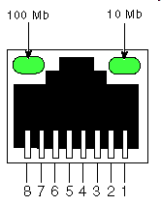
First generation routers
General-purpose computers with several network cards.
Routing software implements the forwarding logic.
  Eg., iptables command configures Linux kernel’s handling of packets
However, memory and bus bandwidth become bottlenecks.
  General-purpose computers are optimized for computing, not I/O
input
port
(e.g.,
Ethernet)
output
port
(e.g.,
Ethernet)
memory
system bus

Slide 7
Modern router architecture
Control plane: run routing algorithms (RIP, OSPF, BGP)
Data plane: forward packets from incoming to outgoing links
forwarding tables computed,
pushed to input ports
routing
processor
routing, management
control plane (software)
forwarding data plane (hardware)
high-speed
switching
fabric
router input ports
router output ports

Slide 8
Input ports process packets in parallel
lookup,
forwarding
queueing
line
termination
link
layer
protocol
(receive)
switch
fabric
physical layer:
bit-level reception
decentralized processing:
each input port has its own processor and memory
given a packet destination, look up output port using a copy of forwarding table in input port memory
goal: complete input port processing at “line speed”
queue packets if they arrive faster than forwarding rate into switch fabric
data link layer:
e.g., Ethernet

Slide 9
Switching fabric – connects input and output ports
Switching rate – the maximum rate of data transfer from all input ports to all output ports. (A very important spec. for a router/switch.)
  Ideally = # inputs × input line rate • In practice, switching rate is smaller.
Two basic types of switching fabric:
  Bus: simplest design. Can only
  be used by one in/out pair.
  Bus should be much faster than
  individual input line rate.
  Crossbar: advanced design for
  core routers. Allows multiple
  simultaneous flows by opening
  and closing (switching) connections appropriately.
bus
crossbar
inputs
outputs
inputs
outputs

Slide 10
Crossbar switch
Open circle means no connection between horizontal and vertical paths (input & output).
Closed circle connects a vertical and a horizontal path, connecting an input to an output.
Crossbar connections are changed as needed.
Expensive to build, compared to bus:
  For n inputs and outputs,
  requires n² switch points in the crossbar.
inputs
outputs

Slide 11
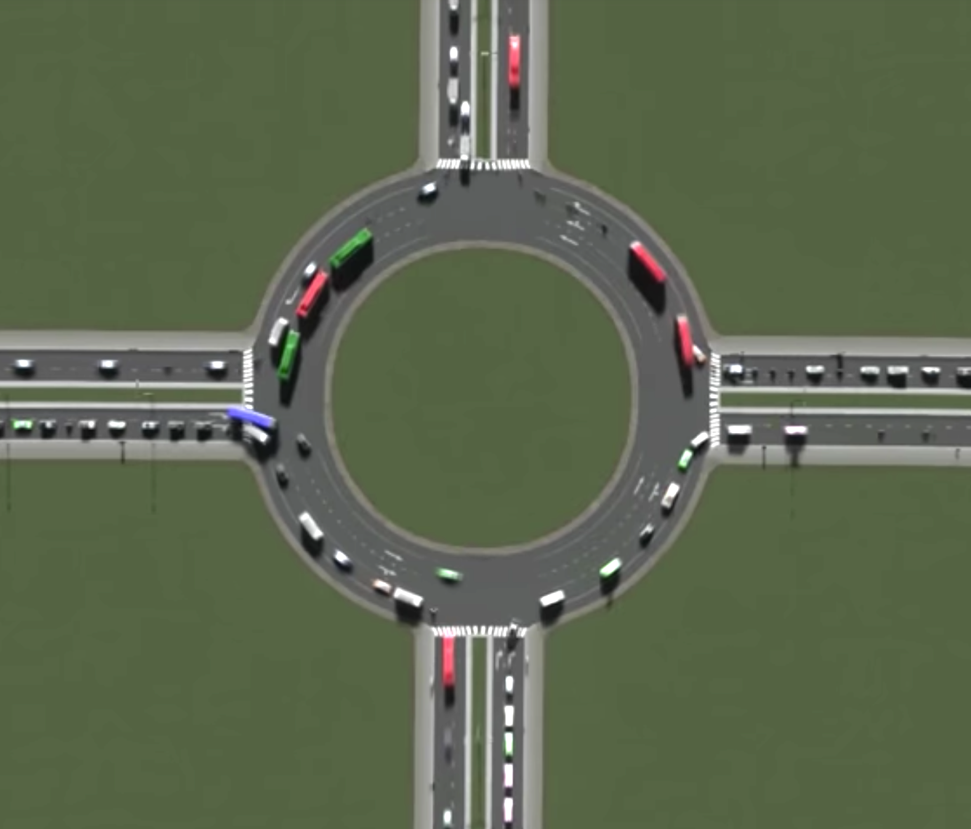
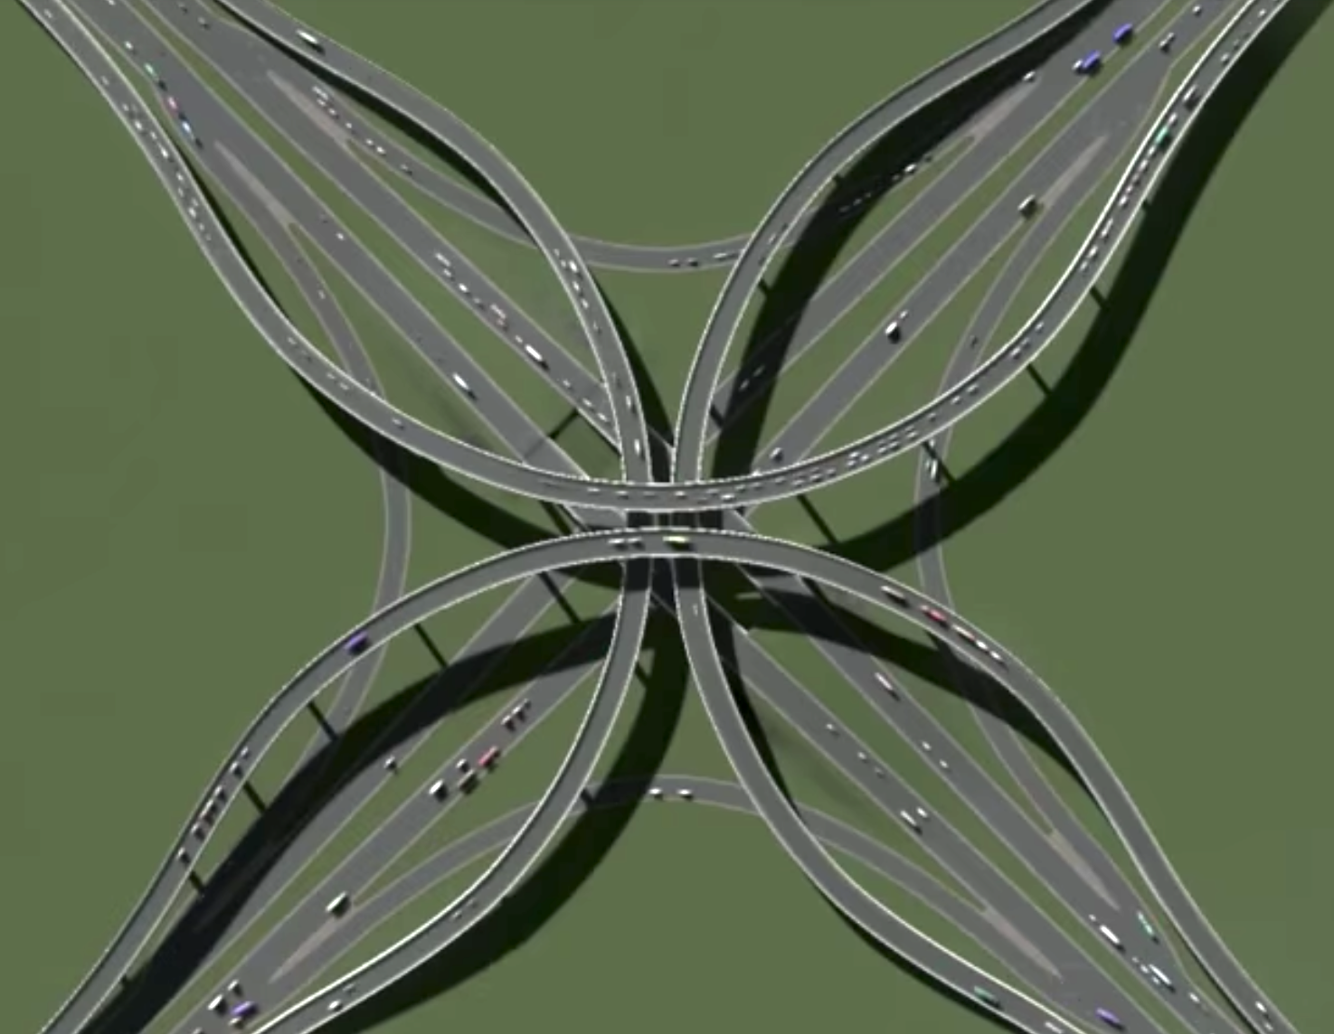
Road analogy for switching fabrics
Bus is like a roundabout
Crossbar is like a stack exchange

Slide 12
Output ports
data link layer:
e.g., Ethernet
physical layer:
bit-level transmission
datagram
buffer
queueing
switch
fabric
link
layer
protocol
(send)
line
termination
Buffering is required because switch fabric may be faster than physical output link, link may be congested.
Queued packet can be scheduled if desired.
  Give higher priority to certain types of packets
  Give higher priority to certain orgins/destination
Net neutrality is the policy debate about whether ISPs can do this.

Slide 13
Queues and packet loss
Packets can be dropped by router if any of the queues are full
  Switching fabric may be overloaded, filling up the input queues
  Output ports may be overloaded, filling up the output queues
Routers silently drop packets when a queue is full.
STOP
and
THINK
If this output line is too slow, what will happen?
high-speed
switching
fabric
router input ports
router output ports

Slide 14
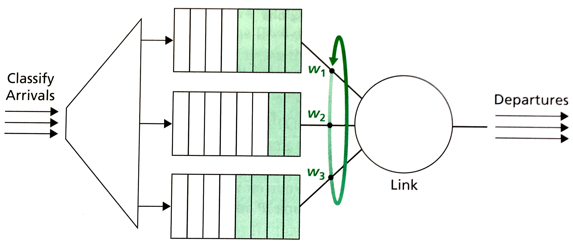
Weighted fair queuing (WFQ)
A discriminative alternative to FIFO packet scheduling policy
  Some traffic gets higher priority. We have multiple queues instead of just one.
Administrator creates rules to classify packets, based on header fields:
  Src./dest. IP address • Port number (service) • TCP vs UDP • QoS
Each class is allocated a certain fraction of link capacity (w_{i}/∑w)
  Spend w_{i} time sending packets from queue i, then move to next queue.

Slide 15
Next Topic:
IP Control Plane
routing algorithm
local forwarding table
dest. address
output link
address-range 1
address-range 2
address-range 3
address-range 4
3
2
2
1
1
How to decide forwarding rules at each router?
(Chapter 5)
3
2

Slide 16
Centralized versus Distributed algorithms
Centralized/Global routing:
  Algorithm has full knowledge of the entire network.
  Makes decisions that affect all routers
  In routing, we call these link state algorithms.
  Used within an organization (autonomous system) (eg., OSPF)
Distributed/Local routing:
  Each router must decide its own routing table using local observations.
  Operates iteratively.
  Routers continually share information with neighbors
  Global information is gradually propagated across the network.
  Used within and between autonomous systems (eg., RIP & BGP, respectively)
Distributed algorithms are more difficult to design correctly.

Slide 17
Graph abstraction of computer networks
A graph is a set of vertexes and edges
  G = (V, E)
Vertexes represents routers:
  V = set of routers = {x, a, b, c, d, y}
Edges represent links:
  E = set of edges = {(x,a), (x,b), (x,c), (a,b), (a,c), (b,c), (b,d), (c,d), (c,y), (d,y)}
Edge labels/weights represent distance or cost to communicate:
  C : E → {0, 1, 2, 3, …} C maps edges to costs
  c(x,a) = 2, c(a,c) = 3, c(x,b) = 1, …
  c(x,y) = ∞ because the two vertices are not connected
For now, cost = delay.
We’ll ignore the limited capacity of links.

Slide 18
Shortest Path problem
Greedy path is disastrous
What edges should I choose to construct a path from x → y with minimal total cost (delay)?
You are given:
  An edge-weighted graph
  A starting vertex
  A destination vertex
Must output:
  The path (a sequence of edges)
  The total cost
Shortest path has cost 1+1+2=4

Slide 19
Shortest path insight
Break down the problem into subproblems
Let d(x,y) represent the cost of the shortest
path between x and y. It must be true that:
  d(x,y) = min{d(x,c) + c(c,y),
  d(x,d) + c(d,y)}
Shortest path to y must pass through a neighbor, either vertex c or d.
The cost of the shortest (x,y) path with c as the final stop is the cost of the shortest (x,c) path plus the edge cost of the final step from c to y.
Just choose the option with minimum total cost.
Cost of path that almost gets there.
Cost of the final step.

Slide 20
Bellman-Ford equation
The equation works for any pair in the graph
Let d(x,y) represent the cost of the shortest
path between x and y. It must be true that:
  d(x,y) = 0 if x=y
  min_{v}{d(x,v) + c(v,y)} if x≠y
In other words,
  Except in the trivial case when x and y refer to the same vertex,
  the shortest path between x and y must pass through some vertex v that is adjacent to y before finally arriving at y.
  The sub-path leading from x to v must be the shortest path from x to v.
  If we know the shortest path distances to all the vertices adjacent to y, then we can easily choose which one of these creates the shortest path to y.

Slide 21
Bellman-Ford recursion
d(x,y) = 0 if x=y
min_{v}{d(x,v) + c(v,y)} if x≠y
When calculating d(x,y), consider every possible v we could pass through.
We know that one of those v’s is the right choice; the path has to pass through some other vertex before arriving at the finish.
Assume we have already computed the minimum cost path to every vertex except y. This assumption leads to a recursive solution.
  Implement the recursive solution efficiently using dynamic programing.
d(x,y) is the shortest path distance from x to y.
c(v,y) is the cost of the edge directly connecting v and y.
  Minimum taken over all neighbors v

Slide 22
Bellman-Ford algorithm
function BellmanFord(list vertices, list edges, vertex source)
// Initialization
for each vertex v in vertices:
dist[v] := INFINITY // Initially, vertices have infinite weight
prev[v] := NULL // and a null predecessor.
dist[source] := 0 // Distance from source to itself is zero
// Relax edges repeatedly.
for i from 1 to size(vertices)-1:
for each edge (u,v):
alt := dist[u] + (u,v).cost()
if alt < dist[v]:
dist[v] := alt
prev[v] := u
// outputs are distance and predecessor arrays
return dist[], prev[]
Invariant:
At round i, distance[j] is the shortest path from source to j having at most i hops.
Runtime complexity:
Θ(|V|·|E|)

Slide 23
Bellman-Ford demo
https://www-m9.ma.tum.de/graph-algorithms/spp-bellman-ford/index_en.html

Slide 24
Dijkstra’s algorithm
function Dijkstra(list vertices, list edges, source):
// Initialization
for each vertex v in Graph:
dist[v] := INFINITY // Unknown distance from source to v.
prev[v] := NULL // Previous node in optimal path from source.
dist[source] := 0 // Distance from source to itself is zero.
Q := vertices.copy() // The list of the “unvisited” vertices.
// “visit” the closest unvisited vertex, u
while Q.size() > 0:
u := vertex in Q with minimum dist[u]
Q.remove(u)
// try using u to make shorter paths
for each neighbor v of u:
alt := dist[u] + (u,v).cost()
if alt < dist[v]:
dist[v] := alt
prev[v] := u
// outputs are distance and predecessor arrays
return dist[], prev[]
Invariant:
distance[j] is shortest path if j was visited, otherwise it’s shortest using visited nodes only.
Runtime complexity:
Θ(|V|²) or Θ(|E|+|V|log|V|)
The faster version uses a priority queue.

Slide 25
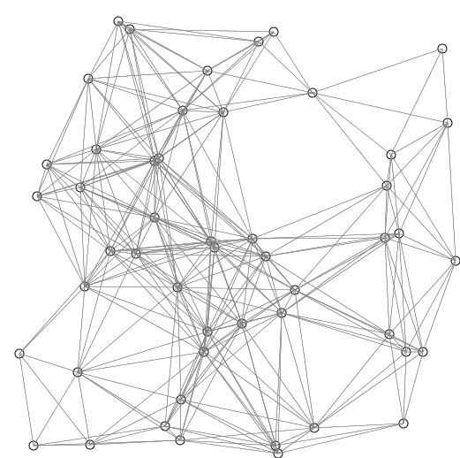

Slide 26
Dijkstra’s algorithm demo
https://www-m9.ma.tum.de/graph-algorithms/spp-dijkstra/index_en.html

Slide 27
Dijkstra’s shortest path example

Slide 28
Bellman-Ford
Dijkstra
vs
Very simple
Slower: Θ(|V|·|E|)
Detects negative cycles
Can be adapted to a distributed implementation in the Distance-Vector algorithm (used by BGP).
Slightly more complicated
Faster: Θ(|E|+|V|log|V|)
Cannot handle negative cycles
Best choice for a centralized implementation.
Book calls it the Link-State (LS) algorithm.
Used by OSPF.

Slide 29
Distance-Vector algorithm
Each vertex/node/router x:
Maintains a distance vector (DV):
  d_{x}(y) = estimate of shortest path from x (myself) to y.
  D_{x} is the distance vector at node x: D_{x} = [d_{x}(y) : ∀y ] = [d_{x}(0), d_{x}(1), …]
Knows the cost to reach each neighbor v:
  cost(x,v) = the cost of the link between x and y (infinity if no link exists).
Initially sends its DV to all neighbors
Keeps a copy of the latest DV received from all neighbors.
After receiving a DV from a neighbor, recalculate its own DV
  If its own DV has changed, send the updated DV to neighbors.
Eventually, the algorithm converges and each node knows the shortest path to every other node.
iterate

Slide 30
DV is recalculated using Bellman-Ford equation
Initially, d_{x}(y) = cost(x,y), or infinity if no direct (x,y) link exists.
After receiving an updated D_{u} from neighbor u, or if we observe a change in local link costs, update D_{x}:
  d_{x}(y) ← min_{v}{cost(x,v) + d_{v}(y)} for each node y ∊ N
Each node:
Waits for changes to local link costs or updated DV from a neighbor.
Recalculates estimates (DV).
Notifies neighbors if DV has changed.
Note: the book’s description of the DV algorithm is over-complicated. Please just learn DV from my two slides.

Slide 31
DV algorithm example

Slide 32
Recap
Weighted Fair Queueing can prioritize classes of packets in router queue.
Routing algorithms determine each router’s forwarding table. It’s a a shortest path problem on the weighted graph graph representing the network.
  May be centralized/global or distributed.
Dijkstra’s Algorithm is a fast centralized (LS) algorithm for shortest path.
  Used by Open Shortest Path First (OSPF) protocol within an AS.
  Routers initially flood/broadcast local link information to entire network.
  Each router then solves shortest path from itself to all other routers.
Distance Vector (DV) algorithm is a distributed shortest path algorithm
  Used by the Border Gateway Protocol (BGP) to route between AS’s.
  Initially, routers only knows distance to neighbors – broadcast to neighbors.
  When receive a neighbor’s DV, update own DV, & broadcast if DV changed.

