Slide 1
CS-340 Introduction to Computer Networking
Lecture 9: NAT and IPv6
Steve Tarzia
Many diagrams & slides are adapted from those by J.F Kurose and K.W. Ross
Many diagrams & slides are adapted from those by J.F Kurose and K.W. Ross

Slide 2
Last Lecture: IPv4 Addressing
IP routing gets packets to their destination on the net.
Each router has a forwarding table mapping addresses → outbound links.
  Uses longest prefix matching.
IPv4 fragments packets larger than MTU. Are reassembled at the destination.
IPv4 header is 20 bytes (UDP header is 8 bytes or TCP header is 20 bytes)
IP subnets define ranges of address that can communicate directly
  CIDR notation (123.100.16.0/28) specifies a range of addresses
    Used both for specifying subnets and for routing rules.
    /28 or 255.255.255.240 is called a subnet mask.
Host’s IP configuration is: address, subnet mask, gateway, and DNS server
  Gateway is IP address of the router who will route packets outside the subnet
  DHCP allows newly-arriving machines to request an IP configuration.

Slide 3
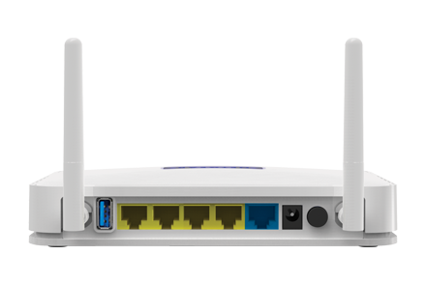
Network Address Translation (NAT)
IPv4 addresses are in short supply (4 billion). ISP often will give you just one address, so how to connect multiple devices?
Key insight: OS already shares one IP address with multiple independent processes running on one machine, using port numbers.
Make the entire local network look like one big host:
Public ports map to ⟨local_IP_address, port⟩ pairs on the local network.
          NAT router must track this mapping and translate IP addresses on packets leaving/entering local network.
STOP
and
THINK

Slide 4
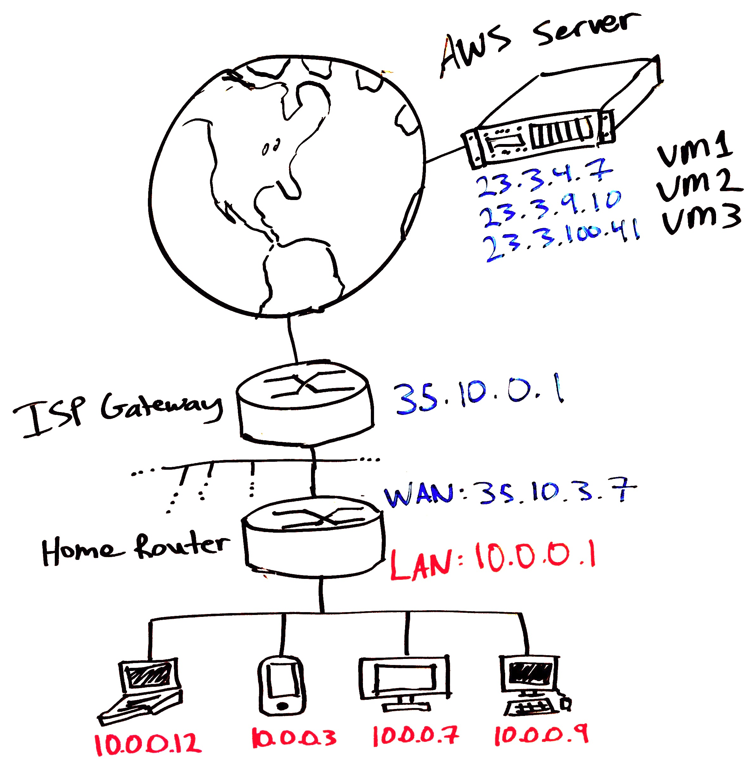
Public Internet
Private LAN
Looks like one big 35.10.3.7 to outside world

Slide 5


Public/Private address translation:
Translate private to public
Source address is private
Dest. address is public
Source address is public
Dest. address is public
Source address is public
Dest. address is public
Translate
public to private
Source address is public
Dest. address is private

Slide 6
Private versus public IP addresses
Public IP addresses specify locations on the Internet.
  Internet is sometime called the wide-area network (WAN)
  Eg: front-end servers, university campus, home router WAN
  Only one machine has the public IP address 54.245.121.172
Private IP addresses are meaningful only on a local network.
  Called local-area network (LAN)
  Eg.: home, office, back-end server
  Usually behind a NAT, to give hosts access to the Internet.
  Always within: 10.0.0.0/8, 172.16.0.0/12, or 192.168.0.0/16
  Eg., millions of machines have the private IP address 192.168.0.100

Slide 7
NAT high-level view
Local 10.0.0.0/24 subnet is not part of the public Internet.
Outgoing packets can reach destination easily
Incoming packets must somehow be routed to the correct local machine. How?
rest of
Internet
local network
(e.g., home network)
10.0.0/24
10.0.0.1
10.0.0.4
10.0.0.2
138.76.29.7
10.0.0.3
all datagrams leaving local
network have same single source NAT IP address: 138.76.29.7, different source port numbers for different local machines
datagrams with source or
destination in this network
have a 10.0.0.0/24 address for
source, destination (as usual)

Slide 8
NAT implementation
NAT router takes these actions:
Outgoing datagrams: replace (source IP address, port #) of every outgoing datagram to (NAT IP address, new port #).
  Remote host will respond using (public NAT IP address, new port #) as destination address.
  Remember (in NAT translation table) every (source IP address, port#) to (NAT IP address, new port #) translation pair.
Incoming datagrams: replace (NAT IP address, new port #) in dest fields of every incoming datagram with corresponding (source IP address, port #) stored in NAT table.

Slide 9
NAT example
2a: NAT router randomly chooses the unused public port 5001 for the connection, and stores the translation.
NAT translation table
WAN side addr LAN side addr
2b: NAT router
changes datagram
source addr from
10.0.0.1, 3345 to
138.76.29.7, 5001
1: host 10.0.0.1
sends datagram to
128.119.40.186, 80
138.76.29.7, 5001 10.0.0.1, 3345
…… ……
S: 10.0.0.1, 3345
D: 128.119.40.186, 80
10.0.0.1
1
2
S: 138.76.29.7, 5001
D: 128.119.40.186, 80
10.0.0.4
10.0.0.2
138.76.29.7
S: 128.119.40.186, 80
D: 10.0.0.1, 3345
4
S: 128.119.40.186, 80
D: 138.76.29.7, 5001
3
4: NAT router
changes datagram
dest addr from
138.76.29.7, 5001 to 10.0.0.1, 3345
10.0.0.3
3: reply arrives
dest. address:
138.76.29.7, 5001

Slide 10
NAT difficulties
Local clients can only be reached by public IPs that they recently contacted. In other words, cannot easily run services behind a NAT.
  Special NAT-router configuration called port forwarding determines where to send unsolicited packets.
Some protocols (eg., SIP) advertise IP address and port in payload of packet, which will not be translated by NAT.
Temporarily-inactive TCP connections may need to send keepalive packets that the NAT router does not “forget” the port mapping.
  NAT’s port mappings timeout eventually to make room for later connections.

Slide 11

Peer-to-peer communication behind a NAT
Neither of the two peers can be reached directly.
  NAT only works if private address contacts a public address.
  Private IP address cannot listen for new connections from Internet.
  NAT will discard any inbound packets not associated with an already-established connection.
10.0.0.5
10.0.0.3
Listening for a call…
But I’m not reachable!
Starts a call
The Internet
(public addresses)
Dropped!
STOP
and
THINK
138.76.29.7
NAT
router
NAT
router
59.6.3.90
Ideas to fix this problem?

Slide 12

Peer-to-peer NAT solution:
Both parties must communicate through a relay server.
  Relay does no processing, so it can handle lots of traffic
  But, it’s no longer a truly P2P, self-scaling system.
    Need to add more relays as service grows.
STOP
and
THINK
Must both clients connect to the same relay?
10.0.0.3
2. connection to a relay initiated by another NATed host.
10.0.0.5
1. connection to a relay initiated
by NATed host.
4. conversation occurs through relay.
NAT
router
59.6.3.90
138.76.29.7
NAT
router
3. both NATs are now willing to accept packets from their relay and forward them to the private hosts.

Slide 13
Other benefits to NAT (besides sharing scarce addresses)
Security: local devices are not publicly reachable by “strangers.”
  For an outside IP address to contact a local device, the local device must first send a packet to that outside address, causing the NAT to create a new public port mapping for the connection.
Configuration isolation: ISP and public IP address can change without reconfiguring local devices.
Load balancing*: NAT can be used to make several servers work in parallel to handle work destined for one IP address.
  However, LB NAT works slightly differently that home NAT:
  Create entries in the translation table in response to new inbound requests from the public.

Slide 14
NAT Load Balancer (for scaling and fault tolerance)
A type of NAT device that proxies requests to multiple equivalent servers.
  Load balancer maintains IP address and port mappings, like a traditional NAT.
Makes multiple servers (with private IP addresses) appear like one big machine with one IP address.
Allows a single IP address to handle lots of requests: port mapping and relaying is easy, whereas responding to requests may require lots of computation or I/O.
Load balancer may monitor health and load of servers to inform its choice of server.
Called a "layer 4" (TCP/UDP) load balancer.
Client 1
4.4.4.4:1230
Client 2
5.5.5.5:3021
Client 3
6.6.6.6:9012
2.2.2.2:80
Load Balancer
10.0.0.1:1002 10.0.0.1:2302 10.0.0.1:5021
10.0.0.2:80
Server A
10.0.0.3:80
Server B
Notes:
Actually, this shows one of two different variations of NAT-based load balancing. In the design shown here, the load balancer changes the source address on packets it receives from the public internet (eg., 4.4.4.4 to 10.0.0.1). Actually, that address change is not strictly necessary. A simpler design could leave the source address and port unchanged. For example, a packet comes in with <src=4.4.4.4:1230, dst= 2.2.2.2:80> and that gets translated into <src:4.4.4.4:1230, dst=10.0.0.2:80>. (By contrast, the pictured design shows a translation into <src=10.0.0.1:1002, dst=10.0.0.2:80>)

Slide 15
Multiple kinds of load balancers
NAT LB forwards individual packets and just maps ports.
HTTP Reverse Proxy relays full HTTP requests.
DNS LB directs users to different IP addresses.
IP Anycast assigns one IP address to multiple machines around the world, and the closest one accepts the traffic (covered in next chapter).
Take CS-310 Scalable Software Architectures for more details on LBs.
Content Delivery Networks (CDNs) combine these two.

Slide 16
Middleboxes
Middleboxes are the category of network devices that transform, filter, or inspect packets but are not routers (not just forwarding). Eg.:
Network Address Translators (NATs)
Load Balancers
Firewalls drop traffic using simple rules:
  Certain ports or source addresses may be blocked. Eg., censor a domain.
Deep Packet Inspection firewalls looks for app-specific behavior.
  For example, access Wordpress admin page with HTTP GET /wp-admin
  Censor certain search terms on a permitted website.
Intrusion Detection Systems (like firewalls, but more long-term)
  Gather traffic information for offline analysis to detect multi-step attacks.

Slide 17
Intermission

Slide 18
IPv6
A much better solution than NAT for the IPv4 address shortage.
Uses 128-bit addresses instead of 32-bit.
  Expressed in hex:
  a39b:239e:ffff:29a2:0021:20f1:aaa2:2112
Invented in early 1990s when IPv4 address shortage was foreseen.
27 years later, IPv6 is slowly being adopted.
But IPv4 is still the standard, with NAT being used extensively.

Slide 19
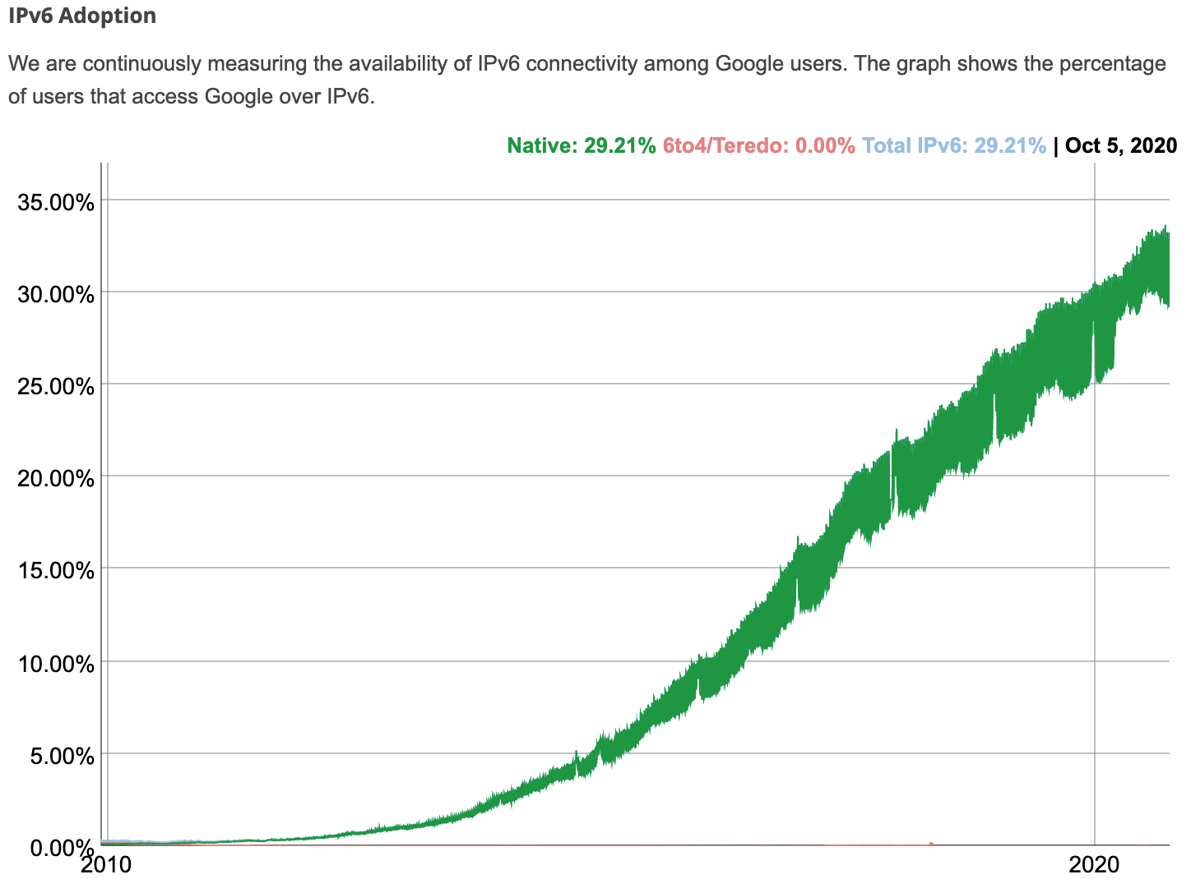
Adoption of IPv6: https://www.google.com/intl/en/ipv6/statistics.html

Slide 20
IPv6 address notation rules
Groups of zeros can be replaced with “::”
  Can only use “::” once
Leading zeros within each 16-bit group can be omitted.
0000:0000:0000:0000:0000:0000:0000:0001 → ::1 (localhost)
2345:1001:0023:1003:0000:0000:0000:0000 → 2345:1001:23:1003::
aecb:0222:0000:0000:0000:0000:0000:0010 → aecb:222::10

Slide 21
IPv4 datagram
32 bits
IP protocol version
head.
len.
type of
service
ver
length
3 fields for fragment-ation
QoS/ECN
fragment
offset
16-bit identifier
flags
time to
live
upper
layer
header
checksum
max number
remaining hops
(decremented at
each router)
32 bit source IP address
32 bit destination IP address
TCP/UDP/ICMP
options (if any)
e.g. timestamp,
record route
taken, specify
list of routers
to visit.
how much overhead?
20 bytes of IPv4
20 bytes of TCP
= 40 bytes + app layer overhead
data
(variable length,
typically a TCP
or UDP segment)

Slide 22
IPv6 datagram format
Priority: like “type of service” in IPv4.
Flow label: ambiguous
Next header: TCP, UDP
Hop limit = TTL
version
priority
flow label
payload length
next header
hop limit
source address
(128 bits)
destination address
(128 bits)
data
(variable length, typically a TCP or UDP segment)
how much overhead?
40 bytes of IPv6
20 bytes of TCP
= 60 bytes + app layer overhead
32 bits

Slide 23
Other improvements in IPv6
Checksum field was dropped
  Checksum already exists above in TCP/UDP & below in Ethernet.
  TTL is decremented at each router, so each router must recalculate checksum!
Fragmentation support was dropped
  Routers should be simple and fast, let endpoints deal w/fragmentation (TCP)
✘But extra 20 bytes header overhead of IPv6 is a tough pill to swallow.
No real incentive to adopt IPv6 if you already have enough addresses.

Slide 24
IPv4 and IPv6 interoperability
Internet is too large, important, and disorganized to force everyone to upgrade simultaneously to IPv6.
Current Internet is a mix of IPv4 and IPv6 routers.
Tunneling puts one protocol inside the payload of another:
Either IPv4 inside IPv6 or IPv6 inside IPv4
IPv4 header fields
IPv6 header fields
IPv4 source, dest addr
IPv6 source dest addr
UDP/TCP payload
IPv6 datagram
(IPv4 payload)
IPv4 datagram

Slide 25
Tunneling illustration
Green routers are tunnel endpoints
IPv4 Internet
Does not have an IPv6 address. Can send/recv only IPv4 packets
Has both an IPv4 and IPv6 address
IPv6 Subregion
IPv6 Subregion
Tunnel provides access to the entire IPv6 Internet.
IPv6-only region
Has no IPv4 address, so cannot communicate with IPv4-only hosts.

Slide 26
Tunneling example
A
B
IPv4 tunnel
connecting IPv6 routers
E
F
logical view:
IPv6
IPv6
IPv6
IPv6
A
B
C
D
E
F
physical view:
IPv6
IPv6
IPv4
IPv4
IPv6
IPv6
flow: X
src: A
dest: F
data
src:B
dest: E
src:B
dest: E
flow: X
src: A
dest: F
data
Tunneled packet is addressed between routers.
Receiving router unpacks the IPv6 packet.
Adds overhead:
  extra header bits
  extra processing
flow: X
src: A
dest: F
data
flow: X
src: A
dest: F
data
A-to-B:
IPv6
E-to-F:
IPv6
B-to-C:
IPv6 inside
IPv4
B-to-C:
IPv6 inside
IPv4

Slide 27
How do IPv6 hosts talk to IPv4 hosts?
IPv6 is not backward compatible with IPv4.
The “true IPv6” Internet is physically a bunch of “islands”
Tunneling joins those islands with IPv4
Dual stack hosts are configured for both IPv4 and IPv6.
  These hosts have two IP addresses.
  DHCP request gives IPv4 address, and DHCPv6 request gives IPv6 address.
  IPv6 access network (ISP) must be a dual-stack network to give customers full access to the Internet.
DNS AAAA (quad A) records list IPv6 addresses for hosts.
  When connecting to www.google.com, a dual-stack client will make both DNS A and AAAA requests, to find both an IPv4 and IPv6 addresses (if any).
  If there is no AAAA record, then fall back to IPv4.

Slide 28
RFC 6555: Happy Eyeballs Dual Stack
Tunneling can make IPv6 slower than IPv4, so some clients will simultaneously try both IPv4 and IPv6 and use whichever connection completes the TCP handshake first:
  DNS Server Client Server
  | | |
  1. |<--www.example.com A?-----| |
  2. |<--www.example.com AAAA?--| |
  3. |---192.0.2.1------------->| |
  4. |---2001:db8::1----------->| |
  5. | | |
  6. | |==TCP SYN, IPv6=======>|
  7. | |--TCP SYN, IPv4------->|
  8. | |<=TCP SYN+ACK, IPv6====|
  9. | |<-TCP SYN+ACK, IPv4----|
  10. | |==TCP ACK, IPv6=======>|
  11. | |--TCP ACK, IPv4------->|
  12. | |--TCP RST, IPv4------->|
Packet 12 cancels the IPv4 connection because IPv6 ACK’ed first.

Slide 29
IPv6/IPv4 interoperability summary
IPv6 → IPv6: normal operation
IPv4 → IPv4: normal operation
IPv6 → (through IPv4 network) → IPv6: tunneling
IPv4 → (through IPv6 network) → IPv4: tunneling
IPv4 → IPv6: Not directly possible! Use dual-stack config with IPv6
IPv6 → IPv4: Not directly possible! Use dual-stack config with IPv4
Further reference: https://pdfs.semanticscholar.org/34bb/2f946f83b656c6989d42fe043bf5f259b514.pdf

Slide 30
How to find an IPv6 tunnel endpoint?
Large organizations operating multiple IPv6 islands will set up their own tunnels.
Organizations may also “peer” with each other by configuring tunnels.
Smaller organization may use a tunnel broker to access the IPv6 Internet:
  Hurricane Electric (a Tier 1 ISP) operates a free tunnel broker service: https://tunnelbroker.net/
  This lets you start using IPv6 at home even if your ISP is not IPv6 enabled!
  But if your IPv4 address changes, then the tunnel must be reconfigured.

Slide 31
Recap
Private networks are isolated from the public Internet, but usually connected through a Network Address Translator (NAT).
  Port mapping makes multiple machines on the private subnet look like multiple sockets (processes) on one big machine.
  NAT requires no awareness or cooperation from hosts on either side.
  NAT is also one way to implement a load balancer.
  Besides NATs, middleboxes include firewalls and other security appliances.
IPv6 uses 128-bit addresses for practically unlimited public addresses.
  IPv6 adds 20 bytes of header overhead.
  Not directly compatible with IPv4. Adopted by ~30% of end hosts.
  Dual-stack hosts have both IPv4 and IPv6 addresses to reach entire Internet.
  Interoperates with IPv4 via tunneling: send IPv6 packet inside IPv4 packet.

