Slide 1
CS-340 Introduction to Computer Networking
Lecture 8: IPv4 Addressing
Steve Tarzia
Many diagrams & slides are adapted from those by J.F Kurose and K.W. Ross
Many diagrams & slides are adapted from those by J.F Kurose and K.W. Ross

Slide 2
Last Lecture: TCP Congestion Control
Congestion control is implemented with a dynamic congestion window, controlled by heuristics. Reno congestion control operate in phases:
  Slow start – exponential growth to find approximate network capacity.
  Congestion avoidance – linear growth, slowly trying to increase throughput.
  Fast recovery – If one packet is lost, then cut window in half.
Additive Increase, Multiplicative Decrease ensures fair sharing.
CUBIC and BBR are newer alternatives that work better in fast networks, particularly long fat pipes. (Read this for more info.)
TCP behavior can be controlled with socket options:
  Nagle’s algorithm merges small packets to reduce header overhead.
  TCP keepalive message can be periodically sent.

Slide 3
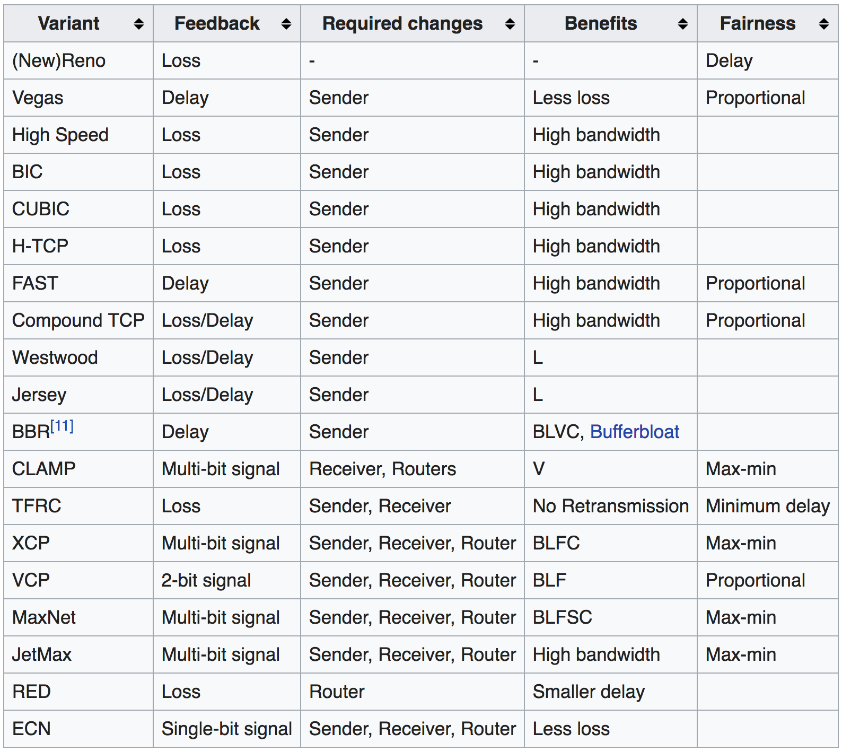
Congestion Control
We covered TCP Reno congestion control in detail.
Many alternative algorithms have been proposed and implemented.
Most real TCP implementations are similar to Reno, but not identical.

Slide 4
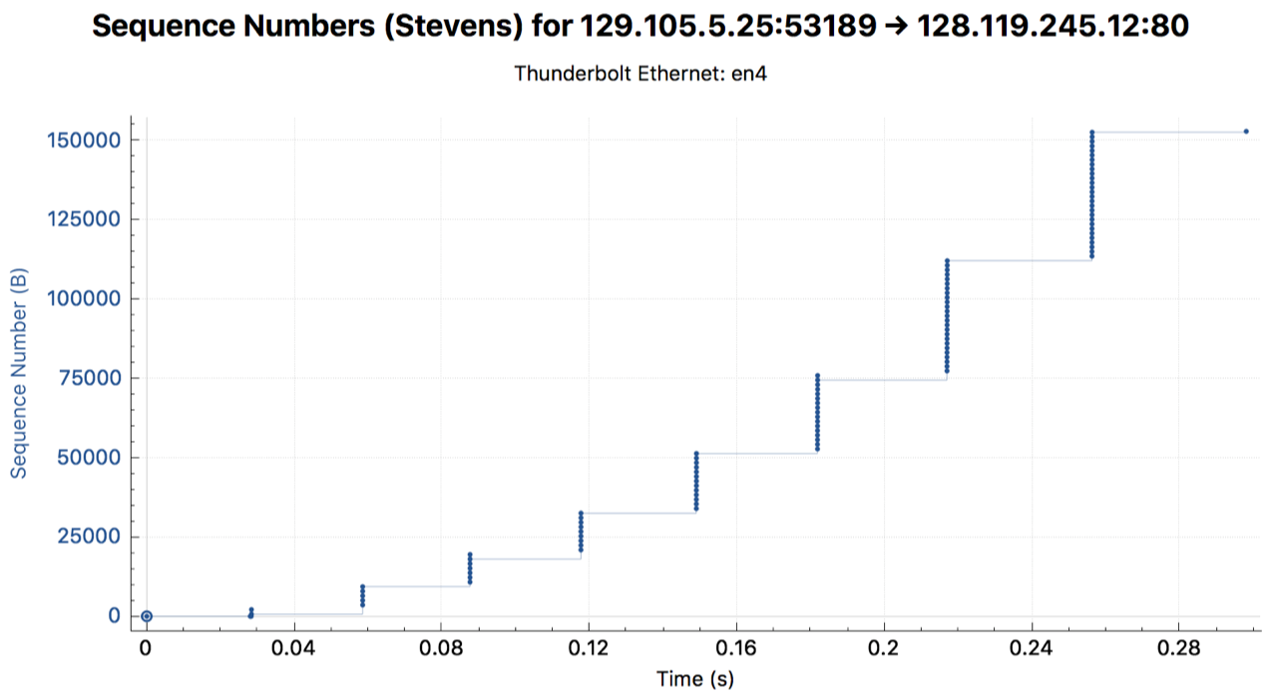
TCP in practice: HTTP POST a small file on Ethernet
STOP
and
THINK

Slide 5
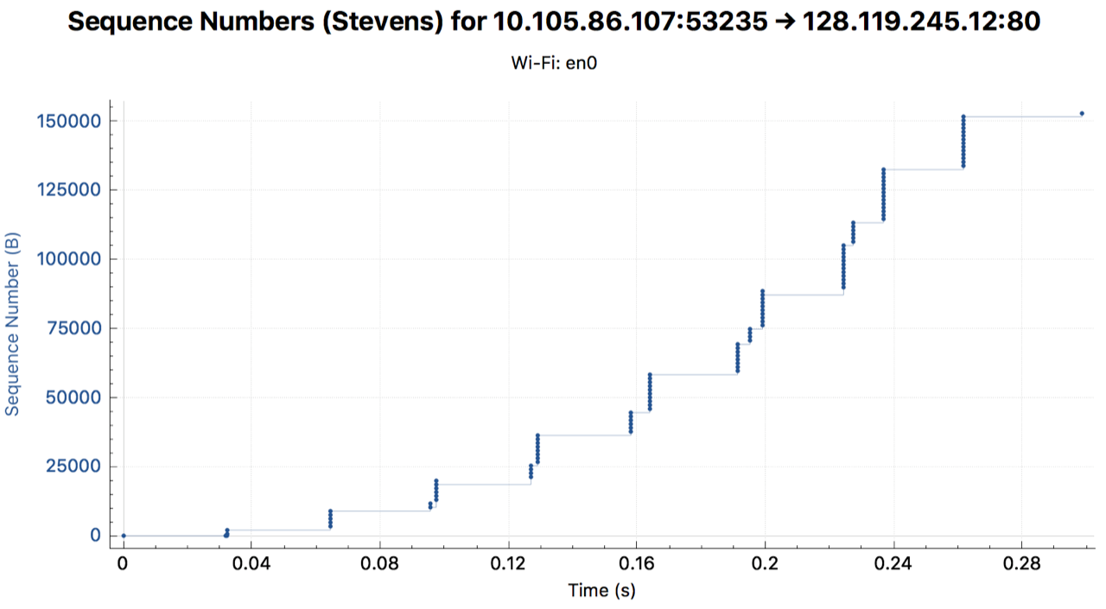
TCP in practice: HTTP POST a small file on WiFi
STOP
and
THINK
Notes:
Carrier sensing is probably causing the short delays

Slide 6
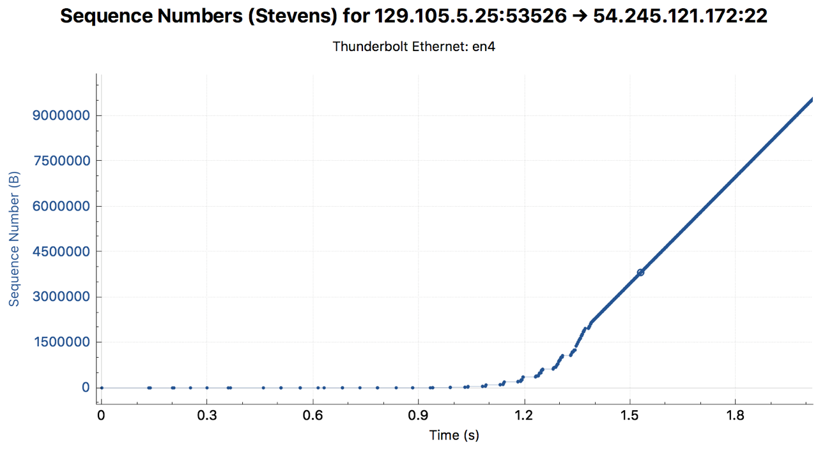
TCP in practice: SCP a large file to Seattle
STOP
and
THINK
Notes:
Initially the application exchanges a few messages to set up the transfer. Speed seems to be limited by 100mbit/sec ethernet connection at client.

Slide 7
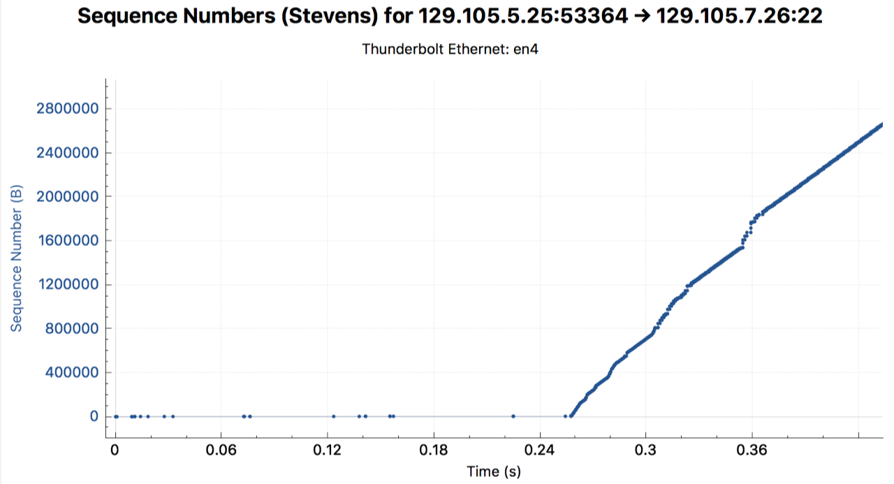
TCP in practice: SCP a large file on campus
STOP
and
THINK
Notes:
Skipped slow start! Maybe the TCP congestion control implementation is doing something different because the destination is on the same subnet?

Slide 8










Next topic:
IP/Forwarding
a.k.a “The Data Plane” of the Network Layer.
Covered in Chapter 4 of Kurose & Ross.

Slide 9
Each layer solves a particular set of problems
Ethernet Packet
MAC addresses, CRC, etc.
Ethernet payload
Link layer: shares a physical channel among several transmitters/receivers
Network layer: routes from source to destination, along many hops.
Transport layer:
  Multiplexing (>1 connection / machine)
  Ordering, • Acknowledgement, • Pacing
HTTP layer:
  Resource urls, • Response codes,
  Caching, • Content-types, • Compression
IP Packet
IP addresses, TTL, etc.
IP payload
TCP Packet
Port #, sequence #, ack #, etc.
TCP payload
HTTP Response
status code, content-type, etc.
<html><body><h1>My great page</h1><p>…

Slide 10
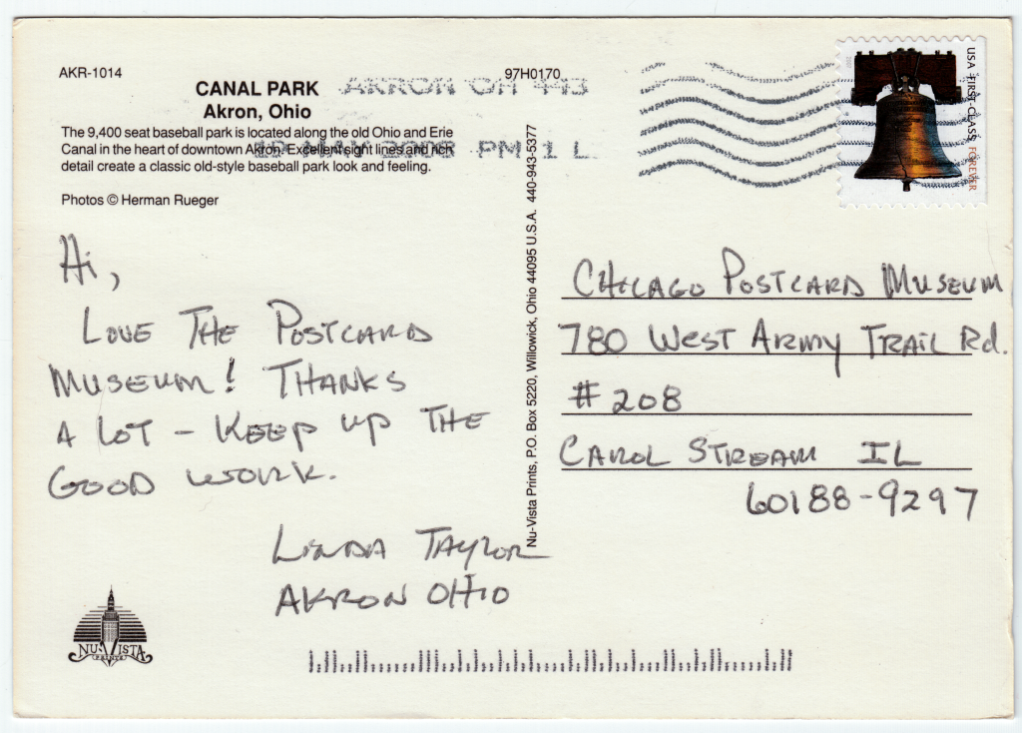
Internet Protocol (IP) delivers packets (datagrams)
Each datagram has receiver and sender IP addresses.
Maximum Transmission Unit (MTU) limits datagram size.
Best effort delivery (may drop packets)
But how do packets reach their intended destination?

Slide 11
Routing
Routing is the process of guiding packets to their destination.
  Done by routers
  in the network core.
Operates in two parts:
  Control plane monitors traffic over the long-term and coordinates with other routers to decide forwarding rules. (Chapter 5)
  Data plane implements the forwarding rules for each arriving packet. (Chapter 4)

Slide 12

Packet Forwarding
This router only controls its own behavior. It sees packet arrive and forwards them on one of its 4 links
application
transport
network
data link
physical
application
transport
network
data link
physical
Each router in network core is ignorant of end-to-end behavior.
  Does not establish connections or reserve capacity (unlike circuit-switching)
Just forwards packets in its neighborhood – an elegant design

Slide 13
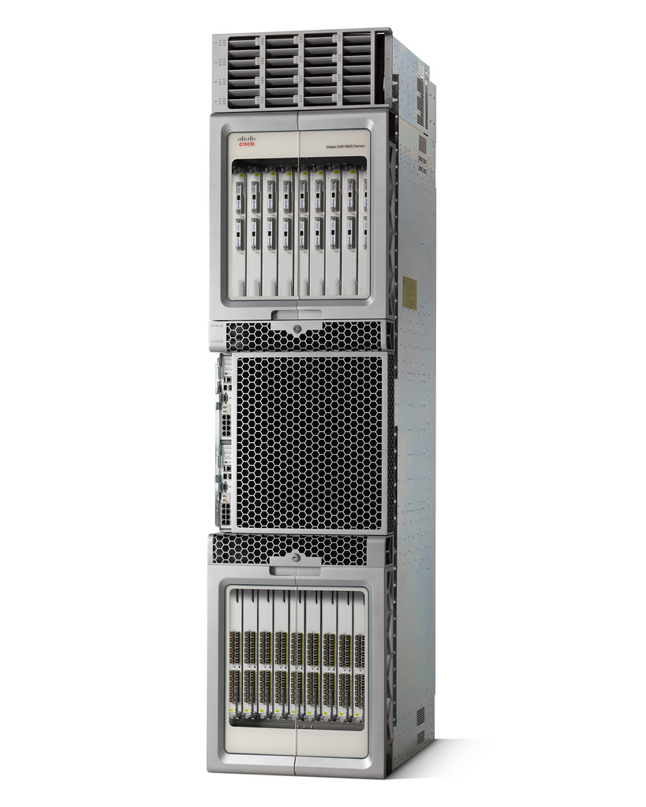
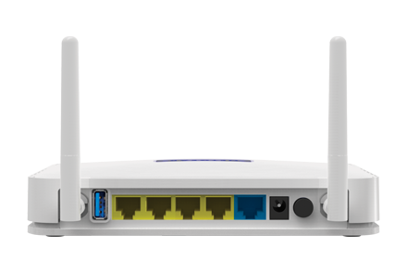
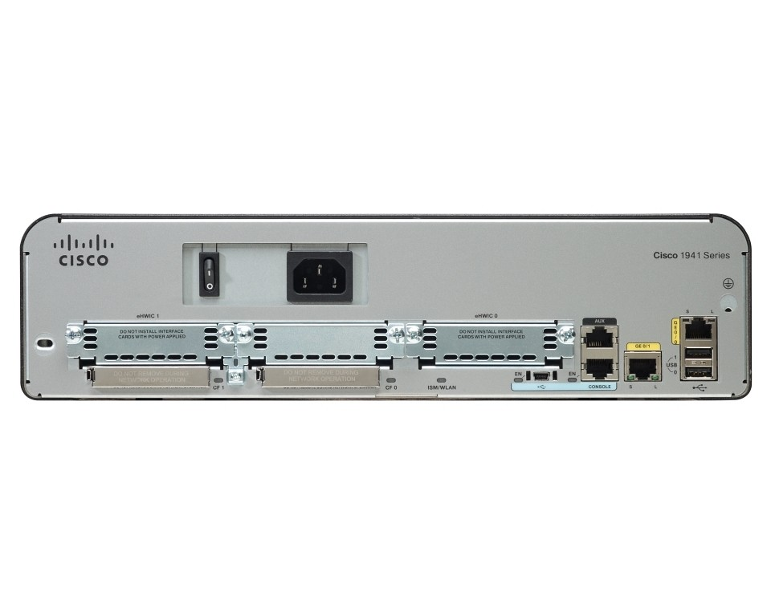
What is a router?
A device with multiple network connections that is dedicated to forwarding packets
(and deciding forwarding rules).
Core routers can handle up to 160 TBps
An edge router has just one connection to the Internet
Routers usually are expandable to connect different types of physical media/cables (cat5, fiber, etc.)

Slide 14
IPv4 addressing
223.1.1.1
223.1.2.1
Interface is a connection between host/router and a link.
Every interface has an IP address (32 bits long in IP version 4)
Routers usually have multiple interfaces (for multiple links)
Hosts usually have one or two interfaces (WiFi + wired).
Dotted quad decimal notation
is used for IPv4 addresss →
223.1.1.2
223.1.1.4
223.1.2.9
223.1.1.3
223.1.3.27
223.1.2.2
223.1.1.4
223.1.3.3
223.1.3.2
223.1.3.1
223.1.1.1 = 11011111 00000001 00000001 00000001
223
1
1
1

Slide 15

Interface connections
223.1.1.1
223.1.2.1
We’ll cover this later when discussing Link and Physical layers.
For now, assume that multiple interfaces can somehow be connected.
  cables connect two interfaces
  switches connect multiple
  wired ethernet interfaces
  base stations connect multiple
  wireless interfaces.
223.1.1.2
223.1.1.4
223.1.2.9
223.1.1.3
223.1.3.27
223.1.2.2
223.1.1.4
223.1.3.3
223.1.3.2
223.1.3.1
Operate below IP layer
Notes:
Here we have to do some kind of preview of MAC addresses, otherwise the concept of subnets does not make sense.

Slide 16
Preview of MAC addresses
Previously, we assumed that links were point-to-point, but…
Links are often shared channels.
  Radio is an obvious example:
  When you broadcast, anyone nearby can hear.
  Ethernet also uses shared channels called "subnets":
MAC addresses are factory-coded addresses that identify the different interfaces on a shared communication channel.
More details are coming later in Chapter 6 on the Link Layer.
An ethernet subnet with four interconnected hosts/interfaces:
192.168.0.11
1A-2F-BB-76-09-AD
192.168.0.10
58-23-D7-FA-20-B1
switch
192.168.0.1
71-65-F7-2B-08-53
58-23-D7-FA-20-B0
0C-C4-11-6F-E3-98
192.168.0.12
192.168.0.12

Slide 17
IP subnets
223.1.1.1
223.1.2.1
Subnets are chunks of IP addresses in that can communicate directly, without traveling through a router.
  Three subnets are shown →
  Routers send packets between subnets.
Subnet mask indicates bit position where subnet is split:
  223.1.1.3/24
  /24 means that the high 24 bits identify the subnet, and remaining 8 low bits identify the host.
  Subnet can also be expressed as a bitmask:
  255.255.255.0 (equivalent to /24)
223.1.1.2
223.1.1.4
223.1.2.9
223.1.1.3
223.1.3.27
223.1.2.2
223.1.1.4
223.1.3.3
223.1.3.2
223.1.3.1
One machine on two different subnets

Slide 18
What are subnets used for?
Informally, host must decide where to “send” the packet:
  if destination IP is in the same subnet, packet can be sent directly to the receiver.
  Otherwise, must give the packet to the the gateway router for relay.
A solid answer requires knowledge of Link Layer, Chapter 6.
  Specifically, we are choosing to address the packet with either the MAC address of the gateway or the final destination.
223.1.1.1
223.1.2.1
223.1.1.2
223.1.1.4
223.1.2.9
223.1.1.3
223.1.3.27
223.1.2.2
223.1.1.4
223.1.3.3
223.1.3.2
223.1.3.1

Slide 19
How many subnets?
223.1.1.2
223.1.1.1
223.1.1.4
Count the groups of interfaces that can communicate without passing through a router.
There are six subnets
223.1.1.3
STOP
and
THINK
223.1.9.2
223.1.7.0
223.1.9.1
223.1.7.1
223.1.8.1
223.1.8.0
223.1.2.6
223.1.3.27
223.1.2.1
223.1.2.2
223.1.3.1
223.1.3.2

Slide 20
IPv4 addressing
ICANN distributes chunks of IP addresses
Early scheme: class A, B, C subnets (/8, /16, /24-bit subnets)
  However, this only allowed block of 256, 65.5k, 17M addresses. Very wasteful!
Nowadays: Classless InterDomain Routing (CIDR) allows blocks to be distributed with any power of 2 subnet size (2^{x})
subnet part
host part
11001000 00010111 00010000 00000000
200.23.16.0/23

Slide 21
Forwarding rules
Stored in each router in its local forwarding table
Rules decide which link a packet should be sent out on, depending on the packet's destination IP address.
Billions of IP addresses are possible, so rules apply to ranges of addresses.
routing algorithm
local forwarding table
dest. address
output link
address-range 1
address-range 2
address-range 3
address-range 4
3
2
2
1
IP destination address in
arriving packet’s header
1
3
2

Slide 22
Forwarding tables in IP use longest prefix matching
IP address ranges are expressed in an unusual way – by prefix.
  This can only express ranges of size 2^{n} and whose starting address is a multiple of 2^{n} (it must have n zeros in the least-significant bits).
Router looks for a rule that matches the high bits of the address.
  IPv4 addresses are 32 bits (up to 4 billion possible addresses)
If more than one rule matches, choose the most specific one.
In other words, choose the rule with longest prefix.
STOP
and
THINK
How is the last address in the range computed?
Forwarding Table
Range Meaning
Destination Address Range | Link
11001000 00010111 00010*** ******** | 1
11001000 00010111 00011000 ******** | 3
11001000 00010111 00011*** ******** | 2
******** ******** ******** ******** | 3
First address | Last address
200.23.16.0 | 200.23.23.255
200.23.24.0 | 200.23.24.255
200.23.24.0 | 200.23.31.255
0.0.0.0 | 255.255.255.255
CIDR notation
200.23.16.0/21
200.23.24.0/24
200.23.24.0/21
0.0.0.0/0

Slide 23
IPv4 packet (datagram)
32 bits
IP protocol version
head.
len.
type of
service
ver
length
3 fields for fragment-ation
QoS/ECN
fragment
offset
16-bit identifier
flags
time to
live
upper
layer
header
checksum
max number
remaining hops
(decremented at
each router)
32 bit source IP address
32 bit destination IP address
TCP/UDP/ICMP
options (if any)
e.g. timestamp,
record route
taken, specify
list of routers
to visit.
how much overhead?
20 bytes of TCP
20 bytes of IP
= 40 bytes + app layer overhead
data
(variable length,
typically a TCP
or UDP segment)

Slide 24
IPv4 fragmentation
Why did this router decide to fragment the packet?
STOP
and
THINK
Links in network may have different maximum transmission unit (MTU)
  Usually MTU=1500 bytes
Large IP datagrams may be fragmented anywhere, and reassembled at final destination.
Much simpler than TCP stream reassembly:
  No ACKs or retransmissions
…
fragmentation:
in: one large datagram
out: 3 smaller datagrams
reassembly
…

Slide 25
IPv4 fragmentation & reassembly example
4000 byte datagram
MTU = 1500 bytes
length
=4000
ID
=13
fragflag
=0
offset
=0
one large datagram becomes
several smaller datagrams
1480 bytes in
data field
length
=1500
ID
=13
fragflag
=1
offset
=0
length
=1500
ID
=13
fragflag
=1
offset
=185
offset =
1480/8
length
=1040
ID
=13
fragflag
=0
offset
=370

Slide 26
Intermission

Slide 27
IP network configuration
For a host to operate on the Internet it must know:
  Its own IP address
  The subnet mask
  The gateway IP address
  The DNS server IP address
In total, four 32-bit numbers are needed.
  Can be statically (manually) configured.
  Or, use dynamic host configuration protocol (DHCP) to request these parameters.
DHCP allows machines to be mobile: connect to new network and get new network configuration automatically.
– to set the source address in outbound messages.
  – to identify which IP address can be reached locally,
  using link-layer MAC address. (Who are my neighbors?)
– the router to which it will send messages destined for IP addresses outside of the subnet.
– to get IP addresses for hostnames.

Slide 28


DHCP, greatly simplified
DHCP server usually runs on a nearby router
(the router in home networks):
But how do we communicate at all if we don’t have an IP address?
  Send local broadcasts – messages that are received by everyone in the subnet.
  We’ll come back to DHCP when we discuss the Ethernet layer.
DHCP server: 223.1.2.5
DHCP discover
arriving
client
src : 0.0.0.0, 68
dest.: 255.255.255.255,67
yiaddr: 0.0.0.0
transaction ID: 654
Broadcast: is there a DHCP server out there?
DHCP offer
src: 223.1.2.5, 67
dest: 255.255.255.255, 68
yiaddrr: 223.1.2.4
transaction ID: 654
lifetime: 3600 secs
Broadcast: I’m a DHCP server! Here’s an IP address (etc.) you can use
DHCP request
src: 0.0.0.0, 68
dest:: 255.255.255.255, 67
yiaddrr: 223.1.2.4
transaction ID: 655
lifetime: 3600 secs
Broadcast: OK. I’ll take that IP address!
DHCP ACK
src: 223.1.2.5, 67
dest: 255.255.255.255, 68
yiaddrr: 223.1.2.4
transaction ID: 655
lifetime: 3600 secs
Broadcast: OK. You’ve got that IP address!

Slide 29
Hierarchical addressing
Routing tables are much simplified (due to route aggregation) if addresses are distributed hierarchically, corresponding to physical connections:
Organization 0
200.23.16.0/23
Organization 1
“Send me anything
with addresses
beginning
200.23.16.0/20”
200.23.18.0/23
These IP address ranges are adjacent
Organization 2
200.23.20.0/23
.
Fly-By-Night-ISP
.
.
.
.
Rest of Internet
Organization 7
.
200.23.30.0/23
ISPs-R-Us
“Send me anything
with addresses
beginning
199.31.0.0/16”
Notes:
The idea of route advertisements is being previewed here. We’ll talk more about route ads in Chapter 5.

Slide 30
Longest-prefix matching, again
Organization 0
200.23.16.0/20 = 11001000 00010111 0001**** ****
200.23.18.0/23 = 11001000 00010111 0001001* ****
200.23.16.0/23
“Send me anything
with address
beginning
200.23.16.0/20”
Organization 2
200.23.20.0/23
.
Fly-By-Night-ISP
.
.
.
.
Internet
Organization 7
.
200.23.30.0/23
ISPs-R-Us
“Send me anything
with addresses
beginning 199.31.0.0/16
or 200.23.18.0/23”
Organization 1
200.23.18.0/23
200.23.16.0/20 and 200.23.18.0/23 IP ranges overlap!
But IPSs-R-Us is advertising a more specific route (longer prefix), so it will receive the traffic for 200.23.18.0/23

Slide 31
Recap
IP routing gets packets to their destination on the net.
Each router has a forwarding table mapping addresses → outbound links.
  The forwarding action of routers is called the data plane in IP networking.
  Later we will learn how forwarding tables are determined (the control plane).
IPv4 fragments packets larger than MTU. Are reassembled at the destination.
IP subnets define ranges of address that can communicate directly
  CIDR notation (123.100.16.0/28) specifies a range of addresses
    Used both for specifying subnets and for routing rules.
    /28 or 255.255.255.240 is called a subnet mask.
Host’s IP configuration is: address, subnet mask, gateway, and DNS server
  Gateway is IP address of the router who will route packets outside the subnet
  DHCP allows newly-arriving machines to request an IP configuration.

