Slide 1
CS-340 Introduction to Computer Networking
Lecture 5: Reliable Transport
Steve Tarzia
Many diagrams & slides are adapted from those by J.F Kurose and K.W. Ross

Slide 2
Last Lecture: Domain Name Service
DNS is the Internet’s directory service
It’s distributed and hierarchical
  13 Root servers are run by ICANN
  Top level domain (TLD) servers manage com, org, edu, cn, au, uk, etc.
  Each subdomain has a set of authoritative nameservers
Various types of records exist to do more than just map name → IP
Domain registrars are accredited by each TLD to sell names.
Dynamic DNS servers can cleverly craft their responses to provide:
  Load balancing and fault tolerance in a cluster of servers
  Content Delivery Networks, that direct you to the closest service “mirror”
  Captive portals

Slide 3
Recall the four main layers on the Internet
Ethernet Frame
MAC addresses, CRC, etc.
Ethernet payload
Ethernet Frame
MAC addresses, CRC, etc.
IP Packet
IP addresses, TTL, etc.
IP payload
IP Packet
IP addresses, TTL, etc.
TCP Segment
Port #, sequence #, ack #, etc.
TCP payload
TCP Segment
Port #, sequence #, ack #, etc.
TCP payload continued
HTTP Response
status code, content-type, etc.
<html><body><h1>My great page</h1><p>…
HTTP Response Continued
…and that is all</p> </body></html>

Slide 4
Each layer solves a subset of problems
Ethernet Frame
MAC addresses, CRC, etc.
Ethernet payload
Link layer: shares a physical channel among several transmitters/receivers
Network layer: routes from source to destination, along many hops.
Transport layer:
  Creates connections/sockets used by apps.
  Multiplexing (>1 connection per machine)
  Ordering, • Acknowledgement, • Pacing
HTTP layer:
  Resource urls, • Response codes,
  Caching, • Content-types, • Compression
None of the layers shown provide security.
IP Packet
IP addresses, TTL, etc.
IP payload
TCP Segment
Port #, sequence #, ack #, etc.
TCP payload
HTTP Response
status code, content-type, etc.
<html><body><h1>My great page</h1><p>…

Slide 5
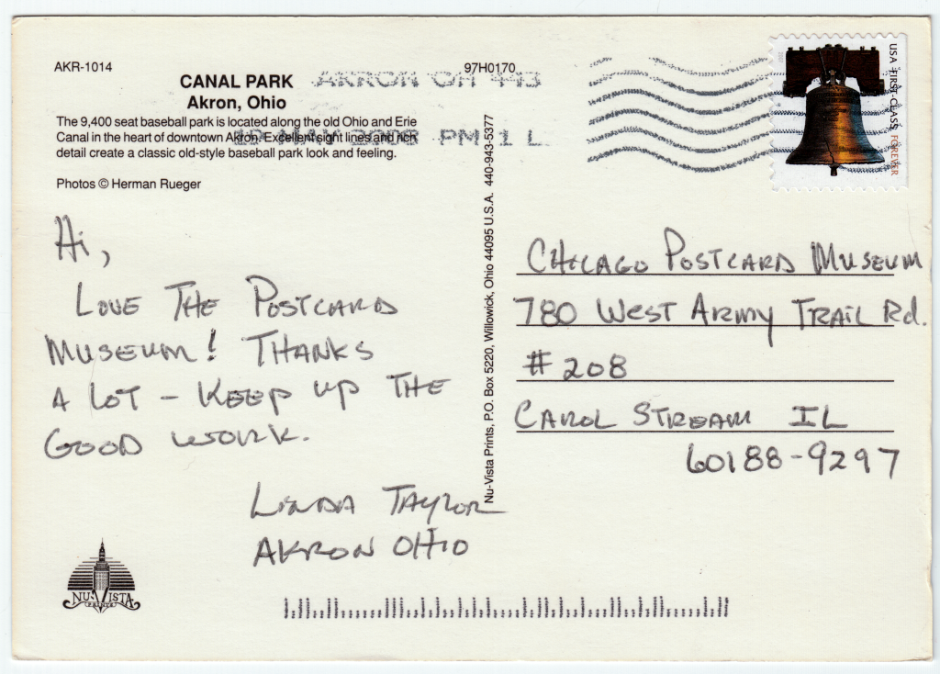
User Datagram Protocol (UDP)
The simplest transport protocol on
the Internet (simpler than TCP).
  “transport” was a bad naming choice.
Does not provide much more than the IP layer below.
  Datagrams are packets sent between software applications.
  IP layer provides “best effort” delivery. Packets may be dropped.
  Thus, UDP is also unreliable.
Adds to each packet:
  A port number, to distinguish different services on the machine.
    Only one process can “listen” for packets on a given port number.
  A checksum to verify that packet data was not corrupted.

Slide 6
UDP header fields
32 bits
source port #
dest. port #
length
checksum
length, in bytes of UDP packet, including header
application data
(payload)
UDP packet format

Slide 7
Checksum is a simple way to detect data corruption
Break the data into a sequence of 16-bit integers
Add the integers
Wrap the carry-out bits to the least-significant position.
Finally, invert the result.
Checksum is redundant information – a summary of the packet data.
1 1 1 1 0 0 1 1 0 0 1 1 0 0 1 1 0
1 1 1 0 1 0 1 0 1 0 1 0 1 0 1 0 1
1 1 0 1 1 1 0 1 1 1 0 1 1 1 0 1 1
1 1 0 1 1 1 0 1 1 1 0 1 1 1 1 0 0
1 0 1 0 0 0 1 0 0 0 1 0 0 0 0 1 1
wraparound
sum
checksum

Slide 8
Checksum in action
Sender wants to send data:
“Hello there, here is my message.”
UDP library in the sender computes a checksum as follows:
  “He” + “ll” + “o ” + “th” + “er” + “e,” + “ h” + “er” + “e ” + “is” “ m” + “y ” + “me” + “ss” + “ag” + “e.” = 0xB51
  Wrap around: 0x51 + 0xB = 0x5C
  Flip bits:
    0101 1100 → 1010 0011 = 0xA3
Sender adds 0xA3 checksum to UDP header of the packet.
Receiver wants to verify the following message:
“Hello there, here is my massage.”
UDP packet’s checksum says checksum is 0xA3.
Receiver calculates checksum of the received message, and finds that it does not equal 0xA3 (because a bit was flipped).
Receiver drops the packet.
Checksum does not repair errors, it simply lets us detect errors.

Slide 9


Slide 10
TCP provides streaming connections to apps
  TCP is usually implemented by the OS. An OS library handles the following:
  Ordering:
    Data must be packetized (chunked) by the sender and reassembled by receiver
    Reassembly is done in the proper order, regardless of delivery order.
  Acknowledgement: (almost, but not exactly “reliability”)
    Delivery of each packet is acknowledged, so lost packets can be retransmitted.
  Pacing:
    Sender adjusts packet send rate so neither receiver nor network are overwhelmed.
    Avoid filling up queues and dropping packets.
  TCP deals with many underlying Internet problems:
  Packet loss/corruption (ack./checksum) • Packet reordering (seq. numbers)
  Finite link speed & Q size (flow & congestion control) • Finite packet size (seq. numbers)

Slide 11
Human solutions to message loss
STOP
and
THINK
How do people deal with "message loss" on the telephone?
Listener may say “OK” or “mm-hmm” after each sentence.
  Called positive acknowledgement or ACK.
  If talker does not hear an ACK, then maybe she repeats herself, or asks
  “are you still there?”
Listener may say “What?” or “Can you repeat that?” if message was corrupted or lost.
  Called negative acknowledgement or NACK.
  Talker retransmits the message in response.
What happens if acknowledgements are lost?
  Positive: talker cannot make progress, gives up.
  Negative: listener cannot recover missed messages, gives up.

Slide 12

Naïve ACKs
sender
receiver
sender
receiver
send pkt0
pkt0
send pkt0
pkt0
rcv pkt0
rcv pkt0
ack0
send ack0
ack0
send ack0
rcv ack0
rcv ack0
send pkt1
pkt1
send pkt1
pkt1
X
rcv pkt1
loss
ack1
send ack1
rcv ack1
send pkt2
pkt2
timeout
resend pkt1
rcv pkt2
pkt1
ack2
send ack2
rcv pkt1
ack1
send ack1
rcv ack1
send pkt2
pkt2
rcv pkt2
(a) no loss
ack2
send ack2
(b) packet loss

Slide 13
Naïve ACKs (continued)
sender
receiver
sender
receiver
send pkt0
pkt0
send pkt0
pkt0
rcv pkt0
rcv pkt0
ack0
send ack0
send ack0
rcv ack0
ack0
send pkt1
pkt1
rcv ack0
rcv pkt1
send pkt1
pkt1
send ack1
rcv pkt1
ack1
send ack1
ack1
X
loss
timeout
resend pkt1
pkt1
rcv pkt1
timeout
resend pkt1
rcv ack1
pkt1
rcv pkt1
pkt2
(detect duplicate)
send pkt2
send ack1
ack1
(detect duplicate)
ack1
rcv pkt2
send ack1
rcv ack1
ack2
rcv ack1
send pkt2
send ack2
send pkt2
pkt2
pkt2
rcv pkt2
rcv pkt2
ack2
(detect duplicate)
ack2
send ack2
send ack2
(c) ACK loss
(d) premature timeout/ delayed ACK

Slide 14
Naïve ACK correctness
Solves packet loss/corruption, and ordering
  Do not send packet n until we get ACK n-1.
Timeout is necessary to decide when a packet is lost
  Sender cannot ever really know the status of a packet, unless got an ACK.
  If timeout is premature, then sender may retry too soon. That’s OK because both sender and receiver can simply discard old/duplicate packets:
  If sender already got ACK n, then there is no need to send packet n in response to ACK n-1.
  If receiver already got packet n, then there is no need to send ACK n-1 in response to packet n-1.
At most, twice the necessary data will be “in flight.”

Slide 15
Naïve ACK performance
It’s a “stop and wait” protocol.
Round-trip time (RTT) of packets dominates performance.
Eg., An ISP’s fiber link from New Jersey to San Jose, CA:
1 Gbps link, 15 ms propagation delay, 1.5 kByte packet size:
  RTT = 2 (15 ms + 1.5 kByte * 8 bit/Byte / 1 Gbps) = 30.01 ms
  RTT is dominated by the 30 ms round-trip propagation delay.
  Effective throughput is just 1.5 kByte * 8 bit/Byte / 30.01 ms = 250 kbps
Performance with ACKs is 4000× slower than without ACKs.

Slide 16
Stop and wait illustration
sender
receiver
first packet bit transmitted, t = 0
last packet bit transmitted, t = L / R
All this time is idle and wasted.
first packet bit arrives
RTT
last packet bit arrives, send ACK
ACK arrives, send next
packet, t = RTT + L / R

Slide 17
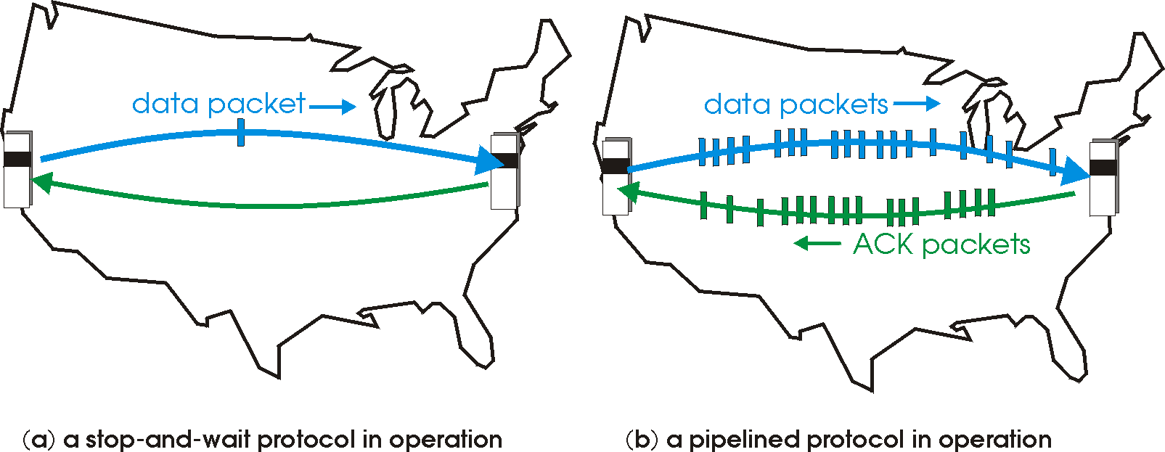

Pipelining hides latency to increase throughput
Pipelining: allow multiple “in-flight” packets, not yet ACK-ed.
Packet buffering & acknowledgement become more complex.
Later we’ll talk about flow/congestion control to prevent overwhelming the receiver/network.
A buffer is a queue of data waiting to be consumed.

Slide 18
Pipelining increases link utilization
sender
receiver
first packet bit transmitted, t = 0
last bit transmitted, t = L / R
first packet bit arrives
RTT
last packet bit arrives, send ACK
last bit of 2nd packet arrives, send ACK
last bit of 3rd packet arrives, send ACK
ACK arrives, send next
packet, t = RTT + L / R
Window size is the maximum number of in-flight packets (here it’s 3).
It’s finite to limit the data buffering required at sender & receiver, and to limit the load placed on the network.

Slide 19
Sequence numbers
(Terminology: segment = packet = frame = datagram)
Pipelining parallelizes the transfer of ACK’ed data.
Parallelism means we must handle out-of-order delivery.
Sequence numbers identify each data segment with an increasing integer. (First segment has seq. # 0, next has seq. # 1, then 2, etc.)
Allows receiver to correctly order and reassemble the received data.
ACKs also must carry sequence numbers.
  Sender has multiple data segments in flight, so the ACK must specify which of the several sequence numbers was received.

Slide 20
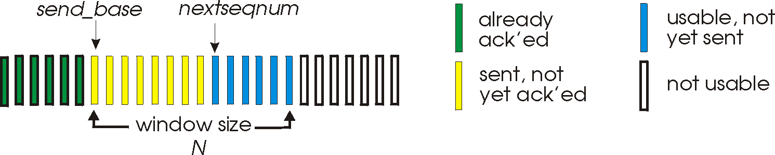
Pipelining attempt #1: Go Back N
Window size is N, sender can have up to N packets in flight.
Receiver sends cumulative ACK: “I got everything up to seq. number x”
  Discard out-of-order packets, re-send ACK of last in-order seq. number
  If sender does not get an ACK after some timeout interval,
  resend all packets starting from packet after the last ACK’ed packet.
If the sender timeout expires several times without receiving any ACK,
then give up on the connection.
Sender's view of the data stream:

Slide 21
Go Back N in action
sender window (N=4)
sender
receiver
0 1 2 3 4 5 6 7 8
send pkt0
send pkt1
send pkt2
send pkt3
(wait)
0 1 2 3 4 5 6 7 8
receive pkt0, send ack0
receive pkt1, send ack1
receive pkt3, discard,
(re)send ack1
0 1 2 3 4 5 6 7 8
X
0 1 2 3 4 5 6 7 8
loss
0 1 2 3 4 5 6 7 8
rcv ack0, send pkt4
rcv ack1, send pkt5
0 1 2 3 4 5 6 7 8
receive pkt4, discard,
(re)send ack1
ignore duplicate ACK
receive pkt5, discard,
(re)send ack1
pkt 2 timeout
0 1 2 3 4 5 6 7 8
send pkt2
send pkt3
send pkt4
send pkt5
0 1 2 3 4 5 6 7 8
0 1 2 3 4 5 6 7 8
rcv pkt2, deliver, send ack2
rcv pkt3, deliver, send ack3
rcv pkt4, deliver, send ack4
rcv pkt5, deliver, send ack5
0 1 2 3 4 5 6 7 8

Slide 22
Go Back N Demo
https://stevetarzia.com/340/gbn.html

Slide 23
Go Back N advantages
Easy to implement:
  Sender just stores # of last ACK and maintains a timer.
  Receiver just stores expected seq number and immediately passes new in-order packets to listening app.
Go Back N shortcomings
A single lost or delayed packet invalidates all the in-flight data.
Receiver can throw out a lot of good data, just because it’s “early.”
  I.e. lacks receiver buffering.
Lose an entire window of data due to one “bad” packet.

Slide 24
Pipelining attempt #2: Selective Repeat
Receiver individually ACKs all received packets.
Out-of-order packets are stored by receiver and later reassembled
Sender keeps many timers, one for each in-flight packet, and will re-send any packets not ACK’ed before timeout.
Window of size N limits the maximum range of un-ACK’ed packets.
  Receiver drops received packets with seq number outside the window.
  This prevents packets from old connection from getting inserted into new connection’s data stream.
Only re-send an individual packet whose transmission or ACK was lost.

Slide 25
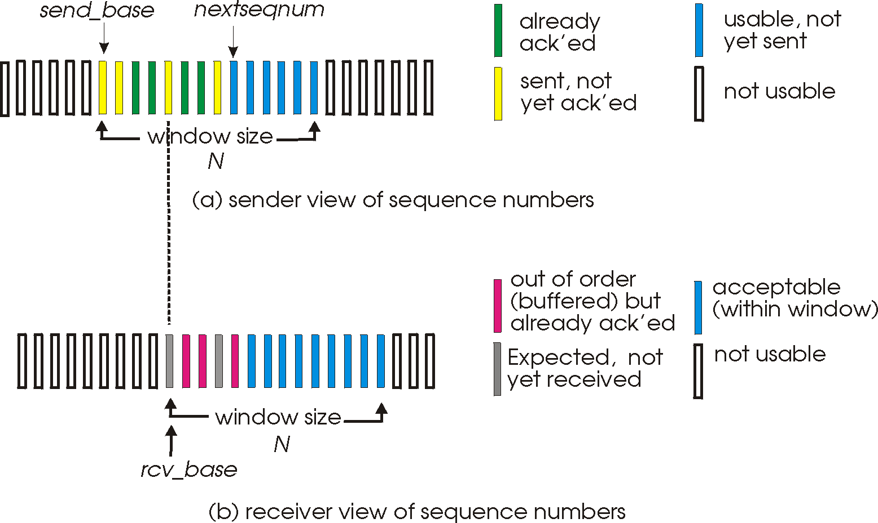
Selective Repeat windows
Sender window advances when lowest packet is ACK’ed.
Receiver window advances when lowest packet is received.

Slide 26
Selective Repeat Demo
https://stevetarzia.com/340/sr.html

Slide 27
Seq number reuse can cause confusion
In TCP, we use a 32-bit number for seq number (0 to 4Gbyte) and it eventually wraps around back to zero.
Simplified illustration below assumes that 2-bit seq number is used:
Solution: window length must be < half the max seq number
sender window
(after receipt)
receiver window
(after receipt)
sender window
(after receipt)
receiver window
(after receipt)
0 1 2 3 0 1 2
pkt0
0 1 2 3 0 1 2
pkt0
0 1 2 3 0 1 2
pkt1
0 1 2 3 0 1 2
0 1 2 3 0 1 2
pkt1
0 1 2 3 0 1 2
0 1 2 3 0 1 2
pkt2
0 1 2 3 0 1 2
0 1 2 3 0 1 2
pkt2
0 1 2 3 0 1 2
X
0 1 2 3 0 1 2
0 1 2 3 0 1 2
X
0 1 2 3 0 1 2
pkt3
timeout
retransmit pkt0
X
X
0 1 2 3 0 1 2
pkt0
pkt0
will accept packet
with seq number 0
0 1 2 3 0 1 2
will accept packet
with seq number 0
(a) no problem
(b) oops!
STOP
and
THINK

Slide 28
Recap
UDP is a connectionless, packet-oriented transport protocol.
  Adds a port number and checksum to packets.
TCP is a streaming transport protocol.
Delivery confirmation & ordering is possible by sending ACKs
  After a timeout, resend packet that was not ACK’ed.
Pipelining packets allow much better use of link capacity.
  Window size determines the number of allowed in-flight packets
Go Back N is a simple pipelining protocol that uses cumulative ACKs.
Selective Repeat adds buffering to the receiver to avoid unnecessary retransmission.
Next time: TCP details, connection setup, flow/congestion control.

