Slide 1
CS-340 Introduction to Computer Networking
Lecture 3: Application-layer protocols, HTTP
Steve Tarzia
Network diagrams adapted from those by J.F Kurose and K.W. Ross
HTTP slides adapted from website by Chua Hock-Chuan: https://www.ntu.edu.sg/home/ehchua/programming/webprogramming/HTTP_Basics.html

Slide 2
Last Lecture
Packets travel along many hops to reach the intended destination
  Each router has a fixed-size queue; packets are dropped if full
  Packet is also dropped if a bit-flip error is detected
Showed four different sources of packet delay at each hop:
  Nodal processing, queueing (associated with the router)
  Transmission, propagation (associated with the link)
Internet is a “network of networks”
  Tier 1 ISPs and big content providers build high-speed backbone links.
  Peering is when networks connect to each other without any payment.
Networks use layered protocols, eg.: Ethernet, IP, TCP, TLS, HTTP
Socket is a software abstraction of a network connection (TCP or UDP)
  It’s one end of a pipe: you can send data in or get data out
  Each socket is bound to a particular port number. Port number determines which process on a host is responsible for handling a given packet.

Slide 3
Separation of concerns
Ethernet Packet
MAC addresses, CRC, etc.
Ethernet payload
Link layer: shares a physical channel among several transmitters/receivers
Network layer: routes from source to destination, along many hops.
Transport layer:
  Multiplexing >1 connection per machine
  Ordering, • Acknowledgement, • Pacing
Session Security layer:
  Encryption, • Authentication.
HTTP Application layer:
  Resource urls, • Response codes,
  Caching, • Content-types, • Compression
IP Packet
IP addresses, TTL, etc.
IP payload
TCP Packet
Port #, sequence #, ack #, etc.
TCP payload
TLS Record
Sequence #, length, MAC
TLS payload
HTTP Response
status code, content-type, etc.
<html><body><h1>My great page</h1><p>…

Slide 4

















Application-layer protocols
application
transport
network
data link
physical
Purpose is to allow apps running on different computers to communicate.
  System is called client-server or peer-to-peer depending on whether it relies on central control (at a server).
Apps don’t worry about low-level details of the network.
Assume that we can send messages (of arbitrary size) to any host on the network if we know it's address.
  Every computer has a unique IP address like 34.200.20.23 and domain names like "cs.northwestern.edu" somehow map to IP addresses (using DNS, discussed in next lecture)
application
transport
network
data link
physical
application
transport
network
data link
physical

Slide 5
Client-server architecture
client
Servers: handle requests
  Always powered on
  Permanent IP addresses
  Usually have a DNS hostname
  Usually reside in data centers
  No display, keyboard, or mouse
  Listen for requests from clients.
Clients: make requests
  Opposite of above, in every way.
  Do not listen for unsolicited messages
    Only accept responses to their requests.
  Do not communicate directly with other clients. Server must relay messages.
client
server
client
Notes:
Web server never asks you for a web page. It’s a very one-sided relationship.

Slide 6
Key difference between client and servers
Servers:
Clients:
Do not move!
Location/address in the network is constant.
Can listen for requests.
Can move around with users.
Are difficult to find.
  Thus, do not listen for requests coming from unknown machines.
Send requests on behalf of user’s apps, and listen briefly for a response from the one server that was contacted.

Slide 7
Peer-to-peer architecture (P2P)
peer
peer
All participants have equal responsibilities, thus are peers.
  Do not rely on powerful, central servers
A very scalable design.
  Each new participant brings new capacity
But there are many difficulties:
  Hosts join and leave the network (churn).
  IP addresses change.
  Firewalls may block access to peers.
  Edge networks have limited upload speed.
Uses kind of centralized directory/tracker.
Examples: BitTorrent, Skype
  Might also think of SMTP as P2P
peer
peer
peer
peer

Slide 8
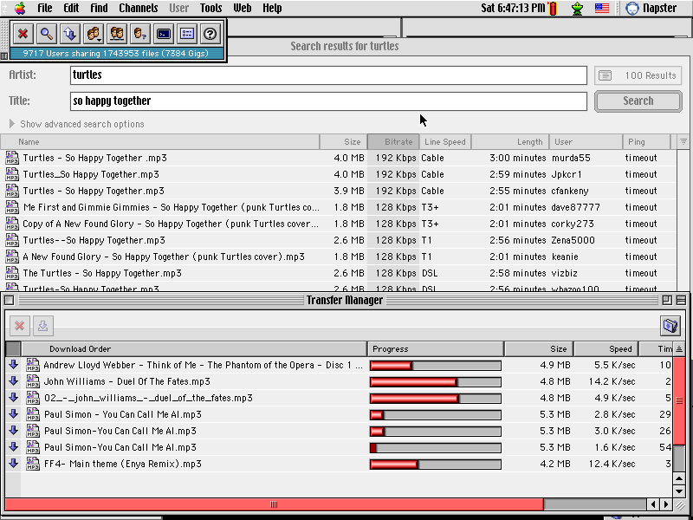

Napster
A technically innovative P2P app.
Allowed music piracy on massive scale in 2000-2001.
Shut down after several copyright lawsuits.
Inspired BitTorrent.
Why was it important for Napster to use a peer-to-peer architecture?
STOP
and
THINK
Notes:
Lower costs to operate, and, above all, they felt they could avoid legal trouble if they did not host the pirated media.

Slide 9
Hyper Text Transport Protocol (HTTP)
HTTP is a client-server data exchange protocol built on top of TCP
  TCP provides a reliable, bi-directional data stream between two machines.
HTTP was invented for browsers to fetch pages from webservers
Request specifies:
  A human-readable header with: URL, method, (plus some optional headers)
  An optional body, storing raw data (bytes).
Response includes:
  A human-readable header with response code, (plus some optional headers)
  An optional body
HTTP is a stateless protocol:
  Each request is self-contained – contains all info needed to give a response.
  Meaning of requests are independent; servers need not remember past requests.

Slide 10
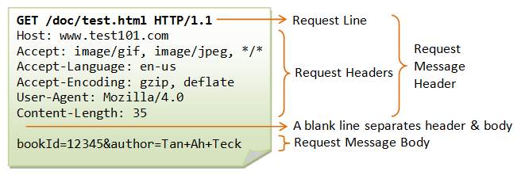
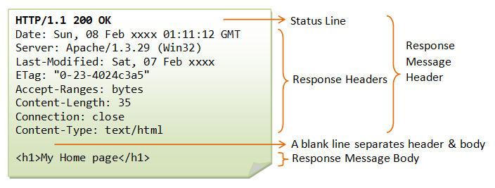
Request:
(optional for GET)
Response:
From https://www.ntu.edu.sg/home/ehchua/programming/webprogramming/HTTP_Basics.html

Slide 11
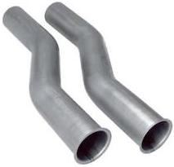
HTTP transaction steps
Notice that “Content-Length” header tells length of message body.
TCP socket.
A bi-directional pipe/stream of bytes
Server
Client
Client creates TCP socket, and server accepts the socket.
Client writes HTTP request to socket; starts listening for response.
Server notices new data on socket and starts reading request data.
Server eventually notices that it has received a full HTTP request.
Server does some work to generate an appropriate response.
Server writes HTTP response to socket.
Client reads and parses response data; stops reading after calculating that the response is complete.

Slide 12
HTTP methods and responses
Methods
Response codes
GET: to request a data
POST: to post data to the server, and perhaps get data back, too.
Less commonly:
PUT: to create a new document on the server.
DELETE: to delete a document.
HEAD: like GET, but just return headers
200 OK: success
301 Moved Permanently: redirects to another URL
Client errors (400–499):
403 Forbidden: lack permission
404 Not Found: URL is bad
Server errors (500-599):
500 Internal Server Error
… and many more

Slide 13
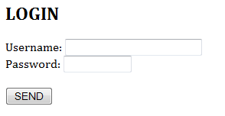
POST method is often used when client supplies data
Send HTTP POST request when click button
POST /api/login HTTP/1.1
Host: somewebsite.com
Accept: image/gif, image/jpeg, */*
Referer: http://somewebsite.com/login.html
Accept-Language: en-us
Content-Type:
application/x-www-form-urlencoded
Accept-Encoding: gzip, deflate
User-Agent: Mozilla/4.0 (…)
Content-Length: 37
Connection: Keep-Alive
Cache-Control: no-cache
User=Peter+Pan&pw=123456&action=login
<html><body>
<h2>LOGIN</h2>
<form method="post" action="/api/login">
Username:
<input type="text" name="user"/><br/>
Password:
<input type="password" name="pw"/>
<br/><br/>
<input type="hidden"
name="action" value="login" />
<input type="submit" value="SEND" />
</form>
</body></html>

Slide 14
Response to login request gives user a cookie
Cookies are how web applications track state, often to track user identity.
If username and password were correct, server will return a cookie in the response:
Response tells the client browser to redirect to http://somewebsite.com/account, but it also gives the browser a cookie to remember.
Browser will include the cookie in all future HTTP requests to somewebsite.com:
Server getting this request can use the cookie to determine which user it came from!
HTTP/1.1 302 Found
Location: http://somewebsite.com/account
Set-Cookie: someweb-id=kfj203d14t9s
GET /account HTTP/1.1
Host: somewebsite.com
Referer: http://somewebsite.com/api/login
Cookie: someweb-id=kfj203d14t9s
…
Is HTTP with cookies still stateless?
STOP
and
THINK

Slide 15
GET requests can send data in a URL’s query string
Send HTTP GET request when click button
GET /api/login?User=Peter+Lee&pw=123456&ac tion=login HTTP/1.1
Host: somewebsite.com
Accept: image/gif, image/jpeg, */*
Referer: http://somewebsite.com/login.html
Accept-Language: en-us
Accept-Encoding: gzip, deflate
User-Agent: Mozilla/4.0 (…)
Connection: Keep-Alive
Cache-Control: no-cache
<html><body>
<h2>LOGIN</h2>
<form method="get" action="/api/login">
Username:
<input type="text" name="user"/><br/>
Password:
<input type="password" name="pw"/>
<br/><br/>
<input type="hidden"
name="action" value="login" />
<input type="submit" value="SEND" />
</form>
</body></html>
Notice that some characters must be translated to be compatible with a URL, eg., space become “+” or “%20”

Slide 16
The evolution of HTTP & the Web
Early 1990s: HTTP was just a document-fetching service
  Web servers would just serve up static HTML and image files (~Project 1).
  GET /index.html → refers to an HTML file stored on the server
Late 1990s: Web servers ran scripts to generate content on-demand
  GET /product/1234 → generates a page using information found in a database relevant to “product 1234” as well as user-specific information.
2005+: Javascript allows pages to be interactive (Gmail, Google Maps)
  AJAX: HTTP request that gets more data w/out re-loading entire page
2010s: HTTP spreads beyond web applications
  HTTP infrastructure is robust:
    libraries, software, caches, proxies, encryption, compression
  It's convenient base all client-server, request-response interactions on HTTP.
  Eg., smartphone-app-to-server, server-to-server

Slide 17
A weather information service (REST API)
HTTP Request
HTTP Response
GET http://api.wthr.com/[key]/forecast?location=San+Francisco HTTP/1.1
Accept-Encoding: gzip
Cache-Control: no-cache
Connection: keep-alive
HTTP/1.1 200 OK
Content-Length: 2102
Content-Type: application/json
{ "wind_dir": "NNW",
"wind_degrees": 346,
"wind_mph": 22.0,
"feelslike_f": "66.3",
"feelslike_c": "19.1",
"visibility_mi": "10.0",
"UV": "5", … }

Slide 18
REST API example (REpresentational State Transfer)
https://petstore.swagger.io/
https://developer.twitter.com/en/docs/tweets/post-and-engage/api-reference/post-statuses-update

Slide 19
Inputs and outputs for an API built on top of HTTP
Request Inputs
Response Outputs
Method
  GET/POST/PUT/DELETE
URL
  Usually identifies the type of request, but may also supply parameters.
Query parameters after URL
Headers
  Cookies, custom headers
Body
  Usually form-encoded or JSON
Status code
  200, 404, 403, etc.
Headers
Body
  Usually JSON encoded
It’s bad style to HTTP headers for input/output.
Goal is to build on top of HTTP, not alter it.

Slide 20
Why use HTTP for new applications?
Web community has already solved the problems you are likely face.
  Encryption
  Compression
  Every programming language already has HTTP client libraries
  Many different server frameworks to choose from, and these already handle encryption, queueing, database connection pooling:
    Eg., Apache httpd, Tomcat, Node.js, Django, Flask
  Web proxies and caches can be reused (Squid, Nginx, Akamai, etc.)
  HTTP response codes are generic enough to be adapted to other services.
Disadvantages:
  Inherit some unneeded complexities, and perhaps unexpected behaviors.
  Human-readable headers introduce overhead (but compression helps)
  May have to rethink your API to fit the URL/resource model.

Slide 21

Simple Mail Transport Protocol
outgoing
message queue
user
agent
user mailbox
Another protocol built on top of TCP.
Defined in RFC 2821.
Uses port 25 by default.
Developed in 1982, earlier than HTTP: Internet’s first popular app.
SMTP is a P2P protocol used by mail servers to exchange users’ messages.
Mail servers act as clients when sending, and as servers when receiving.
  Each domain has its own mail server(s).
User agents use different protocols to fetch emails (IMAP, POP3, webmail)
mail
server
user
agent
SMTP
mail
server
user
agent
SMTP
SMTP
user
agent
mail
server
user
agent
user
agent

Slide 22
Example
S: 220 smtp.example.com ESMTP Postfix
C: HELO relay.example.com
S: 250 smtp.example.com, I am glad to meet you
C: MAIL FROM:<bob@example.com>
S: 250 Ok
C: RCPT TO:<alice@example.com>
S: 250 Ok
C: RCPT TO:<theboss@example.com>
S: 250 Ok
C: DATA
S: 354 End data with <CR><LF>.<CR><LF>
C: From: "Bob Example" <bob@example.com>
C: To: "Alice Example" <alice@example.com>
C: Cc: theboss@example.com
C: Date: Tue, 15 January 2008 16:02:43 -0500
C: Subject: Test message
C:
C: Hello Alice.
C: This is a test message with 5 header fields and 4 lines in the message body.
C: Your friend,
C: Bob
C: .
S: 250 Ok: queued as 12345
C: QUIT
S: 221 Bye
{The server closes the connection}
S: means server
C: means client
How is this different than HTTP?
It’s stateful.
STOP
and
THINK

Slide 23
SMTP telnet demo

Slide 24
Try SMTP for yourself
It’s one of the simplest protocols
$ telnet <servername> 25
  telnet command is available on murphy.wot.eecs.northwestern.edu.
enter HELO, MAIL FROM, RCPT TO, DATA, QUIT commands
This lets you send email without a mail app (or an email account!)
Few SMTP servers will relay arbitrary messages
Try connecting to the specific SMTP server for the recipient:
$ nslookup -type=MX u.northwestern.edu
  Returns: aspmx.l.google.com
However, your message will likely end up in the “junk” folder

Slide 25
Recap
Application-layer protocols are usually built on top of TCP
  Don’t have to worry about network itself, just create socket connections to other hosts. The socket hides many details from the app.
Most applications use a client-server architecture: request-response.
A peer-to-peer architecture is more scalable, but difficult to organize.
HTTP was invented for fetching documents from web servers.
  It’s now used as the basis for many request-response interactions.
  URLs, request method, response status, human-readable headers, body
  REST APIs are built on top of HTTP, so it’s a networking layer itself.
SMTP is an earlier application-layer protocol, for sending email.
  Unlike HTTP, it’s stateful (server must remember what you previously said).

