Slide 1
CS-340 Introduction to Computer Networking
Lecture 1: Introduction
Steve Tarzia
Many diagrams & slides are adapted from those by J.F Kurose and K.W. Ross

Slide 2
Today’s lecture
What will you learn from this class?
How will this course be operated?
Are you ready to take this class?
Overview of the Internet

Slide 3
Course logistics
We’ll use Canvas for assignments, announcements, lecture slides.
I will post two videos on Panopto per week.
  I will record new videos, but last year's lectures are already on YouTube.
Reading assignments will also be posted.
Ask asynchronous questions on Piazza (not by email):
  https://piazza.com/class/kels8h2i9pi2nv
Teaching staff and office hours will be finalized/announced soon.

Slide 4
Discussion sections
MWF 1:50-2:40pm class time will be used for discussion sections.
  The idea is to bring together a small group of students to discuss one problem/question related to the week's topics.
  Participation will be graded (5% of total). Two absences per quarter are allowed. We'll try to schedule one section late at night for people in Asia.
You must attend one 25-minute session per week on Zoom:
  Mon 1:50-2:15
  Mon 2:15-2:40
  Wed 1:50-2:15
  Wed 2:15-2:40
  Wed 9:00-9:25pm central time (for people in faraway time zones)
  Fri 1:50-2:15
  Fri 2:15-2:40

Slide 5
Making the most of remote learning
To make remote learning work, we must learn new habits.
When watching lectures and reading, be ready to write your questions.
  Note the slide number.
  Ask questions later on Piazza or during office hours.
"Stop and Think" cues will ask you to pause the video and ponder a question I have asked. Please do it!
STOP
and
THINK

Slide 6
Office Hours
This is the best time to get help with your projects.

Slide 7
Prerequisites
Data Structures (EECS-214)
Basic C/Unix programming (EECS-213 or EECS-205)
All programming assignments will be in Python
If you’re unsure, then start the first project ASAP
If you’re going to drop, better to drop sooner than later

Slide 8
Grading
50% -- 3 Python Projects
  Done in pairs (or individually)
  Usually due on Mondays at Midnight.
20% -- 4 Homework assignments
  Short written answers, based on reading, lectures, & Wireshark labs
10% -- Midterm exam
15% -- Final exam (cumulative) on Monday, Dec 7th at 9am..
  Exams are similar to homework assignments
  Exams are open book & open notes
  Plan to print all the lecture slides.
5% -- Participation in discussion section

Slide 9
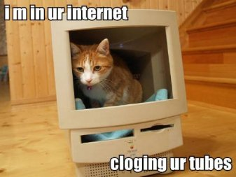
Why take Computer Networking?
To learn how the Internet works!
It’s one of the greatest technical achievements in human history:
  Somehow it’s global, reliable, & scalable
  Without centralized control, and
  with unreliable components.
We will explore several layers:
  Applications (Web, Email, DNS, etc.)
  Encryption (TLS/SSL), at end of class
  Reliable connections (TCP)
  Routing (IP) & Network control (BGP)
  Physical connections (Ethernet, WiFi, Cellular)
Internet principles also apply to other
networks & engineered systems in general.

Slide 10
Projects
Build an HTTP (web) server.
Implement a reliable transport protocol (simplified version of TCP).
Implement distributed routing algorithms (BGP, etc.)
All will be in Python.
Will develop on your machine and test on a shared Linux server.
Will work in pairs or individually
  Groups of three are not allowed. Just take turns working in different pairs.

Slide 11
Collaboration & cheating policy
Helping each other is OK, but you should not do anything that allows another student skip the learning process.
You may talk to other students about the homework and projects
You may look at small parts of each other’s code (on the screen)
You may not send a copy of your code to friends
If you copy code from the Internet, you must add a comment explaining the source.
You must understand what your code does
I will use MOSS to compare your code to everyone else’s code and prior years’ code.
If you spent fewer than 6 hours on a project, then you probably cheated!
I will notify the Dean of blatant cheating and you may be expelled from Northwestern.
If you’re unsure about this policy, please ask me.

Slide 12

Required reading
Computer Networking: A Top-Down Approach (7th Edition),
by Kurose and Ross.
864 page textbook
  Well-written and easy to read.
  Chapter 1-6, 8, part of 7
  To do well on exams you must read it!
Kind of expensive: $155
  Feel free to buy 6th or older edition or “global edition”
Repeats & reinforces lectures
Exams are open-book, so please buy a paper copy of the book

Slide 13
About Steve
Fourth year teaching at Northwestern. “Assistant professor of instruction”
PhD from Northwestern in 2011, BS from Columbia in 2005,
both in Computer Engineering
Research expertise was acoustic sensing on mobile systems.
Worked at a few Chicago area software startups
First as a software engineer, later as VP of Engineering
Have published about ten iOS apps in the app store
Fan of Linux, AWS, Java, Python, Objective-C
Founded nonprofit National Gun Violence Memorial (GunMemorial.org).
Enjoys playing music (guitar, drums, trumpet), cooking, repairing things, exercise, opera, walking around Evanston.
Married 15 years & has lived in Evanston for the past 9 years.

Slide 14
A Quick Overview of the Internet
To get started, I’ll described the entire Internet’s operation very briefly.
Then for the remainder of the course, we’ll study it in more detail, starting at the “top” with the application layer, and moving “down” toward the physical media.

Slide 15
How does the Internet work?
What steps are involved when you visit a website on your laptop?
How is the process different on your smartphone?
What’s the difference between the “world wide web” and the Internet?
STOP
and
THINK

Slide 16



















What is the Internet?
mobile network
A network of billions of computing devices, called hosts or end systems.
  From thermostats to servers
  Each has a unique, numeric
  Internet Protocol (IP) address
Many communication links
  copper wire, fiber optic, or radio
Hosts send data packets to other hosts
  Packets are labeled with IP address of sender and receiver
Routers and switches direct traffic using addresses on the packets.
PC
global ISP
server
wireless
laptop
home
network
smartphone
regional ISP
wireless
links
wired
links
institutional
network
router

Slide 17
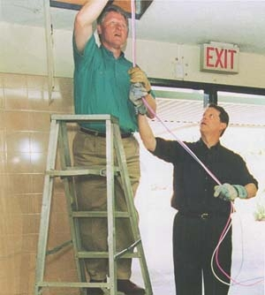
Who controls the Internet?
Al Gore did not create the Internet
Who invented the Internet?
The Internet grew out of ARPANET, a US-military-funded academic research project (in 1970s).
It’s a loose confederation of interconnected networks.
  A “network of networks”
ICANN (Internet Corporation for Assigned Names and Numbers):
  Assigns IP addresses and assigns DNS top-level domains.
  Operates 13 root DNS servers.
IETF (Internet Engineering Task Force):
  Develops protocols that define how Internet devices interact.
  RFCs (Request For Comments) are its documents defining Internet standards.
U.S. President Clinton and Vice President Gore installing Ethernet cabling in 1996.

Slide 18
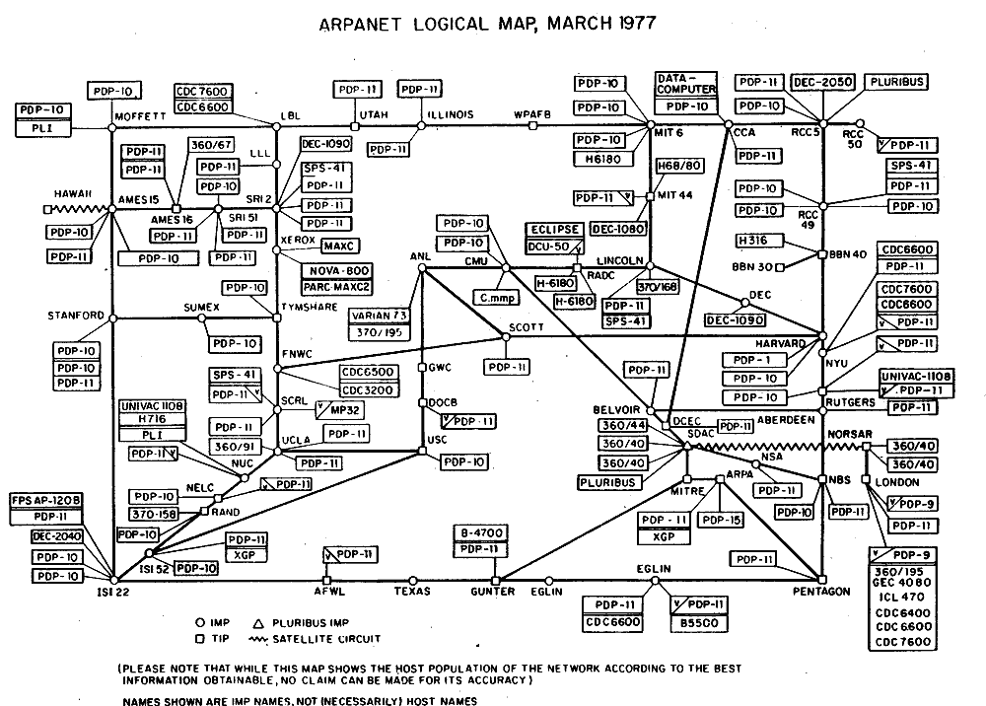

Slide 19
The Internet != The Web
The Internet is a worldwide network of interconnected computers.
  ARPANET adopted TCP/IP protocol in 1983 (birth of the modern Internet)
The Web is a worldwide network of interconnected hypertext pages.
  Web browser app connects to web server apps.
  Web is just one of many applications built on top of the Internet and DNS.
  Uses HTTP protocol (first version, 0.9, was released in 1991)
  Invented at CERN on the France/Switzerland border.
Apart from the Web, many other applications use the Internet:
  Email, SSH, BitTorrent, Voice-over-IP telephony, FTP, Remote Desktop, VNC, Skype, Telnet, Snapchat, FaceTime, Netflix … you name it!
  Any smartphone app that communicate with a backend service

Slide 20
The Internet is distributed and loosely coupled
No one entity is manages all the hosts, routers, and links on the Internet.
Hosts join by building a physical connection to an existing host.
Hardware and software come from many different vendors.
Standard Internet protocols define how devices should interoperate.
A network protocol defines proper communication patterns between devices:
  types of messages that can be sent,
  structure of the messages (bit-level representation),
  possible responses and actions to take.
Clearly-defined protocols allow us to create new devices that are compatible with the existing ones, and thus expand the Internet ad-hoc.

Slide 21

Human protocols
Uncle Owen: "You, I suppose you're programmed for etiquette and protocol."
C-3PO: "Protocol? Why, it's my primary function, sir. …"
Human societies also have widely known protocols (etiquette) to allow
millions of strangers to live harmoniously together.
It would be very inefficient for each pair of people to establish their
own rules of interaction, so we follow certain standards:
  Shake hands when meeting to signal friendliness.
  Stand at the end of the checkout line at a grocery store to make a purchase.
  Drive on the right side of the road, stop at stop signs, green means go…
  Ask a person to see a movie or go to dinner to signal romantic interest.
  … but do not ask a third person along on the date.
  Do not say “hello” to passing strangers in a big city.
  Do say “hello” to passing strangers in rural areas.
Humans are intelligent and adaptable, so human protocols can be flexible.
Computers need very strict protocols to allow “strangers” to interact.

Slide 22
The Internet – in practice
All machines on the Internet can send and receive messages, but there are two distinct categories of participants:
Network edge:
  Hosts: clients and servers
  Have only one link to the Internet
Network core:
  Routers connecting various Internet parts
  These are like hosts with multiple links and living only to relay others’ packets.
Machines are connected by physical media:
  Wired and wireless communication links
mobile network
global ISP
home
network
regional ISP
institutional
network

Slide 23



Access networks and local-area networks
Many different technologies are used to connect devices at the edge
  WiFi, Ethernet, Cellular
  Speed varies depending on the link technology
  Links may be shared or dedicated
Some access networks assign public IP addresses to hosts, and others use private IP addresses and network address translation (NAT).
mobile network
home
network
institutional
network

Slide 24
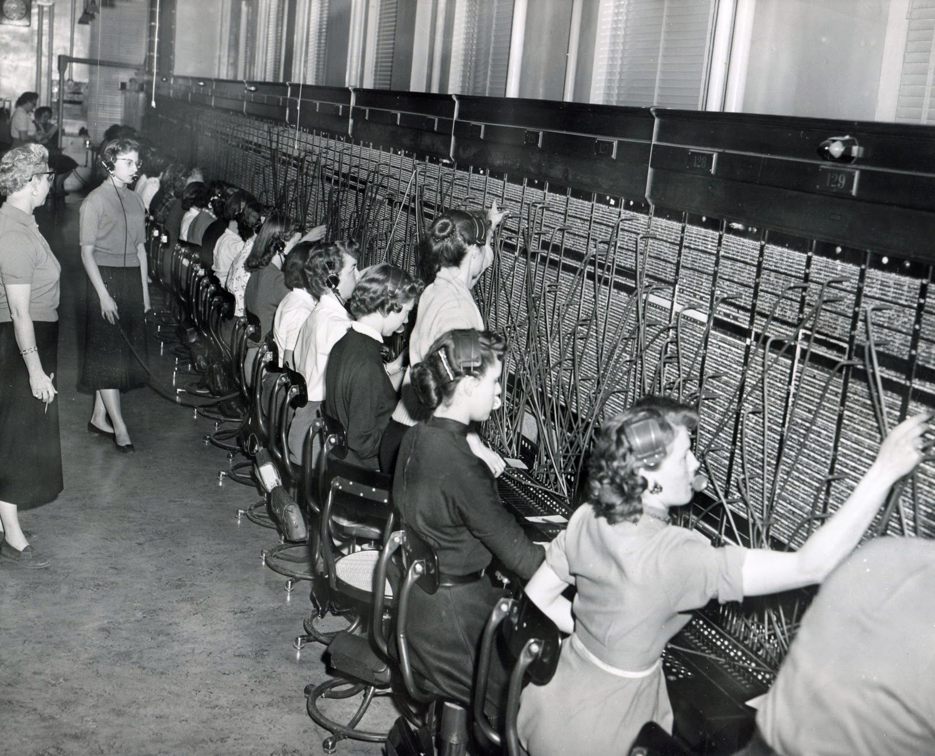
Public Switched Telephone Network (PSTN)
Uses circuit switching -- a very basic design.
An electrical connection is established end-to-end for each call.
Originally done by moving cables plugged into switchboards.
Later, pulse and tone dialing automated switching.
1957

Slide 25
Home Internet access uses old networks
Public Switched Telephone Network (PSTN) still uses analog signals on twisted pair cables (for the “last mile” anyway).
  Early access used telephone modems, up to 56kbps, over the voice channel.
  Modern DSL access uses higher frequencies than voice channel.
Cable Television Networks use coaxial cable.
  Coaxial cable is a much better signal carrier, much less sensitive to noise, and thus can carry much more data.
  It was designed to carry video, which is more complex than just audio.
Both PSTN and Cable have a modern fiber optic network at their core, and these days it’s the same infrastructure that runs the Internet.

Slide 26
Connecting to the Internet in the 1990s
Connect your computer’s fax/modem to a regular telephone line.
Computer dials a local telephone number owned by your Internet Service Provider (ISP).
Data is encoded as sounds in the audio range
ISP has its own connection to the Internet, shared by everyone who is dialed in.
Hope that your mom doesn’t pick up the telephone while you’re surfing and interrupt your session.
Hang up when you’re done so that your household can use the telephone again.
https://www.youtube.com/watch?v=D1UY7eDRXrs

Slide 27

Digital Subscriber Line (DSL)
central office
telephone
network
DSL
modem
splitter
DSLAM
ISP
voice, data transmitted
at different frequencies over
dedicated line to central office
DSL access
multiplexer
Telephone calls do not interfere with data exchange.
Up to ~40MBps
  Limited by noise in “last mile” cabling originally designed for just voice.

Slide 28
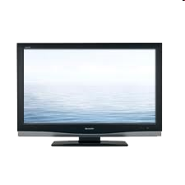


Cable Networks
cable headend
…
cable
modem
splitter
CMTS
cable modem
termination system
data, TV transmitted at different
frequencies over shared cable
distribution network
ISP
Network was originally designed for one-way broadcast of TV
  Entire neighborhood shares the same cable/signal.
Up to ~200 MBps

Slide 29
Frequency Division Multiplexing
A way to share a single communication medium
Different channels are simultaneously transmitted on different frequency bands.
Different transmitters don’t have to “take turns.”
Coaxial cable is a very low-noise medium, so high frequencies can be supported and channels can be narrow.
…
cable
modem
splitter
cable headend
C
O
N
T
R
O
L
V
I
D
E
O
V
I
D
E
O
V
I
D
E
O
V
I
D
E
O
V
I
D
E
O
V
I
D
E
O
D
A
T
A
D
A
T
A
Magnetic shielding “tube” reduces noise dramatically
1
2
3
4
5
6
7
8
9
Channels

Slide 30
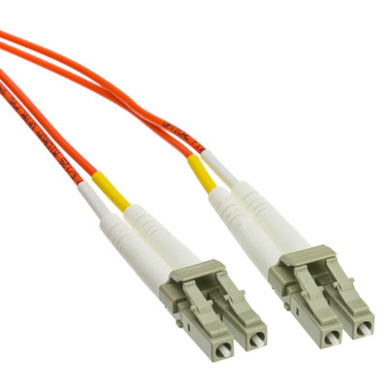
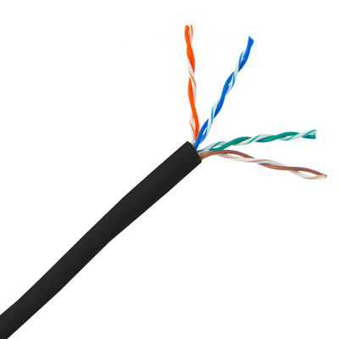
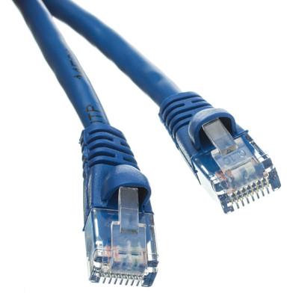
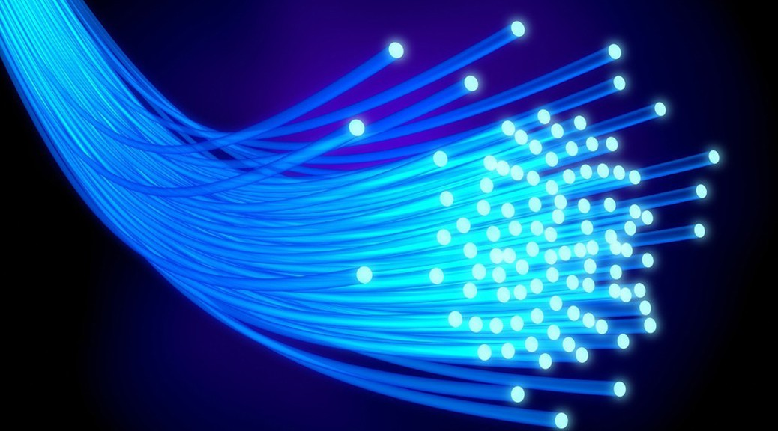
Modern wired/guided media
Twisted Pair (Cat5e, Cat6)
Fiber Optic
Up to 10Gbps over short distances.
Signals are transmitted electrically.
Cheap and easy to install.
Up to 100Gbps over long distances.
Signals encoded as pulses of light.
Immune to electromagnetic interference.
More expensive.

Slide 31
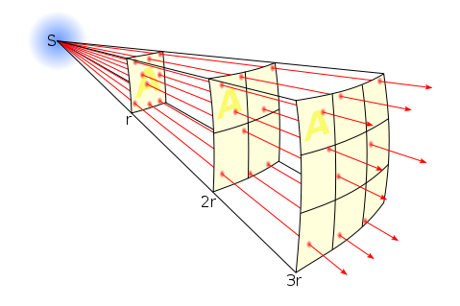
Radio is a wireless/unguided medium
Signal flows through open space
(+) No need to wire-up every device
(-) Lots of noise, interference, and competition for the spectrum.
Objects can block/reflect signal
Signal’s power is proportional to the square root of distance
FCC licenses different frequency bands in the U.S.
to reduce interference between competing devices
Includes: WiFi, Cellular, Satellite
Why is WiFi range much smaller than Cellular?
  Higher Freq., Lower xmit power, Noise in unlicensed band, …
STOP
and
THINK

Slide 32
A look at the network core

Slide 33

Circuit Switching was used in the PSTN
If two people wanted to talk, a dedicated electrical path (circuit) is established.
The circuit remains dedicated to the call until the parties hang up.
(+) Performance is guaranteed.
  Competing calls will not interrupt yours.
(-) You may have to wait for a free link before establishing a call. (Congestion tone)
(-) It’s wasteful because there is much silence during a call
  Both parties rarely talk simultaneously.
Survey:
Who has a land line phone?
From telco or cable provider?
Parents have a land line?
Grandparents?
An “all or nothing” approach. Service does not degrade gracefully when network is crowded, but this is good for telephony.

Slide 34
Circuit switched backbone links are multiplexed
We don’t literally use a reserved electrical path (wire) for each call.
Reserve a channel
on a multiplexed
(shared) link.
Allows one link
to support many
simultaneous
channels (calls).
Covered in Chapter 6.
Frequency division multiplexing (FDM)
4 users
frequency
time
Time division multiplexing (TDM)
frequency
time

Slide 35
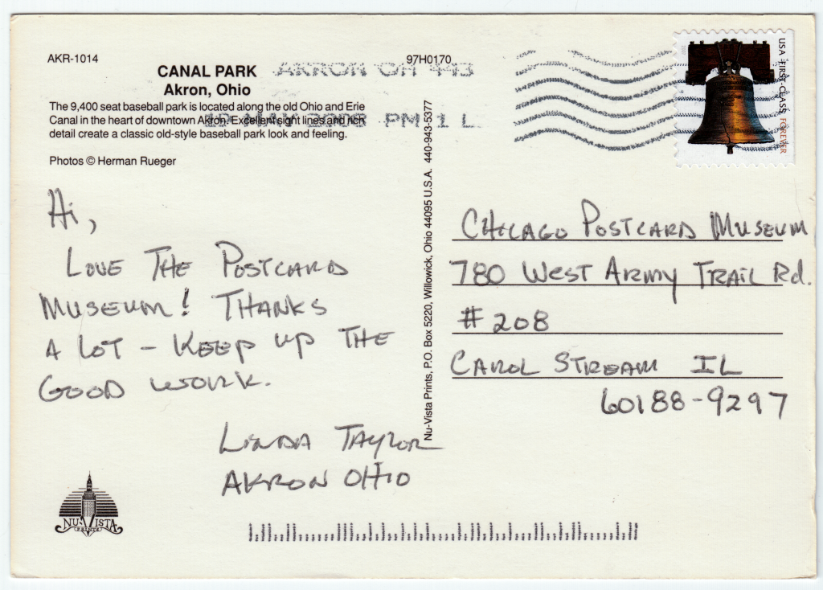
Computer networks use Packet Switching
This is an alternative to circuit switching, and a key Internet innovation.
Data is sent as packets – small chunks (~1.5kb)
A packet is like a postcard.
Contains:
  Destination address
  Sender address
  Limited space for a message
Packets create challenges:
  Large message must be split into
  multiple postcards (packets)
  May arrive in any order
  May take different paths to destination
  Delivery is “best effort,” not guaranteed.

Slide 36
Packet vs Circuit switching
"Switching" here means the way a link is shared by competing users.
Packet benefits:
  Simpler:
    No connection setup is necessary.
    Just address packet correctly and send it.
    Sender need not know full path to endpoint, just the "next hop."
  Very efficient for sharing “bursty” customers.
Circuit benefits:
  Guaranteed performance.
  Very effective for applications requiring constant, steady transfer
  (streaming audio and video).

Slide 37
Network performance metrics
There are many ways to measure network speed.
Throughput – is the rate of data transfer. (a.k.a. bandwidth)
  Usually measured in bits per second (bps) or bytes per second (Bps).
  1 byte = 8 bits
  Data arrives in discrete chunks (packets) so throughput is calculated as an average over some time window.
Latency – is the delay of an action. Network latency is the time it takes for a bit of data to arrive at the destination.
  Often measure packet round trip time (RTT): time to get a response.
Throughput and Latency are totally independent metrics, but both are important and affect applications and user experience.

Slide 38
Network performance is constantly changing!
The Internet is a huge, complex, dynamic system.
Eg., Latency/Throughput will vary over time and space.
We can report:
Mean average
Median average
  But these ignore variation. We want all users to be happy, not just “average” user.
Minimum, Maxium
5th percentile (p05), 95th percentile (p95), 99th percentile (p99)
  These are like minimum or maximum but ignore outliers.

Slide 39
Cumulative distribution function (CDF)
Instead of using summary statistics (mean, median, etc.), you can present the full distribution of measurements.
Y-axis gives the percentage of samples below the X-axis value
Median is 22ms
p95 is 43ms (95% of observations are < 43ms)

Slide 40
Network performance experiment
Go to https://fast.com or https://speedtest.net
What did you get? Now try again… what did you get the 2nd time?
(Mbps = Megabits per second)
Why did you all get different results?
There are dozens of reasons, and we’ll learn about them in this class!
In 2018, Charter-Spectrum ISP paid a $172M settlement for speed fraud. Speeds were 80% slower than advertised!
STOP
and
THINK

Slide 41
Recap: Internet Overview
Various physical media and access network types are used
It’s loosely-couple and de-centralized
  Everyone’s invited to the Internet, assuming you follow the protocols and can somehow connect.
A protocol is a set of rules for communication.
Telephone network used circuit switching (reserves end-to-end path).
Internet uses packet switching (store-and-forwarded along path)
  Delivery is “best effort,” not guaranteed.

Slide 42
TODO
Find a partner for projects (you may ask around on Piazza).
Read Chapter 1 of the Kurose book.
Check out HW1 and Project 1, to be posted soon.

