Slide 1

EECS-317 Data Management and Information Processing
Lecture 18 – Course Review
Steve Tarzia
Spring 2019

Slide 2
Announcements
Final exam on Thursday!
Practice Final exams posted.
All homework answers are posted.
Project due Wednesday, June 12th.

Slide 3
These are a few of my favorite slides

Slide 4
Why use a relational database?
Scalability – work with data larger than computer’s RAM
Persistence – keep data around after your program finishes
Indexing – efficiently sort & search along various dimensions
Integrity – restrict data type, disallow duplicate entries
Deduplication – save space, keep common data consistent
Concurrency – multiple users or applications can read/write
Security – different users can have access to specific data
“Researchability” – SQL allows you to concisely express analysis

Slide 5
Sometimes we start with one redundant table and break it down to reflect the logical components
staff
id | name | department | building | room | faxNumber
11 | Bob | Industrial Eng. | Tech | 100 | 1-1000
20 | Betsy | Computer Sci. | Ford | 100 | 1-5003
21 | Fran | Industrial Eng. | Tech | 101 | 1-1000
22 | Frank | Chemistry | Tech | 102 | 1-1000
35 | Sarah | Physics | Mudd | 200 | 1-2005
40 | Sam | Materials Sci. | Cook | 10 | 1-3004
54 | Pat | Computer Sci. | Ford | 102 | 1-5003

Slide 6
This is called Normalization
staff
id | name | department
11 | Bob | 1
20 | Betsy | 2
21 | Fran | 1
22 | Frank | 4
35 | Sarah | 5
40 | Sam | 7
54 | Pat | 2
department
id | name | building
1 | Industrial Eng. | 1
2 | Computer Sci. | 2
4 | Chemistry | 1
5 | Physics | 4
7 | Materials Sci. | 5
building
id | name | faxNumber
1 | Tech | 1-1000
2 | Ford | 1-5003
4 | Mudd | 1-2005
5 | Cook | 1-3004
6 | Garage | 1-6001
Removes redundancy
  Save space
  Edit values in one place, so duplicates don’t become inconsistent
Tables can be populated separately
But, you are adding a new id column for each table

Slide 7
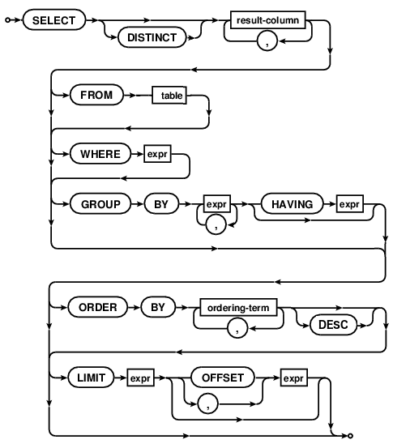
Syntax diagrams
Any path from start to end is a valid statement.
Choose which arrows to follow
The rectangles refer to other diagrams.
Used by our SQL book
Used by SQLite online docs:
https://sqlite.org/lang.html

Slide 8
SELECT steps (abbreviated)
FROM chooses the table of interest
WHERE throws out irrelevant rows
GROUP BY identifies rows to combine
SELECT tells what values to return (allowing math and aggregation)
HAVING throws out irrelevant rows (after aggregation)
ORDER BY sorts
LIMIT throws out rows based on their position in the results
Each step gets closer to the specific result you want.

Slide 9
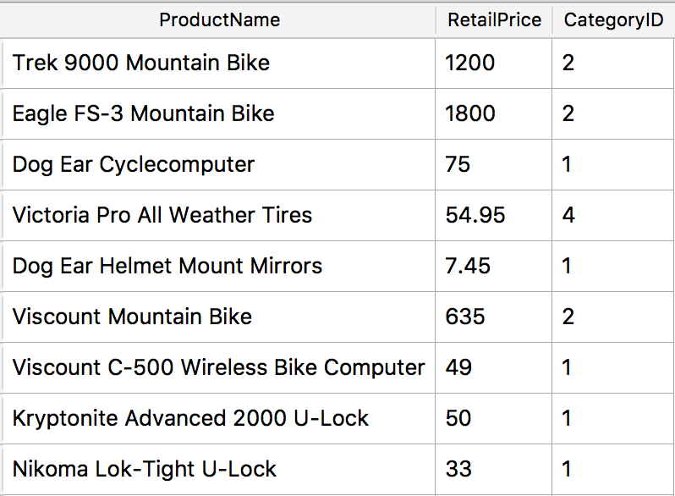
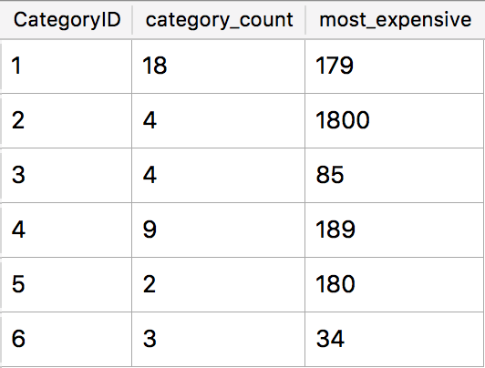
GROUP BY explained
GROUP BY combines multiple rows into one row in the result.
Rows with the same value for the grouping criterion are grouped.
An aggregation function is usually applied.
SELECT CategoryID, COUNT(*) AS category_count,
MAX(RetailPrice) AS most_expensive_price
FROM Products GROUP BY CategoryID;
Notes:
Number of rows in the result will equal the number of unique values taken by the grouping criterion.

Slide 10
How JOIN builds a composite table
SELECT * FROM staff JOIN department
ON staff.departmentId=department.id
Start with the first table (staff)
Join with rows from the 2nd table (department) that match according to the ON columns
staff.id | staff.name | staff.room | staff.departmentId | department.id | department.name | department.buildingId
11 | Bob | 100 | 1 | 1 | Industrial Eng. | 1
20 | Betsy | 100 | 2 | 2 | Computer Sci. | 2
21 | Fran | 101 | 1 | 1 | Industrial Eng. | 1
22 | Frank | 102 | 4 | 4 | Chemistry | 1
35 | Sarah | 200 | 5 | 5 | Physics | 4
40 | Sam | 10 | 7 | 7 | Materials Sci. | 5
54 | Pat | 102 | 2 | 2 | Computer Sci. | 2

Slide 11
Using INNER JOIN, what if rows don’t match one-to-one?
staff
id | name | room | departmentId
11 | Bob | 100 | 1
20 | Betsy | 100 | 2
21 | Fran | 101 | 1
department
id | name | buildingId
1 | Industrial Eng. | 1
2 | Computer Sci. | 2
4 | Chemistry | 1
1 | Physics | 4
1 | Materials Sci. | 5
In output,
multiple matches leads to multiple rows.
no matches leads to no rows
SELECT * FROM staff JOIN department ON staff.departmentId=department.id
staff.id | staff.name | staff.room | staff.departmentId | department.id | department.name | department.buildingId
11 | Bob | 100 | 1 | 1 | Industrial Eng. | 1
11 | Bob | 100 | 1 | 1 | Physics | 4
11 | Bob | 100 | 1 | 1 | Materials Sci. | 5
20 | Betsy | 100 | 2 | 2 | Computer Sci. | 2
21 | Fran | 101 | 1 | 1 | Industrial Eng. | 1
21 | Fran | 101 | 1 | 1 | Physics | 4
21 | Fran | 101 | 1 | 1 | Materials Sci. | 5

Slide 12
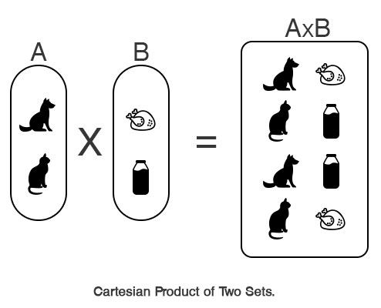
CROSS JOIN is like the cartesian product of two sets
Take every element (row) of the first set (table) and combine it with every element of the second set.
If first set has N elements and second set has M elements, then cartesian product has N·M elements.
There is no “ON” expression to limit results:
  SELECT Orders
  CROSS JOIN Order_Details;

Slide 13
NATURAL JOIN
A shorthand notation to make some JOINs shorter to express.
NATURAL JOIN matches rows using whatever columns have identical names.
For example:
  SELECT * FROM Orders JOIN Order_Details
  ON Orders.OrderNumber=Order_Details.OrderNumber;
Becomes:
  SELECT * FROM Orders NATURAL JOIN Order_Details;

Slide 14
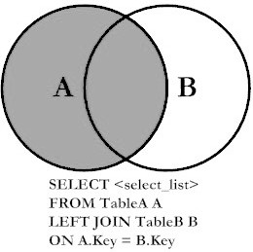
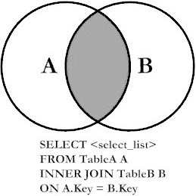
LEFT JOIN
LEFT JOIN includes all rows in the first table (left-hand side)
and just the matching rows in the second table (right-hand side).
(standard)
INNER JOIN
LEFT JOIN
All rows from
First table
Matching rows from Second table

Slide 15
SELECT * FROM staff LEFT JOIN department ON staff.departmentId=department.id;
staff
id | name | room | departmentId
11 | Bob | 100 | 1
20 | Betsy | 100 | NULL
21 | Fran | 101 | 1
22 | Frank | 102 | 99999
35 | Sarah | 200 | 5
40 | Sam | 10 | 7
54 | Pat | 102 | 2
department
id | name | buildingId
1 | Industrial Eng. | 1
2 | Computer Sci. | 2
5 | Physics | 4
7 | Materials Sci. | 5
Betsy and Frank have NULLs in the right haft of the output because no matching department was found.
In other words no pair of rows was found to satisfy the ON staff.departmentId=department.id
staff.id | staff.name | staff.room | staff.departmentId | department.id | department.name | department.buildingId
11 | Bob | 100 | 1 | 1 | Industrial Eng. | 1
20 | Betsy | 100 | NULL | NULL | NULL | NULL
21 | Fran | 101 | 1 | 1 | Industrial Eng. | 1
22 | Frank | 102 | 99999 | NULL | NULL | NULL
35 | Sarah | 200 | 5 | 5 | Physics | 4
40 | Sam | 10 | 7 | 7 | Materials Sci. | 5
54 | Pat | 102 | 2 | 2 | Computer Sci. | 2

Slide 16
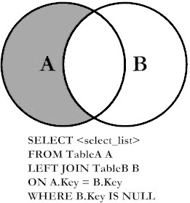
LEFT JOIN with exclusion
Includes rows from a table that must not match another table.
Useful for finding rows lacking something.
Just add a WHERE clause to look for NULL values in the right-hand side of the joined table
For example, to determine which faculty members should be assigned a class:
  SELECT * FROM Faculty NATURAL LEFT JOIN Faculty_Classes
  WHERE ClassID IS NULL;
Which classrooms are unused?
  SELECT * FROM Class_Rooms NATURAL LEFT JOIN Classes WHERE ClassID IS NULL;

Slide 17
JOIN TYPES
Introduced different types of JOINs:
INNER (default): prints all pairs of rows (one from first table, one from second table) that satisfy the JOIN predicate.
LEFT: same as INNER, but adds rows from LEFT table that never satisfied the JOIN predicate.
LEFT with exclusion: only print rows form left table that never satisfied the JOIN predicate.

Slide 18
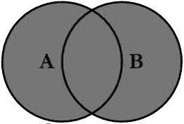
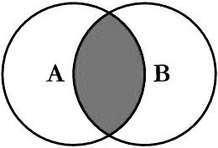
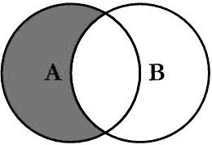
UNION, INTERSECT, and EXCEPT are used to combine two SELECT statements
UNION prints rows from either of two SELECTs
(printing duplicates just once)
INTERSECT prints rows present in both SELECTs
EXCEPT prints rows present in one SELECT but missing from another SELECT

Slide 19
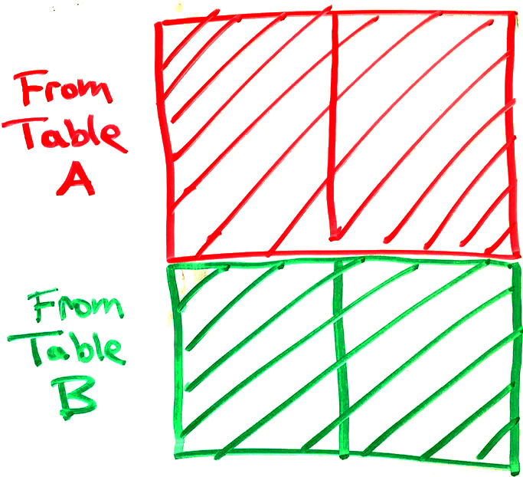
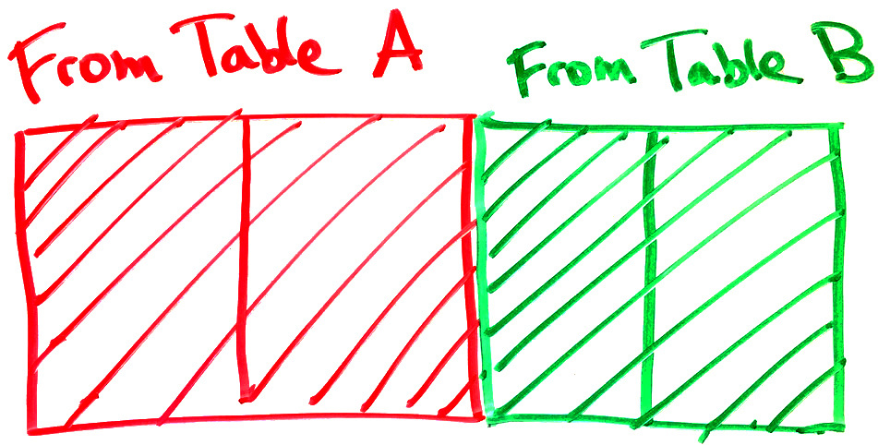
JOIN vs. UNION
JOINs combine tables horizontally.
  Match rows from two tables based on one or more columns matching.
  Creates a wider set of rows, adding columns from both tables.
JOIN:
  UNION, INTERSECT, and EXCEPT combine result tables vertically
  Number & type of columns in the two result tables must match
  Changes the number of rows,
  not columns
UNION:

Slide 20
Summing an indicator variable
Two ways to count recipes with “salsa” in description:
SELECT COUNT(*) FROM Recipes WHERE RecipeTitle LIKE "%salsa%”;
  WHERE clause keeps just the rows matching “salsa,” then these rows are counted.
SELECT SUM(RecipeTitle LIKE "%salsa%")
FROM Recipes;
  A column is created for every recipe indicating whether its title matches “salsa” or not.
  Column’s value will be 1 if it matches and 0 if not.
  Sum of all the ones and zeros will be the count of matching recipes.
First approach is easier to understand, but second is shorter.

Slide 21
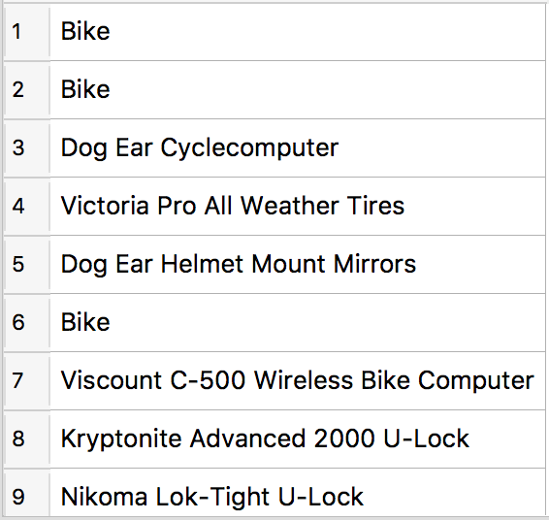
CASE conditional
WHEN condition is tested for every row, giving true or false
SELECT CASE WHEN CategoryID=2
THEN "Bike"
ELSE ProductName END FROM Products;
If condition is true then use the first value.
If condition is false then use the second value.
Output:

Slide 22
Regular Expressions
Regular expressions are used to match text, both in SQL and in many other data management tools.
A match anywhere in the text returns true.
^ anchors to the beginning
$ anchors to the end
. matches any character
[…] specifies a set of possible characters
[a-z] hyphen specifies a range
[^abc] carrot within brackets negates the match
Repetitions are supported:
  * any number
  + one or more
  ? zero or one
  {n,m} n to m repetitions
| pipe character gives OR
(…) can be used for grouping

Slide 23
Examples
^1.*t$ matches: “12 point”, “100.3 feet”, “111ttt”, “1t”
does not match: “This 12 point font”
[Cc]ats? matches: “Cat behavior”, “5 cats”, “catnip”
does not match: “cast”, “CATS”
[0-9]+.[a-z]? matches: “249032/b”, “23.”, “
does not match: “a”, “aa”, “1”
([cC]at|[Dd]og)( food)? matches: “cat food”, “Dog”
does not match: “ food”

Slide 24
Why sorting is not enough
You can’t sort in multiple dimensions
  Let’s say you want to find a product quickly according to either it’s name, manufacturer, or price. You can only sort by one of the there three columns.
Can’t insert new data without shifting everything over to make room.
It doesn’t take advantage of the hardware’s storage hierarchy.
  The binary search will have to access the disk in every step because the index is distributed over the full data set.
  It would be better to put all the index data close together (spatial locality).
The solution:
Indexes provide quick to rows by looking up column values.

Slide 25
When to index columns?
When a query is slow!
Generally, add an index if the column is:
  Used in WHERE conditions, or
  Used in JOIN … ON conditions, or
  A foreign key refers to it.
Also helpful if the column is:
  In a MIN or MAX aggregation function

Slide 26
Key and Index terminology in SQL
Plain key or index is just a way to find rows quickly
  Just creates a search tree.
Unique key is an index that prevents duplicates
  Bottom level of search tree has no repeated values
  DBMS can use the tree to quickly search for existing rows with that value before allowing a row insertion (or column update) to proceed.
Primary key is just a unique key, but there can only be one per table
  We think of the primary key as the most important unique key in the table
Foreign key makes a column’s values match a column in another table
  The referenced column in the other table should be indexed
  (usually it’s the primary key).

Slide 27
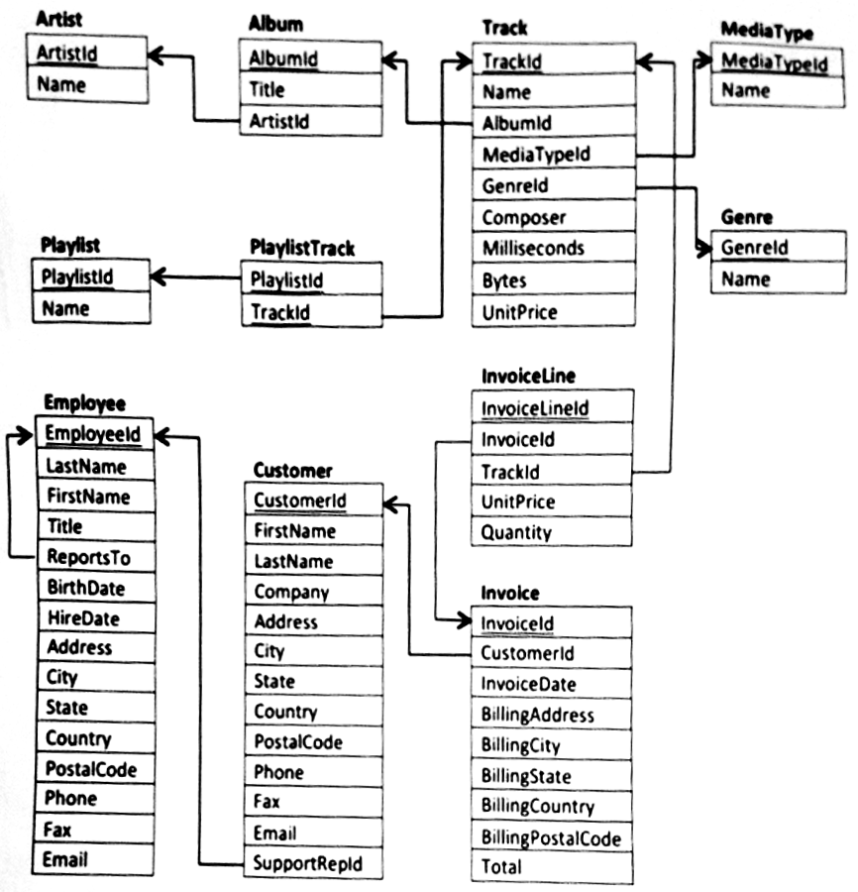
Primary Keys
*
*
*
Every table has a unique
primary key – the column(s) that uniquely identify each row.
No two rows can have the same primary key value.
The primary key defines the principal feature of each row.
Often it’s an integer identifier
PlaylistTrack table is different. It uses a composite primary key (made of two columns) and it lacks an integer identifier.
In this class, we will underline primary keys in the diagrams.
*
*
*
*
*
*

Slide 28
Unique keys
Unique keys are like additional (secondary) primary keys.
No two rows can have the same value for a unique key.
For example, we may wish to require that all Albums have both a unique AlbumId and a unique UPC (bar code):
We write UNIQ next to columns with unique keys in the diagrams
Album
AlbumId
Title
ArtistId
UPC UNIQ
When inserting data into this table, the new row must have both a unique AlbumId and a unique UPC.

Slide 29
Foreign Keys
Tables may be linked by foreign keys – columns that refer to keys in other tables.
Usually these are integers ids, and should refer to a primary/unique key
PlaylistTrack table is made entirely of foreign keys, so we call it a linking table.
Arrows in these diagrams go from a foreign key to the column(s) they reference.
*
*
*
*
*
*
*
*

Slide 30
Parent and Child tables
*
*
*
*
*
Foreign keys define a parent and child table.
  Child points back to parent
  Parent row must be created before child row
A table can simultaneously be both a parent and child.
  Album is a child to Artist, but a parent to Track.
*
*
*
*
*
*
*
*
*
*
*

Slide 31
One to Many
(or equivalently “many to one”)
Most foreign keys create one-to-many relationships
Created when a column that is not a primary key has a foreign key.
All of the arrows in this diagram represent one-to-many relationships.
  Many of the rows in the child table can be related one row in the parent table.
Notes:
It may be more clear for students to think of these as “many to one” relationships

Slide 32
Many to Many
Two one-to-many relationships starting at the same table can create a many-to-many relationship
These are represented with linking tables.
But, some tables can be classified in multiple ways:
  We think of Track as either an object or as a many-to-many relationship between albums and genres.

Slide 33
One to One
One-to-one relationships exists when a primary (or unique) key is also a foreign key.
In other words, there is an arrow pointing from one primary/unique key to another.
  The fact that it’s a unique key prevents it appearing multiple times (thus, not one-to-many).
The child is a subset table.
Subset tables are an alternative to having optional columns in the parent table.
GrammyAward
AlbumId
Year
Return
InvoiceId
Time
RefundAmount

Slide 34
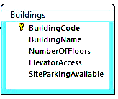
CREATE TABLE Syntax examples from SchoolScheduling.sqlite
Table name
Required column, not optional
CREATE TABLE Buildings (
BuildingCode nvarchar(3) NOT NULL,
BuildingName nvarchar(25),
NumberOfFloors smallint,
ElevatorAccess bit NOT NULL DEFAULT 0,
SiteParkingAvailable bit NOT NULL DEFAULT 0,
PRIMARY KEY (BuildingCode)
);
Text with at most 25 characters
Columns
Column cannot be NULL, but it will take a value of zero if none is specified.
Each column has a data type, like nvarchar(3) or smallint

Slide 35
“Hello!” in ASCII
 | H | e | l | l | o | !
hex | 48 | 65 | 6C | 6C | 6F | 21
binary | 0100 1000 | 0110 0101 | 0110 1100 | 0110 1100 | 0110 1111 | 0010 0001

Slide 36
Variable length character encoding with UTF-8
1st byte | 2nd byte | 3rd byte | 4th byte | # of free bits
0... .... |  |  |  | 7 (ASCII)
110. .... | 10.. .... |  |  | 11
1110 .... | 10.. .... | 10.. .... |  | 16
1111 0... | 10.. .... | 10.. .... | 10.. .... | 21
Single-byte characters are identical to ASCII
First byte tells you how many total bytes to expect
Every “extra” byte starts with “10”
  If you start reading in the middle of a character you’ll know it.
  It’s very easy to know where each new character starts.

Slide 37
NBA_player_of_the_week.csv viewed as text
PlayerID,TeamID,PositionID,First Name,Last Name,Seasons in League,Height ,Weight,Age
1,20,7,Micheal,Richardson,6,77,189,29
2,14,9,Derek,Smith,2,78,205,23
3,9,2,Calvin,Natt,5,79,220,28
4,15,1,Kareem,Abdul-Jabbar,15,80,225,37
5,2,8,Larry,Bird,5,81,220,28
6,32,9,Darrell,Griffith,4,82,190,26
7,11,7,Sleepy,Floyd,2,83,170,24
8,8,8,Mark,Aguirre,3,84,232,25
9,15,7,Magic,Johnson,5,85,255,25
10,1,8,Dominique,Wilkins,2,86,200,25
11,33,6,Tom,McMillen,9,87,215,32
12,6,9,Michael,Jordan,0,88,215,22
13,7,4,World,Free,9,89,185,31
14,10,7,Isiah,Thomas,3,90,180,23
15,18,6,Terry,Cummings,2,92,220,23
16,6,6,Orlando,Woolridge,3,94,215,25
17,30,1,Jack,Sikma,7,95,230,29
18,22,8,Bernard,King,7,96,205,28
19,25,1,Moses,Malone,8,97,215,29
20,9,8,Alex,English,8,98,190,31
21,26,6,Larry,Nance,3,99,205,26
22,13,1,Herb,Williams,4,101,242,28
23,25,6,Charles,Barkley,1,102,252,23
24,32,8,Adrian,Dantley,9,85,208,30
25,18,9,Sidney,Moncrief,6,89,180,28
26,27,9,Clyde,Drexler,2,95,210,23
27,29,9,Alvin,Robertson,1,98,185,23
28,33,1,Jeff,Ruland,4,99,240,27
29,22,1,Patrick,Ewing,0,102,240,23

Slide 38
JSON
JavaScript Object Notation
Used in many web applications and data APIs
Allows an arbitrary amount of nesting
Spaces are ignored, except within quotes.
Basic components are:
[] for ordered lists
  Items are separated by commas
  Items can be any JSON
{} for unordered dictionaries/objects
  Key: value pairs are separated by commas
  Keys must be strings (text)
  Values can be any JSON
Numbers, true, false, null
Strings (text) in double quotes "..."
[
{
"name": "John",
"age": 30,
"cars":
["Ford", "BMW", "Fiat"]
},
{
"name": "Alicia",
"age": 32,
"hometown": "Seattle"
}
]

Slide 39
XML
eXtensible Markup Language
Older than JSON, and now is less common than JSON because many people think XML is unnecessarily complicated.
HTML is an XML document that defines a web page.
Basic components are:
Text
Tags
  <tagname>…</tagname> or just <tagname>
  Have a name, and have XML inside
  Each start tag has a corresponding end tag, but only if it has data inside.
Attributes
  <tag attr="value" …>
  Appear within tags
  Attribute name and value must be text
  Tag can have multiple attributes, but each must have a unique name
<people>
<person name="John"
age="30">
<cars>
<car>Ford</car>
<car>BMW</car>
<car>Fiat</car>
</cars>
</person>
<person name="Alicia"
age="32">
<hometown city="Seattle">
</person>
</people>

Slide 40
Comparison of data exchange formats
 | Proprietary | SQL | CSV | JSON | XML
Space efficiency | Compact binary representation | Bloated text with SQL syntax | Text with little extra syntax | Text with little extra syntax | Text with verbose tag names
Compatibility (readable by many) | Must use specific program/DB | Each DBMS has its own SQL dialect | Standardized format | Standardized format | Standardized format
Expressibility (data complexity) | Complex relationships | Complex relationships | Represents a single table | Complex relationships | Complex relationships
Popularity | Rare | Rare | Common | Common | Less common
Flexibility/rigidity | SQL DBs are have a clearly defined schema that must be obeyed. |  | Rows all have same columns. | Data and schema are defined together. Different elements can have different attributes.
Text-based file formats (SQL, CSV, JSON, XML) are not space efficient, but text files can be compressed using general-purpose file compression utilities like gzip to alleviate the problem (eg., my_data.json.gz)

Slide 41

Fixed point example in 16 bits
Let’s store the chemical elements’ atomic weights.
Smallest value (hydrogen) is 1.00784
Largest value (uranium) is 238.02891
Negative values are not possible
We can reserve 8 bits for the fractional part and 8 bits for the part > 1
In this particular binary fixed point representation, weight of uranium is:
  The radix point is implicit, not stored in the computer.
  11101110.00000111
  = 238 $\frac{7}{256}$ = 238.02734375 (We had to round off, so this is not precisely accurate)
And the weight of hydrogen is:
  00000001.00000010
  = 1 $\frac{2}{256}$ = 1.0078125

Slide 42
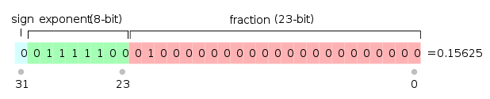
Representing floating point in bits
0.15625_{ten} = 0.00101_{two} = 1.01 × 10⁻¹¹_{two}
Three essential parts are the sign, fraction, & exponent
  Notice that the first significant figure is always “1” so we don’t have to store it
In the mid 1980s, the IEEE standardized the floating point representation of 32 and 64 bit numbers:
  The exponent has a sign too, but the standard says to add a “bias” of 127
1111100 = 124 124-127 = -3 exponent

Slide 43
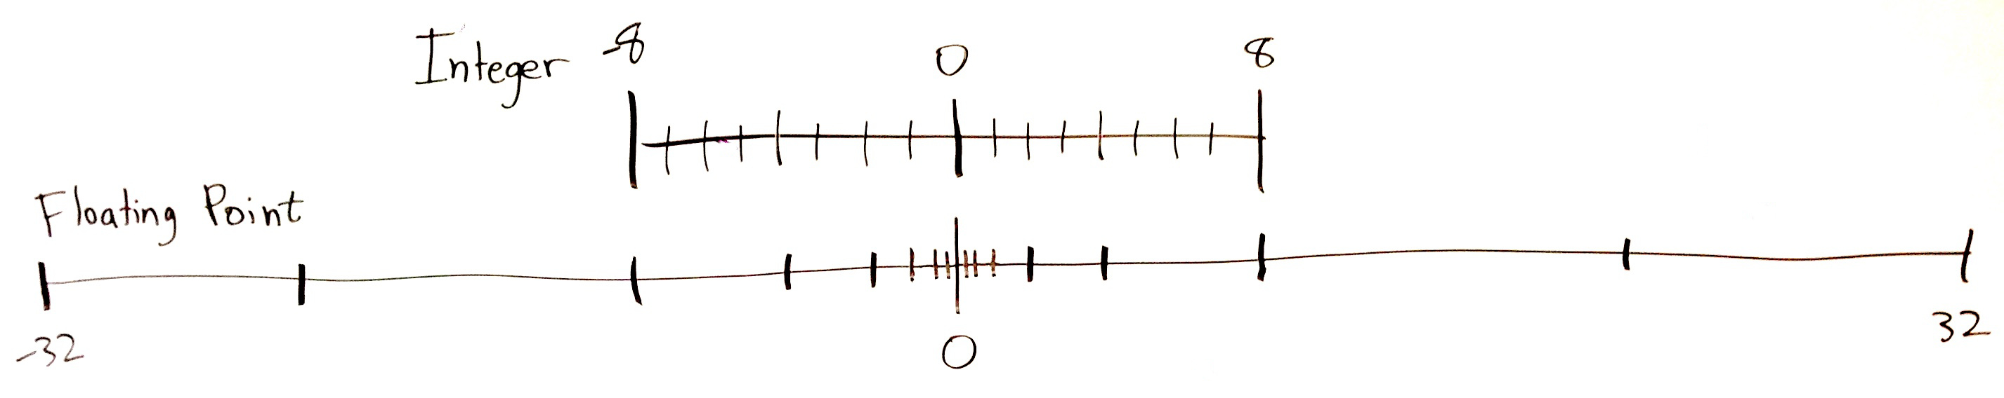
Floats just distribute numbers differently
Above, the dashes represent possible numbers.
Both of the above number lines have 17 dashes (possible numbers)
The only difference is the spacing.
  Integer spacing is constant but floats are exponentially spaced

Slide 44
Number Representation summary
Computers represent numbers with different binary encodings
Text can represent decimal numbers in various formats (eg., CSV, JSON).
Integers represent whole numbers
  Remember that 2¹⁰ = 1024 ≈ 1000, 2³² ≈ 4 billion
  Signed integers use two’s complement
  Used for counting and identifying records.
Fixed point adds an implicit radix point to an integer.
  Allows representing fractional quantities as integers, but with limited range.
  Used for numbers that should round off, like prices.
Floating point is a binary scientific notation representation
  Can represent tiny fractional values and huge values with equal precision
    Single precision ≈ 7 decimal digits, Double precision ≈ 16 decimal digits of precision
  Used for measurements and calculations.

Slide 45
Bulk vs. online data sources
So far, we have assumed that we can bulk export and import data.
  In other words, we can get easily get all the data in one download.
  Data is exchanged as CSV, JSON, XML, or SQL files:
    Dump file(s) from origin database
    Load file(s) into the destination database
However, some data sources do not allow bulk access, and instead provide some kind of web-based access to the data:
  A data API may be provided for users to query the data programmatically.
  Data may be presented in web page for human reading, not intended for programmatic access.

Slide 46
Web scraping
Find the pages that hold the data
  Often you’ll start with a hard-coded index page and then programmatically look for links to additional pages.
  Download the HTML (using Python requests package, for example)
Extract the data from a given page:
  Web pages are usually generated by a computer program, so the data will always be found within a certain pattern of HTML code.
Locations in the HTML document can be specified in one of two ways:
  CSS selectors – used be web page designers in Cascading Style Sheets to specify which fonts/colors/etc. (styles) apply to which parts of the page.
    Python beautifulsoup4 package uses CSS selectors
  XPath queries – used for finding elements in an XML document (remember that HTML is a type of XML).
    Python lxml package used XPath
  CSS selector and XPath syntax can be tested in the Chrome developer tools.

Slide 47
Messy data
Data can have missing, incorrect, or inconsistent values for many reasons:
  Pulled from different sources with different naming or unit conventions
  Paper scanning (OCR) errors
  Human input errors
Variety of tools are needed to deal with messy data:
  Review summary statistics
  Synonym tables
  Named entity matching with ML (dedupe.io and Open Refine)
  Crowdsourcing: MTurk, home-grown solutions
Above all, don’t blindly trust data you are given!

Slide 48
Data modeling practice

Slide 49
Final words of wisdom
Peter Drucker famously said:
  “If you can’t measure it, you can’t improve it.”
MBA programs teach “scientific management” principles.
Data-driven decision making is popular.
  However, data can be easily cherry-picked and misinterpreted.
  Focusing on the measurables is easy, but avoids important long-term issues.
  Many of a business’ most important qualities cannot be queried from the databases:
    Customer satisfaction.
    Employee morale.
    Brand image.
    Long-term sustainability.
Unfortunate reality:
  “If you can’t improve it, measure it!”

Slide 50
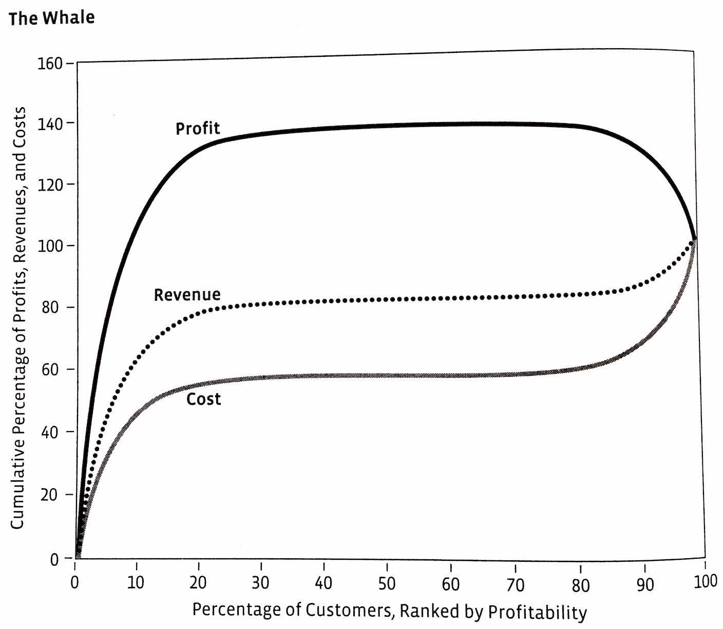
Beware of “whaling” analysts
Naïve analysis:
  Profits could be increased by more than 30% by focusing on the top 20% most profitable customers!
Fatal assumptions:
  It’s possible to drop the “bad” customers without also losing many “good” customers.
    Market dominance has no effect on ability to attract the good customers.
  Per-customer profitability is constant over time.
    Some of those “bad” customers may be very profitable next year (and vice versa).
Supposed gains by dropping 80% of customers
Approximate break-even point
Good customers
“Bad” customers
From “The Management Myth” by Matthew Stewart.

Slide 51
Use data wisely
Analysis doesn’t stop when you get a numeric “answer” or a plot.
Ask yourself:
  What’s missing from this analysis?
  What are we not measuring (where we could search for more data)?
  What cannot be measured?
  Do the results change if we look at different time periods or random subsets of the data? (This indicates a lack of statistical significance.)
Now ask the same questions above to the people most intimately familiar with the business.
Data related to human activities are always a simplification of reality!
View data as a scientist – keep testing your assumptions.

