Slide 1

EECS-317 Data Management and Information Processing
Lecture 16 –
Little, Medium, & Big Data
Steve Tarzia
Spring 2019

Slide 2
Last Lecture: Number Representations
Computers represent numbers with different binary encodings
Text can represent decimal numbers in various formats (eg., CSV, JSON).
Integers represent whole numbers
  Remember that 2¹⁰ = 1024 ≈ 1000, 2³² ≈ 4 billion
  Signed integers use two’s complement
  Used for counting and identifying records.
Fixed point adds an implicit radix point to an integer.
  Allows representing fractional quantities as integers, but with limited range.
  Used for numbers that should round off, like prices.
Floating point is a binary scientific notation representation
  Can represent tiny fractional values and huge values with equal precision
    Single precision ≈ 7 decimal digits, Double precision ≈ 16 decimal digits of precision
  Used for measurements and calculations.
  Float subtraction can lead to catastrophic cancellation.

Slide 3
Truly “Big Data” requires many machines
Why not just add more disks to one machine?
Each CPU has limited input/output capacity
  Because there are only a few dozen I/O “pins” (wires) on the CPU.
Each CPU has limited memory for fast access to data
Each CPU has limited processing (arithmetic) capacity
However, coordinating multiple machines is very difficult.

Slide 4
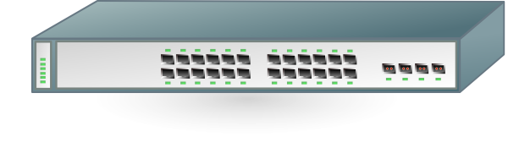
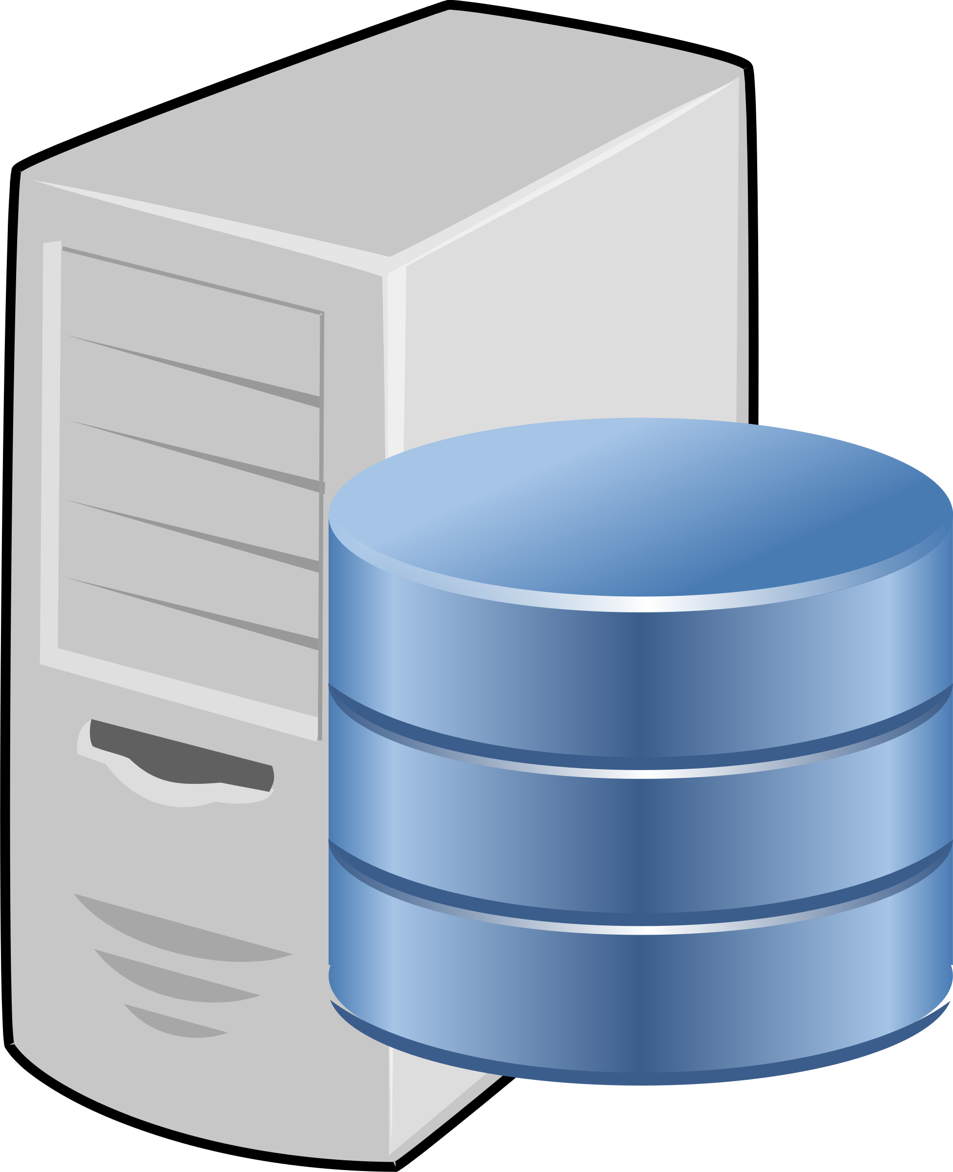
Distributing a database
Create a “cluster” of computers connected to each other.
Each “node” in the cluster stores a fraction of the data set.
Distributed database examples:
  MongoDB, Cassandra, Amazon DynamoDB, …
Distributed filesystems also use the same basic idea:
  Hadoop HDFS, Google File System (Colossus, BigTable), Amazon S3, …

Slide 5
Challenges in distributed DBs
Balancing storage and processing loads
Finding data (on which node is it?)
  Must be careful to involve only a few nodes in each query.
  If all nodes are involved in every query, then we gained nothing by adding more machines! (Every node would be effectively handling the full load.)
Analyses that combine data or process all of the data must be scalable
  No one node can work on all the data
Fault tolerance
  If we have dozens or hundreds of nodes, some are bound to fail
Consistency
  The different nodes cannot provide contradictory information

Slide 6
Hashing is the basis of distributed DBs
A hash is an algorithm that takes a value and returns a pseudo-random value derived from it.
It’s a constant but unpredictable mapping
  A long sequence of arithmetic operations
MD5 is a standard hash function:
  “Steve” → f6e997429bf8cb7b3b98b310a9f7ca30
  “steve” → 2666b87c682f5072f62bab0955d485ce
  “Janice” → 3837607db4754c036425cb1b2a7c8766
  “1” → b026324c6904b2a9cb4b88d6d61c81d1
  “Steve” → f6e997429bf8cb7b3b98b310a9f7ca30
  tale_of_two_cities.txt (806,878 characters)
  → 3ab56b74562a714a5638f94446581977
The same input always gives the same output
Length of the input can vary, but output has fixed length

Slide 7
We can define all kinds of hash functions
If we are dealing with text, and we want to map to a number 0-99, any of these are possible hash functions:
  Use the length of the string (modulo 100)
  Use the ASCII encoding of the first letter in the text (modulo 100)
  Count the ones in the binary representation of the text (modulo 100)
  Multiply the length of the string by the ASCII encoding of the first letter in the text and then subtract the ASCII encoding of the last letter in the text (modulo 100)
These all produce a number in the range 0-99 and they always give the same result for a given input, but the output is not well-balanced.
  Some numbers may be output much more frequently than others.
Standard hashes like MD5 and SHA-1 are very carefully designed

Slide 8
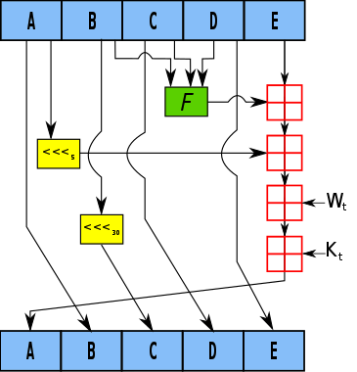
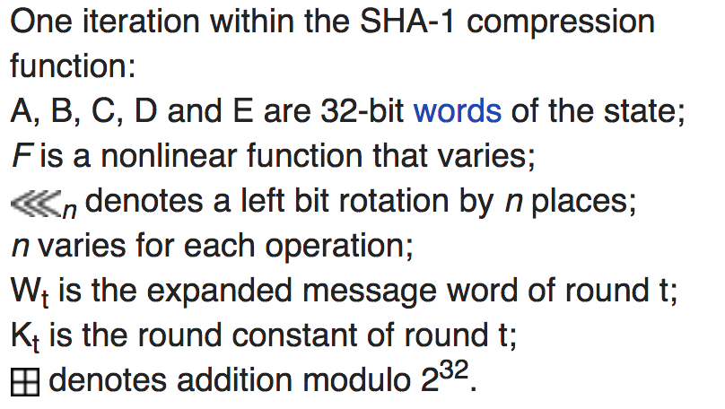
SHA-1 hash function illustration

Slide 9
Hash Table
Stores (key, value) pairs
  This abstract data type is called a dictionary, or map.
For example:
  A word and its definition.
    “word” → “a single distinct meaningful element of speech or writing, …”
    “hash” → “a dish of cooked meat cut into small pieces and cooked again, …”
  A database table’s primary key and the rest of the columns in the row:
    StaffID → [StfFirstName, StfLastName, StfStreetAddress, StfCity, StfState, ...]
    98005 → [“Suzanne”, “Viescas”, “15127 NE 24th, #383”, …]
    98007 → [“Gary”, “Hallmark”, “Route 2, Box 203B”, …]
key
value

Slide 10
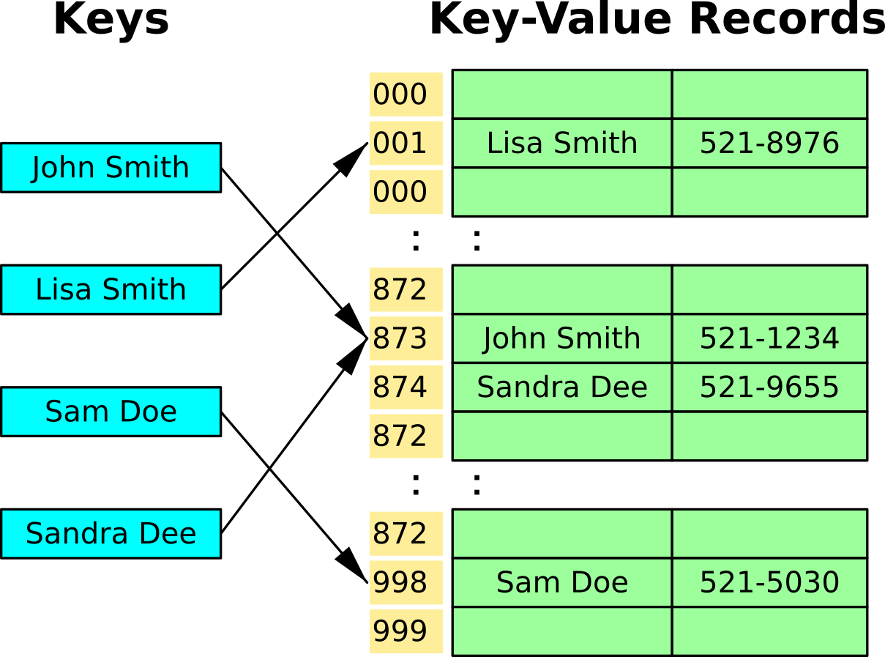
Hash Table mechanics
Hash the key to determine the address where the value is stored
If the address is already filled, then use the next open slot
  This is called a collision and there are other strategies besides “linear probing”

Slide 11
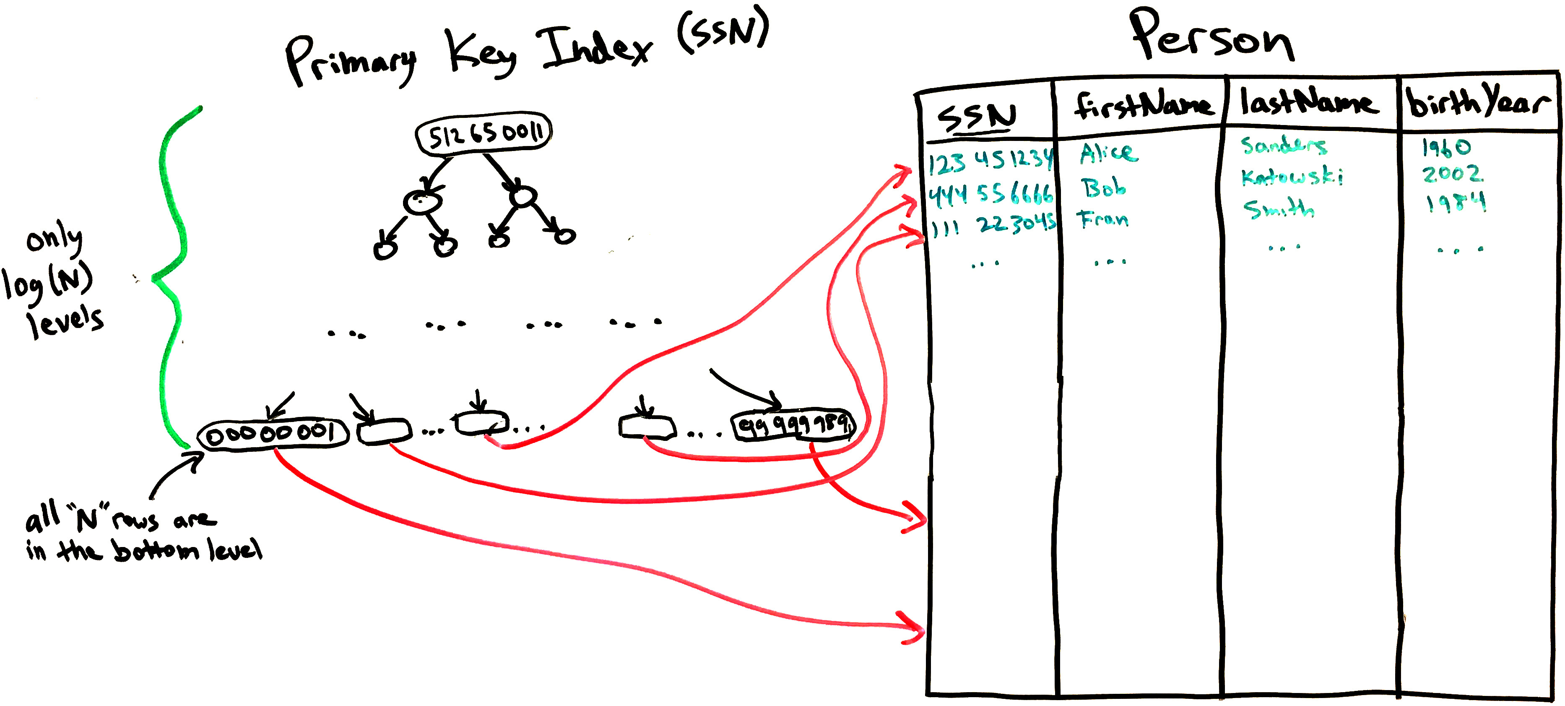
Hash Indexes in SQL databases
A hash table is an alternative to a binary search tree
  It lets you find the data in one step!
  However, it does not support range queries.
    Data is randomly scattered
Tree-based table index
Hash-based table index

Slide 12
Distributed Hash Table
Each cluster node is responsible for a range of hash values
Client software can computer the key hash to determine which node to query for the data:
Node 1 stores hash values 000-332
Node 2 stores hash values 333-665
Node 3 stores hash values 666-999

Slide 13
NoSQL databases
NoSQL databases are distributed key-value stores
Like one big table with just a primary key
They have a map/dictionary interface, do not support SQL queries.
  You can only:
    get a value for a key.
    put a value for a key.
  Each operation only affects the node(s) storing that key
    Very scalable! (can grow large without slowing down)
If we wanted to support full SQL, JOINs would have to pull data from many nodes in the cluster and performance would be slow.

Slide 14
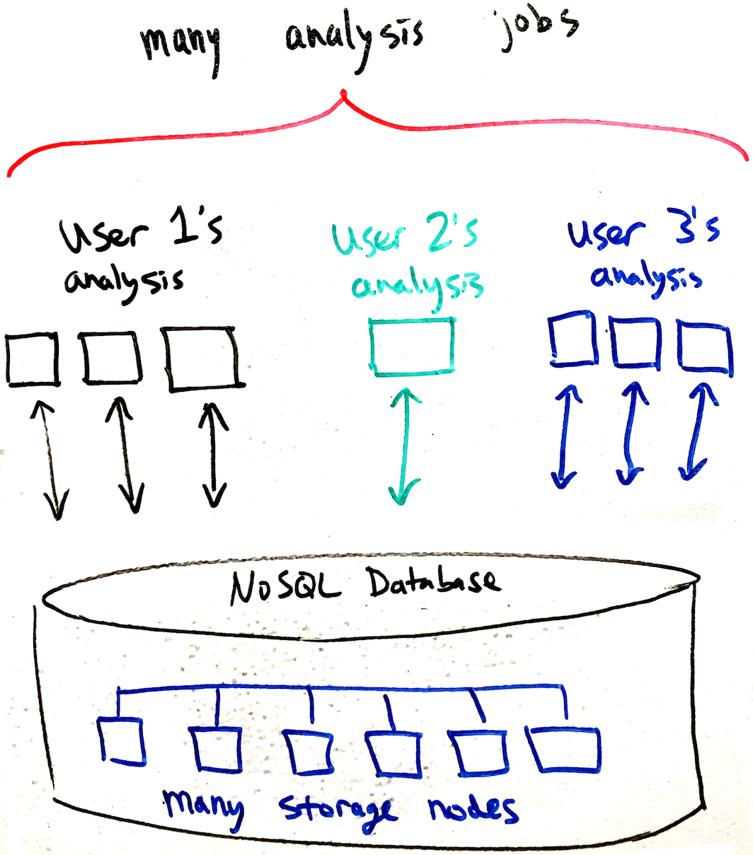
Scalable analysis with a NoSQL database
A distributed database can handle many concurrent queries.
A single analysis can be broken into multiple “workers” that run on different CPU cores or computers.
Similarly, a high-scale website or app can be built on top of a NoSQL database, with many frontend webservers/apps fetching and storing data at once.

Slide 15
NoSQL fault tolerance
Because there can be hundreds of nodes, NoSQL databases are designed to tolerate node failure. (Failures are more likely in a larger population.)
Each key-value pair must be stored on multiple nodes
However, data replication introduces consistency problems
  If two nodes report different values, then which do we use?
Common solution is to hash each key-value pair to three nodes
  Use the “majority opinion” when reading.
  Consider a write as successful if at least two nodes succeed at storing it.
NoSQL database clusters are redundant at the software level
  Can use inexpensive, unreliable servers because system tolerates node deaths.
SQL database servers are redundant at the hardware level.
  Use an expensive server: redundant power supplies, fans, disks, battery backup, etc.

Slide 16
Variety of data processing tools
Data processing tasks vary, so a variety of tools exist to handle different:
Data size
Data persistence (the need to reuse data)
Structured/unstructured data.
Numerical/textual/file data
Types of calculations to be done.

Slide 17
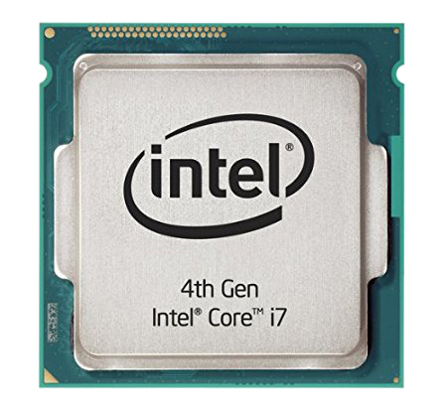
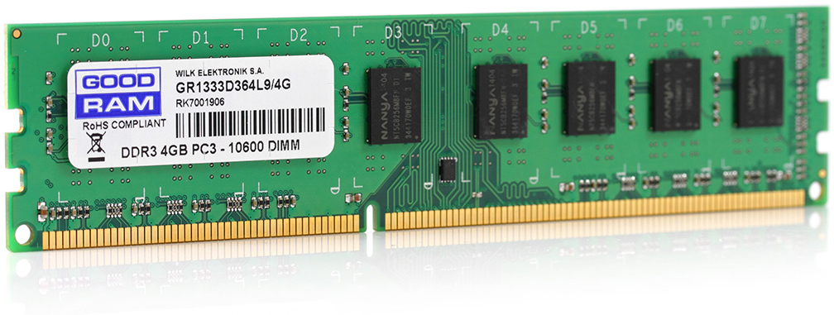
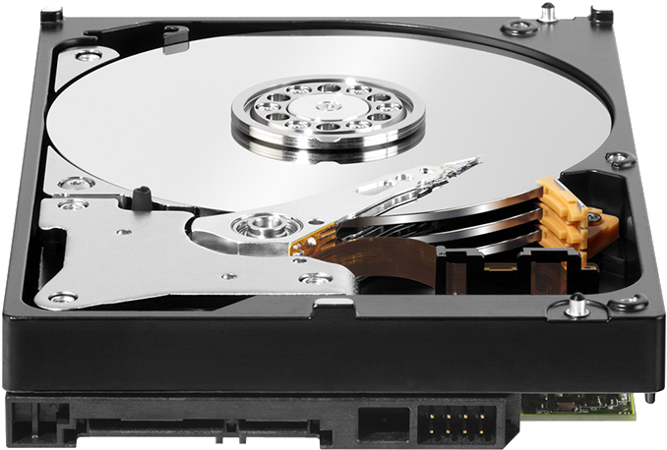
Data Size
Little data – can fit in a computer’s memory (RAM)
  Up to a few gigabytes (billion bytes)
Medium data – can fit in one computer’s filesystem (disks).
  Up to a few terabytes (trillion bytes)
Big data – cannot be stored or processed on one computer.
  10s of terabytes, petabytes (10¹⁵), even exabytes (10¹⁸)!
RAM capacity:
8 GB on a typical laptop
1.5 TB on a good server
Disk capacity:
256 GB on a typical laptop
12 TB on a good desktop
Cluster capacity:
Up to thousands of computers can be connected.
Capacity is unlimited.

Slide 18
Little Data tools
Matlab
General-purpose programming languages:
  R, Python, C++ etc.
  Program variables and data structures are stored in the computer’s memory.
    For example, lists and dictionaries are stored in memory.
  Filesystem access is not truly built-into the language.
    However, programmer can call functions to read/write data from disk.
  Data from files or databases must be copied to in-memory data structures to gain access.
Excel (spreadsheet is saved to a file, but it’s fully in RAM while open)

Slide 19
Medium Data tools
These allow data to remain on disk during analysis.
SQL relational databases
  Users create tables, define indexes, load data, and write queries.
  DBMS (the database server software) handles all the details:
    Tables are stored on disk.
    Queries are answered by pulling the appropriate data from disk.
  SQL databases can be used within tools like Matlab, Python, R, etc. to make the analysis more easily handle lots of data.

Slide 20
Other “medium data” tools
Streaming
  Open a file and read through it.
  Don’t load it all in memory, just examine each small piece and move on.
  Useful for very simple types of processing, like keyword searching or a single aggregation (like looking for the max value).
  For example, grep command for searching text files.
File-based indexing
  Use different folders/filenames to organize data in one dimension.
SAS/STAT
  A statistical analysis software package that can work with data on disk.
  Internally, it works like a SQL DBMS with one table.
“Do it yourself”
Commercial

Slide 21
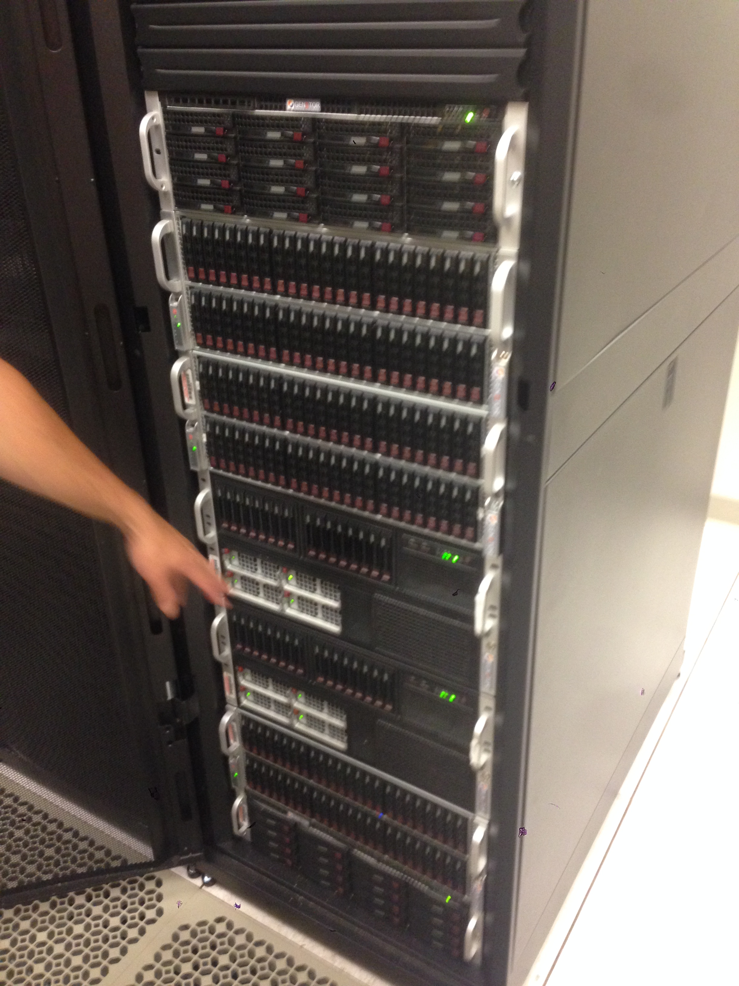
Large database servers
A single hard disk has limited capacity (~12 TB),
and limited throughput (~150 MB/s).
However, you can actually connect 10s or 100s
of disks to a single computer (especially for a DB server).
  Use RAID storage arrays.
Capacity is practically unlimited,
but a single computer has:
  Limited compute power.
  Limited I/O bandwidth
  (theoretical max of ~80 GB/s
  on PCI-express v4).
DBMS running on one machine
One big computer
Limited bandwidth to storage
Many disks can be connected to the computer

Slide 22
“Medium Data” tools are actually pretty scalable
Stack Overflow database (150GB) is stored on our MySQL server.
After adding all the appropriate indexes, analysis on the whole data set can be done very quickly with SQL.
Amazon uses an Oracle SQL database for product information.
  However, they handle shopping carts with their NoSQL database (Dynamo).
However, sometimes you need to work faster or support many simultaneous analyses, and this is where “Big Data” tools are useful.

Slide 23
“Big Data” problems
Let’s say you need to run analyses of 10 petabytes of data each day:
  Theoretically, a single computer can do this in no less than:
  10¹⁵ bytes / (80 * 10⁹ bytes/sec) = 12,500 seconds = 3.5 hours.
  However, in practice you may find the performance is much slower than this.
To speed up an analysis you can use many machines to work on the problem in parallel.
  The analysis is somehow split into pieces (subproblems)
  Each machine works on subproblems that contribute to the final answer.

Slide 24
Distributed computing
Data & analysis are distributed across many machines.
No one machine has direct access to all the data.
Machines must communicate over a network to share data and intermediate results.
We need some special way to define these analyses.
Master
node
User program
Communication Network
Compute task
Compute task
Compute task
Compute task
Compute task
Compute task
Compute task
Data slice
Data slice
Data slice
Data slice
Data slice
Data slice
Data slice

Slide 25
Example: Find the largest sales order
Distribute instructions to all the machines (nodes).
Each node computes its own maximum.
Results are sent to a single node.
Maximum of the maximums is calculated.
Master
node
User program
Communication Network
User program
User program
User program
User program
User program
User program
Compute task
Jan. orders
Data slice
Feb. orders
Data slice
Mar. orders
Data slice
Apr. orders
Data slice
May orders
Data slice
Jun. orders
Data slice
Data slice

Slide 26
Example: Find the largest sales order
Distribute instructions to all the machines (nodes).
Each node computes its own maximum.
Results are sent to a single node.
Maximum of the maximums is calculated.
Master
node
Communication Network
Max=
$32,344
Max= $54,321
Max= $10,302
Max= $31,204
Max= $4,291
Max= $33,201
Compute task
Jan. orders
Feb. orders
Mar. orders
Apr. orders
May orders
Jun. orders
Data slice

Slide 27
Example: Find the largest sales order
Distribute instructions to all the machines (nodes).
Each node computes its own maximum.
Results are sent to a single node.
Maximum of the maximums is calculated.
Master
node
Max=
$32,344
Max= $31,204
Max= $54,321
Max= $10,302
Max= $4,291
Max= $33,201
Communication Network
Max=
$32,344
Max= $54,321
Max= $10,302
Max= $31,204
Max= $4,291
Max= $33,201
Compute task
Jan. orders
Feb. orders
Mar. orders
Apr. orders
May orders
Jun. orders
Data slice

Slide 28
Example: Find the largest sales order
Distribute instructions to all the machines (nodes).
Each node computes its own maximum.
Results are sent to a single node.
Maximum of the maximums is calculated.
Max of monthly maxes = $54,321
Communication Network
Max=
$32,344
Max= $54,321
Max= $10,302
Max= $31,204
Max= $4,291
Max= $33,201
Compute task
Jan. orders
Feb. orders
Mar. orders
Apr. orders
May orders
Jun. orders
Data slice

Slide 29
Hadoop is a distributed computing platform
It’s a type of computing cluster for storing data and running analyses.
Main components are:
  HDFS – Hadoop Distributed File System for storing the data to be analyzed and also for storing intermediate and final results.
    Data is distributed across all the nodes (machines) in the cluster.
    HDFS is closely coupled to the analysis engine.
  MapReduce – a programming model for defining the parallel analysis steps.
    Analysis is usually written in Java, but other languages are possible (Python, R, etc.)
    Analysis is defined in terms of two main operations – Map and Reduce.
    Based on a 2004 Google article: https://ai.google/research/pubs/pub62

Slide 30
MapReduce
A MapReduce analysis has to follow a certain pattern.
First, Map does something, producing many intermediate results.
Later, Reduce aggregates the intermediate results.

Slide 31
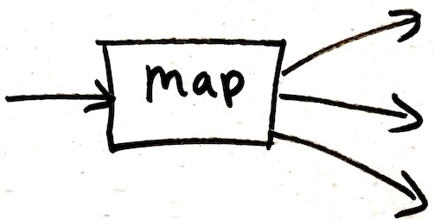

MapReduce programming model
Input & Output: each a set of key/value pairs
Programmer’s task is to define just two functions that will complete the work in parallel:
map(in_key, in_value) -> list(out_key, intermediate_value)
Processes input key/value pair
Produces a set of intermediate pairs
reduce(out_key, list(intermediate_value)) -> list(out_value)
Combines all intermediate values for a particular key
Produces a set of merged output values (usually just one)

Slide 32
MapReduce example: counting words
map(String input_key, String input_value):
// input_key: document name
// input_value: document contents
for each word w in input_value:
EmitIntermediate(w, "1");
reduce(String output_key, List intermediate_values):
// output_key: a word
// output_values: a list of counts
int result = 0;
for each v in intermediate_values:
result += v;
Emit(result);

Slide 33
Counting words example
Splitting and shuffling steps are done automatically by the Hadoop runtime system

Slide 34
Beware of the Hype!
Hadoop is designed for huge scale, but it’s inherently slower than traditional approaches: https://dl.acm.org/citation.cfm?id=1559865
It lacks indexes, has a lot of performance overhead.
Requires a special environment (a Hadoop cluster).
Don’t use Hadoop/MapReduce or NoSQL unless you really need to!
Probably 75% of Hadoop/NoSQL usage would be better served with a different tool (usually a SQL database).

Slide 35
Recap: NoSQL DBs and Hadoop
Hash functions map deterministically to pseudo-random values.
A hash table is a data structure to store (key, value) pairs:
  Hashing the key determines the data’s storage address.
  So, hashing is an alternative to binary search trees for indexing data.
Big Data requires databases (or filesystems) distributed over many computers
  NoSQL databases are distributed hash tables. Lack the full power of SQL.
Hadoop is a distributed computing platform, using MapReduce:
  Map function takes input and produces a bunch of intermediate results.
  Reduce function takes intermediate results and produces an output.
Stop and think before using “big data” tools (SQL is pretty scalable!)

