Slide 1

EECS-317 Data Management and Information Processing
Lecture 15 –
Number representations
Steve Tarzia
Spring 2019

Slide 2
Last Lecture: Web Scraping & Messy Data
Data can be scraped from web pages by writing code that:
  Downloads HTML pages
  Picks out data elements using CSS selectors (or XPath)
  Also pick out links to pages with additional data
  Repeat!
Data can have missing, incorrect, or inconsistent values for many reasons:
  Pulled from different sources with different naming or unit conventions
  Paper scanning (OCR) errors
  Human input errors
Variety of tools are needed to deal with messy data:
  Review summary statistics
  Synonym tables
  Named entity matching with ML (dedupe.io and Open Refine)
  Crowdsourcing: MTurk, home-grown solutions
Above all, don’t blindly trust data you are given!

Slide 3
Computers store information in binary
Ones and Zeros
…000100100001001001110011011010101010111100000…
Called “bits,” meaning “binary digits”
Why?
  Simplicity
  Noise robustness
  By convention
But how do we get meaning from a sequence of ones and zeros?

Slide 4
Data is zeros and ones plus an interpretation/context
An encoding defines what the zeros and ones represent
“01000100011000010111010001100001” can represent:
  The number 1,147,237,473 as an integer
  The number 901.8184 as a float
  The four letters “Data” in the ASCII or UTF-8 character encoding
  This color (at 37% transparency) in RGBA
  32 separate True or False values
Any crazy encoding is possible, but there are some standards.

Slide 5
Decimal numbers in text
CSV, JSON, and XML files store text, usually UTF-8 encoded.
In that text, you can print decimal numbers using the chars [0-9.eE\-]
For example:
  “12” = “1” + “2” = 0x 31 32 = 0011 0001 0011 0010
  “12.2e-4” = “1” + “2” + “.” + “2” + “e” + “-” + “4”
  = 0x 31 32 2E 32 65 2D 34
  = 0011 0001 0011 0010 0010 1110 0011 0010 0110 0101 0010 1101 0011 0100
These text-based encodings are inefficient because they only make use of a small subset of the characters.
However, they are easy to read and machine-independent.
A general-purpose compressor like “gzip” works well on text.
Other numeric encodings work directly with the bits, not with text.

Slide 6
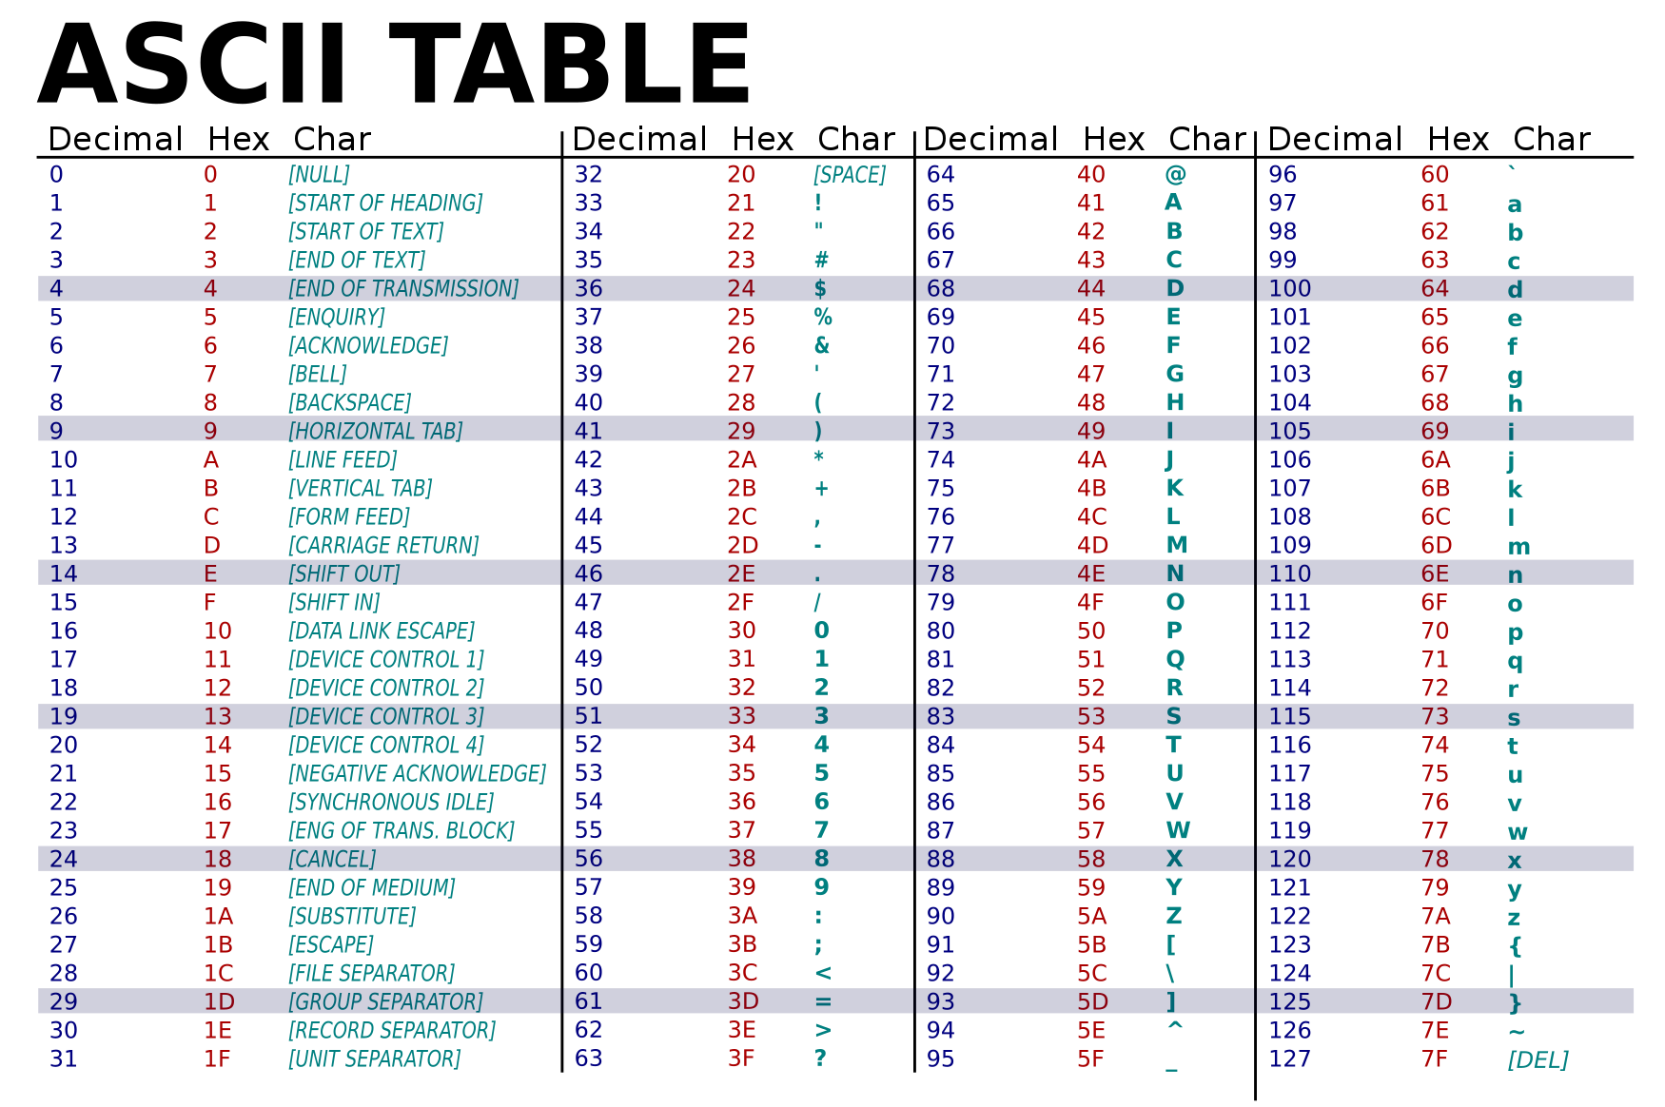
Subset of chars used by numbers are highlighted.

Slide 7
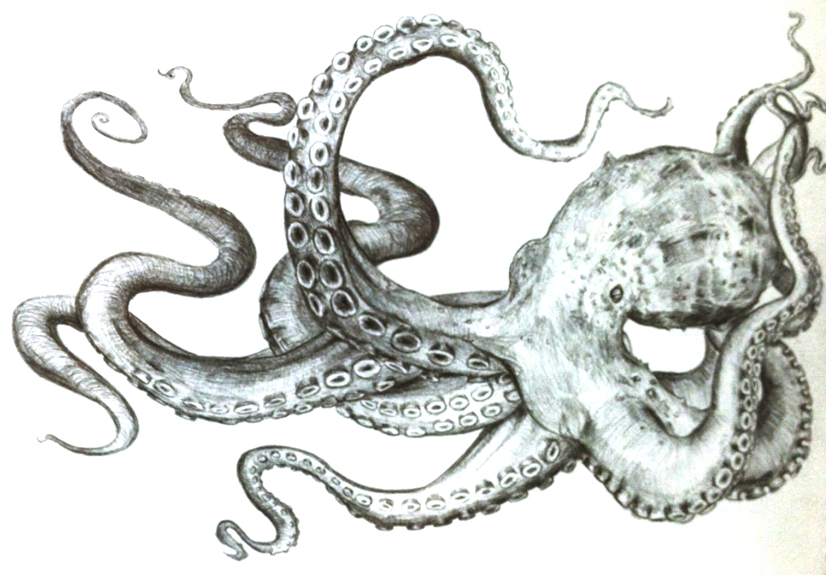
Integers
Integers are the simplest of all data encodings
Whole numbers only (no fractions)
Numbers are represented directly in the “base two” positional notation
The familiar “base ten” representation of numbers is just a convention due to the fact that humans have ten fingers.
What number base will octopuses evolve to use?
(drawing from http://drawingpencilarts.com/realistic-octopus-drawing/)

Slide 8
Integers in detail
Decimal 137_{ten}
1 3 7
x100 x10 x1 ← powers of 10
100 + 30 + 7 = 137
Binary 10001001_{two} = 137_{ten}
1 0 0 0 1 0 0 1
x128 x64 x32 x16 x8 x4 x2 x1 ← powers of 2
128 + 0 + 0 + 0 + 8 + 0 + 0 + 1 = 137

Slide 9
Simple binary integers
1_{ten} = 1_{two}
2_{ten} = 10_{two}
4_{ten} = 100_{two}
8_{ten} = 1000_{two}
16_{ten} = 10000_{two}
32_{ten} = 100000_{two}
64_{ten} = 1000000_{two}
128_{ten} = 10000000_{two}
3_{ten} = 11_{two}
7_{ten} = 111_{two}
15_{ten} = 1111_{two}
31_{ten} = 11111_{two}
63_{ten} = 111111_{two}
127_{ten} = 1111111_{two}
255_{ten} = 11111111_{two}

Slide 10
There are only 10 types of people in this world… those who understand binary and those who don’t.
(Stop and practice)

Slide 11
Binary tricks
Remember the first eight powers of two:
  2, 4, 8, 16, 32, 64, 128, 256
Remember that 2¹⁰ = 1024 ≈ 1000
  Lets you estimate the number of binary digits in a decimal integer:
  Every three decimal digits gives about ten binary digits
Remember the important large powers of two:
  2⁸ = 256
  2¹⁶ ≈ 64 thousand
  2³² ≈ 4 billion
  2⁶⁴ ≈ really big

Slide 12
Addition in binary
4 + 7 = 11
1 ← carry
4
+ 7
1 1
100 + 111 = 1011
1 ← carry
1 0 0
+ 1 1 1
1 0 1 1

Slide 13
More binary addition
63 + 98 = 161
1 1 ← carry
6 3
+ 9 8
1 6 1
11111 + 110010 = 1010001
1 1 1 1 1 ← carry
1 1 1 1 1
+ 1 1 0 0 1 0
1 0 1 0 0 0 1

Slide 14
Subtraction: addition’s tricky pal
161 – 98 = 63
⤳ ⤳ borrow
01 156 11
- 9 8
6 3
1010001 - 110010 = 11111
⤳ ⤳ ⤳ ⤳ ⤳ borrow
01 10 101 10 10 10 1
- 1 1 0 0 1 0
1 1 1 1 1

Slide 15
What about negative integers?
Signed integers can represent both positive and negative integers
We need an extra bit to represent the sign of the number
But we don’t just use a simple sign bit
We use two’s complement to represent negative numbers, because it
  Simplifies the computer’s addition and subtraction circuitry, and
  And it has just one representation of zero
Negative numbers “roll over” from the top of the binary range.

Slide 16
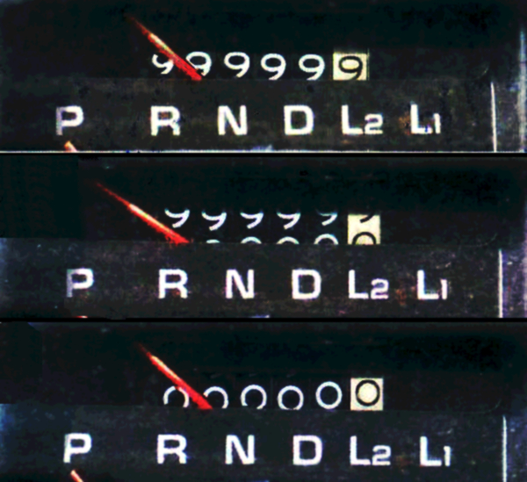
Works like an old-style car odometer

Slide 17
Two’s complement for three-bit numbers
3: 011
2: 010
1: 001
0: 000
-1: 111 ↩︎ rollover
-2: 110
-3: 101
-4: 100
-2 + 1 = -1
110 + 001 = 111
Subtraction is done in the exact same way as addition!
No need to learn how to “borrow.”

Slide 18
Subtraction works just like addition!
No need to learn how to “borrow.”
Just negate the second number and add.
3 – 2 = 3 + (-2) =
1 1 ← carry
0 1 1
+ 1 1 0
0 0 1 ← our answer!
We ignore the final carry because it falls outside of the 3-bits we are working with. That’s how we roll-over between negative and positive.
3: 011
2: 010
1: 001
0: 000
-1: 111
-2: 110
-3: 101
-4: 100

Slide 19
Two’s complement negation
To negate a number:
Flip all the bits. Ones become zeros and zeros become ones.
Add one
For example -3
Start with the bits for three: 011
Flip the bits: 100
Add one: 101
3: 011
2: 010
1: 001
0: 000
-1: 111
-2: 110
-3: 101
-4: 100

Slide 20
Overflow: when numbers don’t fit
For example, 2 + 2 = 4
4 cannot be represented in a three-bit signed integer.
What happens when we try this addition?
1 ← carry
0 1 0
+ 0 1 0
1 0 0 ← answer looks like -4!
The computer will throw an exception if the signs of the operands were the same, but the sign of the result is different.
  positive + negative cannot overflow.
  positive + positive should give a positive
  negative + negative should give a negative
Remember that the left-most bit indicates the sign.
3: 011
2: 010
1: 001
0: 000
-1: 111
-2: 110
-3: 101
-4: 100

Slide 21
Examples with 4 and 8 bits
4-bit is between -8 and 7
8-bit is between -128 and 127
(Stop and practice)

Slide 22
Just for fun over the weekend
This video shows how addition is actually implemented in hardware:
https://www.youtube.com/watch?v=1I5ZMmrOfnA
Search YouTube for “PBS ALU”
If you’re interested in learning more, take
COMP_ENG-203 Intro to Computer Engineering

Slide 23
A few more things about integers
Multiplication: two’s complement works magically here too
Positive division works as expected
Sign extension: when increasing the “bit size” of a negative number, add leading ones.
  Eg., -2 is 1110 as a 4-bit signed integer and 11111110 in 8 bits.
Computers typically use 32 or 64 bit integers.
Any questions on last week’s material?

Slide 24
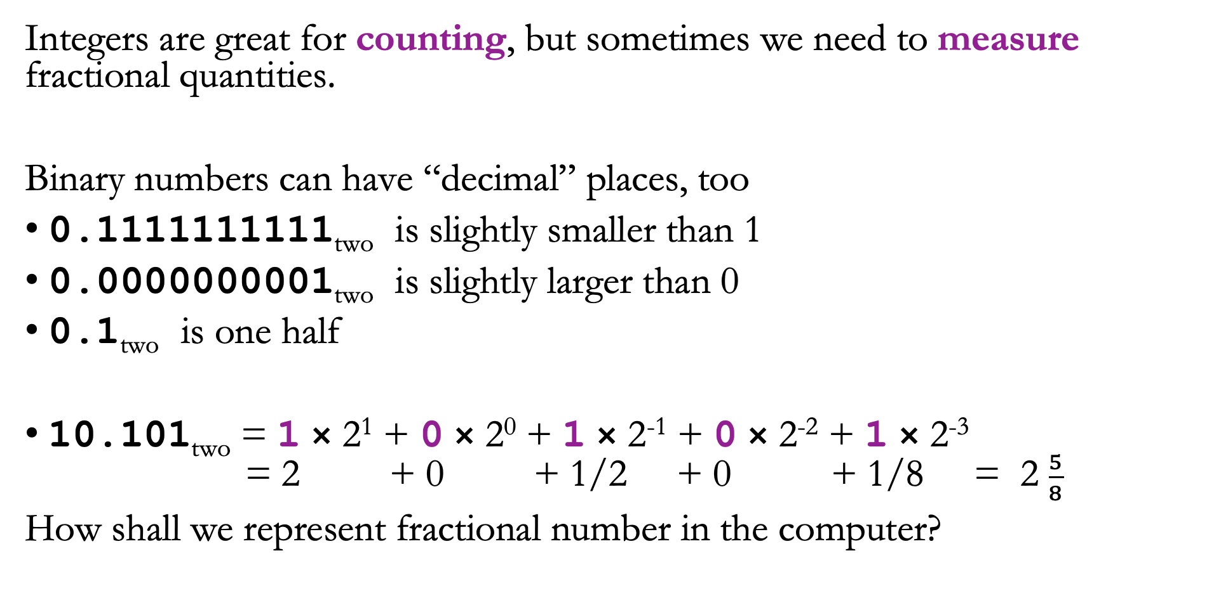
Limitations of Integers
Integers are great for counting, but sometimes we need to measure fractional quantities.
Binary numbers can have “decimal” places, too
0.1111111111_{two} is slightly smaller than 1
0.0000000001_{two} is slightly larger than 0
0.1_{two} is one half
10.101_{two} = 1 × 2¹ + 0 × 2⁰ + 1 × 2⁻¹ + 0 × 2⁻² + 1 × 2⁻³
= 2 + 0 + 1/2 + 0 + 1/8 = 2 $\frac{5}{8}$
How shall we represent fractional number in the computer?

Slide 25
Fixed point: Integers 2.0
Simplest solution is to just stick an implicit radix point somewhere.
  We don’t call it a decimal point because we’re not in base ten.
Examples of fixed point numbers in base ten:
  Represent the cost of a purchase with an integer number of cents.
    The cost of a sandwich is 625 cents.
  Represent the distance between cities by counting the hundredths of a mile.
    Evanston is 1321 hundredths of a mile from Chicago
    and 79,543 hundredths of a mile from Philadelphia

Slide 26

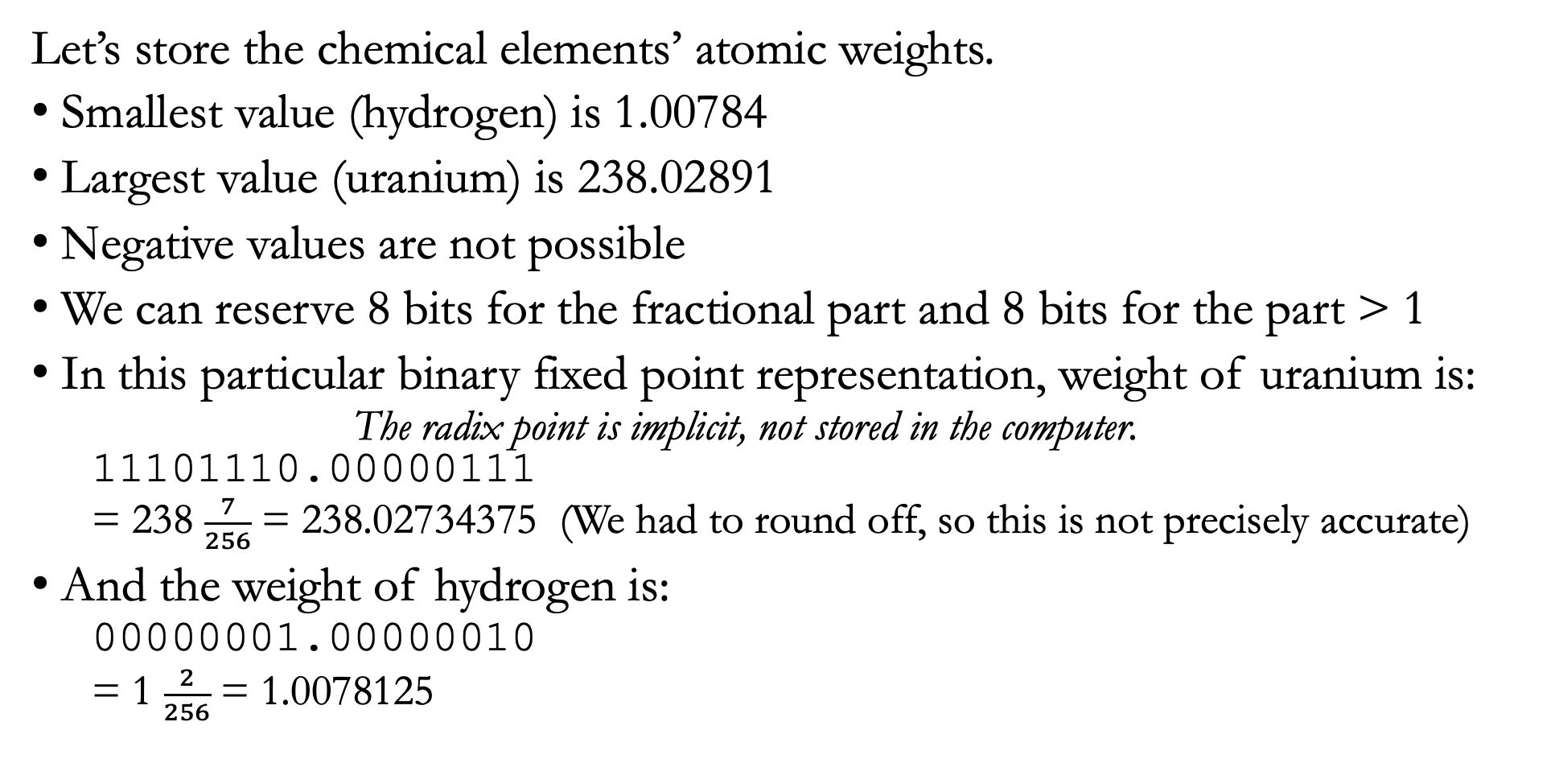
Fixed point example in 16 bits
Let’s store the chemical elements’ atomic weights.
Smallest value (hydrogen) is 1.00784
Largest value (uranium) is 238.02891
Negative values are not possible
We can reserve 8 bits for the fractional part and 8 bits for the part > 1
In this particular binary fixed point representation, weight of uranium is:
  The radix point is implicit, not stored in the computer.
  11101110.00000111
  = 238 $\frac{7}{256}$ = 238.02734375 (We had to round off, so this is not precisely accurate)
And the weight of hydrogen is:
  00000001.00000010
  = 1 $\frac{2}{256}$ = 1.0078125

Slide 27
Fixed point limitations
Fixed point is simple & efficient, but…
Range is very limited
  Multiplication overflows easily – can double the number of bits
    Eg., if working in 32-bits, then we can only multiply 16-bit values without overflow
  Division underflows easily (small values are rounded to zero)
Precision varies across the range:
  Small numbers have few significant figures:
  For example, 00000000.00000010 is not very precise

Slide 28
Floating point
Based on scientific notation:
  10,340 = 1.034 × 10⁴
  0.00424 = 4.24 × 10⁻³
Scientific notation gives a compact representation of extreme values:
  1,000,000,000,000,000,000,000,000 = 1.0 × 10²⁴
  0.000 000 000 000 000 000 000 001 = 1.0 × 10⁻²⁴
In binary:
  100010_{two} = 1.0001_{two} × 2⁵_{ten} = 1.0001 × 10¹⁰¹_{two}
  0.00101_{two} = 1.01_{two} × 2⁻³_{ten} = 1.01 × 10⁻¹¹_{two}

Slide 29
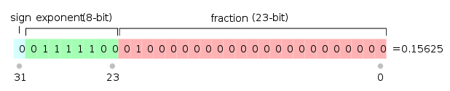
Representing floating point in bits
0.15625_{ten} = 0.00101_{two} = 1.01 × 10⁻¹¹_{two}
Three essential parts are the sign, fraction, & exponent
  Notice that the first significant figure is always “1” so we don’t have to store it
In the mid 1980s, the IEEE standardized the floating point representation of 32 and 64 bit numbers:
  The exponent has a sign too, but the standard says to add a “bias” of 127
1111100 = 124 124-127 = -3 exponent

Slide 30
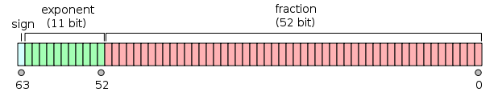
64-bit floating point
Similar to 32-bit, but we have more precision in the fraction and larger exponents are possible.
32-bit is called single precision and 64-bit is called double precision.
Double precision can represent larger, smaller, and more precise numbers.

Slide 31
A few special floats
The IEEE standard allows for a few special values to be stored
  Positive and negative zero (We normally start with an implied “1” which doesn’t work for zero)
  Positive and negative infinity (the result of divide by zero)
  Not a number (the result of zero divided by zero)
These all have the exponent bits set to all ones or all zeros

Slide 32
The Flexibility and Flaws of Floats
A 32-bit signed integer can represent all the whole numbers between
-2,147,483,648 and 2,147,483,647
A 32-bit floating point number can be as large as ±3.402823 × 10³⁸
= 340,282,300,000,000,000,000,000,000,000,000,000,000
or as tiny as 5.8774718 × 10⁻³⁹
= 0.000 000 000 000 000 000 000 000 000 000 000 000 005 877 471 8
But, single-precision floats have only 24 bits of precision:
  Can only precisely store integers up to 2²⁴ = 16,777,216
Floats can store larger numbers than integers of the same bit-length,
but with less precision because 8 bits are set aside for the exponent.

Slide 33
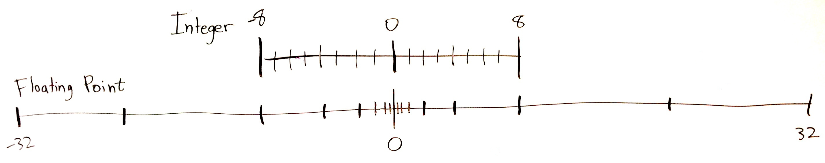
Floats just distribute numbers differently
Above, the dashes represent possible numbers using 4 bits.
Both of the above number lines have 16 dashes (possible numbers)
  Actually, there are 17 dashes, and we have to leave out the largest number (8, 32).
The only difference is the spacing.
  Integer spacing is constant but floats are exponentially spaced

Slide 34
Catastrophic Cancellation
Subtraction of similar-sized numbers leads to a loss of precision:
  0.1234567891 − 0.1234567890 = 0.0000000001
  1.234567891 × 10⁻¹ − 1.234567890 × 10⁻¹ = 1.000000000 × 10⁻¹⁰
  result has 9 insignificant figures
We started with 10 significant figures but the result has just one sig fig!
  Note that I’m giving an example in decimal, but the same idea applies to floating point’s binary representation.
What about:
  addition? multiplication? division?
    Actually, only subtraction can lead to a loss of precision.
  Integers?
    Integers may overflow, precision is not really defined for integers.

Slide 35
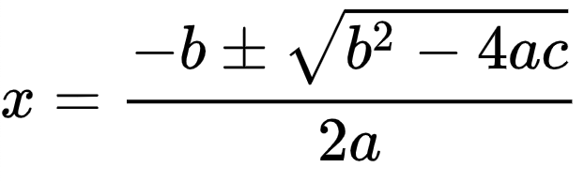
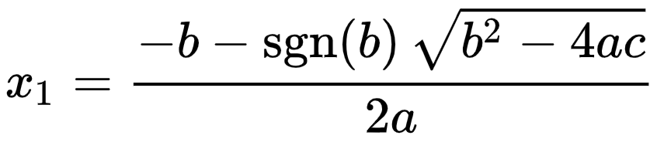
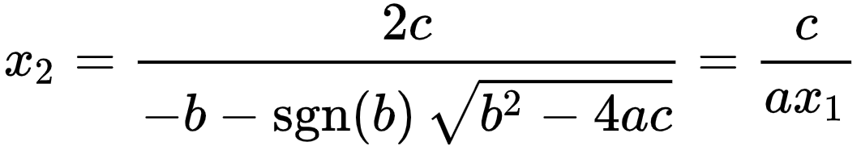
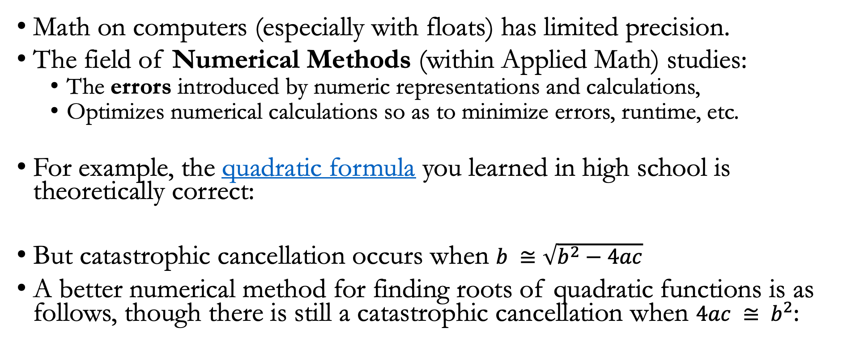
Numerical Methods
Math on computers (especially with floats) has limited precision.
The field of Numerical Methods (within Applied Math) studies:
  The errors introduced by numeric representations and calculations,
  Optimizes numerical calculations so as to minimize errors, runtime, etc.
For example, the quadratic formula you learned in high school is theoretically correct:
But catastrophic cancellation occurs when $b ≅\sqrt{b^{2}−4ac}$
A better numerical method for finding roots of quadratic functions is as follows, though there is still a catastrophic cancellation when $4ac ≅ b^{2}$:

Slide 36
When to use the various number representations
When counting or labelling things, always use integers
When measuring things, usually use floating point
  May use fixed point if speed/simplicity is more important than accuracy
If your machine does not support floating point (eg., a toaster):
  Use fixed point representation for fractional quantities
If rounding is desired then use fixed point
  U.S. currency values usually should be rounded to the nearest cent
Use 64-bit integers when you need values > 2 billion
Floating point rules of thumb:
  Single precision gives ~7 decimal digits of precision, max of ~10³⁸
  Double precision gives ~16 decimal digits of precision, max of ~10³⁰⁸

Slide 37
How do computers work with floats?
It’s complicated and slow!
Have to manipulate both the fraction and the exponent.
Addition is no longer simple, as it was for integers & fixed point.

Slide 38
Recap
Computers represent numbers with different binary encodings
Text can represent decimal numbers in various formats (eg., CSV, JSON).
Integers represent whole numbers
  Remember that 2¹⁰ = 1024 ≈ 1000, 2³² ≈ 4 billion
  Signed integers use two’s complement
  Used for counting and identifying records.
Fixed point adds an implicit radix point to an integer.
  Allows representing fractional quantities as integers, but with limited range.
  Used for numbers that should round off, like prices.
Floating point is a binary scientific notation representation
  Can represent tiny fractional values and huge values with equal precision
    Single precision ≈ 7 decimal digits, Double precision ≈ 16 decimal digits of precision
  Used for measurements and calculations.
  Float subtraction can lead to catastrophic cancellation.

