Slide 1

EECS-317 Data Management and Information Processing
Lecture 14 – Web Scraping & Messy Data
Steve Tarzia
Spring 2019

Slide 2
Announcements
Final project:
  Rubric was posted.
  Part 1 due tomorrow.
HW5 due Friday.

Slide 3
Last Lecture: A Data Safari
CSV files are common
Geographic data uses special file formats (“shape files”)
A data set might include many files (eg., Stanford dogs)
Multiple tables can be distributed as a single SQLite database file
REST APIs allow fetching of data by providing query information in the URL (or in a POSTed JSON object).
  Return value is usually a JSON object.
  The data provider must provide a specification for the API, to tell users how to construct requests and how to interpret responses.

Slide 4
Web Scraping/Crawling
Some data hosts have websites for humans to browse their data, but no clean way to programmatically access the data (no Data API).
You could manually click through all the pages and copy the data, but this would be tedious.
Web scraping is writing a computer program to “crawl” through a website and get all the data you need.
Warning: don’t violate a site’s terms of service (more details)
  For example, Facebook will cancel your account if they think you are scraping content from their site. LinkedIn sued ~100 individuals for scraping.
  Don’t steal data from a subscription service.
  Computer Fraud and Abuse Act (CFAA) may apply even for “public” pages!

Slide 5
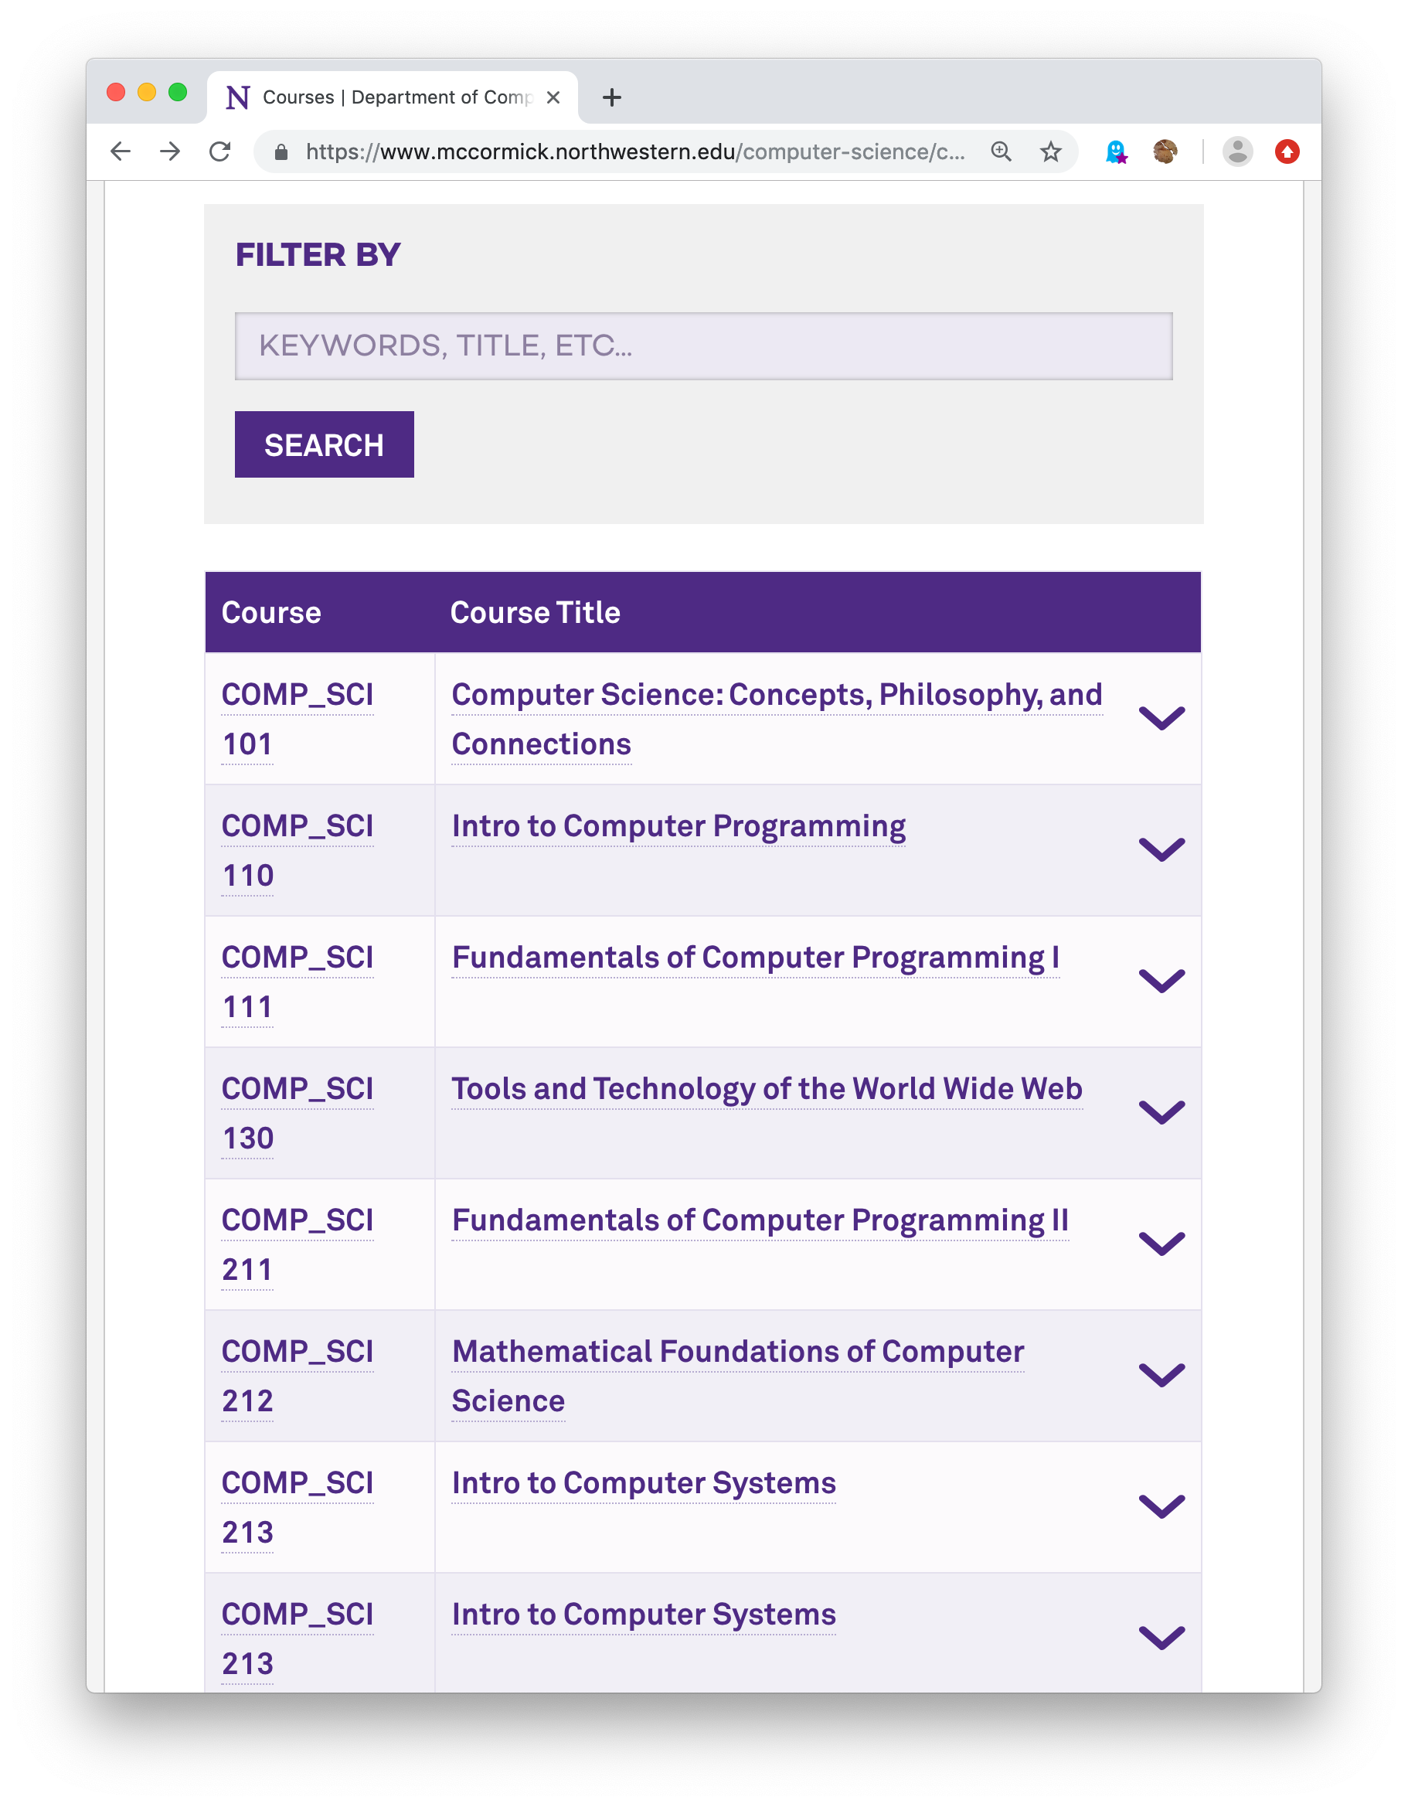
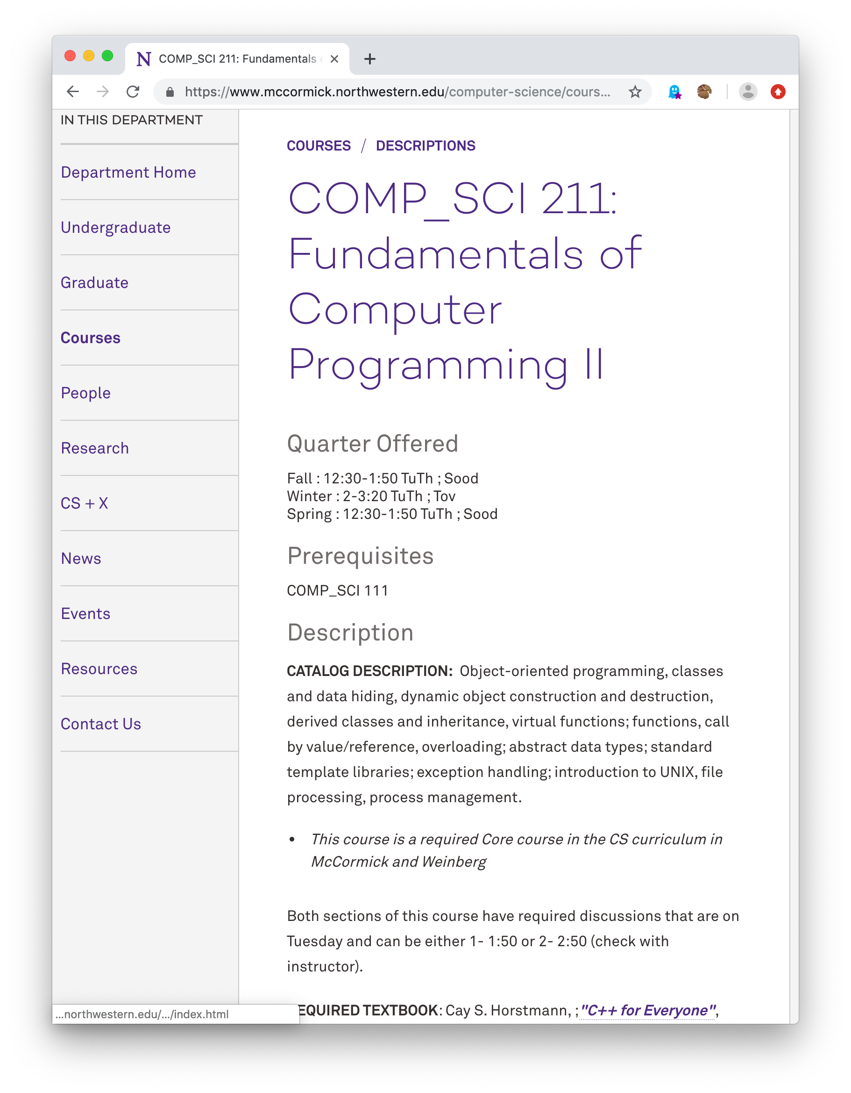
Let’s scrape CS course info:
One index page
Many detail pages

Slide 6
Index page
From the index page, we must scrape each course’s:
Course numbers
Course title
URL for course details
Then we’ll scrape each course’s detail page for further info.

Slide 7
Detail page
From the detail page, we wish to scrape:
Quarter offered, time, instructor
Prerequisites
Description

Slide 8
Recommended scraping tools
Python
requests Python package to fetch web pages using HTTP
  Recall that we also can use this library to get data from REST data APIs.
beautifulsoup4 Python package to parse HTML pages
  Will be able to pick out elements of the page using CSS selectors.
Code for the McCormick course scraping example is at:
  https://github.com/starzia/webscraping-examples
  51 lines of Python code.

Slide 9
Web scraping example: USMS Swim team stats
A slightly more complex example requiring 146 lines of Python code.
https://github.com/starzia/usms-scrape
Downloads a CSV swim team roster.
Then scrapes swim meet results for each swimmer.
  Uses lxml package and XPath syntax to pick out HTML nodes with relevant data.
Reorganizes and prints the data as shown →
  200 IM
  2:09.03 (39) Patrick Lahey
  2:14.23 (23) Daniel Melnick
  2:23.51 (41) David Corr
  2:25.49 (24) William Harris
  2:26.64 (64) Phil Dodson
  2:34.82 (29) Ruby Krueger
  2:41.78 (56) Bill Avery
  2:43.67 (41) Nichelle Pajeau
  2:46.75 (33) Stephen Tarzia
  2:46.94 (57) James Bychowski
  3:02.71 (66) Joe Carroll
  3:15.06 (42) Elizabeth Gjerde
  3:26.16 (61) Kathleen Roderer
  3:27.75 (60) Holly Seguine
  3:31.13 (58) Dana Deane
  3:50.97 (65) Robert Hertel
  4:36.68 (59) Sarah Fodor

Slide 10
A very complex web scraping example
https://github.com/starzia/bibliometrics
Gathers data for an analysis of the “research impact” of the top ten US business schools.
Scrapes faculty directory pages for 10 universities, eg: K, H, S, S2
  Also get lists of publications, like: K, H, S
Also scrapes Google Scholar search results by using Selenium to control Firefox. Using a full browser (instead of requests lib) allows:
  Scraping of pages that require Javascript
  A human attendant can “babysit” the program and solve CAPTCHAs when prompted.

Slide 11
Web scraping overview
Find the pages that hold the data
  Often you’ll start with a hard-coded index page and then programmatically look for links to additional pages.
  Download the HTML (using Python requests package, for example)
Extract the data from a given page:
  Web pages are usually generated by a computer program, so the data will always be found within a certain pattern of HTML code.
Locations in the HTML document can be specified in one of two ways:
  CSS selectors – used be web page designers in Cascading Style Sheets to specify which fonts/colors/etc. (styles) apply to which parts of the page.
    Python beautifulsoup4 package uses CSS selectors
  XPath queries – used for finding elements in an XML document (remember that HTML is a type of XML).
    Python lxml package used XPath
  CSS selector and XPath syntax can be tested in the Chrome developer tools.

Slide 12
CSS selectors pick out a set of HTML elements
Tag type:
  ‘a’ matches <a href="http://link.com">hello</a>
Class name:
  ‘.time’ or ‘td.time’ matches <td class="time">23</td>
Id name:
  ‘#best’ or ‘td#best’ matches <td id="best">103</td>
Attribute values :
  ‘a[href="http://link.com"]’
  matches <a href="http://link.com">hello</a> but not <a>this</a>

Slide 13
Combining CSS Selectors
Descendant: [space]
  ‘table td’ matches <table><tr><td>a</td>this<td>b</td></tr><table>
Direct child: >
  ‘tr > td’ also matches above
General siblings: ~
  ‘td ~ td’ also matches above
Adjacent siblings: +
  ‘p.heading + div.sec’ matches
  <div><p class="heading">hello</p>
  <div class="sec">target</div></div>
References: https://developer.mozilla.org/en-US/docs/Learn/CSS/Introduction_to_CSS/Selectors https://developer.mozilla.org/en-US/docs/Web/CSS/CSS_Selectors

Slide 14
Recap (part 1): Web Scraping
Data can be scraped from web pages by writing code that:
  Downloads HTML pages
  Picks out data elements using CSS selectors (or XPath)
  Also pick out links to pages with additional data
  Repeat!

Slide 15
Intermission
“Bad news, captain. The ship’s computer has been sharing all our personal data with the Romulans.”

Slide 16
Real world data is often messy
Data entered manually can have typographic errors and use inconsistent naming conventions.
Different data sources can us different naming conventions.
Buggy computer programs can produce bad results.
  Program may not behave well when data is missing.
  Data overflow and type conversion can cause problems.
Temporary sensor malfunction can lead to a bogus measurement.
Numbers may have different units
  dollars vs millions of dollars • fraction vs percent
Data can be missing due to an interrupted data import.
Data may be scanned from paper forms (leading to OCR errors).

Slide 17
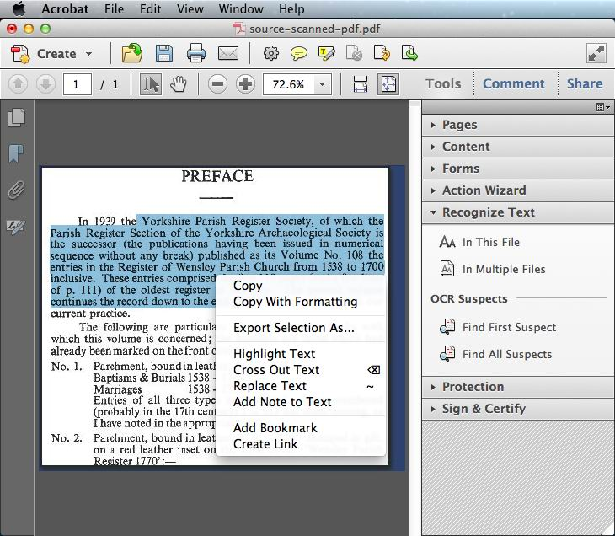
Optical Character Recognition (OCR)
OCR extracts text from scanned images of text.
Adobe Acrobat Pro has OCR.
Many scanners and all-in-one printers come with OCR software.
Python Tesseract is open-source, state-of-the-art OCR.
Text is easy to capture accurately, but punctuation and formatting is difficult.
Handwriting can also be recognized, with less accuracy.

Slide 18
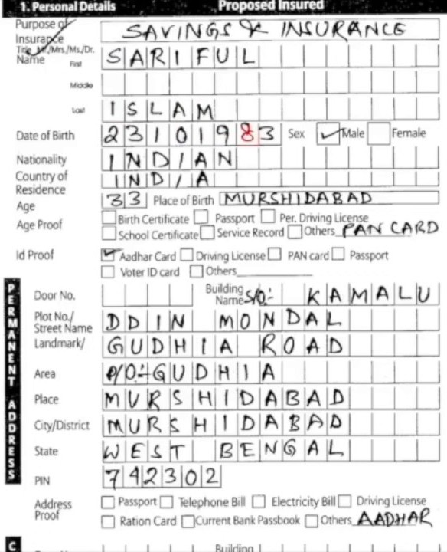
Handwriting OCR
Obviously, more difficult and error-prone than typed text.
“Letter boxes” can help both human and OCR legibility.
Checkboxes can be difficult to scan due to stray marks
  A check mark or X mark may “spill over” into another box.
  This may lead to multiple or zero selections instead of one.

Slide 19
Extract Transform Load (ETL)
ETL programs move data between different storage media.
For example:
  Import data from data files into a database.
  Move from one database to another.
ETL script can help deal with messy data by including:
  List of validation rules to identify problematic data
  List of behaviors to correct or discard problematic data
  Transformations to apply to the input data before inserting into DB
Specialized ETL tools exist, like MS SQL Server Integration Services
ETL also be done with general-purpose data processing tools:
  Plain Python, Pandas, PySpark

Slide 20
How to recognize bad data?
No simple or easy answer.
Start with good documentation. Know what each column means.
Define a very strict schema and look for warnings when importing
  Define columns as NOT NULL, when appropriate, to prevent incomplete data.
  Define columns with numeric types rather than text if you expect numbers.
  Define foreign keys if you expect columns to match between tables.
Look at summary statistics after data is imported:
  SELECT MIN(col), MAX(col), AVG(col)…
  If min and max values are unexpected, then look for outliers by sorting according to that column.
  In R, use the summary(…) command on a data frame.
  In Pandas (Python), use the describe() method on a data frame.

Slide 21
Debugging a data import
If data fails to import completely, try loading it into a temporary text table
  Drop keys and use large text types for every column
Query the text table to look for unexpected values in the source data
This table has strict constraints on what kind of data can be inserted:
CREATE TABLE person (
SSN int NOT NULL,
firstName varchar(30) NOT NULL,
lastName varchar(30) NOT NULL,
birthDate char(10) NOT NULL,
PRIMARY KEY (SSN)
);
This temporary table relaxes those constraints:
CREATE TABLE _import_person (
SSN varchar(1000) NOT NULL,
firstName varchar(1000) NOT NULL,
lastName varchar(1000) NOT NULL,
birthDate varchar(1000) NOT NULL,
);

Slide 22
Named Entity Matching
In real-world data, people, companies, products, etc., all can be represented with variations of their name:
When combining data from multiple sources, we need fuzzy matching to join according to text fields.
  Look for approximate text matches.
  Humans are good at this, but it’s difficult to automate.
Eleanor Roosevelt
E. Roosevelt
Roosevelt, Eleanor
Mrs. Roosevelt
Northwestern Univ.
NWU
Northwestern
Northwestern University
Apple iPhone 6S
iPhone 6 S 32 GB Space Gray
A1633

Slide 23
SQL synonym table
A simple solution is to create a synonym table to list all variations of names.
Use the synonym table as a linking table in a four-way join.
For example, if product and product_details use different variations of the product name:
  SELECT * FROM product
  INNER JOIN product_synonym AS n1
  ON product.name=n1.name
  INNER JOIN product_synonym AS n2
  ON n1.id=n2.id
  INNER JOIN product_details
  ON n2.name=product_details.name;
product_synonym
product_id | name
1 | Apple iPhone 6s
1 | iPhone 6 S
1 | iPhone 6S 32 GB
1 | iPhone 6S Space Gray
1 | iPhone 6S Gold
2 | Google Nexus 6P
2 | Nexus 6P
2 | Nexus 6-P

Slide 24
Shortcomings of synonym table
Creating the synonym table manually is slow
  Cannot be scaled to many thousands of rows
Synonym table must be updated every time new data arrives.
However, we may try to apply Machine Learning to automatically generate synonym tables for named entity matching…

Slide 25
Data cleaning tools
You supply a CSV file, and the tool lets you quickly match synonyms
http://dedupe.io https://youtu.be/9wEA90Fz-lU?t=109
  Uses machine learning.
http://openrefine.org/ https://youtu.be/B70J_H_zAWM
  Lets you quickly define matching rules.
Or, develop your own tools (described next)

Slide 26
Text similarity metrics
An alternative to ML is a graph partitioning approach
Use text similarity metrics to build a name similarity graph.
For example, the edit distance (or Levenshtein distance) is the minimum number of single-character changes needed to make one phrase equal to another.
  Edit distance between “school” and “college” is 7 because you have to delete an s, h, o, and add “lege”
  Edit distance between “iPhone 6S” and “iPhone 6-S” is just one
  (delete the hyphen)
  Edit distance between “iPhone 5” and “iPhone 6” is also just one, but these are different phone models.
  Edit distance is useful, but cannot be used blindly.

Slide 27
Amazon Mechanical Turk
A crowdsourcing marketplace.
Allows you to pay a few cents for a human to answer a short question.
Useful for small, repetitive problems requiring human intelligence, where simple rules or even Machine Learning would not work.
Example: pick out the year of graduation from professors’ CVs:
  Each CV is a PDF document (an academic resumé).
  These documents all have different formats.
  It’s difficult for a computer to reliably parse them, but easy for a person.

Slide 28
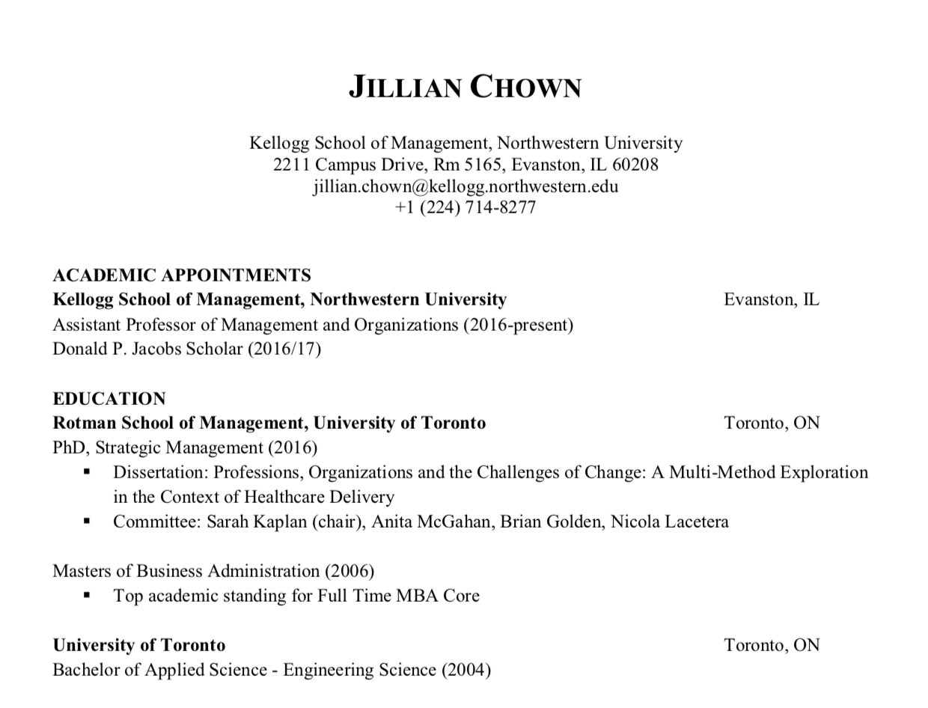

Slide 29
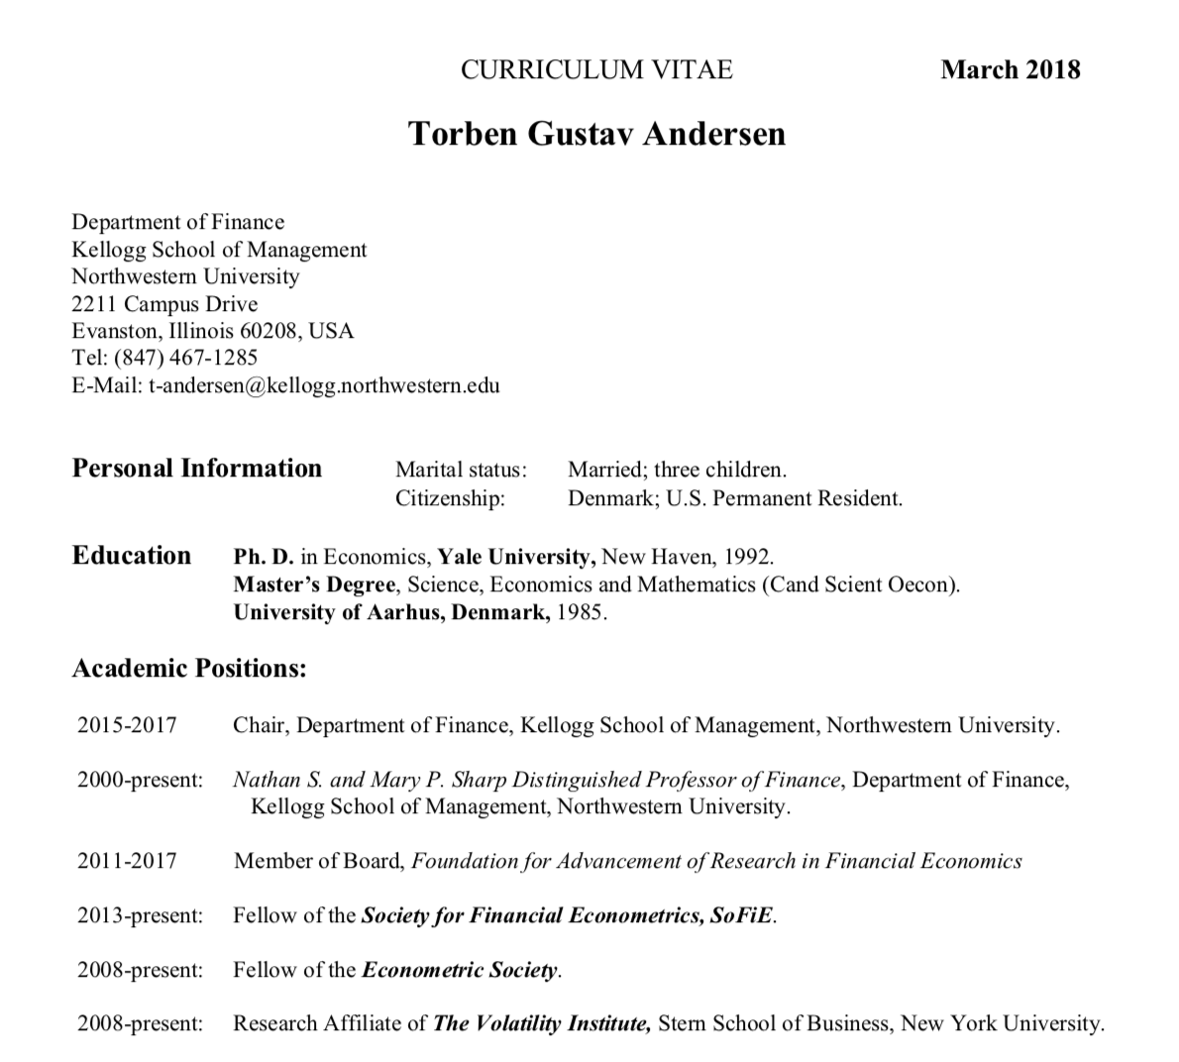

Slide 30
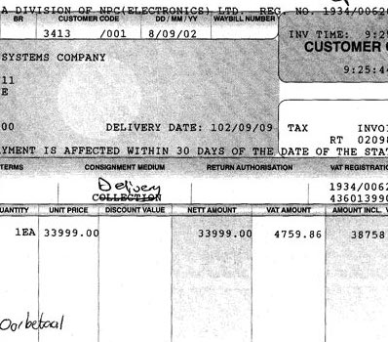
MTurk use cases
Parsing data in unstructured forms
Poorly-scanned documents
Transcribing audio
Photo identification.
Generating training data for Machine Learning.
MTurk tasks can be created by non-programmers,
but there is also an advanced API to setup complex tasks.

Slide 31
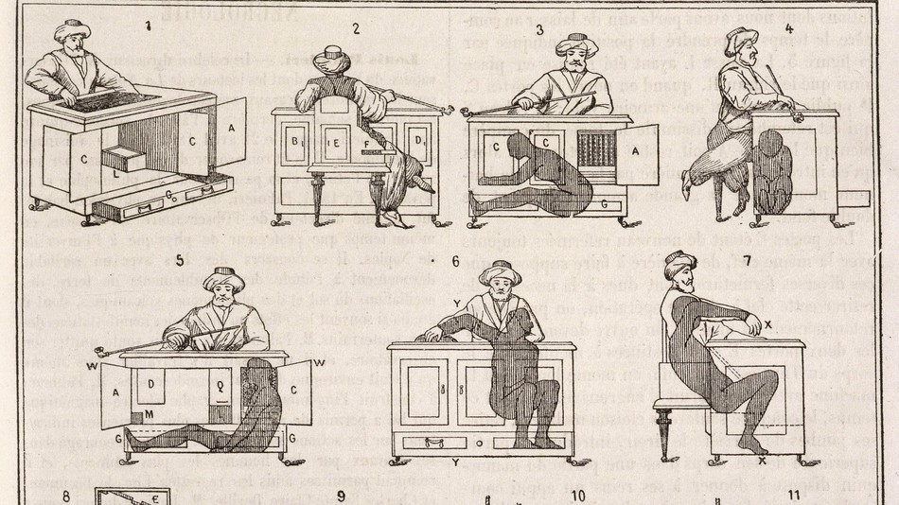
Named after a fake chess-playing automaton (1770)

Slide 32
When to trust human input
Humans are unrealiable, so how can we make MTurk results more trustworthy?
Use only experienced and highly-rated MTurk workers.
Use majority voting:
  Give the same task to three different workers
  If at least two of the three give the same answer, then trust it.
Manually or programmatically check the results, if possible
  Sometimes it’s easier to check the answer than to generate it.

Slide 33
Crowdsourced data gathering & processing
Crowdsourcing is using the power of online crowds to do some work.
MTurk is kind of an example, but usually “crowdsourcing” refers to unpaid work.
Examples:
ProPublica: Free the Files (2012) https://youtu.be/tTlA_TJHq5o?t=198
iNaturalist
National Gun Violence Memorial https://youtu.be/UWzWwT546EY

Slide 34
Additional resources on Data Cleaning
https://github.com/Quartz/bad-data-guide
https://www.coursera.org/learn/data-cleaning

Slide 35
Recap (part 2): Messy Data
Data can have missing, incorrect, or inconsistent values for many reasons:
  Pulled from different sources with different naming or unit conventions
  Paper scanning (OCR) errors
  Human input errors
Variety of tools are needed to deal with messy data:
  Review summary statistics
  Synonym tables
  Named entity matching with ML (dedupe.io and Open Refine)
  Crowdsourcing: MTurk, home-grown solutions
Above all, don’t blindly trust data you are given!

