Slide 1

EECS-317 Data Management and Information Processing
Lecture 12 –
Data files and Data APIs
Steve Tarzia
Spring 2019

Slide 2
Announcements
Final project was posted.
  Part 1 due May 22nd (next Wednesday)
  Part 2 due June 12th (Wednesday of finals week)
Another small homework will also be posted, covering MySQL and indexes.

Slide 3
Last lecture: Defining databases and adding data
Showed how introducing a single identifier column can make foreign keys simpler.
Looked in detail at an example needing two unique composite keys.
Gave SQL syntax for creating and altering tables, and modifying data:
  CREATE TABLE …
  INSERT INTO …
  DELETE FROM …
  UPDATE …
  ALTER TABLE …
Showed how SQL can be used inside of another language (like Python) to build a database programmatically.

Slide 4
Data files
A computer file is a container for data, and files have:
  A path (sequence of folders and a filename):
    C:/Users/Steve/My Documents/my_data.csv
  A sequence of data bytes “in” the file (8 bits = 1 byte):
    00010101 10110101 11010101 11010010 10100011 01010101 1111011 …
  Other metadata like permissions, depending on the filesystem type.
Files are:
  Persistent, meaning that they remain in the computer after it is rebooted
  Sharable by other programs running on the computer
Thus, files allow programs to
  Save their own data
  Share data with other programs on the same computer
  Transfer data between computers
Databases are a more powerful alternative to plain files (“flat files”),
but they are not as portable.
  we still use flat files to exchange bulk data.

Slide 5
Standard data file formats
The filename extension conventionally determines the file format.
  Tells us how to interpret the sequence of bits in the file
Some file formats use human-readable ASCII or UTF-8 text.
  txt, csv, json, xml
More efficient file formats represent data directly in binary form.
  mat (matlab), RData, sqlite, jpg, zip
Some files use both formats in two stages:
  human-readable files that have been compressed to a binary format:
  xlsx, docx, csv.gz, txt.gz

Slide 6
Text encodings
How do computers store text as ones and zeros?
Early standard is called the American Standard Code for Information Interchange (ASCII)
  Developed in the 1960s
  Uses seven bits per character,
  but in practice each character is stored in 8 bits and the top bit is zero.
ASCII text includes:
  Lowercase letters, uppercase letters, numbers, punctuation, other symbols
  Whitespace characters: space, tab, newline, carriage return
  Control characters: null, line feed, vertical tab, bell, escape, delete, backspace, etc.

Slide 7
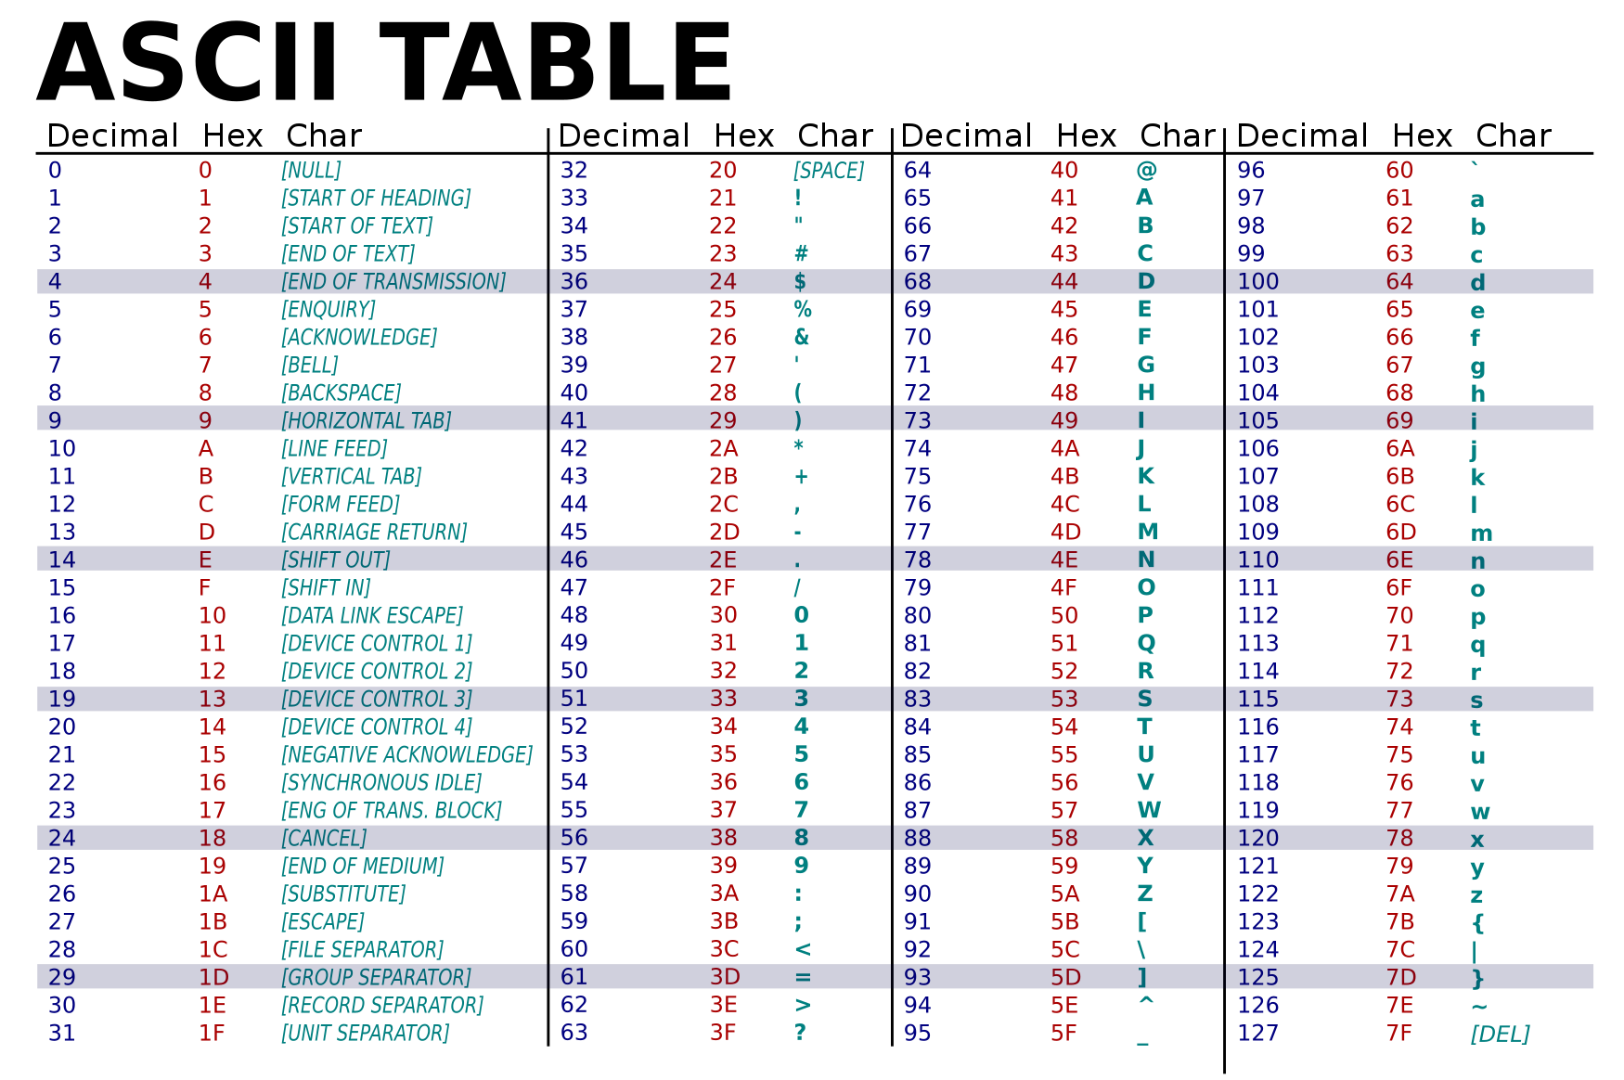

Slide 8
Hexadecimal notation
Decimal | Bits | Hex
0 | 0000 | 0
1 | 0001 | 1
2 | 0010 | 2
3 | 0011 | 3
4 | 0100 | 4
5 | 0101 | 5
6 | 0110 | 6
7 | 0111 | 7
8 | 1000 | 8
9 | 1001 | 9
10 | 1010 | A
11 | 1011 | B
12 | 1100 | C
13 | 1101 | D
14 | 1110 | E
15 | 1111 | F
Computer programmers often use hex notation to represent bit sequences.
Hex takes four bits and represents them as one of sixteen characters:
  0, 1, 2, 3, 4, 5, 6, 7, 8, 9, A, B, C, D, E
It’s the most convenient way for people to represent bit sequences (data):
  binary 0010 1111 0001 0000 = 0x2F10
  “0x” prefix is sometimes added to clarify that what follows is a hexadecimal number.
ASCII “A” = 0x41 = 01000001 in binary

Slide 9
“Hello!” in ASCII
 | H | e | l | l | o | !
hex | 48 | 65 | 6C | 6C | 6F | 21
binary | 0100 1000 | 0110 0101 | 0110 1100 | 0110 1100 | 0110 1111 | 0010 0001
The ASCII table tells us that the letter “H” is represented by this eight-character bit sequence.
“H” encodes to 01001000.
01001000 decodes to “H”.
The character “l” has the same encoding whenever it appears in ASCII text.

Slide 10
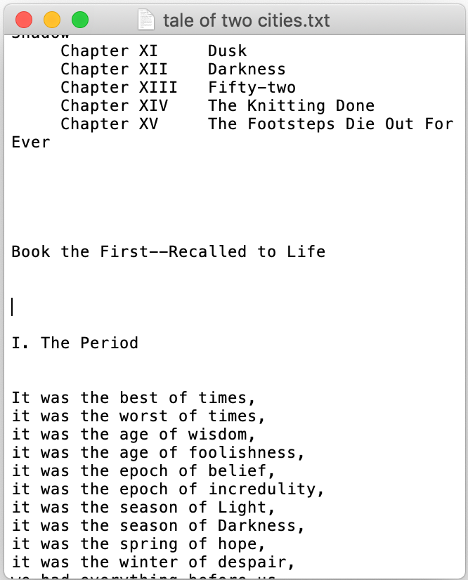
Encoding a text file
C:\Users\Steve\My Documents\tale of two cities.txt
42 6f 6f 6b 20 74 68 65 20 46 69 72 73 74 2d 2d |Book the First--|
52 65 63 61 6c 6c 65 64 20 74 6f 20 4c 69 66 65 |Recalled to Life|
0d 0a 0d 0a 0d 0a 0d 0a 0d 0a 49 2e 20 54 68 65 |..........I. The|
20 50 65 72 69 6f 64 0d 0a 0d 0a 0d 0a 49 74 20 | Period......It |
77 61 73 20 74 68 65 20 62 65 73 74 20 6f 66 20 |was the best of |
74 69 6d 65 73 2c 0d 0a 69 74 20 77 61 73 20 74 |times,..it was t|
68 65 20 77 6f 72 73 74 20 6f 66 20 74 69 6d 65 |he worst of time|
73 2c 0d 0a 69 74 20 77 61 73 20 74 68 65 20 61 |s,..it was the a|
67 65 20 6f 66 20 77 69 73 64 6f 6d 2c 0d 0a 69 |ge of wisdom,..i|
74 20 77 61 73 20 74 68 65 20 61 67 65 20 6f 66 |t was the age of|
20 66 6f 6f 6c 69 73 68 6e 65 73 73 2c 0d 0a 69 | foolishness,..i|
74 20 77 61 73 20 74 68 65 20 65 70 6f 63 68 20 |t was the epoch |
6f 66 20 62 65 6c 69 65 66 2c 0d 0a 69 74 20 77 |of belief,..it w|
61 73 20 74 68 65 20 65 70 6f 63 68 20 6f 66 20 |as the epoch of |
69 6e 63 72 65 64 75 6c 69 74 79 2c 0d 0a 69 74 |incredulity,..it|
Data bits in the the file,
shown in hex notation for brevity.
(from “hexdump -C” command)
Appearance in text editor
ASCII or UTF-8 encoding translates each byte (or up to 4 bytes) to a character

Slide 11
What about other characters we might need?
¿Español?, 中文, Ελληνικά
😀📟🍟⚽️
Different currency symbols
Even American English uses “weird punctuation” sometimes.
A single 8-bit byte will not be enough to store all the possible characters.

Slide 12
UTF-8 to the rescue!
UTF-8 is now the most common text encoding.
The latest version includes 136,690 symbols, and more can be added.
  Can eventually be expanded to more than two million characters
It’s a variable-length encoding
  Characters are represented with one, two, three, or four bytes.
Backward-compatible with ASCII
  ASCII text is also valid UTF-8
  Previous version of Unicode (such as UTF-16) were not widely adopted due to incompatibility with ASCII.

Slide 13
Variable length character encoding with UTF-8
1st byte | 2nd byte | 3rd byte | 4th byte | # of free bits
0... .... |  |  |  | 7 (ASCII)
110. .... | 10.. .... |  |  | 11
1110 .... | 10.. .... | 10.. .... |  | 16
1111 0... | 10.. .... | 10.. .... | 10.. .... | 21
Single-byte characters are identical to ASCII
First byte tells you how many total bytes to expect
Every “extra” byte starts with “10”
  If you start reading in the middle of a character you’ll know it.
  It’s very easy to know where each new character starts.

Slide 14
Comma Separated Values (CSV)
CSV is a simple text format for storing tabular data (spreadsheets)
Each row is represented on one line of text
Columns are separated by commas
Values can be enclosed in double quotes ("...") if necessary
  For example, if value includes comma or newline characters
  Double quotes within a text value must be “escaped” by using two double quotes
Values can be empty by having nothing between the commas

Slide 15
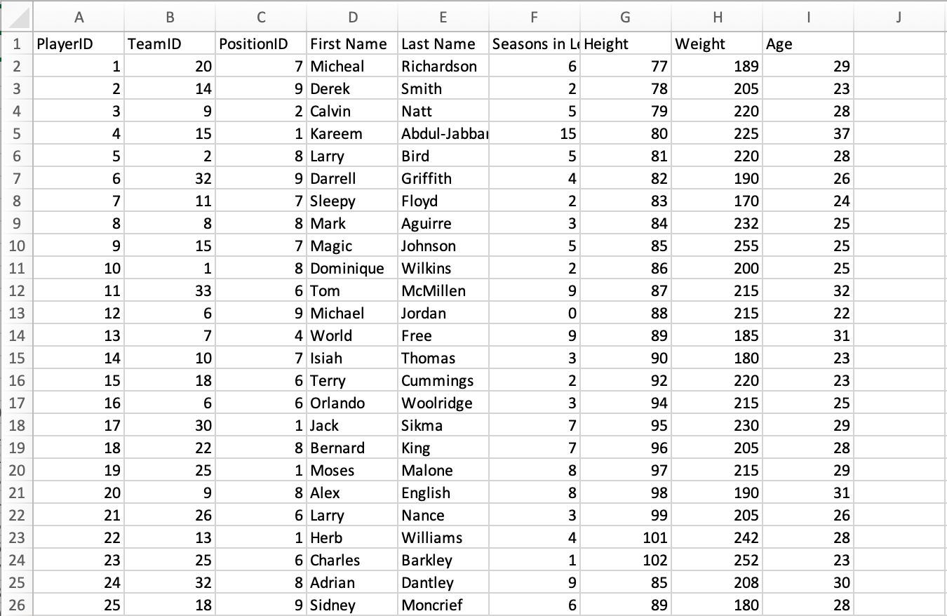
NBA_player_of_the_week.csv viewed in Excel

Slide 16
NBA_player_of_the_week.csv viewed as text
PlayerID,TeamID,PositionID,First Name,Last Name,Seasons in League,Height ,Weight,Age
1,20,7,Micheal,Richardson,6,77,189,29
2,14,9,Derek,Smith,2,78,205,23
3,9,2,Calvin,Natt,5,79,220,28
4,15,1,Kareem,Abdul-Jabbar,15,80,225,37
5,2,8,Larry,Bird,5,81,220,28
6,32,9,Darrell,Griffith,4,82,190,26
7,11,7,Sleepy,Floyd,2,83,170,24
8,8,8,Mark,Aguirre,3,84,232,25
9,15,7,Magic,Johnson,5,85,255,25
10,1,8,Dominique,Wilkins,2,86,200,25
11,33,6,Tom,McMillen,9,87,215,32
12,6,9,Michael,Jordan,0,88,215,22
13,7,4,World,Free,9,89,185,31
14,10,7,Isiah,Thomas,3,90,180,23
15,18,6,Terry,Cummings,2,92,220,23
16,6,6,Orlando,Woolridge,3,94,215,25
17,30,1,Jack,Sikma,7,95,230,29
18,22,8,Bernard,King,7,96,205,28
19,25,1,Moses,Malone,8,97,215,29
20,9,8,Alex,English,8,98,190,31
21,26,6,Larry,Nance,3,99,205,26
22,13,1,Herb,Williams,4,101,242,28
23,25,6,Charles,Barkley,1,102,252,23
24,32,8,Adrian,Dantley,9,85,208,30
25,18,9,Sidney,Moncrief,6,89,180,28
26,27,9,Clyde,Drexler,2,95,210,23
27,29,9,Alvin,Robertson,1,98,185,23
28,33,1,Jeff,Ruland,4,99,240,27
29,22,1,Patrick,Ewing,0,102,240,23

Slide 17
CSV files represent a single table
Relational (SQL) models for complex data involve several tables, so you need several CSV files to represent complex data.
Groups of CSV files are often used for data exchange
The CSV file can have column names in the first row
However, other important schema information is not stored in CSV:
  Data types
  Primary keys
  Unique key constraints
  Foreign key relationships
  Indexes
The above metadata can be included in an SQL script that accompanies the CSV files, or in a human-readable document.
Each DBMS also has its own proprietary format for exchanging databases, including both the data and metadata.
SQLite is the simplest. Its just the *.sqlite file.

Slide 18
SQL files for data exchange
SQL database dumps are also sometimes used to exchange data.
These are text files with a listing of all the SQL commands needed to re-generate the database.
  Includes CREATE TABLE commands and INSERT commands.
  Running these commands on a fresh/empty database will create a copy of the database that was originally dumped.
For example:
  mysqldump commandline tool for MySQL
  .dump command in SQLite
  See the .SQL files in Canvas in the “sqlite databases” folder.
Disadvantages of SQL as a data exchange format:
  SQL language dialects differ, so it may not be compatible with all DBMSs
  It’s not very space efficient (lots of SQL syntax is included).

Slide 19
Semi-structured data
We often must represent complex data in a single file and in a standard way.
JSON and XML files store semi-structured data
Not limited to two dimensions like CSV files
Data is organized in a tree-like/hierarchical way, where any item can have more details below it.
However, unlike a relational database, there is no clear pre-defined structure or schema for the data.
The data defines its own structure.
Compared to CSV, it’s more difficult to read and is more prone to errors because data elements can be missing.

Slide 20
JSON
JavaScript Object Notation
Used in many web applications and data APIs
Allows an arbitrary amount of nesting
Spaces are ignored, except within quotes.
Basic components are:
[] for ordered lists
  Items are separated by commas
  Items can be any JSON
{} for unordered dictionaries/objects
  Key: value pairs are separated by commas
  Keys must be strings (text)
  Values can be any JSON
Numbers, true, false, null
Strings (text) in double quotes "..."
[
{
"name": "John",
"age": 30,
"cars":
["Ford", "BMW", "Fiat"]
},
{
"name": "Alicia",
"age": 32,
"hometown": "Seattle"
}
]

Slide 21
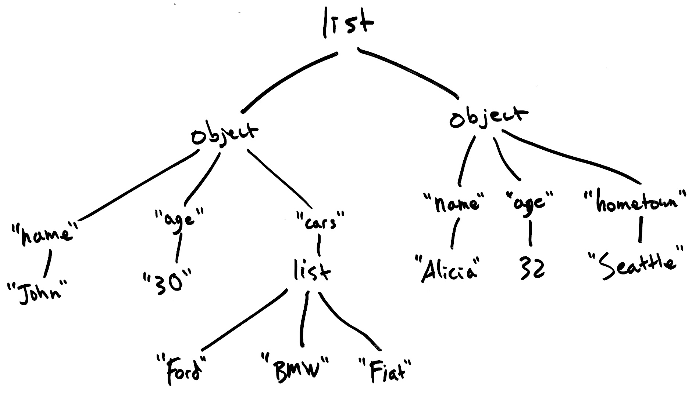
JSON data graph example
[
{
"name": "John",
"age": 30,
"cars":
["Ford", "BMW", "Fiat"]
},
{
"name": "Alicia",
"age": 32,
"hometown": "Seattle"
}
]

Slide 22
XML
eXtensible Markup Language
Older than JSON, and now is less common than JSON because many people think XML is unnecessarily complicated.
HTML is an XML document that defines a web page.
Basic components are:
Text
Tags
  <tagname>…</tagname> or just <tagname>
  Have a name, and have XML inside
  Each start tag has a corresponding end tag, but only if it has data inside.
Attributes
  <tag attr="value" …>
  Appear within tags
  Attribute name and value must be text
  Tag can have multiple attributes, but each must have a unique name
<people>
<person name="John"
age="30">
<cars>
<car>Ford</car>
<car>BMW</car>
<car>Fiat</car>
</cars>
</person>
<person name="Alicia"
age="32">
<hometown city="Seattle">
</person>
</people>

Slide 23
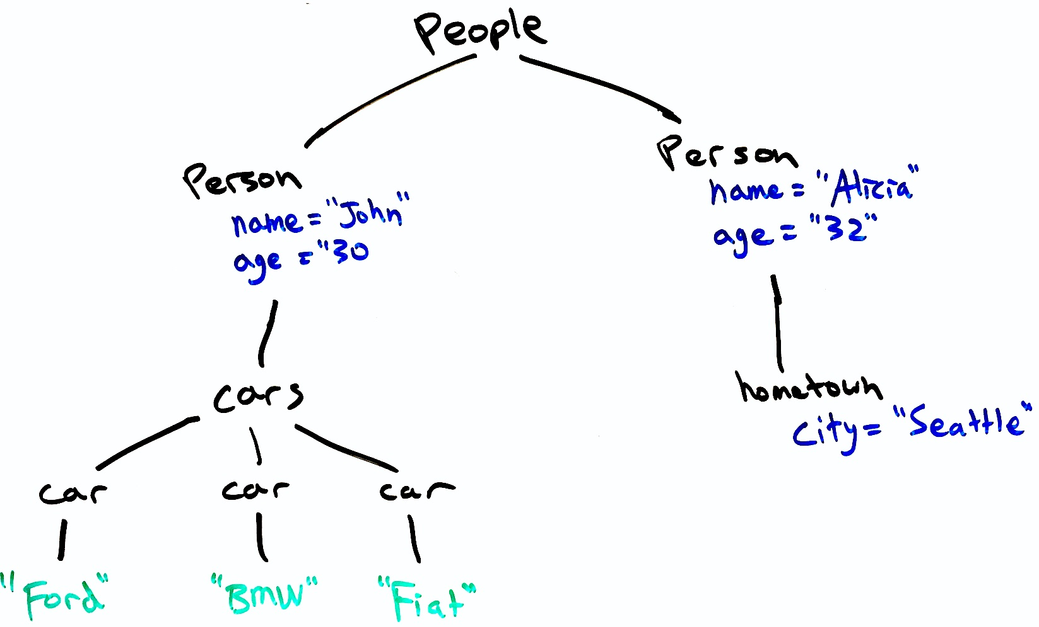
XML data graph example
<people>
<person name="John"
age="30">
<cars>
<car>Ford</car>
<car>BMW</car>
<car>Fiat</car>
</cars>
</person>
<person name="Alicia"
age="32">
<hometown
city="Seattle">
</person>
</people>

Slide 24
Comparison of data exchange formats
 | Proprietary | SQL | CSV | JSON | XML
Space efficiency | Compact binary representation | Bloated text with SQL syntax | Text with little extra syntax | Text with little extra syntax | Text with verbose tag names
Compatibility (readable by many) | Must use specific program/DB | Each DBMS has its own SQL dialect | Standardized format | Standardized format | Standardized format
Expressibility (data complexity) | Complex relationships | Complex relationships | Represents a single table | Complex relationships | Complex relationships
Popularity | Rare | Rare | Common | Common | Less common
Flexibility/rigidity | SQL DBs are have a clearly defined schema that must be obeyed. |  | Rows all have same columns. | Data and schema are defined together. Different elements can have different attributes.
Text-based file formats (SQL, CSV, JSON, XML) are not space efficient, but text files can be compressed using general-purpose file compression utilities like gzip to alleviate the problem (eg., my_data.json.gz)

Slide 25
1st half recap
Data is exchanged by data files (arrays of bits, zeros and ones).
Several file formats are common:
  CSV, XML, JSON, and less commonly SQL and proprietary formats.
Many of these formats are text files with special syntax.
Text files represent each character with a certain bit sequence.
  ASCII uses 8 bits (one byte) for each character
  UTF-8 uses 1-4 bytes for each character, is backward-compatible with ASCII
CSV files store just one table & can be imported into SQL easily.
JSON and XML files represent data with complex, nested relationships
  However, no schema is defined ahead of time.
  Data itself gives the structured (hence, we call it semi-structured data).
  Python and R scripts can easily load these files.

Slide 26
Bulk vs. online data sources
So far, we have assumed that we can bulk export and import data.
  In other words, we can get easily get all the data in one download.
  Data is exchanged as CSV, JSON, XML, or SQL files:
    Dump file(s) from origin database
    Load file(s) into the destination database
However, some data sources do not allow bulk access, and instead provide some kind of web-based access to the data:
  A data API may be provided for users to query the data programmatically.
  Data may be presented in web page for human reading, not intended for programmatic access.

Slide 27
Why is bulk access sometimes not an option?
If the data set is huge, user many not want to download the entire set.
  Instead, let the data remain in the cloud (on some servers on the Internet), and let users query for their desired data as needed.
Data may be constantly changing
  Bulk data files would quickly get “out of date”
  Instead, provide users some kind of access to a live database.
Provider may not want general public to have the full data set.
  For example, Weather Underground lets users get some data, but does not want competing websites to copy all their weather forecasts.

Slide 28
Why isn’t SQL used to access cloud data?
Actually, relational (SQL) databases can be data-sharing platforms.
  Remember that many users can connect to one SQL database and run queries.
For example, students in this class accessed a shared MySQL server to access the large Yelp and Stack Overflow databases.
  murphy DB server is on campus, not “in the cloud,” but it could have been.
A data provider could open up its DB servers for public access
(without any secret username and password required).
  In practice, I have never seen this done. Why not?
    DB servers may not be robust enough for public access.
    One poorly written query can slow down the system for everyone.
    Data users may not know SQL.
    Database may not support SQL, like MongoDB, DynamoDB, etc.

Slide 29
Data API
API means Application Programming Interface
  It’s a very generic term that is applied to different types of interfaces:
  A software library’s API is the list of public functions provided to operate it.
  In other words, the API defines how your software can use the library.
  A web service’s API defines how your software can interact with a remote server to perform various tasks. The API defines what network messages should be passed between the client and server machines.
REST APIs are a type of web service API.
  REST = REpresentational State Transfer (bad name!)
  A REST API’s requests for data look very much like a web browser’s requests for html pages and images, so it’s familiar and attractive to software engineers.
REST APIs are now standard way to provide data access to the public.

Slide 30
Hyper Text Transport Protocol (HTTP)
HTTP is a client-server data exchange protocol
It was invented for web browsers to fetch pages from webservers
Request specifies:
  A human-readable header with: URL, method, (plus some optional headers)
  An optional body, storing raw data (bytes).
Response includes:
  A human-readable header with response code, (plus some optional headers)
  An optional body

Slide 31
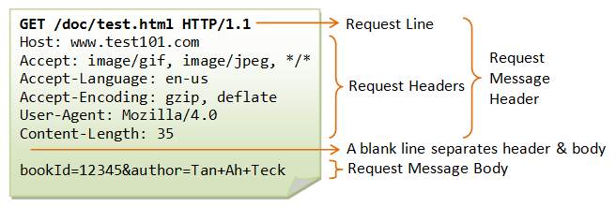
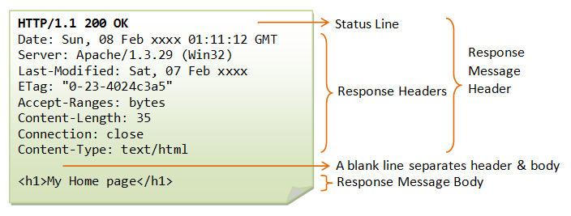
Request:
(optional for GET)
Response:
From https://www.ntu.edu.sg/home/ehchua/programming/webprogramming/HTTP_Basics.html

Slide 32
HTTP methods and responses
Methods
Response codes
GET: to request a data
POST: to post data to the server, and perhaps get data back, too.
And less commonly:
PUT: to create a new document on the server.
DELETE: to delete a document.
HEAD: like GET, but just return headers
200 OK: success
301 Moved Permanently: redirects to another URL
403 Forbidden: lack permission
404 Not Found: URL is bad
500 Internal Server Error
… and many more

Slide 33
A weather information service (REST API)
HTTP Request
HTTP Response
GET http://api.wthr.com/[key]/forecast?location=San+Francisco HTTP/1.1
Accept-Encoding: gzip
Cache-Control: no-cache
Connection: keep-alive
HTTP/1.1 200 OK
Content-Length: 2102
Content-Type: application/json
{ "wind_dir": "NNW",
"wind_degrees": 346,
"wind_mph": 22.0,
"feelslike_f": "66.3",
"feelslike_c": "19.1",
"visibility_mi": "10.0",
"UV": "5", … }

Slide 34
REST API example
Twitter REST API documentation
https://developer.twitter.com/en/docs/tweets/post-and-engage/api-reference/post-statuses-update
Discourse web forum public API documentation:
https://docs.discourse.org
Output examples:
https://meta.discourse.org/categories.json
https://meta.discourse.org/latest.json?category=7
https://meta.discourse.org/t/3423.json (requires authentication)

Slide 35
Inputs and outputs of REST APIs
Request Inputs
Response Outputs
Choice of Method:
  GET for reading data
  POST/PUT/DELETE for editing
URL
  Usually identifies the type of request, but may also supply parameters:
    GET /tweets/connor4real
Query parameters after the main URL
  Written after a “?” character.
    GET /search?startDate=2018-10-10&search=best+restaurant&api_key=3iur20du9302o3i0d
Body
  Usually form-encoded or JSON
Status code
  200, 404, 403, etc.
Body
  Usually JSON encoded
Many APIs require that you provide an API key or access token somewhere your request.
  This is like a password that identifies you to the service.

Slide 36
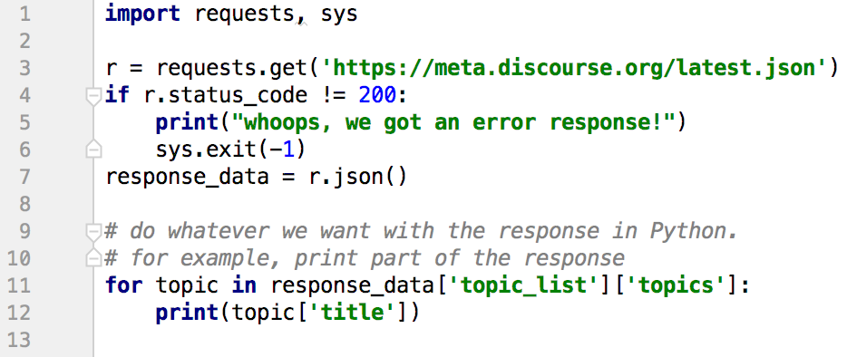
REST APIs in Python
Simplest option is to use requests library:
First, “pip install requests”, then:

Slide 37
2nd half recap
Bulk access to data is simple, not always possible
  Data may be too big, dynamic, or guarded by the owner
Data is often exposed to users through data APIs, which allow users to request pieces of the data. In particular:
  REST APIs use HTTP requests to get data from remote servers.
  This involves web requests that return JSON data instead of HTML pages.

