Slide 1

EECS-317 Data Management and Information Processing
Lecture 11 –
Defining Databases and Adding Data
Steve Tarzia
Spring 2019

Slide 2
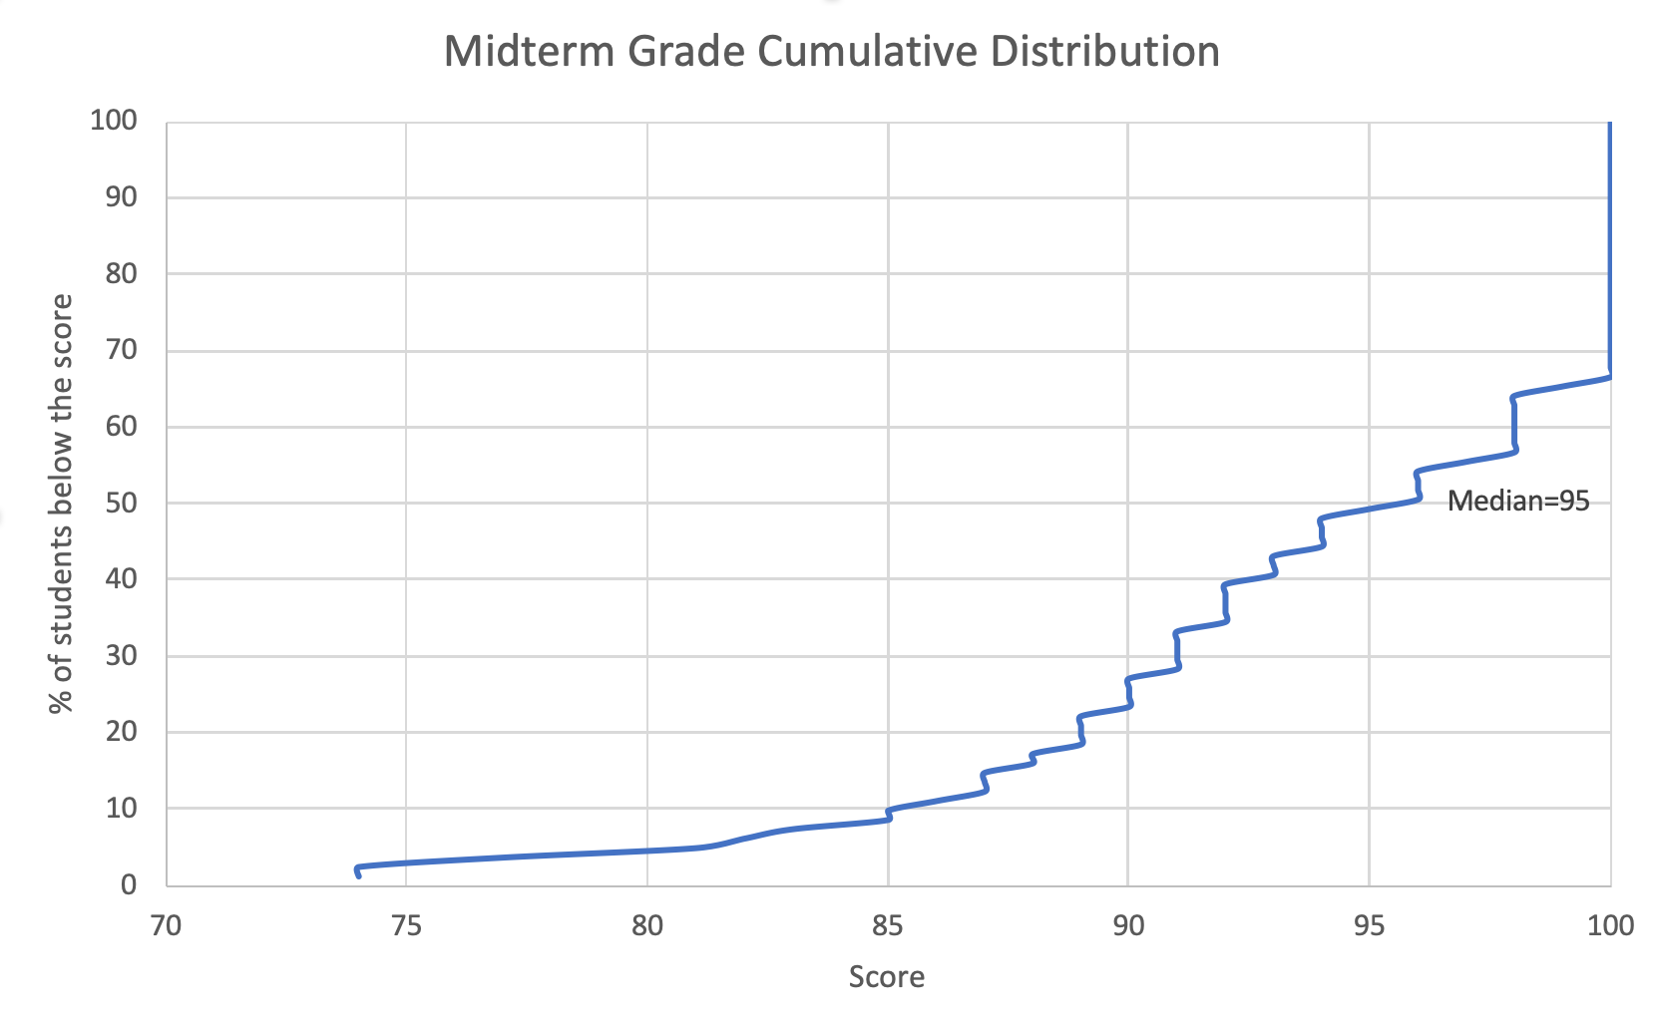
Announcements
HW4 is due on Monday.

Slide 3
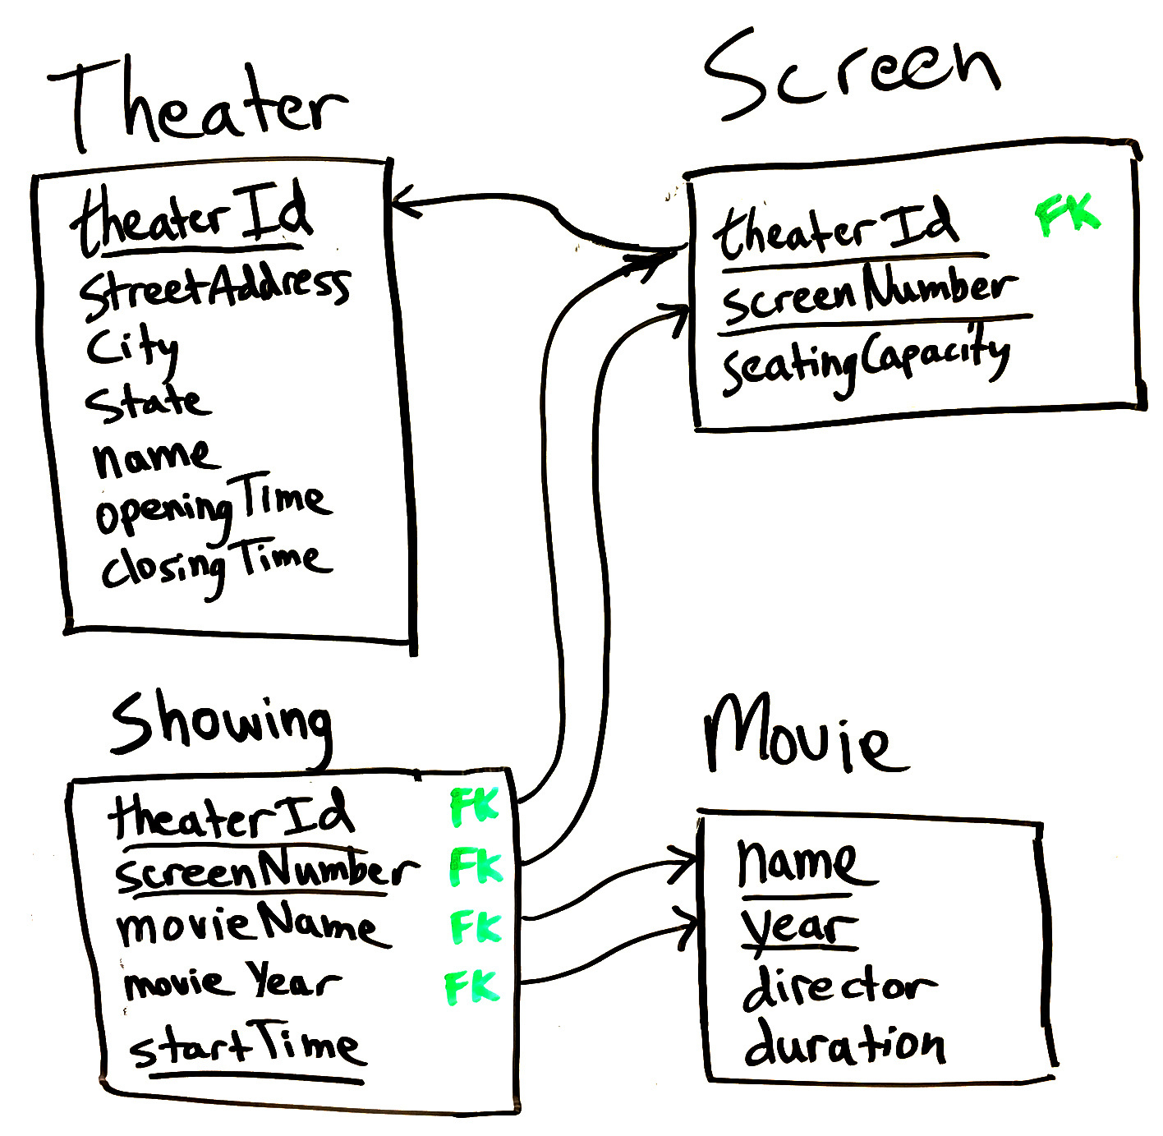
Movie Theater

Slide 4
Composite Primary Keys
Primary Keys uniquely identify rows
  Used as indexes to find a row of interest
  Prevent duplication
Often we need more than one column to uniquely identify rows
  Eg., a Screen is uniquely identified by theaterId and screenNumber.
  theaterId alone cannot be a primary key because it’s OK for multiple screens to exist at the same theater, as long as they have different screenNumber.
  screenNumber alone cannot be a primary key because different theaters can use the same screen numbers (1, 2, 3 …).
However, composite primary keys make foreign keys and parent-child relationships messy.

Slide 5
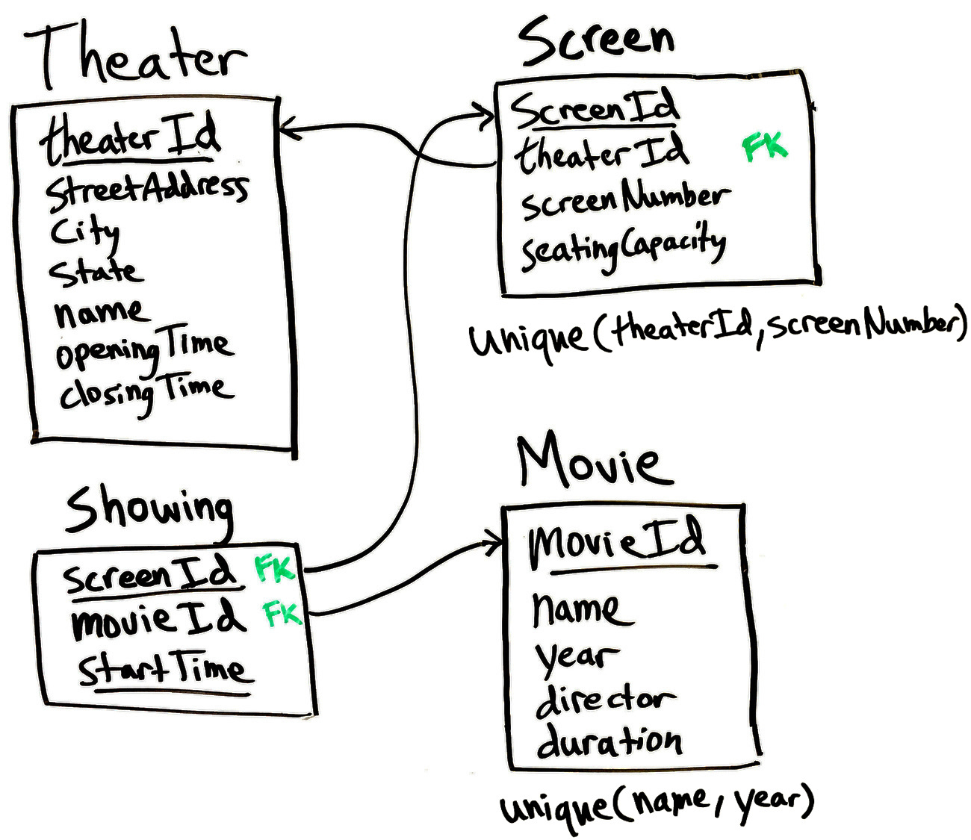
Adding a ScreenId and MovieId simplifies the schema.
Showing table becomes smaller and JOINs are simpler

Slide 6
Non-primary/Unique Keys
When a table is a parent, it is common to create a meaningless “ID” column for the primary key, then add a non-primary composite key to enforce the integrity constraint.
For example, in the movie theater example:
  movieId is meaningless, but it is a convenient way for other tables to refer to movies in foreign keys.
  add a unique key on (name, year) to prevent two instances of the same movie
  Showing table can have just a single column movieId as a foreign key instead of two columns (name, year).

Slide 7
Unique Keys
Unique keys are also sometimes needed when you want to add additional constraints beyond those enforced by the primary key.
In the Music Festival example we needed both:
  primary key (time, artist)
    an artist cannot play on two Stages the same time
  unique key (time, stage)
    a stage cannot host two Artists at the same time

Slide 8
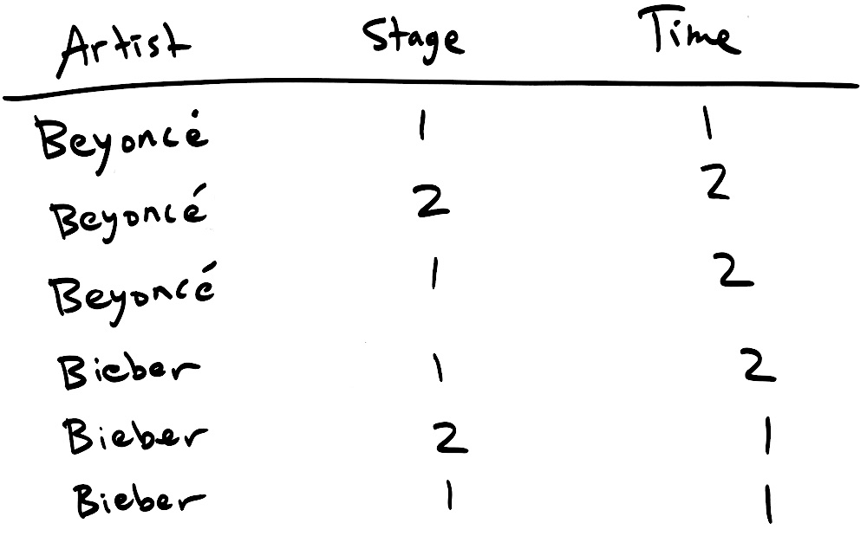
Primary key (time, artist)
This unique key prevents an artist from being on two stages at the same time
The two crossed-out rows are not allowed because they duplicate a previous (time, artist) combination.

Slide 9
Unique key (time, stage)
This unique key prevents a stage from being used by two artists at the same time
The two crossed-out rows are not allowed because they duplicate a previous (time, stage) combination.

Slide 10
Why not make a key on a single column?
Key (artist) would prevent an artist from performing twice (even at different times)
Key (stage) would prevent a stage from ever being used twice.
Key (time) would prevent two artists from performing at the same time (on different stages).

Slide 11
Modifying SQL databases
Define tables
Add rows to tables
Delete rows from tables
Update columns in a row
Alter tables by adding or removing:
  Columns
  Indexes
  Foreign keys
… and much more
CREATE TABLE …
INSERT INTO …
DELETE FROM …
UPDATE …
ALTER TABLE …
I’ll be showing the SQLite dialect in these slides. For the final project, look up the detailed syntax online:
https://sqlite.org/lang.html

Slide 12
Deleting rows
DELETE command deletes rows in a table matching some criterion.
Very similar to the SELECT statements you’re familiar with.
Just replace SELECT with DELETE and don’t specify any columns
This deletes all the rows in the Classes table for classes in a certain room:
  DELETE FROM Classes WHERE ClassRoomID=12;
If you don’t include a WHERE clause, all the rows in that tables will be deleted: 🚷😰
  DELETE FROM Classes;
To be safe, run a SELECT query first to see what will be deleted:
  SELECT * FROM Classes WHERE ClassRoomID=12;

Slide 13
Foreign Keys affect deletions
In the SchoolScheduling database, there is a foreign key in the Classes table which refers to the Class_Rooms table.
  What happens if we try to delete a classroom that has several associated classes?
If you try to delete a row that is a parent to another row there are several possible results, depending on the particular foreign key settings:
  RESTRICT is the default behavior it it would block the deletion
    You would have to delete the classes first, then the classrooms
  CASCADE causes the child rows to be deleted as well
    Classes would be deleted
  SET NULL causes the child rows to have the column set to null
    Classes would remain, but with a NULL ClassRoomId

Slide 14
Updating rows
UPDATE command is used to change one or more columns in rows matching some criterion.
    UPDATE Departments SET DeptName="Social Studies"
    WHERE DeptName="History";
Just like DELETE, a single UPDATE command can affect many rows and it can use subqueries:
  UPDATE Students SET StudMajor=
  (SELECT MajorID FROM Majors WHERE Major="English");
Can also refer to existing column values and use math functions:
  UPDATE Student_Schedules SET Grade=Grade+5
  WHERE ClassID=1500;

Slide 15
Updating multiple columns
Use a comma-separated list to update multiple columns at once:
    UPDATE my_table
    SET column1=value1,
    column2=value2,
    column3=value3
    WHERE id=123;

Slide 16
Inserting new rows
INSERT command creates one row with the column values specified.
List the column values in same order that the columns were defined:
  INSERT INTO Buildings VALUES ("FD", "Ford", 5, 1, 0);
Or, explicitly list the columns being set (this is more clear):
  INSERT INTO Buildings (BuildingName, BuildingCode,
  NumberOfFloors, ElevatorAccess, SiteParkingAvailable)
  VALUES ("Ford", "FD", 5, 1, 0);
Unspecified columns will get the default value specified when the table was created (more on this later).

Slide 17
Bulk loading data
Three options for inserting lots of rows:
Write code in a programming language like R or Python to read the source data and run lots of INSERT statements or one really big INSERT statement:
    INSERT INTO animals VALUES (1, "cat", 5), (2, "dog", 2),
    (3, "mouse", 9), (4, "rat", 3) …
Import a CSV file:
  CSV (Comma Separated Values) is a very simple, standard spreadsheet format.
  Exact import steps are different for each DBMS.
  In DB Browser for SQLite use File → Import → Table from CSV file
Use an ETL software package (Extract, Transform, Load)

Slide 18
Creating tables
CREATE TABLE command defines:
  Table name
  Column names
  Column types (int, float, text, etc.)
  Whether columns are optional or required (NOT NULL)
  Primary key
  Foreign keys
  Unique keys
  Indexes (non-unique keys)
In other words, everything that we drew in the data model diagrams

Slide 19

CREATE TABLE Syntax examples from SchoolScheduling.sqlite
Table name
Required column, not optional
CREATE TABLE Buildings (
BuildingCode nvarchar(3) NOT NULL,
BuildingName nvarchar(25),
NumberOfFloors smallint,
ElevatorAccess bit NOT NULL DEFAULT 0,
SiteParkingAvailable bit NOT NULL DEFAULT 0,
PRIMARY KEY (BuildingCode)
);
Text with at most 25 characters
Columns
Column cannot be NULL, but it will take a value of zero if none is specified.
Each column has a data type, like nvarchar(3) or smallint

Slide 20
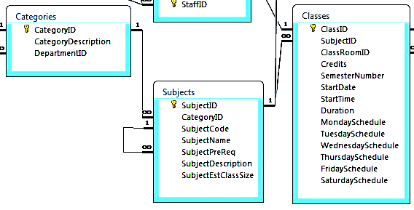
CREATE TABLE Subjects (
SubjectID int NOT NULL DEFAULT 0 ,
CategoryID nvarchar (10) NULL
REFERENCES Categories(CategoryID),
SubjectCode nvarchar (8) NULL ,
SubjectName nvarchar (50) NULL ,
SubjectPreReq nvarchar (8) NULL DEFAULT NULL
REFERENCES Subjects(SubjectCode),
SubjectDescription text NULL ,
SubjectEstClassSize smallint NOT NULL DEFAULT 0,
PRIMARY KEY (SubjectID),
UNIQUE (SubjectCode)
);
Foreign keys

Slide 21
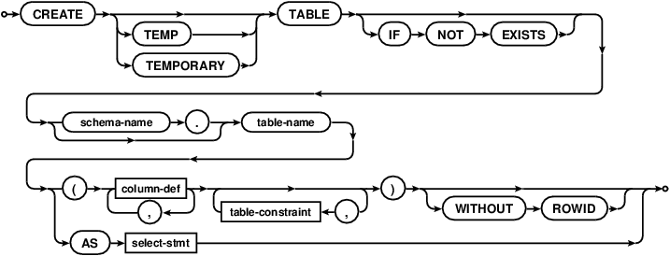

CREATE TABLE syntax diagram
column-def:

Slide 22
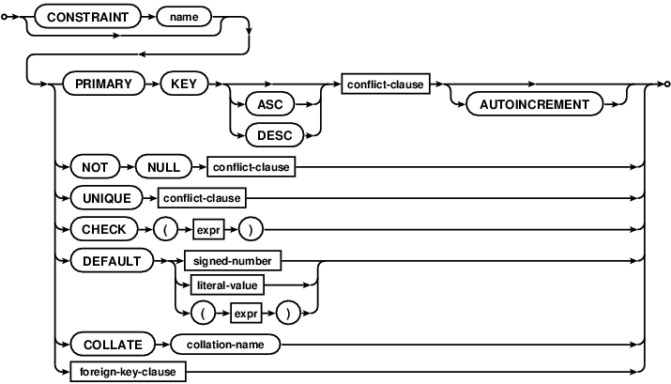
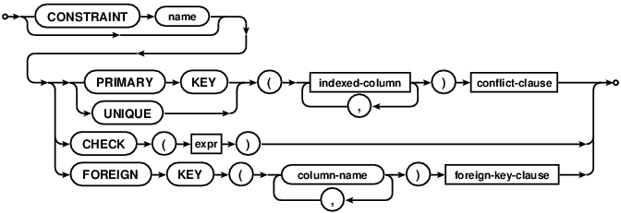
column-constraint:
table-constraint:

Slide 23
Using SQLite within Python
https://docs.python.org/2/library/sqlite3.html
Can use similar syntax to connect to MySQL, etc.
Also possible to use SQL within R or practically any other language:
https://db.rstudio.com/databases/sqlite/

Slide 24
Debugging a data import
If data fails to import completely, try loading it into a temporary text table
  Don’t enforce key constraints and use large text types for every column
Query the text table to look for unexpected values in the source data
This table has strict constraints on what kind of data can be inserted:
CREATE TABLE person (
SSN int NOT NULL,
firstName varchar(30) NOT NULL,
lastName varchar(30) NOT NULL,
birthDate char(10) NOT NULL,
PRIMARY KEY (SSN)
);
This temporary table relaxes those constraints:
CREATE TABLE _import_person (
SSN varchar(1000) NOT NULL,
firstName varchar(1000) NOT NULL,
lastName varchar(1000) NOT NULL,
birthDate varchar(1000) NOT NULL,
);

Slide 25
Using queries to fill tables
You can transfer data from the temporary to permanent tables by putting a SELECT in an INSERT query. For example:
  INSERT INTO orders (col1, col2)
  SELECT col1, col2 FROM tmp_orders;
Above query copies data from tmp_orders to orders table.
Note that DB Browser to sqlite does not always work well with very large CSV files. You may have to be import big files using the commandline version of sqlite.

Slide 26
CSV data import demo
LA County Restaurant Inspections and Violations
https://www.kaggle.com/meganrisdal/la-county-restaurant-inspections-and-violations/home

Slide 27
Recap
Showed how introducing a single identifier column can make foreign keys simpler.
Looked in detail at an example needing two unique composite keys.
Gave SQL syntax for creating and altering tables, and modifying data:
  CREATE TABLE …
  INSERT INTO …
  DELETE FROM …
  UPDATE …
  ALTER TABLE …
Showed how SQL can be used inside of another language (like Python) to build a database programmatically.

