Slide 1

EECS-317 Data Management and Information Processing
Lecture 10 – Indexes
Steve Tarzia
Spring 2019

Slide 2
Announcements
HW4 was posted yesterday, and it’s due on Monday.
Midterm grades will be posted soon.
You can pick up your exam from my office hours.
Friday is the last day to drop.

Slide 3
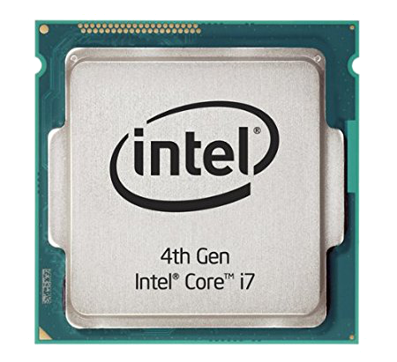
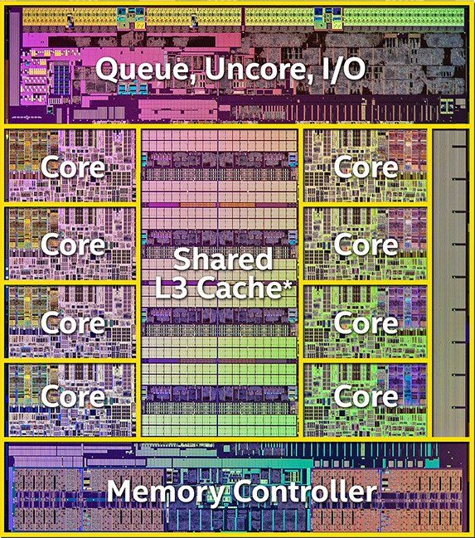
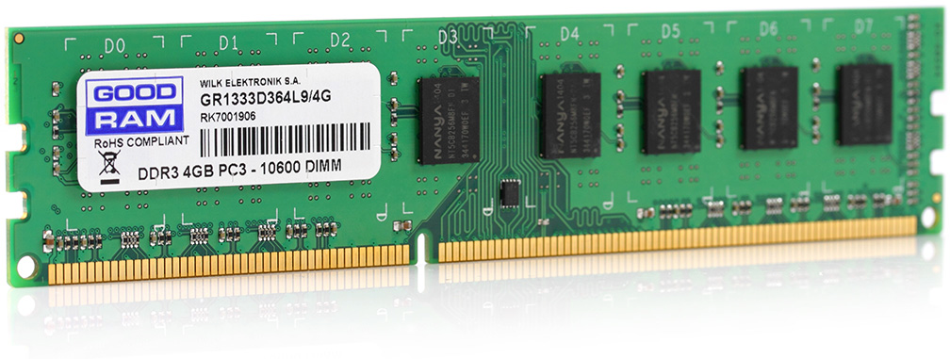
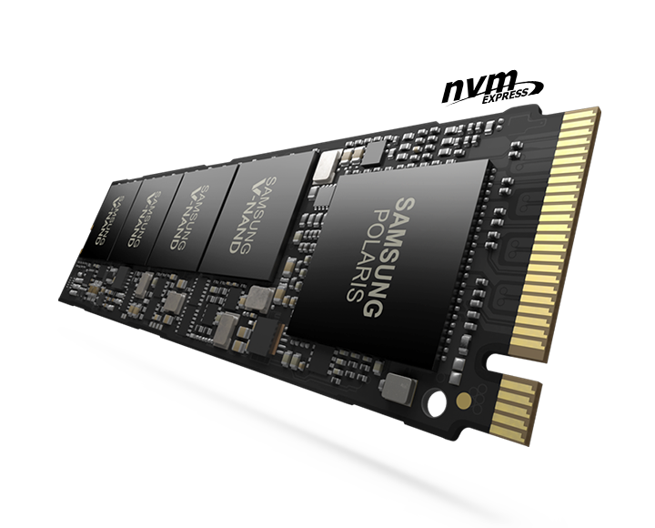
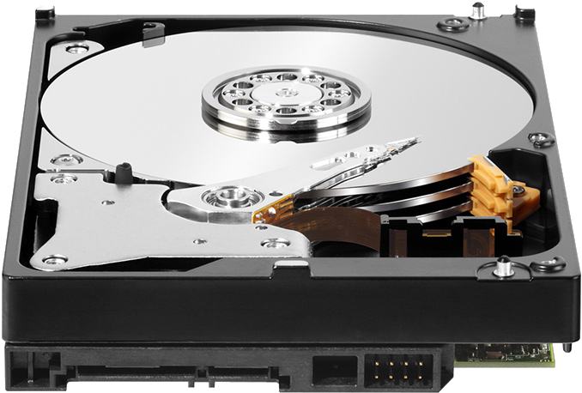
Computers have a hierarchy of storage
delay |  | capacity
0.3ns | CPU Registers | 1 kB (kilobyte)
5ns | CPU Caches (L2) | 16 MB
50ns | Random Access Memory (RAM) | 16 GB
100μs | Flash Storage (SSD) | 1 TB
5ms | Magnetic Disk | 8 TB
Larger, but slower
Disk is about ten billion times larger than registers,
but has about ten million times larger delay (latency).
Goal is to work as much as possible in the top levels.
Large, rarely-needed data is stored at the bottom level

Slide 4
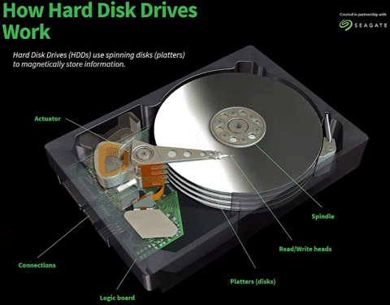
Storage has limited bandwidth
Magnetic disk’s data can only be read at current location of the read/write head.
All types of computer storage are limited to reading/writing just a small fraction at once.
Magnetic disks:
  The read/write head can read the charges on a tiny portion of the magnetic disk.
RAM (memory):
  Memory and flash chips store lots of data, but only a few bytes can be transferred at once, because there are only a couple hundred electrical connections at the edge.
  SSDs (flash) is similar, with even fewer electrical connections.
https://animagraffs.com/hard-disk-drive/
Just a couple hundred electrical connections at the edge of a RAM card.

Slide 5
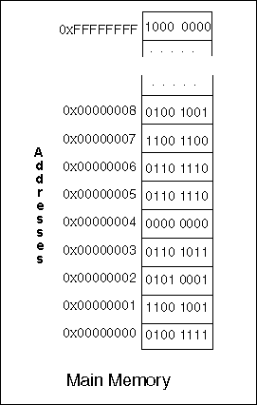
Abstract view of computer storage
Storage is a big array of bytes (numbers).
Computer can read or write from one location (address) at a time.
The picture at left is misleading because a human observer can see all the data at once. The computer cannot!
Computer requests one address at a time:
Data being stored
Memory.
a “black box”
Give me address 23.
Address 23 is storing the value “49”

Slide 6
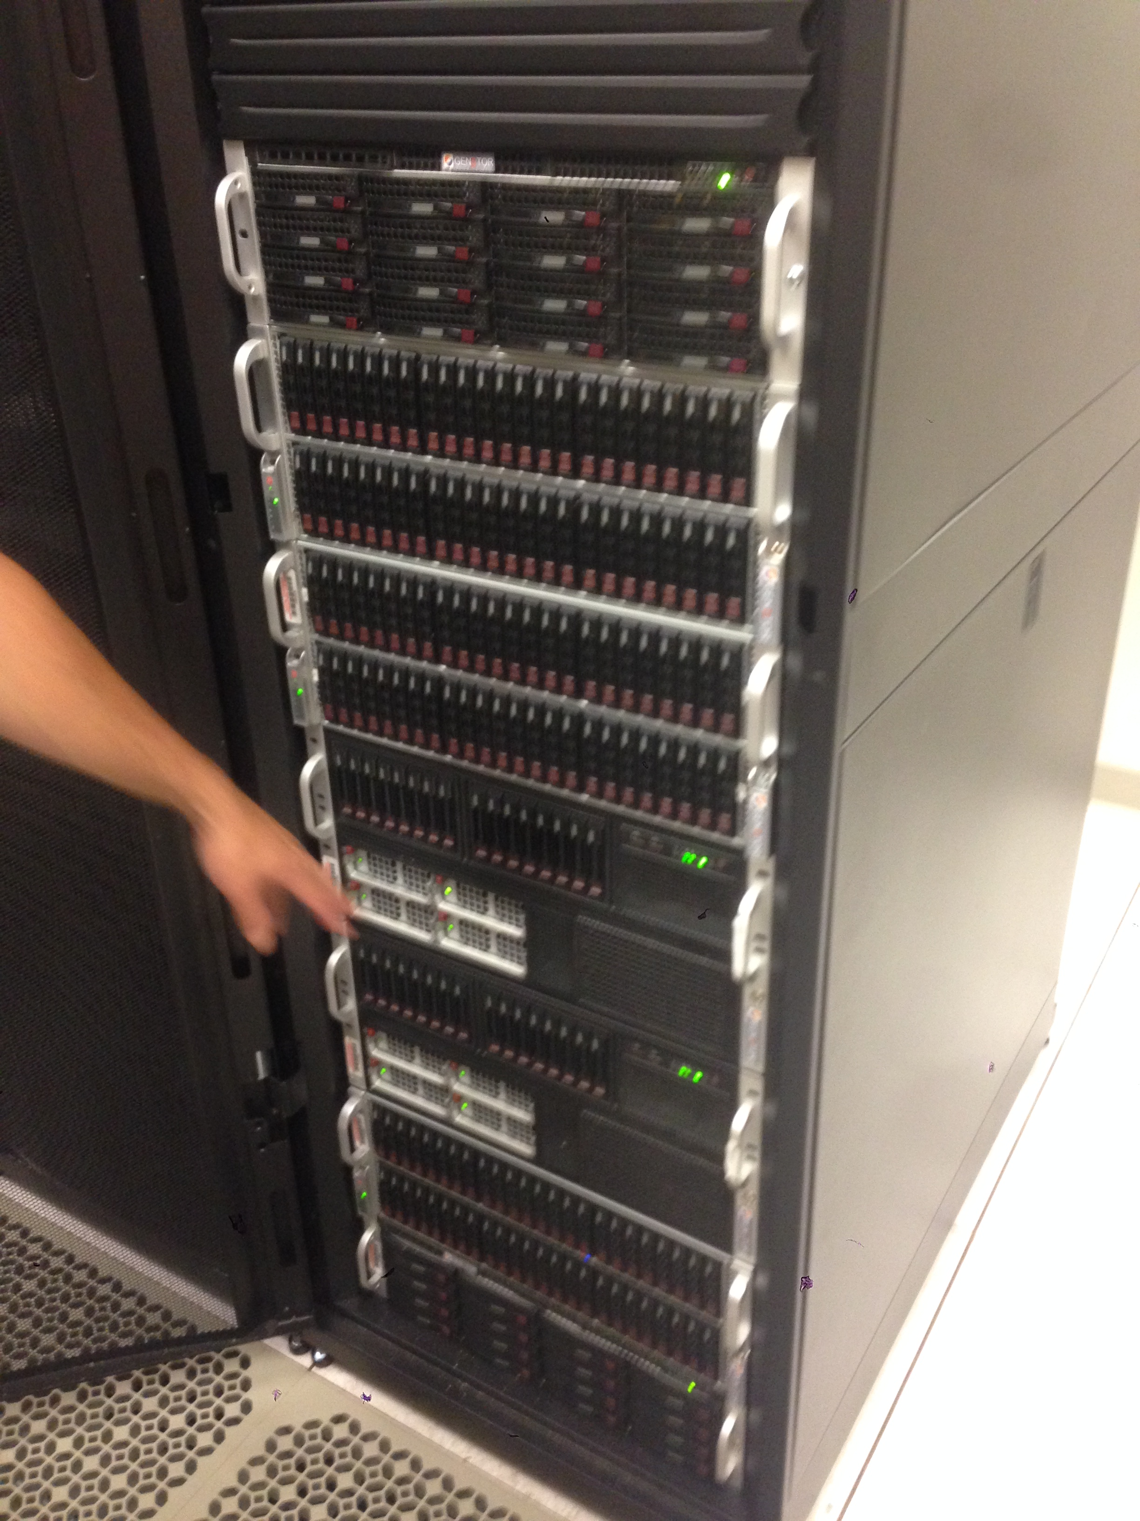

A Database Server @ NU
Front view
264 fast (10k RPM) magnetic disks (for production)
56 slow (7200 RPM) magnetic disks (for backup)
~150 TB storage capacity
Comprised of 6 physical chassis (boxes) in one big cabinet, about the size of a coat closet.
SAS cabling in back

Slide 7
Stack Overflow database
Questions and Answers from a popular programming help website
  150 GB of data
  29M posts
  55M comments
Reading through all the data takes about 1,000 seconds (17 minutes).
We don’t want to wait 17 minutes for an answer.
It’s impractical to scan through all the data to find what we need.
We need a way to quickly find the data of interest (indexing!)

Slide 8

Indexing
When working with large amounts of data it can be a challenge to find an item of interest.
We don’t want to request every storage address to find what we’re looking for.
Sorting the data can help tremendously, because it allows binary search.

Slide 9
Sorting and Binary Search
We know it’s easy to find data if it’s in a sorted list.
  That’s why printed dictionaries and phone books are alphabetical.
Binary Search is how computers find entries in a sorted list.
  Let’s say you’re looking for the word “key” in a list of 10,000 words
    Compare “key” to the word in the middle position (5,000th word).
    If you’re lucky and that middle word is equal to “key”, then you’re done!
    If the middle word is greater than “key” then go back to step 1,
    but refine your search to just the left half of the list (words 0 through 4,999).
    If the middle word is less than “key” then go back to step 1,
    but refine your search to just the right half of the list (words 5,001 through 10,000).
  At most is will take log₂N steps to find the entry, where N is the list size.
    Eg., 32 steps for binary search in a list of 4 billion entries (because 2³² ≅ 4 billion)

Slide 10
Why sorting is not enough
You can’t sort in multiple dimensions
  Let’s say you want to find a product quickly according to either it’s name, manufacturer, or price. You can only sort by one of the there three columns.
Can’t insert new data without shifting everything over to make room.
  Shifting data in storage would require rewriting about half of it (on average).
  That’s incredibly amount of work to accommodate just one tiny addition.
Sorting doesn’t take advantage of the hardware’s storage hierarchy.
  The binary search will have to access the disk in every step because the index is distributed over the full data set.
  It would be better to put all the index data close together (spatial locality).

Slide 11
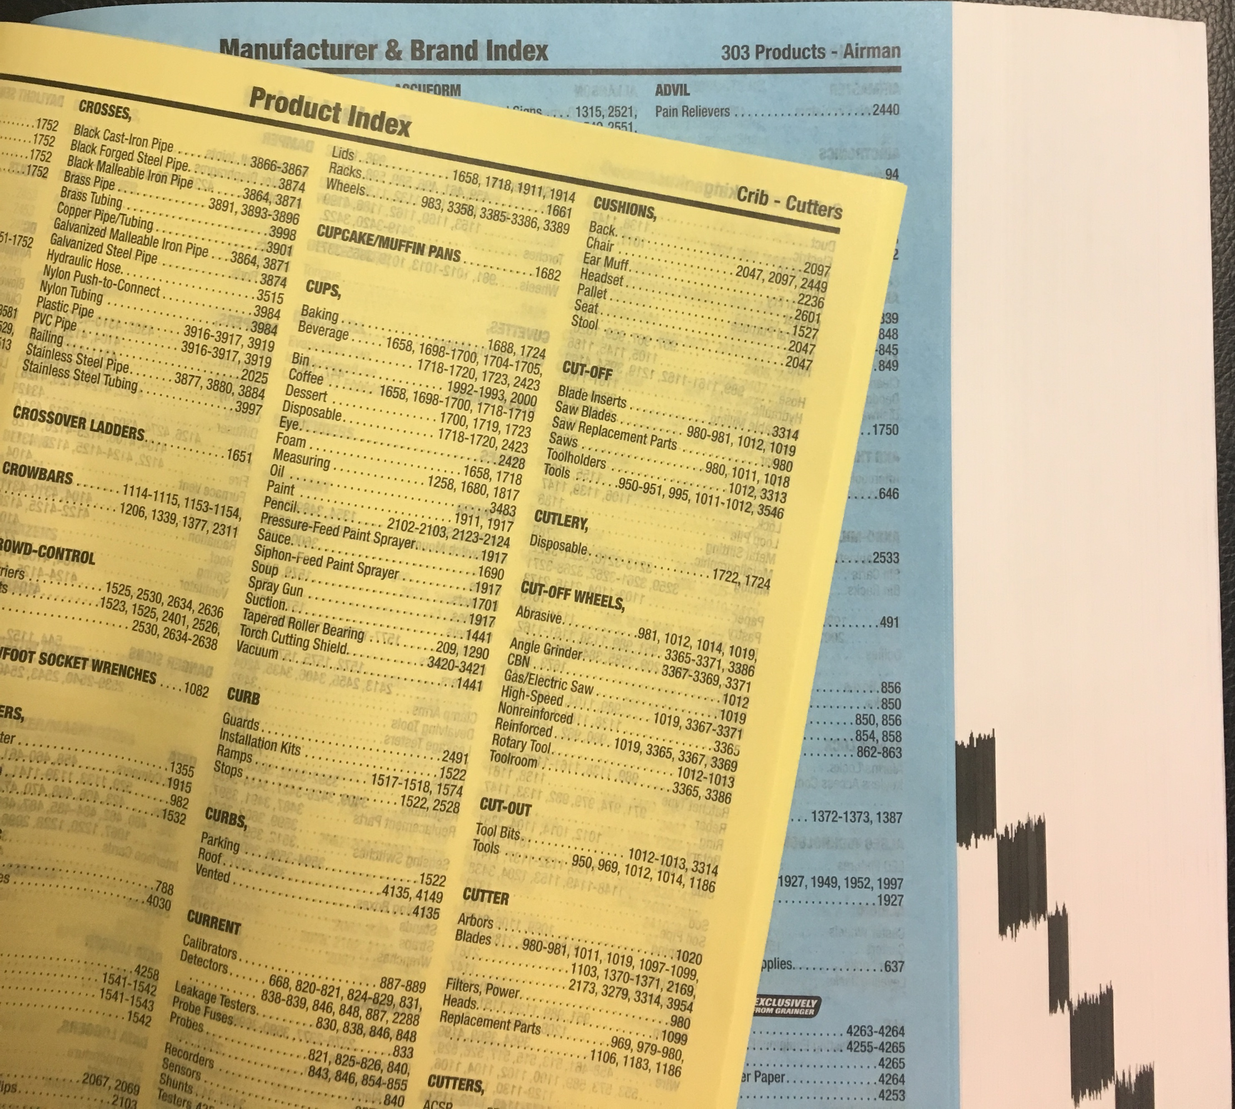
A printed catalog can add multiple indexes
Grainger catalog is sorted according to high-level product categories.
It has both yellow and blue index pages.
These allow efficient lookup by:
  product type names
  manufacturer names
In total, products can be efficiently found in three ways.
Simple sorted lists are effective here because data is never added.

Slide 12
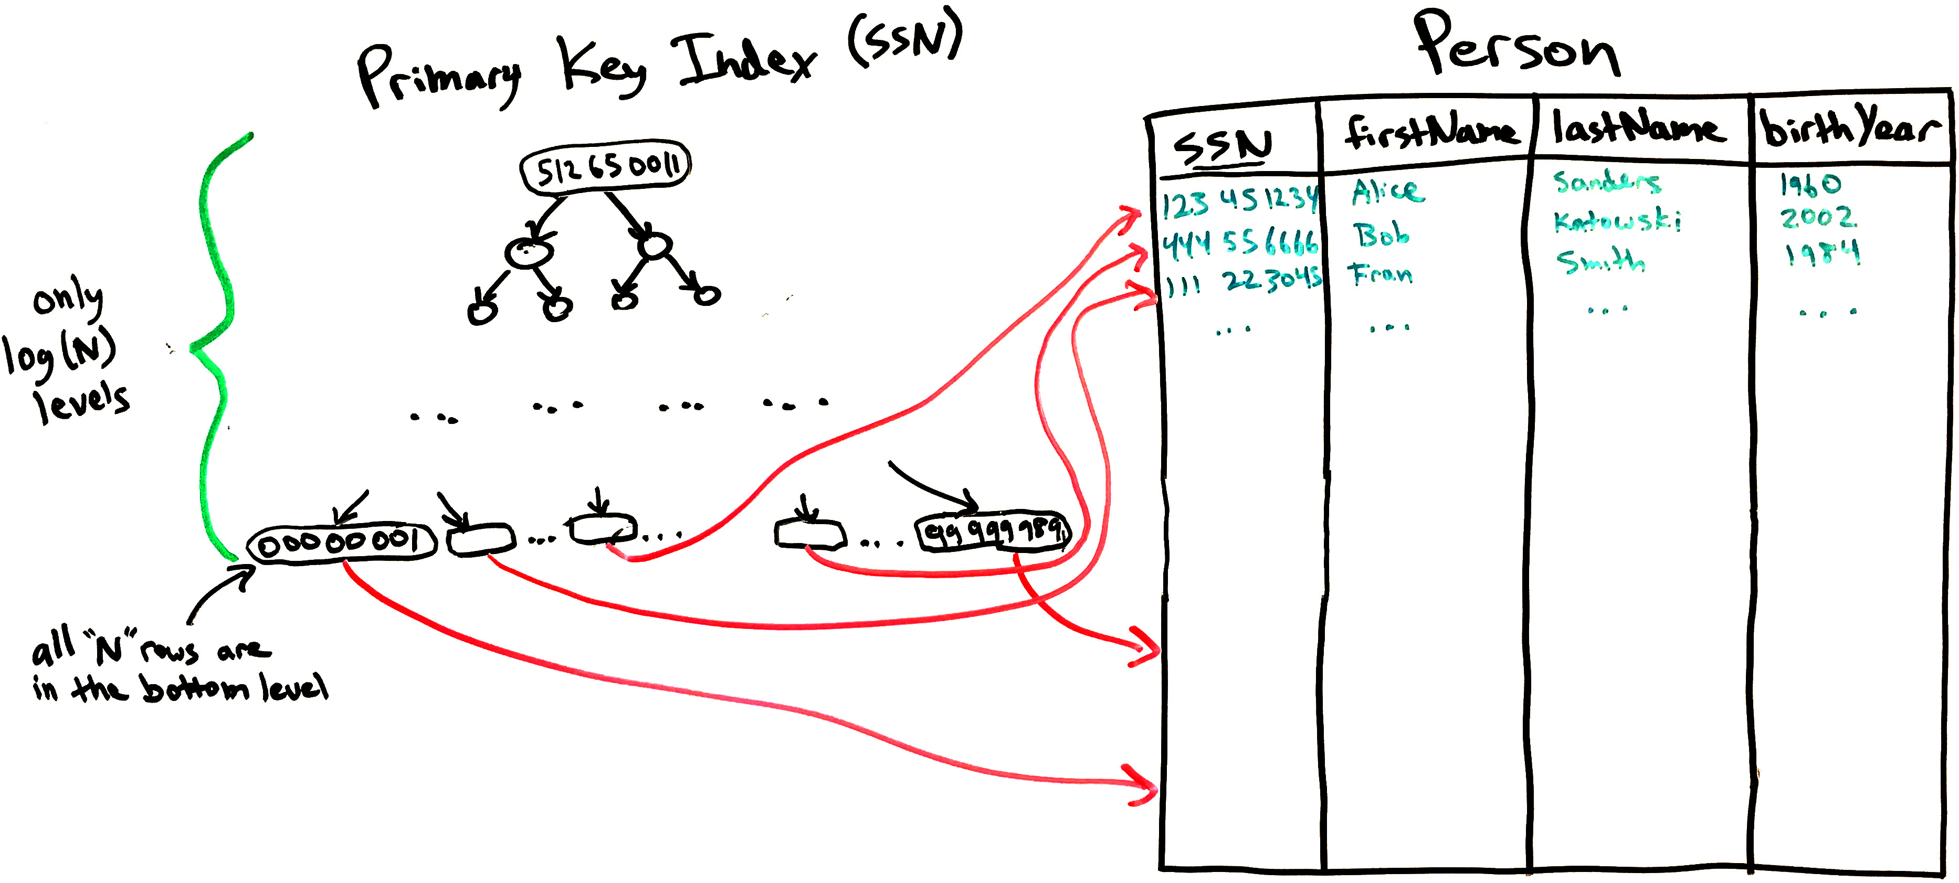
DB indexes use a tree or hashtable instead of sorting
Self-balanced binary trees give the log(N) speed of a binary search,
while also allowing entries to be quickly added and deleted.
The details are beyond scope of this class (covered in CS-214 Data Structures).

Slide 13
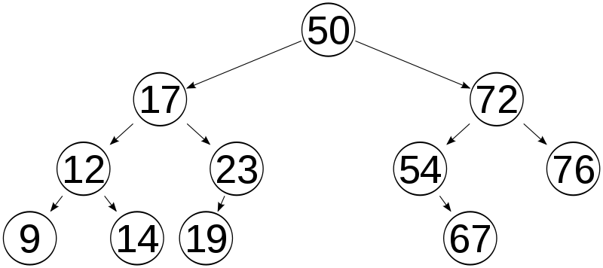
Balanced binary search tree
Finding an element is very similar to binary search of a sorted list.
Start from the root. Move to the left subtree if the value you’re looking for is smaller, otherwise move to the right subtree.
Repeat.

Slide 14
Creating indexes/keys
Indexes are usually defined when the table is created
  Primary key must be unique for each row.
  We must be able to quickly check that new value does not already exist.
  Thus, unique/primary keys are indexed.
But you may later realize that certain queries are too slow
  Without proper indexes, DBMS will have to examine every row in the table to find the relevant rows.
  Adding one or more indexes may dramatically speed up a query.
Basic syntax:
  CREATE INDEX index_name ON table_name (column_name)

Slide 15
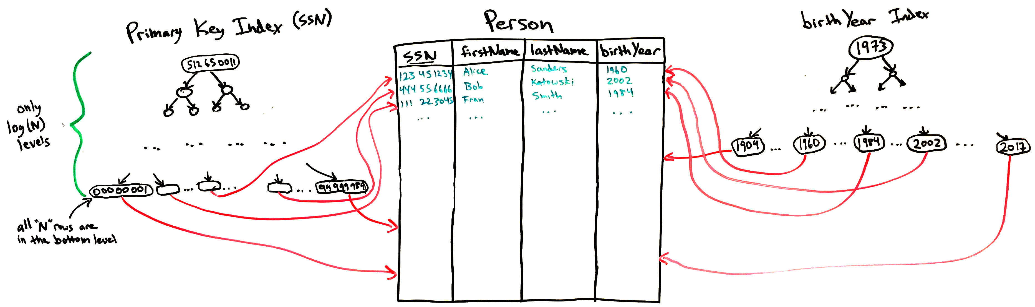
Multiple indexes in one table are possible
Allow finding rows quickly based on multiple criteria
Need two indexes to quickly get results for both:
  SELECT * FROM Person WHERE SSN=543230921
  SELECT * FROM Person
  WHERE birthYear BETWEEN 1979 AND 1983

Slide 16
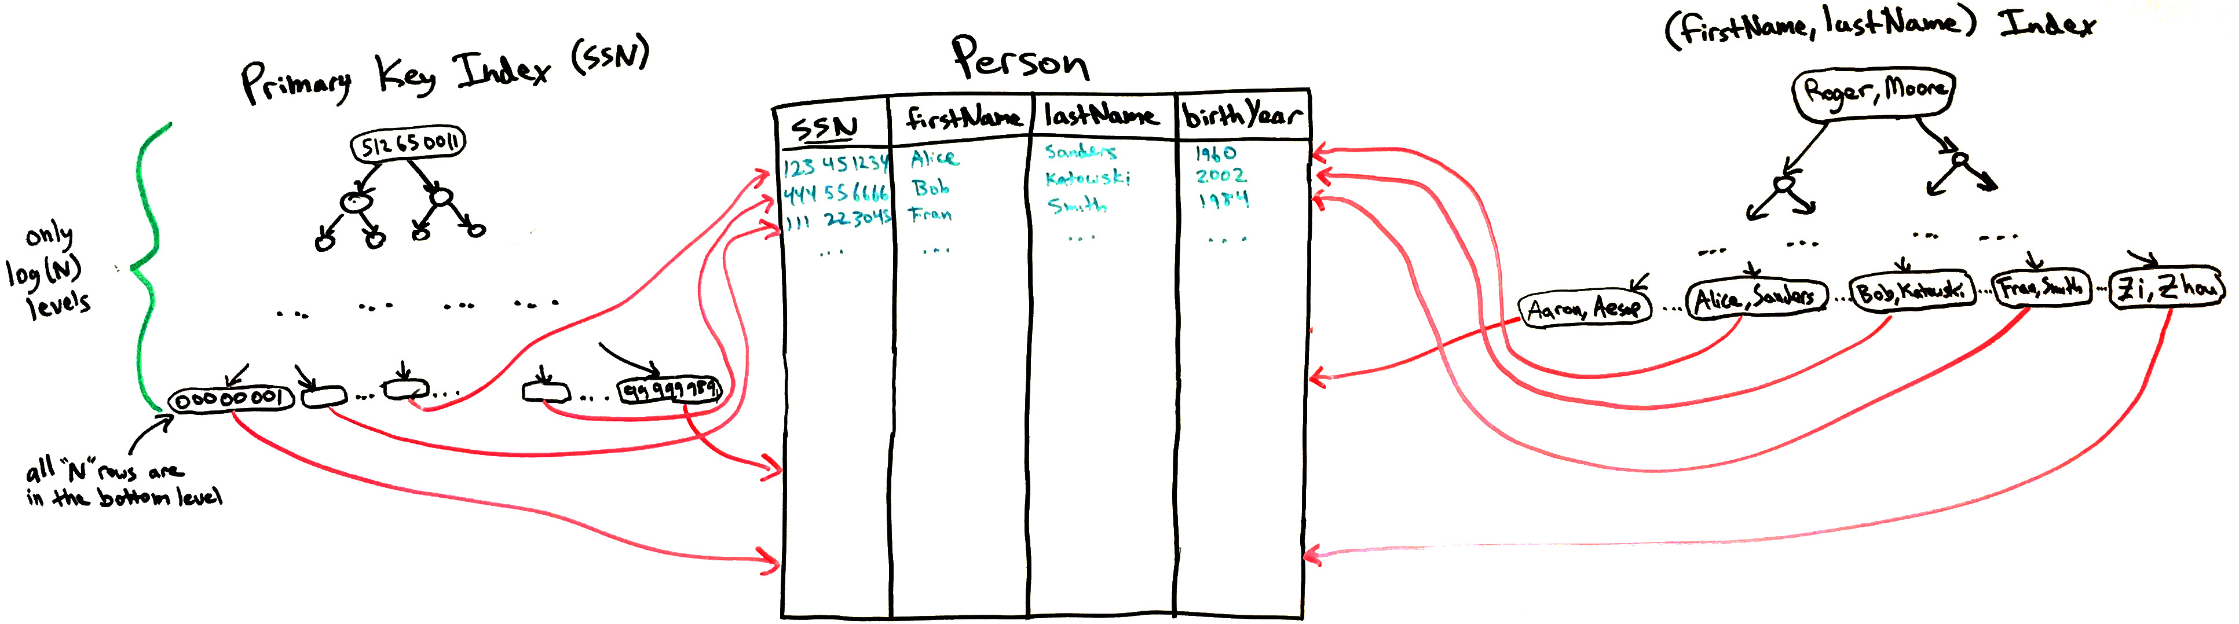
Composite indexes involve multiple columns
Useful when WHERE clauses involves pairs of column values:
  SELECT * FROM Person WHERE firstName = “Alice” AND lastName = “Sanders”
Unlike two separate indexes, you can find the matching pair of values with one lookup.
Otherwise, would have to first find results for firstName = “Alice” and scan through all the Alices checking for lastName = “Sanders”
However, example below does not allow you to quickly find rows by lastName

Slide 17
Query execution plans
The DBMS must translate your SELECT query into a series of table lookups.
A complex query has many choices about what to do first, and it will try to make the most efficient choice.
  For example, if a JOIN is used, either of the two tables can be examined first.
  The presence of indexes make some choices more efficient than others.
DBMSs have special commands that explain the query execution plan:
  SQLite: EXPLAIN QUERY PLAN SELECT …
  MySQL: EXPLAIN SELECT …
  This usually tells you how many rows will be examined, and adding indexes can reduce these numbers. (examples follow)

Slide 18
When to index columns?
When a query is slow!
Generally, add an index if the column is:
  Used in WHERE conditions, or
  Used in JOIN … ON conditions, or
  A foreign key refers to it.
Also helpful if the column is:
  In a MIN or MAX aggregation function

Slide 19
Indexes are not free!
Don’t add indexes unless you need them.
Rookie mistake is to index every column “just in case.”
Indexes consume storage space (storage overhead),
Indexes must be updated when data is modified (performance overhead).

Slide 20
Key and Index terminology in SQL
Plain key or index is just a way to find rows quickly
  Just creates a search tree.
Unique key is an index that prevents duplicates
  Bottom level of search tree has no repeated values
  DBMS can use the tree to quickly search for existing rows with that value before allowing a row insertion (or column update) to proceed.
Primary key is just a unique key, but there can only be one per table
  We think of the primary key as the most important unique key in the table
Foreign key makes a column’s values match a column in another table
  The referenced column in the other table should be indexed
  (usually it’s the primary key).

Slide 21
Recap
Large relational databases can store many terabytes of data.
However, it can take hours days to scan through all the data.
Column Indexes allow row with particular values to be quickly found.
  If we have N rows, an index allows data to be found in log(N) time.
Tables can have multiple (secondary) indexes.
  These should be added for columns whole values are often tested in queries.
Composite indexes operate on multiple column values.
Indexes (a.k.a. keys) are classified as:
  Primary Keys
  Unique Keys (similar to above)
  Foreign Keys (referring to keys in another table)

