Slide 1

EECS-317 Data Management and Information Processing
Lecture 7 –
Relational Database Design
Steve Tarzia
Spring 2019

Slide 2
Announcements
HW2 was due yesterday
HW3 posted and due in one week.
Midterm exam one week from Thursday (May 2nd)
  Practice exams and additional practice HW questions are posted.

Slide 3
Last Lecture: Combining SELECTs, Adv. predicates
UNION, INTERSECT, and EXCEPT
Used to combine two SELECT statements.
Combines results table vertically (rather than horizontally for JOINs)
Necessary when answer requires two different (virtual) tables.
Discussed more advanced uses of predicates.
  Summing an indicator variable.
Introduced CASE statement which chooses between two different options depending on some condition in the row.

Slide 4
Next topic: Data Modeling
In other words, how to define a relational database schema

Slide 5
Database Schema defines the data’s structure
Also called a data model
  It’s metadata – data about data
Defines the tables, including:
  Columns in each table (both the name and type)
  Primary Key for each table
  Foreign Keys that link tables
  Unique Keys, if any
  Data type for each column (integer, floating point, text, date, time, etc.)
  Whether columns required (default) or optional.
  Default values for columns (optional) to be used when no value is supplied.
Tables represent objects, events, or relationships

Slide 6
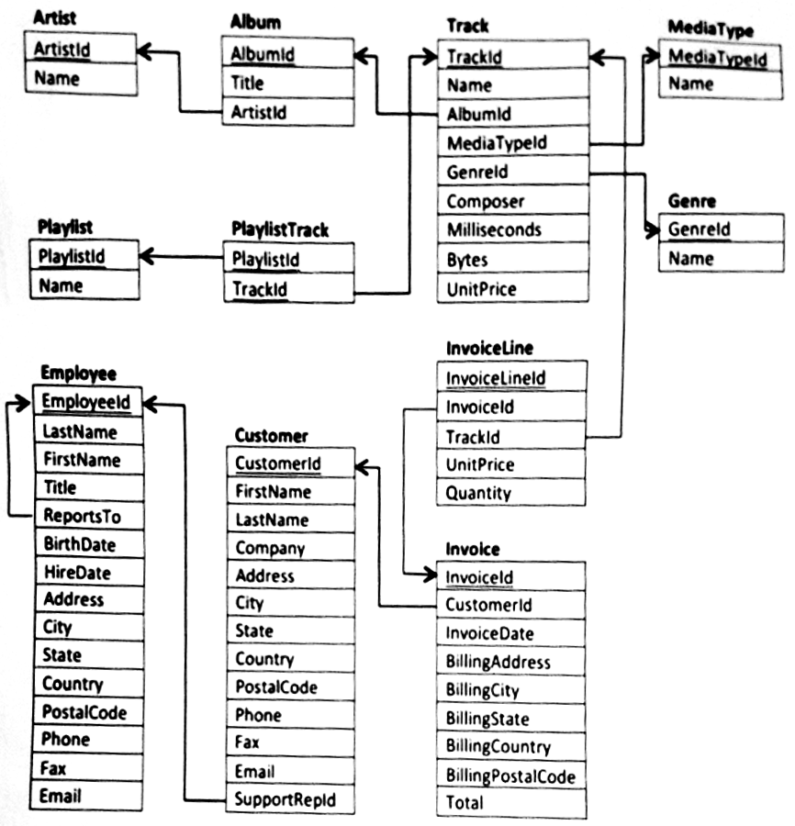
“Chinook” online music store
11 tables
Let’s explore what this diagram means, and why this design was chosen.

Slide 7
Primary Keys
*
*
*
Every table has a unique
primary key – the column(s) that uniquely identify each row.
No two rows can have the same primary key value.
The primary key defines the principal feature of each row.
Often it’s an integer identifier
PlaylistTrack table is different. It uses a composite primary key (made of two columns) and it lacks an integer identifier.
In this class, we will underline primary keys in the diagrams.
*
*
*
*
*
*

Slide 8
Unique keys
Unique keys are like additional (secondary) primary keys.
No two rows can have the same value for a unique key.
For example, we may wish to require that all Albums have both a unique AlbumId and a unique UPC (bar code):
We write UNIQ next to columns with unique keys in the diagrams
Album
AlbumId
Title
ArtistId
UPC UNIQ
When inserting data into this table, the new row must have both a unique AlbumId and a unique UPC.

Slide 9
Foreign Keys
Tables may be linked by foreign keys – columns that refer to keys in other tables.
Usually these are integers ids, and should refer to a primary/unique key
PlaylistTrack table is made entirely of foreign keys, so we call it a linking table.
Arrows in these diagrams go from a foreign key to the column(s) they reference.
*
*
*
*
*
*
*
*

Slide 10
Parent and Child tables
*
*
*
*
*
Foreign keys define a parent and child table.
  Child points back to parent
  Parent row must be created before child row
A table can simultaneously be both a parent and child.
  Album is a child to Artist, but a parent to Track.
*
*
*
*
*
*
*
*
*
*
*

Slide 11
Highest-level parent tables
In this example, you must create rows in these five tables before creating rows in the other tables.
Just follow the arrows outward to determine all the rows that are necessary to fill a table.
A Track requires MediaType, Genre, Album, and Artist.

Slide 12
Policies for deleting Foreign Keys
Theoretically, you cannot delete a row from a parent table if a child table refers to it.
For example, we cannot delete an artist if we still have one of her albums defined.
  If the artist were deleted, the album row would have an invalid ArtistId.
However, in practice, DB software is flexible.
Three foreign key options for “ON DELETE”:
  Restrict (don’t allow delete)
  Cascade (delete children)
  Set NULL (make orphan)
Notes:
Many tables have an “active” column for this reason. Consider the Employee field. What happens when an employee quits?

Slide 13
Objects, Events, and Relationships
These are not firm concepts and there are no strict definitions, but:
  Relationships always have at least two foreign keys
  Events always have a time and can repeat with a different id and time.

Slide 14
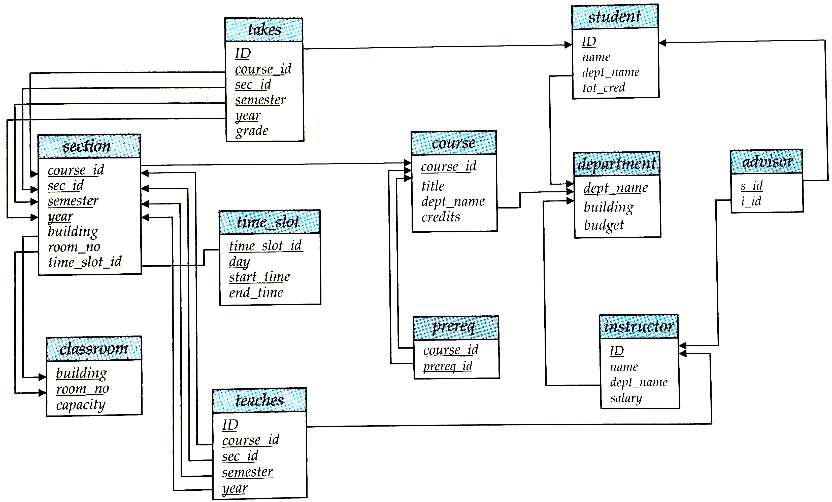
Another university database
Find:
Relationships
Composite Primary Keys
Change the design to allow multiple majors per student.

Slide 15
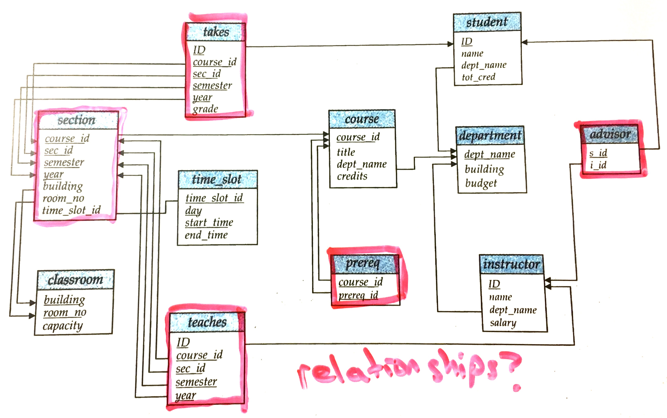

Slide 16
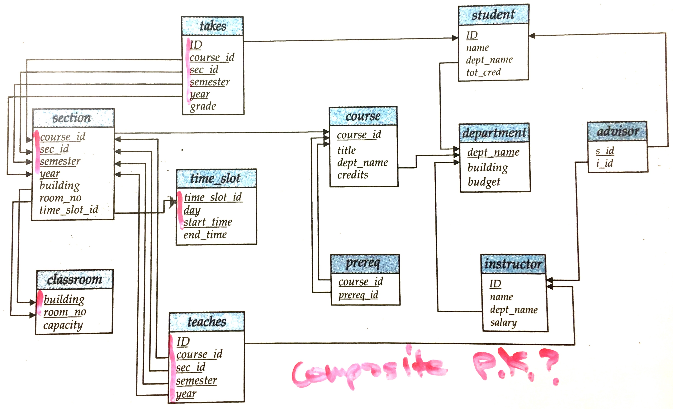

Slide 17
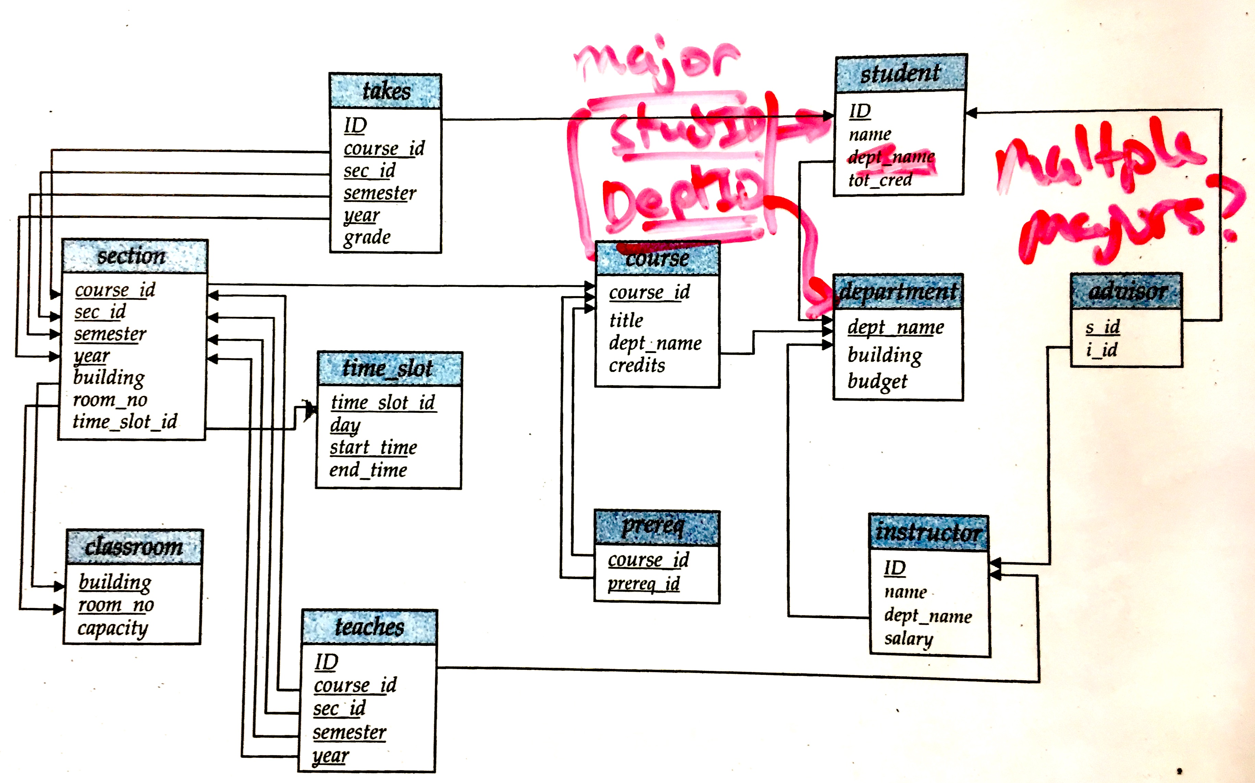

Slide 18
Table relationships in depth
Foreign keys can relate table rows in three ways:
One to One
One to Many
Many to Many

Slide 19
One to Many
(or equivalently “many to one”)
Most foreign keys create one-to-many relationships
Created when a column that is not a primary key has a foreign key.
All of the arrows in this diagram represent one-to-many relationships.
  Many of the rows in the child table can be related one row in the parent table.
Notes:
It may be more clear for students to think of these as “many to one” relationships

Slide 20
Many to Many
Two one-to-many relationships starting at the same table can create a many-to-many relationship
These are represented with linking tables.
But, some tables can be classified in multiple ways:
  We think of Track as either an object or as a many-to-many relationship between albums and genres.

Slide 21
One to One
One-to-one relationships exists when a primary (or unique) key is also a foreign key.
In other words, there is an arrow pointing from one primary/unique key to another.
  The fact that it’s a unique key prevents it appearing multiple times (thus, not one-to-many).
The child is a subset table.
Subset tables are an alternative to having optional columns in the parent table.
GrammyAward
AlbumId
Year
Return
InvoiceId
Time
RefundAmount

Slide 22
Optional columns
Strictly speaking, optional columns are not necessary
  Just move the column to a new subset table
But in practice, optional columns are common
  Absent values have NULL value.
  When defining the database tables you specify whether NULL is allowed.
We write OPT next to optional columns in the diagrams
Album
AlbumId
Title
ArtistId
GrammyWinningYear OPT
This is a good alternative design to the Grammy Award table on the previous slide.

Slide 23
Subset tables vs optional columns
Grammy Award subset table supplies just one optional value, so it can be replaced by an optional column in Album.
However, the Return table provides several related columns of optional information that must be provided “all or none.”
  If there is a return Time, then we must have a RefundAmount
Thus, returns cannot be well modeled with optional columns in the Invoice table.
GrammyAward
AlbumId
Year
Return
InvoiceId
Time
RefundAmount

Slide 24
Data Modeling summary
Primary and unique keys prevent rows from repeating certain columns.
Foreign keys link tables and point to primary/unique keys.
  Create parent/child table relationships. Must fill in parent before child.
  Parent rows cannot be deleted unless default foreign key behavior is changed.
    Must kill children first!
Tables can represent Objects, Events (have time), and Relationships:
  One to many relationships allow multiple child rows referencing one parent row
    Implemented with a single foreign key.
  Many to many relationships link two or more rows
    Implemented with a linking table
  One to one relationships create subset tables
    Implemented with a single foreign key that is also a unique key.

Slide 25
Database Schema Design steps
List tables
  (Objects, events, relationships)
Choose primary key for each table
Choose foreign keys to link tables
Add uniq keys and/or optional columns
Refine the design, revisiting decisions made above

Slide 26
Data modeling examples

Slide 27
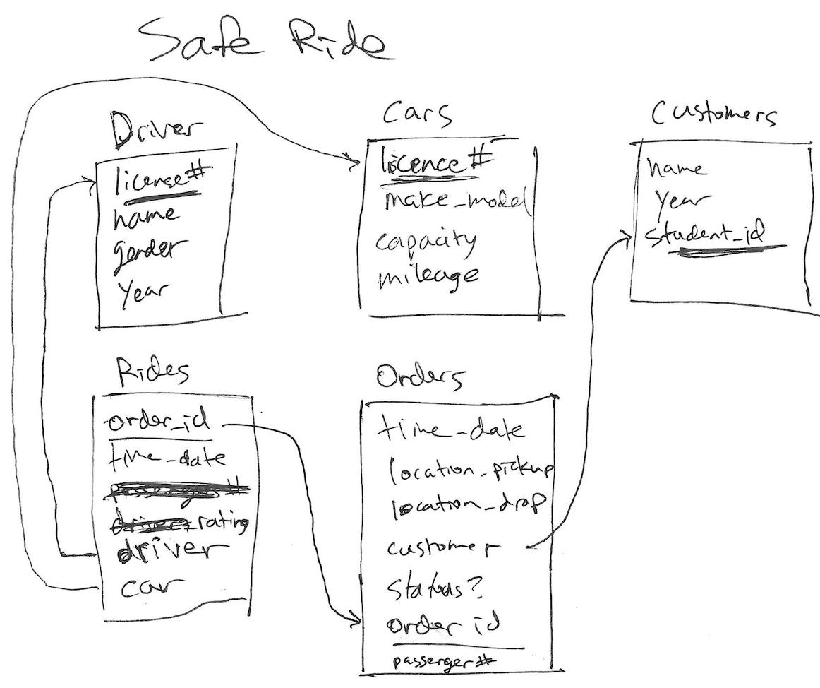

Slide 28
