Slide 1

EECS-317 Data Management and Information Processing
Lecture 5 – OUTER JOINs and CROSS JOINs
Steve Tarzia
Spring 2019

Slide 2
Announcements
HW2 is due on Monday.

Slide 3
Last Lecture
Illustrated GROUP BY
Introduced JOINs
Default type of JOIN is the INNER JOIN
Combines rows from two tables using a join predicate, which usually specifies that two columns must be equal.
Multiple JOINs can be combined
Must refer to columns as table.column
Can use AS to give a table an alias for use in the statement
  Do this when joining a table two or more times, to distinguish each copy of the table.

Slide 4
INNER JOIN review
staff
id | name | room | departmentId
11 | Bob | 100 | 1
20 | Betsy | 100 | 2
21 | Fran | 101 | 1
department
id | name | buildingId
1 | Industrial Eng. | 1
2 | Computer Sci. | 2
4 | Chemistry | 1
1 | Physics | 4
1 | Materials Sci. | 5
In output,
multiple matches leads to multiple rows.
no matches leads to no rows
SELECT * FROM staff JOIN department ON staff.departmentId=department.id
staff.id | staff.name | staff.room | staff.departmentId | department.id | department.name | department.buildingId
11 | Bob | 100 | 1 | 1 | Industrial Eng. | 1
11 | Bob | 100 | 1 | 1 | Physics | 4
11 | Bob | 100 | 1 | 1 | Materials Sci. | 5
20 | Betsy | 100 | 2 | 2 | Computer Sci. | 2
21 | Fran | 101 | 1 | 1 | Industrial Eng. | 1
21 | Fran | 101 | 1 | 1 | Physics | 4
21 | Fran | 101 | 1 | 1 | Materials Sci. | 5

Slide 5
NATURAL JOIN
A shorthand notation to make some JOINs shorter to express.
NATURAL JOIN matches rows using whatever columns have identical names.
For example:
  SELECT * FROM Orders JOIN Order_Details
  ON Orders.OrderNumber=Order_Details.OrderNumber;
Becomes:
  SELECT * FROM Orders NATURAL JOIN Order_Details;

Slide 6
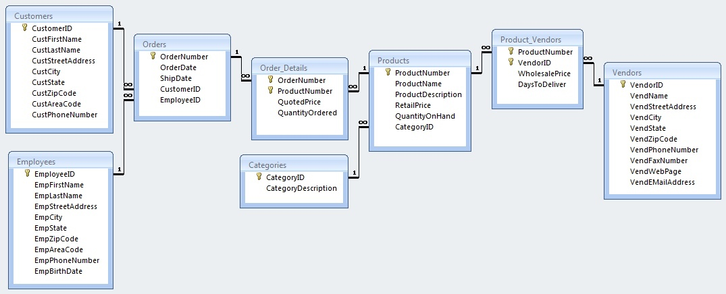
Designing your data model NATURAL-ly
Consistent column naming allows you to use NATURAL JOINs.
This is a reason to avoid generic column names like “id” or “name”

Slide 7
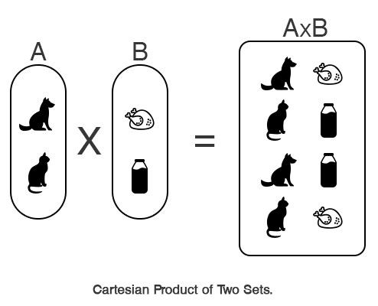
CROSS JOIN is like the cartesian product of two sets
Take every element (row) of the first set (table) and combine it with every element of the second set.
If first set has N elements and second set has M elements, then cartesian product has N·M elements.
There is no “ON” expression to limit results:
  SELECT * FROM Orders
  CROSS JOIN Order_Details;

Slide 8
ON functions exactly like WHERE
These two expressions are actually equivalent:
SELECT * FROM Orders JOIN Order_Details
ON Orders.OrderNumber=Order_details.OrderNumber;
SELECT * FROM Orders CROSS JOIN Order_Details
WHERE Orders.OrderNumber=Order_details.OrderNumber;
However, using ON may be more efficient because it tells the DBMS to avoid building the full N·M cartesian product, and just match rows according to a rule.
It’s also makes the join easier to think about, by separating the filtering and JOINing predicates.

Slide 9
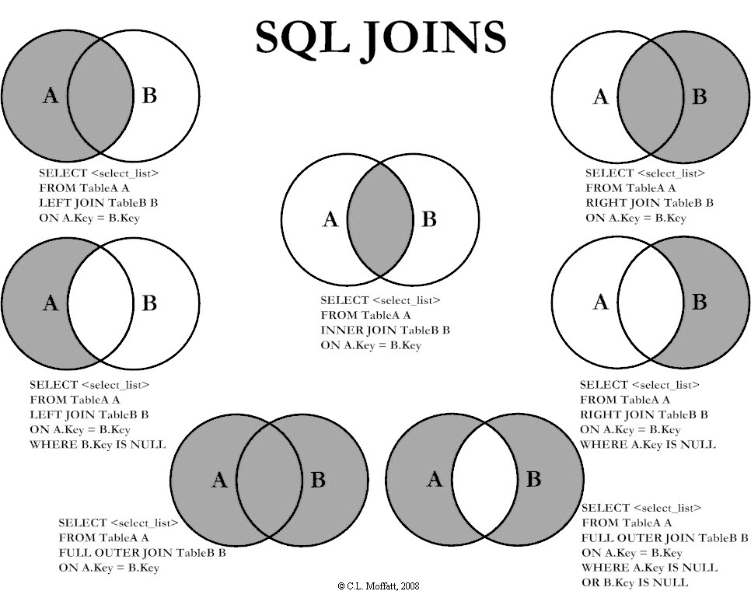
Different JOINs
INNER JOIN constructs a table of all pairs of matching rows from two tables.
  INNER is the default.
  Useful for foreign keys
  (numeric identifiers)
However, there are many other ways to JOIN tables if you don’t require matching.

Slide 10
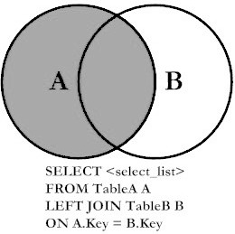
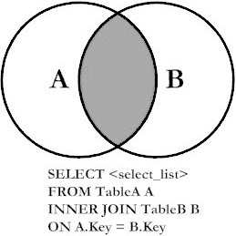
LEFT JOIN
LEFT JOIN includes all rows in the first table (left-hand side)
and just the matching rows in the second table (right-hand side).
(standard)
INNER JOIN
LEFT JOIN
All rows from
First table
Matching rows from Second table

Slide 11
LEFT JOIN output
Like all JOINs, LEFT JOIN prints columns from the left table followed by columns from the right table.
However, with LEFT JOIN, some rows will have NULL values in the right table columns, meaning that no match was found in the right table.
When to use LEFT JOIN?
  To supplement a table with additional information that may be available for some rows, but not available for all the rows.

Slide 12
SELECT * FROM staff LEFT JOIN department ON staff.departmentId=department.id;
staff
id | name | room | departmentId
11 | Bob | 100 | 1
20 | Betsy | 100 | NULL
21 | Fran | 101 | 1
22 | Frank | 102 | 99999
35 | Sarah | 200 | 5
40 | Sam | 10 | 7
54 | Pat | 102 | 2
department
id | name | buildingId
1 | Industrial Eng. | 1
2 | Computer Sci. | 2
5 | Physics | 4
7 | Materials Sci. | 5
Betsy and Frank have NULLs in the right haft of the output because no matching department was found.
In other words no pair of rows was found to satisfy the ON staff.departmentId=department.id
staff.id | staff.name | staff.room | staff.departmentId | department.id | department.name | department.buildingId
11 | Bob | 100 | 1 | 1 | Industrial Eng. | 1
20 | Betsy | 100 | NULL | NULL | NULL | NULL
21 | Fran | 101 | 1 | 1 | Industrial Eng. | 1
22 | Frank | 102 | 99999 | NULL | NULL | NULL
35 | Sarah | 200 | 5 | 5 | Physics | 4
40 | Sam | 10 | 7 | 7 | Materials Sci. | 5
54 | Pat | 102 | 2 | 2 | Computer Sci. | 2

Slide 13
LEFT JOIN with Grouping
When computing an aggregation on a many-to-one relationship, LEFT JOIN includes rows from the parent table with no children.
In ClassScheduling.slite, count the classes taught by each faculty member:
  If you want this report to include faculty members teaching zero classes, you must use LEFT JOIN:
  SELECT StaffID, ClassID,
  COUNT(ClassID) AS num_classes
  FROM Faculty NATURAL LEFT JOIN Faculty_Classes
  GROUP BY StaffID;
  Note that “COUNT(*)” would return “1” for faculty members with no classes, because there would still be one unmatched row from the left table.

Slide 14
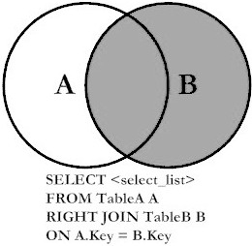
RIGHT JOIN is symmetrical to LEFT
Includes all rows from right table and matching rows from left table
Reordering the tables makes a RIGHT JOIN a LEFT JOIN, so it is not necessary to use the RIGHT JOIN syntax.
RIGHT JOIN
LEFT JOIN
Matching rows from 1st table
All rows from 2nd table

Slide 15
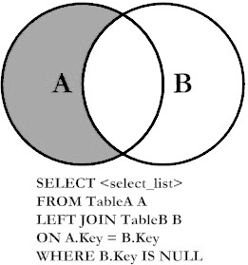
LEFT JOIN with exclusion
Includes rows from a table that must not match another table.
Useful for finding rows lacking something.
Just add a WHERE clause to look for NULL values in the right-hand side of the joined table
For example, to determine which faculty members should be assigned a class:
  SELECT * FROM Faculty NATURAL LEFT JOIN Faculty_Classes
  WHERE ClassID IS NULL;
Which classrooms are unused?
  SELECT * FROM Class_Rooms NATURAL LEFT JOIN Classes WHERE ClassID IS NULL;

Slide 16
FULL OUTER JOINs are not available in MySQL or SQLite
You can emulate FULL OUTER JOIN with the UNION of two queries.

Slide 17
SalesOrders.sqlite: List all products and the dates for any orders (of that product).
SELECT Products.ProductNumber, ProductName, OrderDate FROM Products LEFT NATURAL JOIN (Order_Details NATURAL JOIN Orders);

Slide 18
Display customers who have no sales rep (employees) in the same ZIP Code.
SELECT * FROM Customers LEFT JOIN Employees ON CustZipCode=EmpZipCode WHERE EmpZipCode IS NULL;
SELECT * FROM Customers WHERE CustZipCode IN (SELECT CustZipCode FROM Customers EXCEPT SELECT EmpZipCode FROM Employees);

Slide 19
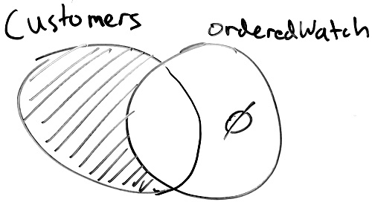
Show me customers who have never ordered a Watch.
First solution uses EXCEPT (introduced later), second solution uses LEFT JOIN with exclusion:
SELECT CustomerID FROM Customers EXCEPT
SELECT CustomerID FROM Customers NATURAL JOIN Orders
NATURAL JOIN Order_Details NATURAL JOIN Products
WHERE ProductName LIKE "%Watch%" GROUP BY CustomerID;
SELECT CustomerID FROM Customers LEFT JOIN
(SELECT CustomerID AS watch_customer FROM Orders
NATURAL JOIN Order_Details NATURAL JOIN Products
WHERE ProductName LIKE "%Watch%" GROUP BY CustomerID)
ON CustomerID=watch_customer
WHERE Watch_customer IS NULL;

Slide 20
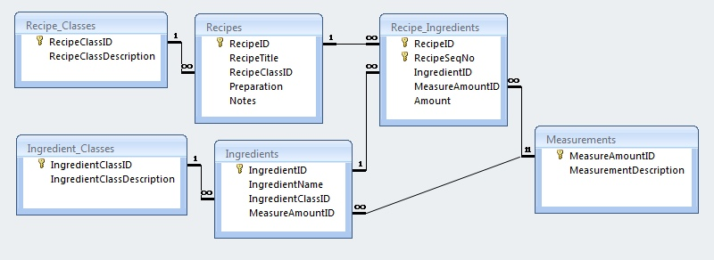
Recipes.sqlite: List the number of recipes in each category (RecipeClassID)
SELECT RecipeClassDescription, COUNT(RecipeID) AS RecipeCount
FROM Recipe_Classes LEFT NATURAL JOIN Recipes GROUP BY RecipeClassID

Slide 21
Recipes: Print every pair of recipes and the number of ingredients they share in common
SELECT r1.RecipeTitle, r2.RecipeTitle,
COUNT(i2.IngredientID) AS common_ingredients
FROM
Recipes AS r1 CROSS JOIN Recipes AS r2
JOIN Recipe_Ingredients AS i1 ON r1.RecipeID = i1.RecipeID
LEFT JOIN Recipe_Ingredients AS i2 ON
r2.RecipeID = i2.RecipeID AND i1.IngredientID=i2.IngredientID
GROUP BY r1.RecipeID, r2.RecipeID
HAVING r1.RecipeID < r2.RecipeID
ORDER BY common_ingredients DESC;

Slide 22
Recap
Introduced different types of JOINs:
INNER (default): prints all pairs of rows (one from first table, one from second table) that satisfy the JOIN predicate.
LEFT: same as INNER, but adds rows from LEFT table that never satisfied the JOIN predicate.
LEFT with exclusion: only print rows from left table that never satisfied the JOIN predicate.
CROSS JOIN: print the cartesian project, meaning all rows from the first table combined with all rows from the second table. There is no “ON” to match rows.

