Slide 1

EECS-317 Data Management and Information Processing
Lecture 4 – GROUP BY and INNER JOINs
Steve Tarzia
Spring 2019

Slide 2
Announcements
First HW assignment is due Monday night.

Slide 3
Last lecture: Integer division, aggregation, subqueries
When dividing two integers, the result is always rounded down.
  You may have to multiply by 1.0 in your SQL formulas to convert to floats.
COUNT, SUM, MIN, MAX, AVG are aggregation functions
  Operate on all rows unless GROUP BY is used.
Subqueries can be used to replace a single value, list of values, or an entire table in a parent query.
Answered ten sample questions in class.

Slide 4
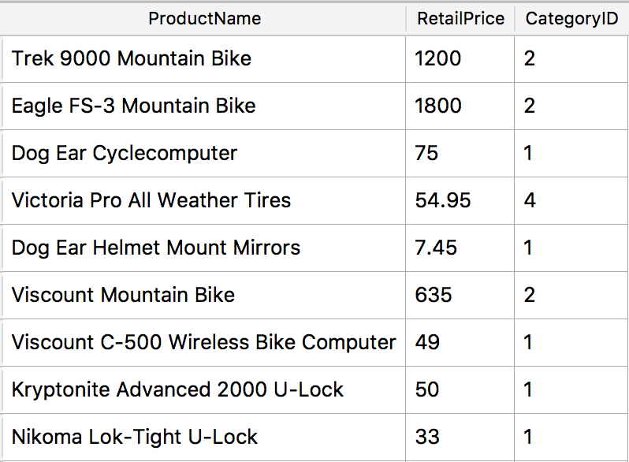
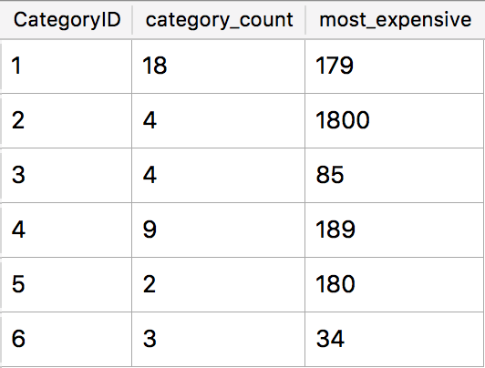
GROUP BY explained
GROUP BY combines multiple rows into one row in the result.
Rows with the same value for the grouping criterion are grouped.
An aggregation function should be applied.
SELECT CategoryID, COUNT(*) AS category_count,
MAX(RetailPrice) AS most_expensive_price
FROM Products GROUP BY CategoryID;
Notes:
Number of rows in the result will equal the number of unique values taken by the grouping criterion.

Slide 5
The GROUP BY expression
“GROUP BY x” means:
Each row in the output will represent many aggregated rows having the same value for x.
Thus, the number of rows in the result is the number of distinct values taken by x (after the WHERE filtering).
Usually it’s just the name of a column, but it can be an arbitrary expression.
Notes:
Number of rows in the result will equal the number of unique values taken by the grouping criterion.

Slide 6
SELECT category, AVG(price)
FROM product GROUP BY category
Table “product”
Output
id | name | price | category
1 | Quart Skim Milk | 2.49 | 3
2 | Rye Bread | 1.99 | 1
3 | 1lb Butter | 5.99 | 3
4 | 32oz Yogurt | 4.99 | 3
5 | Navel Orange (each) | 0.89 | 2
6 | Pineapple (each) | 1.99 | 2
7 | English Muffins | 3.99 | 1
8 | Spinach (bunch) | 1.49 | 2
9 | Carrots (lb bag) | 0.99 | 2
10 | Dozen Eggs | 2.49 | 3
category | AVG(price)
1 | 2.99
2 | 1.34
3 | 3.99
This is a typical GROUP BY example.

Slide 7
SELECT price, COUNT(*)
FROM product GROUP BY price ORDER BY price
Table “product”
Output
id | name | price | category
1 | Quart Skim Milk | 2.49 | 3
2 | Rye Bread | 1.99 | 1
3 | 1lb Butter | 5.99 | 3
4 | 32oz Yogurt | 4.99 | 3
5 | Navel Orange (each) | 0.89 | 2
6 | Pineapple (each) | 1.99 | 2
7 | English Muffins | 3.99 | 1
8 | Spinach (bunch) | 1.49 | 2
9 | Carrots (lb bag) | 0.99 | 2
10 | Dozen Eggs | 2.49 | 3
price | COUNT(*)
0.89 | 1
0.99 | 1
1.49 | 1
1.99 | 2
2.49 | 2
3.99 | 1
4.99 | 1
5.99 | 1
This is a typical GROUP BY example.

Slide 8
SELECT category, price
FROM product GROUP BY category
Table “product”
Output
id | name | price | category
1 | Quart Skim Milk | 2.49 | 3
2 | Rye Bread | 1.99 | 1
3 | 1lb Butter | 5.99 | 3
4 | 32oz Yogurt | 4.99 | 3
5 | Navel Orange (each) | 0.89 | 2
6 | Pineapple (each) | 1.99 | 2
7 | English Muffins | 3.99 | 1
8 | Spinach (bunch) | 1.49 | 2
9 | Carrots (lb bag) | 0.99 | 2
10 | Dozen Eggs | 2.49 | 3
category | price
1 | 1.99
2 | 0.89
3 | 2.49
This GROUP BY is weird. ☹
It’s missing an aggregation function (like SUM, MIN, etc.). It prints a random price for each category.

Slide 9
SELECT id, name FROM product GROUP BY id
Table “product”
Output
id | name | price | category
1 | Quart Skim Milk | 2.49 | 3
2 | Rye Bread | 1.99 | 1
3 | 1lb Butter | 5.99 | 3
4 | 32oz Yogurt | 4.99 | 3
5 | Navel Orange (each) | 0.89 | 2
6 | Pineapple (each) | 1.99 | 2
7 | English Muffins | 3.99 | 1
8 | Spinach (bunch) | 1.49 | 2
9 | Carrots (lb bag) | 0.99 | 2
10 | Dozen Eggs | 2.49 | 3
id | name
1 | Quart Skim Milk
2 | Rye Bread
3 | 1lb Butter
4 | 32oz Yogurt
5 | Navel Orange (each)
6 | Pineapple (each)
7 | English Muffins
8 | Spinach (bunch)
9 | Carrots (lb bag)
10 | Dozen Eggs
This GROUP BY is useless because id is always different. ☹

Slide 10
SELECT AVG(price)
FROM product GROUP BY “hello”
Table “product”
Output
id | name | price | category
1 | Quart Skim Milk | 2.49 | 3
2 | Rye Bread | 1.99 | 1
3 | 1lb Butter | 5.99 | 3
4 | 32oz Yogurt | 4.99 | 3
5 | Navel Orange (each) | 0.89 | 2
6 | Pineapple (each) | 1.99 | 2
7 | English Muffins | 3.99 | 1
8 | Spinach (bunch) | 1.49 | 2
9 | Carrots (lb bag) | 0.99 | 2
10 | Dozen Eggs | 2.49 | 3
AVG(price)
2.73
This GROUP BY is weird. ☹
“hello” is the same for every row, so it always aggregates all rows to one output row.
AVG would have given the same result without any GROUP BY.

Slide 11
SELECT category=2, AVG(price)
FROM product GROUP BY category=2
Table “product”
Output
id | name | price | category
1 | Quart Skim Milk | 2.49 | 3
2 | Rye Bread | 1.99 | 1
3 | 1lb Butter | 5.99 | 3
4 | 32oz Yogurt | 4.99 | 3
5 | Navel Orange (each) | 0.89 | 2
6 | Pineapple (each) | 1.99 | 2
7 | English Muffins | 3.99 | 1
8 | Spinach (bunch) | 1.49 | 2
9 | Carrots (lb bag) | 0.99 | 2
10 | Dozen Eggs | 2.49 | 3
category=2 | AVG(price)
0 (false) | 3.6566667
1 (true) | 1.34
This is an advanced GROUP BY example.
It divides the rows into two groups, those with category=2 in one group and everything else in the other group.
Prints the average price of fruits & vegetables vs the average price of other foods.

Slide 12
What if you need to combine data from multiple tables?
FROM chooses the table of interest
WHERE throws out irrelevant rows
GROUP BY identifies rows to combine
SELECT tells what values to return (allowing math and aggregation)
HAVING throws out irrelevant rows (after aggregation)
ORDER BY sorts
LIMIT throws out rows based on their position in the results
A subquery can draw data from another table, but JOINs are a more powerful way to use multiple tables.

Slide 13
JOINs create virtual tables from several tables
Normalizing this staff directory left us with three tables
This split eliminated redundant information, but now we have to look in three different tables to answer some questions.
staff
id | name | room | departmentId
11 | Bob | 100 | 1
20 | Betsy | 100 | 2
21 | Fran | 101 | 1
22 | Frank | 102 | 4
35 | Sarah | 200 | 5
40 | Sam | 10 | 7
54 | Pat | 102 | 2
department
id | name | buildingId
1 | Industrial Eng. | 1
2 | Computer Sci. | 2
4 | Chemistry | 1
5 | Physics | 4
7 | Materials Sci. | 5
building
id | name | faxNumber
1 | Tech | 1-1000
2 | Ford | 1-5003
4 | Mudd | 1-2005
5 | Cook | 1-3004
6 | Garage | 1-6001

Slide 14
What if we want to print the staff directory?
staff
id | name | department | building | room | faxNumber
11 | Bob | Industrial Eng. | Tech | 100 | 1-1000
20 | Betsy | Computer Sci. | Ford | 100 | 1-5003
21 | Fran | Industrial Eng. | Tech | 101 | 1-1000
22 | Frank | Chemistry | Tech | 102 | 1-1000
35 | Sarah | Physics | Mudd | 200 | 1-2005
40 | Sam | Materials Sci. | Cook | 10 | 1-3004
54 | Pat | Computer Sci. | Ford | 102 | 1-5003
We can generate a virtual table like this with INNER JOIN

Slide 15
SELECT * FROM staff JOIN department ON staff.departmentId=department.id
staff
id | name | room | departmentId
11 | Bob | 100 | 1
20 | Betsy | 100 | 2
21 | Fran | 101 | 1
22 | Frank | 102 | 4
35 | Sarah | 200 | 5
40 | Sam | 10 | 7
54 | Pat | 102 | 2
department
id | name | buildingId
1 | Industrial Eng. | 1
2 | Computer Sci. | 2
4 | Chemistry | 1
5 | Physics | 4
7 | Materials Sci. | 5
ON tells how rows are matched
staff.id | staff.name | staff.room | staff.departmentId | department.id | department.name | department.buildingId
11 | Bob | 100 | 1 | 1 | Industrial Eng. | 1
20 | Betsy | 100 | 2 | 2 | Computer Sci. | 2
21 | Fran | 101 | 1 | 1 | Industrial Eng. | 1
22 | Frank | 102 | 4 | 4 | Chemistry | 1
35 | Sarah | 200 | 5 | 5 | Physics | 4
40 | Sam | 10 | 7 | 7 | Materials Sci. | 5
54 | Pat | 102 | 2 | 2 | Computer Sci. | 2

Slide 16
How JOIN builds a composite table
SELECT * FROM staff JOIN department
ON staff.departmentId=department.id
Start with the first table (staff)
Join with rows from the 2nd table (department) that match according to the ON columns
staff.id | staff.name | staff.room | staff.departmentId | department.id | department.name | department.buildingId
11 | Bob | 100 | 1 | 1 | Industrial Eng. | 1
20 | Betsy | 100 | 2 | 2 | Computer Sci. | 2
21 | Fran | 101 | 1 | 1 | Industrial Eng. | 1
22 | Frank | 102 | 4 | 4 | Chemistry | 1
35 | Sarah | 200 | 5 | 5 | Physics | 4
40 | Sam | 10 | 7 | 7 | Materials Sci. | 5
54 | Pat | 102 | 2 | 2 | Computer Sci. | 2

Slide 17
Just print the columns we need
SELECT staff.id, staff.name, staff.room,
department.name, department.buildingId
FROM staff JOIN department
ON staff.departmentId=department.id
staff.id | staff.name | staff.room | department.name | department.buildingId
11 | Bob | 100 | Industrial Eng. | 1
20 | Betsy | 100 | Computer Sci. | 2
21 | Fran | 101 | Industrial Eng. | 1
22 | Frank | 102 | Chemistry | 1
35 | Sarah | 200 | Physics | 4
40 | Sam | 10 | Materials Sci. | 5
54 | Pat | 102 | Computer Sci. | 2

Slide 18
Reorder and rename the columns
SELECT staff.id AS staffID, staff.name AS name,
department.name AS department,
department.buildingId AS buildingId, staff.room AS room
FROM staff JOIN department
ON staff.departmentId=department.id
staffId | name | department | buildingId | room
11 | Bob | Industrial Eng. | 1 | 100
20 | Betsy | Computer Sci. | 2 | 100
21 | Fran | Industrial Eng. | 1 | 101
22 | Frank | Chemistry | 1 | 102
35 | Sarah | Physics | 4 | 200
40 | Sam | Materials Sci. | 5 | 10
54 | Pat | Computer Sci. | 2 | 102

Slide 19
JOIN to the third table
SELECT staff.id AS staffId, staff,name, department.name AS department,
building.name AS building, staff.room AS room,
building.faxNumber AS faxNumber
FROM staff JOIN department
ON staff.departmentId=department.id
JOIN building ON department.buildingId=building.id
staffId | name | department | building | room | faxNumber
11 | Bob | Industrial Eng. | Tech | 100 | 1-1000
20 | Betsy | Computer Sci. | Ford | 100 | 1-5003
21 | Fran | Industrial Eng. | Tech | 101 | 1-1000
22 | Frank | Chemistry | Tech | 102 | 1-1000
35 | Sarah | Physics | Mudd | 200 | 1-2005
40 | Sam | Materials Sci. | Cook | 10 | 1-3004
54 | Pat | Computer Sci. | Ford | 102 | 1-5003

Slide 20
Who teaches the largest class & what is the average grade?
Instructor names are in Staff table
Instructor→class assignments are in Faculty_Classes table.
Class enrollments are in Student_Schedules table
Can use two subqueries to answer the first part of the question:
  Get the largest class:
    SELECT ClassID FROM Student_Schedules GROUP BY ClassID ORDER BY COUNT(*) DESC LIMIT 1;
  Get the instructor ID of that class:
    SELECT StaffID FROM Faculty_Classes WHERE ClassID=…
  Get the instructor name:
    SELECT StfFirstName, StfLastName FROM Staff WHERE StaffID=…
SELECT StfFirstName, StfLastName FROM Staff
WHERE StaffID=
(SELECT StaffID FROM Faculty_Classes WHERE ClassID=
(SELECT ClassID FROM Student_Schedules
GROUP BY ClassID ORDER BY COUNT(*) DESC LIMIT 1));

Slide 21
Who teaches the largest class & what is the average grade?
Alternative approach:
Use JOINs to create a composite table listing instructors, classes, and their average grades:
SELECT Student_Schedules.ClassID, StfLastname, AVG(Grade)
FROM Student_Schedules
JOIN Faculty_Classes ON
Student_Schedules.ClassID=Faculty_Classes.ClassID
JOIN Staff ON
Faculty_Classes.StaffID = Staff.StaffID
GROUP BY Student_Schedules.ClassID
ORDER BY COUNT(*) DESC LIMIT 1;

Slide 22
Using INNER JOIN, what if rows don’t match one-to-one?
staff
id | name | room | departmentId
11 | Bob | 100 | 1
20 | Betsy | 100 | 2
21 | Fran | 101 | 1
department
id | name | buildingId
1 | Industrial Eng. | 1
2 | Computer Sci. | 2
4 | Chemistry | 1
1 | Physics | 4
1 | Materials Sci. | 5
In output,
multiple matches leads to multiple rows.
no matches leads to no rows
SELECT * FROM staff JOIN department ON staff.departmentId=department.id
staff.id | staff.name | staff.room | staff.departmentId | department.id | department.name | department.buildingId
11 | Bob | 100 | 1 | 1 | Industrial Eng. | 1
11 | Bob | 100 | 1 | 1 | Physics | 4
11 | Bob | 100 | 1 | 1 | Materials Sci. | 5
20 | Betsy | 100 | 2 | 2 | Computer Sci. | 2
21 | Fran | 101 | 1 | 1 | Industrial Eng. | 1
21 | Fran | 101 | 1 | 1 | Physics | 4
21 | Fran | 101 | 1 | 1 | Materials Sci. | 5

Slide 23
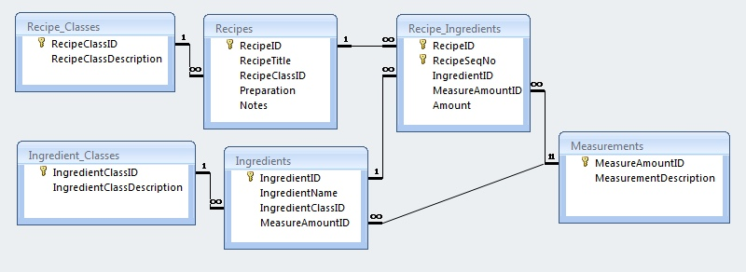
(Recipes.sqlite) Print the recipe for Irish Stew (RecipeID = 1)

Slide 24
(Recipes.sqlite) Print the recipe for Irish Stew (RecipeID = 1)
SELECT RecipeSeqNo, Amount,
Measurements.MeasurementDescription, IngredientName
FROM
Recipe_Ingredients JOIN Ingredients
ON Recipe_Ingredients.IngredientId
= Ingredients.IngredientID
JOIN Measurements
ON Recipe_Ingredients.MeasureAmountID
= Measurements.MeasureAmountID
WHERE RecipeId=1
ORDER BY RecipeSeqNo;

Slide 25
What is the name of the recipe with the most ingredients?
(Can be done with either a subquery or a JOIN)

Slide 26
What is the name of the recipe with the most ingredients?
SELECT RecipeTitle, COUNT(*) AS numIngredients
FROM
Recipe_Ingredients JOIN Recipes
ON Recipes.RecipeID
= Recipe_Ingredients.RecipeID
ORDER BY numIngredients DESC
LIMIT 1
GROUP BY Recipes.RecipeID

Slide 27
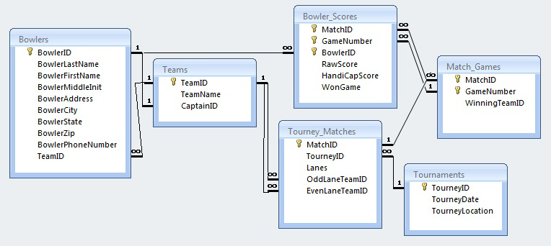
(BowlingLeague.sqlite) Print a schedule of all the team matchups over the whole season (Date, Location, TeamName, TeamName)

Slide 28
Print a schedule of all the team matchups over the whole season
(Date, Location, TeamName, TeamName)
SELECT TourneyDate, TourneyLocation, OddTeam.TeamName,
EvenTeam.TeamName
FROM
Tourney_Matches JOIN Tournaments
ON Tourney_Matches.TourneyID = Tournaments.TourneyID
JOIN Teams AS OddTeam
ON OddLaneTeamID=OddTeam.TeamID
JOIN Teams AS EvenTeam
ON EvenLaneTeamID = EvenTeam.TeamID

Slide 29
Print game results for Tournament #1, including bowler names, team names, & raw score

Slide 30
Print game results for Tournament #1, including bowler names, team names, & raw score
SELECT
Bowler_Scores.MatchID, GameNumber, TeamName,
BowlerFirstName || " " || BowlerLastName AS Bowler,
RawScore
FROM
Bowler_Scores JOIN Tourney_Matches
ON Bowler_Scores.MatchID = Tourney_Matches.MatchID
JOIN Bowlers
ON Bowlers.BowlerID = Bowler_Scores.BowlerID
JOIN Teams
ON Bowlers.TeamID = Teams.TeamID
WHERE TourneyId=1

