Slide 1

EECS-317 Data Management and Information Processing
Lecture 3 – More SQL
Steve Tarzia
Spring 2019

Slide 2
Announcements
First HW assignment was posted, due Monday night.
Datacamp online lessons actually seem to require a $20 payment.
  I updated the assignment to give an alternative free options which was suggested by a student:
  https://pgexercises.com/questions/basic/
  https://pgexercises.com/questions/joins/
  https://pgexercises.com/questions/aggregates/

Slide 3
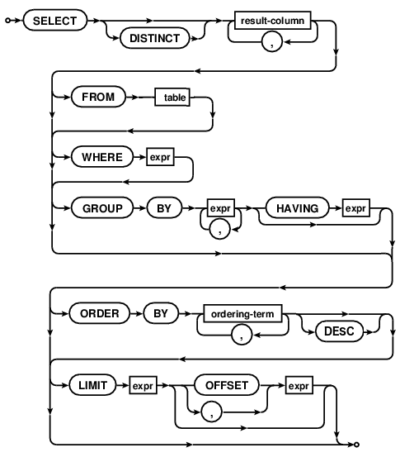
Last lecture: SQL Basics
Showed syntax diagram for SELECT.
Described my 7-step process for building a SELECT query.
  Start with a short query:
    SELECT * FROM some_table
  Gradually refine the results, making the query more complex.
  Choose table, filter, choose columns, apply mathematic operations, sort, etc.
Demonstrated how to build a query to answer a few questions about recipes.

Slide 4
SELECT steps (abbreviated)
FROM chooses the table of interest
WHERE throws out irrelevant rows
GROUP BY identifies rows to combine
SELECT tells what values to return (allowing math and aggregation)
HAVING throws out irrelevant rows (after aggregation)
ORDER BY sorts
LIMIT throws out rows based on their position in the results
Each step gets closer to the specific result you want.

Slide 5
Integer vs. floating point division
Computers store numbers in two basic ways:
  Integers are whole numbers (0, 3, -40,921)
  Floating Point numbers (floats) can be fractional (1.234, 0.0, -9.9×10⁻⁴)
When doing arithmetic on two integers, an integer is always produced.
  1+1 = 2, 2-1=1, 4*3=12, 13/4=3
When doing arithmetic involving at least one float, a float is produced.
  1.0 + 1.0 = 2.0, 1.5 * 2 = 3.0, 13/4.0=3.25
Integer division is weird – it always rounds down: 2/3 = 0, -5/2 = -3
Usually you need floating-point (not integer) division in your queries.
  Just precede the expression with a floating point operation to force the division to be floating point: 1.0 * -5 / 2 = -2.5

Slide 6
Aggregation functions
COUNT, SUM, MIN, MAX, AVG
These can be used to print out values that depend on multiple rows.
For example, how many ounces of ingredients are used?
  We have to add up the “Amount” from many rows to get this answer:
  SELECT SUM(Amount) FROM Recipe_Ingredients
  WHERE MeasureAmountID=1;
  (“ounce” corresponds to MeasureAmountID=1)
Normally, aggregation applies to all the rows, but…
GROUP BY causes aggregations to occur on subsets of rows, where rows are grouped according to some rule.
  Each group contains rows having the same value for the grouping expression
  SELECT SUM(Amount) FROM Recipe_Ingredients
  GROUP BY MeasureAmountID;
  Same as above, but list amounts of all ingredients

Slide 7
Subqueries
Any single value, list of values, or table can be replaced by a subquery
A subquery is a query that appears inside of parentheses.
  The subquery is computed first and its result is “plugged into” the parent expression.
  SELECT SUM(Amount) FROM Recipe_Ingredients
  WHERE MeasureAmountID=
  (SELECT MeasureAmountID FROM Measurements
  WHERE MeasurementDescription="Ounce");

Slide 8
SalesOrders.sqlite
List all customers in California (CA). Count them.
List all customers in a west coast state (CA, OR, WA).
Count the unique customer area codes in California (CA).
What is the full address of customer John Viescas?
What is the most expensive product? Cheapest? Cheapest 5?
What is the value of the product inventory on hand? Bike inventory?

Slide 9
List all customers in California (CA). Count them.

Slide 10
List all customers in a west coast state (CA, OR, WA).

Slide 11
Count the unique customer area codes in California (CA).

Slide 12
What is the full address of customer John Viescas?

Slide 13
What is the single most expensive product? Cheapest? Cheapest 5?

Slide 14
What is the value of the product inventory on hand? Bike inventory?

Slide 15
SalesOrders.sqlite (answers)
List all customers in California (CA).
SELECT * FROM Customers WHERE CustState = "CA";
List all customers in a west coast state (CA, OR, WA).
SELECT * FROM Customers WHERE CustState IN ("CA","OR", "WA");
Count the unique customer area codes in California (CA).
SELECT COUNT(DISTINCT CustAreaCode) FROM Customers
WHERE CustState = "CA";
What is the full address of customer John Viescas?
SELECT CustStreetAddress || "
" || CustCity || " " || CustState || " " || CustZipCode AS FullAddress FROM Customers
WHERE CustFirstName = "John" AND CustLastName = "Viescas";
What is the single most expensive product? Cheapest 5?
  SELECT ProductNumber, ProductName FROM Products
  WHERE RetailPrice = (SELECT MAX(RetailPrice) FROM Products);
  SELECT ProductName, RetailPrice FROM Products ORDER BY RetailPrice LIMIT 5;
What is the value of the product inventory on hand? Bike inventory?
  SELECT SUM(RetailPrice * QuantityOnHand) FROM Products;
  SELECT SUM(RetailPrice * QuantityOnHand) FROM Products WHERE CategoryID=2;

Slide 16
SchoolScheduling.sqlite
What is the mean average classroom capacity? Median?
How much classroom capacity is there in each building?
  (Hint: use “GROUP BY BuildingCode”)
How many classes does each instructor teach on average?
What is the average grade earned by students?

Slide 17
What is the mean average classroom capacity? Median?

Slide 18
How much classroom capacity is there in each building?
(Hint: use “GROUP BY BuildingCode”)

Slide 19
How many classes does each instructor teach on average?

Slide 20
What is the average grade earned by students?

Slide 21
SchoolScheduling.sqlite (answers)
What is the mean average classroom capacity? Median?
  SELECT AVG(Capacity) FROM Class_Rooms;
  SELECT Capacity FROM Class_Rooms ORDER BY Capacity LIMIT 1 OFFSET (SELECT COUNT(*)/2 FROM Class_Rooms);
How much classroom capacity is there in each building?
  SELECT BuildingCode, SUM(Capacity) FROM Class_Rooms
  GROUP BY BuildingCode;
How many classes does each instructor teach on average?
  SELECT AVG(NumClasses) FROM
  (SELECT COUNT(*) AS NumClasses
  FROM Faculty_Classes GROUP BY StaffID);
What is the average grade earned by students?
  SELECT AVG(Grade) FROM Student_Schedules WHERE Grade > 0;

