Slide 1

EECS-317 Data Management and Information Processing
Lecture 2 – Structured Query Language (SQL)
Steve Tarzia
Spring 2019
Please take a copy of the 3 handouts before sitting down

Slide 2
Announcements
First HW assignment was posted, due April 15th (a Monday).
First “reading” assignment was also posted:
  Complete Datacamp’s Intro to SQL for Data Science.
  You actually should do this first, before the homework.
Office hours will be held in the Wilkinson Lab (Tech M338)

Slide 3
Last lecture: Data Modeling with Tables
Complex data are more than just streams of numbers!
Data model or schema defines the data’s structure
  It’s a list of tables, each with a fixed number of columns
  Data rows are added after the data model is designed.
    Within a row, each column may store only one value.
    A column may refer to a row in another table.
These are called Relational or SQL databases.
  Can represent much more complex data than a simple spreadsheet.
  Eliminate data redundancy:
  Saves space and allows updates to happen in one place
  Allows objects, events, and relationships to be added separately

Slide 4
Last lecture (continued)
Introduced data model diagrams, but did not go into much detail.
product
id
name
description
price
inventoryQty
orderItem
id
order
product
quantity
order
id
customer
totalCost
placedTime
shippedTime
trackingNumber
customer
id
name
streetAddress
city
province
postalCode
country

Slide 5
DB Browser for SQLite

Slide 6
Structured Query Language (SQL)
The standard programming language for relational databases
Each DB Management System (DBMS) has its own dialect
  In this course we will be using SQLite’s and MySQL’s variants of SQL
SQL is a declarative language (most other languages are imperative)
  You describe the results you want to see
  You do not describe the detailed steps necessary to gather those results
  The DBMS cleverly determines an execution plan behind the scenes to carry out your requested analysis.
We will be using a client program to connect to the DBMS and running SQL statements interactively:
  run one statement and look at the results before running another one

Slide 7
SELECT gets data
SELECT FirstName, LastName FROM customers WHERE City = "Paris";
Columns to print Table to examine Filter
Result is a table with two rows:
FirstName | LastName
Camille | Bernard
Dominique | Lefebvre

Slide 8
Filtering, sorting, and limiting
We can use more complex filters:
SELECT FirstName, LastName FROM customers
WHERE City = "Chicago"
AND (State = "Illinois"
OR State = "IL");
Get all columns, sort the results (descending) and limit the results to just the first ten rows:
SELECT * FROM tracks ORDER BY UnitPrice DESC LIMIT 10;

Slide 9
Arithmetic
Your SELECT statements can include arithmetic
SELECT 1+1;
SELECT ABS(COS(PI()));
SELECT Name, UnitPrice / (Milliseconds/1000/60)
AS PricePerMinute FROM tracks;
Check your DBMS’s documentation for the specific math functions.

Slide 10
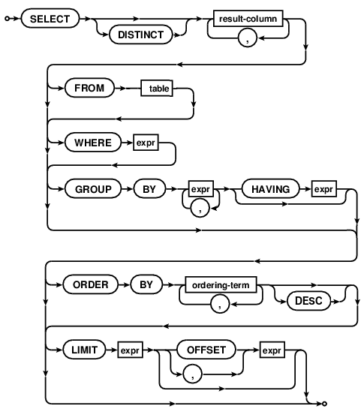
Syntax diagrams
Any path from start to end is a valid statement.
Choose which arrows to follow
The rectangles refer to other diagrams.
Used by our SQL book
Used by SQLite online docs:
https://sqlite.org/lang.html

Slide 11
Syntax grammars
SELECT
[ALL | DISTINCT | DISTINCTROW ]
[HIGH_PRIORITY]
[STRAIGHT_JOIN]
[SQL_SMALL_RESULT] [SQL_BIG_RESULT]
[SQL_BUFFER_RESULT]
[SQL_CACHE | SQL_NO_CACHE][SQL_CALC_FOUND_ROWS]
select_expr [, select_expr ...]
[FROM table_references
[PARTITION partition_list]
[WHERE where_condition]
[GROUP BY {col_name | expr | position}
[ASC | DESC], ... [WITH ROLLUP]]
[HAVING where_condition]
[ORDER BY {col_name | expr | position}
[ASC | DESC], ...]
[LIMIT {[offset,] row_count | row_count OFFSET offset}]
[PROCEDURE procedure_name(argument_list)]
[INTO OUTFILE 'file_name'
[CHARACTER SET charset_name]
export_options
| INTO DUMPFILE 'file_name'
| INTO var_name [, var_name]]
[FOR UPDATE | LOCK IN SHARE MODE]]
A set of rules for building all possible statements
Used by MySQL docs
Optional items are in square braces: [ ]
Pipe character for “or”: this | that
Curly braces for a required choice: {one | two}
... for repetition
Lowercase italics for things defined elsewhere.

Slide 12
Grouping
The GROUP BY clause combines multiple rows and lets you perform aggregation math functions.
SELECT AlbumId,
SUM(Milliseconds/1000/60) AS AlbumMinutes
FROM tracks GROUP BY AlbumId ORDER BY AlbumMinutes;
Result:
AlbumId | AlbumMinutes
340 | 0.86300000
345 | 1.11065000
318 | 1.68821667
… | …

Slide 13
SQLite
A lightweight and easy-to-setup database management system
Similar to Microsoft Access, but free and more portable
Can handle very large databases (terabytes)
The whole database is stored in a single file (.db or .sqlite)
But SQLite does not handle remote access from multiple users
A good choice for an individual needing to set up his/her own database.
Download a version of it from sqlitebrowser.org

Slide 14
SQLite SELECT Syntax
For example:
SELECT FirstName, LastName FROM customers WHERE City = "Paris";

Slide 15
SELECT queries are series of filtering & manipulation steps
The FROM expression gives the starting point – a full table.
  The final result will be a subset or aggregation of this.
The WHERE expression keeps only those rows passing some test
    This expression can be very complex, but it must be something than can be evaluated on each row, one at a time.
GROUP BY combines rows if something about them is the same
The SELECT result-columns are computed, including aggregation.
    At this point we have thrown out the columns we don’t need.
HAVING expression keeps only the aggregated rows passing a test.
ORDER BY sorts what’s left.
LIMIT truncates the results to just a certain number of rows.

Slide 16
SELECT steps (abbreviated)
FROM chooses the table of interest
WHERE throws out irrelevant rows
GROUP BY identifies rows to combine
SELECT tells what values to return (allowing math and aggregation)
HAVING throws out irrelevant rows (after aggregation)
ORDER BY sorts
LIMIT throws out rows based on their position in the results
Each step gets closer to the specific result you want.

Slide 17
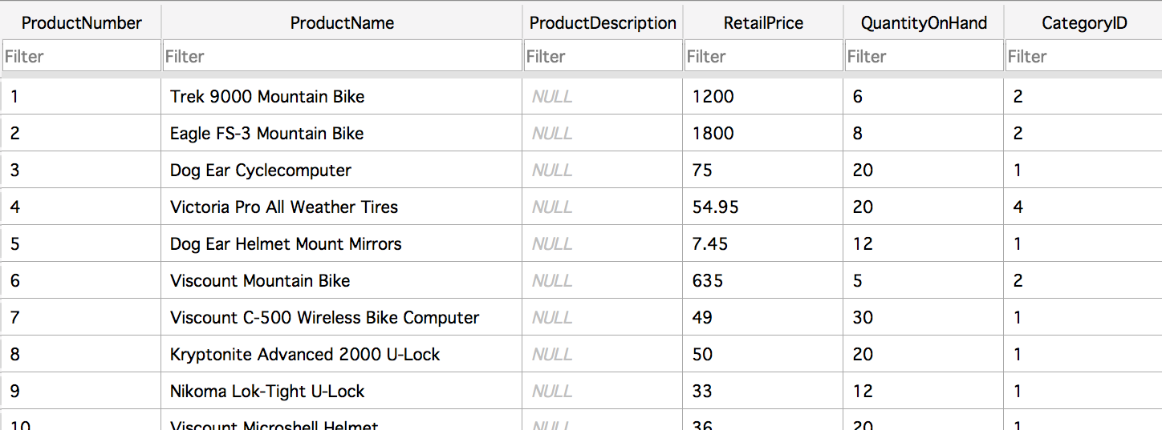
What’s the average price of a bike car rack?
FROM chooses the table of interest
WHERE throws out irrelevant rows
GROUP BY identifies rows to combine
SELECT tells what values to return (allowing math and aggregation)
HAVING throws out irrelevant rows (after aggregation)
ORDER BY sorts
LIMIT throws out rows based on their position in the results
Products table has the price info, so we start there:
SELECT * FROM Products
This placeholder will change in step 4.

Slide 18
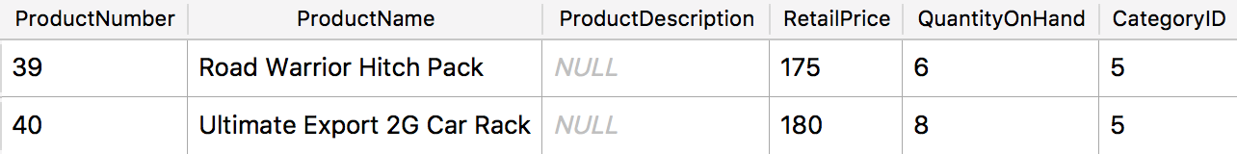
What’s the average price of a bike car rack?
FROM chooses the table of interest
WHERE throws out irrelevant rows
GROUP BY identifies rows to combine
SELECT tells what values to return (allowing math and aggregation)
HAVING throws out irrelevant rows (after aggregation)
ORDER BY sorts
LIMIT throws out rows based on their position in the results
We only need the bike rack products, so we filter on CategoryID = 5
SELECT * FROM Products WHERE CategoryID = 5;

Slide 19
What’s the average price of a bike car rack?
FROM chooses the table of interest
WHERE throws out irrelevant rows
GROUP BY identifies rows to combine
SELECT tells what values to return (allowing math and aggregation)
HAVING throws out irrelevant rows (after aggregation)
ORDER BY sorts
LIMIT throws out rows based on their position in the results
A GROUP BY statement is not needed because we will group all of the rows together.
SELECT * FROM Products WHERE CategoryID = 5

Slide 20
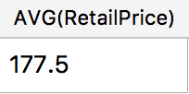
What’s the average price of a bike car rack?
FROM chooses the table of interest
WHERE throws out irrelevant rows
GROUP BY identifies rows to combine
SELECT tells what values to return (allowing math and aggregation)
HAVING throws out irrelevant rows (after aggregation)
ORDER BY sorts
LIMIT throws out rows based on their position in the results
We want the RetailPrice column, and we want to aggregate all the rows with the average function
SELECT AVG(RetailPrice) FROM Products WHERE CategoryID = 5

Slide 21
Recipes.sqlite (download it from Canvas)
Print an alphabetically sorted list of ingredients (hint: ORDER BY).
How many times is butter used as an ingredient?
How many ingredients are in the Yorkshire Pudding recipe?
What percentage of ingredients are vegetarian? Vegan?
How many recipes have multi-word names? Nine-letter names?

Slide 22
Print an alphabetically sorted list of ingredients (hint: ORDER BY).

Slide 23
How many times is butter used as an ingredient?

Slide 24
How many ingredients are in the Yorkshire Pudding recipe?

Slide 25
What percentage of ingredients are vegetarian?

Slide 26
How many recipes have multi-word names? Nine-letter names?

Slide 27
Recipes.sqlite (answers)
Print an alphabetically sorted list of ingredients (hint: ORDER BY).
  SELECT IngredientName FROM Ingredients ORDER BY IngredientName;
How many times is butter used as an ingredient?
  SELECT COUNT(*) FROM Recipe_Ingredients WHERE IngredientID=47;
How many ingredients are in the Yorkshire Pudding recipe?
  SELECT COUNT(*) FROM Recipe_Ingredients WHERE RecipeID=10;
What percentage of ingredients are vegetarian?
  SELECT 100.0* COUNT(*)/(SELECT COUNT(*) FROM Ingredients)
  FROM Ingredients WHERE IngredientClassID NOT IN (2, 10);
How many recipes have multi-word names? Nine-letter names?
  SELECT COUNT(*) FROM Recipes WHERE RecipeTitle LIKE "% %";
  SELECT COUNT(*) FROM Recipes WHERE RecipeTitle LIKE "_________";
  SELECT COUNT(*) FROM Recipes WHERE LENGTH(RecipeTitle) = 9;

Slide 28
Recap: SQL Basics
Showed syntax diagram for SELECT.
Described my 7-step process for building a SELECT query.
  Start with a short query:
    SELECT * FROM some_table
  Gradually refine the results, making the query more complex.
  Choose table, filter, choose columns, apply mathematic operations, sort, etc.
Demonstrated how to build a query to answer a few questions about recipes.

