Slide 1

EECS-317 Data Management and Information Processing
Lecture 1 – Course Logistics & Modeling Data with Tables
Steve Tarzia
Spring 2019

Slide 2
What is/are Data?

Slide 3
EECS-317 in a nutshell
Learn how to handle real-world, complex, messy data with
SQL relational databases:
  A powerful foundational technology
  Like a filesystem, but better
    (easy queries, indexing, concurrency, crash tolerance)
Roughly speaking “Data Science” is:
  Data management (this course!)
  Statistics (eg., IEMS-304 Statistical Methods for Data Mining, or EECS-349)
  Visualization (eg., PSYCH-245 Presenting Ideas and Data)
You’ll learn to answer questions (about the past) using complex data sets

Slide 4
Data are not just numbers
“Simple” data sets are just arrays or matrices of numbers:
  Time-series of stock price data
  matrix of pixel colors in an image
  3D “matrix” of atmospheric temperatures in a weather simulation.
Complex data also represent relationships
  For example, the course scheduling information at Northwestern
  It’s not just a sequence of numbers.
  It’s is a complex web of students, professors, courses, classrooms, grades, etc.
  This course will teach you how to handle such data.

Slide 5
Things you cannot do with Excel and Matlab
Model complex data relationships
  Spreadsheets and matrices are very limiting formats
  Every row has a fixed number of attributes (columns)
  Can’t model one-to-many and many-to-many relationships
  You can try using multiple spreadsheet tabs or multiple matrices for different types of data, but linking them is difficult
Enforce data integrity constraints
  Spreadsheet cells can have all kinds of weird data
  Matlab matrices cannot easily handle anything other than numbers
Keep data and analysis separate

Slide 6
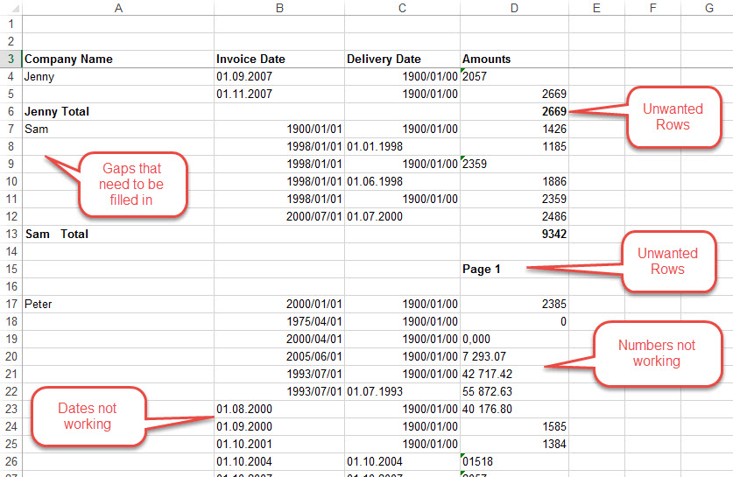

Slide 7
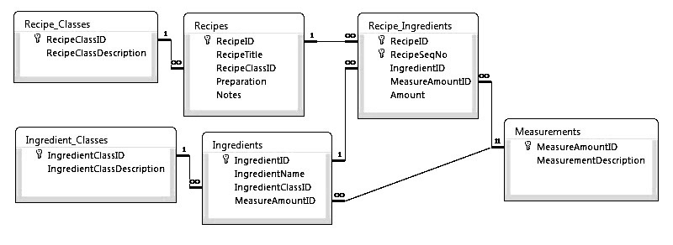
SQL database example
This is the data schema – how it’s organized, not the recipe data itself.
First design the structure of the data, then fill it in.

Slide 8
Questions to be answered from the recipe DB
How many steps are in the “Chocolate chip cookie” recipe?
What are the titles of the recipes that have seafood ingredients?
Do any recipes use the same ingredient twice?
Which recipe has the greatest number of steps?
Etc.

Slide 9
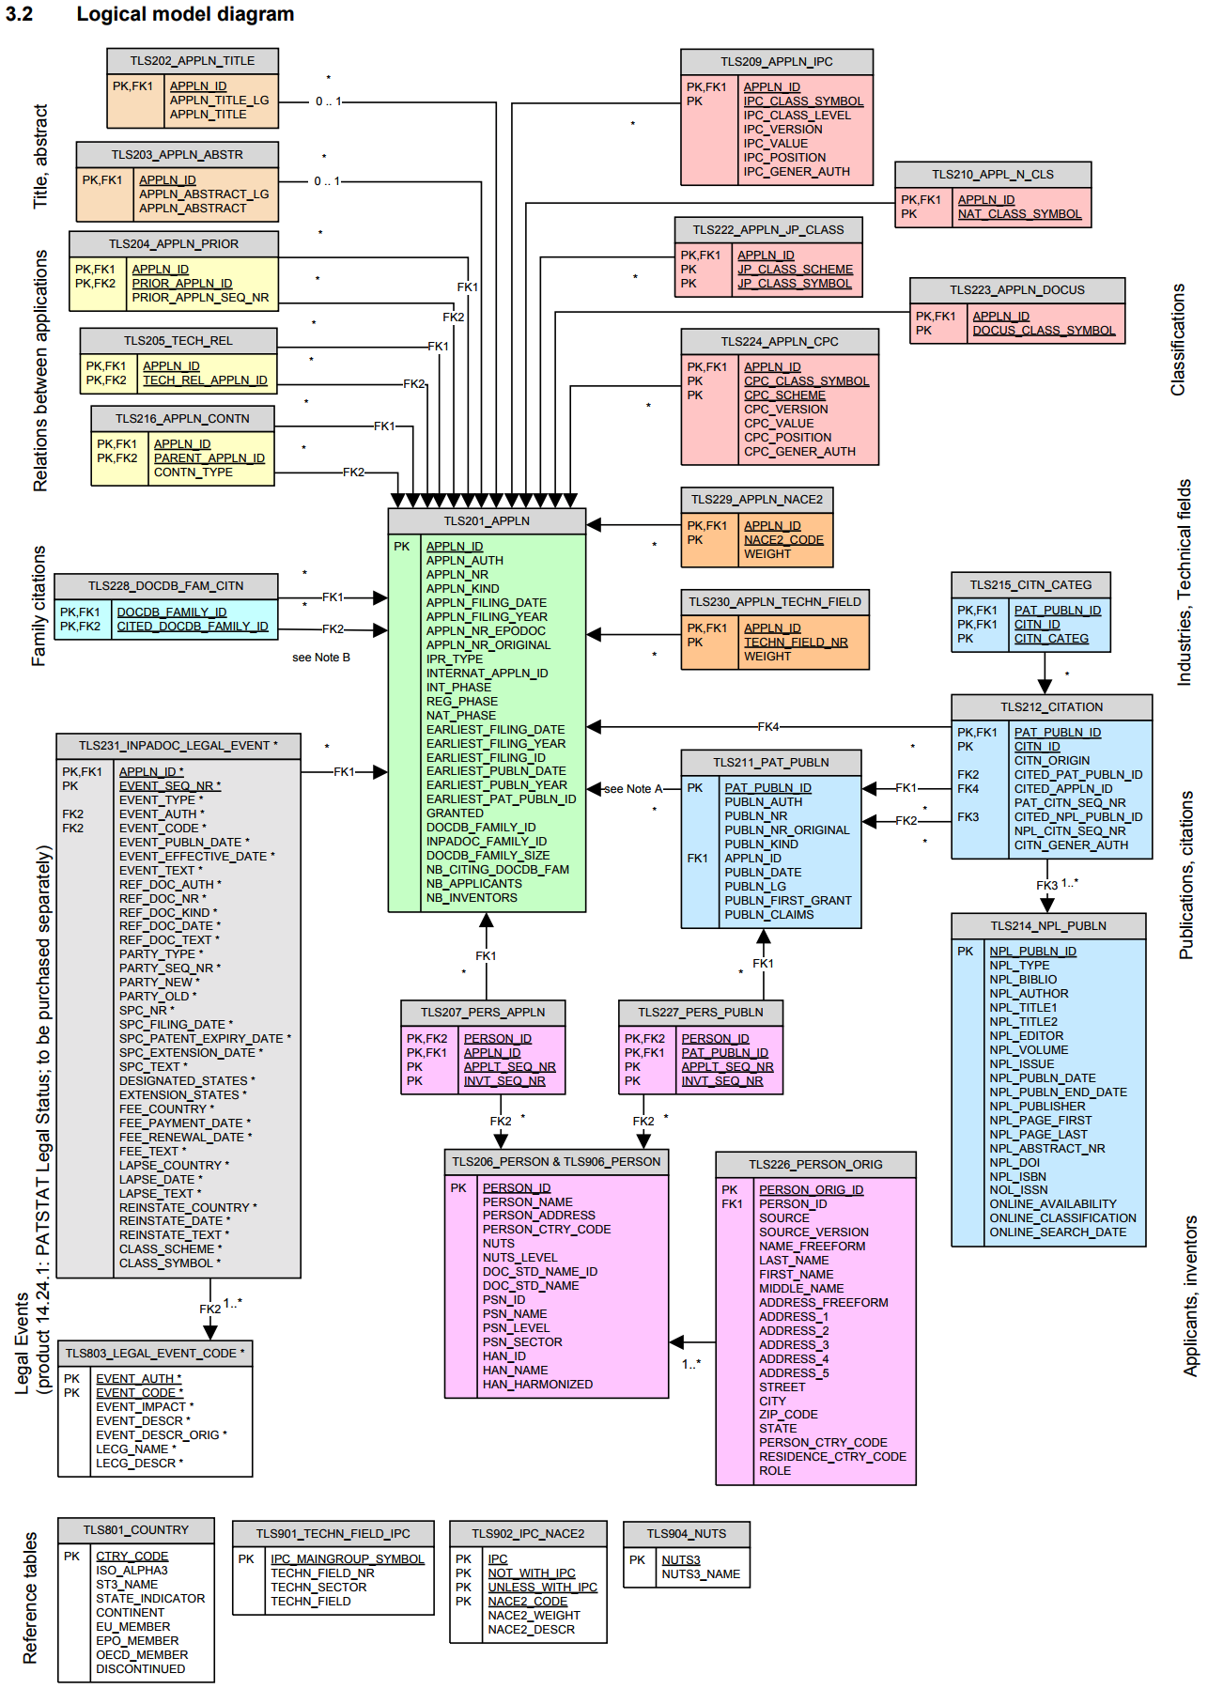
PATSTAT: European Patent Office’s International Patent Database
29 cross-referenced tables
6 DVDs of data
119GB of CSV files after unzipping
This example has both complex structure and lots of data entries.

Slide 10
Difficulties in plain Python, R, C++, Java, etc.
Working with data that is larger than the computer’s RAM (scalability)
Keeping your data around after your program finishes (persistence)
Efficiently searching through lots of data (indexing)
Easily filtering and summarizing data (querying)
Sharing data between multiple applications (concurrency)
Computation and data management typically use different tools.
Many systems use both SQL and a general-purpose language.

Slide 11
The Goal: Easy & Clean Descriptive Analytics
Answer a wide variety of complex questions using the same database:
Where did our 10 biggest customers live in 2007?
  SELECT customer.name, customer.city, customer.province FROM
  customer JOIN order ON order.customer == customer.id
  JOIN order_item ON order_item.order == order.id
  JOIN product ON order_item.product = product.id
  WHERE order.placed >= “2007-01-01” AND order.placed < “2008-01-01”
  GROUP BY customer.id
  ORDER BY SUM(order_item.qty * product.price) DESC
  LIMIT 10;
  This is code in the SQL language.
How many widgets are left in stock?
What is the average price of the chairs we sell?

Slide 12
Database Management Systems (DBMSs)
A DBMS is a data management software that allows users to define databases, load them with data, and query them.
  Eg., Oracle, MS SQL Server, MySQL, PostgreSQL, (SQLite, Access)
Often run on a remote, multi-user server
  Typically you need to know the hostname and have a username and password.
May be connected to one or more software applications or may stand alone.
Client libraries exist for every common programming language
  But you usually query the database using the SQL language
You purchase/download a DBMS, then use it to create your own databases.

Slide 13
Course Outline
SQL relational databases:
  Structured Query Language (SQL)
    Select, create table, update, delete
    Joining tables
    Subqueries & temporary tables
    Indexes and execution plans
  Data modelling
    One-to-many, many-to-many relationships
    Integrity & foreign key constraints
Getting data from the real world:
  Numeric formats
    Binary, integers, floats, precision
    Dates and times
  Text encodings
    ASCII, UTF-8, special characters
  Organizing data in files
    CSV, XML, JSON
  Messy data
    Missing entries, fuzzy matching
  Regular expressions
  Data APIs
  Web scraping

Slide 14
Prerequisites
Very few.
You should have done some programming in some language.
I assume you have used spreadsheets.
NOTE:
Computer Science and Computer Engineering students will not get credit for this course, except as an unrestricted elective.
  They should take EECS-339 instead.

Slide 15
Questions about course content?

Slide 16
Course Logistics
All materials and HW submission will be on Canvas
Lecture slides and videos will be posted (Panopto section in Canvas)
Ask your questions on Piazza (not by email)
TA is Panitan Wongse-Ammat
Peer Mentors (like TAs):
  Amanda Demopoulos, Moli Mesulam, Keren Zhou, Tianhao Zhang
Exams will be open book and open notes (no sharing books or papers)
  Midterm Exam is Thursday May 2nd during class.
  Final Exam is Thurs June 6th or Friday June 14th?

Slide 17
Office hours
TA/PM office hours in Mudd 3303:
  Monday: 1:30-3:30pm
  Tuesday: 12-2pm
  Wednesday: 1:30-5pm
Prof. Tarzia’s office hours (in Mudd 3225):
  Mon 1-3pm, Tues 3:30-4:30pm,
  Wed 3-5pm, Thurs 3:30-4:30pm

Slide 18
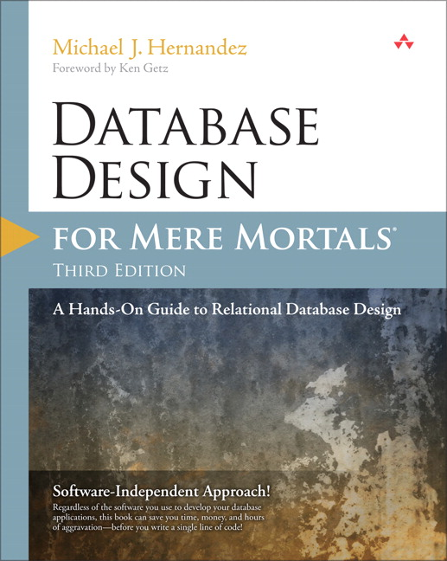
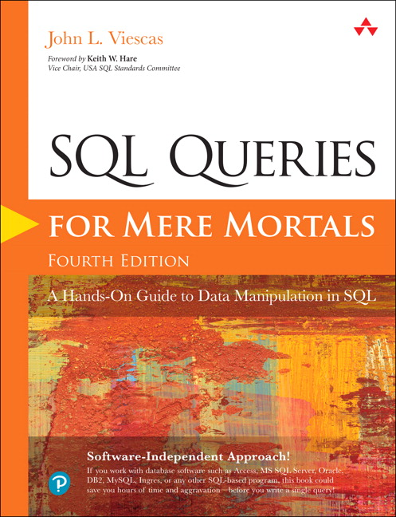
Optional Reference Books
Hernandez “Database Design for Mere Mortals” ($30 on Amazon)
Viescas & Hernandez “SQL Queries for Mere Mortals” ($32 on Amazon)

Slide 19
Grading
Homework (6 × 6.67% = 40%), including a final project.
Midterm exam (25%)
Final exam (35%)

Slide 20
Tentative Homework
HW 1, 2, 3: SQL queries
  Write SQL queries to perform analytics on a small, local database (SQLite).
  Wire more advanced queries.
  Connect to a large, remote database.
HW 4: Getting data
  Numeric types, regular expressions
HW 5, 6: Database design project
  Design a data model from scratch to model a data domain of your choice.
  Load data & perform queries.

Slide 21
Questions about logistics?

Slide 22
Why use a relational database?
Scalability – work with data larger than computer’s RAM
Persistence – keep data around after your program finishes
Indexing – efficiently sort & search along various dimensions
Integrity – restrict data type, disallow duplicate entries
Deduplication – save space, keep common data consistent
Concurrency – multiple users or applications can read/write
Security – different users can have access to specific data
“Researchability” – SQL allows you to concisely express analysis

Slide 23
Tables are the main concept in relational DBs
Table name
4 Columns
Primary key
customer
id | name | address | city
1 | Becky G. Novick | 1131 Poe Road | Houston
2 | Pamela C. Tweed | 3554 College View | Greenville
3 | Danny C. Bost | 1720 Gateway Ave | Brattleboro
3 Rows

Slide 24
DB design process answers these questions:
What tables do we need?
  How to logically separate the data?
What columns?
  Data types for columns?
  How will rows be uniquely identified?
  Are some columns optional?
How will tables be linked?
customer
id | name | address | city
1 | Becky G. Novick | 1131 Poe Road | Houston
2 | Pamela C. Tweed | 3554 College View | Greenville
3 | Danny C. Bost | 1720 Gateway Ave | Brattleboro

Slide 25
Sometimes we start with one redundant table and break it down to reflect the logical components
staff
id | name | department | building | room | faxNumber
11 | Bob | Industrial Eng. | Tech | 100 | 1-1000
20 | Betsy | Computer Sci. | Ford | 100 | 1-5003
21 | Fran | Industrial Eng. | Tech | 101 | 1-1000
22 | Frank | Chemistry | Tech | 102 | 1-1000
35 | Sarah | Physics | Mudd | 200 | 1-2005
40 | Sam | Materials Sci. | Cook | 10 | 1-3004
54 | Pat | Computer Sci. | Ford | 102 | 1-5003

Slide 26
This is called Normalization
staff
id | name | department
11 | Bob | 1
20 | Betsy | 2
21 | Fran | 1
22 | Frank | 4
35 | Sarah | 5
40 | Sam | 7
54 | Pat | 2
department
id | name | building
1 | Industrial Eng. | 1
2 | Computer Sci. | 2
4 | Chemistry | 1
5 | Physics | 4
7 | Materials Sci. | 5
building
id | name | faxNumber
1 | Tech | 1-1000
2 | Ford | 1-5003
4 | Mudd | 1-2005
5 | Cook | 1-3004
6 | Garage | 1-6001
Removes redundancy
  Save space
  Edit values in one place, so duplicates don’t become inconsistent
Tables can be populated separately
But, you are adding a new id column for each table

Slide 27
Tables
Represent objects, events, or relationships
  Each of its rows must be uniquely identifiable
  Has attributes that the DB will store in columns
  Can refer to rows in other tables
Objects: people, places, or things
Events: usually associated with a specific time. Can recur.
Relationships: associations
Designing a set of tables is called data modelling, and it’s best learned by example.

Slide 28
Database Schema defines the data’s structure
Also called a data model
It’s metadata – data about data
Defines the tables, including:
  Columns in each table (both the name and type)
  Primary Key for each table
  Foreign Keys that link tables

Slide 29
DB Design diagram:
staff
id | name | room | depart-ment
11 | Bob | 100 | 1
20 | Betsy | 100 | 2
21 | Fran | 101 | 1
22 | Frank | 102 | 4
35 | Sarah | 200 | 5
40 | Sam | 10 | 7
54 | Pat | 102 | 2
department
id | name | building
1 | Industrial Eng. | 1
2 | Computer Sci. | 2
4 | Chemistry | 1
5 | Physics | 4
7 | Materials Sci. | 5
building
id | name | faxNumber
1 | Tech | 1-1000
2 | Ford | 1-5003
4 | Mudd | 1-2005
5 | Cook | 1-3004
6 | Garage | 1-6001
staff
id
name
department
department
id
name
building
building
id
name
faxNumber

Slide 30
Online retail example
product
id
name
description
price
inventoryQty
orderItem
id
order
product
quantity
order
id
customer
totalCost
placedTime
shippedTime
trackingNumber
customer
id
name
streetAddress
city
province
postalCode
country

Slide 31
Some columns are just internal references
product
id
name
description
price
inventoryQty
orderItem
id
order
product
quantity
order
id
customer
totalCost
placedTime
shippedTime
trackingNumber
customer
id
name
streetAddress
city
province
postalCode
country

Slide 32
Can make the model more complex
product
id
name
description
price
orderItem
id
order
product
quantity
order
id
customer
totalCost
placedTime
customer
id
name
primaryAddress
stock
id
product
quantity
supplier
address
id
streetAddress
city
province
postalCode
country
shipment
id
order
shippedTime
carrier
address
carrier
id
name

Slide 33
Basic steps
Create table:
  Table has a name
  Table has certain named & typed columns.
Add rows to table
  Each row gives exactly one value to each column (except optional columns can take a null or empty value in a row).
Write queries to fetch data from the table.
staff
id | name | room | depart-ment
11 | Bob | 100 | 1
20 | Betsy | 100 | 2
21 | Fran | 101 | 1
22 | Frank | 102 | 4
35 | Sarah | 200 | 5
40 | Sam | 10 | 7
54 | Pat | 102 | 2

Slide 34
Recap
Complex data are more than just streams of numbers!
Data model or schema defines the data’s structure
  It’s a list of tables, each with a fixed number of columns
  Data rows are added after the data model is designed.
These are called Relational or SQL databases.
Can represent much more complex data than a simple spreadsheet.
TODO:
Maybe buy or print a SQL book.
Download DB browser for SQLite http://sqlitebrowser.org/
  Open and view the sample databases on Canvas (.sqlite files)

