Slide 1

CS-310 Scalable Software Architectures
Lecture 18:
Computing Platforms
Steve Tarzia

Slide 2
Last Time: Twitter Database Architecture
Twitter's storage design choices offer a tradeoff between:
  Relational DB: space-efficient, fast writes, but slow reads.
  NoSQL DB: duplicative, slow writes, but fast reads.
A hybrid design is ideal:
  Most users are consumers (reads > writes): put their tweets in NoSQL.
  Celebrities are different (writes > reads): put their tweets in SQL.

Slide 3
App packaging, distribution, and deployment is tricky
Unfortunately, an app usually requires a very specific environment:
  Application server or middleware. Eg., Tomcat, Maven, Express.js
  Language interpreter / runtime. Eg., Python 3.5, Java 10, Node.js
  Libraries (within the language). maybe loaded by mvn, npm, pip, ld
  Command line tools & services. Eg., imagemagick, mysql, openssl
  Operating system features & config. Eg., filesystem structure, firewall,
  subprocesses/threads, user security.
As on the homework, “it worked on my machine” is not good enough.
Many app packaging solutions exist, and they are constantly evolving.
  We’ll compare some common choices:
  Java JVM, Full VMs, Containers, Serverless functions

Slide 4
Your experiences?
What have been your best/worst experiences trying to run code someone else has written?
What have been your best/worst experiences distributing code you’ve written?
What language/tool features make distribution easier?
STOP
and
THINK
STOP
and
THINK

Slide 5
Packaging option #0: Binary Executable
Common for distributing apps on consumer OSes.
Windows and Mac desktop apps are distributed through an app store or a special installer program.
  Both app stores and installers take care of installing prerequisite libraries.
  Or distribute a binary executable. Will only run on very similar systems.
  Windows has been carefully designed for backward compatibility.
    Apps packaged for Windows XP (2001) should still run on Windows 10 today!
Android and iOS mobile apps are easier to package because they are more heavily sandboxed. Cannot access outside command line or files.
  Anyway, developers use tools provided by the OS for packaging apps.
Linux distributions have package managers like apt and yum to install FOSS program binaries and their dependencies.

Slide 6
Packaging option #1: Source code + README
Most small code projects are not well packaged.
Post the source code somewhere (github!).
Maybe write a README with some instructions for how to set up the environment.
Hopefully provide a build script
(makefile, requirements.txt, rakefile, build.sh, depending on the language).
✘ Low probability that user will be able to reproduce a working env.
It worked on my machine…
Exception: Maven/Gradle for Java source code is pretty reproducible.

Slide 7
Packaging option #2: JVM Bytecode
Compiled Java code runs on Java Virtual Machine (JVM).
  JRE emulates the JVM and translates “hot” (critical) JVM code to native code.
“Write once, run anywhere” (hopefully).
Code is distributed as .jar or .war file (Java bytecode archive)
Many new languages also compile to the same JVM:
  Write code in Java or Scala, Kotlin, Clojure, Groovy, Jython, Jruby.
Pros: ✓ Small code size. ✓ Simplicity. ✓ Performance.
Cons: ✘ Limited choice of languages.
✘ App is not truly isolated from host OS.
✘ No control of outside environment
(eg., command-line tools and filesystem).

Slide 8
Virtual Machines
In the old days, you installed one Operating System on a server.
  To share resources (and save money), you might run both a web server and an email server simultaneously on the same OS/machine.
  Think of your own laptop. The OS can share one CPU/memory among many concurrent applications (called processes). (details in CS-343)
  Nowadays, running multiple server apps on one OS is rare.
A hypervisor or VMM allows a single machine
run multiple virtual machines.
  Each VM has its own OS installed, can be the same
  OS version or different. VMs are isolated.
  VMs can communicate over the network.
  Hypervisors include: KVM, Xen, VMware, Hyper-V.

Slide 9
Why use virtual machines?
The hypervisor introduces complexity and some inefficiency, but…
VMs allow problems in one service to be isolated from other services.
  Eg., if web server has a [ memory leak | security breach | OS crash ],
  the mail server on another VM will not be affected.
VMs can be migrated on the fly (if supported by the hypervisor).
  If physical machine must be retired or replaced, the guest VMs can continue running on another machine.
Servers are big, but you may not require a full machine.
  Eg., moore has 48 CPU cores and 256 GB or RAM.
  Eg., stevetarzia.com webserver needs < one CPU core and 512mb of RAM.
Resources allocated to VMs can be dynamically scaled vertically.
  Hypervisor can grant more RAM or CPU cores to a VM, just reboot to see it!

Slide 10
Elastic Compute Cloud (EC2)
EC2 is AWS’ virtual machine rental service, started in 2006.
Outsourcing server mgmt is an old idea. Amazon's innovation was to charge by the hour, not month, and it started a cloud computing revolution.
Customer chooses:
  VM “size” (# CPU cores, RAM, network bandwidth, GPU?).
  Operating system (various versions of Linux, Windows, now even Mac).
  Storage type/size (SSD or magnetic? what capacity? billed separately).
  Location. us-east-1 (Virginia), us-east-2 (Ohio), ap-east-1 (Hong Kong), …
  Reservation period (no contract, one year, or three year).
  Networking details (on the public Internet, or in a private network?)
  Login credentials (SSH public key, so you can log in after it’s created!)
A VM instance is created for you within a few minutes.
Billed by the hour ($0.003 to $26.68 per hour = $2 to $19,200/month)

Slide 11
VM operational concerns
Renting a VM frees you from hardware concerns, but many software operational concerns remain. These are all called DevOps:
Install and configure 3rd party software:
  databases, web servers, libraries, distributed caches, message queues, coordination tools, OS updates, etc., etc.
Deploy new versions of your application when released.
Monitor application and OS health:
  Log files, CPU utilization, free memory, free disk space.
Manage security:
  Configure users, set/rotate passwords/keys, configure firewall.

Slide 12
Packaging option #3: Virtual Machine
An extreme option for packaging an app.
Ship the entire software stack, from boot code onward.
Any hypervisor using the same CPU architecture (eg., x86-64) and emulating same generic hardware (network card, disk controller) can run the code.
Create a virtual hard disk big enough to install the OS, libs, & app.
  At least a Gbyte or so. (maybe 1,000× larger than your source code).
On AWS, pre-configured VMs are called AMIs (Amazon machine images).
Pros: ✓ Consistent & controlled runtime environment.
✓ Isolates app from outside apps.
Cons: ✘ Large in size. ✘ Performance overhead for virtual/guest OS.
✘ Slow startup (must boot the OS before running your app).

Slide 13
Packaging option #4: Docker Containers
Similar to a VM, but much smaller and a bit more efficient.
  Unlike a VM, a container is intended to run just one process/app.
A Hypervisor runs VMs, Docker runs Containers.
Container is defined by a Dockerfile which lists:
  The parent image it’s based on. This might be an official base image like alpine 3.10.3 (a tiny Linux distro). Base images are very similar to VMs.
    Base images are very stripped-down: Alpine is 5mb, Ubuntu is 190mb.
    Child images can add additional OS software packages as needed. (eg., “apt-get gcc”)
  Instructions to modify the parent image. Eg., this postgres container is based on the alpine image, but it downloads and configures the postgres database.
  The dockerfile is just a small text file, but it is a blueprint for the app’s complete runtime environment.
  This idea borrows from OS config management tools like Puppet, Chef, Salt.

Slide 14
Containers vs Virtual Machines

Slide 15
Containers can be run on VMs
App D
App A
App B
App C
Docker

Slide 16
Docker layered filesystem
Recall that containers are derived from a base image.
You might have many containers running on a machine based on the same big parent image. There is an opportunity to share.
A Docker filesystem layer is a set of changes to a base filesystem:
It's a copy-on-write filesystem.
The figure at right shows two
containers running Elasticsearch
with different configurations.
The majority of the container data
is shared (bottom three layers).

Slide 17
Linux support for containers
Linux has built-in support for isolating processes from each other.
Docker uses this Linux container functionality (LXC, runc), and adds:
  Build toolchain (Dockerfiles, etc.)
  Layered filesystem images.
  Central image repository (Docker hub)
  Mac and Windows runtime environments (that run Linux in a VM).
Note that containers cannot see each other, but they feel each other’s effects more than VMs (eg., memory & CPUs are shared dynamically).
References:
https://docs.docker.com/engine/faq/
https://stackoverflow.com/questions/16047306/how-is-docker-different-from-a-virtual-machine

Slide 18
Where to deploy containers?
AWS gives two basic options for deploying containerized apps:
A Virtual Machine (EC2) cluster.
  Kubernetes is the standard container orchestration system for such clusters.
  Eg., create five m4.xlarge instances running Linux & manage w/Kubernetes.
  ✓ You can SSH into the VMs if you wish, for debugging.
  ✘ You control # of VMs. Idle instance? you waste money. Overloaded? it’s slow.
Managed infrastructure (AWS Fargate, Azure Container Instances).
  Your container is deployed somewhere (the cloud provider handles this).
  Most likely deployed to a dedicated VM pulled from a pool, but who knows?
  Container specifies #CPU cores and RAM size to reserve for the container.
  ✘ You cannot SSH into it the VM and debug or configure it.
  ✓ You pay only when your code is running, and scaling is much more dynamic.

Slide 19
Launch comparison
Virtual Machine
Container
Copy disk image to VMM.
Reserve CPU and RAM share.
Boot VM OS.
Copy Dockerfile and application code to host.
Download base image
  Skip this step if another container is using the same base image.
Run setup commands in Dockerfile.
Run the app command in the Dockerfile.

Slide 20
Serverless functions abstract away the platform
Your code just runs somewhere in the cloud.
Serverless functions are heavily constrained. They must run on a standardized platform that can simultaneously support all tenants.
  All code is in one language, on a certain runtime (eg., Python 3.5).
    Simple Lambda functions can actually be written/pasted in the AWS web console.
  Dependencies must be included in the app bundle that is deployed.
    In other words, the only thing “installed” is your function code.
    Eg., in Python, install libs in a subdirectory: “pip install --target ./package urllib3”
  Serverless functions are stateless (no global variables to retain state).
  Code cannot spawn other command-line processes.
  Code can only write to one folder in the filesystem (eg., “/tmp”).
    This folder is isolated (sandboxed) from other functions running on the VM.
✓ Much less overhead and startup delay than container or VM.
👍 Note that a Java jar is an ideal package for a serverless function.

Slide 21
How Serverless Works
Some cloud-configured event triggers/calls the function.
In response, the code is deployed to a VM, perhaps along with other functions (those details are abstracted away).
There can be a short delay in starting the function (if it’s not already on a VM) called a cold start.
Function is deployed to as many machines as necessary, on demand.
AWS Lambda functions are currently limited to 15 minutes.
The association between the code and VM is short-term.
Note that serverless functions must be coded to work with a particular vendor's platform (eg., AWS Lamba), so there is vendor lock-in.

Slide 22
Invoking a Serverless Function
On AWS, a Lambda function can be triggered by:
Admin clicking a button in the Lambda console.
Your code calling into the lambda API.
Client request reaching an AWS API Gateway configured to route certain endpoints (paths) to your lambda.
Cloudwatch event configured in the AWS console to run periodically.
An event in a managed service, like S3 or Simple Queueing Service.
  S3 can be configured to run a lambda whenever a file is stored in a bucket.
  SQS can run a lambda to handle messages added to the queue.

Slide 23
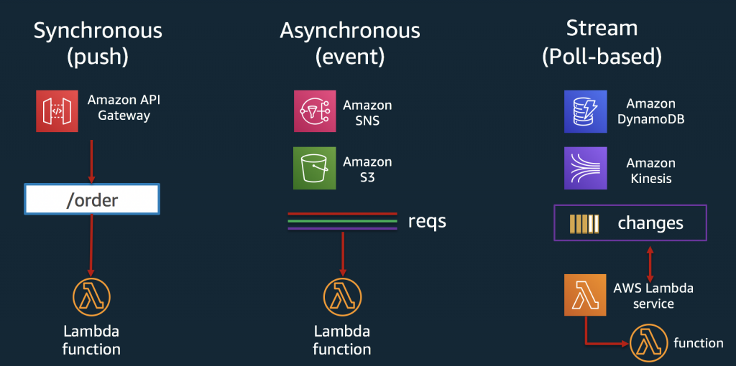

Slide 24
Serverless Function use cases
Good for infrequently-executed code and batch processing.
  No resources are wasted while the code is idle.
Good for bursty workloads.
  A serverless function can spin up in a few seconds.
    It’s just a code copy and the code startup time.
    This is much faster than starting a new VM (a few minutes) or container.
For example, quickly processing a sudden burst of thousands documents.
  To do it quickly, the work must be done in parallel on lots of machines.
  Keeping lots of VMs available (and idle) would be costly.
  Creating new VMs would be slow (and costly because you pay during bootup).

Slide 25
Computing Platform comparison
✓ Run multiple isolated OSes on one machine.
✓ Consistent environment
✘ High space overhead.
✘ Slow to start/stop.
✘ Horizontal scaling and resource mgmt. is manual.
✓ Consistent runtime environment without overhead of a full VM.
✓ Automatic horiz. scaling.
✘ Less configurable than a VM.
✓ Quickest startup, least storage overhead.
✓ Automatic horiz. scaling.
✘ Must work entirely in one programming language.
✘ Must be stateless, <15min.
✘ Cloud vendor lock-in.

Slide 26
Cloud architecture tutorials from AWS
https://github.com/aws-samples/aws-modern-application-workshop/tree/java
https://github.com/aws-samples/aws-serverless-airline-booking
Tips:
API Gateway is an alternative way to develop APIs, using Lambdas:
  https://us-east-2.console.aws.amazon.com/apigateway/home
Long-running processing work can be done in ECS on Fargate:
  https://kalinchernev.github.io/solving-aws-lambda-timeouts-fargate

Slide 27
Recap – Computing Platforms
Virtual Machines let multiple tenants share a single physical server.
  Apps can be distributed as a VM disk image.
Containers create a consistent environment for your application.
  Distribute as an image (like a VM disk image, but more lightweight),
  Or as source code + a Dockerfile (a blueprint for the image).
Serverless functions are code that is staged in the cloud, ready to run:
  They are automatically deployed and run on one or more VMs on demand.
  Pros: • Gives more dynamic & fine-grained scalability than container/VM.
  • Uses as many machines as needed, when needed. (zero to 1000s!)
  Cons: • “Cold start” delay of several seconds (to copy code & launch).
  • Function runtime is often limited (eg., 15 minutes for Lambda).

