Slide 1

CS-310 Scalable Software Architectures
Lecture 17:
Twitter Design Exercise
Steve Tarzia

Slide 2
Summarizing the quarter so far!
Finally, we have an end-to-end view of a basic scalable architecture!
  (for services, at least)
Frontend: Client connects to “the service” via a load balancer.
  Really, the client is being directed to one of many copies of the service.
  Global LBs (DNS and IP anycast) have no central bottlenecks.
  Local LBs (Reverse Proxy or NAT) provide mid-level scaling and continuous operation (health checks & rolling updates).
Services: Implemented by thousands of clones.
  If the code is stateless then any worker can equally handle any request.
  OS/VM can be abstracted away: develop serverless functions or containers.
Storage: Distributed data stores can handle many requests in parallel.
  NoSQL DBs are implemented as distributed hash tables (shared nothing).
  SQL databases can scale (but not infinitely) with read-replicas or sharding.

Slide 3
Twitter design example
Imagine it’s represented by a SQL database with three tables.

Slide 4
Original/simplest design
When a tweet arrives, just copy it to the tweets table. Writes are fast.
What about reading a user’s feed?
JOIN tweets and follows table.
  Reads are slower than writes :(
SELECT tweets.*, users.* FROM tweets JOIN users ON tweets.sender_id = users.id JOIN follows ON follows.followee_id = users.id WHERE follows.follower_id = current_user

Slide 5
Why is building my twitter feed slow?
STOP
and
THINK
Tweets
It reads from three different tables:
  Users, Follows, Tweets.
More importantly, the tweets in my feed are scattered throughout the Tweets table.
  Disks and RAM are both much better at reading large blocks of contiguous data.
If the Tweets table is sharded, it reads from multiple shards.
id | sender | text | time
1 | 12 | just setting … | 2020…
2 | 4 | Hey y'all, … | 2021…
3 | 843 | eating this … | 2021…
4 | 12 | What are … | 2021…
5 | 234 | Found a … | 2021…
6 | 523 | Picard manag… | 2021…
7 | 4 | in my car… | 2021…

Slide 6
Second Twitter design
Pre-build feeds. Schema is denormalized – each tweet is duplicated and stored on all follower's feeds. Store feed data in a NoSQL database.
Each tweet (write) now requires writing to many user feeds (maybe millions!)
Do we want to make tweeting slow for people with 10 million followers?

Slide 7

The slow celebrity tweet
POST
DB
Twitter phone app
Twitter backend
10M insertions
200 OK
A celebrity's tweet triggers 10M database writes, so the request could take up to a full minute to complete!
Solution?
  Do the writes asynchronously.
  Store celebrity tweets differently.
STOP
and
THINK

Slide 8
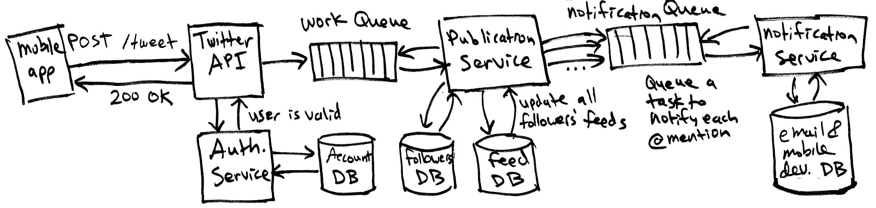
Our theoretical Twitter architecture 2.0
Feed DB (NoSQL)
First design used a relational database and did a JOIN to build feeds.
But pre-building each user’s feed will make reads much faster.
  Also, allows us to use a NoSQL database, putting all of a given user’s data in one place that’s easy to find (using a distributed hash table).
  Each tweet must be duplicated to all followers. Do this asynchronously.

Slide 9
Getting your feed
GET /feed
Fetch feed data
for user X
[{“author”:”person1”, tweet: “hello world I like to twt!”},…]
Auth token matches user X
Feed DB (NoSQL)
The common case (reading a feed) is synchronous and efficient.
Validate the authentication token and get the userId.
Query a NoSQL database for the feed, with the userId as the key.
  All of the users’ data is on one set of replicas (maybe 3 nodes) so it’s scalable.
Build and return a JSON object to the client.

Slide 10
Review
NoSQL databases can be
designed as shared-nothing
distributed systems.
Clients can find servers without
consulting a centralized resource.
Servers need not coordinate
with each other.
Each request involves a constant number of servers
Thus, regardless of the number of clients or servers:
The number of clients that can be handled scales directly with the number of servers. This is perfect scalability.
There is no overhead for growing the system.
To handle larger crowds, just keep adding more ticket booths.
Sales are independent, so this is a shared-nothing distributed system.

Slide 11
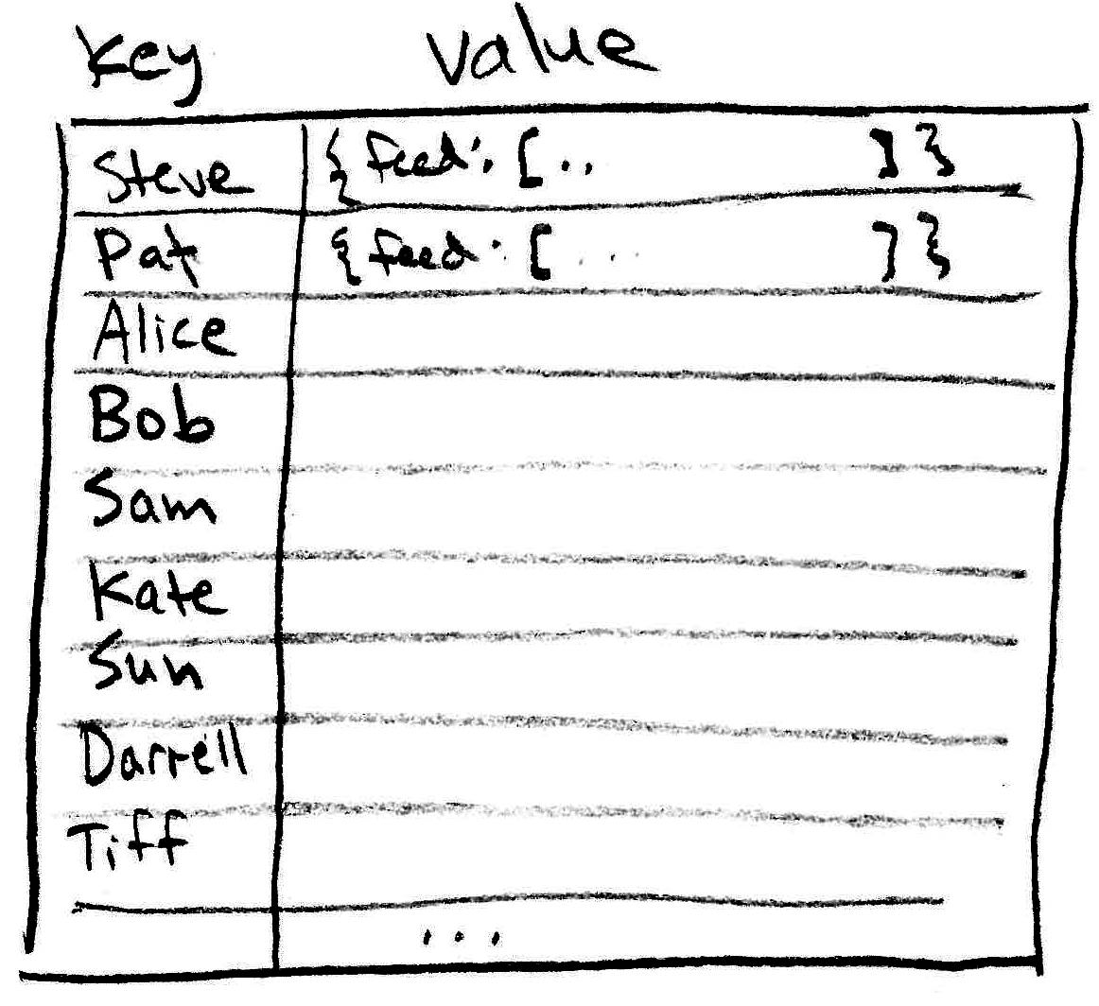

Twitter feeds in a NoSQL database
We must somehow store everything using the key-value abstraction.
Keys are users, value includes the latest feed data and other items that are commonly needed.
Hash the key (user) to assign each user’s data to set of replicated storage nodes:
Notice that a tweet now requires writing to all of the followers’ feeds! Data is duplicated!
This is called denormalization.

Slide 12
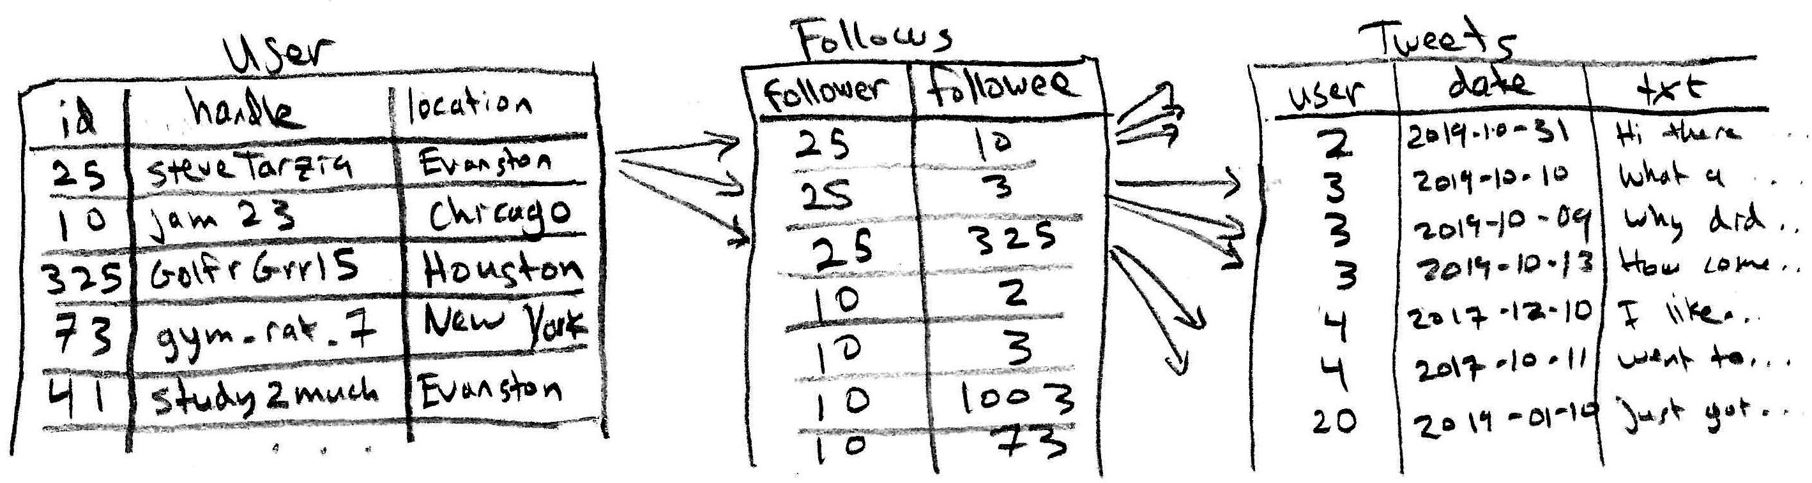
Twitter in a Relational Database
A relational database would give a more logical design.
Data is normalized, without any duplication.
A JOIN is done to build a user’s feed:
If the system gets large, we must partition the data into multiple storage nodes, and this presents a problem in the Tweets table.

Slide 13
Partitioning the Tweets table
Green: partition 1
We cannot avoid conflicts when assigning tweets to partitions! 😞
For scalability, we want to JOIN to only involved a few partitions.
Follows table can be reasonably partitioned:
  Place follow rows in the same partition as the follower’s user row.
However, Tweets must be quickly accessible to all followers.
Followers can be many and diverse, & distributed on many partitions.
Assigning a tweet from user 3 to partition 1 is great for SteveTarzia, but it’s probably not the ideal placement for most of the other followers.

Slide 14
Data partitioning problem
We want to split the data into partitions (storage nodes) such that:
  Related data is on the same node.
  Thus, queries can be served by one (or a few) nodes.
However, human social networks are not orderly, there are lots of random connections.
  Thus, the table of Twitter “follower” data cannot be cleanly partitioned.
  Any balanced partitioning of the graph will lots of edge crossings.
A random graph, representing a set of people (red dots) with random twitter follow relationships (black edges)

Slide 15
Twitter storage tradeoff
How can Twitter get the best features of both designs?
STOP
and
THINK
Relational Design:
Writes are fast/simple.
Cannot handle lots of data/users.
Reads are slower.
Pre-built Feeds:
Can use NoSQL,
so much more scalable.
Duplicates tweets.
  Very wasteful for celebrities with millions of followers.
Writes are slow.
  Celebrities’ tweets may not reach all user feeds within 5 seconds.
  Lots of publication work is done.

Slide 16
Hybrid Design – Twitter 3.0
Pre-build feeds for most users.
But celebrity tweets are stored in a small relational database.
Fetch a user feed in two steps:
  Get normal-user tweets from pre-built NoSQL feed.
  Query relational database read-replica to get recent tweets from any celebrities that the user is following.
Celebrity tweets are relatively rare, so a single primary SQL database can handle these writes.
  Many read-replicas handle the reads.

Slide 17
Twitter Architecture Recap
Twitter's storage design choices offer a tradeoff between:
  Relational DB: space-efficient, fast writes, but slow reads.
  NoSQL DB: duplicative, slow writes, but fast reads.
A hybrid design is ideal:
  Most users are consumers (reads > writes): put their tweets in NoSQL.
  Celebrities are different (writes > reads): put their tweets in SQL.

