Slide 1

CS-310 Scalable Software Architectures
Lecture 15:
Choosing a Database
Steve Tarzia

Slide 2
Last Time: Distributed DB Consistency
Replication of data ensures that a single failure does not lose data.
  The more nodes you have, the more likely a failure!
However, replication introduces consistency problems.
  Tradeoff: must choose 2 of Consistency, Availability and Partition Tolerance.
A distributed DB client, at very least, would want to achieve:
  Montonic reads, monotonic writes, read your writes (together: linearizability).
Ensure consistency by waiting for responses from multiple replicas.
Different quorum levels (all, majority, one) trade delay of reads/writes and determine whether reads or writes are unavailable during recovery.
  Cassandra DB lets programmer choose the quorum level for each read/write.
  Other NoSQL databases are designed to use just one read/write strategy.

Slide 3
Recall the goals of a Database:
Scalability – work with data larger than computer’s RAM.
Persistence – keep data around after your program finishes.
Indexing – efficiently sort & search along various dimensions.
Concurrency – multiple users or applications can read/write.
Analysis – SQL query language is concise yet powerful. Avoid transferring lots of data. Run analysis on the storage machines.
Separation of concerns – decouples app code from storage engine.
Also, allows apps to be stateless, allowing parallelism.
Less importantly:
Integrity – restrict data type, disallow duplicate entries.
Deduplication – save space, keep common data consistent.
Security – different users can have access to specific data.

Slide 4
Data storage options
 | Examples | Use cases
SQL Relational DB | MySQL, Oracle | Structured data. Transactional data.
Column-oriented DB | Snowflake, BigQuery | SQL queries for analytics on huge datasets (OLAP).
Search engine | Elastic search | Searchable text documents.
Document store | MongoDB | Semi-structured data (JSON docs).
Distributed cache | Redis | In-memory cache with expiration. Very fast.
NoSQL DB | Cassandra, Dynamo | Huge data to be accessed in parallel.
Cloud object store | S3, Azure Blobs | Images, videos, & other static content.
Cluster filesystem | Hadoop dist. fs. | Files to be processed in huge parallel computation.
Networked filesystem (NAS) | NFS, EFS, EBS | App is designed to write to local file system, but we want that storage to be scalable and shared.
With so many options, choosing the “right” storage option is difficult!
Dozens of other DBs exist, but these examples are popular and representative examples.

Slide 5
SQL Relational Databases
The most common, traditional solution.
Data is organized into tables, with foreign keys to cross reference.
  The format of the data (schema) is predefined. Consistent, not flexible.
SQL language run common data analyses inside the database:
  SELECT category, avg(price) FROM products GROUP BY category;
  Running calculations on the storage machine helps performance.
  Data transfer (I/O) is a bottleneck in most systems.
  Reduces data transfer between app and data store.
  Above query just returns a short answer over the network.
Supports transactions (sequence of ops to be committed all or none).
Works very well up to a certain size.
  Writes must happen on one “master” machine.
  Read-replicas give read scaling (w/delay). Sharding can help write scaling.

Slide 6
Database transaction example: spending gift card balance
-- 1. start a new transaction
START TRANSACTION;
-- 2. get the gift card balance
SELECT @cardBalance:=balance FROM giftCards
WHERE cardId=23902;
-- 3. insert a new order for customer 145
INSERT INTO orders(orderDate, status,
customerNumber)
VALUES('2021-02-22', 'In Process', 145);
-- 4. get the newly-created order id
SELECT @orderId:=LAST_INSERT_ID();
-- 5. Insert order line items
INSERT INTO orderdetails(orderNumber, product,
quantity, priceEach)
VALUES(@orderId,'S18_1749', 3, '136'),
(@orderId,'S18_2248', 5, '55');
-- 6. deduct from balance
UPDATE giftCards SET balance=(@cardBalance-683)
WHERE cardId=23902;
-- 7. end the transaction (commit changes)
COMMIT;
Why must these steps be completed atomically (together)?
Prevent card balance from being spent twice.
Prevent clients from seeing the order without line items.
The first is a race condition, the second is an inconsistency.

Slide 7
Transactions on a distributed (NoSQL) DB?
Transactions less common on NoSQL DBs because they are slow.
Often, transactions are not necessary because a single key stores a lot of related data that can be modified at once.
Transaction can be implemented by locking the keys involved:
  Lock the keys involved (the lock prevents reads/writes).
    All replicas must agree to the lock.
    Multiple competing lock requests may occur in parallel, but one must be chosen, so multiple rounds of communication may be needed to agree.
  Execute the transaction on all replicas. Wait for all to confirm.
  Unlock the keys involved (let reads/writes proceed).
Reference: Google's Spanner OSDI 2012 paper

Slide 8
How to implement a distributed lock?
A lock requires an atomic conditional write operation, like:
  PUT("key", "new_val") IF GET("key") == "old_val";
Many NoSQL databases support something like this (Cassandra, Mongo).
Or if you don’t care too much about scalability:
  Store your transactional data in a SQL Database.
  Or use a SQL Database to implement a lock used to control access in NoSQL.
NoSQL transaction to deduct $1 from an account:
id=37; // my unique client id
while(GET("lock") != id) {
// get the lock if possible
PUT("lock", id)
IF GET("lock") == 0;
}
// do my 2-step transaction:
x = GET("balance");
PUT("balance", x – 1);
// release the lock
PUT("lock", 0);

Slide 9
Throughput/scaling limitations
Data store | Examples | Throughput limitations
SQL Relational DB | MySQL, Oracle | All writes to primary. Read-replication adds delay.
Column-oriented DB | Snowflake, BigQuery
Search engine | Elastic search
Document store | MongoDB
Distributed cache | Redis
NoSQL DB | Cassandra, Dynamo
Cloud object store | S3, Azure Blobs
Cluster filesystem | Hadoop dist. fs.
Networked filesystem | NFS, EFS, EBS | One machine, many disks (RAID).
All use a scalable data partitioning method, such as hashing.

Slide 10
Data abstractions
Data store | Examples | Data abstraction
SQL Relational DB | MySQL, Oracle | Tables, rows, columns
Column-oriented DB | Snowflake, BigQuery | Tables, rows, columns
Search engine | Elastic search | JSON, text
Document store | MongoDB | Key → JSON
Distributed cache | Redis | Key → value (lists, sets, etc.)
NoSQL DB | Cassandra, Dynamo | 2D Key-value (pseudo-cols)
Cloud object store | S3, Azure Blobs | K-V / Filename-contents
Cluster filesystem | Hadoop dist. fs. | K-V / Filename-contents
Networked filesystem | NFS, EFS, EBS | Filename-contents
Highly structured
Semi-structured
Files with data "blobs"
Files may have some internal structure, but the storage API is not aware of it and makes no use of it.

Slide 11
Column-oriented Relational Databases
Previously, we saw that:
Read-Replication and Sharding allow lots of parallel reads and writes.
This is useful for OLTP applications (Online Transaction Processing).
OLAP (Online Analytics Processing) involves just a few huge queries
Eg., Over the past three years, in which locations have customers been most responsive to our mailed-to-home coupons?
Analytics queries involve scanning tables, not using indexes.
Must be parallelized over many nodes.
The workload is mostly reads, with occasional importing of new data.
Column-oriented DBs are optimized for SQL analytics workloads.

Slide 12
Many choices for semi-structured, scalable stores!
Data store | Examples | Data abstraction
SQL Relational DB | MySQL, Oracle | Tables, rows, columns
Column-oriented DB | Snowflake, BigQuery | Tables, rows, columns
Search engine | Elastic search | JSON, text
Document store | MongoDB | Key → JSON
Distributed cache | Redis | Key → value (lists, sets, etc.)
NoSQL DB | Cassandra, Dynamo | 2D Key-value (pseudo-cols)
Cloud object store | S3, Azure Blobs | K-V / Filename-contents
Cluster filesystem | Hadoop dist. fs. | K-V / Filename-contents
Networked filesystem | NFS, EFS, EBS | Filename-contents
Semi-structured
Best choice depends on the structure of data being stored.

Slide 13
Distributed data store comparison
Copied from: https://kkovacs.eu/cassandra-vs-mongodb-vs-couchdb-vs-redis

Slide 14
MongoDB stores JSON objects
Below, "_id" is the sharding key used for data partitioning:
{
_id: ObjectId("5099803df3f4948bd2f98391"),
name: { first: "Alan", last: "Turing" },
birth: new Date('Jun 23, 1912'),
death: new Date('Jun 07, 1954'),
contribs: [ "Turing machine", "Turing test", "Turingery" ],
views : NumberLong(1250000)
}

Slide 15
MongoDB (3.2) – a “document store”
Main point: JSON document store.
Best used: If you like JSON. If documents change frequently, and you want to keep a history of changes.
For example: For most things that you would do with MySQL or PostgreSQL, but having predefined columns really holds you back.

Slide 16
MongoDB (3.2) – a “document store”
Written in: C++
Main point: JSON document store
License: AGPL (Drivers: Apache)
Protocol: Custom, binary (BSON)
Master/slave replication (auto failover with replica sets)
Sharding built-in
Queries are javascript expressions
Run arbitrary javascript functions server-side
Geospatial queries
Multiple storage engines with different performance characteristics
Performance over features
Document validation
Journaling (efficiently keeping previous versions of documents)
Powerful aggregation framework
Text search integrated
GridFS to store big data + metadata (not actually a FS)
Has geospatial indexing
Data center aware
Best used: If you need dynamic queries. If you prefer to define indexes, not map/reduce functions. If you need good performance on a big DB. If documents change frequently, and you want to keep a history of changes.
For example: For most things that you would do with MySQL or PostgreSQL, but having predefined columns really holds you back.

Slide 17
ElasticSearch also stores JSON documents
But it's designed to index every word in the document and to handle advanced queries:
{
"date": "2020-04-15",
"txt": "$1,000 in donations buy lunch for ambulance, victim assistance workers ... WATERTOWN, N.Y. (WWNY) - Two anonymous donations at a downtown Watertown restaurant are buying first responders lunch. Vito's Gourmet received the donations totaling $1,000 from people who wanted to give back to the community. On Wednesday, owner Todd Tarzia delivered gift certificates to Guilfoyle Ambulance and the Victims Assistance Center for each of its employees. \u201cOne of the donors in particular specifically designated first responders as who they wanted the lunch to go to and we thought, well, geez, first responders don\u2019t all sit around a lunch table, especially in the world with the virus right now so what can we do to get lunch to them on their schedule. So we decided to make up gift certificates for amounts that\u2019s enough for everyone to have lunch,\u201d said Tarzia. \"To get a gift like this is just so thoughtful and our people are going to be very thankful for this,\" said Bruce Wright, CEO, Guilfoyle Ambulance. …",
"title": "$1,000 in donations buy lunch for ambulance, victim assistance workers",
"lang": "en",
"url": "https://www.wwnytv.com/2020/04/15/donations-buy-lunch-ambulance-victim-assistance-workers/"
}
How could you use a simple Distributed Hash Table (eg., Redis or Cassandra) to implement an index of all the words in this document? User wants to search for "Watertown AND gift".
An inverted index. For each word in document, store this document id under the word key.

Slide 18
ElasticSearch – a “search engine”
Main point: Advanced Search
Best used: When you have objects with (flexible) fields (or plain text), and you need search by all words in the document, or you need to construct complex search queries (AND, OR, NOT, …)
For example: Full-text document search, a leaderboard system that depends on many variables.

Slide 19
ElasticSearch (0.20.1) – a “search engine”
Written in: Java
Main point: Advanced Search
License: Apache
Protocol: JSON over HTTP (Plugins: Thrift, memcached)
Stores JSON documents
Has versioning
Parent and children documents
Documents can time out
Very versatile and sophisticated querying, scriptable
Write consistency: one, quorum or all
Sorting by score (!)
Geo distance sorting
Fuzzy searches (approximate date, etc) (!)
Asynchronous replication
Atomic, scripted updates (good for counters, etc)
Can maintain automatic "stats groups" (good for debugging)
Best used: When you have objects with (flexible) fields, and you need "advanced search" functionality.
For example: A dating service that handles age difference, geographic location, tastes and dislikes, etc. Or a leaderboard system that depends on many variables.

Slide 20
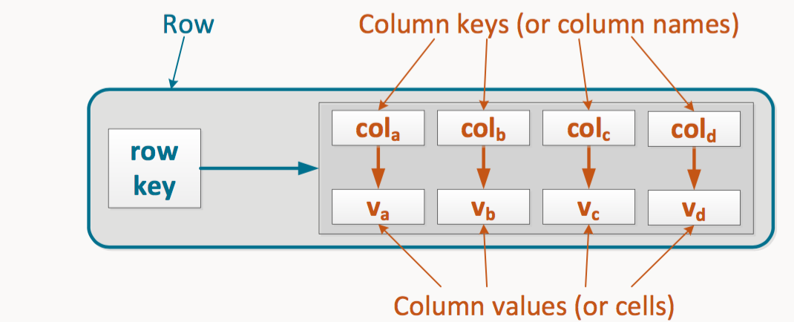
Cassandra rows (NoSQL, 2d key-value store)
Each row's value is a map of "columns" to value. Column names are indexed within the row.
Row key is the hashing key that determines on which nodes the row is stored.
Columns are defined separately for each row!
Details: https://tech.ebayinc.com/engineering/cassandra-data-modeling-best-practices-part-1/

Slide 21
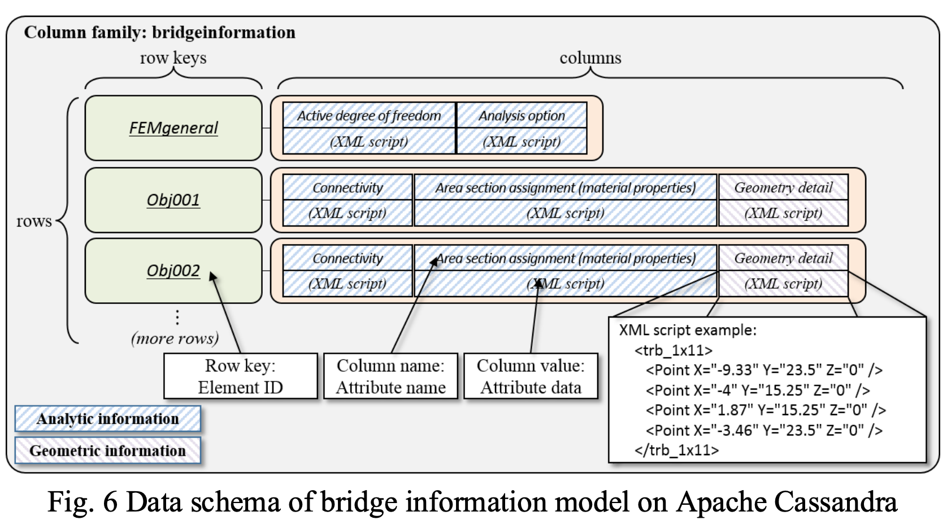
Cassandra bridge information example
https://www.researchgate.net/publication/301630614_A_NoSQL_data_management_infrastructure_for_bridge_monitoring

Slide 22
Cassandra – a “NoSQL database”
Main point: Store huge datasets.
Best used: When you need to store data so huge that it doesn't fit on server, but still want a friendly familiar interface to it.
For example: Web analytics, to count hits by hour, by browser, by IP, etc. Transaction logging. Data collection from huge sensor arrays.

Slide 23
Cassandra (2.0) – a “NoSQL database”
Written in: Java
Main point: Store huge datasets in "almost" SQL
License: Apache
Protocol: CQL3 & Thrift
CQL3 is very similar to SQL, but with some limitations that come from the scalability (most notably: no JOINs, no aggregate functions.)
Querying by key, or key range (secondary indices are also available)
Tunable trade-offs for distribution and replication (N, R, W)
Data can have expiration (set on INSERT).
Writes can be much faster than reads (when reads are disk-bound)
Map/reduce possible with Apache Hadoop
All nodes are similar, as opposed to Hadoop/HBase
Very good and reliable cross-datacenter replication
Distributed counter datatype.
You can write triggers in Java.
Best used: When you need to store data so huge that it doesn't fit on one server, but still want a friendly familiar interface to it.
For example: Web analytics, to count hits by hour, by browser, by IP, etc. Transaction logging. Data collection from huge sensor arrays.

Slide 24
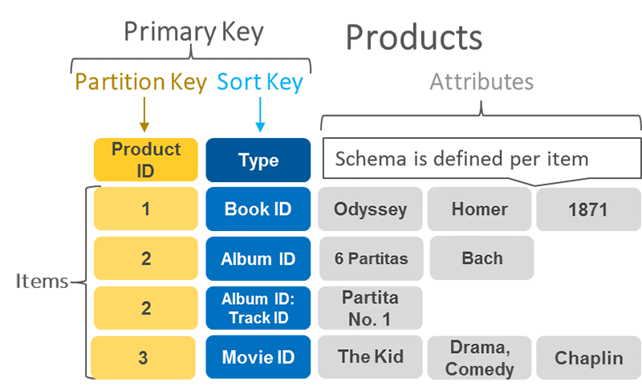
DynamoDB is a 2D key-value store, like Cassandra
Partition Key (like Cassandra's row key) is hashed to find partition.
Sort Key (optional) allows efficient range queries within the partition key.
  Together, the Partition and Sort keys form the Primary Key.
Attributes are key-value pairs stored under the Primary Key.
Reference: https://aws.amazon.com/blogs/database/choosing-the-right-dynamodb-partition-key/
Compare to Cassandra:

Slide 25
Redis DB/cache values
All data is stored in RAM (not just disk), for high performance.
Redis understands many types of data values:
  allows operations like "add to a set" that modify (or get) part of a value.

Slide 26
Distributed Caches
For example: Redis, Memcached, ElastiCache, Riak
Originally developed in order to reduce load on relational databases.
  Cache responses to frequent DB requests or other materialized application data.
  Always support timed expiration of data.
Use the same basic key-value abstraction as NoSQL distributed DBs.
Store data across many nodes.
Have the same data consistency issues as NoSQL databases.
Often optimized to do everything in-memory,
  but most also store data persistently to disk.
So… distributed caches and NoSQL databases are very similar.

Slide 27
Comparison
NoSQL Database
Distributed Cache
Items are permanent/persistent.
All items are stored on disk (some are cached in RAM).
Scale is the primary goal.
Items expire.
Items are stored in RAM
(though maybe persisted to disk).
Speed is the primary goal.
RAM capacity is limited.
  Once capacity is reached, start evicting oldest/least-used items.

Slide 28
Comparison
CDN / Reverse Proxy Cache
Distributed Cache
Cache common HTTP responses.
Transparent to the application.
Just configure the cache's origin
Cache common's used data that contributes to responses.
For example:
  A leaderboard in header of ever HTML page.
  Session information for the user.

Slide 29
Redis (V3.2) – a “cache”
Main point: Blazing fast storage.
Best used: For rapidly changing data with a foreseeable database size (should fit mostly in memory). Also, for caching data than can be rebuilt from another data store.
For example: To store real-time stock prices. Real-time analytics. Leaderboards. Real-time communication. And wherever you used memcached before.

Slide 30
Redis (V3.2) – a “cache”
Written in: C
Main point: Blazing fast
License: BSD
Protocol: Telnet-like, binary safe
Disk-backed in-memory database,
Master-slave replication, automatic failover
Simple values or data structures by keys
but complex operations like ZREVRANGEBYSCORE.
INCR & co (good for rate limiting or statistics)
Bit and bitfield operations (eg. to implement bloom filters)
Has sets (also union/diff/inter)
Has lists (also a queue; blocking pop)
Has hashes (objects of multiple fields)
Sorted sets (high score table, good for range queries)
Lua scripting capabilities
Has transactions
Values can be set to expire (as in a cache)
Pub/Sub lets you implement messaging
GEO API to query by radius (!)
Best used: For rapidly changing data with a foreseeable database size (should fit mostly in memory).
For example: To store real-time stock prices. Real-time analytics. Leaderboards. Real-time communication. And wherever you used memcached before.

Slide 31
Filesystem choices
Data store | Examples | Data abstraction
SQL Relational DB | MySQL, Oracle | Tables, rows, columns
Column-oriented DB | Snowflake, BigQuery | Tables, rows, columns
Search engine | Elastic search | JSON, text
Document store | MongoDB | Key → JSON
Distributed cache | Redis | Key → value (lists, sets, etc.)
NoSQL DB | Cassandra, Dynamo | 2D Key-value (pseudo-cols)
Cloud object store | S3, Azure Blobs | K-V / Filename-contents
Cluster filesystem | Hadoop dist. fs. | K-V / Filename-contents
Networked filesystem | NFS, EFS, EBS | Filename-contents
Files with arbitrary data

Slide 32
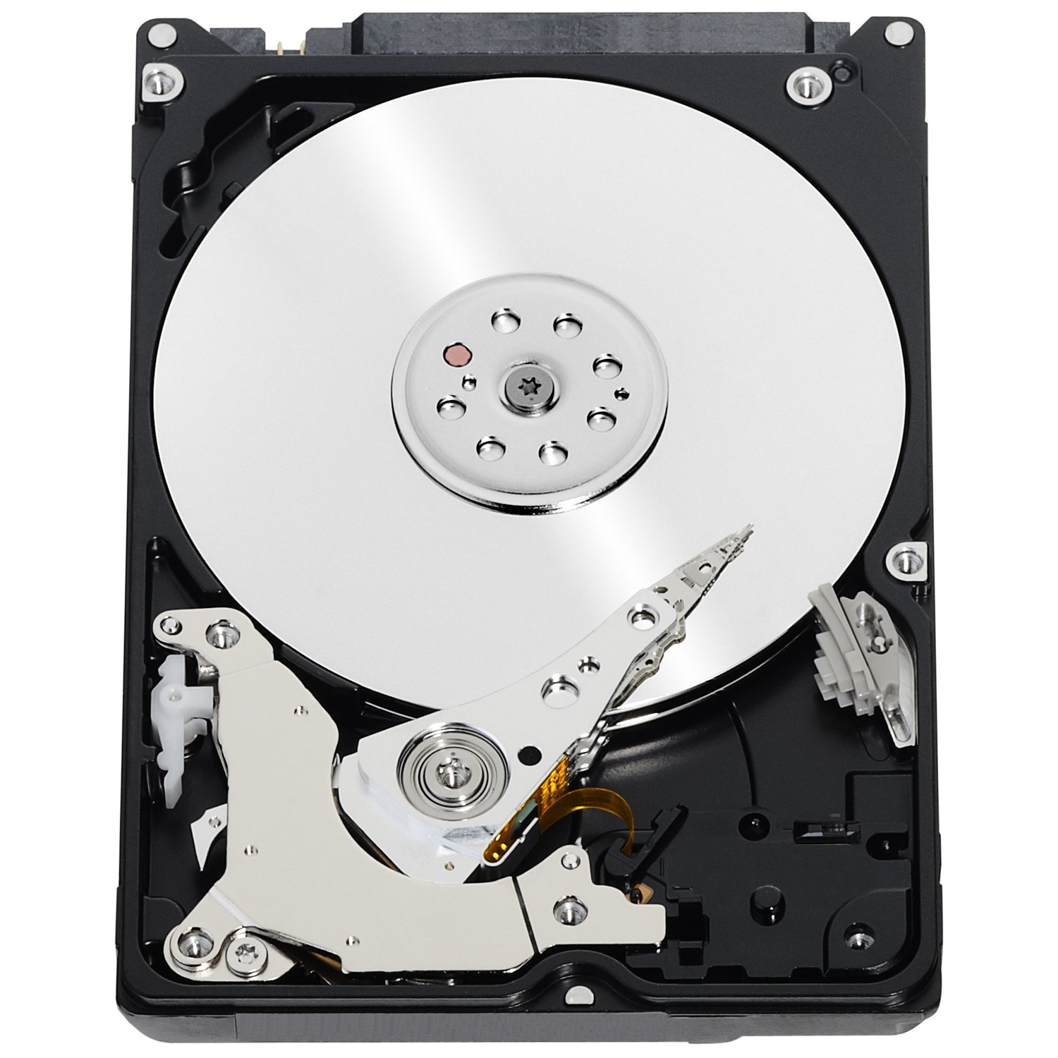
Networked file system
App Server
Some folders map to a remote filesystem
App
Eg., NFS (unix), SMB (Windows).
Managed by the OS.
Provides a regular filesystem interface to applications by mounting the remote drive.
Not too useful in modern applications, but may be necessary if your app is built to work directly with a local file system.
Modern apps should instead interact with cloud-based storage services.
Filesystem
~/out.txt /mnt/nfs-client/ibdata1
OS NFS module
Network request
File Server
NFS service
Filesystem
/var/lib/nfs-server/ibdata1

Slide 33
Cloud object store (S3)
A flexible general-purpose file store for cloud apps.
Managed by cloud provider. Capacity available is "unlimited."
Provides a network API for accessing files (maybe REST).
In other words, app accesses files like a remote database.
Often provides a public HTTP GET interface to access files:
  Can be easily connected to CDN or urls used directly

Slide 34
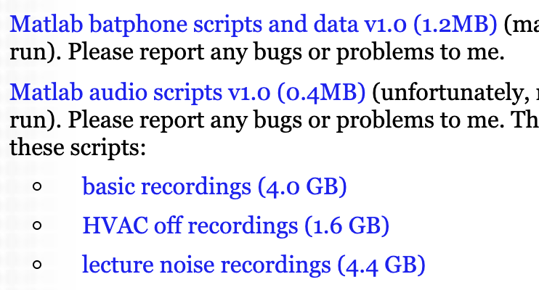
S3 example for hosting media files on web
https://stevetarzia.com/localization
HTML:
<li><p><a href="mobisys11_batphone_v1.0.tar.gz">Matlab batphone scripts and data v1.0 (1.2MB)</a> (may require some toolkits to run). Please report any bugs or problems to me.</li>
<li><p><a href="mobisys11_scripts_v1.0.tar.gz">Matlab audio scripts v1.0 (0.4MB)</a> (unfortunately, requires several toolkits to run). Please report any bugs or problems to me. The following data is needed for these scripts:
<ul><li><p><a href="https://s3-us-west-2.amazonaws.com/starzia/www/mobisys11_recordings_passive.tar.gz">basic recordings (4.0 GB)</a>
<li><p><a href="https://s3-us-west-2.amazonaws.com/starzia/www/mobisys11_recordings_HVAC_off.tar.gz">HVAC off recordings (1.6 GB)</a>
<li><p><a href="https://s3-us-west-2.amazonaws.com/starzia/www/mobisys11_recordings_lectures.tar.gz">lecture noise recordings (4.4 GB)</a></ul>
Browser view:

Slide 35
Hadoop File System (HDFS)
When you need to use Hadoop/Spark to do distributed processing.
Data is too big to move it for analysis.
Allows data to reside on the same machines where computation happens, thus making processing efficient.
Hadoop distributed filesystem and its distributed processing tools were designed to work together.

Slide 36
Recap – Choosing a data store
Data store | Examples | Data abstraction
SQL Relational DB | MySQL, Oracle | Tables, rows, columns
Column-oriented DB | Snowflake, BigQuery | Tables, rows, columns
Search engine | Elastic search | JSON, text
Document store | MongoDB | Key → JSON
Distributed cache | Redis | Key → value (lists, sets, etc.)
NoSQL DB | Cassandra, Dynamo | 2D Key-value (pseudo-cols)
Cloud object store | S3, Azure Blobs | K-V / Filename-contents
Cluster filesystem | Hadoop dist. fs. | K-V / Filename-contents
Networked filesystem | NFS, EFS, EBS | Filename-contents
Highly structured
Semi-structured
Files with data "blobs"
Your choice depends mainly on the structure of data and pattern of access.

