Slide 1

CS-310 Scalable Software Architectures
Lecture 14:
Distributed DB Consistency
Steve Tarzia

Slide 2
Last Time: NoSQL databases
Data partitioning is necessary to divide write load among nodes.
  Should minimize references between partitions.
  Can be treated as a graph partitioning problem.
  SQL sharding was a special case of data partitioning, done in app code.
NoSQL databases make partitioning easy by eliminating references.
Without references, data becomes denormalized.
  Duplicated data consumes more space, can become inconsistent.
Distributed NoSQL databases are very scalable, but they provide only a very simple key-value abstraction. One key is indexed.
Distributed Hash Table can implement a NoSQL database.
  The hash space is divided evenly between storage nodes.
  Client computes hash of key to determine which node should store data.

Slide 3

Hash-based partitioning of distributed DB
aka, a Distributed Hash Table.
Each cluster node is responsible for a range of hash values corresponding to
an equal chunk of data
Hash the key to determine
where the (key, value) is stored.
To find data, client must have:
  A list of all nodes.
  hash ranges assigned to each node
Sharing this node/range info is
a distributed consensus problem.
Node 0 stores hash values 00000000-3FFFFFF
Node 3 stores hash values C0000000-FFFFFFF
Node 1 stores
hash values
40000000-7FFFFFF
Node 2 stores hash values 80000000-BFFFFFF

Slide 4
A Shared Nothing architecture
Each request is handled by one node.
  There are no bottlenecks!
Both throughput and capacity
are directly proportional to
the number of nodes.
DHTs can scale to thousands
of nodes.
Node 0 stores hash values 00000000-3FFFFFF
Node 3 stores hash values C0000000-FFFFFFF
Node 1 stores
hash values
40000000-7FFFFFF
But what about reliability?
Node 2 stores hash values 80000000-BFFFFFF

Slide 5
Making the DHT robust
Node 0 is assigned the hash values 00000000-3FFFFFF, but also stores replicas of data for the two next partitions.
Having Many nodes means a high chance of a node failure, so we must replicate data to avoid data loss.
Create some overlap in the hash ranges covered by nodes.
  Node 0: 0-7
  Node 1: 3-F
  Node 2: 0-3 and 8-F
  Node 3: 0-7 and C-F
Other schemes are possible,
but this one is simple and effective.
0
3
40000000-7FFFFFF is also on Node 0
1
2
80000000-BFFFFFF is also on Node 0

Slide 6
Consistency
Whenever data is replicated, there is a possibility of inconsistency.
  Eg., an update was sent to three replicas, and one of them gets it first:
What happens if we try to read while replicas are inconsistent?
Put x=2
Communication and queueing delays are unpredictable. We can send messages, but don’t know exactly when they’ll arrive.
Got it! x=2
Didn’t get the change yet, still think x=1
Get x
2
1
1
Query returns inconsistent answers!

Slide 7
CAP Theorem
The most famous result in distributed systems theory.
It says that a distributed system cannot achieve all three of the following:
Consistency: reads always get the most recent write (or an error).
Availability: every request received a non-error response.
Partition tolerance: an arbitrary number of messages between nodes can be dropped (or delayed).
In other words:
When distributed DB nodes are out-of-sync (partitioned), we must either accept inconsistent responses or wait for the nodes to resynchronize.
To build a distributed DB where every request immediately gets a response that is globally correct, we need a network that is 100% reliable and has no delay.
"Pick Two"

Slide 8
Client-centric consistency models
The CAP theorem gives us a tradeoff between consistency & delay.
Inconsistency is bothersome. It can cause weird bugs.
Fortunately, delay is usually something our apps can handle.
If we really need both consistency and timeliness, then we must go back to a centralized database (probably a SQL relational DB).
Distributed (NoSQL) DB designs give different options for handling the consistency/delay tradeoff.
We'll consider a client connecting to the DB cluster.
What consistency properties might we want to ensure?
STOP
and
THINK

Slide 9
Client-centric consistency properties
"More recently written" can include any write by another client.
Monotonic Reads
If a client reads the value of x, later reads of x by that same client will always return the same value or a more recently written value.
Read your Writes
If a client writes a value to x, later reads of x by that same client will always return the same value or a more recently written value.
Monotonic Writes
If a client writes twice to x, the first write must happen before the second.

Slide 10
Failing the Monotonic Read property
Distributed DB
Definition of Monotonic Reads:
If a client reads the value of x, later reads of x by that same client will always return the same value or a more recently written value.
How might it fail?
Read from two different nodes during an incomplete write.
Client
2
1
Get x
Get x
Put x=1
3
Write has not yet reached replica.
STOP
and
THINK
How to prevent this problem?
Make client connect to same node for every request.
Or delay the second request…

Slide 11
Failing to Read your Writes
Distributed DB
Definition of Read your Writes:
If a client writes a value to x, later reads of x by that same client will always return the same value or a more recently written value.
If the system allows you to write on one node and read from another, you can get the old value if you read too quickly.
Again, to fix this problem, stick with one node or "slow down."
Client
Put x=1
Get x
Write has not yet reached replica.
STOP
and
THINK

Slide 12
Failing the Monotonic Writes property
Distributed DB
Definition of Monotonic Writes:
If a client writes twice to x,
the first write must happen before
the second.
The second write can occur on
a node before the first arrives.
Does this matter?
  Not unless the writes are cumulative. (eg., an increment operation)
  Note that including a sequence number or timestamp would prevent the delayed write x=1 from being accepted on the third node.
Solution: same as before.
Client
1
Put x=1
Put x=2
Write has not yet reached replica.
STOP
and
THINK
2

Slide 13
Two alternatives for achieving Consistency
Set some rules for client and replication behavior to achieve consistency.
Make client send all requests to one replica node.
  Pro: Simplicity.
  Con: Consistency problems arise when a node fails.
    Client must switch to another node, and the consistency problems are again possible.
    Note: if don't care about fault tolerance, then avoid replication to get consistency.
    MongoDB does not replicate data and thus has Consistency and Partition Tolerance but lacks Availability because a failed node causes downtime (CAP).
Make client wait until the the read or write is synchronized across the whole system.
  For efficiency, we only care about the single key/value being synchronized.
  How do we know when the value is synchronized?
  Simplest approach is for the client to send the request to all nodes and wait!
STOP
and
THINK

Slide 14
Waiting for Consistency
Monotonic Read:
Read your Write:
Client
2
Client
1
1
Get x
Put x=1
Wait until all three give the same value.
Put x=1
Wait until all acknowledge the write.
Write is slow to reach last replica.
3
2
Get x
Get x
Second get has been delayed enough to get the new value
Get has been delayed enough to get the new value

Slide 15
Waiting for Consistency with Quorums
A set of solutions for consistency in distributed DBs.
  A quorum is a minimum percentage of a committee needed to act.
Wait for an acknowledgement of consistent data from a certain number of replicas before considering the read/write completed.
  Prevents progress until the replicas have a certain degree of consistency.
  We send requests to all nodes but wait for the prescribed # of responses.
Write Quorum | Read Quorum | Optimized for
All | One | Fast reads
Majority | Majority | Balanced read/write performance
One | All | Fast writes

Slide 16
Majority-read, majority-write example (three nodes)
Client wants to write X=1.
  Sends three write requests to three replicas.
  When an acknowledgement from two replicas is received it can proceed.
  The third/last write proceeds in the background.
Client reads X
  Sends three read requests to three replicas.
  At this point, one of the replicas may still have old data, but that’s OK!
  Client will be satisfied when it receives two responses.
  If they're different, use the most recent one.
  (Every write is timestamped by the client.)
Because writes are not finished until at least two acknowledge, there is at most one old value being stored. At least one of two must be new.

Slide 17
Single-read, unanimous-write example
Client wants to write X=1.
  Sends three write requests to three replicas.
  Must wait until all three replicas acknowledge before proceeding.
Client reads X
  Sends three read requests to three replicas.
  At this point, all three replicas must have received my previous write!
  Client will be satisfied when it receives any one response.
  Note that the responses from different nodes may be different (due to partial writes from other clients), but all will reflect data state after my own write.
    Choose the latest value.
Notice that writes are slow (max latency of the 3),
but reads are fast (min latency of the 3).

Slide 18
Question: What happens if a DHT replica fails?
Example 1: write and read quorum of two (of three replicas).
Client performs a write, gets two ACKs and proceeds.
At this point, replicas store two new values, and one old value.
Now one of the written-to replicas fails!
Can read and writes proceed?
Yes. Two different values will be read, but client can choose the most recent one.
The 3rd write will eventually be received, and two copies made available.
Put x=2
Boom!
Got it! x=2
Got it! x=2
Didn’t get the change yet, still think x=1
Replacement joins ASAP and requests lost data from replicas

Slide 19
Question: What happens if a DHT replica fails?
Example 2: write quorum of three
(read quorum of one)
A replica fails!
Can reads and writes proceed?
Client performs a write, and cannot get three ACKs.
  Write is impossible! (but reads can proceed)
  Part of the system is stalled, temporarily.
The write can be retried after a replacement joins the DHT and gets copies of all the data.
Put x=2
Boom!
No one to receive?!
Got it! x=2
Got it! x=2
Replacement joins ASAP and requests lost data from replicas

Slide 20
Reminder: Why is this scalable?
My consistency examples showed only three nodes == three replicas.
This was not a scalable system because all nodes stored all data.
In practice you can have a very large number N of nodes, and a constant number of replicas for each data key.
Hashing will map each data key to a subset (often 3) of the N nodes.
Quorum only apply to replica nodes. "Write to all" means all replicas (3 nodes).
Why use more than 3 replicas?
Put z=7
Put x=2
Put y=5
Get z
Get x
Get y
Distributed DB

Slide 21
Another way of looking at consistency
A distributed system is linearizable if the partial ordering of distributed actions is preserved.
  The distributed actors each know the order of their own actions.
  This certain knowledge must never be contradicted by the distributed system.
  This creates a partial ordering of all the events in the distributed system
For example:
  if Anita does A, B, C (in that order)
  and Sam does S, T, U, (in that order)
  Then no one should see B before A, nor U before T, etc.
Every observed serialization of the parallel activity must be agreeable to the individual actors. Observations will vary across the system.
  There are all valid: (A, B, C, S, T, U) (S, A, B, T, U, C) (S, T, U, A, B, C)
These happen concurrently

Slide 22
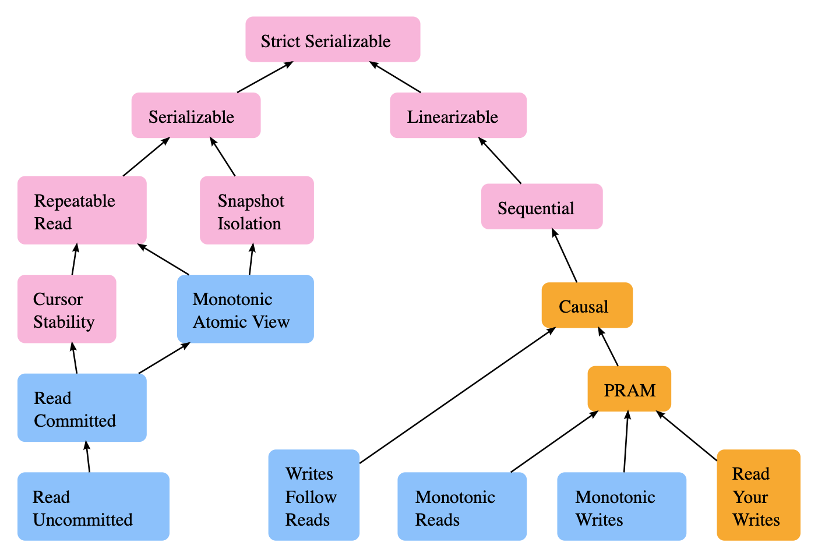
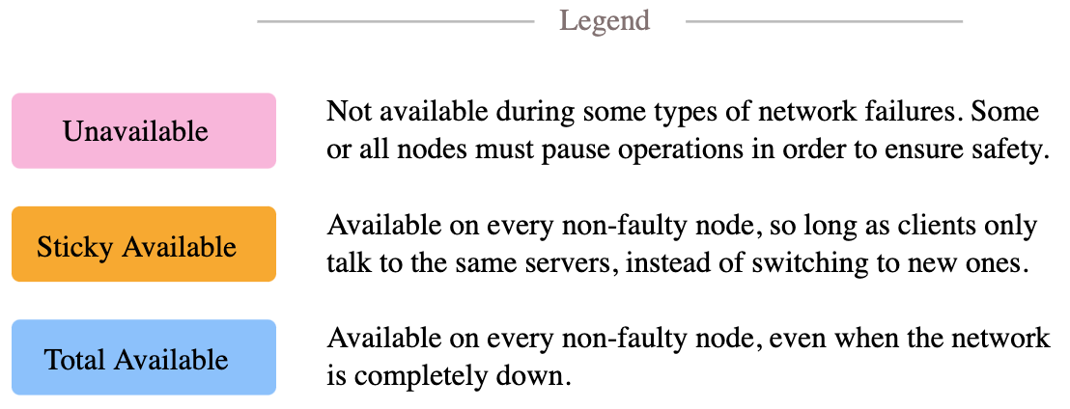
Consistency is a subtle topic, with many models.

Slide 23
For more info on this fascinating topic
CS-345 Distributed Systems
Chapter 7 of Distributed Systems by van Steen and Tanenbaum.
Part II (and Chapter 9 in particular) of the Designing Data Intensive Applications book by Kleppmann.
  We covered the client-centric view of consistency.
  Other models take a data-centric view.
It’s a nice mixture of CS theory and real system design.

Slide 24
NoSQL databases use DHTs or similar schemes
Amazon DynamoDB
Apache Cassandra
ElasticSearch
MongoDB (hashed sharding option)
Distributed filesystems can also use DHTs
Filename/path is the key.
Value is the file’s contents.
Hadoop HDFS, Google File System (Colossus, BigTable), Amazon S3

Slide 25
Recap: Distributed DB Consistency
Replication of data ensures that a single failure does not lose data.
  The more nodes you have, the more likely a failure!
However, replication introduces consistency problems.
  Tradeoff: must choose 2 of Consistency, Availability and Partition Tolerance.
A distributed DB client, at very least, would want to achieve:
  Montonic reads, monotonic writes, read your writes (together: linearizability).
Ensure consistency by waiting for responses from multiple replicas.
Different quorum levels (all, majority, one) trade delay of reads/writes and determine whether reads or writes are unavailable during recovery.
  Cassandra DB lets programmer choose the quorum level for each read/write.
  Other NoSQL databases are designed to use just one read/write strategy.

