Slide 1

CS-310 Scalable Software Architectures
Lecture 13:
Distributed NoSQL Databases
Steve Tarzia

Slide 2
Last Time: Push Notifications
Traditional web/app design uses a client-server model, but sometimes we want to push data to client instead of client always pulling.
Asynchronously sending data to clients can be a challenge.
Mobile OSes have special push notification services.
  Allows a single connection to be shared by all apps on the phone.
  Allows notifications to be delivered even if app is not running.
Web browsers can use Websockets or Long-polling.
  In both cases, client is connected to one machine and service must somehow relay messages to that connection.

Slide 3
Recall from Lecture 9: Scaling SQL Databases
Read replicas horizontally scale databases for reading.
  Writes are done in one place and propagated to many replicas.
  Data on a given replica may lag behind master, but it's self-consistent.
  Works well if writes are much less common than reads.
Horizontal scaling of writes suggests data partitioning.
  Each data row/element is assigned a single "home" (or a constant number).
  If not, each node must accept all writes, which is not scalable.
Sharding is data partitioning for SQL/relational DBs.
  Works well for queries that can be handled within a single shard.
  Sharding divides data along just one dimension, so inevitably some queries will involve all the nodes, and thus will not be scalable.

Slide 4
Review of Sharding:
Splits data among many machines.
Accept writes on all machines.
But the data partitioning is done manually.
  Programmer chooses a sharding key or rule, and to write code that joins results from the different shards.
Works well for queries that can be handled within a single shard.
If we keep the relational model, with normalized data, many queries will involve all the nodes, so scaling is limited.
NoSQL databases all solve this problem by denormalizing data, meaning that data is duplicated to isolate queries to one node.

Slide 5
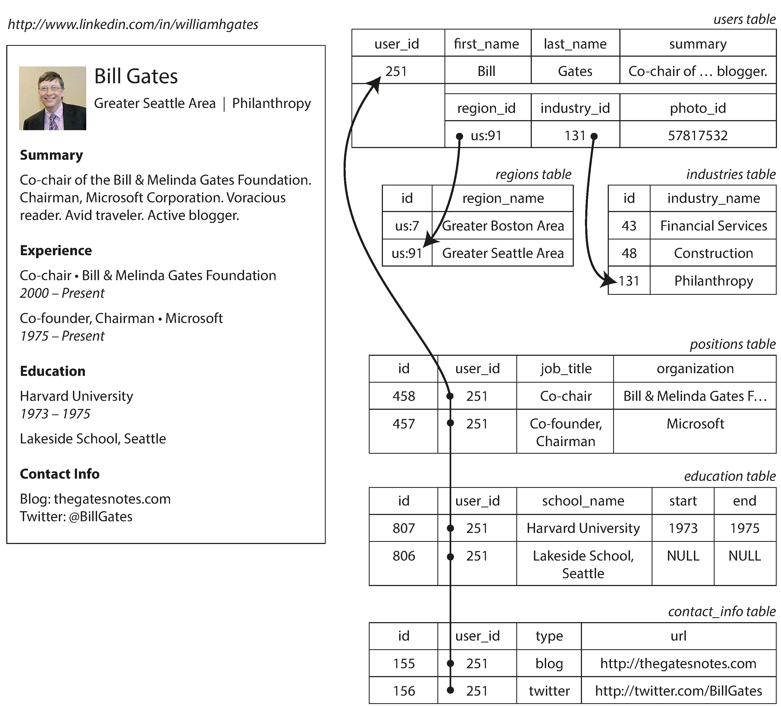
Normalized data
A normalized relational database has no duplication of data.
References (foreign keys) point to shared data.
Eg., at right, the Philanthropy industry is shared by many LinkedIn users.
  In effect, many users are related to each other by all being linked to that industry
To optimally partition the rows into shards, we could solve a balanced graph partitioning problem.
… line wrapped

Slide 6
Graph partitioning model for DB sharding
Partition 1
Partition 2
Nodes represent database rows.
Edges represent references (foreign keys)
Task: assign the rows to shards
(partition the nodes),
Such that:
Total edges between partitions is minimized.
  (Need to fetch data from another shard for a JOIN is minimized.)
Nodes per partition is roughly balanced.
  (Data stored on each shard is balanced.)
Edges between partitions imply data transfers between nodes.
Reference: Facebook's social graph sharding: https://www.usenix.org/conference/atc13/technical-sessions/presentation/bronson

Slide 7
Partitioning challenges
Partition 1
Partition 2
Solving this problem is NP-complete.
(But we can approximately solve it fairly well.)
This model's cost function is too simplistic:
  Some rows are fetched more often.
  An edge can pull data transitively from lots of nodes. Ie., the cost of a reference can vary dramatically.
Even with an optimal partitioning, we still have data references between partitions.
How does the data (graph structure) affect the solution quality?
  Random interconnections hurt.
  Nodes with high degree (many edges) hurt.
  Structured, independent relationships are easy.
  Nodes with one edge (spurs) are easy.
STOP
and
THINK
Edges between partitions imply data transfers between nodes.

Slide 8
The jump from SQL to NoSQL
SQL sharding
Eliminating the edges (references) would make the data partitioning problem trivial!
Foreign keys (references) and JOINs (dereferences) are fundamental to SQL and relational databases.
Removing the ability to create references gives us a NoSQL database.
Instead of following references with JOINs, we store denormalized data, with copies of referenced data.
NoSQL partitioning
Super easy to partition!

Slide 9
From Normalized … to Denormalized Data
SQL
NoSQL
user_id | value
251 | { "first_name": "Bill", "last_name:" "Gates", "summary": "Co-chair of … blogger.", "region": "Greater Seattle Area", "industry": "Philanthropy", "photo_id": 57817532, "positions": [ { "job_title": "Co-chair", "organization": "Bill & Melinda …" }, { "job_title": "Co-founder, Chairman", "organization": "Microsoft" } ], "education": [ { "school_name": "Harvard University", "start": 1973, "end": 1975 } { "school_name": "Lakeside School, …"} ] }
… line wrapped

Slide 10
NoSQL rationale
Why just one column?
Without references, it's impossible to define finite/fixed columns (a schema).
Consider "positions": we don't know how many position columns to add.
Some NoSQL DBs allow multiple columns, but each row can have different columns ("wide columns")
Why just one table?
Some NoSQL DBs allow multiple tables, but since rows can have any format, it's kind of meaningless.
NoSQL DBs are key-value stores.
key | value
user251 | { "first_name": "Bill", "last_name:" "Gates", "summary": "Co-chair of … blogger.", "region": "Greater Seattle Area", "industry": "Philanthropy", "photo_id": 57817532, "positions": [ { "job_title": "Co-chair", "organization": "Bill & Melinda …" }, { "job_title": "Co-founder, Chairman", "organization": "Microsoft" } ], "education": [ { "school_name": "Harvard University", "start": 1973, "end": 1975 } { "school_name": "Lakeside School, …"} ] }
user444 | { first_name: "Steve", last_name: "Tarzia",
One key is indexed.
Precise format of value varies by NoSQL DB type.

Slide 11
Hashing is the basis of distributed NoSQL DBs
A hash is an algorithm that takes a value and returns a pseudo-random value derived from it.
It’s a constant but unpredictable mapping
  A long sequence of arithmetic operations
MD5 is a standard hash function:
  “Steve” → f6e997429bf8cb7b3b98b310a9f7ca30
  “steve” → 2666b87c682f5072f62bab0955d485ce
  “Janice” → 3837607db4754c036425cb1b2a7c8766
  “1” → b026324c6904b2a9cb4b88d6d61c81d1
  “Steve” → f6e997429bf8cb7b3b98b310a9f7ca30
  tale_of_two_cities.txt (806,878 characters)
  → 3ab56b74562a714a5638f94446581977
The same input always gives the same output
Length of the input can vary, but output has fixed length
This hash is case sensitive

Slide 12
Hash Table
Stores (key, value) pairs
  This abstract data type is called a dictionary, or map.
For example:
  A word and its definition.
    “word” → “a single distinct meaningful element of speech or writing, …”
    “hash” → “a dish of cooked meat cut into small pieces and cooked again, …”
  A database table’s primary key and the rest of the columns in the row:
    StaffID → [StfFirstName, StfLastName, StfStreetAddress, StfCity, StfState, ...]
    98005 → [“Suzanne”, “Viescas”, “15127 NE 24th, #383”, …]
    98007 → [“Gary”, “Hallmark”, “Route 2, Box 203B”, …]
key
value

Slide 13
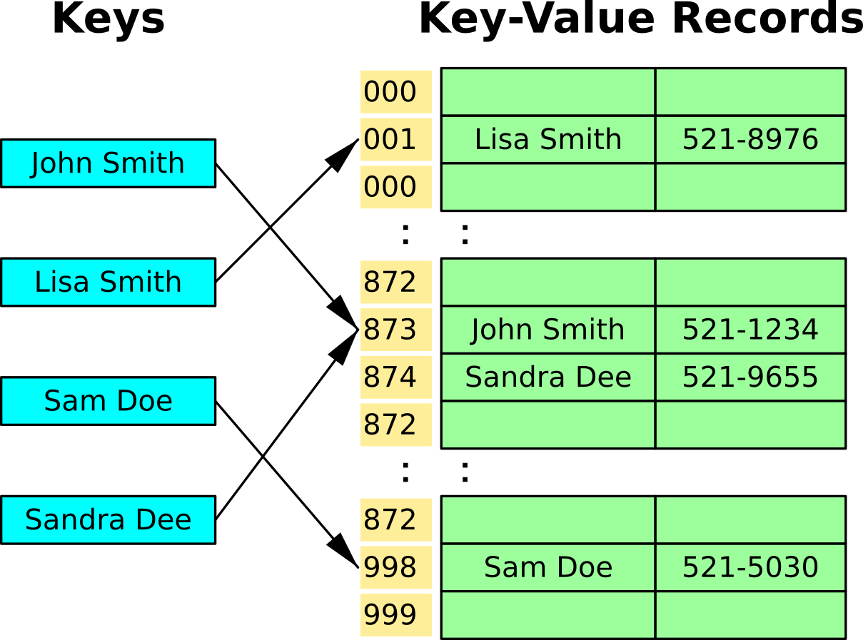
Hash Table mechanics
Hash the key to determine the address where the value is stored
If the address is already filled, then use the next open slot
  This is called a collision and there are other strategies besides “linear probing”

Slide 14
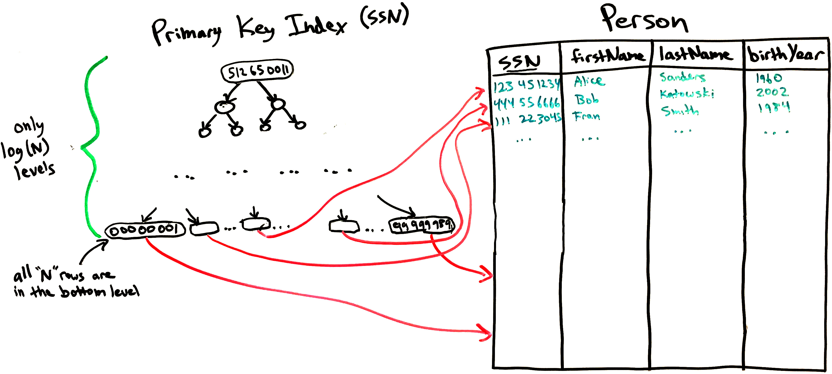
Hash Indexes in SQL databases
A hash table is an alternative to a search tree
  It lets you find the data in one step!
  However, it does not support efficient range queries.
    A hash table scatters data randomly, so walking though a range is difficult.
Tree-based table index
Hash-based table index

Slide 15

Distributed Hash Table
Each cluster node is responsible for a range of hash values
Each client gets the list of nodes and the range assigned to each.
When querying for a key's value, client computes the key hash to determine which node to query for the data:
Hash of the key partitions the data
Node 1 stores hash values 000-332
Node 2 stores hash values 333-665
Node 3 stores hash values 666-999

Slide 16
DHT is a NoSQL database
NoSQL databases are distributed key-value stores
Like one big table with just a primary key
They have a map/dictionary interface, do not support SQL queries.
  You can only:
    get a value for a key.
    put a value for a key.
  Each operation only affects the node(s) storing that key
    Very scalable! (can grow large without slowing down)
If we wanted to support full SQL, JOINs would have to pull data from many nodes in the cluster and performance would be slow.
What limits the scalability?
STOP
and
THINK

Slide 17
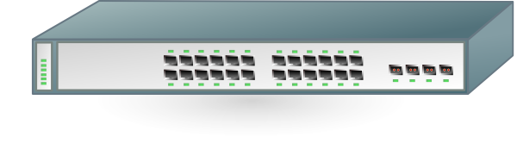
Distributed, shared-nothing architecture
Create a cluster of computers connected to each other.
Each node in the cluster stores a fraction of the data set.
Distributed database examples:
  MongoDB, Cassandra, Amazon DynamoDB, …
Distributed filesystems also use the same basic idea:
  Hadoop HDFS, Google File System (Colossus, BigTable), Amazon S3, …

Slide 18
NoSQL downsides :(
Just one indexed column (the key).
  Because index is built with hash-based partitioning.
Denormalized data is duplicated.
  Wastes space.
  Cannot be edited in one place.
  Eg., "Greater Seattle Area" is repeated in many user profiles instead of "region:91"
References are possible, but:
  Following the reference requires another query, probably to another node.
  There is no constraint checking
  (refs can become invalid after delete).
key | value
user251 | { "first_name": "Bill", "last_name:" "Gates", "summary": "Co-chair of … blogger.", "region": "Greater Seattle Area", "industry": "Philanthropy", "photo_id": 57817532, "positions": [ { "job_title": "Co-chair", "organization": "Bill & Melinda …" }, { "job_title": "Co-founder, Chairman", "organization": "Microsoft" } ], "education": [ { "school_name": "Harvard University", "start": 1973, "end": 1975 } { "school_name": "Lakeside School, …"} ] }
user444 | { "first_name": "Steve", "last_name": "Tarzia",

Slide 19
Normalization thought experiment
key | value
user251 | { "first_name": "Bill", "last_name": "Gates", "summary": "Co-chair of … blogger.", "region": "us:91" "industry": 131 "photo_id": 57817532, "positions": [458, 457], "education": [807, 806] }
reg:us:91 | { "region_name": "Greater Seattle Area" }
ind:131 | { "industry_name": "Pilanthropy"
pos:458 | { "user_id": 251, "job_title": "Co-chair", "organization": "Bill and Melinda Gates …" }
pos:457 | { "user_id": 251, "job_title": "Co-founder, Chairman", "organization": "Microsoft"
edu:807 | { "user_id": 251, "school_name": "Harvard University", "start": 1973, "end": 1975 }
What happens if we try to store normalized data, like this, in a NoSQL database?
Is it possible?
Why isn't it done?
It's possible, but you would need many serial queries to many different DB nodes to fetch the user's profile.
References are not enforced by the schema, so they can become broken.
STOP
and
THINK

Slide 20
Summary
Data partitioning is necessary to divide write load among nodes.
  Should minimize references between partitions.
  Can be treated as a graph partitioning problem.
  SQL sharding was a special case of data partitioning, done in app code.
NoSQL databases make partitioning easy by eliminating references.
Without references, data becomes denormalized.
  Duplicated data consumes more space, can become inconsistent.
NoSQL databases are very scalable, but they provide only a very simple key-value abstraction. One key is indexed.
Distributed Hash Table can implement a NoSQL database.
  The hash space is divided evenly between storage nodes.
  Client computes hash of key to determine which node should store data.

