Slide 1

CS-310 Scalable Software Architectures
Lecture 11:
Basic Architecture Design
Steve Tarzia

Slide 2
Last Time: Authentication
Webservice requests are rarely open to the public.
Each request must include an input that authenticates and identifies the user.
Passwords are the most common auth mechanism.
Email/SMS (a trusted side channel of communication) can be used.
Authentication tokens are strings randomly generated (and stored) on the backend to verify user identity.
  Variations include session keys, cookies, and api keys.
  Often a separate microservice is dedicated to authentication (and other user management tasks, like account creation).

Slide 3
Case Study: National Gun Violence Memorial
https://gunmemorial.org
Java servlet w/JSP, connecting to a SQL database, with S3 for images.
AWS deployment uses these services:
Elastic Beanstalk
EC2: Elastic Compute Cloud (Virtual Machines)
RDS: Relational Database Service
CloudFront (CDN)
Route 53 (DNS)
Simple Email Service (SES)

Slide 4
NGVM architecture diagram
Stripe & Paypal (donation processors)
Email (SMTP) Server
DNS
Web App
(Stateless & Monolithic)
SQL Database
Web Scraper
(run by cron)
gunviolencearchive.org
Web Browser
gunmemorial.org
talk.gunmemorial.org
Discourse App
(open source)
s3.amazonaws.com/gunmemorial-media
media.gunmemorial.org
CDN
S3 file store
SQL Database
S3 file store
Public HTTP
server

Slide 5
Monolithic web app API: Public Pages
HTML pages:
HTML Form and JS endpoints:
GET /
GET /[year]/[mon]/[day]/[name]
GET /[year]/[mon]/[day]
GET /about
GET /search
… etc.
For full list of public pages, see:
http://gunmemorial.org/sitemap.txt
http://gunmemorial.org/sitemap.txt?startYear=2020&endYear=2020
POST /doLightCandle?victim=[id]
POST /doPublicPostPhoto
  Body: multipart/form-data:
    victim (int)
    source (string)
    contact (string)
    mine (boolean)
    grant (boolean)
    sure (boolean)
    file (binary image data)
POST /poll/doAnswerQuestion?...
POST /poll/doModerateQuestion?...
POST /doDonate?
stripeToken=[…]&amount=[cents]
Note that this API's design does not follow REST style. Paths specify actions, not resources.

Slide 6
Monolithic web app API: Volunteers' Portal
HTML pages
HTML Form and JS endpoints:
GET /sign-in (no cookie required, response sets a cookie)
GET /admin
GET /admin/victim_edit.jsp?id=[id]
GET /admin/photo_edit.jsp?photo=[id]
GET /admin/moderate_photos.jsp
GET /admin/moderate_answers.jsp
GET /admin/victim_add.jsp
… etc.
In all these requests, require a cookie to authenticate and identify the user.
POST /admin/doAddVictim?...
  Query params:
    date (YYYY-MM-DD)
    city (string)
    province (two-letter abbreviation)
    name (string)
    gender (string)
POST /admin/doChangePassword?
POST /admin/doChoosePhoto?
POST /admin/doEditPhoto?
POST /admin/doDeleteVictim?
How to rewrite this following REST design principles?
Answer: DELETE /victim/{id}

Slide 7
SQL Database Schema (simplified)
article_link
url_hash
victim (index)
url
title
photo_candidate
id
victim (index)
photo_url
…
Arrows are foreign keys, underlines are primary keys,
other keys described in italics.
volunteer
id
name
email (unique)
passwd_hash
active
…
edit_log
victim (index)
time
author (index)
description
victim
id
name (index)
date (index)
city (index)
province (index)
…
primary_photo
victim
photo
…
photo
id
victim (index)
source_url
source_title
width
height
…
session
id
user
expiry_time
cookie (unique)
moderation
comment (index)
up_or_down
ip_address
…
comment
id
victim (index)
category
comment
ip_address
…
candle
victim (index)
date
ip_address
cookie
unique(victim, date, cookie)
global_property
key
value

Slide 8
S3 File Store details
candidate_photo/[uuid].jpg
photo/[photo_id].jpg
photo_thumb/100/[photo_id].jpg
photo_thumb/400/[photo_id].jpg
photo_thumb/800w/[photo_id].jpg
web_archive/[article_url_md5hash].html
Files have read-only public access at:
https://s3.amazonaws.com/gunmemorial-media/...
https://media.gunmemorial.org/...
Use a randomized uuid to prevent public scan.
100px-tall thumbnail
400px-tall thumbnail
800px-wide thumbnail
Copy of news article HTML (in case original article is taken down).
Served from Virginia.
Using CDN (costs more).

Slide 9
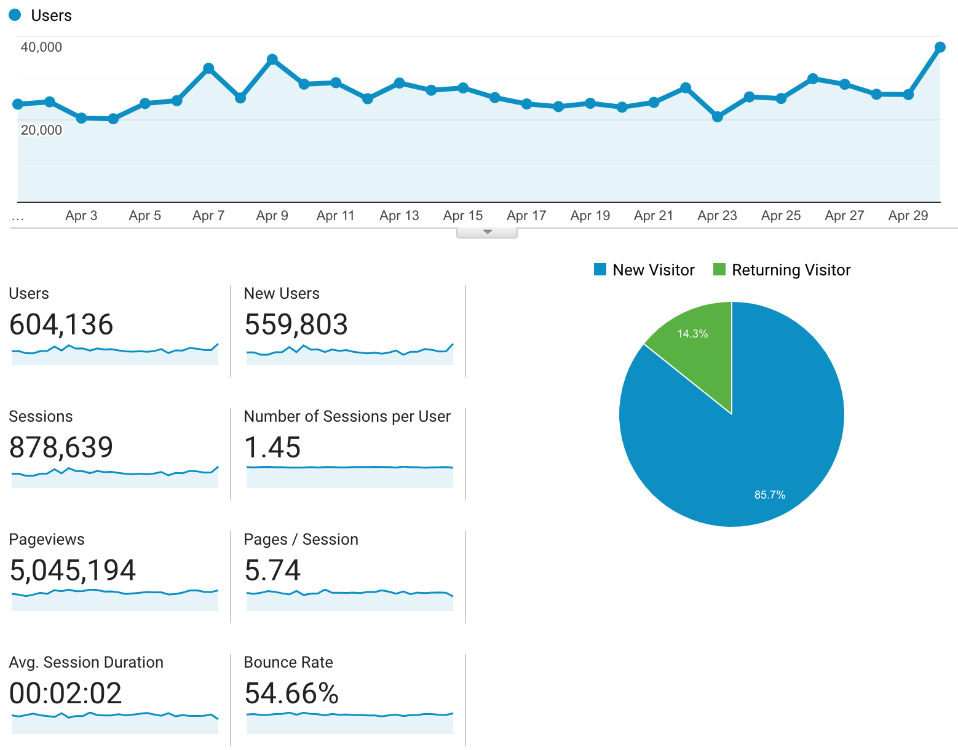
April 2020 monthly operating cost ($136 total)
Traffic: (from Google Analytics).
Typically about 150 users on the site at any given time.
37k pageviews per $ cost

Slide 10
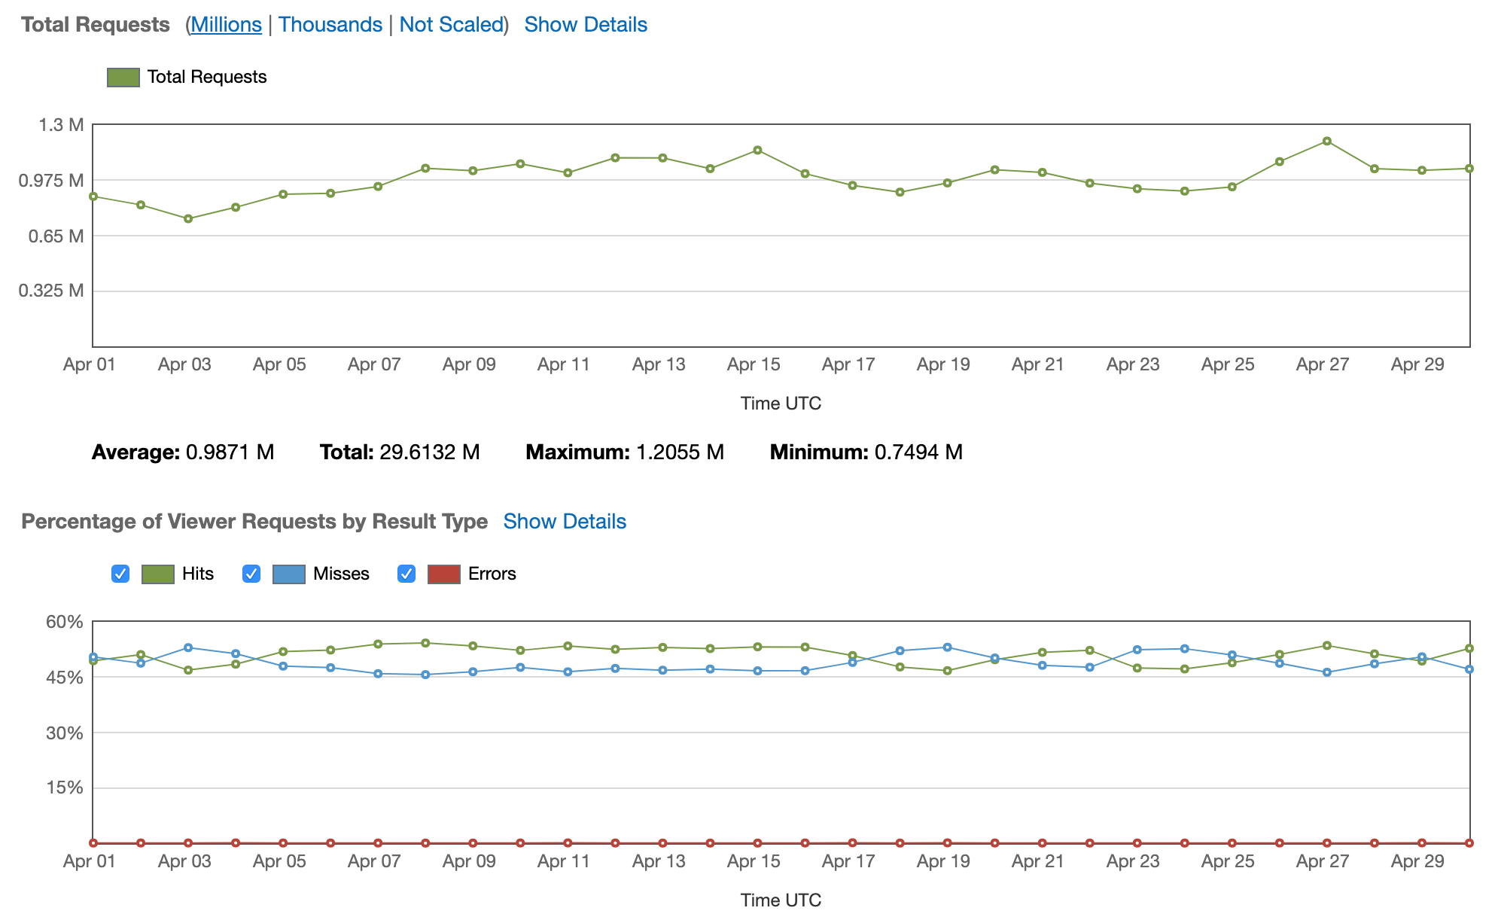
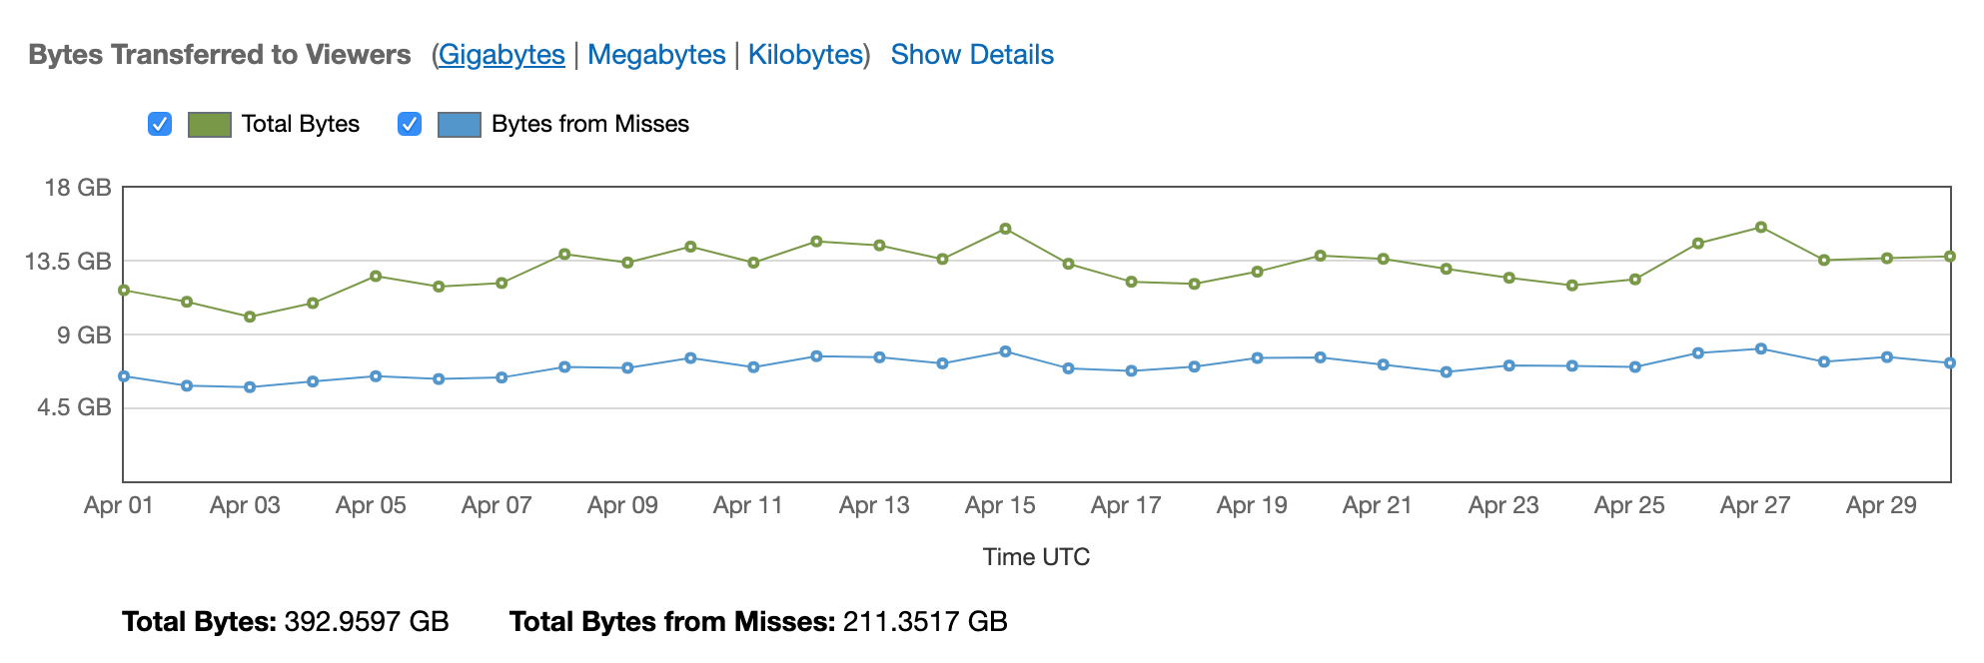
CDN statistics in April

Slide 11
Deployment sizing and monthly costs
Stripe & Paypal (donation processors)
Email (SMTP) Server
DNS
One t2.micro + 9GB = $4
One t3.small + 100GB storage = $29
Web App
(Stateless & Monolithic)
SQL Database
Web Scraper
(run by cron)
gunviolencearchive.org
Web Browser
gunmemorial.org
talk.gunmemorial.org
One t2.nano + 8GB = $2.50
Discourse App
(open source)
s3.amazonaws.com/gunmemorial-media
media.gunmemorial.org
CDN
S3 file store
EC2/RDS instances are reserved for one year to reduce hourly cost
App and its SQL DB share a t2.micro + 35GB storage = $6
SQL Database
S3 file store
Public HTTP
server

Slide 12
Scaling up to 200x traffic (equal to cnn.com)
STOP
and
THINK
Stripe & Paypal (donation processors)
Email (SMTP) Server
DNS
Web App
(Stateless & Monolithic)
SQL Database
Web Scraper
(run by cron)
Web Browser
gunmemorial.org
gunviolencearchive.org
s3.amazonaws.com/gunmemorial-media
media.gunmemorial.org
CDN
S3 file store
Public HTTP
server

Slide 13
Database scaling
Stripe & Paypal (donation processors)
Email (SMTP) Server
Add read-replicas (horizontal)
Use bigger instances (vertical)
Upgrade primary from t3.small → r5d.24xlarge
Web App
(Stateless & Monolithic)
SQL Primary
Web Browser
Web Scraper
(run by cron)
gunmemorial.org
Load balancing lib
Read Replicas
gunviolencearchive.org
s3.amazonaws.com/gunmemorial-media
media.gunmemorial.org
CDN
S3 file store
Public HTTP
server

Slide 14
App scaling
Stripe & Paypal (donation processors)
Email (SMTP) Server
Add lots of app servers and load balancing.
SQL Primary
Web App
(Stateless & Monolithic)
Web Browser
Load Balancer
(reverse proxy)
Web Scraper
(run by cron)
gunmemorial.org
Load balancing lib
Read Replicas
gunviolencearchive.org
s3.amazonaws.com/gunmemorial-media
media.gunmemorial.org
CDN
S3 file store
Public HTTP
server

Slide 15
More front-end caching
Stripe & Paypal (donation processors)
Email (SMTP) Server
CDN in front of web app to cache HTML.
CDN for all media files, even on detail pages.
SQL Primary
Web App
(Stateless & Monolithic)
Web Browser
CDN
Load Balancer
(reverse proxy)
Web Scraper
(run by cron)
gunmemorial.org
Load balancing lib
media.gunmemorial.org
Read Replicas
gunviolencearchive.org
CDN
S3 file store
s3.amazonaws.com/gunmemorial-media
Public HTTP
server

Slide 16
Final scalable design
Stripe & Paypal (donation processors)
Email (SMTP) Server
DNS
SQL Primary
Web App
(Stateless & Monolithic)
Web Browser
CDN
Load Balancer
(reverse proxy)
Web Scraper
(run by cron)
gunmemorial.org
Load balancing lib
media.gunmemorial.org
Read Replicas
gunviolencearchive.org
CDN
S3 file store
s3.amazonaws.com/gunmemorial-media
Public HTTP
server

Slide 17
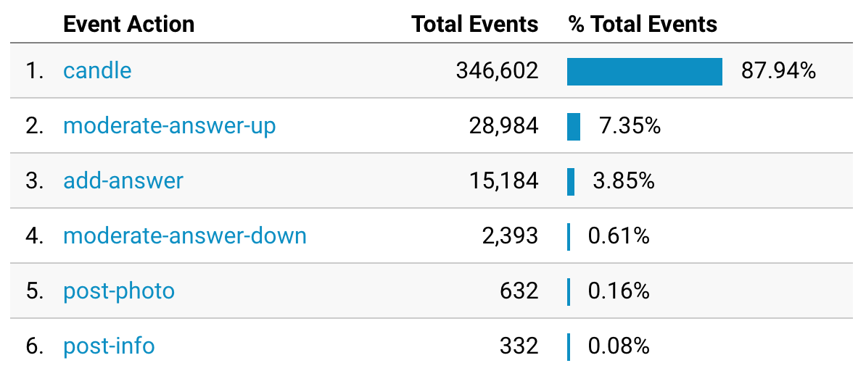
Can a single SQL database handle the write load?
At 200x the load, we'd expect about 400k×200 = 80M events/month
80M/month × 1 month/2.6M sec
≅ 30 DB writes per second
This is definitely achievable:
  Magnetic disk can do ~100 IOPS
  SSD can do > 5,000 IOPS [ref.]
But this is just a theoretical projection. It's better to look at the load in practice…
Month of April UI events (leading to DB writes):
There are also DB writes to add new victims to the database, but this negligible and does not scale with traffic. Visitor actions are the main concern for scaling.

Slide 18
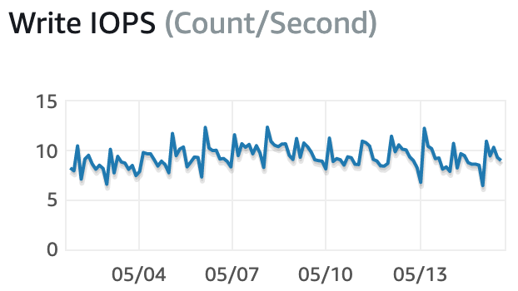
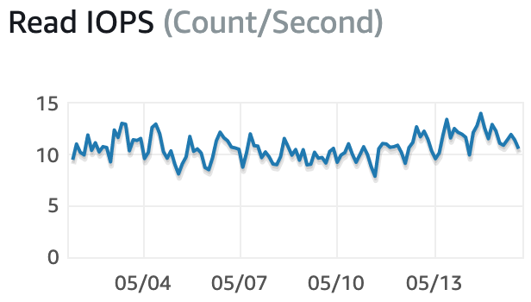
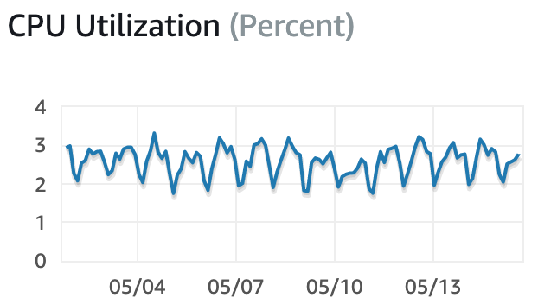
Empirical scaling analysis (real traffic on t3.small)
Data at left is from two weeks in May 2020, running the database on a t3.small instance.
Remember, our goal is to scale traffic by 200x.
AWS allows DB instances with up to 32k IOPS.
  Can a single machine's storage handle 200x the load?
  Yes! 200x more load would be just 2k IOPS.
The biggest DB instance available (r5.24xlarge) has 96 CPU cores instead of just two.
  Can a single machine's CPU handle 200x the load?
  Yes! Two CPU cores can handle 30x more load. 48x more CPU cores might handle 1,400x the load.
On t3.small (two CPU cores)

Slide 19
NGVM is easy to scale. Why?
STOP
and
THINK
Traffic is mostly reads.
Visitors are not logged in.
  There are no personal recommendations or user behavior models.
  Each user gets the same HTML, and responses can be cached in CDN.
Effects of visitor actions (lighting candles, leaving comments) need not be visible immediately to other visitors. Caching is possible.
Users don't interact directly with each other. No user notifications.
Memorial pages are independent of each other.
Data size does not scale with traffic (number of memorial pages is fixed). Legacy.com would be more difficult to scale.
Writes don't involve any transactions.

Slide 20
Recap
Showed NVGM architecture design case study.
It's another article publishing system, so arch is similar to Wikipedia.
  Caching and load balancers on frontend,
  Stateless app,
  SQL DB with read-replicas.
S3 file store was used for large media files (photos).

