Slide 1

CS-310 Scalable Software Architectures
Lecture 08:
Relational Databases
Steve Tarzia

Slide 2
Last Time: Load balancers
2
We have 2/3 of the end-to-end view of a basic scalable architecture!
  (for services, at least)
Frontend: Client connects to “the service” via a load balancer.
  Really, the client is being directed to one of many copies of the service.
  Global LBs (DNS and IP anycast) have no central bottlenecks.
  Local LBs (Reverse Proxy or NAT) provide mid-level scaling and continuous operation (health checks & rolling updates).
Services: Implemented by thousands of clones.
  If the code is stateless then any worker can equally handle any request.
Data Storage??
  The next big topic!
Today’s topic

Slide 3
On to Databases
Will summarize the most important parts of CS-339 or CS-217 in one lecture.

Slide 4
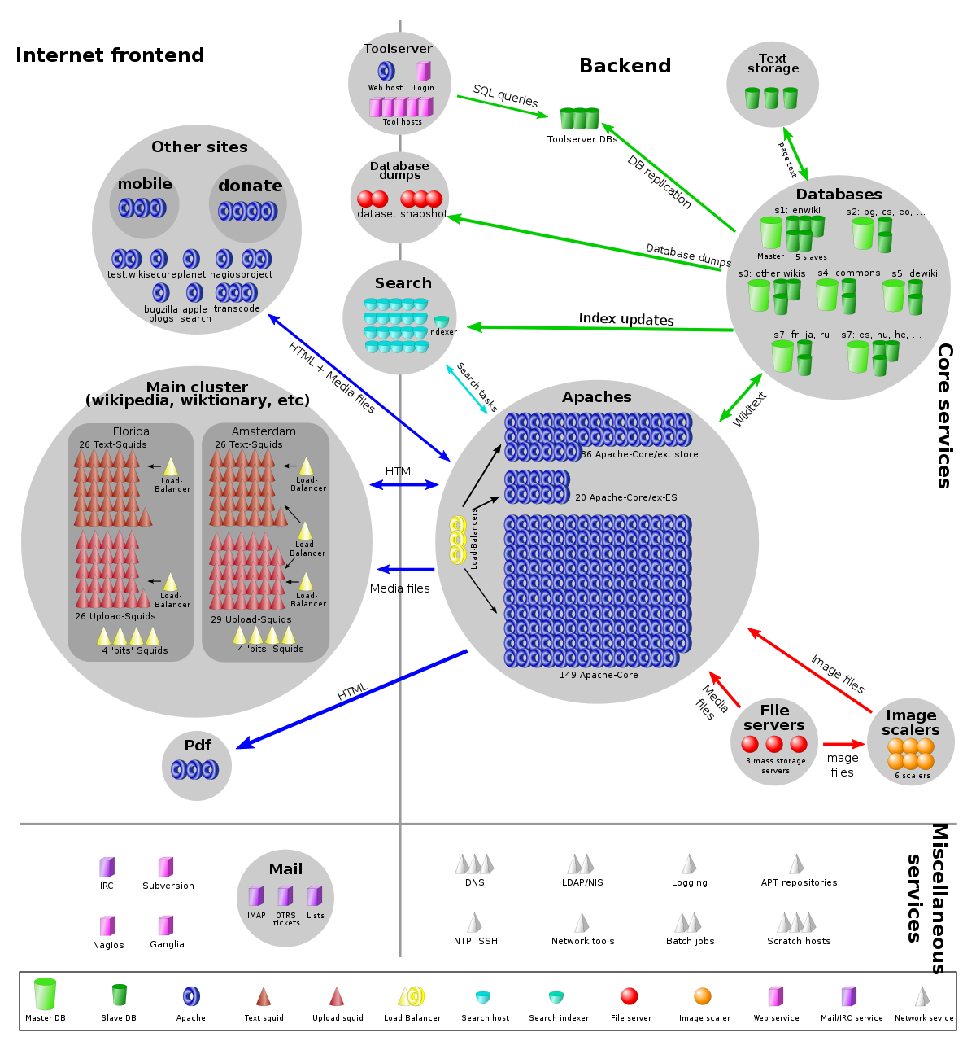
Back to Wikipedia
Recall that we pushed all app state to the DB, allowing MediaWiki app to be stateless and thus trivially parallelizable.
Databases provide both persistent storage
and coordination in large-scale system.
MediaWiki
In general, these are our two biggest scalability challenges and both are the concerns of databases.
Web browser

Slide 5
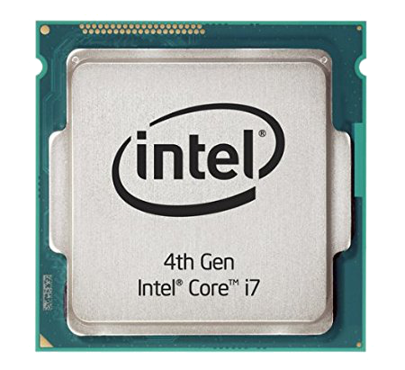
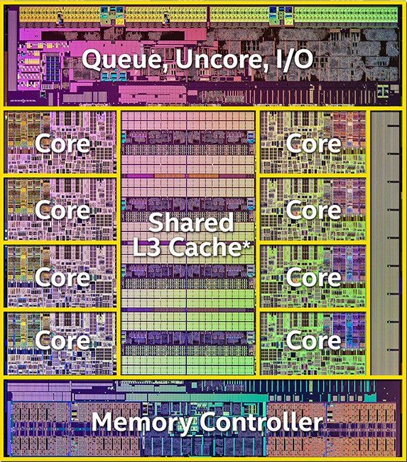
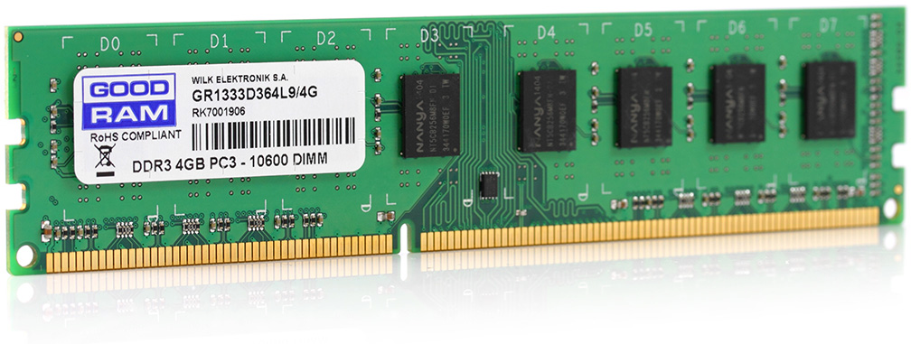
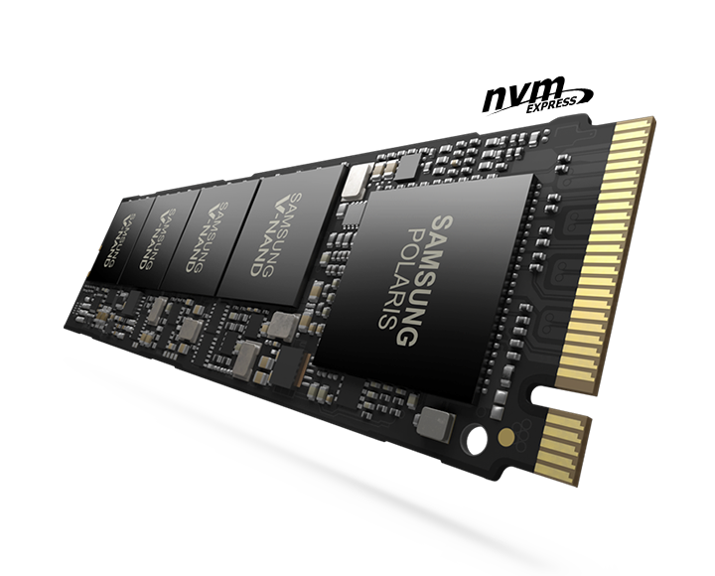
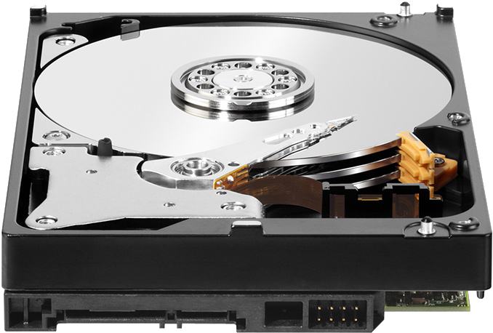
Computers have a hierarchy of storage
delay |  | capacity
0.3ns | CPU Registers | 1 kB (kilobyte)
5ns | CPU Caches (L2) | 16 MB
50ns | Random Access Memory (RAM) | 16 GB
100μs | Flash Storage (SSD) | 1 TB
5ms | Magnetic Disk | 8 TB
Larger, but slower
volatile memory
persistent storage
Disk is about ten billion times larger than registers,
but has about ten million times larger delay (latency).
Goal is to work as much as possible in the top levels.
Large, rarely-needed data is stored at the bottom level

Slide 6
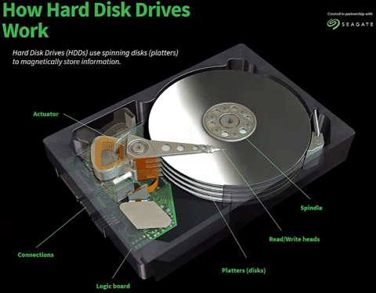
Storage has limited bandwidth
Magnetic disk’s data can only be read at current location of the read/write head.
All types of computer storage are limited to reading/writing just a small fraction at once.
Magnetic disks:
  The read/write head can read the charges on a tiny portion of the magnetic disk.
RAM (memory):
  Memory and flash chips store lots of data, but only a few bytes can be transferred at once, because there are only a couple hundred electrical connections at the edge.
  SSDs (flash) is similar, with even fewer electrical connections.
https://animagraffs.com/hard-disk-drive/
Just a couple hundred electrical connections at the edge of a RAM card.

Slide 7
Redundant Array of Independent Disks (RAID)
Disks have a few shortcomings:
  Limited capacity (~12TB)
  Limited throughput (~150MB/s)
  Likelihood of failure (especially for magnetic/rotating disks)
RAID uses multiple disks to solve these problems
  Many different variations of RAID, depending on your budget and which of the above three problems are most important.
Basic ideas are:
  Increase capacity by making multiple disks available to store data.
  Increase throughput by accessing data in parallel on multiple disks.
  Reduce impact of a disk failure by storing data redundantly on multiple disks.
Disk interface is very simple (just an array of sectors), so it’s easy to create a logical/virtual disk made of sectors from multiple physical disks.

Slide 8
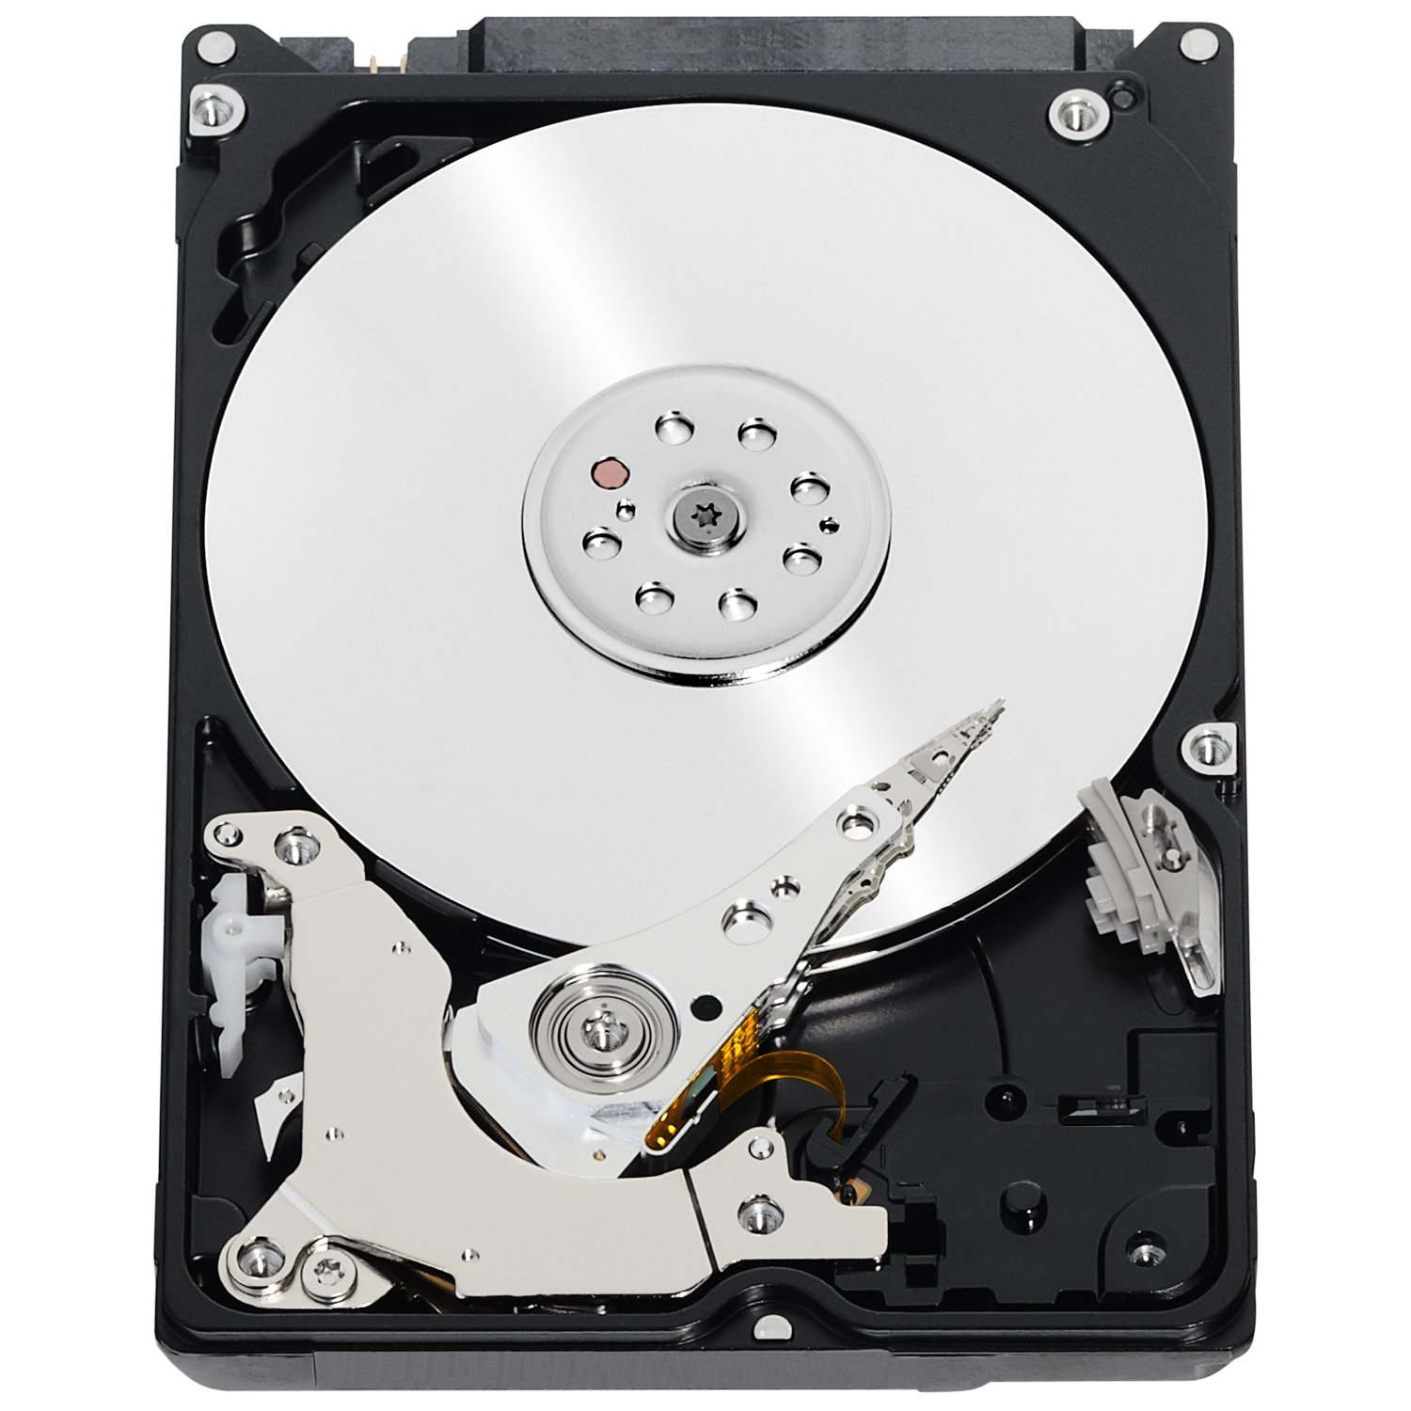

Basic idea of RAID
Combine many disks to create one superior virtual disk.
The RAID array provides the same interface as a single disk.
OS thinks it’s dealing with this:
But it’s just an illusion. The reality is:
Sector r/w requests
Sector r/w requests
RAID virtual disk
RAID controller

Slide 9
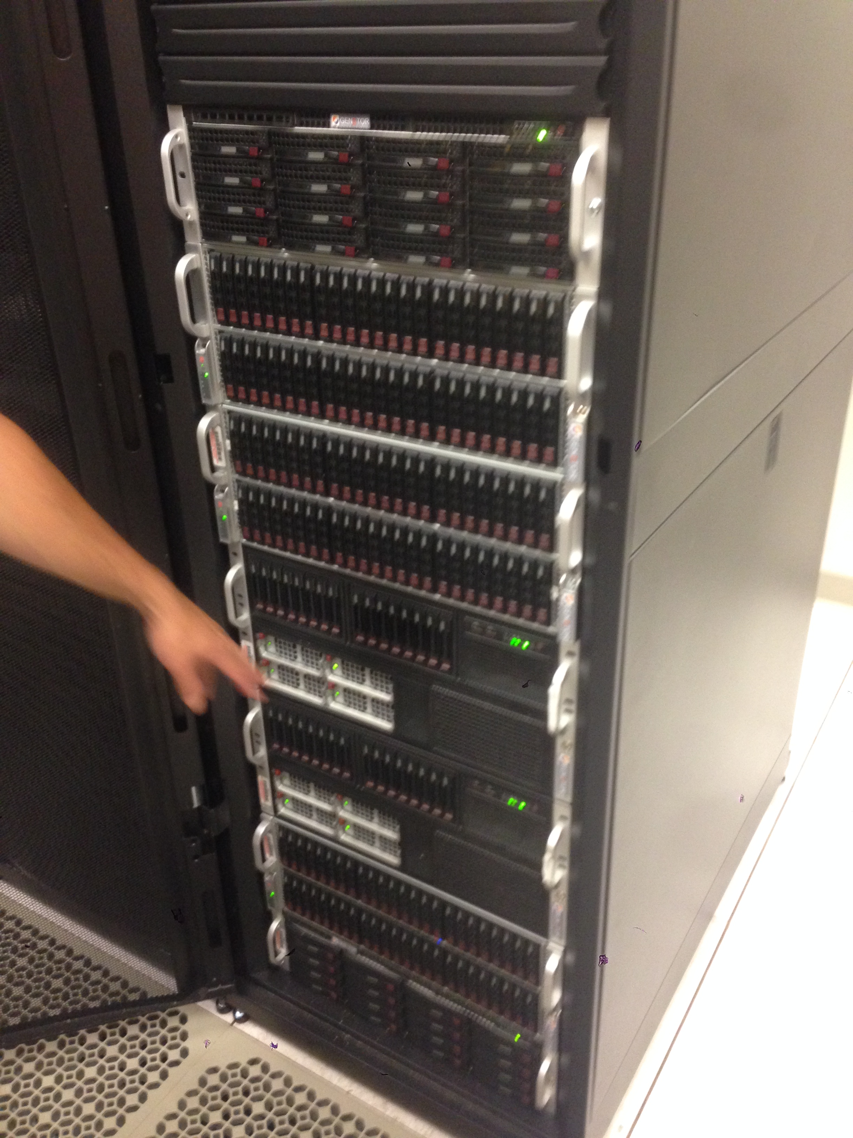
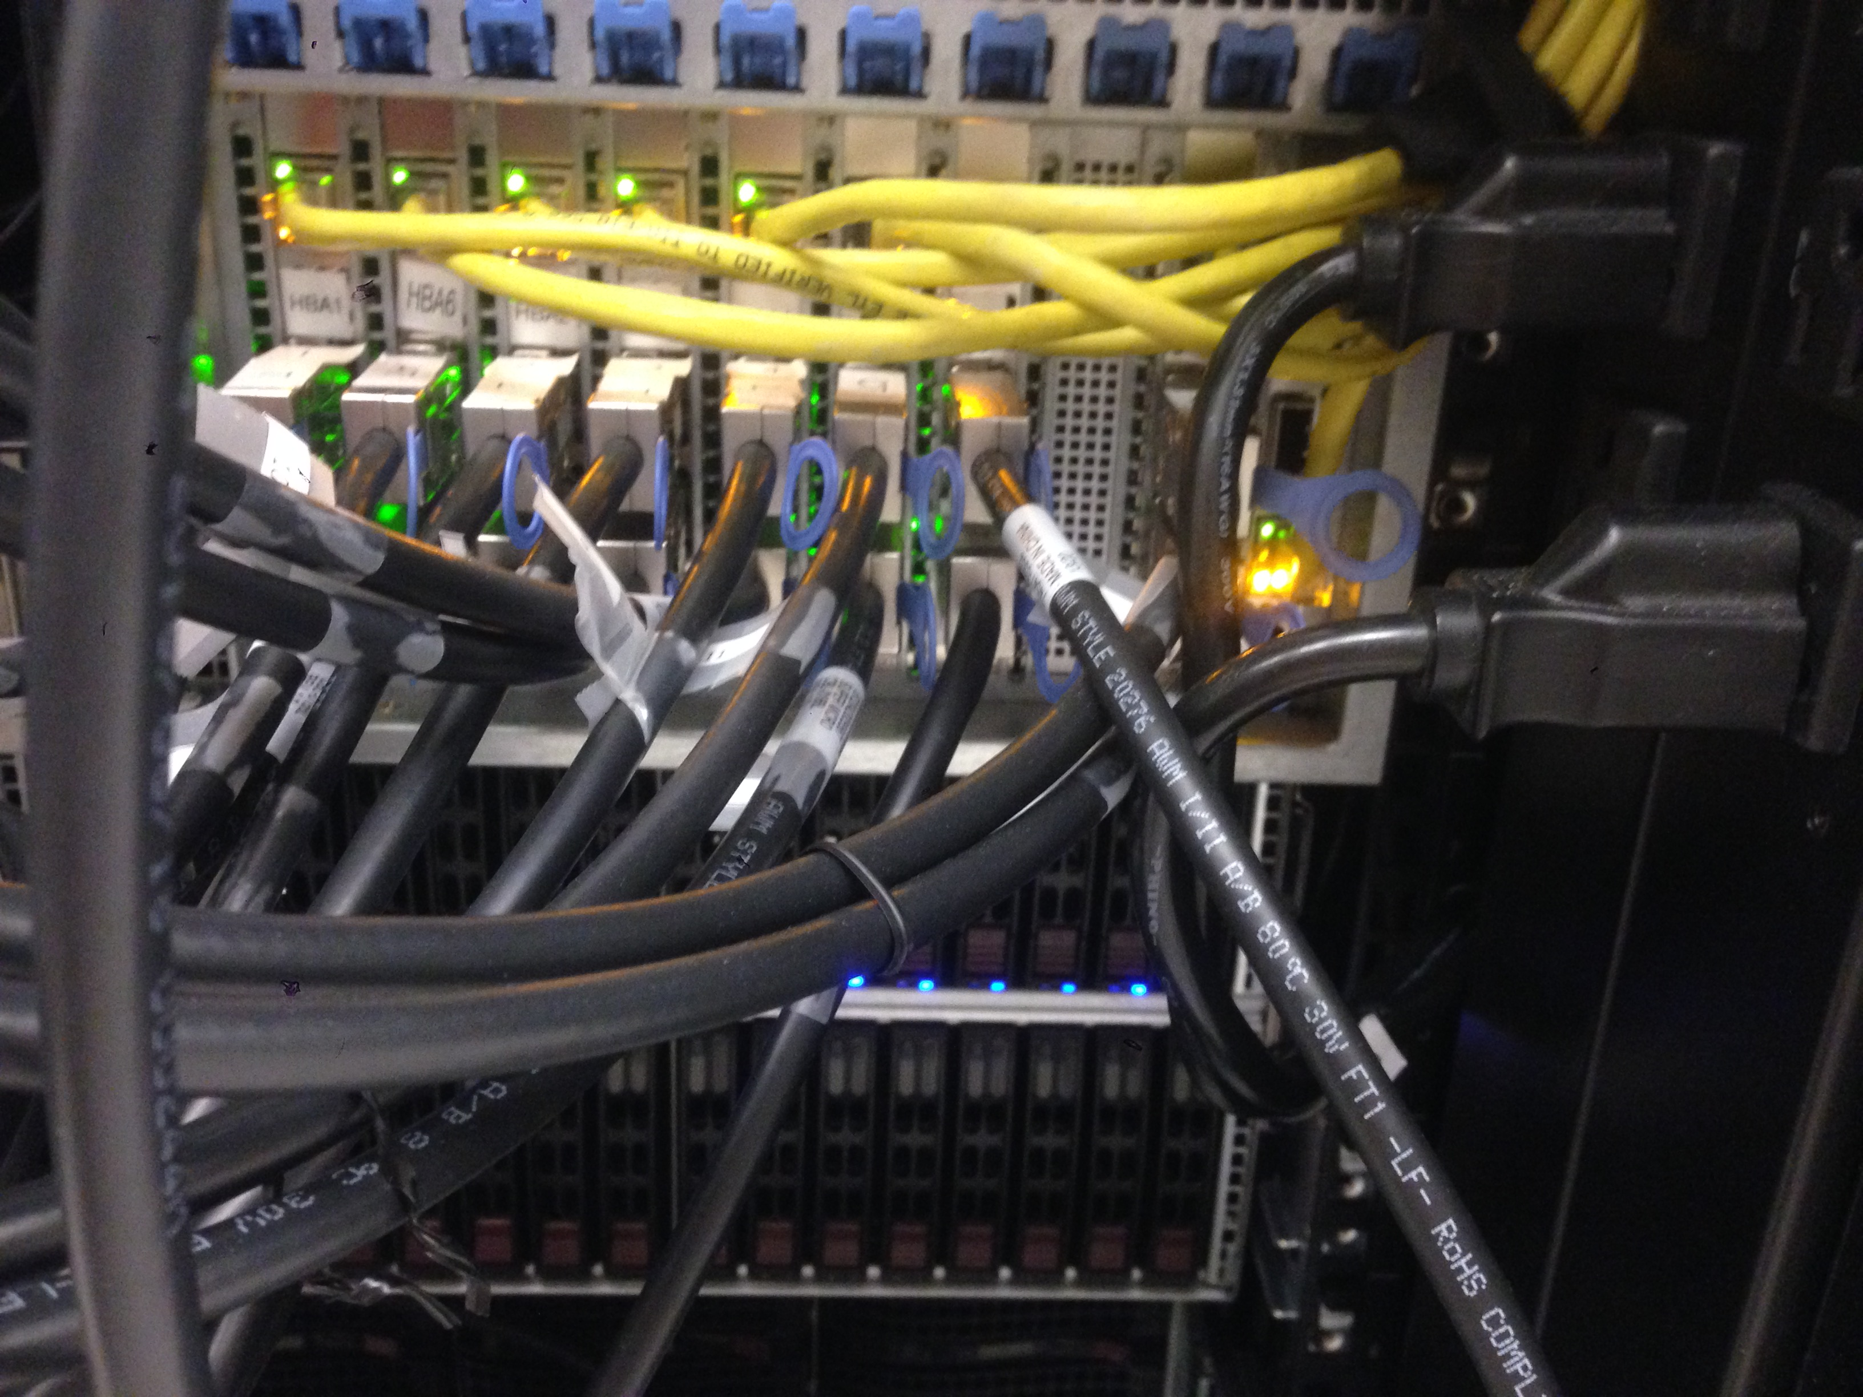
A Database Server @ NU
Front view
264 fast (10k RPM) magnetic disks
56 slow (7200 RPM) magnetic disks (for backup)
~150 TB storage capacity
Comprised of 6 physical chassis (boxes) in one big cabinet, about the size of a coat closet.
SAS cabling in back

Slide 10
Large database servers
Capacity is practically unlimited, but a single computer has:
  Limited compute power.
  Limited I/O bandwidth
  (theoretical max of
  ~80 GB/s on
  PCI-express v4).
This single-machine design
can actually scale pretty well!
Relational (aka SQL) DBs use this design
Database SW running on one machine
One big computer
Limited bandwidth to storage (80GB/s)
Many disks can be connected to the computer

Slide 11
Persistent (disk) storage has always been different
Programming languages rarely deal with storage directly (except SQL).
  Programmer must write code to move data from memory to disk.
  Disks are slow, so making the programmer think before using it is OK.
  But it’s also really tedious to operate on large data sets, where data is constantly shuffled between disk and RAM.
Normal way of accessing persistent storage:
  Pass data into and out of files using system's open/read/write functions.
Databases let the programmer use persistent storage w/out worrying about file-level transfers, with advanced performance optimizations.
Usually interact with DB using a special query language (eg., SQL).

Slide 12
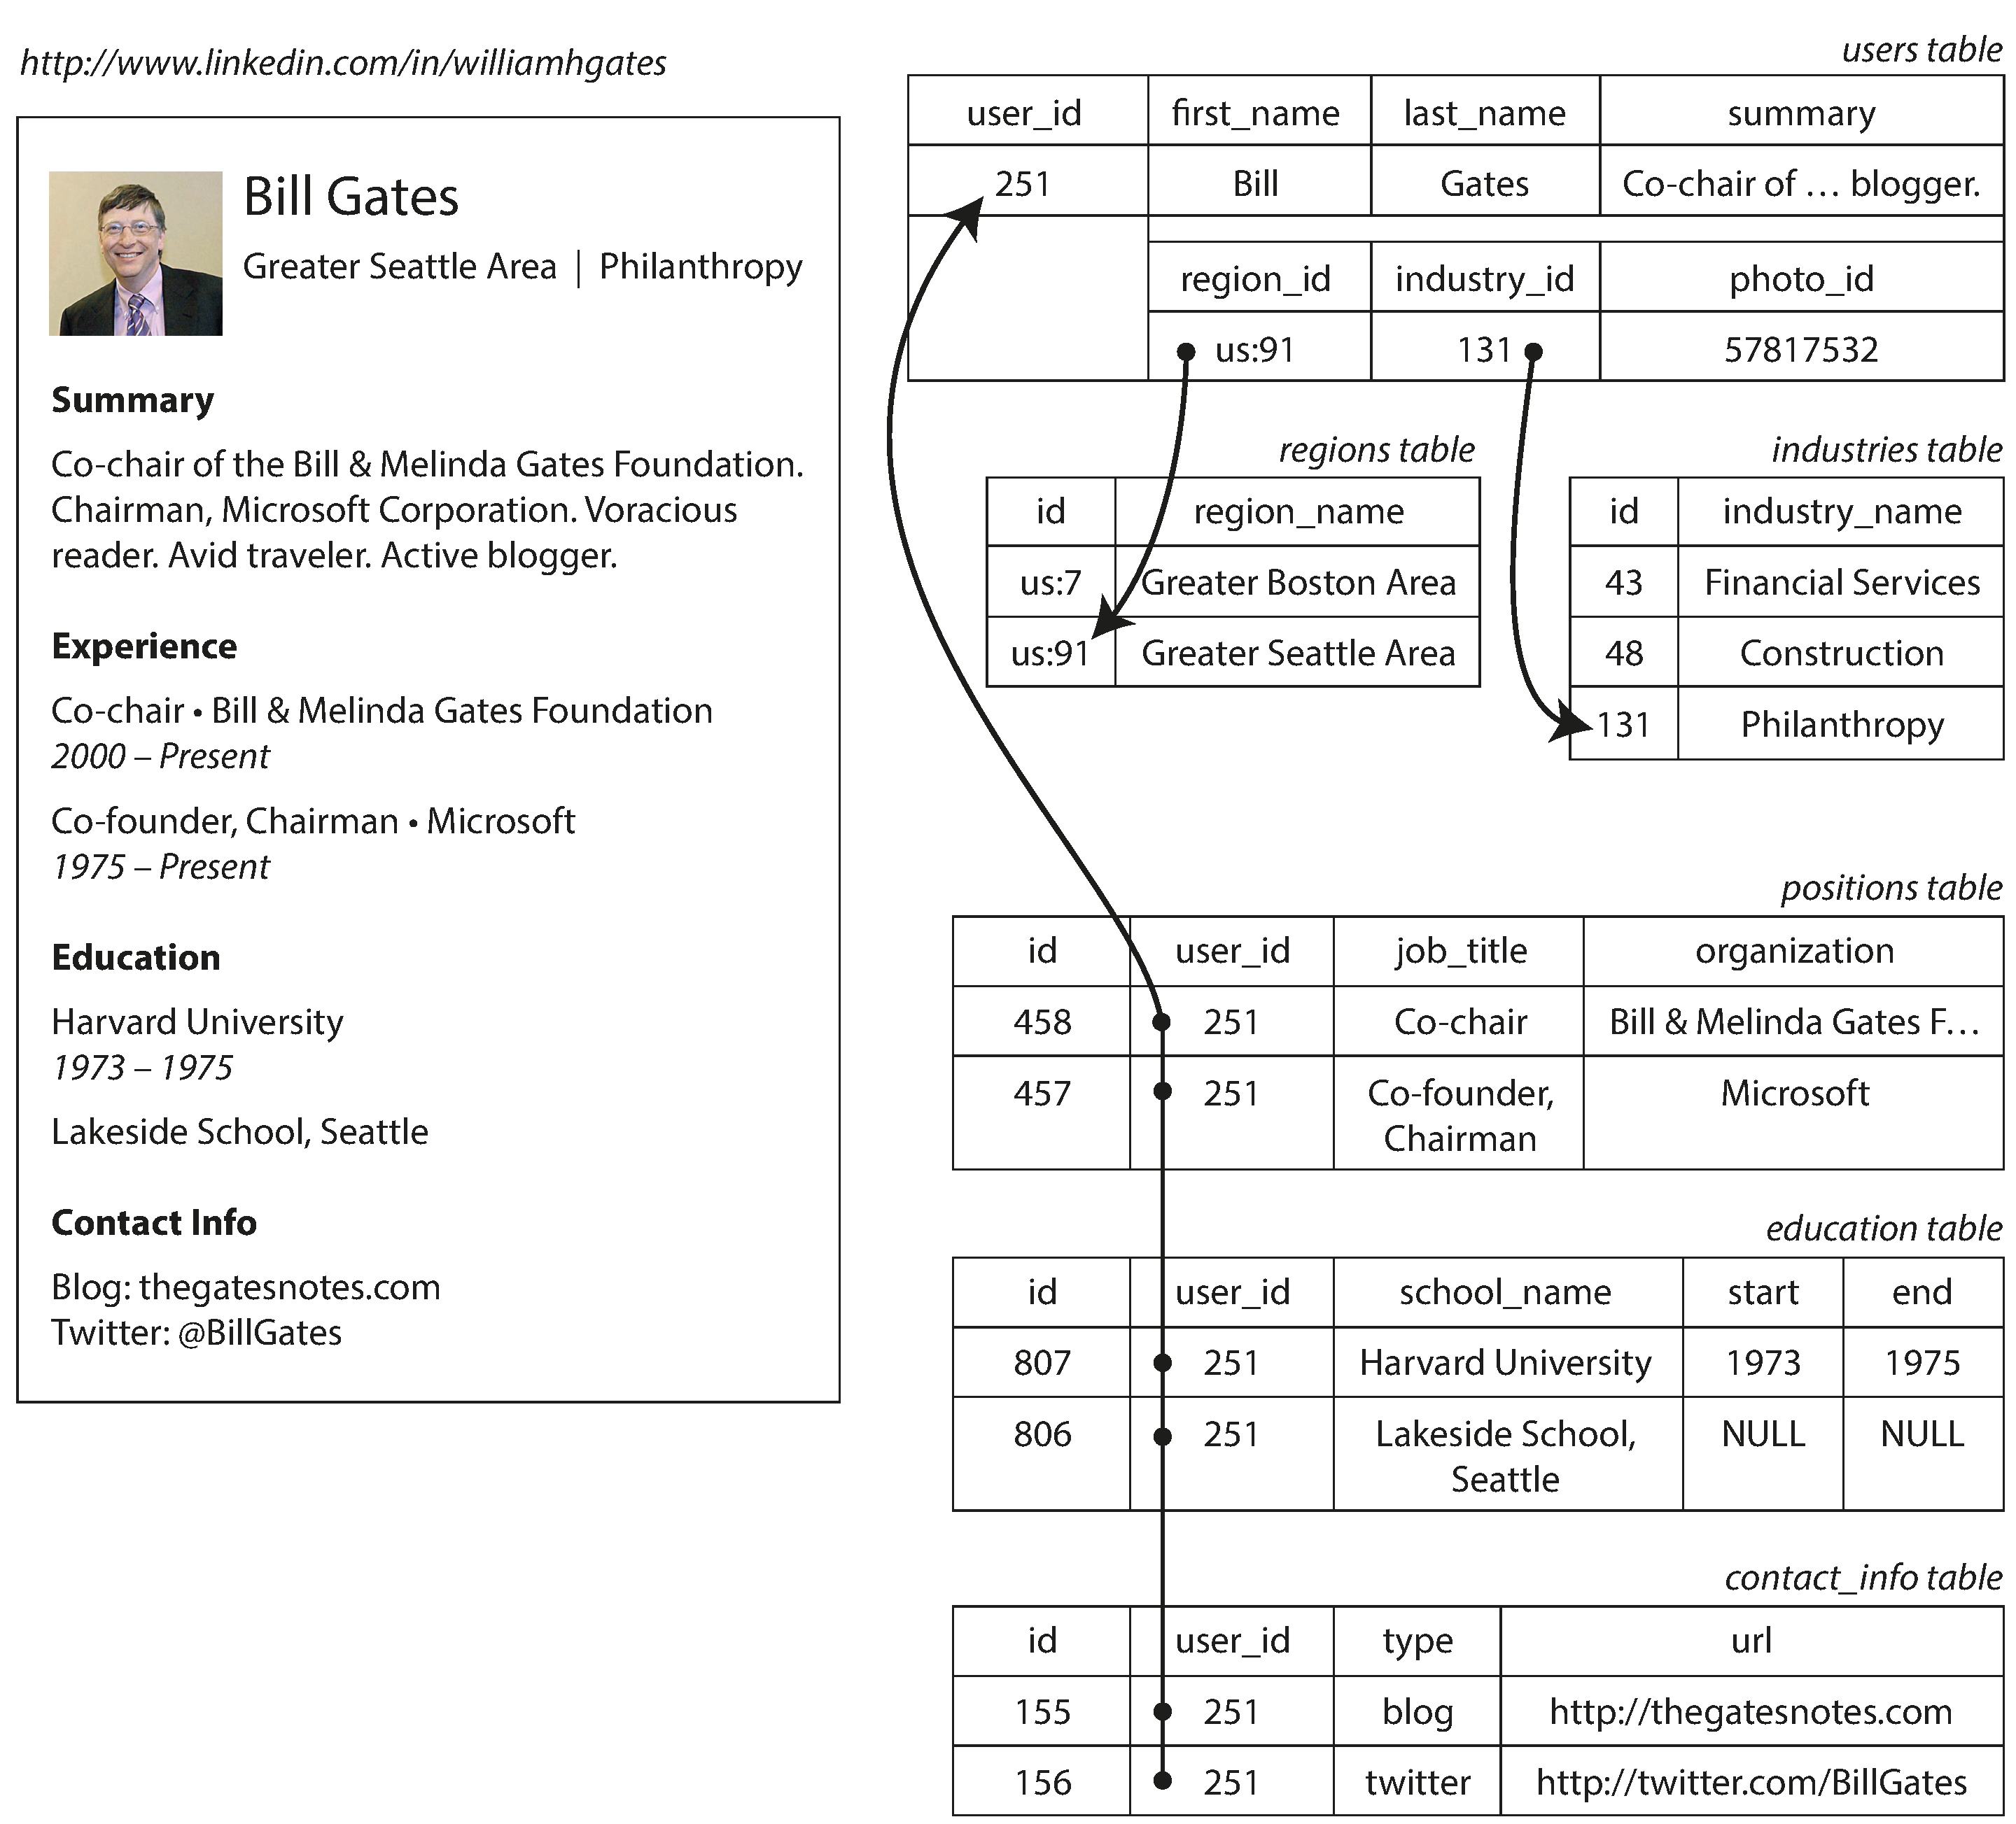
Relational DBs
Relational databases store
data in multiple tables.
Each table has pre-defined
set of columns (schema).
Rows are added over time.
Rows can refer to other
rows through foreign keys.
(the arrows)
  “Philanthropy” is defined
  once, but referenced by the
  industry id 131 in many user rows.
The final LinkedIn page may be generated by JOINing rows from many tables.
… line wrapped

Slide 13
Why so many tables?
Regions:
  Allows many users to refer to shared region data without repetition or inconsistency.
Positions:
  Allows a user to have an arbitrary number of positions (zero to infinity).
Industries? Education? Contact_info?
In summary:
A multi-table (relational) DB allows many-to-one and many-to-many relationships while keeping columns finite and clearly defined.
… line wrapped
A "relation" is a table

Slide 14
DB Design diagram: (my style)
staff
id | name | room | depart-ment
11 | Bob | 100 | 1
20 | Betsy | 100 | 2
21 | Fran | 101 | 1
22 | Frank | 102 | 4
35 | Sarah | 200 | 5
40 | Sam | 10 | 7
54 | Pat | 102 | 2
department
id | name | building
1 | Industrial Eng. | 1
2 | Computer Sci. | 2
4 | Chemistry | 1
5 | Physics | 4
7 | Materials Sci. | 5
building
id | name | faxNumber
1 | Tech | 1-1000
2 | Ford | 1-5003
4 | Mudd | 1-2005
5 | Cook | 1-3004
6 | Garage | 1-6001
A graphical representation of the DB schema.
Defines the tables, columns, primary and foreign keys
staff
id
name
department
department
id
name
building
building
id
name
faxNumber

Slide 15
For more coverage of relational DB schema design:
https://youtu.be/kqNpwL14nns?t=267
Or search Youtube for "Tarzia 317 Lecture 07"
This is highly recommended if you have not taken a database course, and probably helpful even if you have taken CS-339.

Slide 16
SQL Query language
SELECT staff.id, staff.name, staff.room,
department.name, department.buildingId
FROM staff JOIN department
ON staff.departmentId=department.id
staff.id | staff.name | staff.room | department.name | department.buildingId
11 | Bob | 100 | Industrial Eng. | 1
20 | Betsy | 100 | Computer Sci. | 2
21 | Fran | 101 | Industrial Eng. | 1
22 | Frank | 102 | Chemistry | 1
35 | Sarah | 200 | Physics | 4
40 | Sam | 10 | Materials Sci. | 5
54 | Pat | 102 | Computer Sci. | 2

Slide 17
SQL DB schema design exercise
Safe Ride
Music Festival

Slide 18
Why a Relational Database?
Most importantly:
Scalability – work with data larger than computer’s RAM.
Persistence – keep data around after your program finishes.
Indexing – efficiently sort & search along various dimensions.
Concurrency – multiple users or applications can read/write.
Analysis – SQL query language is concise yet powerful.
And also:
Integrity – restrict data type, disallow duplicate entries, transactions.
Deduplication – save space, keep common data consistent.
Security – different users can have access to specific data.

Slide 19
Can we just read/write files to disk to achieve these?
STOP
and
THINK
Scalability – work with data larger than computer’s RAM.
Persistence – keep data around after your program finishes.
Indexing – efficiently sort & search along various dimensions.
Concurrency – multiple users or applications can read/write.
Analysis – SQL query language is concise yet powerful.
Integrity – restrict data type, disallow duplicate entries, transactions.
Deduplication – save space, keep common data consistent.
Security – different users can have access to specific data.

Slide 20
Filesystem is like a basic database, it gives:
Scalability – work with data larger than computer’s RAM.
Persistence – keep data around after your program finishes.
Indexing – efficient access in just one dimension – the path/filename.
Concurrency – multiple apps can read/write, but lacks transactions.
Analysis – SQL query language is concise yet powerful.
Integrity – restrict data type, disallow duplicate entries, transactions.
Deduplication – save space, keep common data consistent.
Security – different users can have access to specific data.

Slide 21

Indexing
When working with large amounts of data it can be a challenge to find an item of interest.
We don’t want to read every storage address to find what we’re looking for.
Sorting the data can help tremendously, because it allows binary search.

Slide 22
Why sorting is not enough
You can’t sort in multiple dimensions
  Let’s say you want to find a product quickly according to either it’s name, manufacturer, or price. You can only sort by one of the there three columns.
Can’t insert new data without shifting everything over to make room.
  Shifting data in storage would require rewriting about half of it (on average).
  That’s incredibly amount of work to accommodate just one tiny addition.
Sorting doesn’t take advantage of the hardware’s storage hierarchy.
  The binary search will have to access the disk in every step because the index is distributed over the full data set.
  It would be better to put all the index data close together (spatial locality).

Slide 23
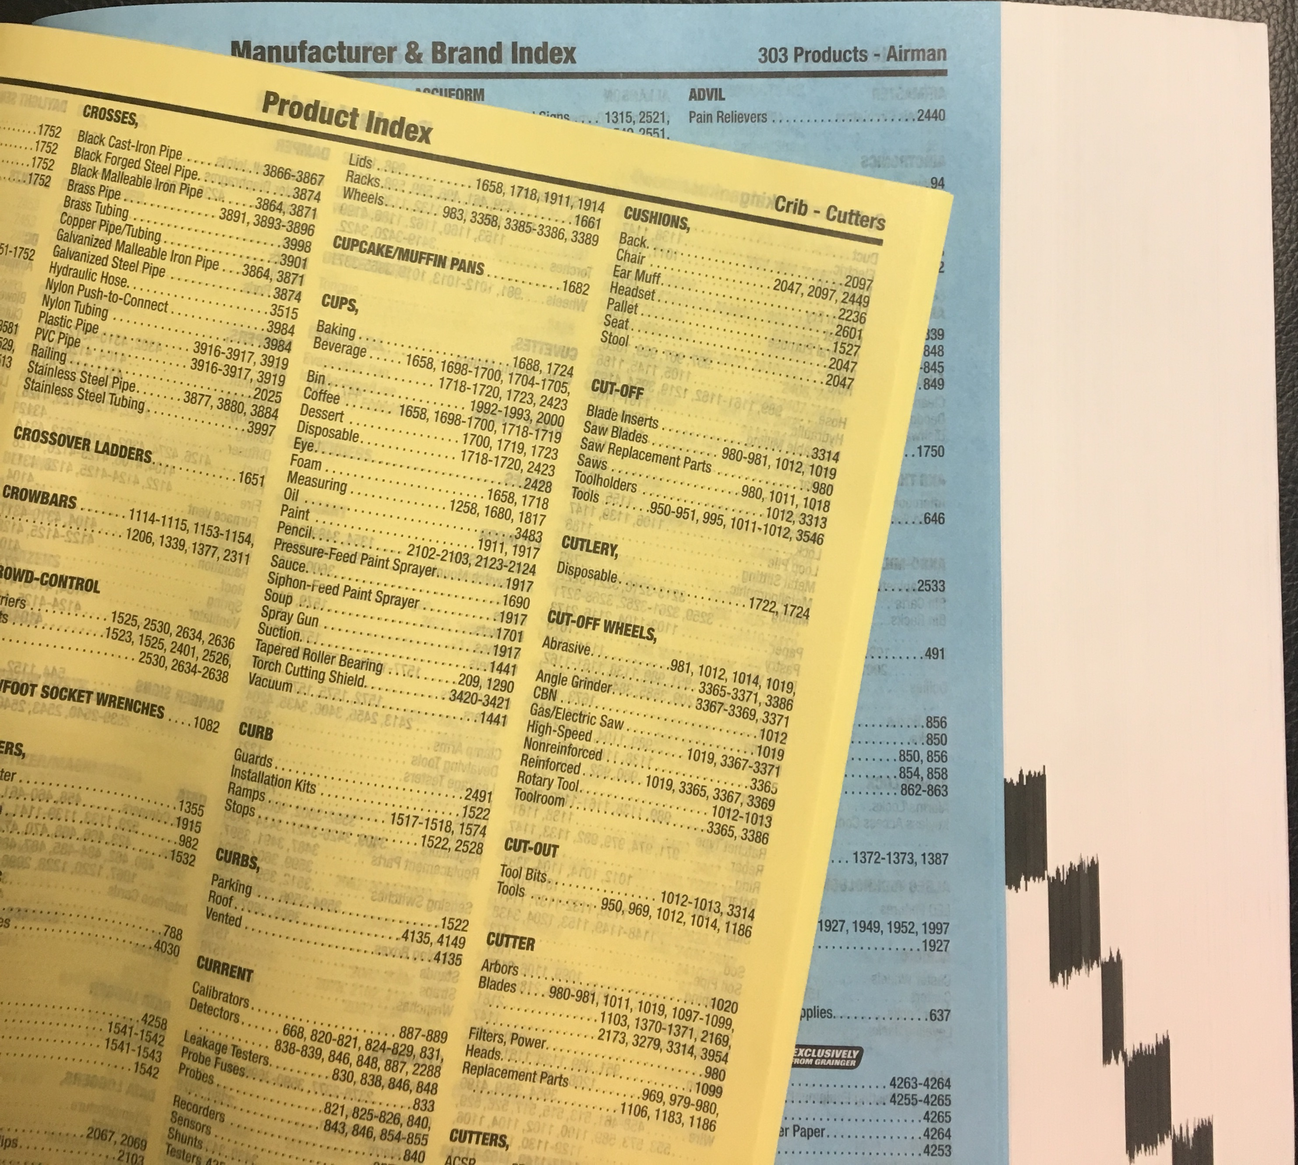
A printed catalog can add multiple indexes
Grainger catalog is sorted according to high-level product categories.
It has both yellow and blue index pages.
These allow efficient lookup by:
  product type names
  manufacturer names
In total, products can be efficiently found in three ways.
Simple sorted lists are effective here because data is never added.

Slide 24
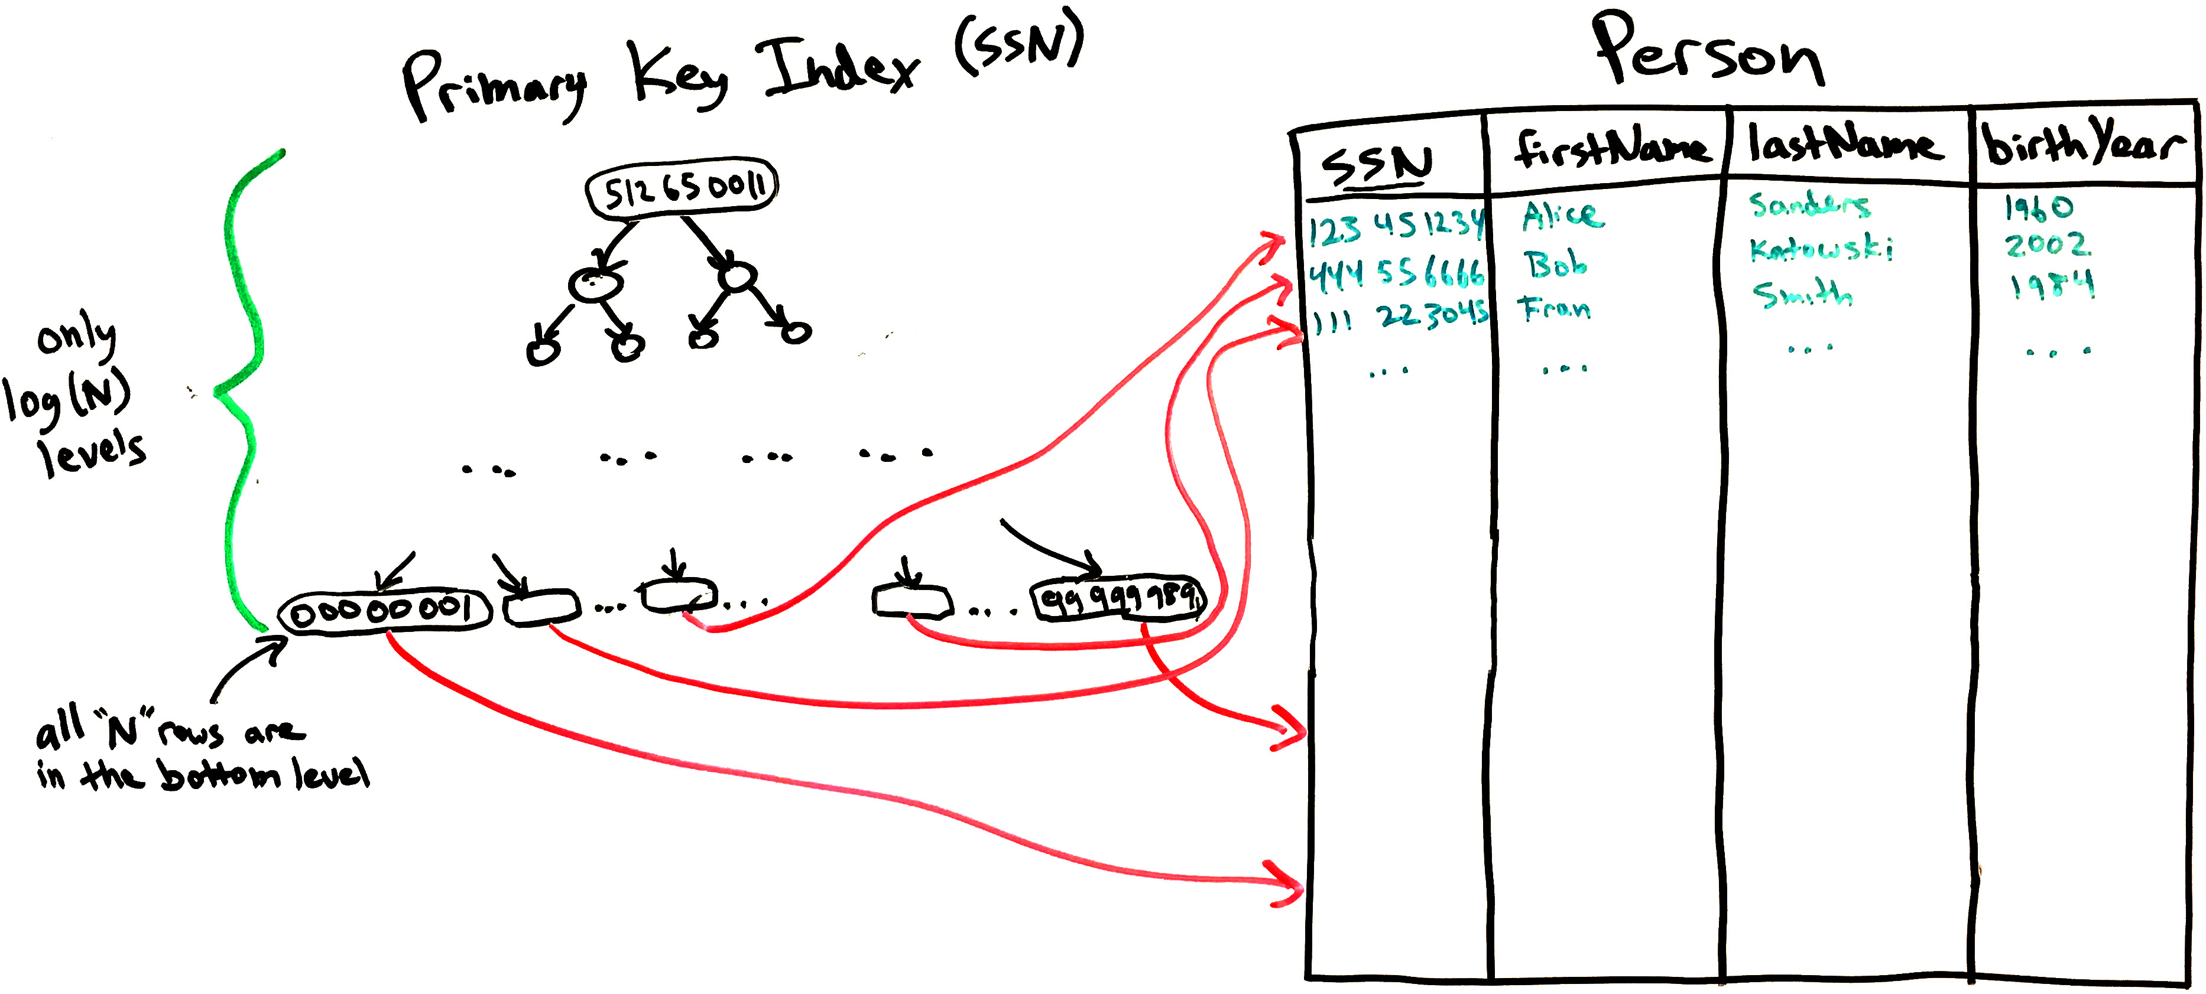
DB indexes use a tree or hashtable instead of sorting
Self-balanced binary trees give the log(N) speed of a binary search,
while also allowing entries to be quickly added and deleted.
This is all review of CS-214 Data Structures.

Slide 25
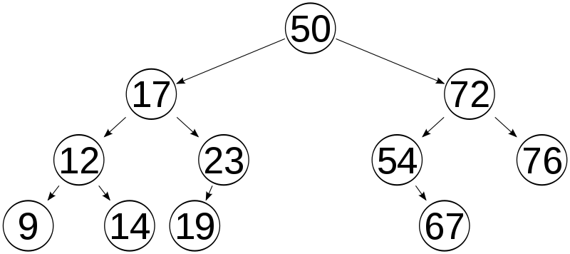
Balanced binary search tree
Finding an element is very similar to binary search of a sorted list.
Start from the root. Move to the left subtree if the value you’re looking for is smaller, otherwise move to the right subtree.
Repeat.

Slide 26
Creating indexes/keys
Indexes are usually defined when the table is created
  Primary key must be unique for each row.
  We must be able to quickly check that new value does not already exist.
  Thus, unique/primary keys are indexed.
But you may later realize that certain queries are too slow
  Without proper indexes, DBMS will have to examine every row in the table to find the relevant rows.
  Adding one or more indexes may dramatically speed up a query.
Basic syntax:
  CREATE INDEX index_name ON table_name (column_name)

Slide 27
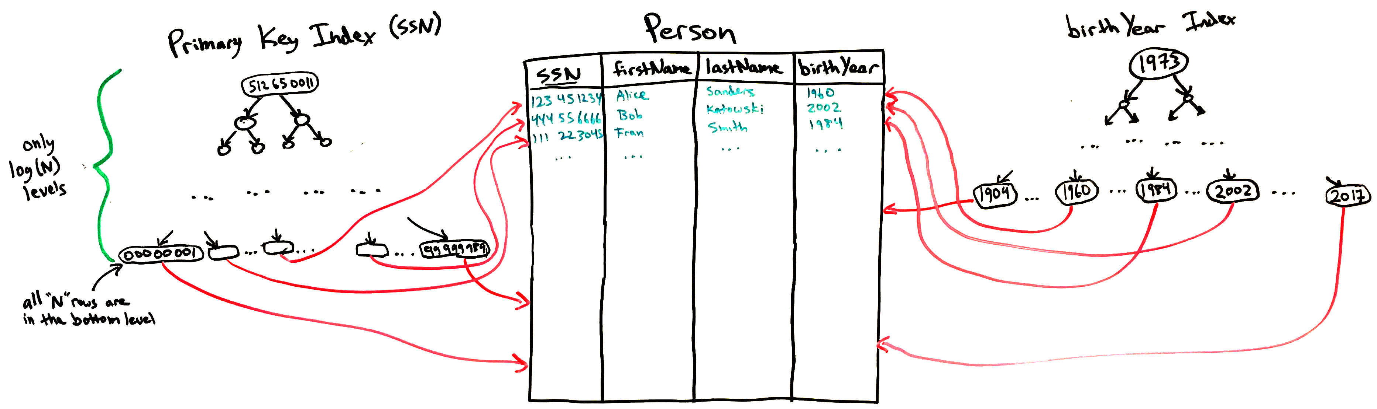
Multiple indexes in one table are possible
Allow finding rows quickly based on multiple criteria
Need two indexes to quickly get results for both:
  SELECT * FROM Person WHERE SSN=543230921
  SELECT * FROM Person
  WHERE birthYear BETWEEN 1979 AND 1983

Slide 28
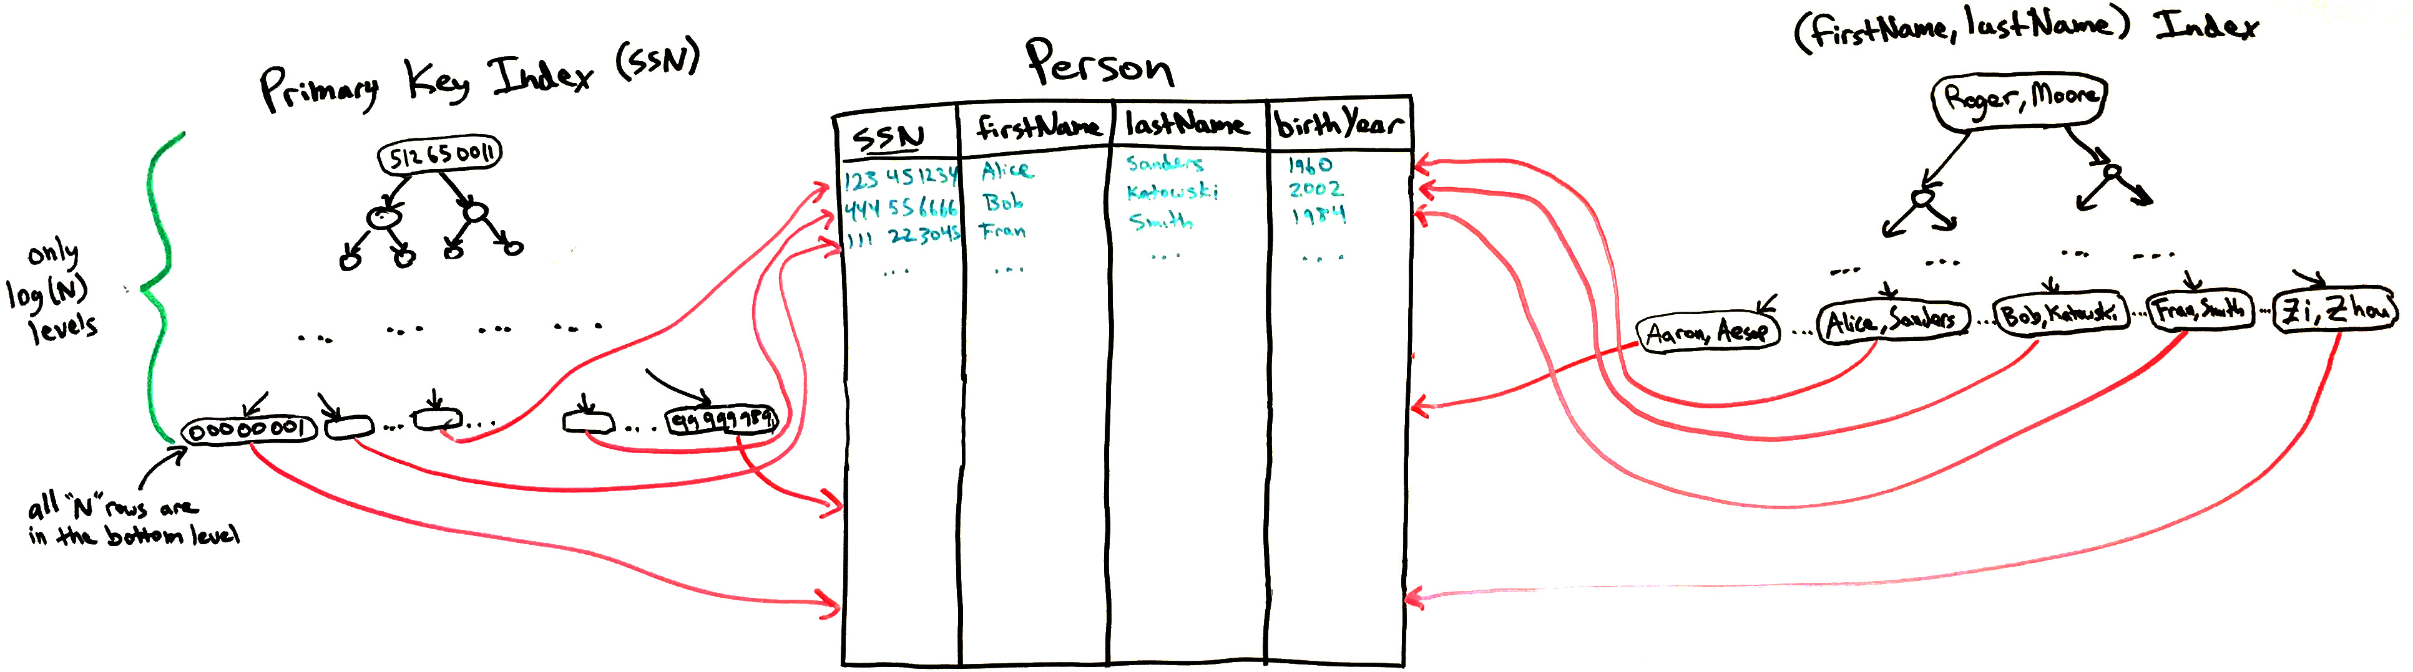
Composite indexes involve multiple columns
Useful when WHERE clauses involves pairs of column values:
  SELECT * FROM Person WHERE firstName = “Alice” AND lastName = “Sanders”
Unlike two separate indexes, you can find the matching pair of values with one lookup.
Otherwise, would have to first find results for firstName = “Alice” and scan through all the Alices checking for lastName = “Sanders”
However, example below does not allow you to quickly find rows by lastName

Slide 29
Query execution plans
The DBMS must translate your SELECT query into a series of table lookups.
A complex query has many choices about what to do first, and it will try to make the most efficient choice.
  For example, if a JOIN is used, either of the two tables can be examined first.
  The presence of indexes make some choices more efficient than others.
DBMSs have special commands that explain the query execution plan:
  SQLite: EXPLAIN QUERY PLAN SELECT …
  MySQL: EXPLAIN SELECT …
  This usually tells you how many rows will be examined, and adding indexes can reduce these numbers.

Slide 30
When to index columns?
When a query is slow!
Generally, add an index if the column is:
  Used in WHERE conditions, or
  Used in JOIN … ON conditions, or
  A foreign key refers to it.
Also helpful if the column is:
  In a MIN or MAX aggregation function

Slide 31
Indexes are not free!
Don’t add indexes unless you need them.
Rookie mistake is to index every column “just in case.”
Indexes consume storage space (storage overhead),
Indexes must be updated when data is modified (performance overhead).

Slide 32
Key and Index terminology in SQL
Plain key or index is just a way to find rows quickly
  Just creates a search tree.
Unique key is an index that prevents duplicates
  Bottom level of search tree has no repeated values
  DBMS can use the tree to quickly search for existing rows with that value before allowing a row insertion (or column update) to proceed.
Primary key is just a unique key, but there can only be one per table
  We think of the primary key as the most important unique key in the table
Foreign key makes a column’s values match a column in another table
  The referenced column in the other table should be indexed
  (usually it’s the primary key).

Slide 33
Summary
Persistent storage requires special consideration due to slow performance and lack of language-level support.
Databases solve lots of problems:
  scalability, persistence, indexing, concurrency, etc.
  Filesystems can solve some, but not all, of these problems.
Relational (SQL) databases store data in tables.
Developer defines the DB schema first (tables, columns, keys).
  Rows are added during DB operation, and they must fit the schema.
Indexes let us find rows quickly with value of one or more column.
SQL query language lets us run analysis code "close to" data storage (filtering, aggregation – sum, count, min, max, avg, etc.).

