Slide 1
CS-310 Scalable Software Architectures
Lecture 7:
Load Balancing
1
Steve Tarzia

Slide 2
Last Lecture: Microservices, etc.
2
Introduced microservices as an alternative to monolithic design.
Services are black boxes, exposing network APIs.
  Decouples development of different parts of the system.
  Network APIs define the format and meaning of requests and responses.
JS Single-page Applications (SPAs) interact directly with services.
  Moves UI concerns away from backend code.
In a cross-platform system design, the same backend service/API can serve mobile, web, and desktop apps.

Slide 3
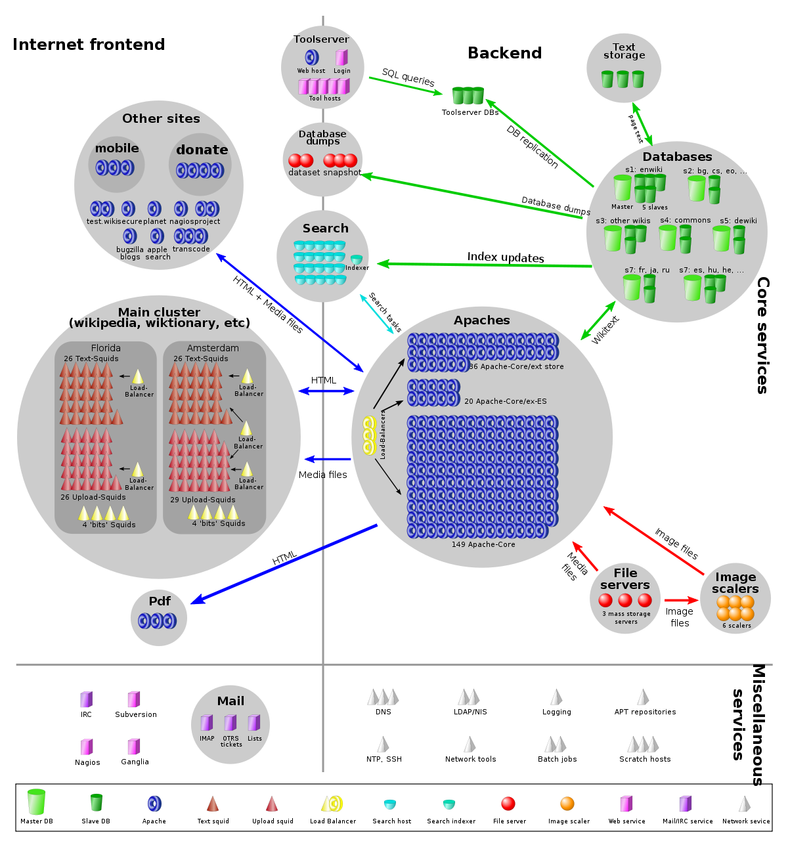
Load balancers
3
In the diagram below, there are 3 load balancers in front of 200 MediaWiki servers.
Load balancer is a single point of contact for a service.
Requests are proxied to a cluster of workers.
Load balancer does very little work:
  Just forward request/response and
  remember the request source.
  Load balancer can relay requests
  for 10s-100s of application servers.
Makes one IP address appear like
one huge machine, but it’s actually a cluster.
Web browser
MediaWiki

Slide 4

Basic idea of load balancer
4
Make a cluster of servers look like one superior server.
The load balancer provides the same interface as a single server.
(An HTTP server operating on a single IP address)
Client thinks it’s dealing with this:
But it’s just an illusion. The reality is:
HTTP request
HTTP request
Load-balanced cluster
Load
Balancer
Workers

Slide 5
Additional benefits of a load balancer
5
Pros and cons of rolling vs. synchronized updates?
STOP
and
THINK
Individual servers can be replaced without affecting overall service.
  Deploy “rolling” app updates. • Or deploy a synchronized update
Proxy can monitor health of servers
  Periodically send a “health check” request. A simple GET API call.
  If the request fails, then the server must be crashed.
  Stop relaying new requests to that server.
Load Balancer
Load Balancer
Version 1.1
Version 1.1
Up-grading
Version 1.0
Version 1.0
v1.0
v1.0
v1.0
v1.0
v1.1
v1.1
v1.1
v1.1
Update rolls through servers
Created new VMs with updated SW. Will reconfigure LB all at once.

Slide 6
Two types of local load balancers
6
Network Address Translation
Reverse Proxy
Works at the TCP/IP layer.
  Called a Layer-4 load balancer
Forwards packets one-by-one, but remembers which server was assigned to each client.
Is compatible with any type of service, not just HTTP.
Works at the HTTP layer.
  Called an application-layer LB.
Stores full requests/response before forwarding.
Eg., Nginx (or maybe Squid)
Reverse Proxy can also do:
  SSL termination.
  Caching.
  Compression.

Slide 7
NAT Load Balancer
7
For details, take CS-340.
A type of NAT device that relays requests to multiple equivalent servers.
NAT LB changes IP addresses and ports of packets in both directions.
Load balancer maintains IP address and port mappings, like a traditional NAT.
Simpler and more efficient than reverse proxy because it need not implement TCP, HTTP, or store full request/responses.
Client 1
4.4.4.4:1230
Client 2
5.5.5.5:3021
Client 3
6.6.6.6:9012
2.2.2.2:80
Load Balancer
10.0.0.1:1002 10.0.0.1:2302 10.0.0.1:5021
10.0.0.2:80
Server A
10.0.0.3:80
Server B

Slide 8
Nginx is can be used as a Reverse Proxy Load Balancer
8
Client sends request to the LB.
LB choses an “upstream” server.
LB relays request to upstream server.
Upstream server sends response to LB.
LB accepts response and looks up the client associated with this connection.
LB relays response to client.
Load balancer

Slide 9
Additional benefits of a Reverse Proxy LB
9
(load balancer)
TLS/SSL certificates can be stored just on the proxy.
  Internal communication may be unencrypted.
Proxy might also cache responses, but this limits its scalability.
  Eg., Squid in the Wikipedia architecture.

Slide 10
Comparison of Local load balancing options
10
 | NAT | Reverse Proxy
Routing done by: | IP address/port translation | HTTP proxy
Scale | ✅ ~1–10M requests/s | ~100k–1M requests/s
Services supported | Any | Only HTTP
Additional features | None | SSL termination. Caching.
Expensive "hardware" load balancers implement NAT.
Reverse proxies are the cheap, open-source option.
Cloud-based LBs can do either.

Slide 11
Local load balancer limitations
11
STOP
and
THINK
Load balancer machine is a single point of failure.
Can only handle ~1M requests/sec.
Resides in one data center, thus:
  It’s not near all your customers.
  The data center is also a single point of failure.
Huge services need more than just local load balancers.
Can clients find a service replica without contacting a central bottleneck?
We have a distributed service discovery problem.

Slide 12
Domain Name Service (DNS)
12
DNS is a distributed directory that maps hostnames to IP addresses.
  mail.stevetarzia.com → 54.245.121.172
DNS uses a distributed, hierarchical, caching architecture for scalability.
On campus, my machine sends queries to NU’s DNS server.
This local DNS resolver has cached copies of recent (common) answers.
  gmail.com, northwestern.edu, facebook.com, etc…
Local DNS resolver asks up the hierarchy if answer is not in its cache.
  Need to ask the nameserver for “stevetarzia.com” for IP address of “mail”.
  To get IP address of that nameserver, would ask the “com” nameserver.
  IP address of “com” TLD nameserver is almost certainly cached, but if not then query one of the few hard-coded root nameservers.
For more details, take CS-340 Intro. to Computer Networking.
AWS outage on October 22nd, 2019 was due to a DDoS attack on AWS DNS.

Slide 13
Round-robin DNS for load balancing
13
DNS allows multiple answers to be given for a query
(multiple IP addresses per domain name).
  Client can then randomly choose one of the IP addresses.
  Even better, DNS server can store multiple answers, but give different responses to different users (either randomly, or cyclically).
Remember that DNS is a cached, distributed system.
  Northwestern’s DNS resolver may have been told google.com = 172.217.9.78.
  UChicago’s DNS resolver may have been told google.com = 172.217.9.80.
  Comcast Chicago’s DNS resolver was told google.com = 172.217.7.83.
  Different answers are cached and relayed to all the users on the 3 networks.
Each of those three IP addresses are different reverse-proxying load balancers sitting in front of hundreds of app servers.
Is there a limit to scaling by DNS?
STOP
and
THINK
There’s no limit, at least on the frontend!

Slide 14
Geographic load balancing with DNS
14
More than just balancing load, DNS can also connect user to the closest replica of a service.
Clever DNS server examines IP address of requester and resolves to the server that it thinks is closest to the client (IP address geolocation).
In other words, the IP address answers are not just different, but customized for the particular client.
👀 (command line demo with nslookup)

Slide 15
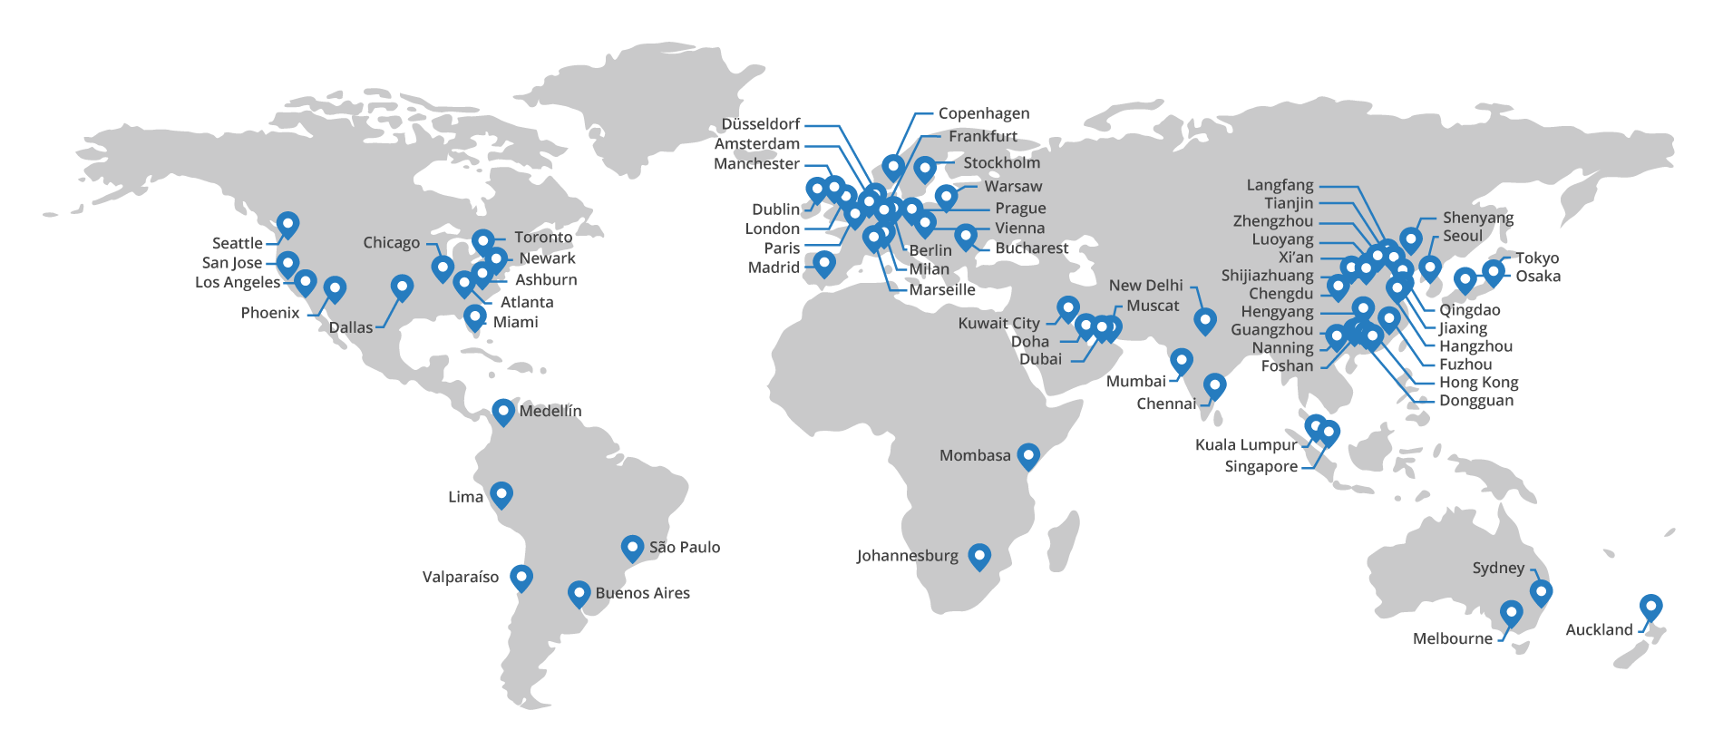
Content Delivery Network (CDN)
15
Globally distributed web servers that cache responses for local clients.
A CDN is just a distributed caching HTTP reverse proxy that uses DNS (and other techniques) to geographically load-balance.
Eg., Akamai, Cloudflare, Cloudfront, Fastly
Distributed “edge” servers

Slide 16
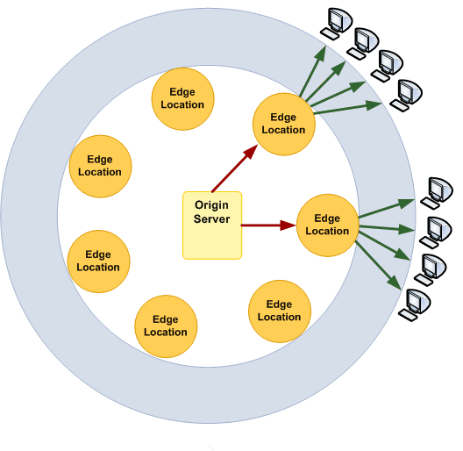
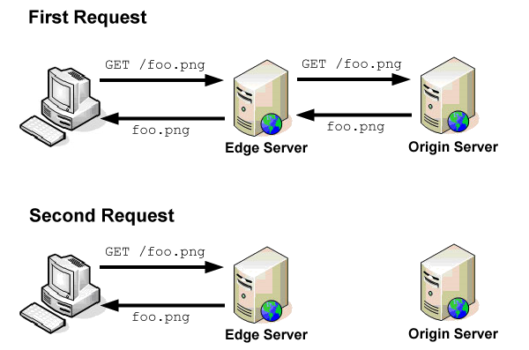
CDN uses HTTP caching proxies
Origin Server is the original, central web server. (Sets cache-control HTTP headers in responses).
Edge Servers are caching proxies.
Ask origin server if don’t have a cached response.

Slide 17
CDNs are add-on services
Website operator manages origin server
CDN operator manages edge servers
(Cloudflare, Akamai, Cloudfront, Fastly)

Slide 18
Cache-Control headers in HTTP responses
Command line demo:
https://www.google.com does not allow caching:
  cache-control: private, max-age=0
https://www.google.com/images/branding/googlelogo/2x/googlelogo_color_272x92dp.png allow caching for one year
  cache-control: private, max-age=31536000
https://www.northwestern.edu also does not allow caching:
  Cache-Control: max-age=0
https://common.northwestern.edu/v8/css/images/northwestern.svg allows caching for one day:
  Cache-Control: max-age=86400

Slide 19
Geographic load balancing with IP Anycast
19
8.8.8.8 is the one IP address for Google’s huge public DNS service.
Handles >400 billion DNS requests per day! Anyone here use it?
Cannot rely on DNS for load balancing, because it is the DNS server!
IP Anycast load balancing is implemented with BGP. (Details in CS-340)
Basic idea is that many of Google’s routers (around the world) all advertise to their neighbors that they can reach 8.8.8.8 in just one hop.
Thus, traffic destined for 8.8.8.8 is sent to whichever of these Google routers are closest to the customer.
Technically, this violates the principle that an IP address is a particular destination, but for DNS this doesn’t matter because it’s UDP and stateless.
5 million QPS!
Notes:
= 500k requests per second.

Slide 20
Comparison of Global load balancing options
20
 | DNS | IP anycast
Routing done by: | Domain Name Service | BGP
Maximum scale limited by: | Internet itself. | Internet itself.
How quickly can changes be made? | DNS TTL (minutes to hours) | BGP convergence (~minute)
Easy of deployment: | Requires advanced DNS software/config. | Must operate your own Autonomous System (ISP)
For global load balancing, DNS is the most common choice.
Tech giants (Google, Facebook, Amazon, MS, etc.) can use IP anycast.

Slide 21
Comparison of load balancing Levels
21
 | Local | Global
Routing done by: | NAT or HTTP Proxy | DNS or BGP
Maximum scale limited by: | Speed of one machine. | Internet itself.
How quickly can changes be made? | Milliseconds | minutes to hours
Easy of deployment: | Simple, using off-the-shelf software/HW. | Requires advanced DNS software/config.
Most large services load balance at two levels:
Local – provides continuous operation and scale within a data center
  Includes health checks & rolling updates.
DNS – for global scalability and low latency (send users to nearby data center).

Slide 22
Recap: Load balancers
22
We have 2/3 of the end-to-end view of a basic scalable architecture!
  (for services, at least)
Frontend: Client connects to “the service” via a load balancer.
  Really, the client is being directed to one of many copies of the service.
  Global LBs (DNS and IP anycast) have no central bottlenecks.
  Local LBs (Reverse Proxy or NAT) provide mid-level scaling and continuous operation (health checks & rolling updates).
Services: Implemented by thousands of clones.
  If the code is stateless then any worker can equally handle any request.
Data Storage??
  The next big topic!
Today’s topic

