Slide 1

CS-310 Scalable Software Architectures
Lecture 6:
Microservices
1
Steve Tarzia

Slide 2
Last time: REST APIs and Data Serialization
2
Services are black boxes, exposing network APIs.
  Decouples development of different parts of the system.
  Network APIs define the format and meaning of requests and responses.
REST is the most popular format for network APIs
  Based on HTTP and uses url, method, response codes, usually JSON bodies.
JSON is a common data serialization format. XML is also used.

Slide 3
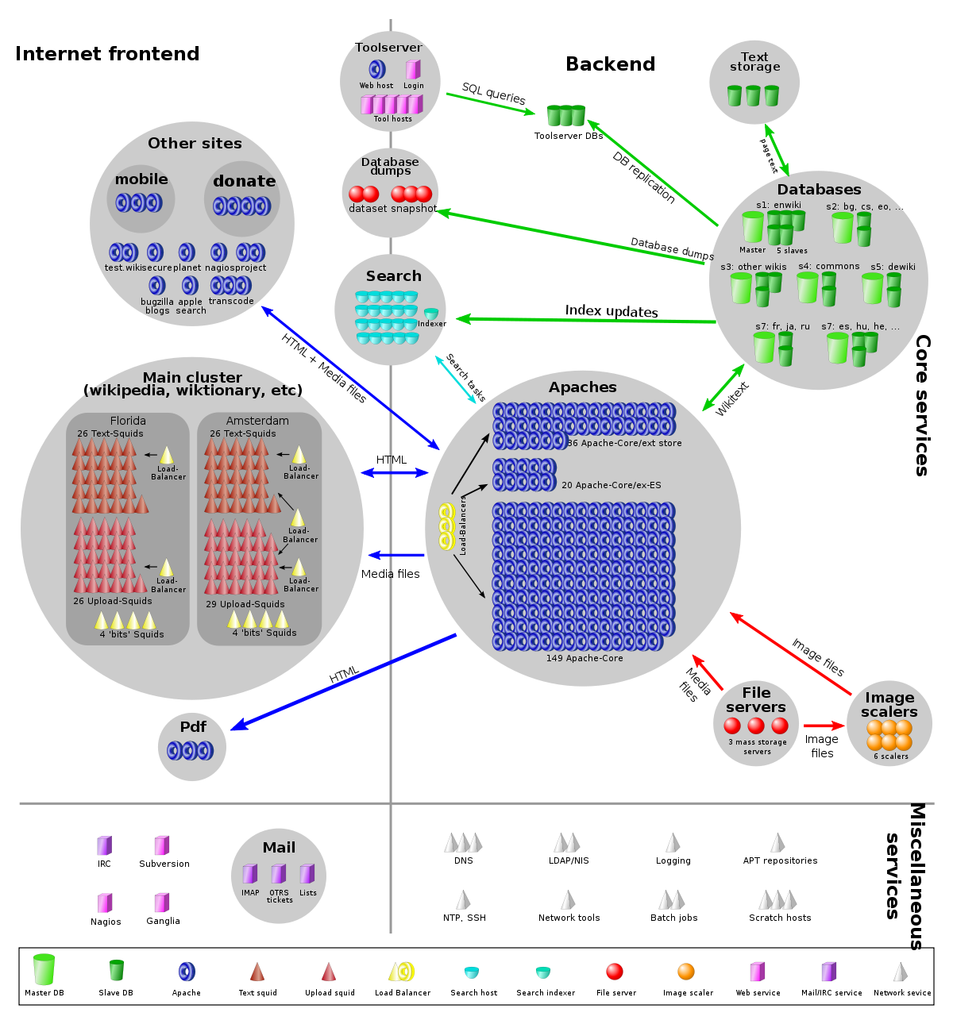
Wikipedia is mostly one big PHP app
3
The app uses a monolithic architecture.
  Roughly means “one big thing.”
HTTP cache
MediaWiki
Your browser

Slide 4
Cache and Database are “off-the-shelf” software
4
Caching proxies are Squid.
Databases are MariaDB.
HTTP cache
MediaWiki
Your browser

Slide 5
Monolithic apps
5
Each of instance of Mediawiki ( ) can handle any request on its own.
  Caveat: it needs the help of the centralized database, but let’s ignore the DB for now.
The only reason we have 200 of instances is
to handle many independent requests
in parallel.
  They’re interchangeable clones.
When a developer is testing new
code, they can just run one
instance locally.
MediaWiki
Web browser

Slide 6
Advantages of a Monolithic design
6
Easy to build, deploy, test, coordinate, share data.
  Certainly, the best choice for simple apps.
  Even some very large services (eg., Facebook) use a monolithic design.
Disadvantages
Creates bottlenecks in SW development processes.
  Lots of developers working on one codebase – lots of coordination/merging.
One huge codebase can lead to messy, fragile code.
  A change here can cause unexpected bugs there.
The whole app must be redeployed for small new functionality.
Must choose one programming language, build system, runtime env.

Slide 7
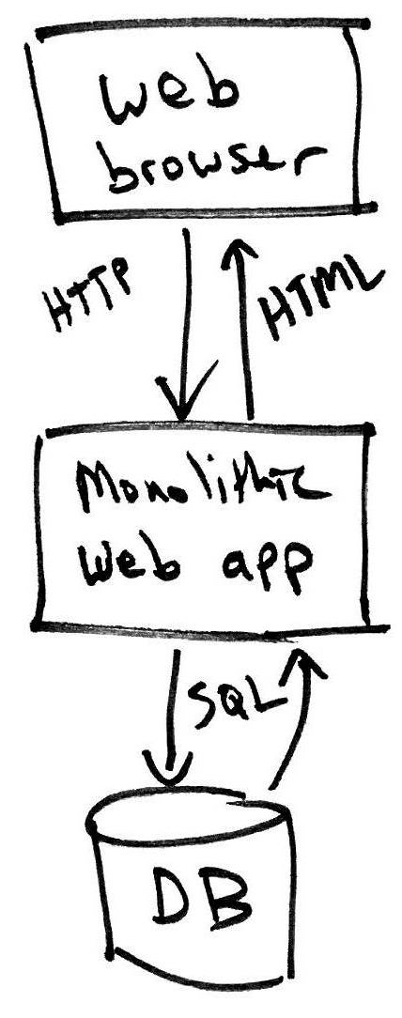
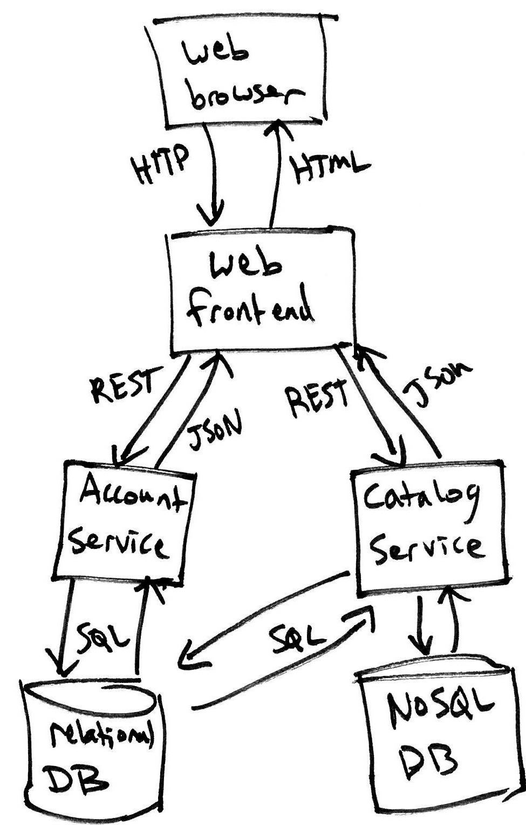
Breaking up a monolithic architecture, example
7
One big service
Several services
User’s machine
The cloud

Slide 8
Microservices
8
In a Service Oriented Architecture many smaller services work together. Recently, this idea has been re-branded as Microservices.
Responsibilities are split among specialized services.
To the outside world it still looks like one app, but internally there are many different apps working together.
Notice that microservices may interact with other services, databases, etc. to do their job.

Slide 9
Microservice interactions
9
Each microservice is a black box to the rest of the system. It’s an independent service.
Microservice handles requests from the network.
Implementation (and programming language) details are hidden from the rest of the system.
However, a clear and language-independent network-level API is needed to specify the format of requests and responses.
  From last lecture, could be:
  REST, Thrift, ProtoBuf, GraphQL, etc.

Slide 10
A few microservice disadvantages
10
More difficult to trace through request handling code for debugging, because request handling spans many apps.
  On the other hand, it’s easier to write tests for each smaller service.
(ACID) Transactions are more difficult to support.
  A monolithic design can manage a single DB connection with a transaction that can be rolled-back.
Developers get silo-ed/isolated in sub-projects.
  Collaboration and innovation can be blocked.

Slide 11
Developing a service with a team
11
Microservices isolate codebases with clear network API boundaries, allowing work to proceed in parallel.
When starting a new project, a typical design process will:
  Organize the system into several services and databases.
  Agree on the network-level API for each service.
  Assign engineers to each service, and build them independently!
If your application interacts with a service that is under construction, then you can build a quick mock of the service.
  Mock services obey the network-level API, but return hard-coded data for testing purposes.

Slide 12
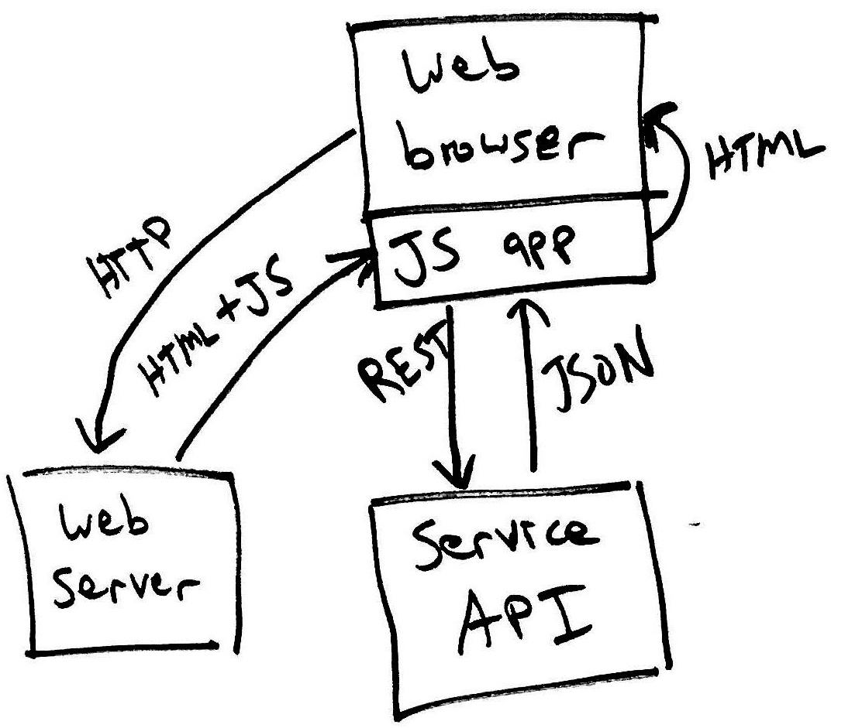
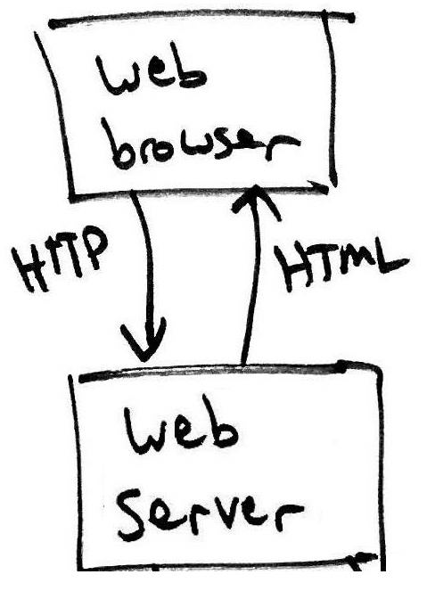
Traditional web app vs. JavaScript Single-Page app
12
Server generates HTML dynamically.
Browser doesn’t run much JS.
  Eg., Wikipedia.
JS app runs in the browser, makes REST requests and generates HTML.
  Eg., Facebook & other React apps.
User’s machine
The cloud
*Note: many apps combine these two styles.

Slide 13
Continuum between traditional and SPA

Slide 14
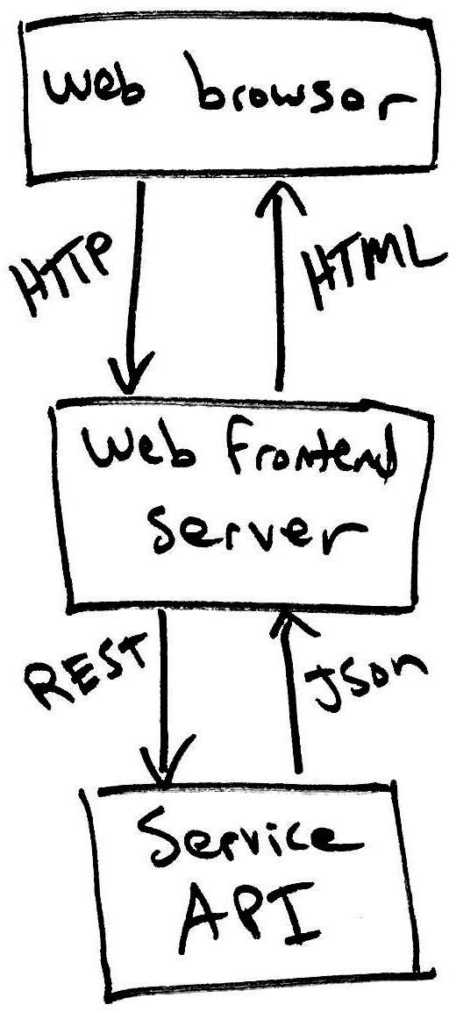
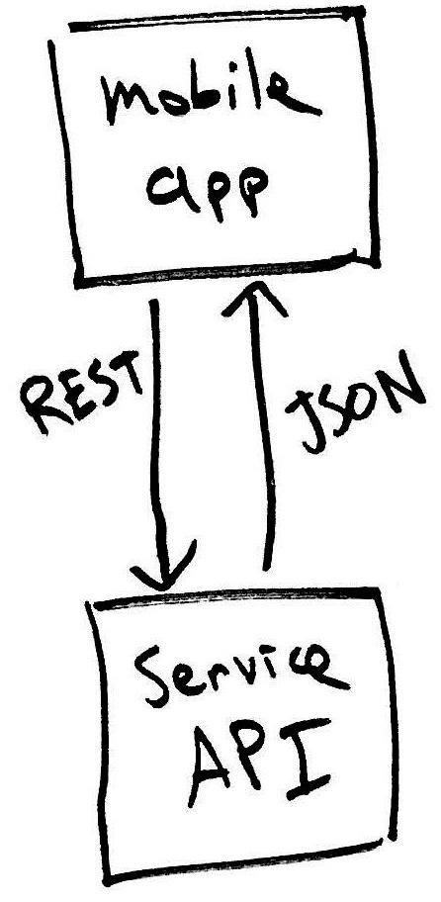
Cross-platform architecture
14
A service API (eg., REST or GraphQL) is essential for supporting mobile and desktop apps with cloud-based data and services.
A single API can handle all client types.
JS SPA
User’s machine
desktop app
The cloud
How many specialist software engineers might work on this system?
Service API
STOP
and
THINK

Slide 15
Review
15
Introduced microservices as an alternative to monolithic design.
Services are black boxes, exposing network APIs.
  Decouples development of different parts of the system.
  Network APIs define the format and meaning of requests and responses.
JS Single-page Applications (SPAs) interact directly with services.
  Moves UI concerns away from backend code.
In a cross-platform system design, the same backend service/API can serve mobile, web, and desktop apps.

