Slide 1

CS-310 Scalable Software Architectures
Lecture 5:
REST APIs and
Data Serialization
1
Steve Tarzia

Slide 2
Last time: Proxies, and Caches
2
Introduced proxies and caching.
A proxy is an intermediary for handling requests.
  Useful both for caching and load balancing (discussed later).
Often, many of a service's requests are for a few popular documents.
  Caching allows responses to be saved and repeated for duplicate requests.
HTTP has built-in support for caching.

Slide 3
Application Programming Interfaces (APIs)
3
An API defines how software can be used by other software.
The API for a code library is the list of functions/classes it provides.
Software services provide network remote procedure call (RPC) APIs.
  Network-level APIs can have any format, but most commonly:
    REST built on top of HTTP
    SOAP (old)
    Thrift binary protocols, more efficient than REST.
    Protocol buffers
    GraphQL
  Usually includes some form of authentication:
    Service must identify you to give access or personalized data.

Slide 4
HTTP methods and responses
4
Methods
Response codes
GET: to request a data
POST: to post data to the server, and perhaps get data back, too.
Less commonly:
PUT: to create a new document on the server.
DELETE: to delete a document.
HEAD: like GET, but just return headers
200 OK: success
301 Moved Permanently: redirects to another URL
403 Forbidden: lack permission
404 Not Found: URL is bad
500 Internal Server Error
… and many more

Slide 5
A weather information service (REST API)
5
HTTP Request
HTTP Response
GET http://api.wthr.com/[key]/forecast?location=San+Francisco HTTP/1.1
Accept-Encoding: gzip
Cache-Control: no-cache
Connection: keep-alive
HTTP/1.1 200 OK
Content-Length: 2102
Content-Type: application/json
{ "wind_dir": "NNW",
"wind_degrees": 346,
"wind_mph": 22.0,
"feelslike_f": "66.3",
"feelslike_c": "19.1",
"visibility_mi": "10.0",
"UV": "5", … }

Slide 6
Idempotence
6
An idempotent request can be repeated without changing the result.
HTTP expects every method except POST to be idempotent.
HTTP proxies/servers may repeat your PUT or DELETE requests, and your REST API implementations should be OK with this.
For example, creating an Elasticsearch document:
  PUT /my-index/_doc/2345
  {"title": "My Great Article", "txt": "Hi everyone. I'm here to write about…"}
  POST /my-index/_doc
  {"title": "My Great Article", "txt": "Hi everyone. I'm here to write about…"}
The PUT variation can be repeated and it will just overwrite the doc.
The POST variation would create duplicate docs if repeated.

Slide 7
REST API semantics must work with HTTP's rules
7
Let's say we're developing a a social media application.
What's wrong with this API definition for deleting my latest post?
  DELETE /user/[user-id]/feed/posts/latest
Http DELETE should be idempotent.
However, repeating the request above changes the system state.
From the services' perspective, repetition of one deletion looks the same as if the user had purposely deleted multiple latest posts.
What's the solution? Make each deletion look different:
  DELETE /user/[user-id]/feed/post/[post-id]
STOP
and
THINK

Slide 8
REST API example
8
Twitter REST API documentation
https://developer.twitter.com/en/docs/tweets/post-and-engage/api-reference/post-statuses-update
Elastic Search: https://www.elastic.co/guide/en/elasticsearch/reference/current/rest-apis.html
Discourse web forum public API documentation:
https://docs.discourse.org
Output examples, viewable in a web browser:
https://meta.discourse.org/categories.json
https://meta.discourse.org/latest.json?category=7
https://meta.discourse.org/t/3423.json (requires authentication)
http://ssa-hw2-backend.stevetarzia.com/api/search?query=northwestern&date=2020-04-16

Slide 9
Inputs and outputs of REST APIs
9
Request Inputs
Response Outputs
Choice of Method:
  GET for reading data
  POST/PUT/DELETE for editing
Path
  Usually identifies the type of request, but may also supply parameters:
    GET /tweets/connor4real
Query parameters after the main URL
  Written after a “?” character.
    GET /search?startDate=2018-10-10&search=best+restaurant&api_key=3iur20du9302o3i0d
Headers
  Cookies, custom headers
Body
  Usually form-encoded or JSON
Status code
  200, 404, 403, etc.
Headers
Body
  Usually JSON encoded
Custom HTTP headers are frowned upon.
Goal is to build on top of HTTP, not alter it.
Many APIs require that you provide an API key or access token somewhere your request.
  This is like a password that identifies you to the service.
  Is this secure?
STOP
and
THINK

Slide 10
RESTful API design style
10
Paths represent "resources" – data or objects in your system.
GET reads data
PUT/POST creates or modifies data
DELETE deletes data
Representing arbitrary actions in REST can be tricky.
Usually we can convert an action into an event resource.
This is acceptable, but not RESTful: POST /inbox/createMessage
Here is a RESTful alternative: POST /inbox/message
And finally, an even better design: PUT /inbox/message/[uuid]
HTTP method should be the only verb
Verbs in path are not RESTFUL!
Resource/noun

Slide 11
JSON – JavaScript Object Notation
11
A data format returned by most REST APIs
Allows an arbitrary amount of nesting
Spaces are ignored, except within quotes.
Basic components are:
[] for ordered lists
  Items are separated by commas
  Items can be any JSON
{} for unordered dictionaries/objects
  Key: value pairs are separated by commas
  Keys must be strings (text)
  Values can be any JSON
Numbers, true, false, null
Strings (text) in double quotes "..."
[
{
"name": "John",
"age": 30,
"cars":
["Ford", "BMW", "Fiat"]
},
{
"name": "Alicia",
"age": 32,
"hometown": "Seattle"
}
]

Slide 12
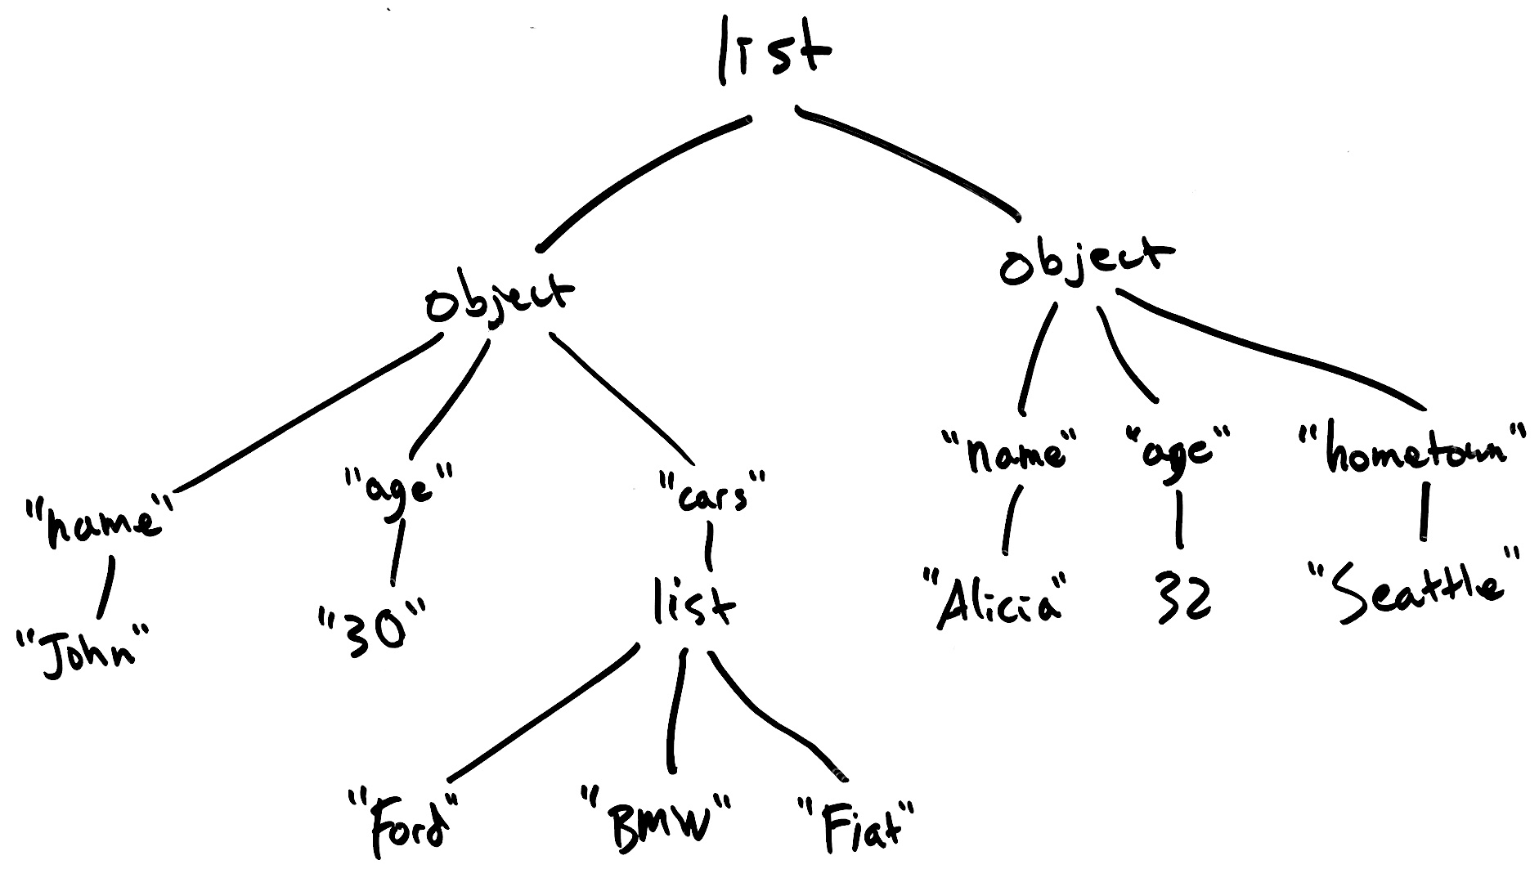
JSON data graph example
12
[
{
"name": "John",
"age": 30,
"cars":
["Ford", "BMW", "Fiat"]
},
{
"name": "Alicia",
"age": 32,
"hometown": "Seattle"
}
]

Slide 13
XML – eXtensible Markup Language
13
Older than JSON, and now is less common than JSON because many people think XML is unnecessarily complicated.
HTML is an XML document that defines a web page.
Basic components are:
Text
Tags
  <tagname>…</tagname> or just <tagname>
  Have a name, and have XML inside
  Each start tag has a corresponding end tag, but only if it has data inside.
Attributes
  <tag attr="value" …>
  Appear within tags
  Attribute name and value must be text
  Tag can have multiple attributes, but each must have a unique name
<people>
<person name="John"
age="30">
<cars>
<car>Ford</car>
<car>BMW</car>
<car>Fiat</car>
</cars>
</person>
<person name="Alicia"
age="32">
<hometown city="Seattle">
</person>
</people>

Slide 14
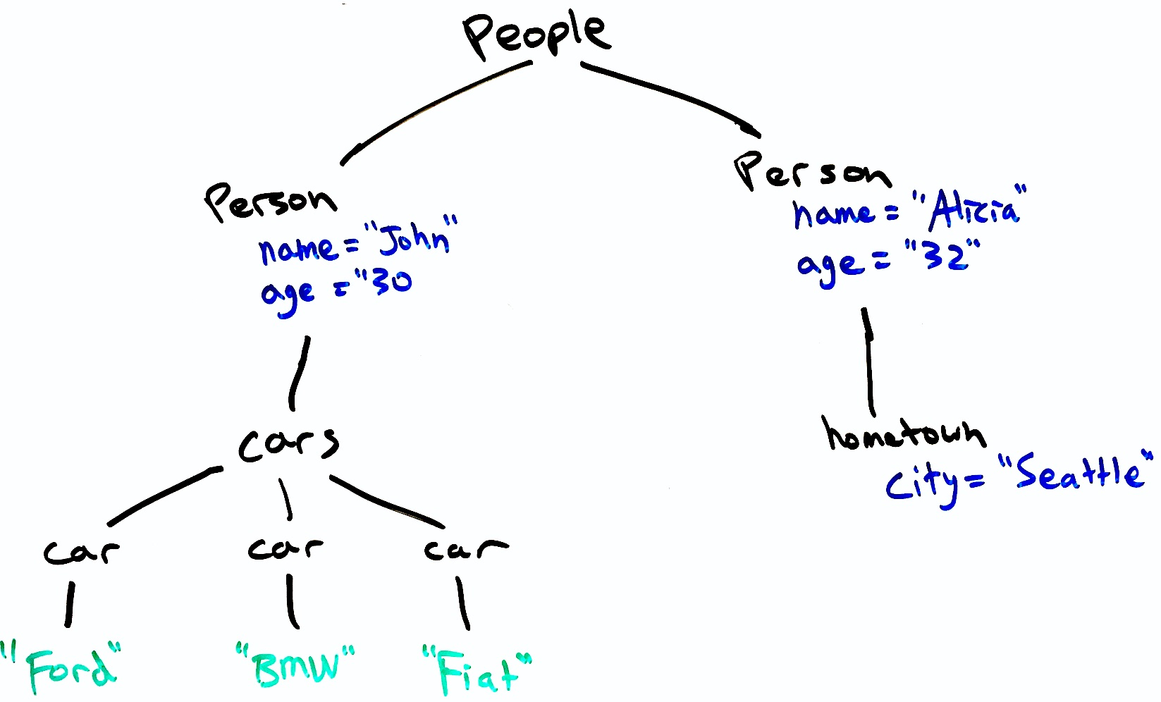
XML data graph example
14
<people>
<person name="John"
age="30">
<cars>
<car>Ford</car>
<car>BMW</car>
<car>Fiat</car>
</cars>
</person>
<person name="Alicia"
age="32">
<hometown
city="Seattle">
</person>
</people>

Slide 15
JSON and XML are data serialization formats
15
Computer memory is one big array, but programs and databases use references to organize data into complex structures:
Data files are arrays of bytes.
Messages sent over the network are serial streams of bytes.
Serialization is converting a data object into a sequence of bytes:
<people>
<person name="John"
age="30">
<cars>
<car>Ford</car>
<car>BMW</car>
<car>Fiat</car>
</cars>
</person>
<person name="Alicia"
age="32">
<hometown
city="Seattle">
</person>
</people>

Slide 16
Byte-level view of XML serialization
16
$ hexdump -C test.xml
00000000 3c 70 65 6f 70 6c 65 3e 0a 20 20 3c 70 65 72 73 |<people>. <pers|
00000010 6f 6e 20 6e 61 6d 65 3d 22 4a 6f 68 6e 22 20 0a |on name="John" .|
00000020 20 20 20 20 20 20 20 20 20 20 61 67 65 3d 22 33 | age="3|
00000030 30 22 3e 0a 20 20 20 20 3c 63 61 72 73 3e 0a 20 |0">. <cars>. |
00000040 20 20 20 20 20 3c 63 61 72 3e 46 6f 72 64 3c 2f | <car>Ford</|
00000050 63 61 72 3e 0a 20 20 20 20 20 20 3c 63 61 72 3e |car>. <car>|
00000060 42 4d 57 3c 2f 63 61 72 3e 0a 20 20 20 20 20 20 |BMW</car>. |
00000070 3c 63 61 72 3e 46 69 61 74 3c 2f 63 61 72 3e 0a |<car>Fiat</car>.|
00000080 20 20 20 20 3c 2f 63 61 72 73 3e 0a 20 20 3c 2f | </cars>. </|
00000090 70 65 72 73 6f 6e 3e 0a 20 20 3c 70 65 72 73 6f |person>. <perso|
000000a0 6e 20 6e 61 6d 65 3d 22 41 6c 69 63 69 61 22 20 |n name="Alicia" |
000000b0 0a 20 20 20 20 20 20 20 20 20 20 61 67 65 3d 22 |. age="|
000000c0 33 32 22 3e 0a 20 20 20 20 3c 68 6f 6d 65 74 6f |32">. <hometo|
000000d0 77 6e 0a 20 20 20 20 20 63 69 74 79 3d 22 53 65 |wn. city="Se|
000000e0 61 74 74 6c 65 22 3e 0a 20 20 3c 2f 70 65 72 73 |attle">. </pers|
000000f0 6f 6e 3e 0a 3c 2f 70 65 6f 70 6c 65 3e 0a 0a |on>.</people>..|
000000ff
UTF-8 / ASCII encoding of XML text. Each character is one byte.

Slide 17
References (pointers) make serialization non-trivial
17
If an object is referenced many times, should it be repeated?
[{
"name": "Jess",
"hometown": {
"city": "Evanston",
"province": "Illinois",
"population": 74106
}
},
{
"name": "Jonah",
"hometown": {
"city": "Evanston",
"province": "Illinois",
"population": 74106
}
}]
How to handle circular references?
{
"name": "Jess",
"best_friend": {
"name": "Tom",
"best_friend": {
"name": "Kate",
"best_friend": {
"name": "Jess",
"best_friend": {
... And so on to infinity! ...
}
}
}
}
}

Slide 18
Solution: serialize with references
18
{
"hometowns": [
{
"hometown_id": 1,
"city": "Evanston",
"province": "Illinois",
"population": 74106
},
{
"hometown_id": 2,
"city": "Chicago",
"province": "Illinois",
"population": 2705994
}
],
"people": [
{
"name": "Jess",
"hometown_id": 1,
},
{
"name": "Jonah",
"hometown_id": 1
}
]
}
[
{
"person_id": 1,
"name": "Jess",
"best_friend_id": 2
},
{
"person_id": 2,
"name": "Tom",
"best_friend_id": 3
},
{
"person_id": 3,
"name": "Kate",
"best_friend_id": 1
}
]
The downside of using references?
Requires more than one pass through the data:
  Producer must find and store all the referenced objects before printing.
  Consumer may need to read more before finding the data being referred-to.
STOP
and
THINK

Slide 19
Why use HTTP for new applications?
19
Web community has already solved the problems you’re likely face.
  Encryption
  Compression
  Every programming language already has HTTP client libraries
  Many different server frameworks to choose from, and these already handle encryption, queueing, database connection pooling:
    Eg., Apache httpd, Tomcat, Node.js, Django, Flask
  Web proxies and caches can be reused (Squid, Nginx)
  HTTP response codes are generic enough to be adapted to other services.
Disadvantages:
  Inherit some unneeded complexities, and perhaps unexpected behaviors.
  Human-readable headers introduce overhead (but compression helps)
  May have to rethink your API to fit the URL/resource model.

Slide 20
More efficient network API formats
20
Both Thrift and Protocol Buffers are alternative standards for network APIs, and they not build on top of HTTP.
Messages are more space-efficient (smaller), but less human-readable.
Without HTTP overhead, there is less processing on both sides.
You specify a list of functions for the API, and the tools generate libraries to easily use the API in the language of your choice
  In other words, each API call is wrapped in a function in your particular programming language. Most languages are supported.
  Usually don't implement the API at the network-level.
However, message complexity is not a primary concern in most applications, so REST remains the most popular network API format.

Slide 21
REST design exercise?
21
(will do on Zoom on Wednesday).

Slide 22
Review
22
Services are black boxes, exposing network APIs.
  Decouples development of different parts of the system.
  Network APIs define the format and meaning of requests and responses.
REST is the most popular format for network APIs
  Based on HTTP and uses url, method, response codes, usually JSON bodies.
JSON is a common data serialization format. XML is also used.

